Slide 1

Smart Health Data Mapping
From Raw Data to Insights – A Hackathon Challenge
A Deep Dive into unifying fragmented healthcare data across systems, formats, and facilities — and your opportunity to build something that matters. March 18, 2026

Slide 2

Who We Are?
The epaSystem is based on the results of a research project that
we have been continuously developing since 2002.
Our team of scientist, engineer like visionaries has been working
on the future of nursing care for over 20 years.
Our mission: Empowering healthcare professionals to make informed decisions with data — at scale, in real time, and across every care setting.

Slide 3

Where We Are?
1,400 Active Sites
4 Countries
Healthcare facilities across the DACH region already working with our platform every day.
Operating across borders, supporting diverse regulatory and clinical environments.
4 Languages
Serving multilingual care teams with at least one of our integrated products.

Slide 4
Why This Matters
The scale of healthcare data in the DACH region is enormous — and so is the opportunity. Even small efficiency gains translate into massive real-world impact for patients, providers, and systems alike.
1,400
630K
€100B
1-2%
Institutions
Active Users
DACH Market
Efficiency Gain
Already working with data from care facilities today — a proven foundation to build on.
Real healthcare professionals whose daily work could be improved.
Annual healthcare expenditure in the region — representing the full scope of the opportunity.
Even a modest improvement could unlock hundreds of millions in savings across the system.

Slide 5

The Problem: Data Everywhere, But Isolated
Every healthcare system generates enormous volumes of data — but those systems rarely speak to each other. Combining sources for meaningful analytics still requires many manual steps, making the process slow, error-prone, and difficult to scale.
Hospital Information Systems
Core clinical records in different formats.
Lab Software
Diagnostic results locked inside isolated databases, rarely accessible in real time.
Excel Exports
Manual data extracts with inconsistent structure, prone to versioning and mapping errors.
Sensor & Free Text
Unstructured data from devices and clinical notes that resists automated processing entirely.

Slide 6






Real-World Healthcare Data
Across care facilities, data is generated continuously in six core categories — each critical for delivering quality care, yet each stored independently across disconnected systems. Understanding these data types is the first step to unifying them.
Care Assessments
Diagnoses
Structured nursing evaluations capturing patient condition, needs, and care plan progress over time.
ICD-coded or free-text clinical diagnoses recorded at admission, discharge, and throughout the care pathway.
Lab Parameters
Vital Signs
Quantitative results from blood work, urinalysis, and other diagnostic tests — often in isolated lab systems.
Continuous or episodic measurements including pulse, blood pressure, temperature, and oxygen saturation.
Medication Plans
Resource Planning
Inpatient and outpatient drug regimens with dosage, frequency, and administration records.
Staff assignments, bed management, and operational scheduling data that intersects with clinical workflows.

Slide 7
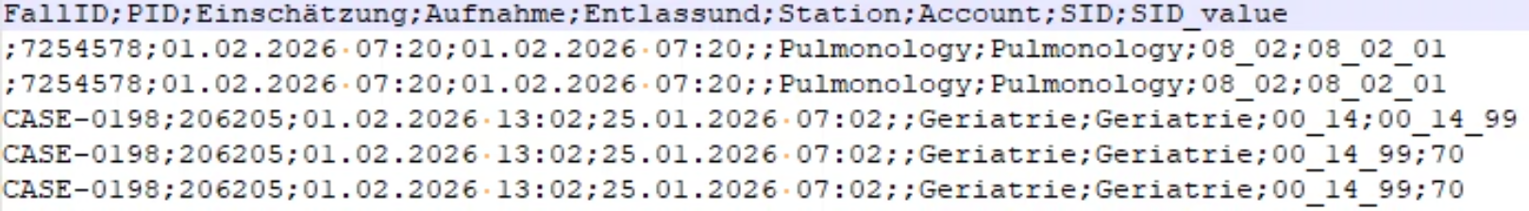
Header Schema: The Raw Data Reality
The challenge begins with the data itself. Below are three CSV export formats from the System — each representing the same assessments structured differently. Participants will work with all three formats and must bridge these structural gaps programmatically.
epaAC-Data-1.csv
epaAC-Data-2.csv
One record per assessment item (Pro Item 1 Dataset). Each row represents a single scored item with its station, account, and SID value.
One record per full assessment with all item data as columns — SID-based wide format. Extremely wide rows, one row per evaluation episode.
epaAC-Data-3.csv
One record per assessment with text-based headers and IID-based columns — the most human-readable but least machine-friendly format.

Slide 8
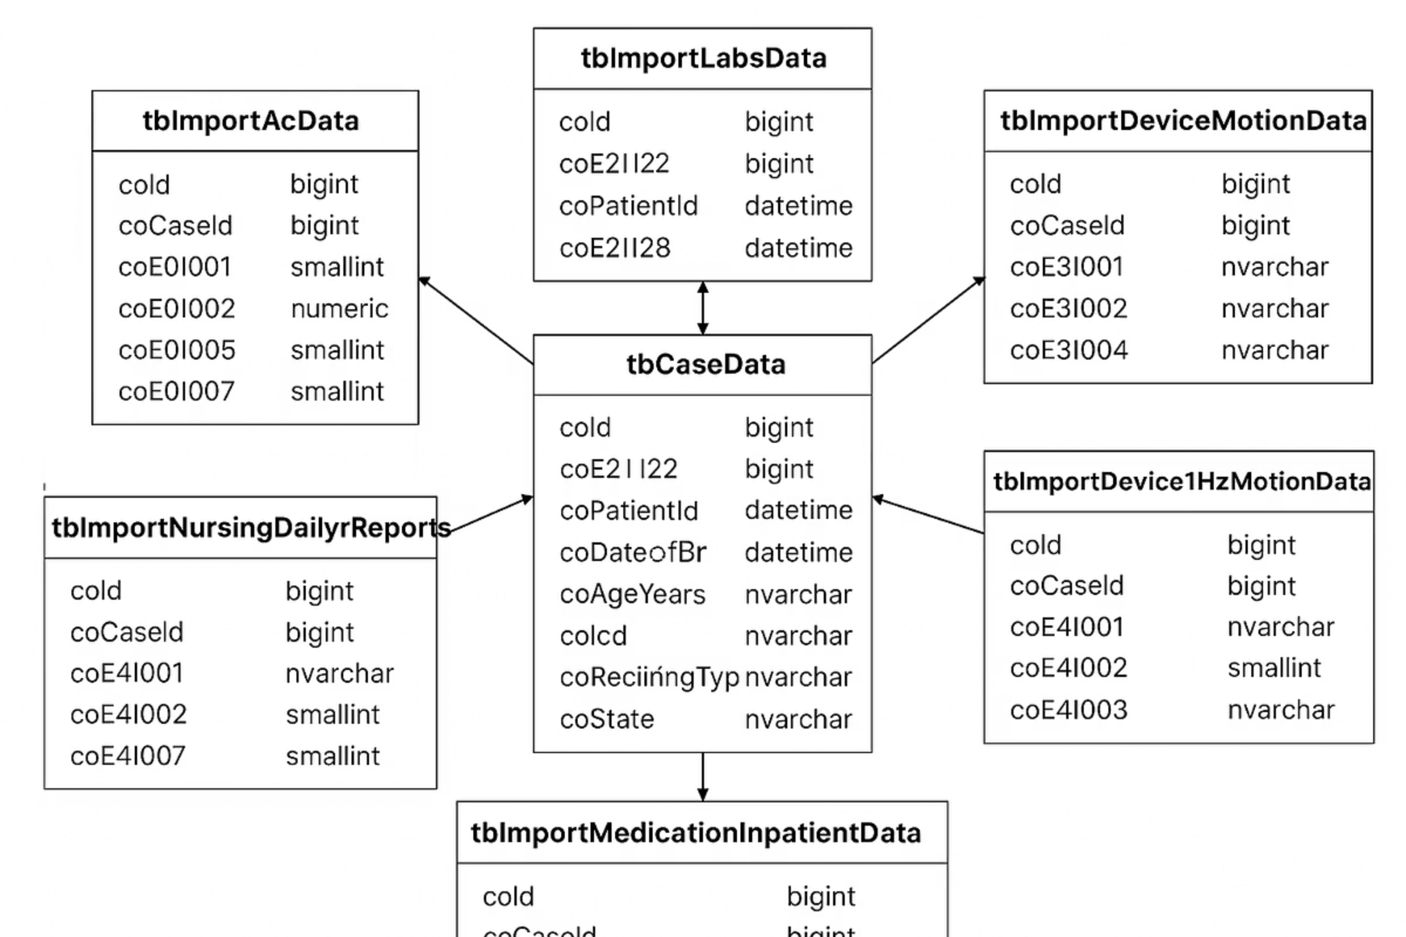
Database Design
The underlying relational schema organizes incoming data from all source systems into a unified case-centric structure. The central tbCaseData table anchors all imports — connecting assessments, lab results, nursing reports, medication records, and motion sensor data into a single patient timeline.
Each import table (tbImportAcData, tbImportLabsData, tbImportNursingDailyReports, tbImportMedicationInpatientData, tbImportDeviceMotionData) links to the core case record via shared keys — forming the data model your mapping solution must target.

Slide 9


Your Mission
Build an Intelligent Application that automatically maps healthcare data from different sources into a unified data model — reducing manual effort and enabling reliable analytics at scale.
Structured Tables & CSV Files
Parse, normalize, and map multi-format tabular exports from HIS and lab systems into the target schema.
PDF Documents
Extract structured data from clinical PDFs including discharge letters, assessment forms, and reports.
Unstructured Free Text
Identify, align, and transform natural-language clinical notes into consistent, structured data fields.

Slide 10
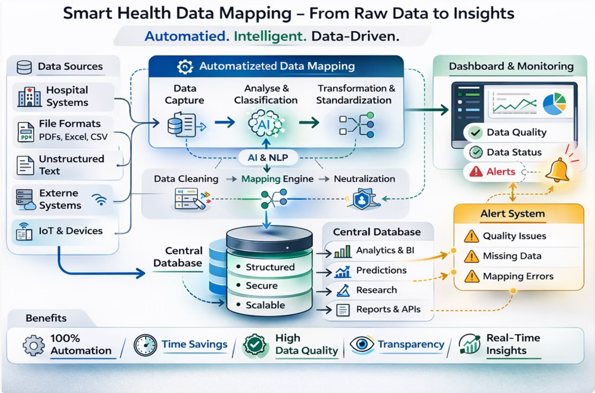





Ingest
Parse & Normalize
Map & Align
Validate & Load
Your solution should implement this end-to-end pipeline — from raw, heterogeneous inputs to validated, analytics-ready records in the unified data model.

Slide 11








In Addition: Interactive Dashboard
Beyond data mapping, your solution should surface insights through a purpose-built dashboard that gives clinical and operational teams full visibility into the quality, provenance, and integrity of their data — in real time.
Data Origin & Structure
Quality & Completeness
Visualize where each data field comes from, which source system it originated in, and how it was mapped to the unified model.
Surface gaps, missing values, inconsistencies, and field-level coverage metrics across all imported datasets.
Anomaly Detection
Alerts & Corrections
Automatically flag unusual patterns, outliers, or values that fall outside expected clinical or statistical ranges.
Proactive alerts for mapping issues combined with an intuitive interface for reviewing and correcting flagged records.

Slide 12

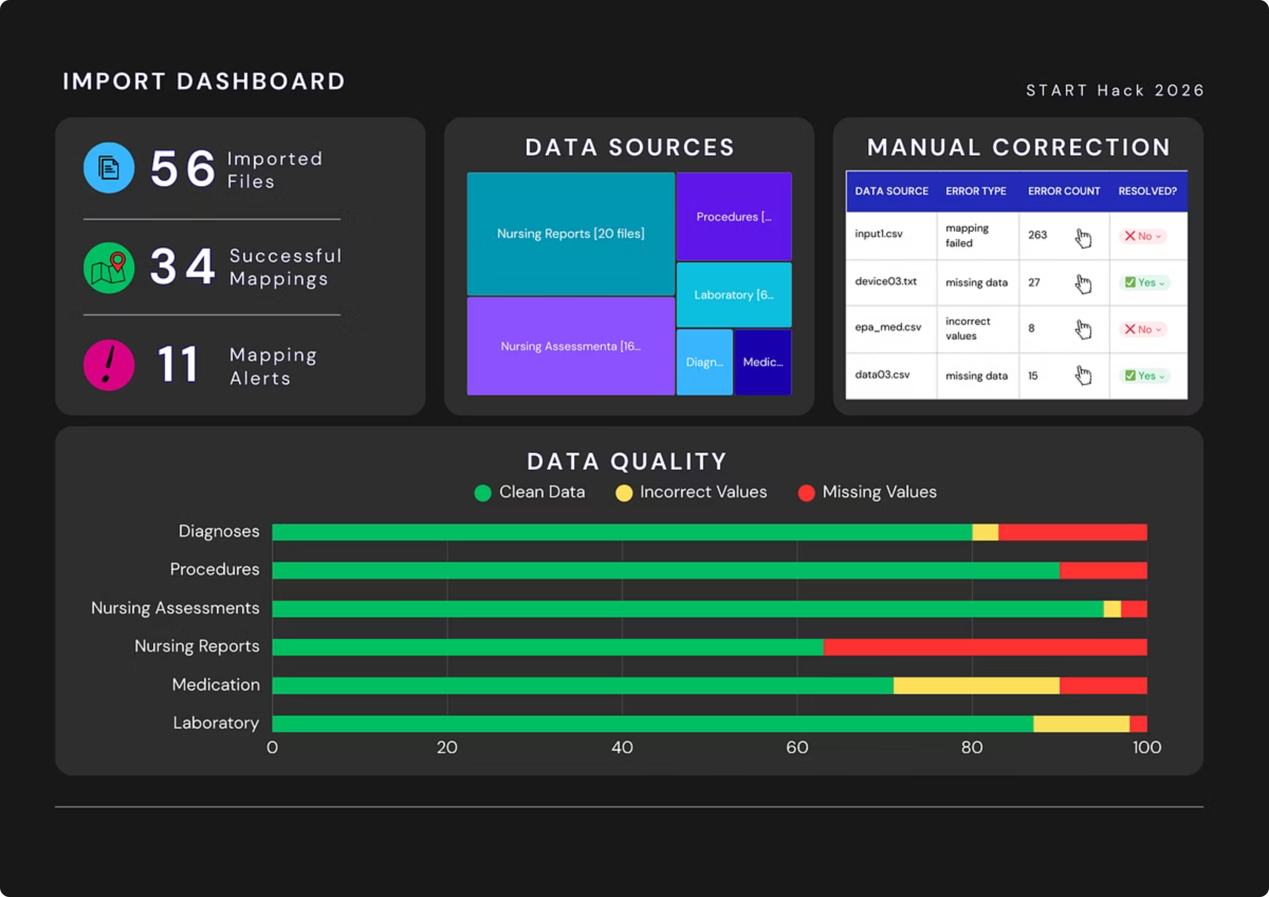

Full technical details are available in the README of our challenge repository. Make sure to review it thoroughly before you begin building.

Slide 13

Technology: Your Choice
Freedom to Innovate
Use any technology stack, framework, or approach that works best for your team — AI/ML models, NLP pipelines, LLM-based agents, rule-based logic, or any combination thereof. There are no restrictions on language or tooling.
One Key Requirement
Your solution must be deployable on-premises. Healthcare data is sensitive — it must remain securely within the institution's own infrastructure at all times. No cloud-only solutions will be accepted.
Whether you're leveraging transformer models for entity extraction, building deterministic schema-matching pipelines, or designing a hybrid agent architecture — the best approach is the one that solves the problem reliably, securely, and at scale.

Slide 14




Judging Criteria
Submissions will be evaluated by a panel of technical and business experts across six dimensions. Each criterion carries a specific weight — design your solution with the full scorecard in mind.
25%
20%
Viability & Business Applicability
Complexity & Technical Sophistication
20%
15%
Feasibility & Maturity Level
Creativity & Innovation
10%
10%
Design & Usability
Presentation Quality

Slide 15
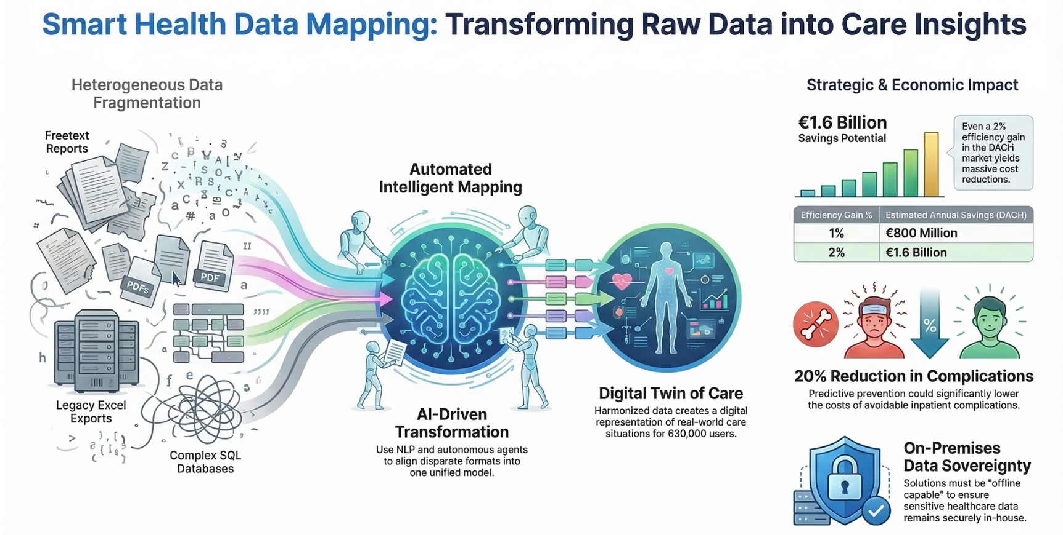
Summary
01
02
Understand the Problem
Build the Mapping Engine
Healthcare data lives in silos — HIS, labs, Excel, free text. Your job is to bridge them.
Automatically ingest, parse, and align data from all source types into the unified DB schema.
03
04
Visualize & Validate
Deploy On-Premises
Build a dashboard that surfaces data quality, provenance, anomalies, and correction workflows.
Ensure your solution runs securely within institutional infrastructure — no external cloud dependency.

Slide 16





Contact
Questions? Need clarification on the data model, schema, or challenge scope? Reach out to our team — we're here to help you build something great.
Andreas Scherzinger
Michael Roth
Lewis Koua
Madlen Fiebig
CTO
Software Developer/
Data Engineer
Head of Products & Science
UI/UX Expert
Lena Frischen
Data Scientist

Slide 17

Good Luck – Enjoy the Hackathon!
We're excited to see what you build. Push the boundaries of what's possible with healthcare data — your solution could genuinely change how care is delivered across thousands of institutions.
ePA-CC GmbH
Bernhard May Str. 58, Haus J
65203 Wiesbaden, Germany
Web
www.epa-cc.de

