Slide 1
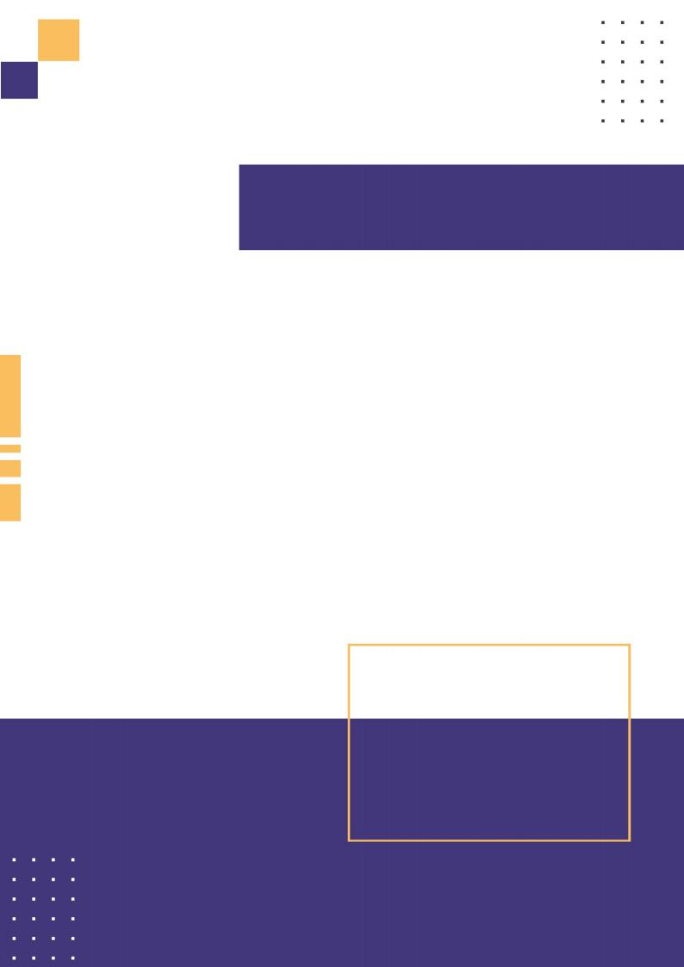
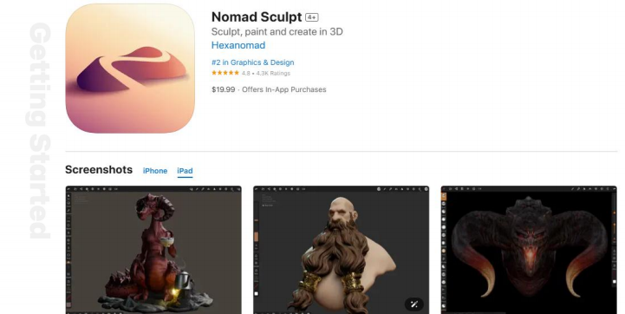
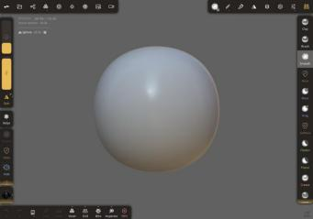
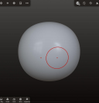
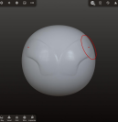
Lesson 1
Getting to Know Nomad Sculpt
Welcome to Nomad!
Nomad is a 3d sculpting app that works best on tablets with a pressure sensitive stylus, eg an Apple iPad and pencil, or a Samsung Galaxy Tab with stylus.
It is inspired by desktop sculpting apps like Zbrush and Blender, with a focus on an easy to understand UI, without sacrificing on features. If you've used 3d sculpting apps before, Nomad will feel very familiar.
If this is your first time doing 3d sculpting, then it's good to know some basics.
Your first sculpt
When you first start Nomad you'll see a sphere on screen. Simply drag your stylus on the sphere to start sculpting. Symmetry is enabled by default to make sculpting easier.

