Slide 1


HydroShare: Advancing Collaboration through Hydrologic Data and Model Sharing
David Tarboton, Ray Idaszak, Jeffery Horsburgh, Dan Ames, Jon Goodall, Larry Band, Venkatesh Merwade, Alva Couch, Jennifer Arrigo, Rick Hooper, David Valentine, David Maidment, Jeff Heard, Pabitra Dash, Tian Gan, Tony Castronova, Stephen Jackson, Cuyler Frisby, Stephanie Mills, Brian Miles
USU, RENCI, BYU, UNC, UVA, CUAHSI, Tufts, Texas, Purdue, SDSC
http://www.hydroshare.org
Permalink: http://beta.hydroshare.org/r/ce9c114a36f541c88aecd9c6ff0a06a4/
OCI-1148453
OCI-1148090
2012-2017

Slide 2

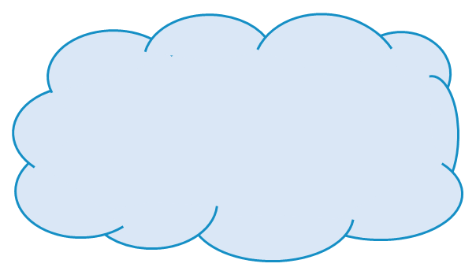
What is (will) HydroShare (be)?
HydroShare will be a community collaboration website that enables users to easily discover and access data and models, retrieve them to a desktop computer or perform analyses in a distributed computing environment that includes grid, cloud, or high performance computing model instances as necessary.
Understanding will be advanced through the ability to integrate information from multiple sources.
Outcomes (data, results, models) can then be published as new resources that can be shared with collaborators.
Analysis
Data
Models
Our goal is to make sharing of hydrologic data and models as easy as sharing videos on YouTube or shopping on Amazon.

Slide 3
Collaborative data analysis and publication
Observe
Store
Discover and access
Analyze
Model
Collaborate
Publish (DOI)
Analysis
Data
Models

Slide 4

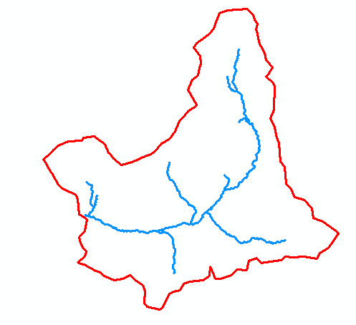
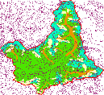
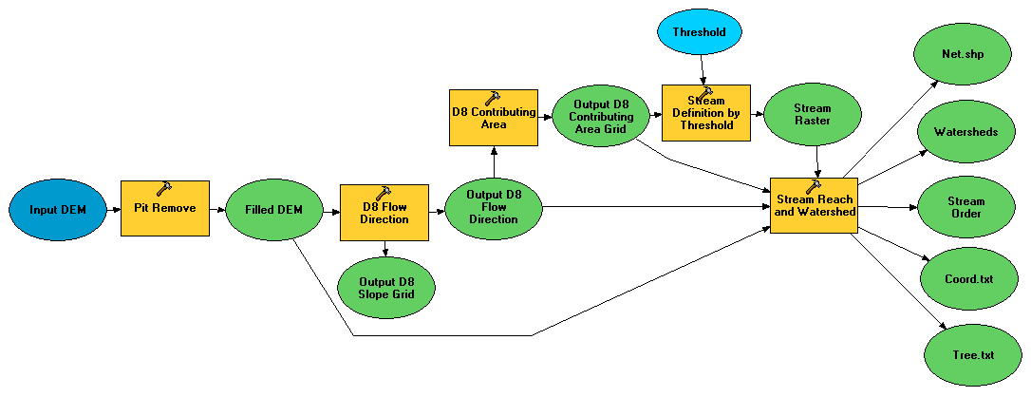
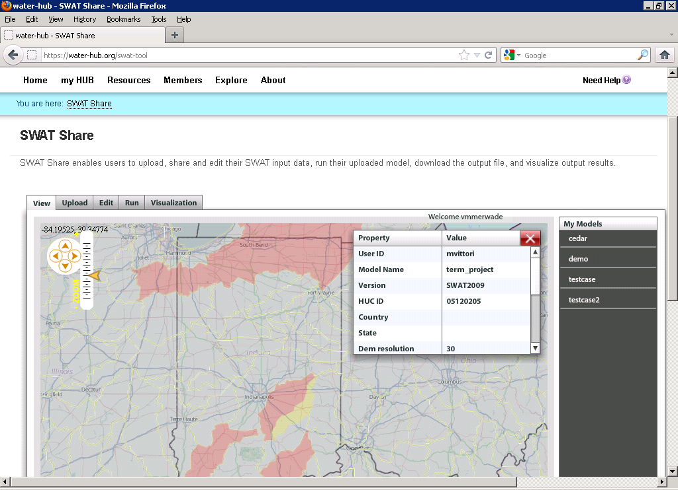
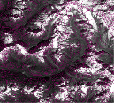
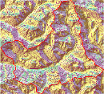
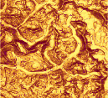
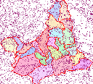
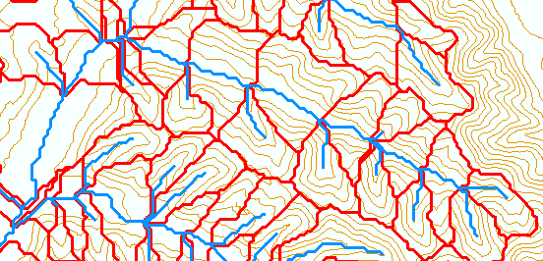
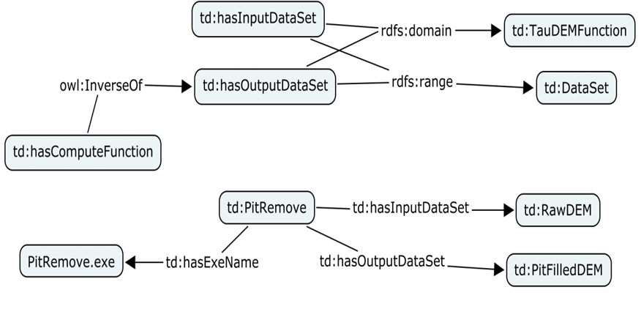
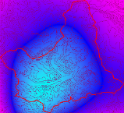
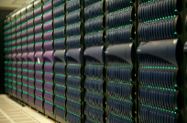
Collaborative Integrated Modeling
Flow
Time
P
Flow
Time
t
Time
Pre-processing and model linking
y
x
Modeling Services (e.g. SWATShare)
Data: Links to national and global data sets of essential terrestrial variables (e.g. NASA NEX, HydroTerre)
Tools to preprocess and configure inputs (EcoHydroLib, TauDEM, CyberGIS)
Preconfigured models and modeling systems as services (SWATShare)
Standards for information exchange for interoperability (OpenMI, CSDMS BMI)
Tools for visualization and analysis
Notes:
Data: Links to national and global data sets of essential terrestrial variables (e.g. NASA NEX, HydroTerre)
Tools to preprocess and configure inputs
Preconfigured models and modeling systems as services
Standards for information exchange for interoperability (OpenMI, CSDMS BMI)
Tools for Visualization and Analysis
Automated reasoning to couple models based on purpose, context, data and resources

Slide 5
Architecture
Users
Browser
Client (HydroDesktop)
3rd party clients, interoperable systems and web tools
Web Tools
Web Pages
Web Services (HydroShare REST API)
Compute Engines (Docker or HPC)
Connection point for partners
BiG CZ SSI
CI-WATER
SEAD
CyberGIS
SESYNC GI Venture
Django web application framework
iRODS Native REST API
iRODS “Network File System”
Content
Resource Files
Resource Science Metadata
User Accounts
Functionality
Authentication and Authorization Infrastructure (AAI) for Access Control
Discovery (using e.g. ElasticSearch via MSVC plugin)

Slide 6
