Slide 1

Data analysis for frito lay
Brian Gaither

Slide 2
Overview
Data Description
Attrition Classification
Questions of Interest:
Can we classify employees based on whether they are likely to quit or not?
Do we observe attrition patterns based on Job Role?
Monthly Income Prediction
Question of Interest
Can we predict Monthly Income based on various employee attributes?

Slide 3
Data Description
We have been provided 870 employee records with 36 columns
For the purposes of classification of whether or not an employee is likely to quit, we use the column “Attrition”
The dataset is unbalanced based on Attrition:
No: 730 records
Yes: 140 records
For modeling, we have balanced the data by downsampling such that we have an equal number (140) of records for each classification
We have several other variables such as: Age, Business Travel, DailyRate, Department, DistanceFromHome, Education, …
A complete data description is in the appendix of this deck

Slide 4
classification of attrition
Using knn

Slide 5
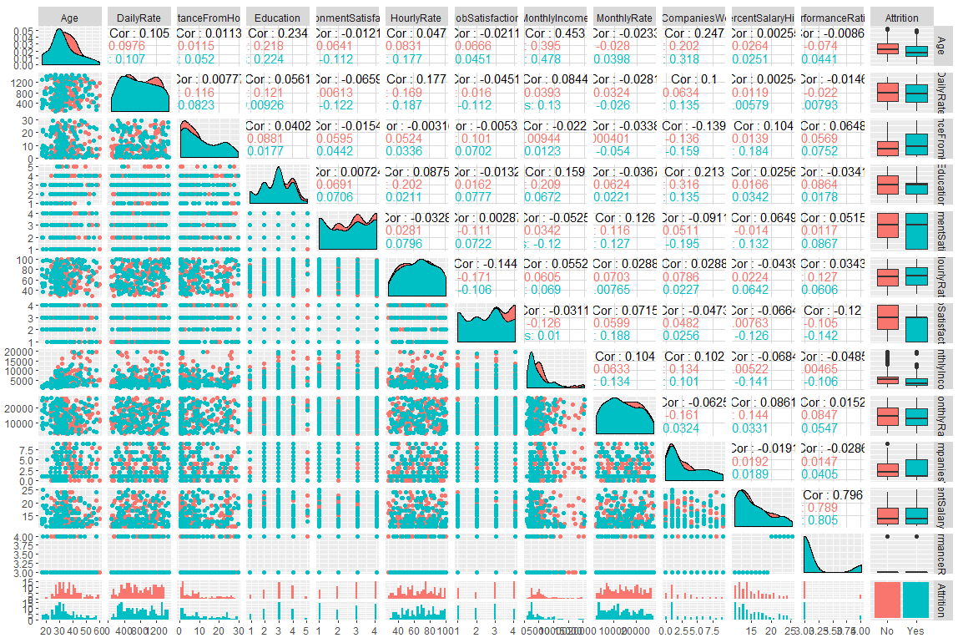
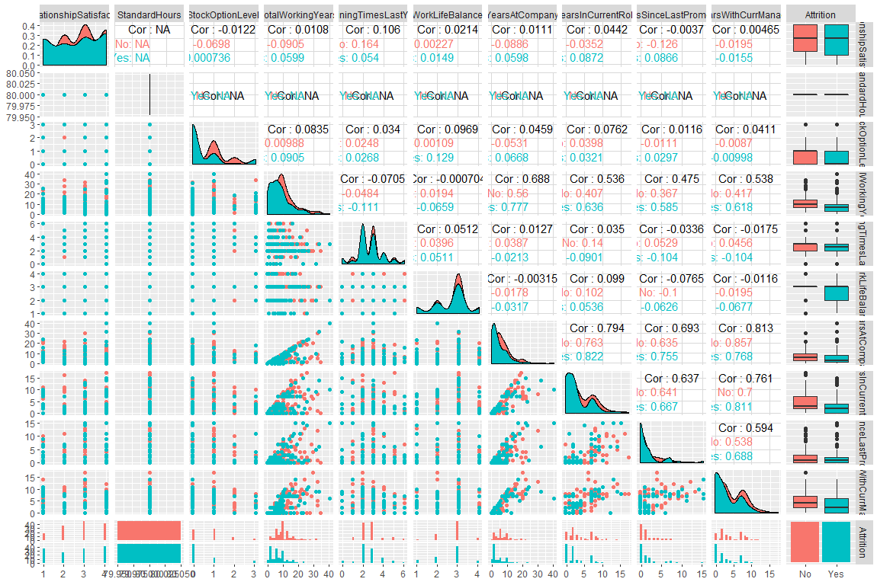
Classification of attrition
Plotting helps us evaluate relationships in the data with Attrition
Job Satisfaction stands out as being related to attrition The lower the job satisfaction, the more attrition we see
Similar patters can be seen in Environment Satisfaction, distance from home and Work Life Balance

Slide 6
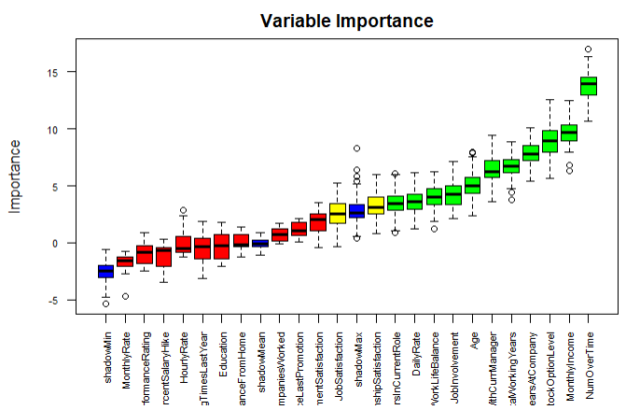
Boruta Variable importance
Performing a Boruta Variable Importance Analysis we can see similarities in the observations we found using the pair plot analysis
The top 3 factors that lead to attrition are:
Amount of Overtime
Monthly Income
Stock Option Level

Slide 7
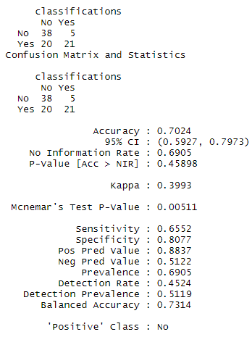
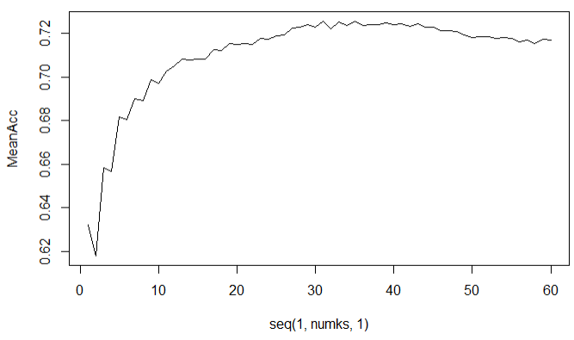
Classification of attrition using KNN
Model Results
Identified optimal model using KNN (K=35)
Using 11 most important features:
Over Time
Monthly Income
Stock Option Level
Years At Company
Total Working Years
Years With Current Manager
Age
Job Involvement
Work Life Balance
Daily Rate
Years in Current Role
Mean Accuracy Curve

Slide 8
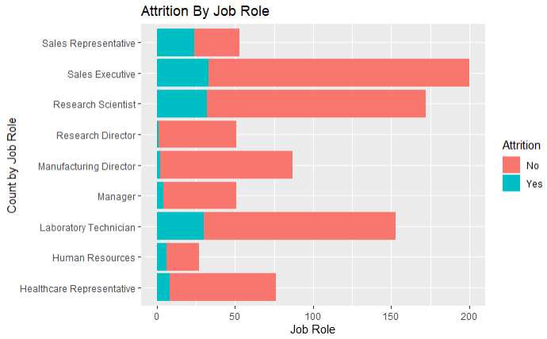
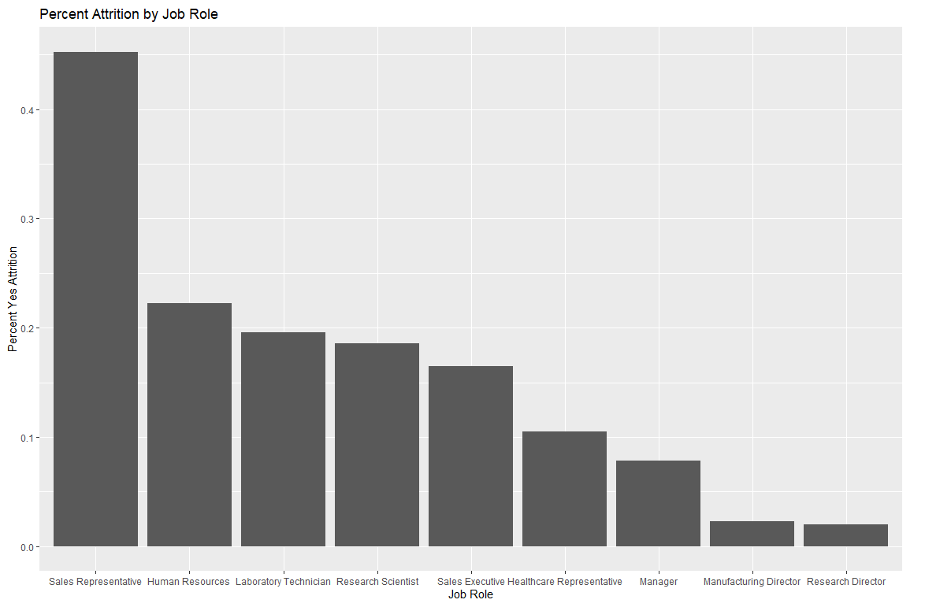
Attrition by Job Role
Analysis of Attrition by Job role
Looking at the count of Attrition By Job Role gives misleading inference
Indicates Sales Executive, Research Scientist and Laboratory Technician have highest turnover by count
If we look at percent attrition by Job Role, we get a different picture
Looking at it this way, we see the top 3 turnover roles are
Sales Representative
Human Resources
Laboratory Technician

Slide 9
Prediction of Monthly Income
Using Multiple regression

Slide 10
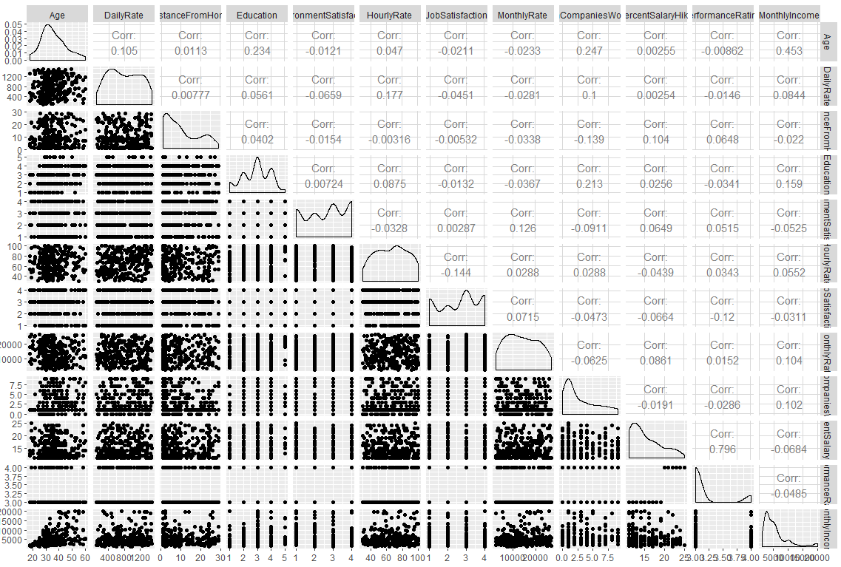
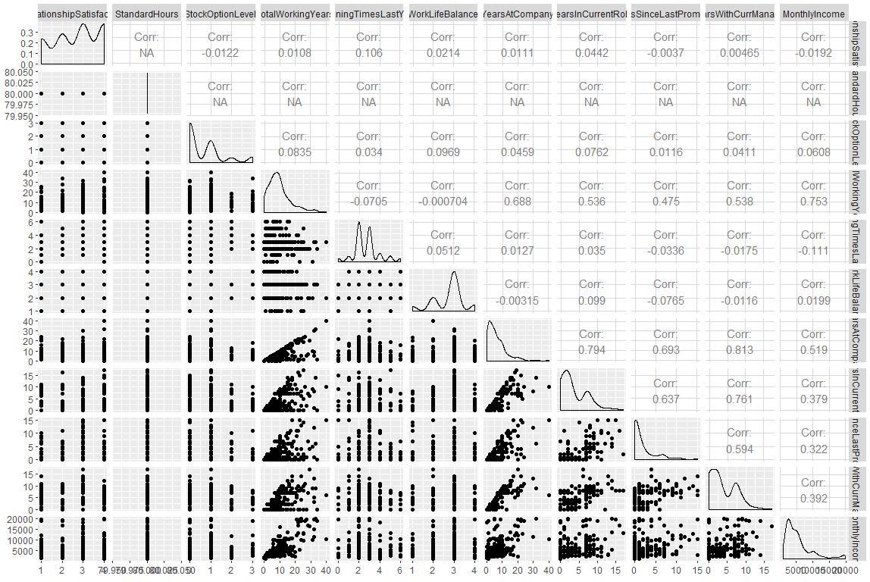
Prediction of monthly income
Plotting helps us evaluate relationships in the data with Monthly Income
The pair plots indicate Age, Total Working Years, Years at Company and Years in Current Role are highest correlated with Monthly Income

Slide 11
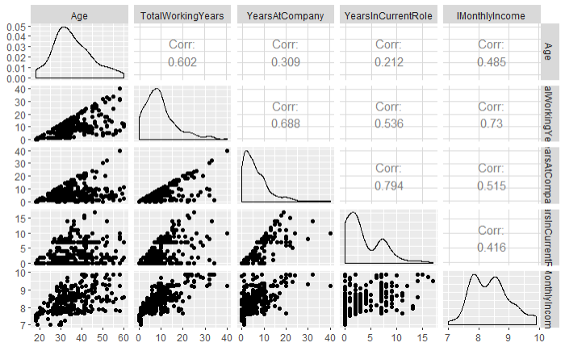
Prediction of monthly income
Plotting helps us evaluate relationships in the data with Monthly Income
With our reduced highly correlated variables, there was evidence that we needed to log transform Monthly Income
Here we see the correlation with our variables of interest after performing the log transformation

Slide 12

Multiple linear regression model
Simple model using Total Working Years with a quadratic term for Total Working Years along with Job Role proved to be the best model
The quadratic term was to address the curve in the relationship with log(Monthly Income)
Note the curve

Slide 13
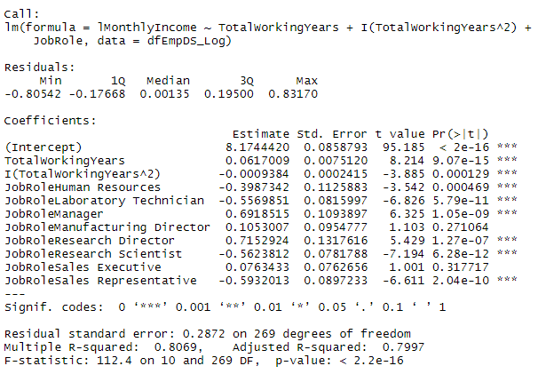
Linear regression model results
All coefficients are extremely significant
Only exception are two levels of JobRole
Manufacturing Director
Sales Executive
Adjusted R-Squared: 0.7997
RMSE = 0.281

Slide 14
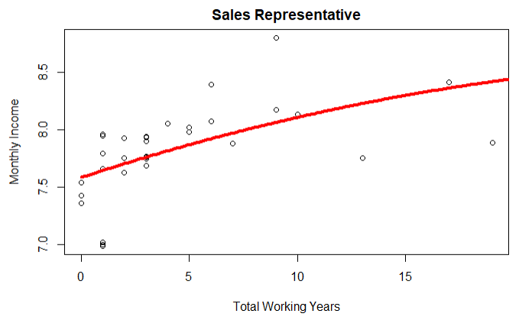
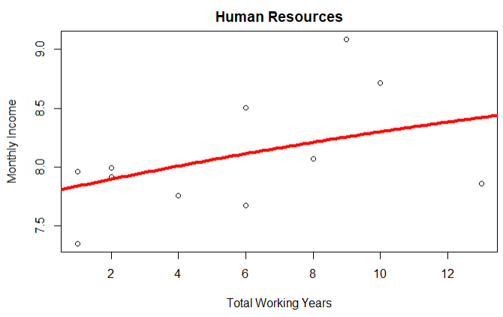
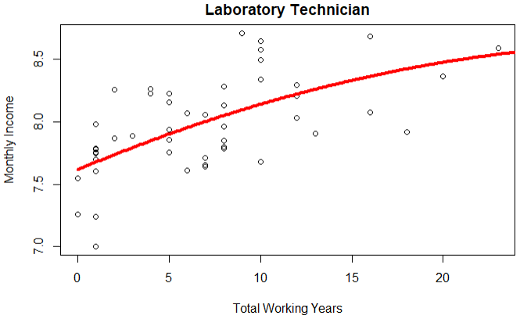
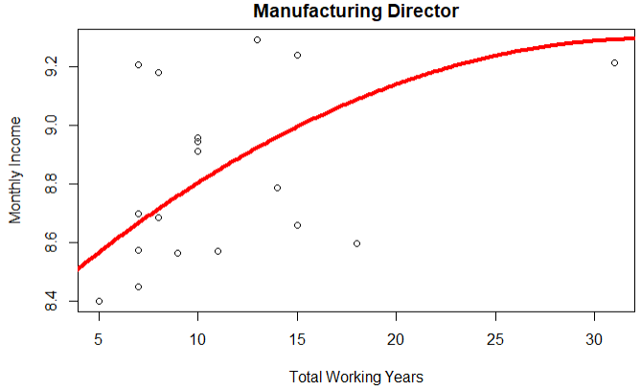
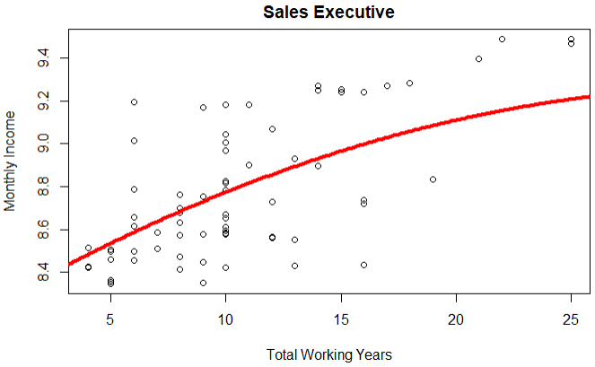
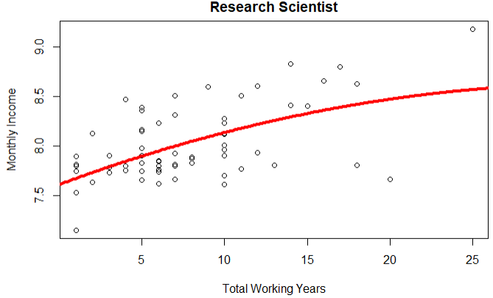
Prediction analysis
Plotting several of the salaries by job role we can see how the model predicts salary by total working years
Red line is the prediction line
Visually, the model appears to fit the curve quite well

Slide 15
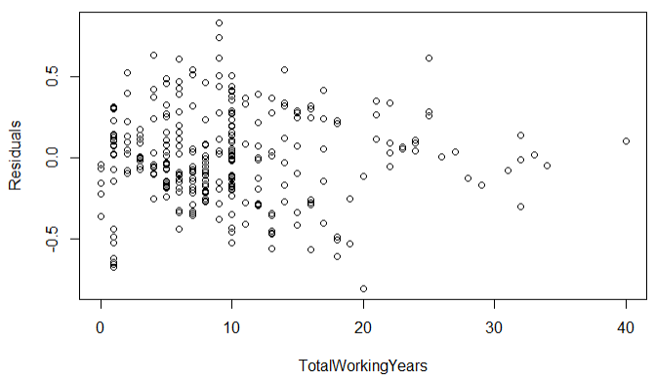
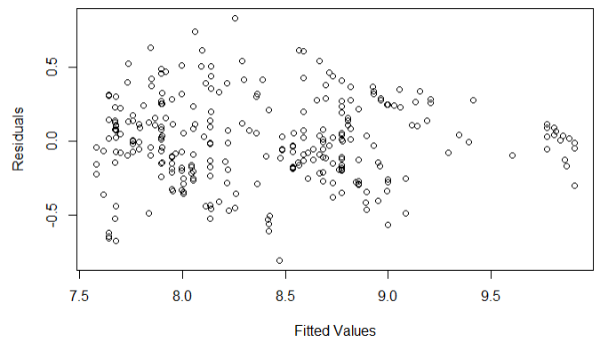
Residual plots
The residuals by Total Working Years indicates constant variance which is what we want
The residuals by Fitted Values indicates no pattern (random cloud) which is what we want to see

Slide 16
Conclusion

Slide 17
Conclusion
Classification of Attrition
I’ve demonstrated that is possible to classify employees based on likelihood of attrition with a model that has
Accuracy: 0.7973
Sensitivity: 0.6552
Specificity: 0.8077
There does appear to be a pattern of high turnover in the following job roles:
Sales Representative
Human Resources
Laboratory Technician
Prediction of Monthly Income
I’ve demonstrated that it’s possible to predict monthly income using only Total Working Years and Job Role with a quadratic term for Total Working Years
Adjusted R-Squared: 0.7997
RMSE: 0.281

Slide 18
Thank You!

Slide 19
Appendix

Slide 20
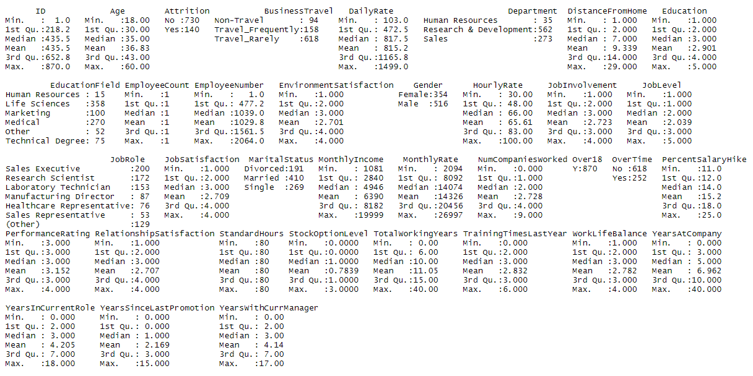
Summary of data

