Slide 1
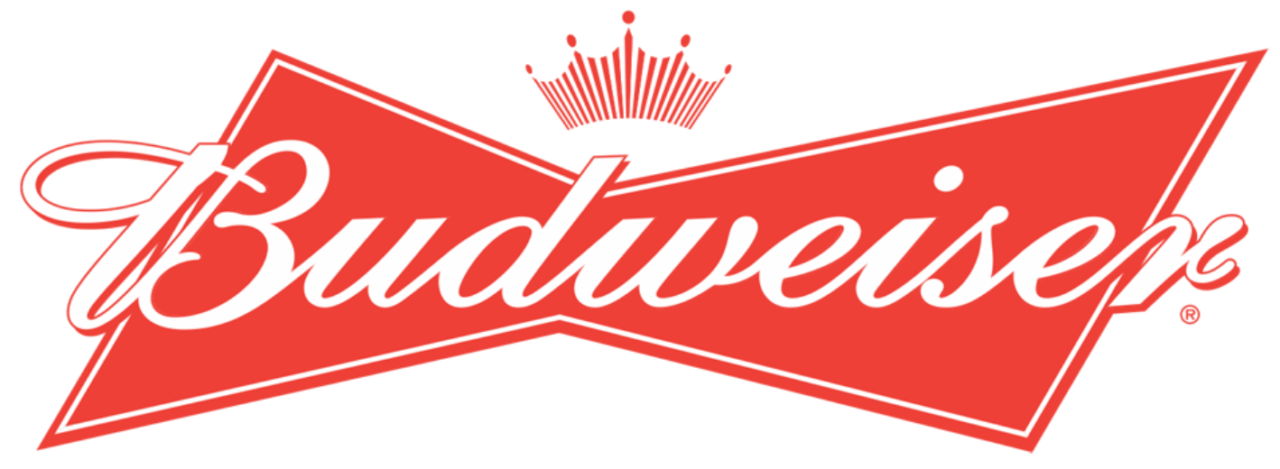
Link to Recording: https://youtu.be/8-YE9g4wqIo
Analytic report for Budweiser
Brewery and Beer analysis
Andrew Mejia, Andrew Larsen and Brian Gaither
Notes:
Thank you for joining us today as we walk you through our Analytic report for Budweiser where we’ll cover our analysis of US Breweries and their Associated Beers.
We’ll specifically cover
where in the US there is a higher proportion of Breweries,
Which states have highest ABV and highest IBU,
the correlation between IBU and ABV
as well as the association between size of beer and the region with regard to IBU and ABV.

Slide 2
Evaluating the datasets
Two datasets were used for this analysis
Beers.csv
Breweries.csv
These datasets were merged on Brewery_id=Brew_ID
Resulting in 2,410 total observations
There are two columns that contains NA's
ABV has 62 NA's
IBU has 1005 NA's
We removed NA's from the dataset when performing classification and correlation using ABV and IBU
Notes:
We’ve included over 2400 observations in our analysis including both beer types and their associated IBU’s and ABVs.
It should be noted that we’ve identified some missing data in the ABV and IBU variables and those observations have been omitted from the classification and correlation analysis.

Slide 3
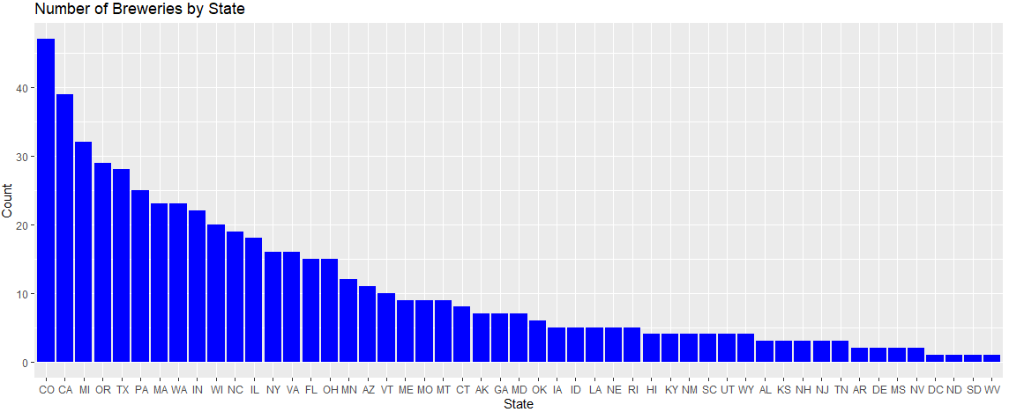
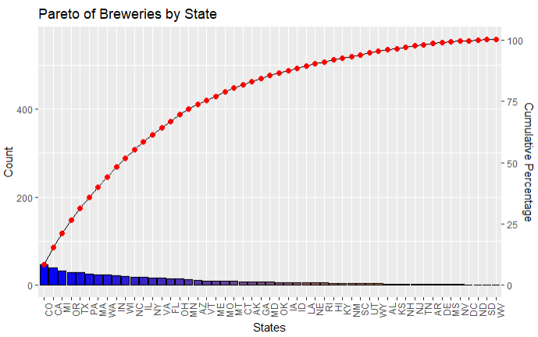
Breweries by State
50% of all Breweries
558 Breweries across all states
Colorado has the largest number of breweries with 47
25% of all breweries are within four states
Colorado
California
Michigan
Oregon
50% of all breweries are within 9 states as noted in top chart
25% of all Breweries
Notes:
There are 558 breweries across the United States. The Pareto Analysis indicates that 25% of all breweries are contained within Colorado, California, Michigan and Oregon. 50% of all US breweries are contained within only 9 states.

Slide 4
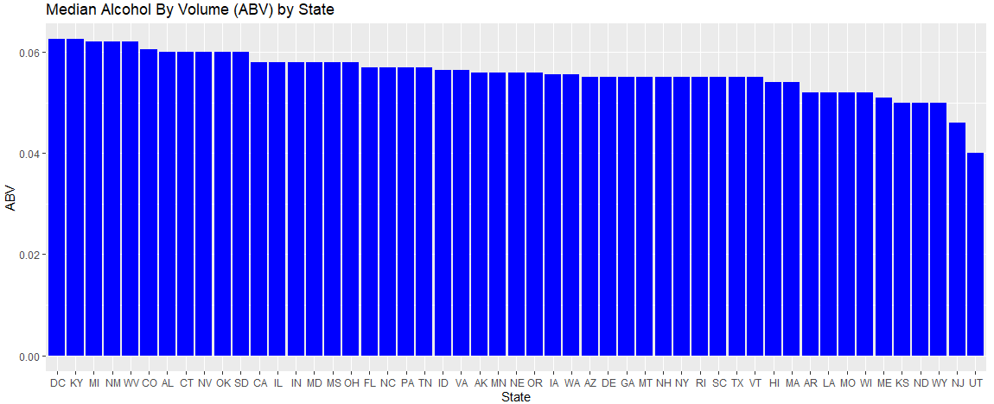
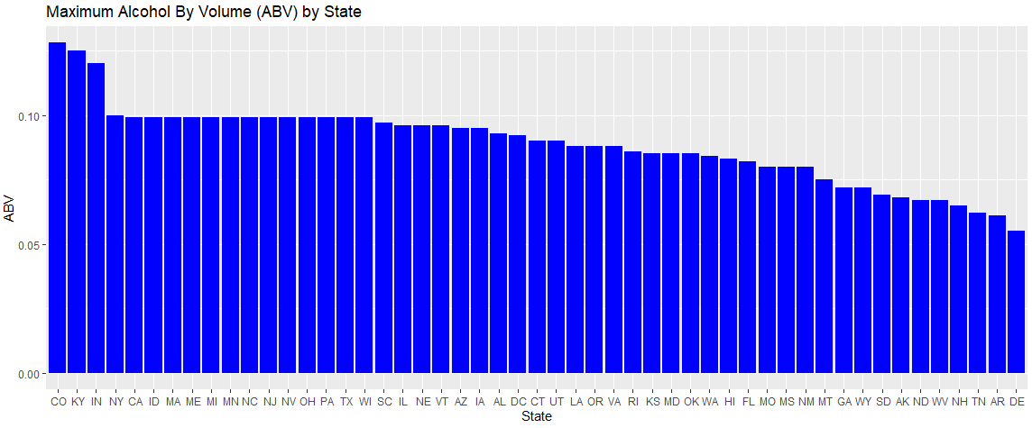
ABV by State comparison
Little Variance
Generally, breweries by state have a relatively similar Median ABV
States like Delaware have low variance across beers with regards to ABV where the max and median are nearly the same
Larger Variance
Notes:
Looking at ABV, the median Alcohol by Volume [click] has little variance across states, however the maximum ABV across states [click] varies quite a bit.

Slide 5
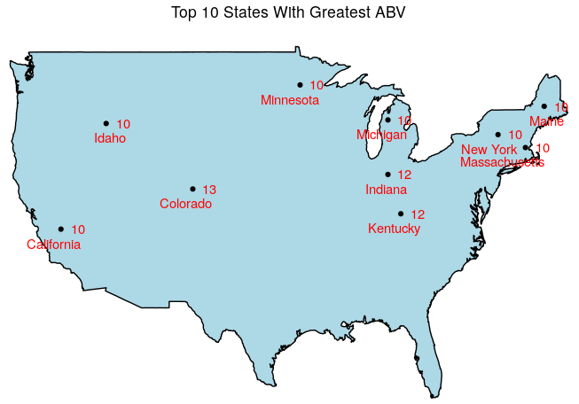
ABV Top 10 state comparison
However, three states have significantly higher Max ABV
Colorado (highest Max ABV at 13%)
Kentucky
Indiana
Notes:
Here we show the top 10 states with highest Max ABV
We can see that three states have significantly higher max ABV than other states. These states are [click] Colorado, Indiana and Kentucky

Slide 6
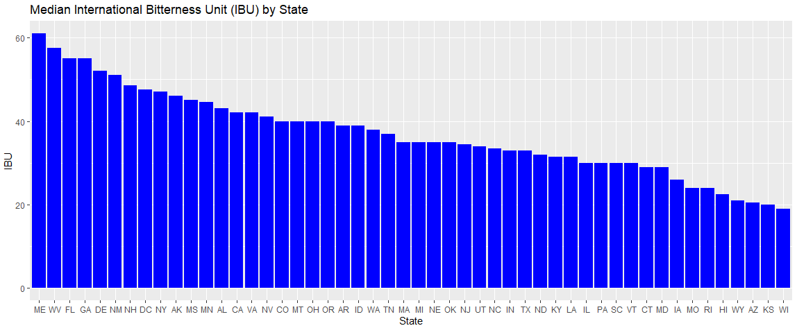
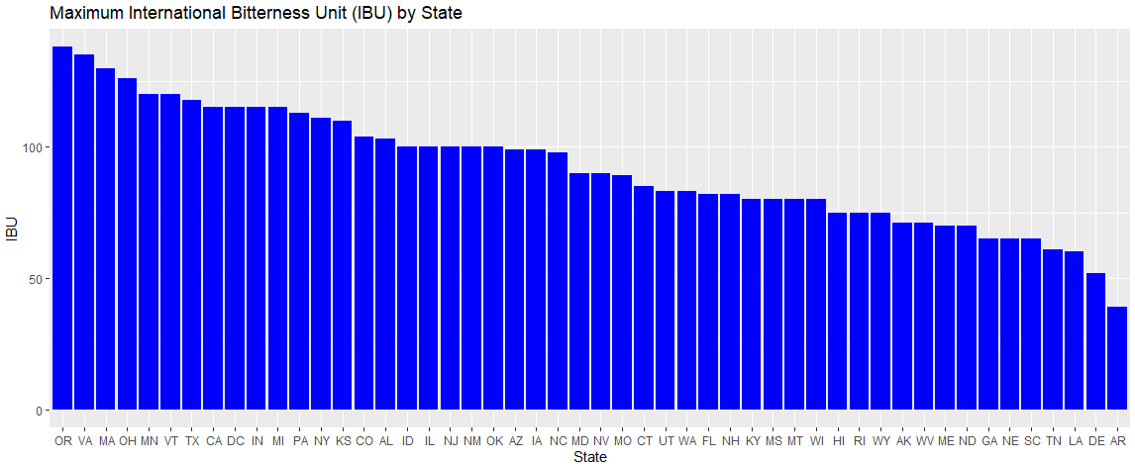
Ibu by state comparison
Median IBU varies drastically across state breweries from 20 to 60 IBUs
Maximum IBU follows a similar trend across state with Oregon having the max IBU at 138
Large Variance
Large Variance
Notes:
Looking at IBU, we see that there is quite a large variance across states in both the median IBU as well as the Max IBU as can be seen in the graphs shown here.

Slide 7
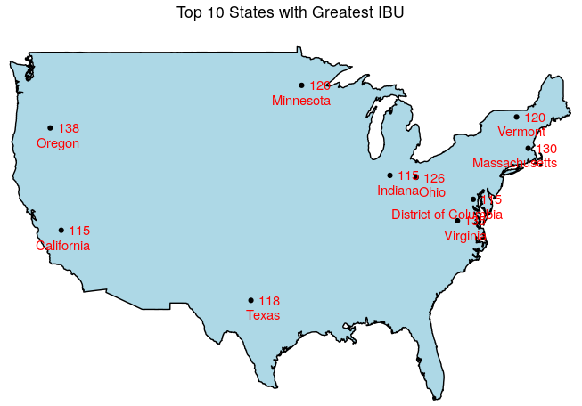
Ibu Top 10 state comparison
Oregon is known for having beer with a lot of hops
Although Oregon has highest IBU, it’s not one of the states with highest max ABV
However, MA and MN are in top 10 for ABV as well as IBU
Notes:
Here, we show the top 10 states with the highest max IBU
Oregon is known for having a lot of beer with a lot of hops.
Although Oregon [click] has the highest IBU, it’s not one of the top 10 states with highest ABV. However, [click] Massachusetts and Minnesota have some of the highest IBU and highest ABV of all states.

Slide 8
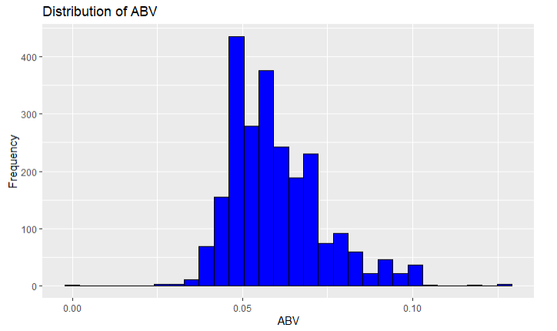
Distribution of abv
Summary of ABV
The mean and median of ABV are nearly equal
The distribution indicates the majority of beers contain roughly 5% ABV which corresponds to the summary of ABV
This would indicate a market preference for beers with around 5% ABV
Notes:
Again, looking at ABV, [click] the median and mean are nearly equal and the distribution indicates that majority of beers [click] have roughly 5% ABV which indicates a market preference for beers around 5% ABV

Slide 9
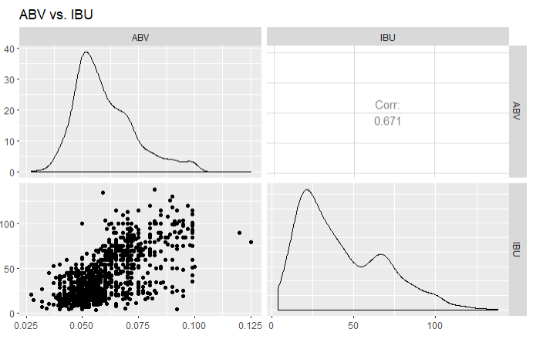
ABV compared to IBU is there a relationship?
We see a positive relationship between IBU to ABV
As the IBU increases, we see an increase in ABV
This suggests that beers that are increasingly bitter also generally have an increase in ABV
The more malted barley you add, the more fermentable sugars are available to the yeast, which generally results in higher ABV. To offset the higher sweetness, brewers throw in more bittering hops to balance beer. ... Balance is everything in a good beer.
https://www.quora.com/Why-do-hoppy-beers-generally-have-a-higher-ABV-1
Notes:
We looked to see what the correlation is between ABV and IBU and we can see [click] a moderately high positive correlation. This is because of the fermentation process. The more barley you add, the more sugars there are, so brewers add more bittering hops to offset the sweetness.
9

Slide 10
Classification
KNN versus Naïve Bayes
Notes:
Let’s take a look at how we can classify beers using KNN and Naïve Bayes.

Slide 11
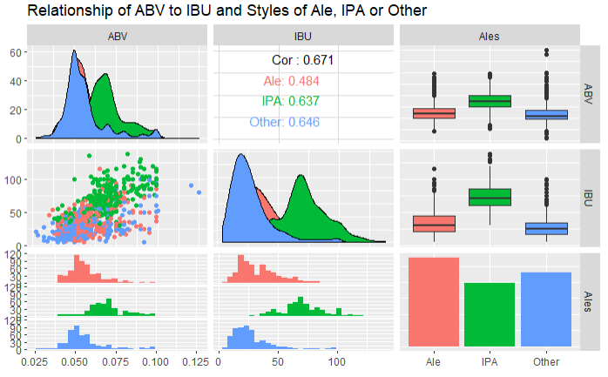
Ales, ipa and other styles vs ABV and IBU
We see that IPA’s have a higher distribution of IBUs than that of Ales and Other styles of beer
We can also see that as IPAs, having a higher IBU, also have a higher distribution of ABV
Notes:
To do this, we grouped beers into three different categories: Ales, IPA and Other types of beer. We can see that [click] IPAs have a higher distribution of IBUs than Ales and Other types of beers and that [click] IPAs also have a higher distribution of ABV than Ales and Other types of beers.

Slide 12
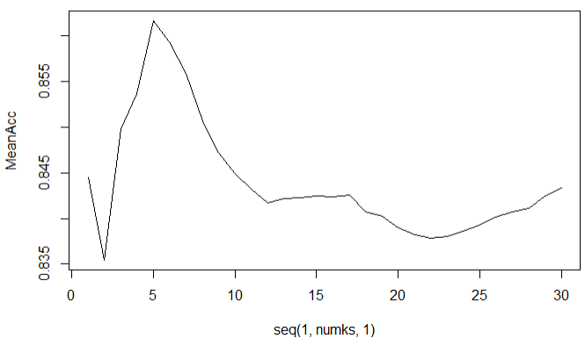
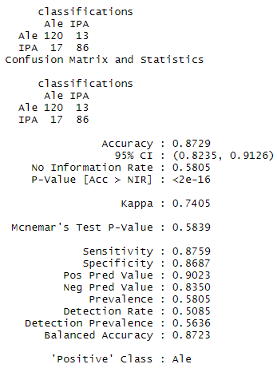
KNN Classification of beers based on ABV and ibu
Finding the optimum k hyperparameter for model
Knowing that IPAs, Ales and Other types of beer generally have different ABV and IBU’s, we can classify beers into these styles given an ABV and IBU
Using a KNN (k=5) classifier, we see that we can classify beers with an 83% accuracy
This is a decent accuracy, but let’s show what a Naïve Bayes classifier looks like next
Notes:
Building off what we know about IPAs, Ales and Other beers, we used the ABV and IBU’s to classify their type using KNN. We identified that a [click] KNN with k=5 resulted in a model that has an 83% accuracy. Let’s take a look at Naïve Bayes next as a comparison.

Slide 13
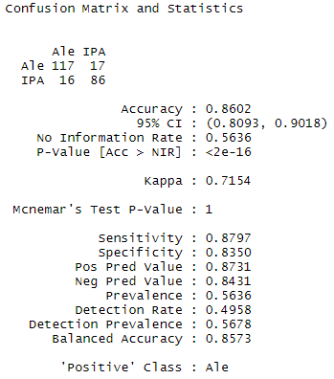
Naïve bayes classification of beers on abv and ibu
Again, knowing that IPAs, Ales and Other styles of beers have different ABV and IBU combinations, we can leverage that information to classify beers into these categories
Here, a Naïve Bayes classifier is used and we see an accuracy of 86%
The Naïve Bayes classifier outperforms the KNN classifier and would be the suggested classifier for Budweiser
Notes:
Naïve Bayes was able to predict the type of beer using ABV and IBU with an 86% accuracy. With these results, we recommend the Naïve Baye’s model for Budweiser.

Slide 14
Comparison of ABV and IBU
Compare ABV and IBU differences in each region
Northeast, Midwest, South, West
Defined by the Census Regions of the United States
Compare ABV and IBU differences in beer size
12oz vs. 16oz
Is there an interaction term between region and beer size for ABV or IBU?
Notes:
Let’s compare regional differences against ABV and IBU as well as ABV and IBU compared to the size of the beer. That is, how big the bottles or cans are. Let’s see if there’s an interaction between region and beer size for ABV or IBU.

Slide 15
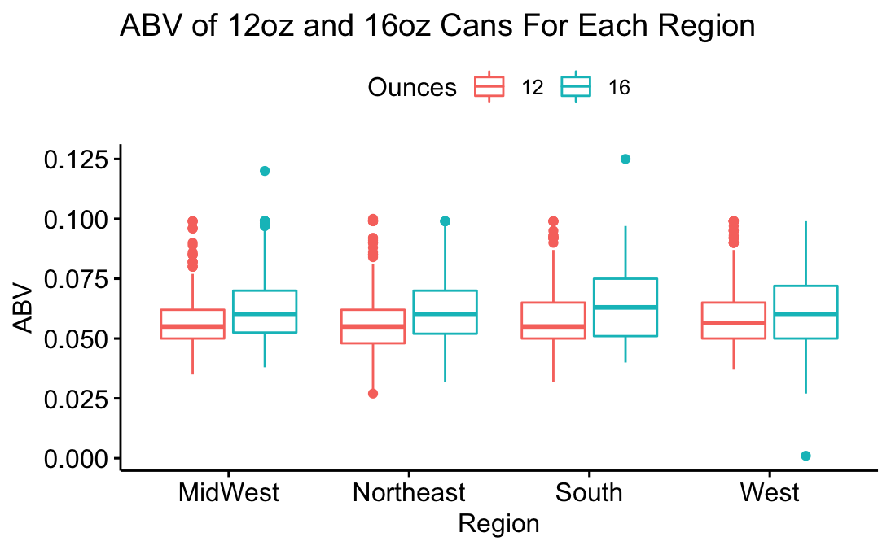
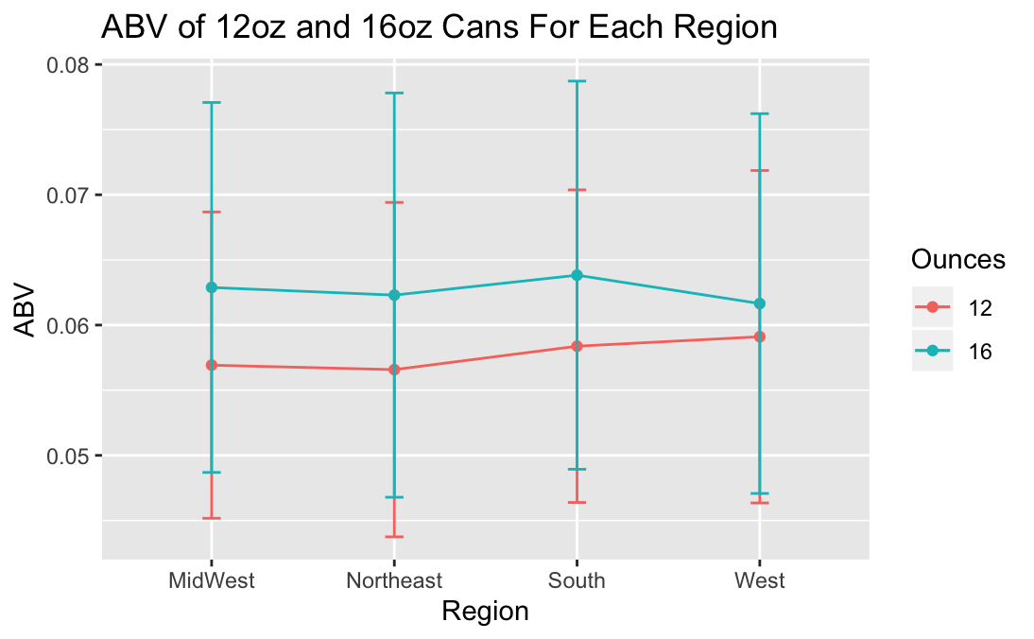
ABV for 12oz cans and 16oz cans for each region
16oz ABV seems to be higher than 12oz ABV in each region
The standard deviation of 12oz and 16oz cans overlap their mean values in each region
Visually, it looks like an additive model
Notes:
Looking at ABV, [click] we can see that there is a slightly higher ABV by can size across all regions for the 16 oz size.
We also see [click] that the standard deviations between can size across regions overlap and the profile plot appears to have nearly parallel lines which indicates it’s an additive model with no significant interaction between beer size and region.

Slide 16
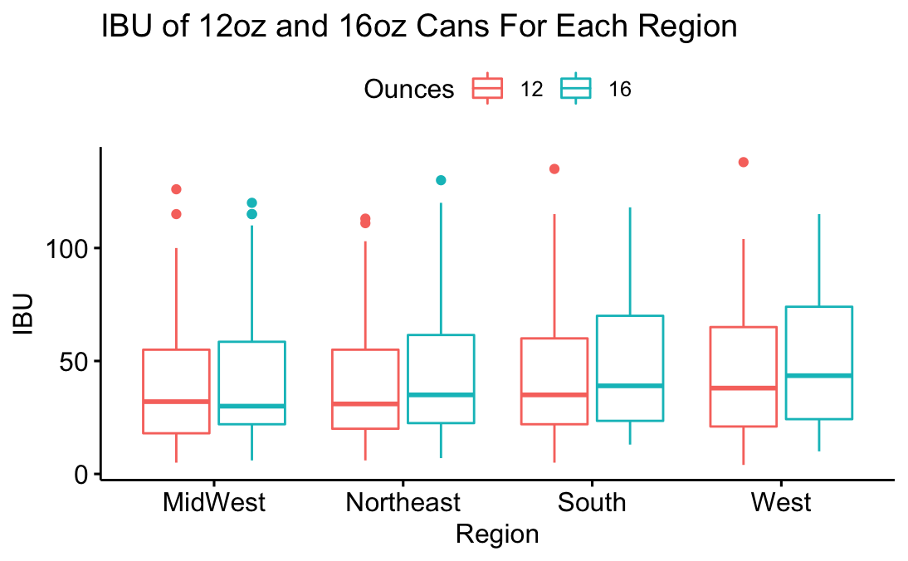
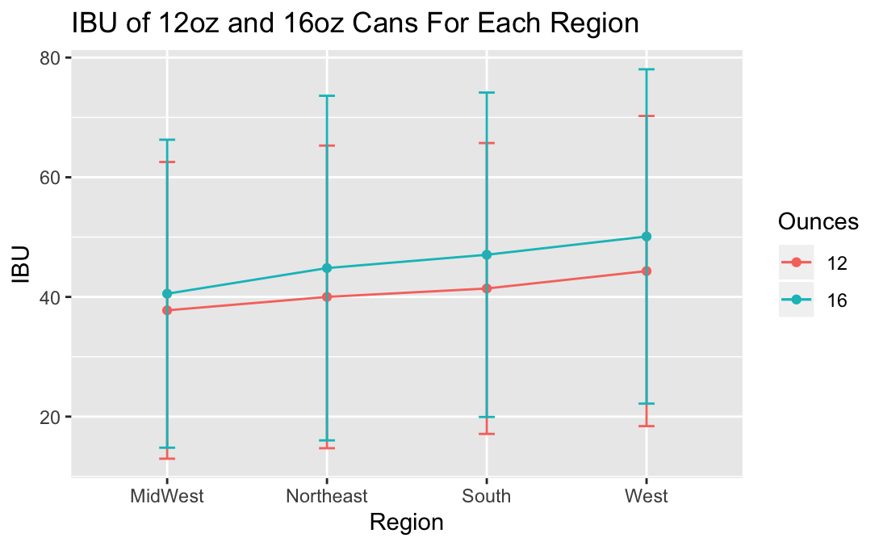
IBU for 12oz cans and 16oz cans for each region
16oz IBU seems to be higher than 12oz IBU in each region, except for Midwest.
The standard deviation of 12oz and 16oz cans overlap their mean values in each region
Visually, this also looks like an additive model
Notes:
Looking now at IBU, we see that [click] 16oz seems to be slightly higher in IBU except for the Midwest. The South and West regions show slightly higher IBUs for the16ounce size. We again see [click] that the profile plot indicates no interaction between size of can and region for IBU.

Slide 17
Two-Way ANOVA Conclusions
ABV
The two-way ANOVA test shows that there does not seem to be an interaction term between ounces and region
Ounces is a significant factor in determining ABV, and there is some evidence that region is a factor too
Differences occur between the Northeast and Midwest Regions and the ounces in the beer
IBU
The two-way ANOVA test shows no evidence of an interaction term
Both ounces and region are significant factors in determining IBU
Differences occur between the West and Midwest Regions and the ounces in the beer
Notes:
The takeaway is that there’s no interaction between size and region for both ABV and IBU, however both ounces and region are both significant independently. This indicates that there is a market preference for higher IBU and higher ABV in 16ounce sizes. Coupling this with what we know about types of beers, we would recommend that if Budweiser wishes to begin offering IPA’s you would want to include a 16ounce size for this type of beer.

Slide 18
Thank You
Notes:
Thank you for your time. We hope you found this analysis informative and useful. Goodbye

Slide 19
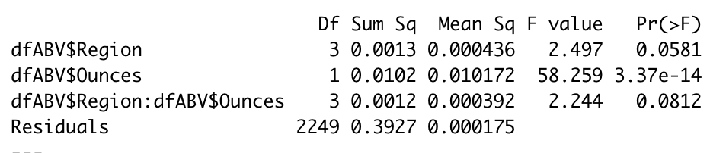
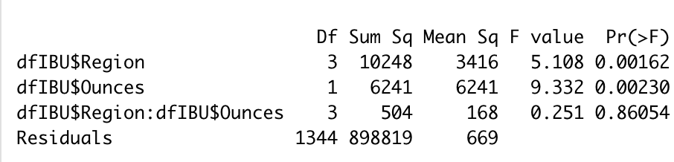
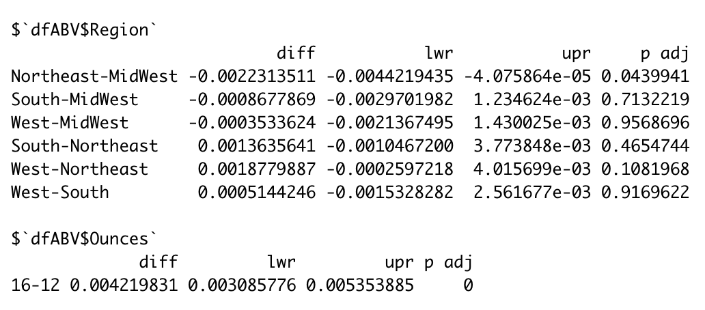
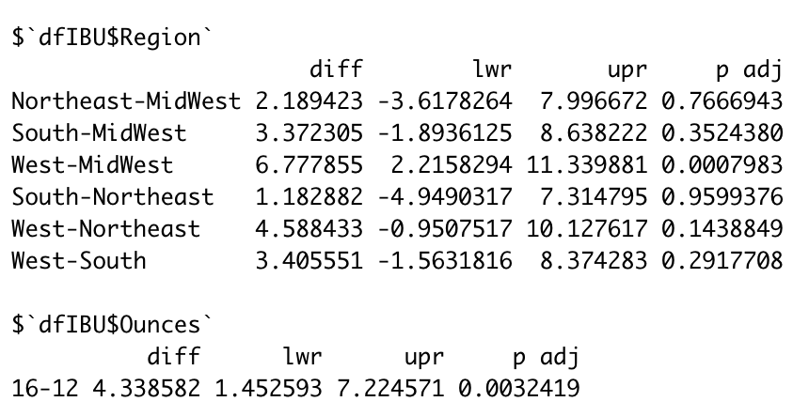
Appendix
Two-Way ANOVA Results for ABV Given Region and Beer Size
Two-Way ANOVA Results for IBU Given Region and Beer Size

