Slide 1
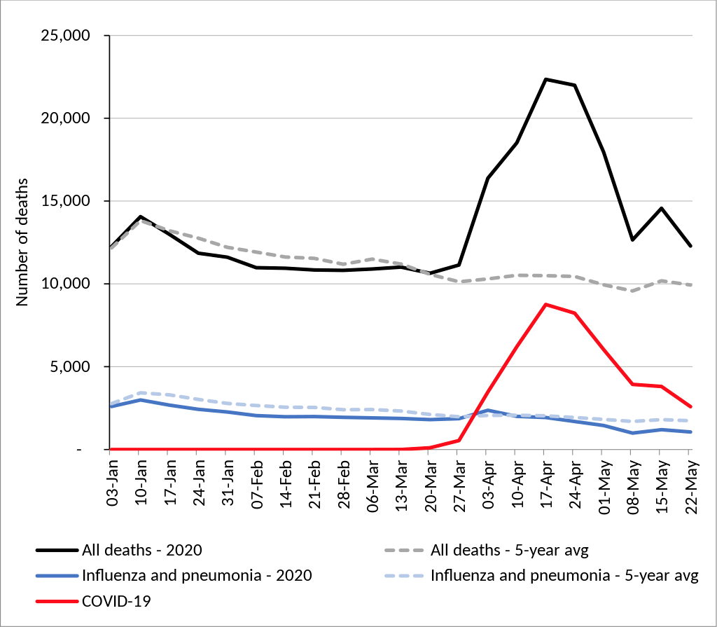
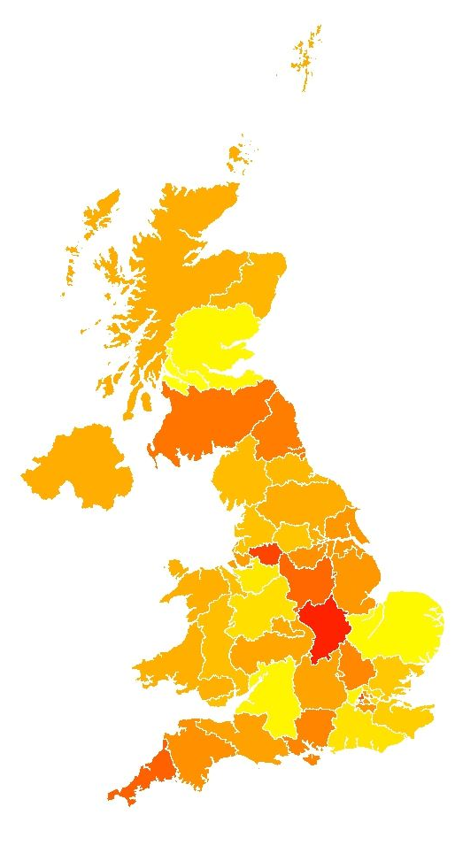
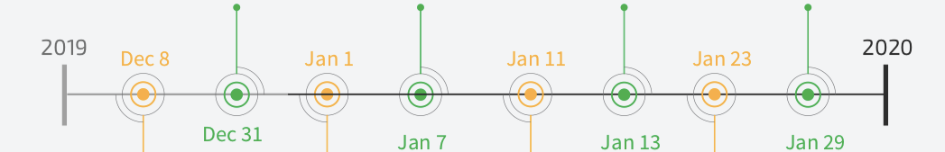
The Pandemic, People and the Environment timeline
COVID cases
Park Mobility
Weather
January
25 January – The Foreign and Commonwealth Office advises against all travel to China's Hubei Province, where the city of Wuhan, the original epicentre of the outbreak, is located.^{[5]}
27 January – The Health Secretary, Matt Hancock, tells the House of Commons that 200 British citizens trapped in Wuhan, China, will be offered repatriation to the UK, in light of the coronavirus outbreak there.^{[6]}
28 January – The Foreign and Commonwealth Office updates its travel advisory, advising against all but essential travel to the rest of Mainland China.^{[7]}
29 January – British Airways suspends all flights to and from mainland China with immediate effect, due to the ongoing coronavirus threat.^{[8]}
31 January – The first two cases of coronavirus (2019-nCoV) in the United Kingdom are confirmed.^{[9}

