Slide 1
Web Dataming and Semantics - project
By Áron Bege and Corentin Dauvissat

Slide 2
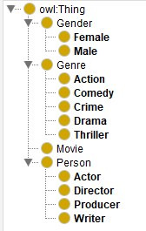
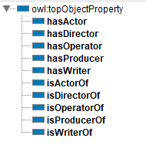
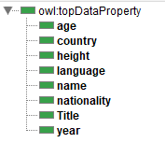
I - Modeling the ontology
We created the classes, the object properties and the data properties on protege :

Slide 3
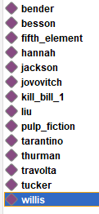
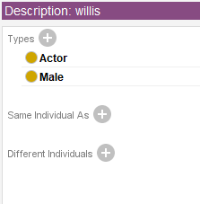
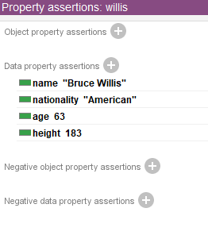
II – Populating the ontology
We added some individuals to the ontology (movies and persons). Each individual have types and properties :

Slide 4
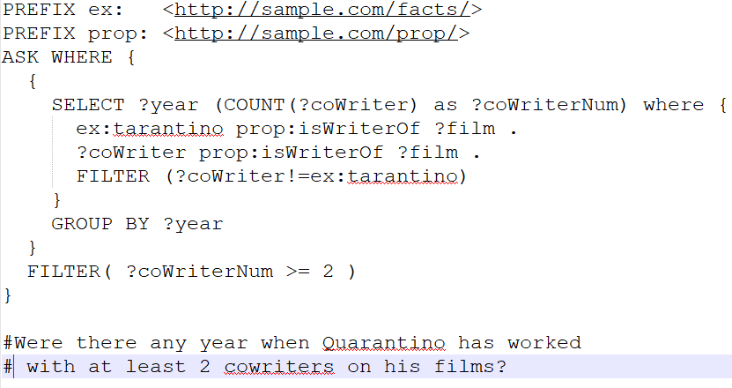
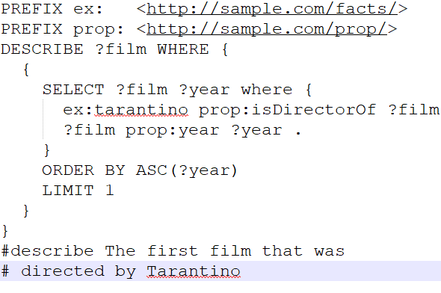
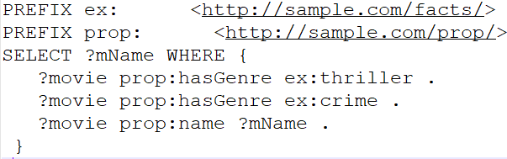
III – Querying the ontology
We made some queries to the .rdf file of the ontology. For example :

Slide 5
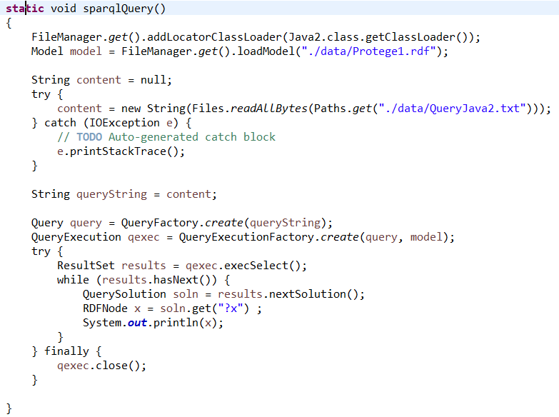
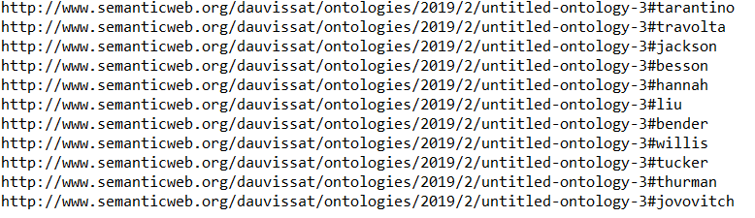
IV – Manipulating the ontology
We created a program in Java using Jena to display the persons in the ontology. It’s availible in the « movies » file :

Slide 6
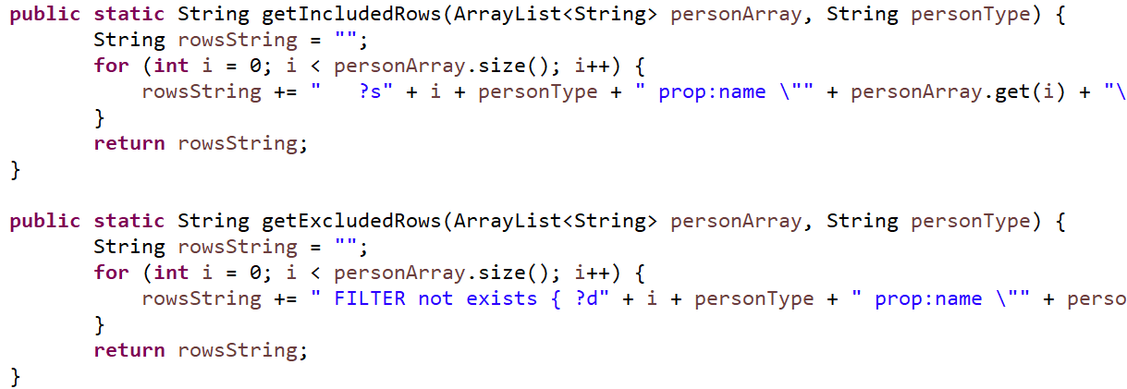
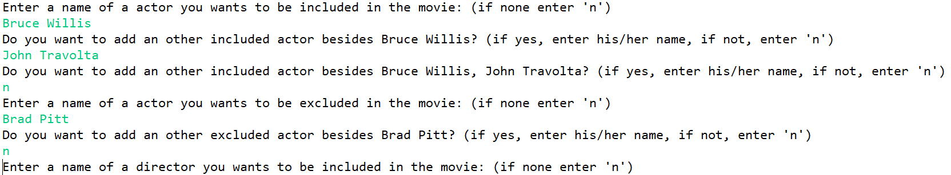
V – Java application
We created a Java console application that allows the user to filter the movies by included/excluded actors, directors and genres:

