Slide 1

GJK AND BVH FOR OBJECT COLLISION DETECTION
Berke Egli
Chris Müller
Liam van der Poel
Mihai Zorca
TexPoint fonts used in EMF.
Read the TexPoint manual before you delete this box.: AAAAA

Slide 2
Algorithms
Collision detection of two 3D objects
Gilbert-Johnson-Keerthi (GJK)
- Intersection of convex objects
Bounding volume hierarchy (BVH)
- Intersection of two triangle meshs

Slide 3
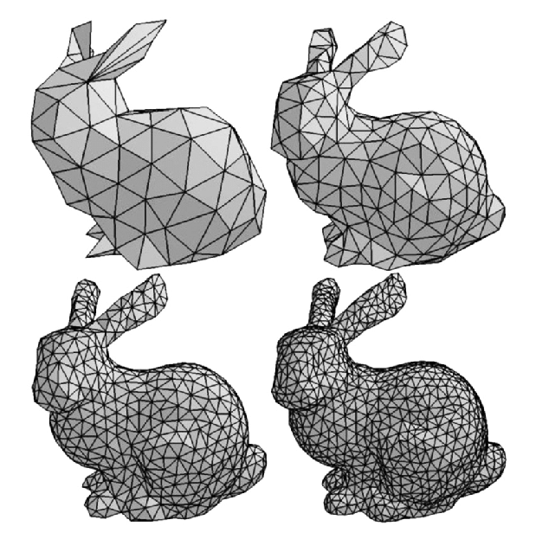
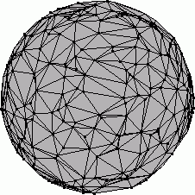
Input data
GJK
BVH

Slide 4
Cost analysis
    Cost measure GJK: (C_FMA, C_MUL)
    Cost measure BVH: TODO

Slide 5
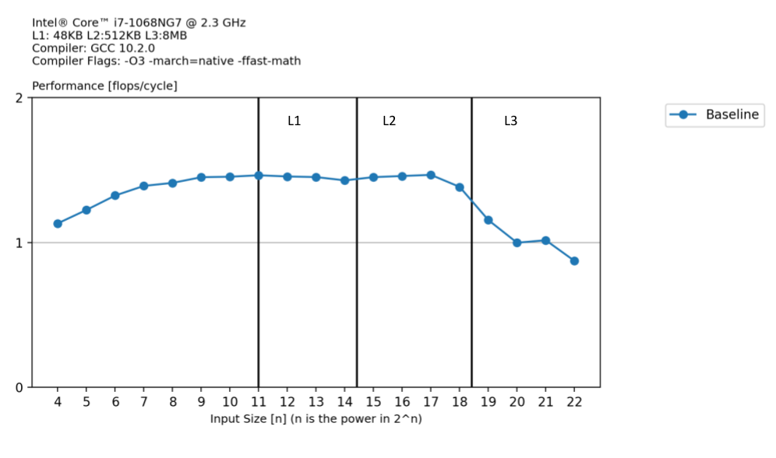
Baseline GJK

Slide 6
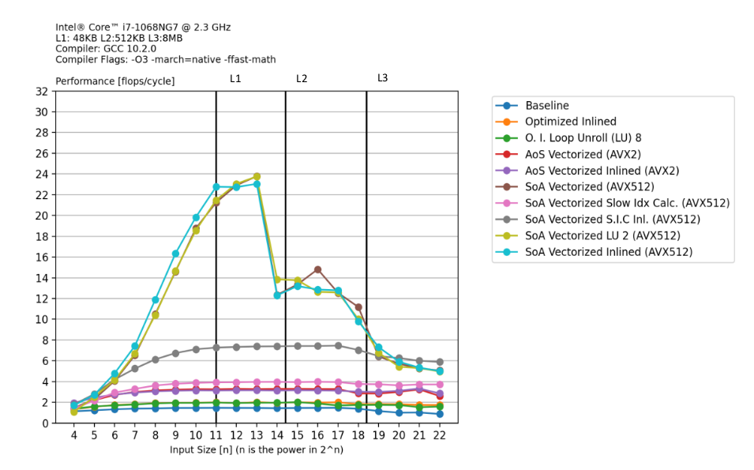
Optimized GJK

Slide 7
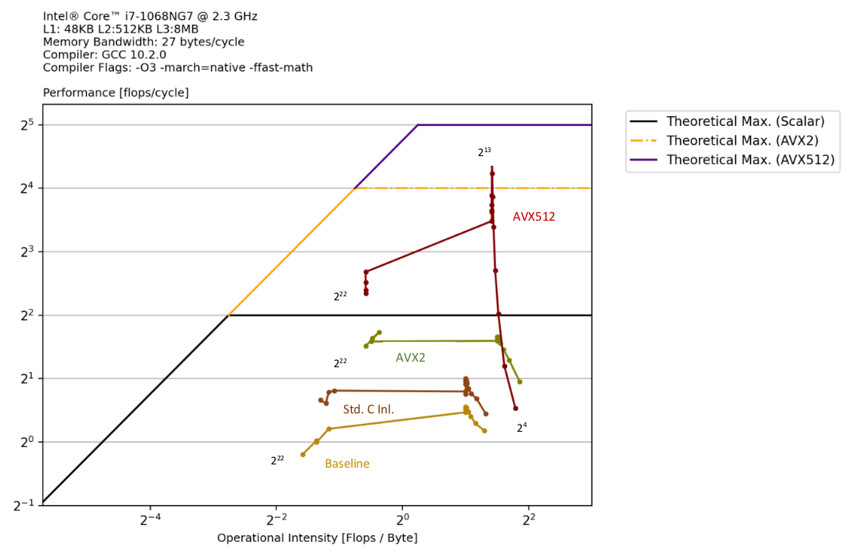
Roofline Plot GJK

Slide 8
Baseline BVH

Slide 9
Optimized BVH

