Slide 1
Maven Lifecycle & Advantages
By
Sachin Sajwan
Shorya

Slide 2

What is Maven?
Maven is a project management and comprehension tool that provides developers a complete build lifecycle framework.
Its helps in:
Builds
Documentation
Dependencies
Distribution

Slide 3
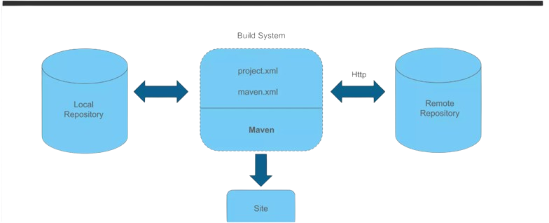
Maven Architecture

Slide 4
Features of Maven
Simple project setup that follows best practices.
Consistent usage across all projects.
Dependency management including automatic updating.
Backward Compatibility

Slide 5
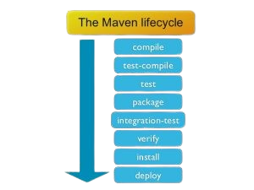
Maven LifeCycle

Slide 6
THANK YOU

