Slide 1
Dockerfile
Sameer Zulfi

Slide 2
How to ??
Write a Dockerfile
Build an image from a Dockerfile

Slide 3
Dockefile is a build recipe for a Docker image.
Conains series of instructions telling Docker how an image is constructed.
So , the docker build command builds an image from a Dockerfile.
Dockerfile -> using the build command -> DockerImage

Slide 4
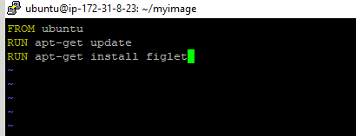
Writing our First Dockerfile
Create a directory to hold our Dockerfile
mkdir myimage
cd myimage
vi Dockerfile
Please enter the below instructions into your Dockerfile
FROM Ubuntu
RUN apt-get update –y
RUN apt-get install figlet

Slide 5
FROM indicates - > the base image for our build
Each RUN line will be executed by Docker during the build.
Okkk.. Enough.. Let’s build it..
Save the file and then execute the below command.
Syntax : docker build –t <newimagename> .
docker build –t figlet .
Don’t forget the DOT(.) at the end of the build command
The . Decides where your Dockerfile is located. We call that as Build Context wherever your Dockerfile is located.

Slide 6
The Caching System
If you run the same build again, it will be instantaneous. Whyyy ?
After each build step, Docker takes a snapshot of the resulting image.
Before executing a step, Docker checks if it has already built the same sequence.

Slide 7
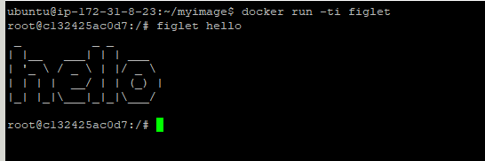
Running the image
Docker run –ti figlet

Slide 8
Introducing JSON Syntax
Most Dockefile arguments can be passed in two forms:
Plain string: RUN apt-get install figlet
JSON list: RUN [“apt-get”, “install”, “figlet”]
We are going to change our Dockefile to see how it affects the resulting image.

Slide 9

Using JSON Syntax in our Dockerfile
Okay. Let’s change our Dockerfile as follows.
Then build the new Dockerfile
docker build –t figlet .
Don’t forget the (dot) at the end of the build command.

Slide 10

CMD and ENTRYPOINT
Both the commands allow us to set the default command to run as soon as the container starts
Let’s start with this example.
When people run our container, we want to greet them with a nice hello message, and using a custom font.
We will execute the below command
figlet –f script hello
So “-f script” tells figlet to use a fancy font
“hello” is the message that we want it to display.

Slide 11
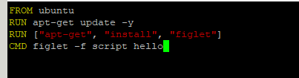
Adding CMD to our Dockerfile
Our new Dockefile should look like this
CMD -> defines default command to run
CMD -> can appear anywhere in the file
You can have multiple CMD commands. But each CMD will replace and override the previous one.
As a result, while you can have multiple CMD lines, but it’s useless.

Slide 12
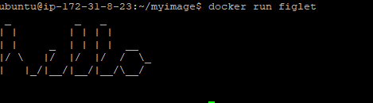
Build and test our image
Let’s build it.
docker build –t figlet .
Great. It’s built now.
What’s next ??
Run a container using the image. What should be the output as soon as you run the container. See yourself.
docker run figlet
Ok. So we got a nice greeting as
Promised.
Go back to previous slides and think what exactly happened

Slide 13
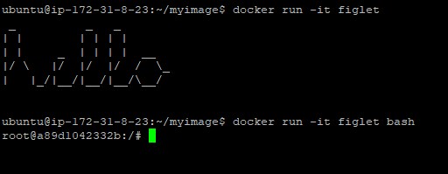
Overriding CMD
If you don’t want the inbuilt CMD command to be executed when you start the container, then you can give your command as an argument while running the container.
docker run –it figlet bash
The above command will allow you the container’s bash shell.
Which means it replaced the value of CMD.
See the screenshot and compare both the commands

Slide 14
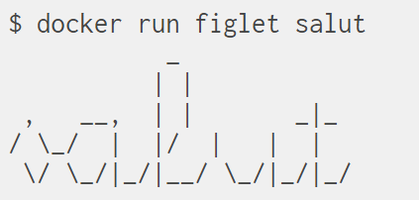
Using ENTRYPOINT
We want to be able to specify a different message on the command line
What we are trying to achieve here, if we type this command
docker run figlet salut
If you open your Dockerfile now, we will have
CMD command and the message says “hello”
In order to execute the above command, we
Need to use ENTRYPOINT

Slide 15

Adding ENTRYPOINT to our Dockerfile
Our new Dockefile should look like this
Always go back to our previous slides and compare things for better understanding.
Like CMD, ENTRYPOINT can appear anywhere and replaces the previous value

Slide 16
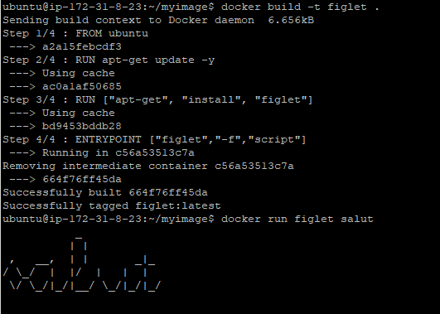
Build and test our image
Let’s build it.

Slide 17

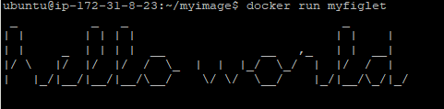
Using CMD & ENTRYPOINT together
ENTRYPOINT will be the base command
CMD will carry the parameters for the above base command
Our new Dockerfile should look like this
Let’s build it.
Docker build –t myfiglet .
Now let’s run the container.
Let’s analyse in detail in the next slide

Slide 18
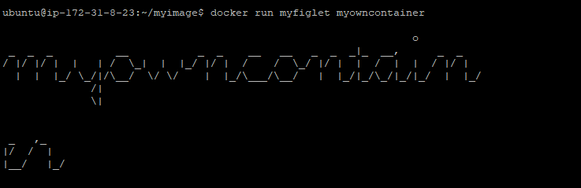
ENTRYPOINT [“figlet”, “-f”, “script”]
The above command is a figlet software command where whatever strings or words you are giving in the CMD parameter, it will list out in the stylist format.
CMD [“hello world”]
So when we ran the container in the last slide, we got the default string as hello world in stylish format.
Now let’s add a parameter in the run command itself.
Compare the previous slide and this slide
Output.
Think and Dig more on this. You will
understand

Slide 19
What is Dockerizing/Containerizing ?
The Process of taking an application and configuring it to run as a Container.
How to container a Simple Application ?
1. Start with your App Code
2. Create a Dockerfile, it’s dependancies
3. Feed this Dockerfil into Docker image build command.
4. Sit back relax while docker build your application into a docker image
Once the image is built, shipt it and run as Container

Slide 20
High Level Steps
Get the App Code
Inspect the Dockerfile
Containerize the App
Run the app

Slide 21
Getting the App Code
Do the git clone https://github.com/beginners-sameer/psweb.git
Dockerfile -> describes the app and tells docker how to build it into an image
Build Context -> The Directory containing the app is called

Slide 22
Dockerfile Instructions
FROM = Always Dockerfile starts with FROM and describes the base image. It’s like your VM guest OS name
RUN = Execute the respective commands
COPY/ADD = Does the same work. However ADD will compress, uncompress while copying the files
WORKDIR = from which location you need to execute the commands.
EXPOSE = Exposing the container port
ENTRYPOINT & CMD – we have seen it already. Please go back to those slides

Slide 23
To inspect the image
Docker image inspect <imagename> or <imageid>
Please visit my github site for more Dockefile Examples

