Slide 1
Kubernetes/K8S
Sameer Zulfi

Slide 2

What is this ??
It is an Orchestrator.
What is Orchestrator?
What is this image says ?
A Music Orchestrator
What is his Job ?
Is he controlling the other Musicians?
What will he do if any musician does wrong ?

Slide 3
Orchestrator in technical term
A backend system which deploys and manages applications
It will help you to deploy your
Application
Scale up and down
Perform updates
Rollbacks and more

Slide 4
Where did Kubernetes came from ???
It came out of Google
It was open sourced in 2014
Handed over to CNCF – Cloud Native Computing Foundation
It’s written in Go Language
Docker & Kuberenetes goes hand in hand. i.e., Kubernetes is high level and Docker is low level which means Kubernetes controls the Docker Containers

Slide 5
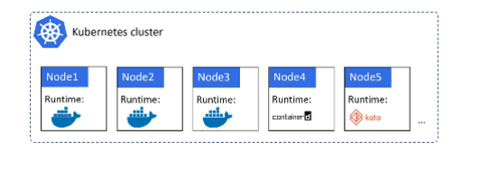
How is Kubernetes Cluster Look like ?

Slide 6
What about Kubernetes vs Docker Swarm?
We had orchestration war between Docker Swarm, Kubernetes & Mesosphere.
Kubernetes won because of the market share and also it came out of Google. Hence everyone started choosing Kubernetes
Rite now Kubernetes is an Open Source Project under CNCF

Slide 7
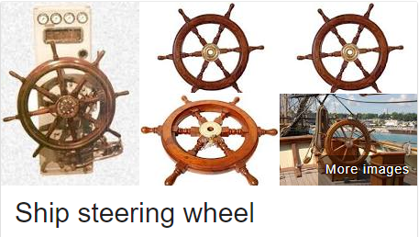
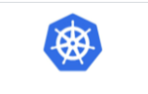
What do you mean by Kubernetes? Why that name ?
Koo-ber-net-eez
It’s a greek word meaning “Helmsman”
Helmsman- google it, you will see “person who steers the ship”
The same theme reflected in the logo also
Sometimes people call it as “K8S”
Because KuberneteS, in between K & S there are 8 characters
KuberneteS
K12345678S

Slide 8
Analogy – Courier Service
If you want to send a courier to someone else, you will package it and put the “To Address” and submit to the courier office.
That’s it. Your job is done. You don’t need to worry about how the courier will reach the recipient.
It’s courier office responsibility to choose which van, which highway, which road etc.,
The only requirement which they are expecting from us is “Make sure we package the item well and put the “ To Address Label “
Same process goes with K8S

Slide 9
K8S Principles of Operation
Two things here.
1. Clustering Concept
2. Orchestration
On the ClusterFront – it is just a bunch of nodes
On the OrchestrationFront – It acts like Manager

Slide 10
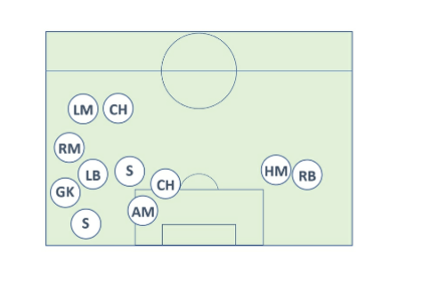
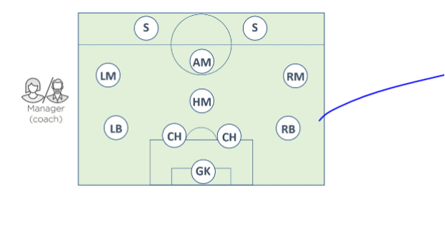
Football Analogy
Football is made of individuals
Now two players are same. Each player has different role to play in the team.
Some player will defend, some are good in passing, some tackle, some shoot
Along with these players, we have a coach outside who instructs the position of all the players and organizes them into a team with the mission/purpose.

Slide 11

Coach Responsibility:
Make sure the team maintain its formation
Sticks to the Game Plan
Deals with any injuries etc.,
Now, K8S is like Football Coach. Like SRK.
IN the Sports World, we call it’s Coaching
In the Application World, we call as Orchestrator
Well, to make this happen, we start out with an app, package it up and give it to the cluster.
Cluster is made up of one or more master and bunch of nodes.

Slide 12
Now, MASTER sometimes we call it as HEADS or HEAD NODES.
So what I am trying to say is .. MASTER/HEADS/HEAD NODES all are same.
Keep this in mind
MASTER is in charge of your Clusters.
MASTER responsibility:
Scheduling Decisions
Perform Monitoring
Implement Changes
Respond to Events and more…
For these reasons we often refer to the MASTER as the CONTROL PLANE
So Master we call it as Control Plane. Remember this.

Slide 13
Now… We earlier saw about MASTER. Let’s talk about NODES.
So Nodes are where the work is being done… means where the application services run. We sometime call as DataPlane.
So. Let me rephrase it . MASTER = CONTROL PLANE. NODE = ???????? . Fill it up.
They have a connection to the MASTER and keep watching for new work assignments.

Slide 14
High level overview of how to run apps on K8S Cluster
Step 1 : Write the App in your favourite Language. Mostly this is done by Developers and they follow micro-services pattern services.
Step 2 : Package each service in its own Container
Step 3 : Wrap each container in its own pod
Step 4 : Deploy Pods to the Cluster via HIGHER-LEVEL Controllers such as “Deployments” or “DaemonSets” or “StatefulSets” or “CronJobs” etc.,
Step 5 : Deployment controller – it offers scalability and rolling updates
Step 6 : DaemonSets – it run one instance of pod on every node
Step 7 : StatefulSets – For Stateful Application
Step 8 : CronJobs – Need to run at set times.
Ok.. What the hell are we talking about ???? Well Don’t worry. It’s just an high level overview. Come along with me.

Slide 15
New Term.. Declarative.. ??
K8S likes to manage applications declaratively
Declarative means HOW WE WANT OUR APPLICATION TO LOOK AND FEEL in set of YAML files.
We have to write this file and POST these files to K8S. That’s it. Our job is done.

Slide 16
Masters & Nodes
K8S Cluster is made up of Masters & Nodes
MASTERS means Control Plane. Hope you remember.
MASTER is the one who controls the Cluster.
For Test & Dev purpose, we can have one single master. No problem.
But For Production, you should have multi-master for High Availability. Even if one master fails, other masters will handle the cluster.
So recommended is 3 or 5 replicated masters in HA config is recommended.

Slide 17
API Server
API Server is a logical piece of component which is inside your master.
It is like your Bangalore Central Station.
All the Communication between all components goes through this API Server.
API server is like Brain of the Cluster which does all the smart work.
We POST the YAML files here in MASTER.
This YAML file which is nothing but the Declarative File which we saw in the earlier Slide.
What this file contains ( which image to use, Which ports to expose, how many pod replicas to run )

Slide 18
ClusterStore
This is another Logical Component inside MASTER
If API Server is the Brain of the K8S, then ClusterStore is the Heart. ☺
It persistently stores the entire configuration and state of your cluster
Very important component
NO ClusterStore means No Cluster

Slide 19
The Controller Manager
This is the King of Kings. Means Controller of Controllers.
This implements couple of control loops that keep watching the cluster and respond to any events
Some of the Control Loop include, Node Controller, EndPoint Controller, Replicaset Controller
Each one runs as a background watch-loop that is constantly watching the API server for changes
The Aim of this component is to ensure the CURRENT STATE of the Cluster matches the DESIRED STATE
Logis implemented by each Control Loop is :
1. Obtain Desired State
2. Observe the Current State
3. Determine the Differences
4. Reconcile the Differences
So Control Loop = Watch Loop = Reconciliation Loop

Slide 20
The Scheduler
Another Sub-component under Master.
This acts like a Watchman who keeps checking for new work tasks and assigns them to appropriate healthy nodes
It filters out the nodes which are incapable of running the pods.
And ranks the nodes that are capable.
Nodes which gets highest ranking points is eventually selected to run the POD
Now once it’s identified the nodes, It will do the pre-check whether that particular node is having any security loop holes, any damages, is there any free resources available to run the work etc.,

Slide 21
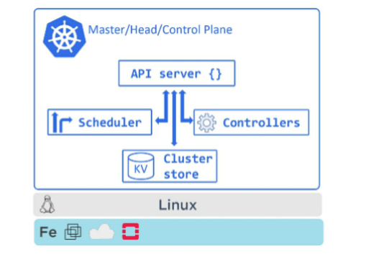
Control Plane Summary
K8S master will run all of the cluster’s Control Plane Services
Think as it’s like brain of the cluster where all control and scheduling decisions are made
But Behind the scenes, master is made up of small specialized control loops and services these include API Server, Cluster Store, ControllerManager and Scheduler.

Slide 22
Let’s talk about Nodes
Earlier we have done with master and it’s sub components. Now in this section we are going to t)alk about Nodes.
Nodes are workers of your K8S Cluster.
They do 3 things. Remember.
1st = They keep watching the API Server for new work assignments
2nd = They execute new work assignments
3rd = They report back to the Control Plane ( master )

Slide 23
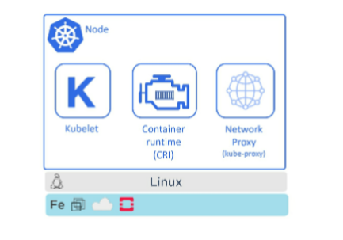
3 Major Components of a Node

Slide 24
Kubelet
It is an agent which runs on every node
It is the Star of the show in every node.
Infact in industry, it’s common to say node and kubelet interchangeably.
When you join a new node to the cluster, the process involves installation of Kubelet which is then responsible for the node registration process.
Main job of Kubelet is :
To watch the API Server for new work assignments.
If it sees one, it executes and reports back to control plane.
if a kubelet can't run a particular task, it reports back to master and lets the control plan decide what actions to take.
for ex : if pod failes to start on a node, the kubelet is not responsible for finding another node to run. control plane will decide it

Slide 25
Container Runtime
Kubelet needs a Container runtime to perform Container related tasks.
Things like Pulling Images, Starting, Stopping Containers etc.,

Slide 26
Kube-Proxy
This runs on every node
Responsible for Local networking
It makes sure each node gets its own unique IP address

Slide 27
Packaging Apps
Ok.. So we have covered all the components inside master & nodes. Let’s put our car gear from 1st to 2nd.
Here we are going to see how we package applications to run on K8S.
1. Package as a Container
2. Wrap in a Pod
3. Deploy via a Declarative Manifest File. i.e., Yaml file
Go to the Next Slide for detail insruction

Slide 28
1. Write the application based on your favourite language. This is usually done by the developers.
2. then build it to a container image and store in Dockerhub registry
3. At this point, You application is Dockertized/Containerized.
Correct ?
Next
We define K8S pod to run the Containerized Service in.
A pod is just a Wrapper that allows containers to run on a K8s Cluster.
Once we defined a pod for the container, we are ready to deploy it on the cluster.
K8s offers several objects for deploying and managing pods.
Most common is Deployment controller.. If you remember this ?
This Deployment controller offers scalability, self-healing & rolling updates.
We define these in YAML file.

Slide 29
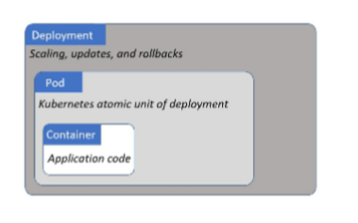
Just relate with the previous slide
Once everything is defined in YAML file
We POST it to the cluster as the DESIRED STATE
Of the application
And K8S will implement it. Like our Courier Service

Slide 30
Declarative Model & Desired State
It’s like another heart for K8S. Remember which is the first heart ??
If you take this declarative model away, K8S is nothing
Declarative model work like this
1. Declare the desired state of the application in a manifest file
2. POST it to the API Server
3. K8S stores this in the clusterstore as applications DESIRED state
4. K8S implements the DESIRED state on the cluster
5. K8S implements watch loops to make sure the CURRENT STATE of the application doesn’t vary from the DESIRED STATE

Slide 31
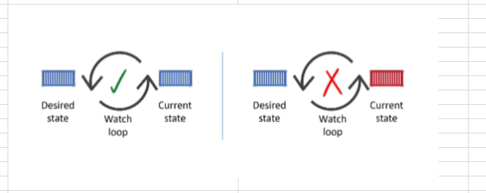
Manifest files are written in YAML. Ohhh.. How many times I am repeating this. Lol
We call this as DESIRED state.
This Manifest file will have all the details like which images to use, how many replicas should run, which network port to expose and how to perform updates
When the current state of the cluster varies from the desired state, K8S will perform necessary action to reconcile the issue.

Slide 32
Example
One application the Desired state which was given in YAML file ( manifest file ) is 10 replicas should be running.
Somereason 2 replicas fail. Only 8 replicas are running.
Our original requirement is 10 which is our DESIRED STATE. But our ACTUAL state is only 8.
Now this will be obserbed by Reconciliation Loop and K8S will schedule two new replicas on other nodes in the cluster.
That’s it…. Very easy.. Isn’t it ?

Slide 33
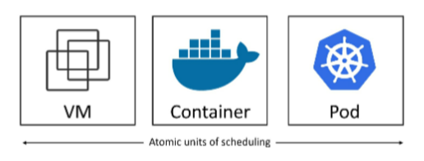
What is PODS ???
In VMWARE world – Virtual Machine was the main component
In Docker World - Containers are the main component
In K8S World - Pods are the main component.
Thumb Rule is
It’s true that Kubernetes runs containerized apps. However, you cannot run a container directly on a Kubernetes cluster – containers must always run inside of Pods.

Slide 34
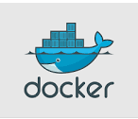
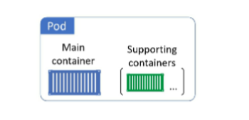
Pods and Containers
Term Pod comes from “ Pod of Whales “ means “ Groups of whales “
If you see the Docker logo, it is the whale.
As the Docker log is the whatle, it make sense that we call a group of containers as POD.
Simplest model is to run a single container per pod

Slide 35
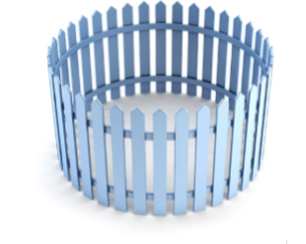
Pod Anatomy
Pod is like a separate environment dedicated to you to run containers.
In this diagram , you have 3 fences which I am referring it as PODS. So I have 3 PODS
HOST MACHINE

Slide 36
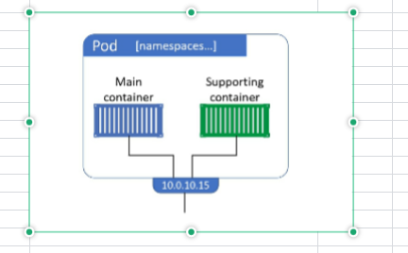
When I am talking about POD, I am going to allocate one particular area in the host os which is the fenced one as per the earlier slide.
I will run the containers inside that fenced area. So that area is called pod.
All the containers in the same POD will share the same IP address. Which is POD’s Ip address

Slide 37
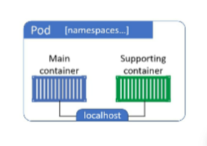
Two containers in the same POD

Slide 38
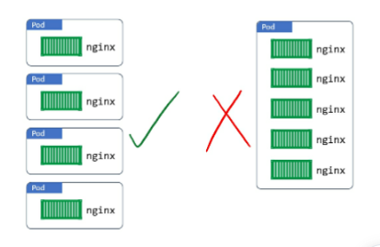
Pods as the Unit of Scaling
If you want to scale you application,
You Add or Remove PODS
You will not scale by adding more containers to an existing POD.
A single Pod can only be scheduled to a
Single node

Slide 39
Pod LifeCycle
Pods are Mortal. Means it is not GOD. It is like Human being.
It will be created, It will Live and will Die also.
If the pod died unexpectedly, we will not bring them back in life. Instead we will start a new one.
New Pod will have New IP address.

Slide 40
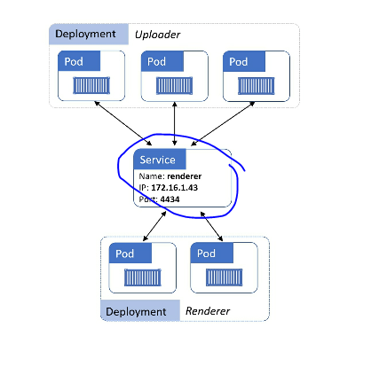
Service

Slide 41
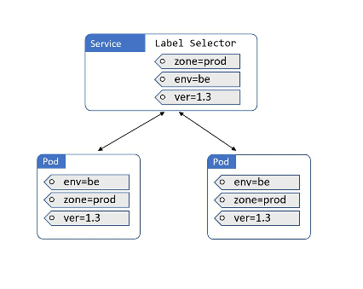
Connecting Pods to Services
Services use labels and a label selector to know which set of Pods to load-balance traffic to.
Service has a label selector that is a list of all the labels a Pod must posses in order for it to receive traffic from the service.

Slide 42
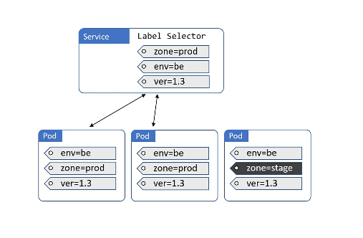
Service will not load balance to it

Slide 43
Summary
We have learnt about major components of K8S Cluster
Masters are control plane
Under the hood, we have several system-services, including API Server and others.
Masters make all the deployment and scheduling decisions
Multi-master HA is important for Production-grade envs
Nodes are where user application run
Each node runs a service called Kubelet that registers the node with the cluster and communicates with Control Plane.
Nodes also have Container Runtime & Kube-Proxy services.
We also seen major K8S API objects such as Pods, Deployments and Services.
Deployments add self-healing, scaling and updates.
Services add stable networking and load-balancing
WE are done with the Basics.. Next is all about Practical

