Slide 1


VPC
Sameer Zulfi

Slide 2
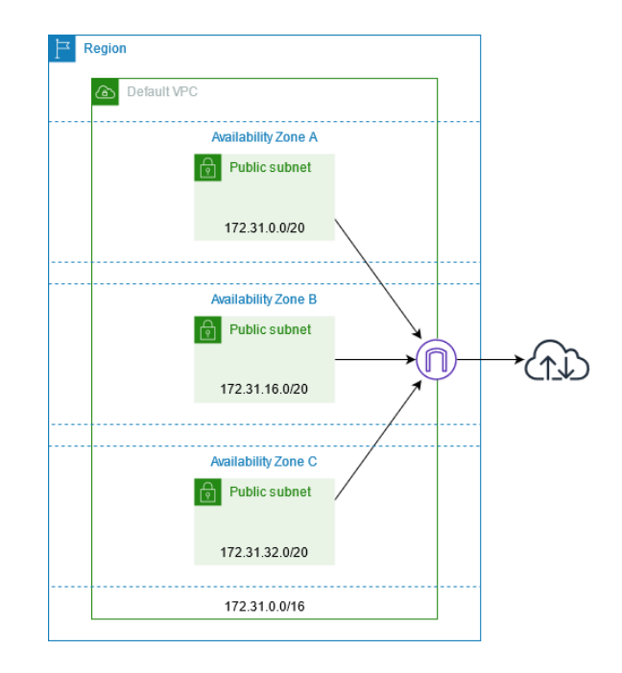
Key Components for Default VPC

Slide 3
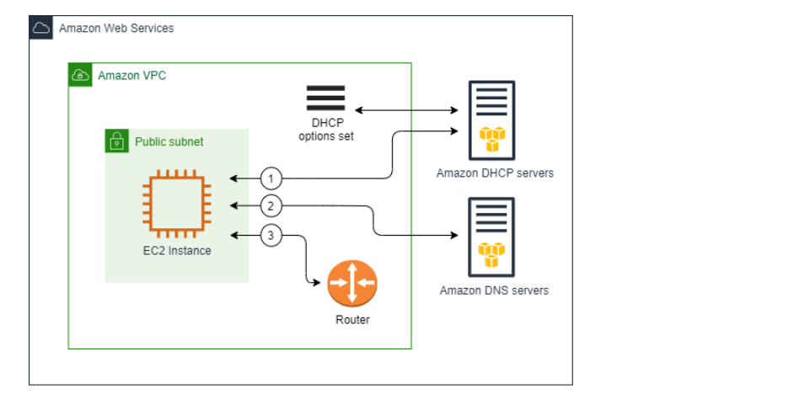
Default DHCP Option Set
If you use the default option set, the Amazon DHCP server uses the network configurations stored in the default option set. When you launch an instance into your VPC, the instance interacts with the DHCP server(1), interact with the Amazon DNS server (2), and connect to other devices in the network through your VPC's router (3). The instances can interact with the Amazon DHCP server at any time to get their IP address lease and additional network configurations.

Slide 4
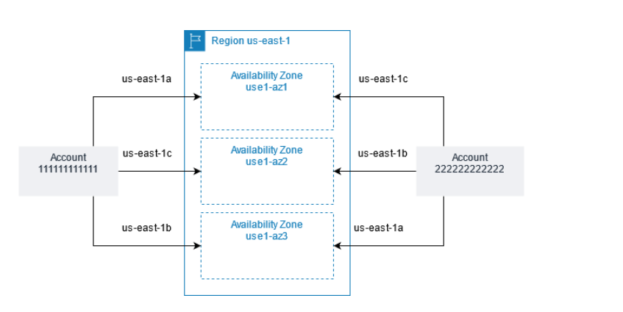
two accounts with different mappings of Availability Zone code to AZ ID

Slide 5
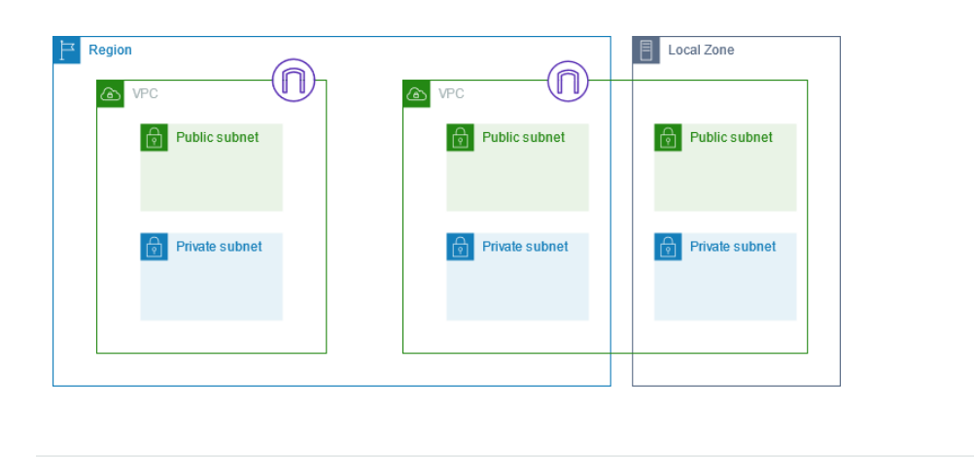
Subnet Diagram

Slide 6
For example, if you create a VPC with CIDR block 10.0.0.0/24, it supports 256 IP addresses. You can break this CIDR block into two subnets, each supporting 128 IP addresses. One subnet uses CIDR block 10.0.0.0/25 (for addresses 10.0.0.0 - 10.0.0.127) and the other uses CIDR block 10.0.0.128/25 (for addresses 10.0.0.128 - 10.0.0.255).

Slide 7
The first four IP addresses and the last IP address in each subnet CIDR block are not available for your use, and they cannot be assigned to a resource, such as an EC2 instance. For example, in a subnet with CIDR block 10.0.0.0/24, the following five IP addresses are reserved:
10.0.0.0: Network address.
10.0.0.1: Reserved by AWS for the VPC router.
10.0.0.2: Reserved by AWS. The IP address of the DNS server is the base of the VPC network range plus two. For VPCs with multiple CIDR blocks, the IP address of the DNS server is located in the primary CIDR. We also reserve the base of each subnet range plus two for all CIDR blocks in the VPC. For more information, see Amazon DNS server.
10.0.0.3: Reserved by AWS for future use.
10.0.0.255: Network broadcast address. We do not support broadcast in a VPC, therefore we reserve this address.

