Slide 1
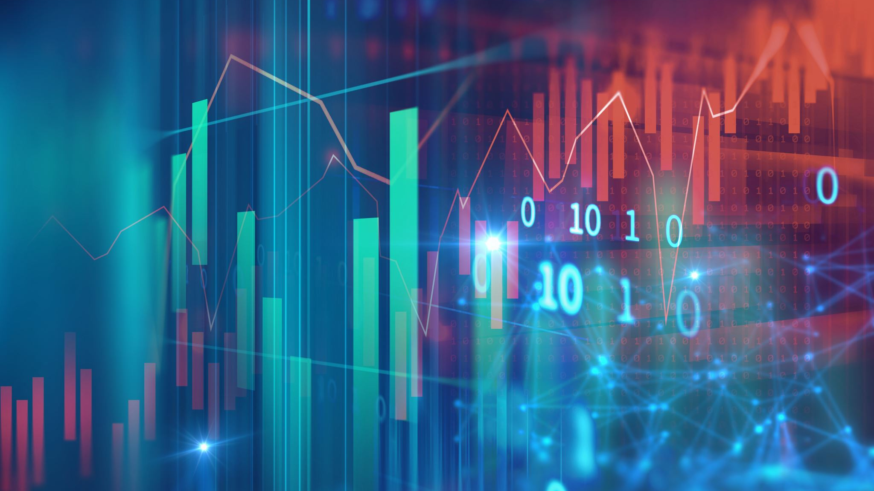
IMAGE PROCESSING
Dr: neven ibrahim

Slide 2
Members
Radwa Hamdy 20182893
Maryam Emad 20182164
Noureen Tarek 20182622
Ahmed Abdelmaqsod 20184849

Slide 3
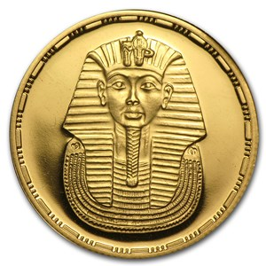
Coin
The ancient Egyptians understood the importance of metal as it was used as a means of exchange.
The coined money had a crucial impact on domestic economy and the trade.

Slide 4
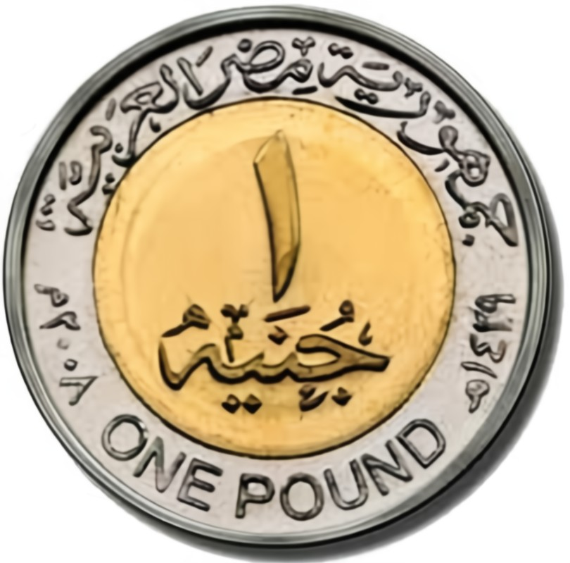
Don't underestimate the power of a nickel, they add up.

Slide 5

Counting all these pennies can be cumbersome, to say the least.

Slide 6
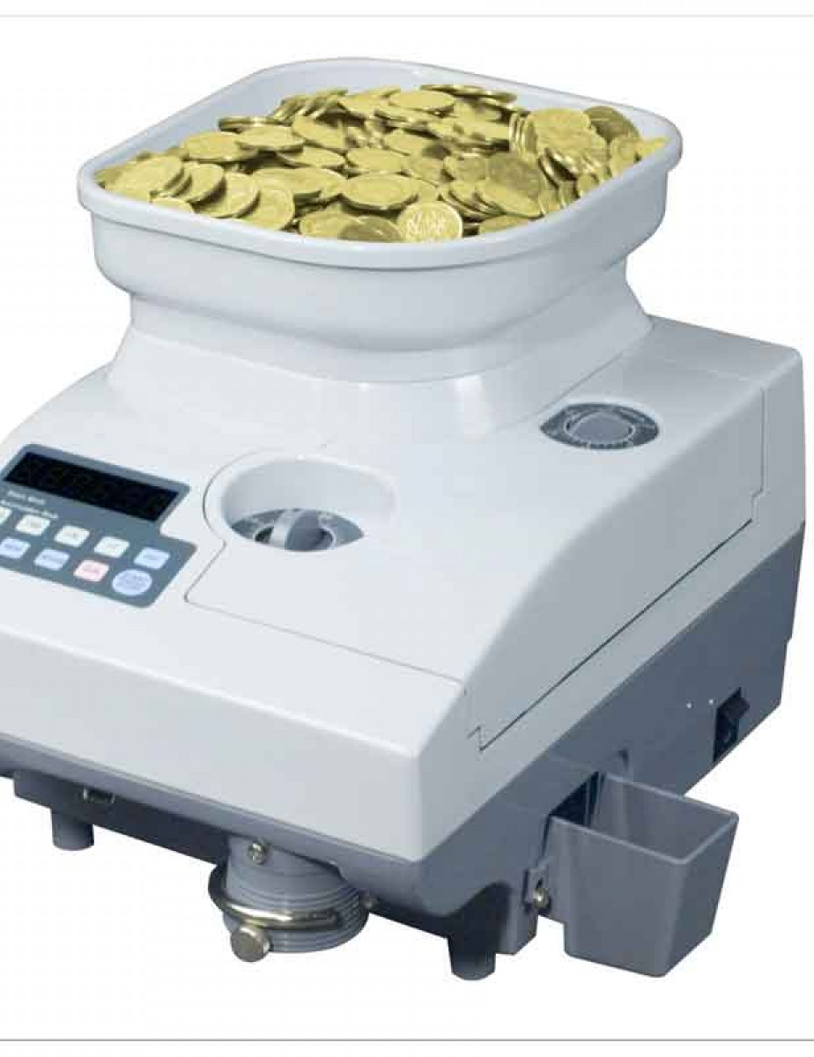
Coin counter
One of the major benefits of owning your own coin counter machine is that you can utilize it anytime you want.
With your own coin counter, you can choose when and where to count.

Slide 7
Our steps in image processing
We use some functions in our code :
rgb2gray(Img);
BW=im2bw(z,0.9);
BW = ~BW;
fill=imfill(BW,'HOLES’);
[L, num] = bwlabel(BW);
RGB = label2rgb(L);

Slide 8
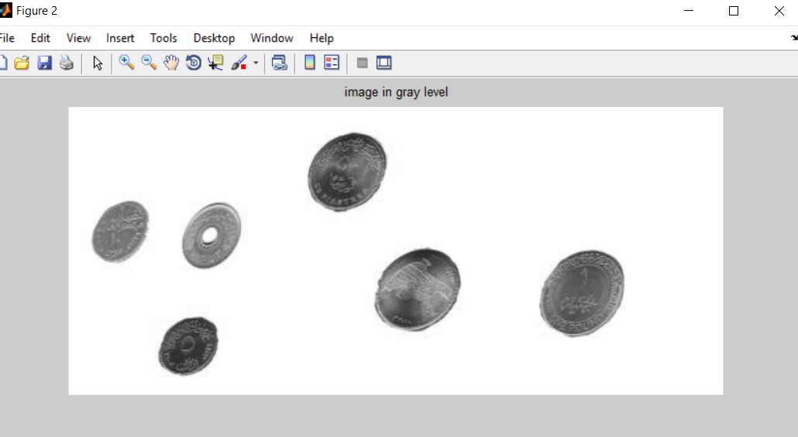
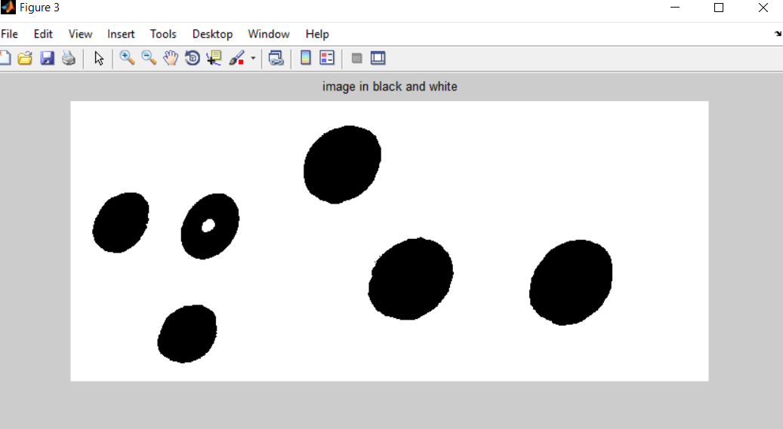
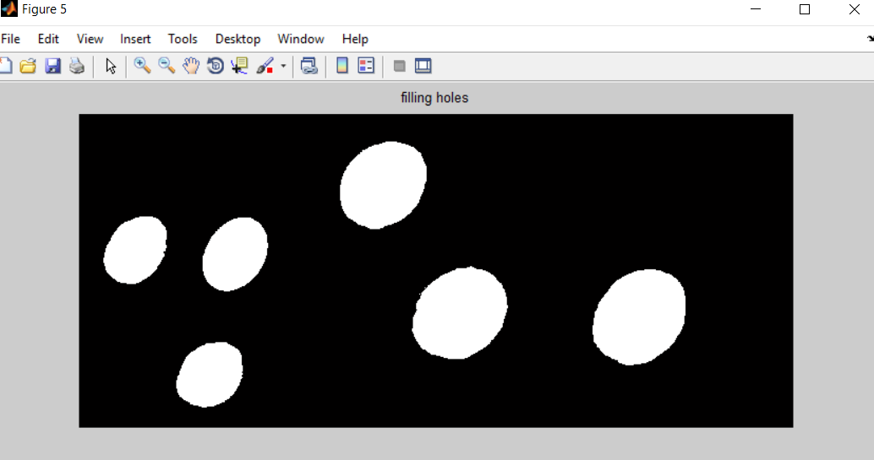
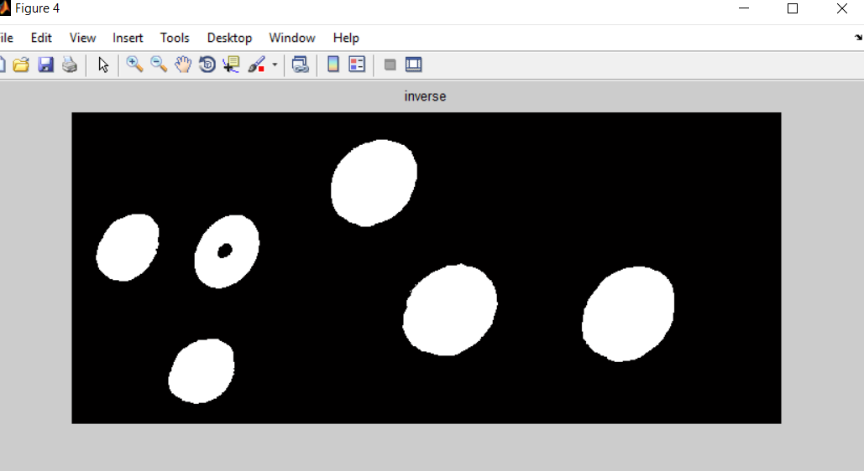
Sample of output

