Slide 1

Berlin
Meetup
June 8, 2016
User Group
Berry Boessenkool
berry-b@gmx.de
Survey results
Performant coding
- for-loops
- lapply
- pblapply, mclapply
- Rcpp

Slide 2
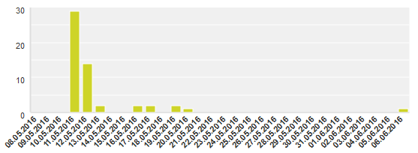
Member Survey May 2016: 53 Responses

Slide 3
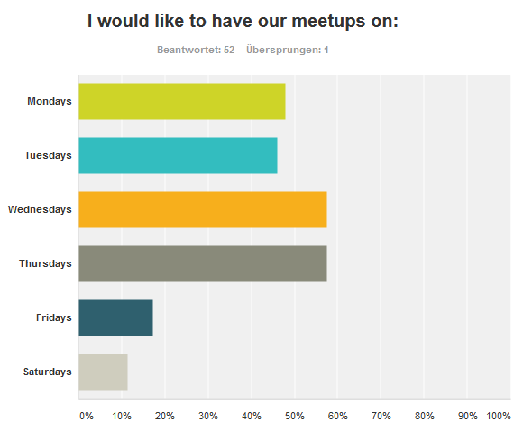

Slide 4
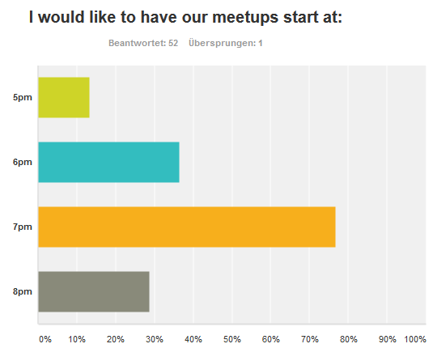

Slide 5
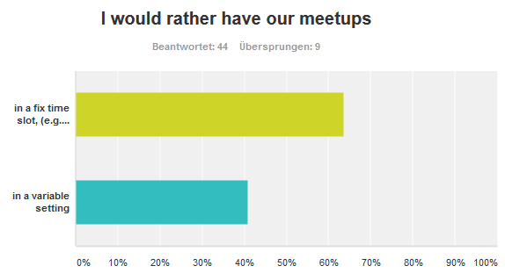

Slide 6
I work / Research in
Science/Math | 22
Engineering/computer science | 14
Social sciences/psychology | 12
Business / Finance / Marketing | 12
Health sciences | 11
Agriculture/Environmental studies | 6
Communications/journalism | 2
Education | 2
Humanities | 2
Performing and Fine Arts | 1
Architecture | 0
General studies | 0
Law | 0
Military/naval science | 0

Slide 7
I am familiar with R possibilities in the following domains:
(non)linear regression | 34
machine learning | 29
hypothesis tests | 28
classification algorithms | 26
time series | 20
distribution functions | 17
bayesian stats | 15
spatial analysis, mapping, geostatistics, GIS, etc | 10
optimization | 10
econometrics, finance | 8
data processing reporting, dashboard (rmarkdown, shiny...) graphics
networks
item response theory
Data management
graph theory (igraph, RBGL)

Slide 8
I am familiar with R techniques related to:
programming conditions, loops, functions | 42
computationally efficient programming (apply, tapply, lapply/sapply, replicate, etc) | 40
graphics (plotting publication-ready visualisations) | 33
character string operations | 27
Rmd, knitR, sweave etc | 25
package development | 18
interactive plots, tcltk, shiny, etc | 11
webserver integration
Not really, yet I would like to learn :-) Just have basic knowledge

Slide 9
I would like someone to present something on:
- computationally efficient programming, code optimization
- Simulation and Bayesian optimization
- Deep learning Mixed models
- starting understanding R
- interactive graphics
- Out of memory handling of large datasets
- Rccp
- Graphics, text mining, efficient programming, package development
- * graphics done right, presenting data in visually appealing way * extracting non-trivial information from series of events * integrating R with smth (preferably insane)
- bayesian statistics, mcmc
- time series analysis, (choice based) conjoint analysis, recommender systems, survival analysis, mixed effects models, neural networks
- Using R in production Shiny The "good parts" of R (à la Douglas Crockford)
- Bayesian stats in R, Probabilistic graphical models, time series, global optimization , efficient R usage and advanced programming techniques.
- Rcpp
- knitr, how to build reports
- time series analysis multilevel modeling visualisation computationally efficient programming machine learning
- Advanced classification, advanced machine learning, natural language processing, provenance (keeping data, code, and reports in sync)
- S.P., per mail: I'd really like someone to give a talk on MCMC in R starting from scratch. I'm interesting in learning how to perform MCMC AND to perform diagnostics on my chains (how do I know if they're well mixed, converged, etc.?)...

Slide 10
I could present on:
- R and Docker
- Developing SPSS extensions based on R-packages.
- graphics subsystems
- Caret, basic machine learning
- knitr (although rather basic stuff)
- Using R for environmetal/hydrological studies
- a website i built with r/shiny to compare data collected with different questionnaires
- efficient data wrangling with data.table - bayesian stats with rstan (or rstanarm) - choice modeling (= multiclass classification) with mlogit
- Psychological topics, Market research topics
- Packages I wrote. Package development. Programming in R: S3, S4, OOP, FP. Topics related to R in business and production systems.
- not sure if I am ready to present. I could do a very basic workshop on correlation and linear regression (what is it? what does it mean? and on how to do it in R obviously, what you have to pay attention to in the output, what the numbers mean etc.). If that's not too basic but I guess not everyone has a stats background, so maybe its useful. I have a PhD in psychology/neuroscience.
- creative data frame operations using Hadley's packages (dplyr, tidyr, tibble), visualizations (ggplot2, shiny), creating reports with Rmarkdown, R package development, microarray analysis and other packages from Bioconductor

Slide 11
Other comments:
- Some of the Meetups I've attended had a very poor speaker quality. Also, it appeared to be an excuse for many companies/one-man persons self-promoting.
- keep up the good job, fellows!
- It would be great to offer the formation of learning groups
- Thanks for organising!!
- Since I work a lot with Python, too, I can also talk a bit about the Jupyter Notebook, rpy2, and I could prepare something about the new data exchange format "feather".

Slide 12
Future Topics (distilled):
Rcpp
Interactive graphics (shiny)
MCMC (chains well mixed? converged?)
Bayesian stats in R (rstan)
Report / slides generation (knitr, rmarkdown)
Time series analysis
Large dataframes (data.table vs dplyr, tidyr, tibble)
Jupyter notebooks: Julia, Python, R (rpy2)
Programming: S3, S4, OOP, FP, R6
Machine learning (caret)
Package development (devtools, roxygen2)
Spark, Hadoop, Amazone Azure, Docker (envisioned: July 6th)
…

Slide 13
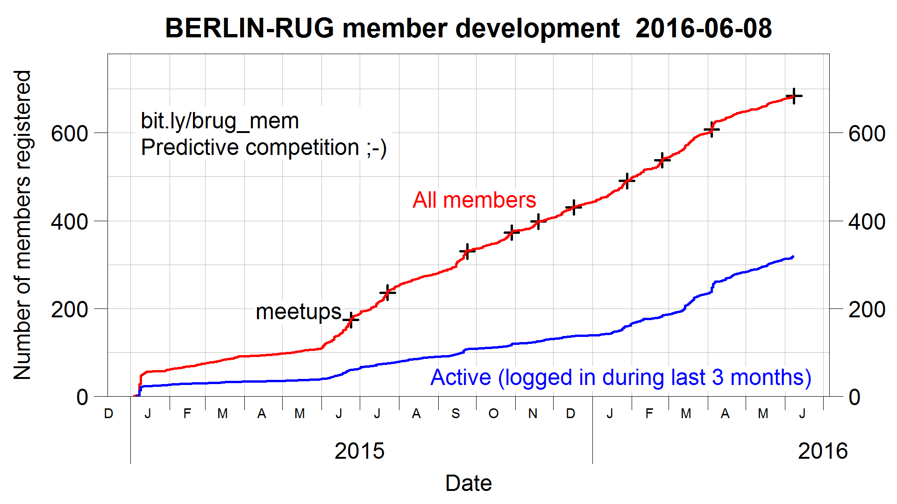
bit.ly/brug_mem

Slide 14
for-loops, lapply, Rcpp – motivational example
files <- dir(pattern="*.csv")
# bad and slow way:
dfs <- list() # initiate empty list
for(i in 1:length(files))
dfs[[i]] <- read.csv(files[i], as.is=TRUE)
# much better way: apply function to each file
dfs <- lapply(X=files, FUN=read.csv, as.is=TRUE)
# single data.frame if all files have n columns:
df <- do.call(rbind, dfs)
# PS: much faster in this example could be
library("data.table")
dfs <- lapply(X=files, FUN=fread, sep=",")
df <- rbindlist(dfs)

Slide 15
for-loops, lapply, Rcpp – lapply is easy to expand
library("pbapply") # progress bar with remaining time
library("parallel") # for multicore parallel execution
nc <- detectCores()-1
dfs <- lapply(X=files, FUN=read.csv, as.is=TRUE)
dfs <- pblapply(X=files, FUN=read.csv, as.is=TRUE)
dfs <- mclapply(X=files, FUN=read.csv, as.is=TRUE,
mc.cores=nc) # easy on linux
# more code needed on windows:
cl <- makePSOCKcluster(nc)
dfs <- parLapply(cl, X=files, fun=read.csv, as.is=TRUE)
stopCluster(cl)
# sometimes needed before parLapply call:
clusterExport(cl, c("files","otherObjects"))
clusterEvalQ(cl, library("somePackage"))
# time your code:
begintime <- Sys.time(); begintime
parLapply(cl, X, fun)
Sys.time() – begintime ; rm(cl, begintime)

Slide 16
for-loops, lapply, Rcpp – better code timing
#install.packages("microbenchmark")
library(microbenchmark)
forbad <- function(n) # fibonacci
{
fibvals <- c(1,1)
for (i in 3:n) fibvals[i] <- fibvals[i-1]+fibvals[i-2]
fibvals
}
forgood <- function(n)
{
fibvals <- rep(1,n)
for (i in 3:n) fibvals[i] <- fibvals[i-1]+fibvals[i-2]
fibvals
}
mb <- microbenchmark(forbad(2000), forgood(2000))
mb
Unit: milliseconds
expr min lq mean median uq max neval
forbad(2000) 5.186815 5.500281 6.251113 5.662076 6.319942 40.908350 100
forgood(2000) 2.302748 2.432611 2.533551 2.489203 2.587277 3.323405 100

Slide 17
for-loops, lapply, Rcpp – loop unavoidable, but slow?
Rcpp saves the day!
Loops are fast in C++, so outsource that part of your code into C.
The package Rcpp will compile it for you and make it available as a normally accessible R function.
Start learning at
http://adv-r.had.co.nz/Rcpp.html
Speed gain is highly variable, of course, but you might be able to reduce your computing time from 2 hours to 20 seconds!
To find the slow parts of your code, you perform a process called "profiling":
www.r-bloggers.com/profiling-r-code
https://stat.ethz.ch/R-manual/R-devel/library/utils/html/Rprof.html
http://adv-r.had.co.nz/Profiling.html
New and very promising:
https://blog.rstudio.org/2016/05/23/profiling-with-rstudio-and-profvis
https://support.rstudio.com/hc/en-us/articles/218221837-Profiling-with-RStudio

