Slide 1
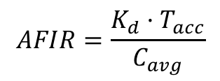
Model A (DT) – Start with standard binding model fits to data
$$AFIR=\frac{K_{d}·T_{acc}}{C_{avg}}$$
Central (1)
k_{syn1}
Dose_{iv}
D₁
+
T₁
k_{on1}
k_{off1}
DT₁
Dose_{sc}
dep
F, k_{a}
k_{eD1}
k_{eM1}
k_{eDM1}
k_{12D}
k_{21D}
D = Drug
T = Target
DT = Complex
Peripheral (2)
D₂

Slide 2
Model B (DT2): adding receptor shedding
k_{synS1}
S₁
k_{on1}
k_{off1}
DS₁
Central (1)
+
Dose_{iv}
D₁
k_{eS1}
k_{shed1}
k_{shed1}
k_{eDS1}
Dose_{sc}
dep
k_{synM1}
F, k_{a}
+
k_{eD1}
M₁
k_{on1}
k_{off1}
DM₁
k_{12D}
k_{21D}
k_{eM1}
k_{eDM1}
D₂
Peripheral (2)
D = Drug
S = Soluble Target
M = Membrane-Bound Target
DS, DM = Complex

Slide 3
Model C (3cmt_DT): adding tumor distribution
k_{syn3}
Tumor (3)
D₃
+
T₃
k_{on3}
k_{off3}
DT₃
k_{eD3}
k_{eM3}
k_{eDM3}
k_{13D}
k_{31D}
Central (1)
k_{syn1}
Dose_{iv}
D₁
+
T₁
k_{on1}
k_{off1}
DT₁
Dose_{sc}
dep
F, k_{a}
k_{eD1}
k_{eM1}
k_{eDM1}
k_{12D}
k_{21D}
D = Drug
T = Target
DT = Complex
Peripheral (2)
D₂

Slide 4
Model D: include shedding from tumor into blood
k_{synM3}
Tumor (3)
D₃
+
M₃
k_{on3}
k_{off3}
DM₃
k_{eD3}
k_{eM3}
k_{eDM3}
k_{13D}
k_{31D}
k_{shed-dist}
Central (1)
Dose_{iv}
D₁
+
S₁
k_{on1}
k_{off1}
DS₁
Dose_{sc}
dep
F, k_{a}
k_{eD1}
k_{eS1}
k_{eDS1}
k_{12D}
k_{21D}
D = Drug
S = Soluble target
M = Membrane-Bound Target
DM = Complex
Peripheral (2)
D₂

Slide 5
Model E: include shedding in tumor and distribution to blood
k_{synM3}
Andy has explored use of this model for LAG525
+
M₃
k_{on3}
k_{off3}
DM₃
D₃
Tumor (3)
k_{shed3}
k_{shed3}
+
k_{eD3}
S₃
DS₃
k_{on3}
k_{off3}
k_{13D}
k_{31D}
k_{13T}
k_{31T}
k_{13DT}
k_{31DT}
Central (1)
Dose_{iv}
D₁
+
S₁
k_{on1}
k_{off1}
DS₁
Dose_{sc}
dep
F, k_{a}
D = Drug
S = Soluble Target
M = Membrane-Bound Target
DS, DM = Complex
k_{eD1}
k_{eS1}
k_{eDS1}
k_{12D}
k_{21D}
D₂
Peripheral (2)

Slide 6
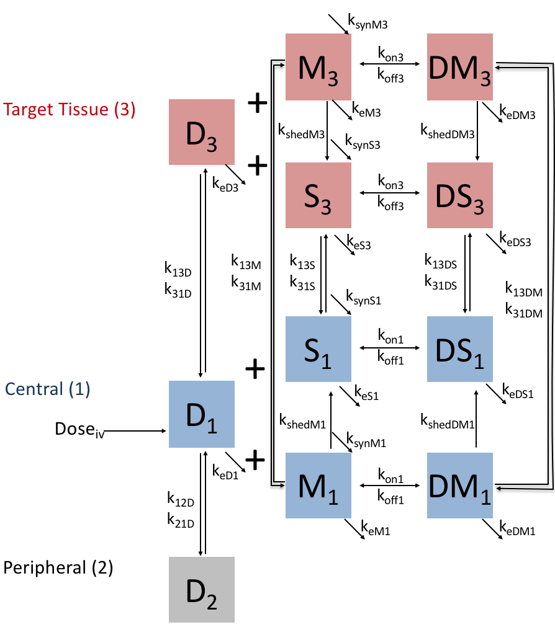
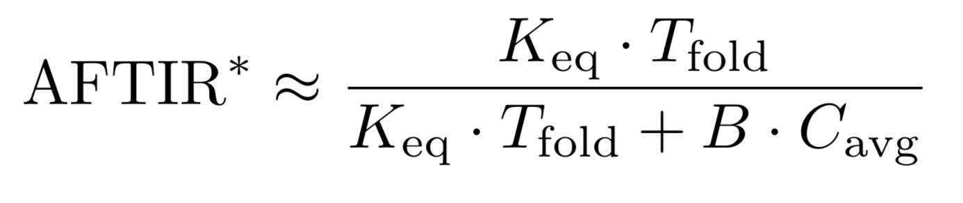
Model F (3cmt_DT2): integrate previous models, adding lymphocyte trafficking historically, also called 4cmt_shedct
D = Drug
S = Soluble Target
M = Membrane-Bound Target
DS, DM = Complex

Slide 7
Model G (DTL): Include Ligand (L)
k_{synT}
k_{synL}
Drug
Periph.
(D2)
k₁₂
k₂₁
Drug
(D)
+
Target
(T)
+
Ligand
(L)
k_{eD}
k_{eT}
k_{eL}
k_{onDT} k_{offDT}
k_{onTL} k_{offTL}
Signal
D = Drug
T = Target
L = Ligand
DT, TL = Complex
Complex
(DT)
Complex
(TL)
k_{eDT}
k_{eTL}
Need a new potency metric (see Peletier18, or Stein17_DrugTargEndog)

Slide 8
Model H (DT2L): Include ligand and both membrane-bound and soluble target
Signal
Complex
(DTm)
Complex
(TmL)
k_{eDTm}
k_{eTLm}
k_{onDT} k_{offDT}
k_{synTm}
k_{onTL} k_{offTL}
Mem Target
(Tm)
+
+
k_{synL}
Drug
Periph.
(D2)
k₁₂
k₂₁
Drug
(D)
Ligand
(L)
k_{synT}
k_{eTm}
+
+
Sol Target
(T)
k_{eD}
k_{eL}
k_{onDT} k_{offDT}
k_{eT}
k_{onTL} k_{offTL}
Signal
Complex
(DT)
Complex
(TL)
k_{eDT}
k_{eTL}

Slide 9

Model G (DTLf): Include Ligand with feedback
k_{synT}
k_{synL}
Drug
Periph.
k₁₂
k₂₁
Drug
(D)
+
Target
(T)
+
Ligand
(L)
k_{eD}
f(DT)
k_{eL}
k_{onDT} k_{offDT}
k_{onTL} k_{offTL}
Signal
D = Drug
T = Target
L = Ligand
DT, TL = Complex
Complex
(DT)
Complex
(TL)
k_{eDT}
k_{eTL}
Need a new potency metric (see Peletier18, or Stein17_DrugTargEndog)
$f\left(DT\right)=k_{eT}\left(1+\frac{E_{max}(DT)}{(DT)+EDT_{50}}\right)$

