Slide 1

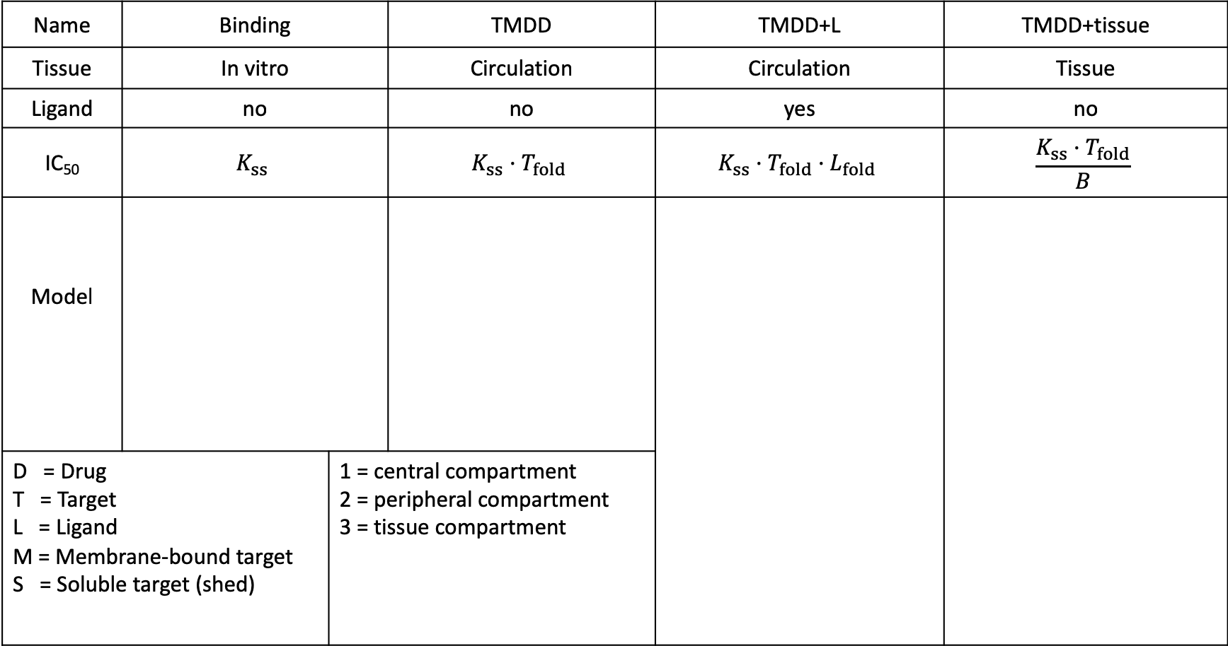
$$\frac{C_{ss}}{C_{ss}+IC50}$$
Steady State Inhibition Metric (SSIM) =
Name | Binding |  | TMDD | TMDD+L | TMDD+tissue
Tissue | In vitro |  | Circulation | Circulation | Tissue
Ligand | no |  | no | yes | no
IC₅₀ | $$K_{ss}$$ |  | $$K_{ss}·T_{fold}$$ | $$K_{ss}·T_{fold}·L_{fold}$$ | $$\frac{K_{ss}·T_{fold}}{B}$$
Model
D = Drug T = Target L = Ligand M = Membrane-bound target S = Soluble target (shed) |  | 1 = central compartment 2 = peripheral compartment 3 = tissue compartment
Dose_{iv}
Dose_{iv}
M₃
DM₃
D
+
T
DT
D
+
T
DT
D
+
T
+
L
D₃
+
+
S₃
DS₃
DT
TL
D₂
Dose_{iv}
+
S₁
DS₁
D₂
D₁
+
M₁
DM₁
T_{fold} = fold-increase in total target after binding drug
L_{fold} = fold-increase in ligand after drug binds target
B = tissue biodistribution coefficient
D₂

