Slide 1
Proposal for analyzing the drug/target/endogenous-ligand system
toci
periph.
tocilizumab
(anti-IL6R)
+
+
sIL6R
IL6
Signaling
toci-sIL6R
IL6-sIL6R
Andy Stein
(with input from Brian Stoll, Kostas Biliouris, and Prasad Ramakrishna)

Slide 2
Background
Models describing the binding of a drug (e.g. tocilizumab) to its target (e.g. IL6R) are frequently used to predict free target inhibition, which is used as a surrogate for a reduction in downstream signaling
However, the effect on target signaling is actually driven by the reduction in target-endogenous-ligand complexes (IL6R-IL6).
If binding affinity for sIL6R and IL6 is high, free sIL6R may not be a good surrogate predictor for drug efficacy.
Under what conditions is it ok to neglect target-endogenous-ligand binding and use a simpler model (just drug and target) to predict efficacy?
Model-predicted surrogate for signaling
toci
periph.
tocilizumab
(anti-IL6R)
+
+
sIL6R
IL6
Signaling
toci-sIL6R
IL6-sIL6R

Slide 3
Background - Additional Question
For tocilizumab, IL6 is also measured.
Developing an IL-6 assay is potentially easier than an sIL6R assay (ask Brian why)
With the multi-dose data, we see that the two can be related. But there is an issue where is some sort of long-term potentiation (i.e. IL6 synthesis seems to decline a bit at longer doses)

Slide 4
Proposal
Implement model for realistic system
Start with Andy’s work of tocilizumab/sIL6R/IL6 in rheumatoid arthritis (steady state) and also consider Siltuximab, which binds IL6.
Consider also canakinumab/IL-1β/IL1R/Anakinra
Explore parameter space and how both free target and signaling complex is affected by:
Differences in Kd between drug-target and target-ligand. e.g. is it necessary for the toci-IL6R Kd to be less than the IL6R-IL6 Kd?
How are results affected by target and ligand concentrations? Does it make a difference if IL6R conc. >> IL6 conc., or vice versa?
Next Steps to consider
Extending model to cytokine release syndrome, where binding dynamics (kon/koff) and transient IL6 increase are important.
Think through benefits in targeting soluble factor, receptor, or both.

Slide 5
Other Questions
Could IL-6 levels be used to predict target engagement using dose-response data?

Slide 6
application – understanding anti-il6 therapy

Slide 7
Tocilizumab/sIL-6R/IL6 model could be used to estimate effect on IL6 signaling
CART cells
toci
periph.
tocilizumab
(anti-IL6R)
+
+
sIL6R
IL6
CRS
toci-sIL6R
IL6-sIL6R
RA patient

Slide 8
Model Details – Model G
k_{synT}
k_{synL}
Drug
Periph.
k₁₂
k₂₁
Drug
(D)
+
Target
(T)
+
Ligand
(L)
k_{eD}
k_{eT}
k_{eL}
k_{onDT} k_{offDT}
k_{onTL} k_{offTL}
Signal
Complex
(DT)
Complex
(TL)
k_{eDT}
k_{eTL}

Slide 9
Model Details – Model H
Signal
Complex
(DTm)
Complex
(TmL)
k_{eDTm}
k_{eTLm}
k_{onDT} k_{offDT}
k_{synTm}
k_{onTL} k_{offTL}
Mem Target
(Tm)
+
+
k_{synL}
Drug
Periph.
k₁₂
k₂₁
Drug
(D)
Ligand
(L)
k_{synT}
k_{eTm}
+
+
Sol Target
(T)
k_{eD}
k_{eL}
k_{onDT} k_{offDT}
k_{eT}
k_{onTL} k_{offTL}
Signal
Complex
(DT)
Complex
(TL)
k_{eDT}
k_{eTL}

Slide 10
backups – additional data

Slide 11
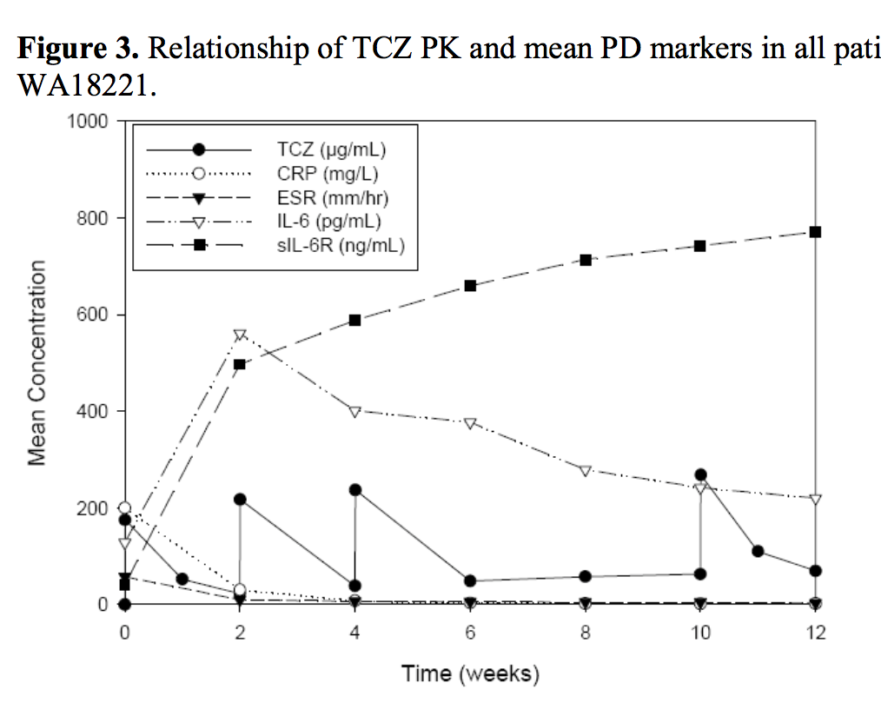
From FDA CP Review - SJIA

Slide 12
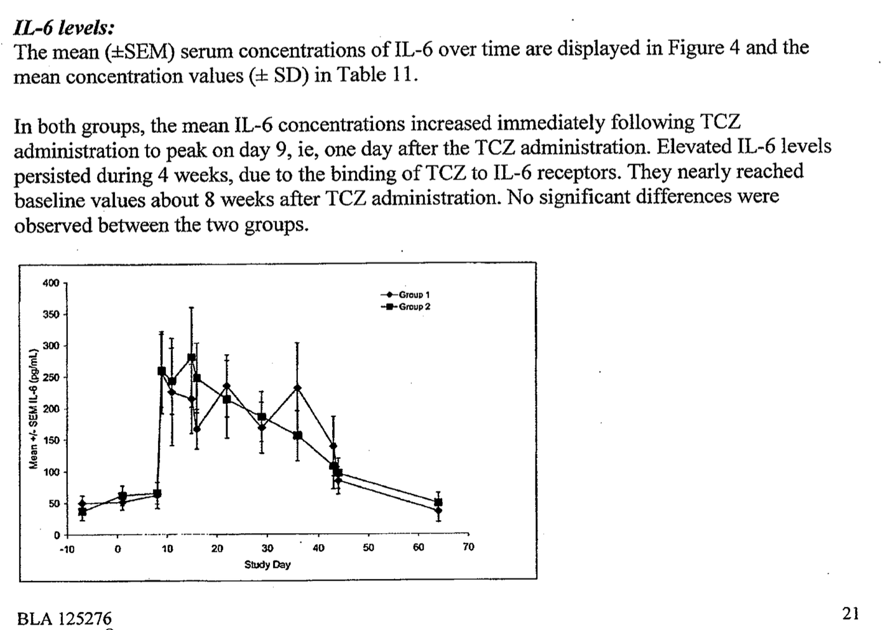
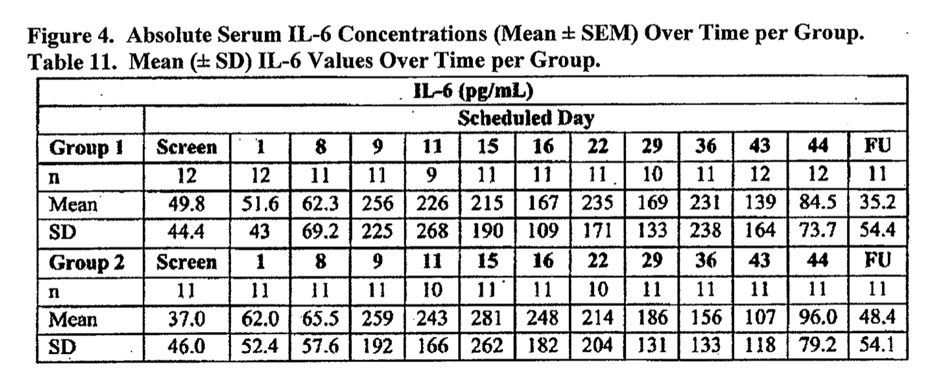
IL6 – From FDA CP Review – RA Single Admin 10 mg/kg p18 PDF

Slide 13
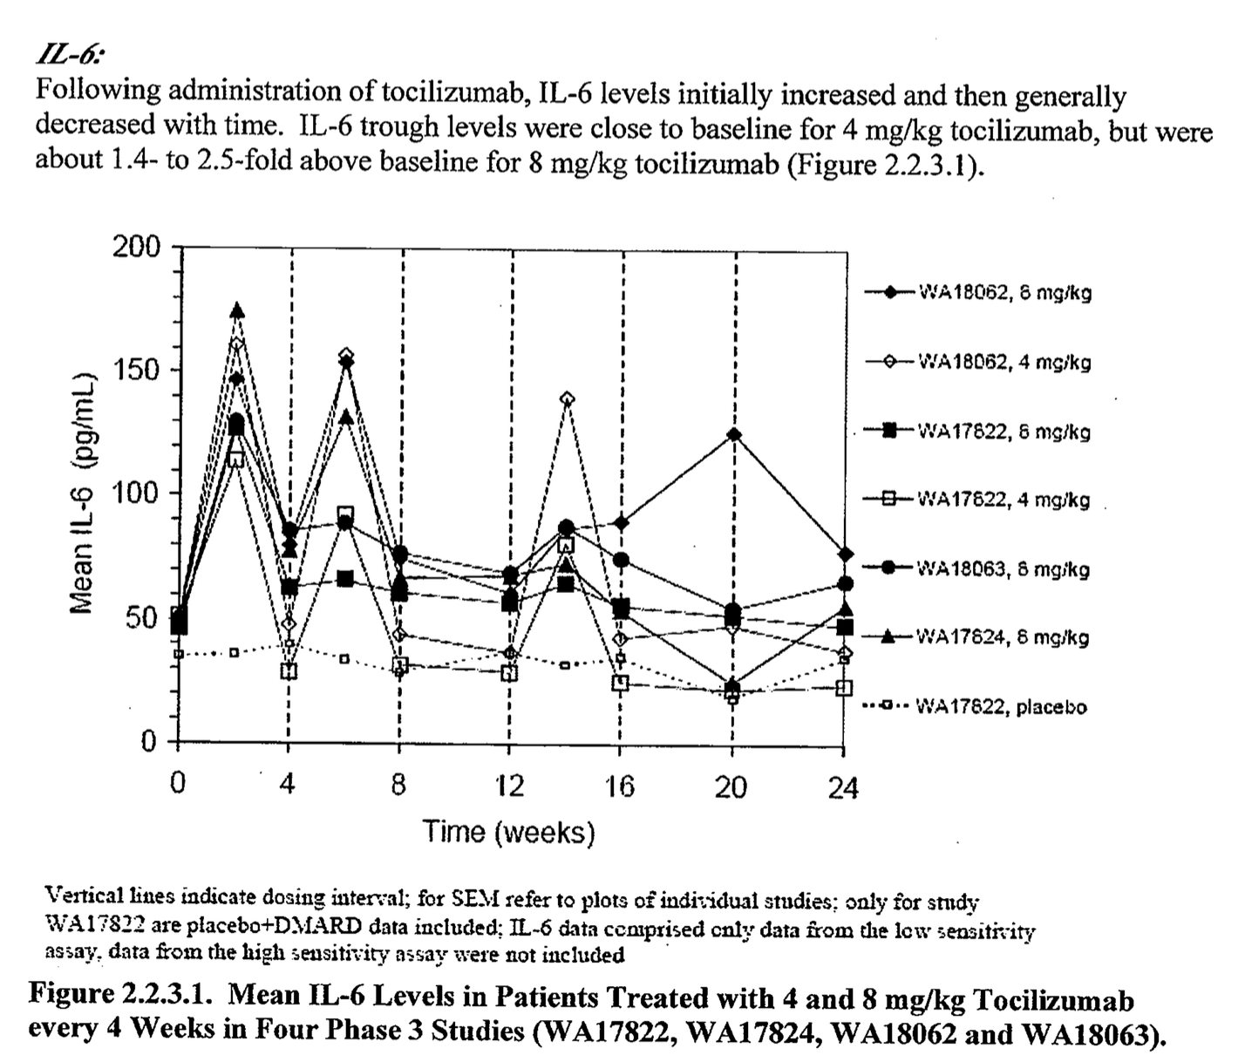
Multiple Dose IL-6 from p17 FDA CP Review RA p39 PDF
In between doses, 4, 8 are similar.
At trough when toci is nearly gone for 4 mg=kg, there is a difference

Slide 14
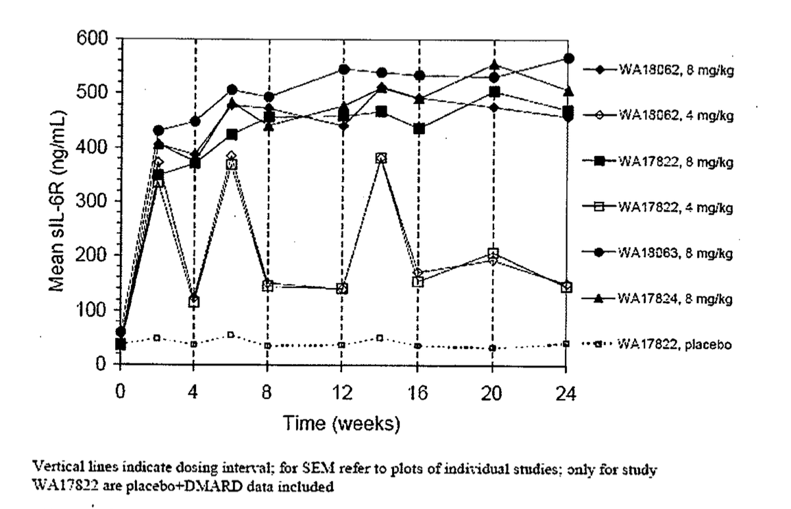
sIL6R – p41

Slide 15
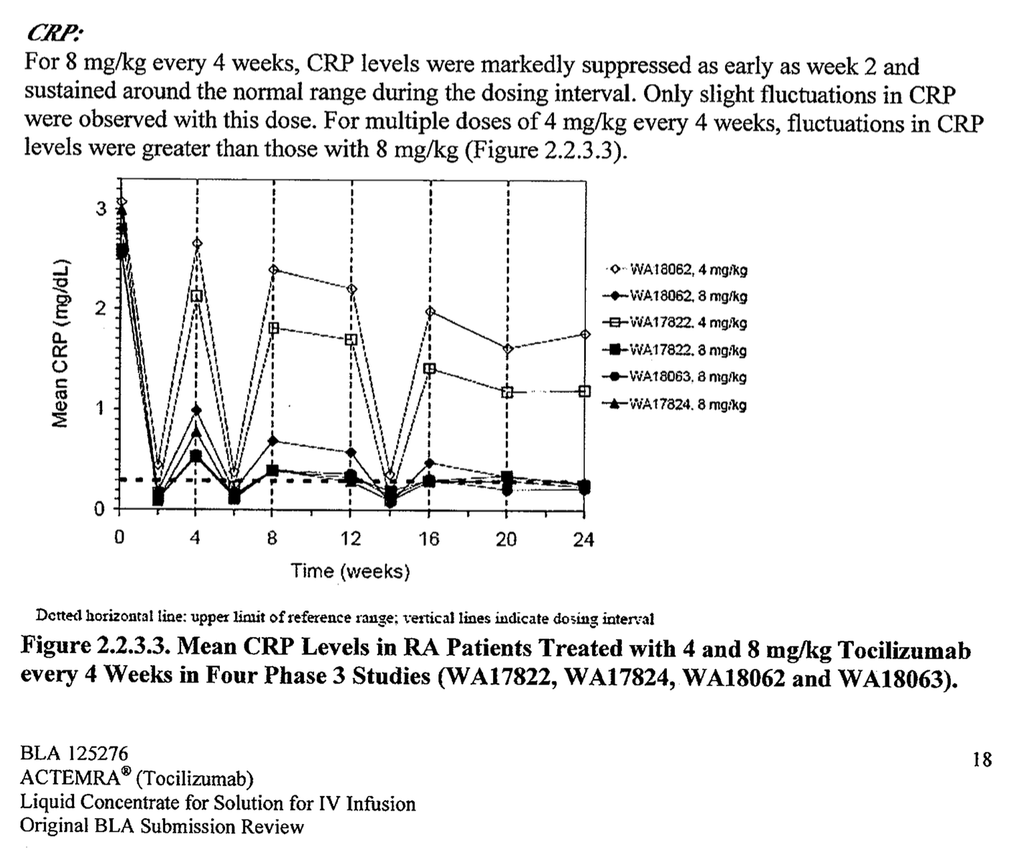
CRP – p18 FDA CP Review RA p41

Slide 16
Individual simultaneous fits of TCZ, IL-6R and CRP in some representative RA patients from phase I to III (Charoin10)
o observations
— fits
Notes:
On this slide we have an illustration of full TMDD model performance where individual simultaneous fits of TCZ, IL6R and CRP in some representative RA patients from phase I to III are shown.
Each graph is representing one patient. In total we have here 9 patients. On the x axis, time expressed in day, on the y axis TCZ PK in black, sIL6R complex in blue and CRP in red. Dots are representing actual data, when lines represent model fit.
The two top left graphs represent TCZ effect after a SD IV dose of 10 mg/kg. You can notice that the sampling is very rich and allow to capture the full onset and offset of our parameters of interest.
Note as well for example the patients PK variability, the right one reaching BLQ around day 45, when the other still have measurable conc. at day 50.
The others graphs are representing patients from PII and PIII, MD setting, administration every 4 weeks, with dose going from 2, 4 and 8 mg/kg. Here the sampling is much more sparse, but still gives an insight of TCZ dose response between 2, 4 and 8, starting from graph on top right to left middle panel. How for example you can have a more profound and sustained effect on CRP over time.
Please note as well on the bottom left graph this unusual time course. This patient was in a PIII where he started the trial under MTX and then switching to TCZ at week16, as illustrated by TCZ pharmacological marker sIL-6R and CRP.
Now after having introduced the full TMDD model, I would like to switch to a concrete example of the application of such a model during TCZ development (transition to next slide)

