Slide 1
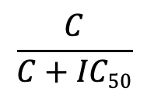
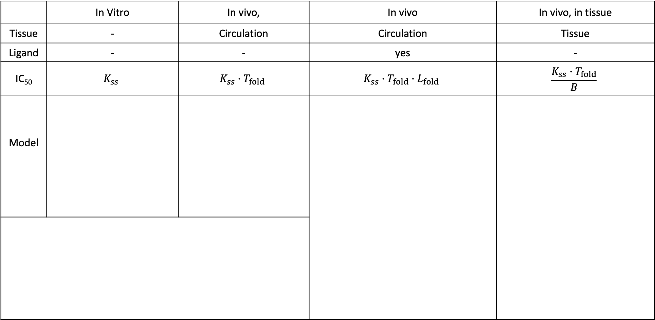
$$\frac{C}{C+IC50}$$
Steady State Inhibition Metric =
 | In Vitro | In vivo, | In vivo | In vivo, in tissue
Tissue | - | Circulation | Circulation | Tissue
Ligand | - | - | yes | -
IC₅₀ | $$K_{ss}$$ | $$K_{ss}·T_{fold}$$ | $$K_{ss}·T_{fold}·L_{fold}$$ | $$\frac{K_{ss}·T_{fold}}{B}$$
Model
Dose_{iv}
Dose_{iv}
Target
Tissue (3)
M₃
DM₃
D
+
T
DT
D
+
T
DT
D
+
T
+
L
D₃
+
+
S₃
DS₃
DT
TL
D₂
+
S₁
DS₁
Central (1)
1 = central compartment
2 = peripheral compartment
3 = tissue compartment
T_{fold} = fold-increase in total target after binding drug
L_{fold} = fold-increase in ligand after drug binds target
B = biodistribution coefficient
D₁
D = Drug
T = Target
L = Ligand
M = Membrane-bound target
S = Soluble target (shed)
D₂
Dose_{iv}
+
M₁
DM₁
Peripheral (2)
D₂

