Slide 1
TEAM: PROTEIN
Tutor: Marcus Krantz
Matteo Cantarelli
Yin Hoon Chew
Begum Alaybeyoglu
Daewon Lee

Slide 2
Processes
3.9. Macromolecular Complexation
3.11. Protein Activation
3.12. Protein Decay
3.13. Protein Folding
3.14. Protein Modification
3.15. Protein Processing I
3.16. Protein Processing II
3.17. Protein Translocation
3.20. Ribosome Assembly
3.24. Terminal Organelle Assembly

Slide 3
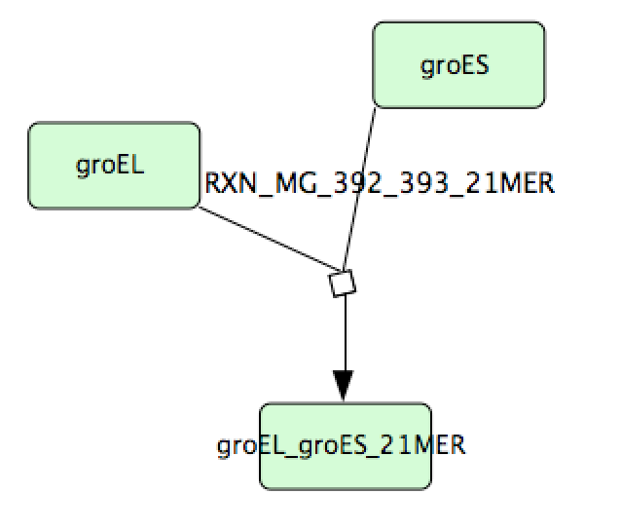
3.9. Macromolecular Complexation

Slide 4
3.9. Macromolecular Complexation
Python script is prepared to get all the reactions (over 200) from the KnowledgeBase.
etc.
etc.

Slide 5
3.11. Protein Activation

Slide 6
3.11. Protein Activation
Model is prepared using COPASI
All/nothing type reactions
EVENTS are triggered when metabolite, temperature etc. requirements are satisfied.
Model tested, seems valid.

Slide 7
3.13. Protein Folding

Slide 8
3.17. Protein Translocation

Slide 9
3.20. Ribosome Assembly

Slide 10
3.20. Ribosome Assembly
Model is prepared using COPASI
Reactions take place simultaneously and in random order when requirements are satisfied.
Model tested, seems valid.
etc.

Slide 11
3.24. Terminal Organelle Assembly

Slide 12
3.24. Terminal Organelle Assembly
Model is prepared using COPASI
All/nothing type reactions
Assignments are used…
Model tested, seems valid.
etc

Slide 13
Challenges/Problems

