Slide 1
TEAM: PROTEIN
Tutor: Marcus Krantz
Matteo Cantarelli
Yin Hoon Chew
Begum Alaybeyoglu
Daewon Lee

Slide 2
Processes
3.9. Macromolecular Complexation
3.11. Protein Activation
3.12. Protein Decay
3.13. Protein Folding
3.14. Protein Modification
3.15. Protein Processing I
3.16. Protein Processing II
3.17. Protein Translocation
3.20. Ribosome Assembly
3.24. Terminal Organelle Assembly

Slide 3
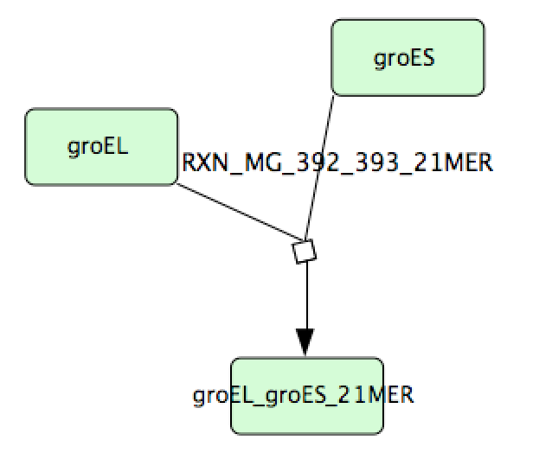
3.9. Macromolecular Complexation

Slide 4
3.9. Macromolecular Complexation
Python script was written to parse all the reactions (i.e. 201 reactıons) from the KnowledgeBase into SBML.
CellDesigner and COPASI used for vısualızatıon and stochastıc simulatıon, respectively.

Slide 5
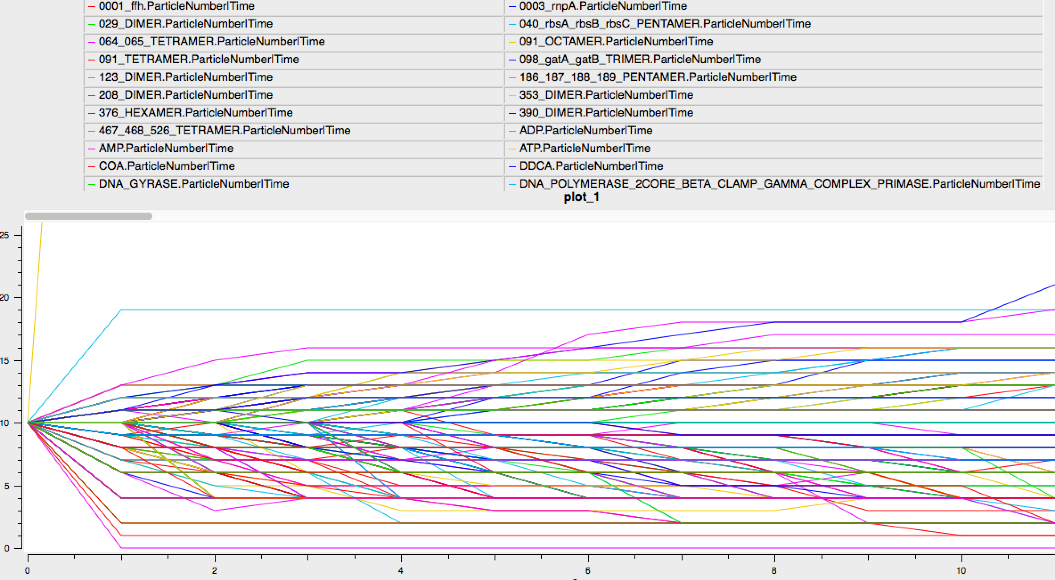
3.9. Macromolecular Complexation

Slide 6
3.11. Protein Activation

Slide 7
3.11. Protein Activation
Model is prepared using COPASI
All/nothing type reactions
EVENTS are triggered when metabolite, temperature etc. requirements are satisfied.
We did a round-trip: COPASI to SBML back to COPASI. Model tested, seems valid.

Slide 8
3.13. Protein Folding
We now have the Python script to extract the relevant data from the Supplementary Excel File(s)
Initially we had some problems with random distribution
We have now found a way to do Stochastic simulation in COPASI where the rate constant for each reaction is weighted

Slide 9
3.20. Ribosome Assembly

Slide 10
3.20. Ribosome Assembly
Assembly of 30S AND 50S
30S: Prepared using CellDesigner
50S: Ad-hoc Python script was used to generate 50S starting from the 30S template
SBML and SBGN exported from CellDesigner then manually edited to add stoichiometry
Reactions take place simultaneously and in random order when requirements are satisfied
Random simulation executed in COPASI using a stochastic simulator
Model tested manually, seems valid.

Slide 11
3.24. Terminal Organelle Assembly

Slide 12
3.24. Terminal Organelle Assembly
Model is prepared using COPASI
All/nothing type reactions
Assignments are used
We did a round-trip: COPASI to SBML back to COPASI. Model tested, seems valid.

Slide 13
SBGN
We used CellDesigner for:
Terminal Organelle Assembly
Part of Ribosome Assembly
The models can be opened in VANTED and exported to SBGN
Models also exported to SBML and then imported into COPASI

Slide 14
Challenges/Problems
Random distribution
We have found a way to do that using weighted rate constants and stochastic simulation in COPASI

