Slide 1
Exploring SF Bay area via Airbnb

Slide 2
Exploring SF Bay area via Airbnb

Slide 3
WHY?

Slide 4
Dublin | €70,000
London | £66,115
Data Analysts in SF Bay Area earn an average annual salary of $144,362

Slide 5
But…

Slide 6
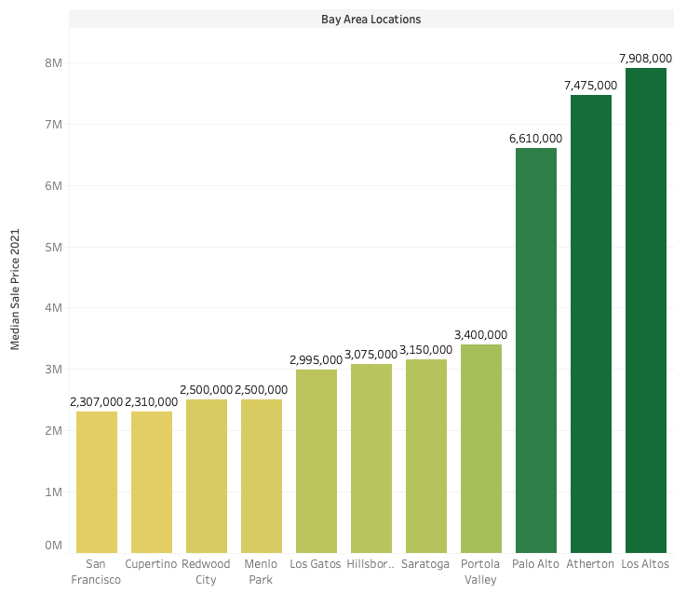
Add a Slide Title - 2
2021’s top 50 most expensive zip codes in the U.S.

Slide 7
Then How about a discovery?

Slide 8
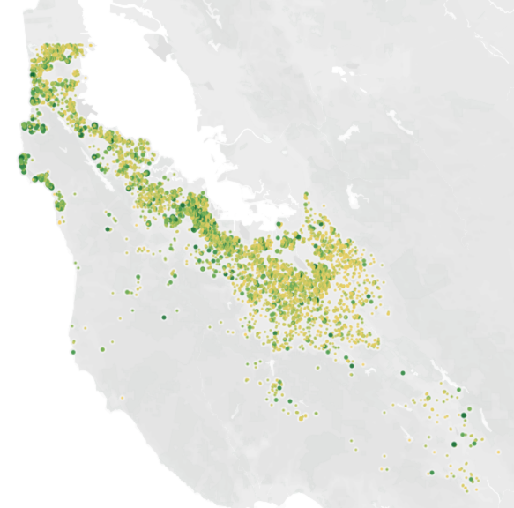

Average price of Airbnb in the region

Slide 9
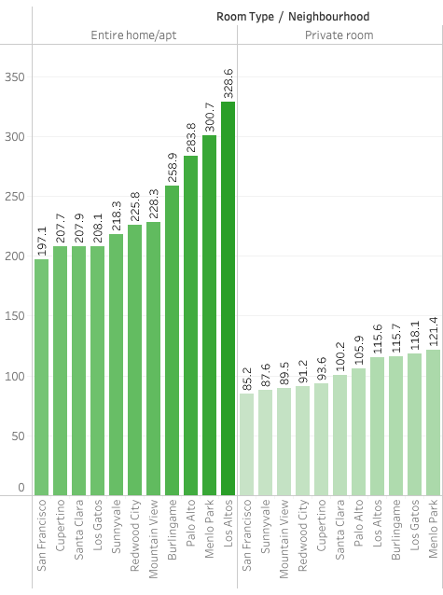
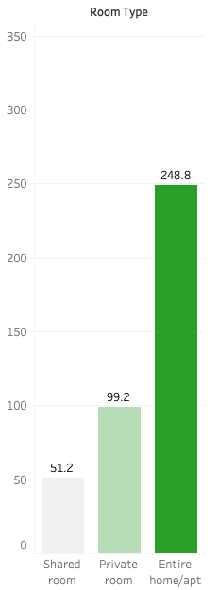
<=
Average price vs Property type
=>
Average price per neighborhood

Slide 10
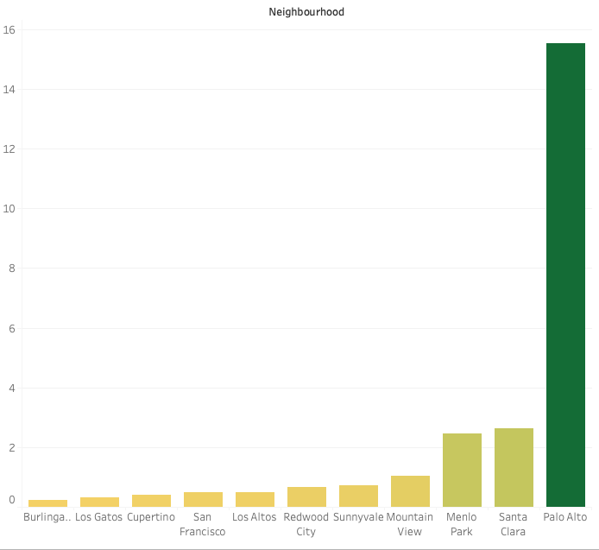
Total earnings of an Airbnb host in the neighbourhood
Possible reasons of Palo Alto’s dominance:
Higher average price
Higher occupation rate throughout the year

Slide 11
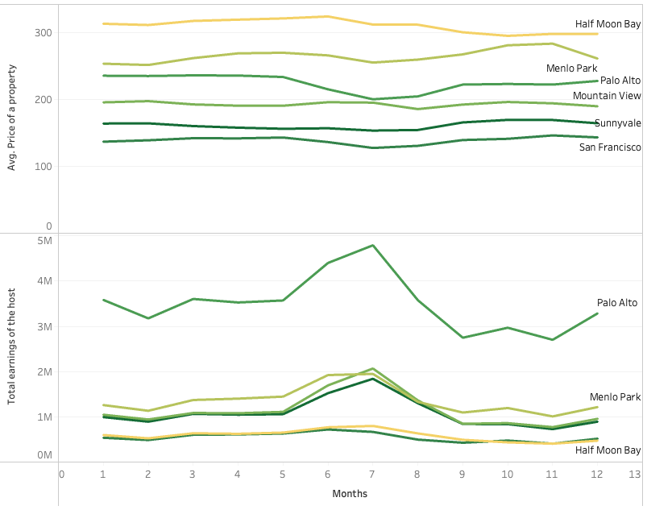
Possible reasons for Half Moon Bay’s price:
Ocean city
Weekend occupancy
Only a touristic place
Possible reasons for Palo Alto’s high earning rate:
Very high demand
Big competition
Relatively high price

Slide 12
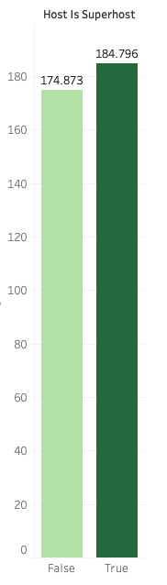
Being a super host:
They can charge 6% more per night
It doesn’t really show a big impact thinking about the effort the host has to put

Slide 13
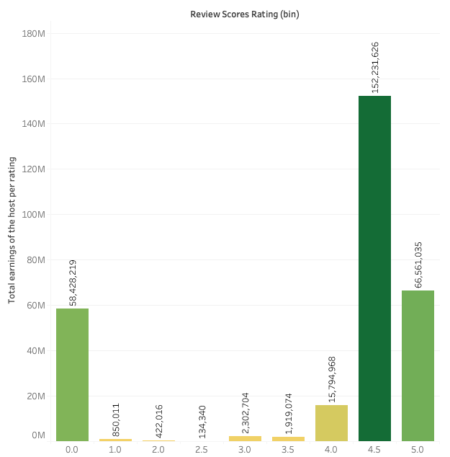
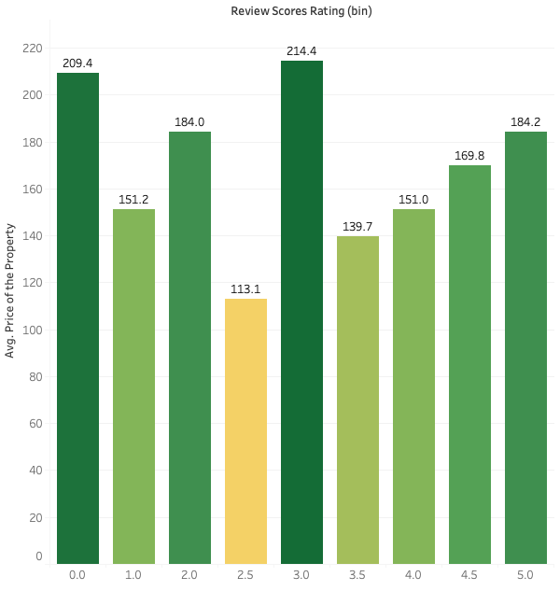

Slide 14
Future work:
Correlation between stay length and neighbourhood.
Hypothesis: Customers rent longer in Palo Alto
Hypothesis: Tech company visitors stay shorter and prefer hotels
Hypothesis: Vacation rentals are only occupied mostly for the weekends

Slide 15
Blank slide
References:
https://hired.com/salaries/san-francisco-bay-area/data-analyst
https://www.propertyshark.com/Real-Estate-Reports/most-expensive-zip-codes-in-the-us/
http://insideairbnb.com/get-the-data

