Slide 1

Statistics & Probability
Hypothesis Testing

Slide 2
Agenda
In this session, you will learn about:
Introduction to Hypothesis Testing
Terminologies used in Hypothesis Testing
Procedure for testing a Hypothesis
Test for Population Mean
Small Sample Tests
Large Sample Tests
Test for normality of Data

Slide 3

Introduction to Hypothesis Testing

Slide 4
Hypothesis Testing
Example
Question:
A manufacturer produces light bulbs. He claims that the life of his bulb is 10,000 hours. Can we verify his claim?
Solution:
A trivial solution is to test the life of all the bulbs produced by the manufacturer. Further compute its average life hours. And hence verify his claim.

Slide 5
Hypothesis Testing
Is the trivial solution feasible?
No. If the manufacturer uses up all the bulbs produced to test his claim, he will have no bulbs left to sell.
This is where we use hypothesis testing.

Slide 6
Hypothesis Testing
Hypothesis testing is testing a claim made based on a sample drawn from the population
This sample acts as the representative of the entire population
Any claim verified by the sample can be generalised for the entire population
For our example: To verify the manufacturers claim, draw a random sample and obtain the mean of the average life of those bulbs

Slide 7
Terminologies used in Hypothesis Testing

Slide 8
Statistic
Statistic are numbers that summarize data from a sample i.e some subset of the entire population
It’s a measure of characteristics that tells us something about fraction (a sample) of a population
The goal is to estimate certain population parameter so that using the sample data you can generalize the characteristics of the population

Slide 9
Parameters
Parameter are the numbers that summarize the data for entire population
It is a measure of a characteristic of an entire population (a mass of all units that share common characteristics) based on all the features within that population

Slide 10
Statistic and Parameter: Statistical Notation
Statistical Notation | Population Parameter | Sample Statistic
Mean | µ | x̄
Variance | σ² | s²
Standard Deviation | σ | s
Standard Error of mean | σ_{x̄} | s_{x̄}
Standard Error of proportion | σ_{p} | s_{p}

Slide 11

Standard deviation is the spread or departure of the values from the mean in a single sample. Standard error is the spread or departure of the values from the mean of means in a sampling distribution.

Slide 12
Statistic and Parameter
Example
Question:
A researcher wants to estimate the average farm size in Boston. From a simple random sample of 50 farms, the researcher obtains a sample mean farm size of 831 acres.
Solution:
The parameter is the average farm size in Boston and the statistic is the mean farm size of 831 acres from the sample of 50 farms.

Slide 13
Statistic and Parameter: Difference
A parameter is a fixed measure that describes whole population(population being a group of whole people, things, animal any phenomena that share common characteristics ). A statistic is characteristic of a sample i.e a portion of a target population
A parameter is a fixed, unknown value, while statistic is a number which depends upon the portion(sample) of a population

Slide 14
Hypothesis Testing
Hypothesis testing is the statistical method that is used in making statistical decision using experimental data
In hypothesis testing, the objective is to select sample data from the population and based on analysis of this sample data, decide whether a hypothesis about the population is true or false with a given level of significance
The objective is to design a process such that the probability of making a wrong decision is as small as possible
A rule that decides the acceptance or rejection of the claim made is called a statistical test

Slide 15

Discuss Question 1 from the
Faculty notes pdf for Hypothesis Testing

Slide 16
Hypothesis Testing: Types
Hypothesis Testing
Null Hypothesis
Alternative Hypothesis

Slide 17
Hypothesis Testing: Null Hypothesis
Null hypothesis is denoted by H₀
In null hypothesis we test the likelihood of the statement being true in order to decide whether to accept or reject our alternative hypothesis

Slide 18
Hypothesis Testing: Alternative Hypothesis
Alternative hypothesis is often denoted by H_{a}
This statement directly contradicts the null hypothesis
We determine whether or not to accept or reject this statement based on the likelihood of the null (opposite) hypothesis being true.

Slide 19
Simple and Composite Hypothesis
Simple Hypothesis:
Composite Hypothesis:
It refers to the one in which all the parameters associated with the respective distribution are specified.
Example: θ₀ = θ
It refers to the hypothesis that does not stand to be simple.This is because, in either of the cases, the exact distribution is not known.
Example: θ₀ ≥ θ or θ₀ ≤ θ
Ex: Let X: diameter of a screw and let μ be the average diameter of screws
H₀: μ = 70
Ex: Let X: diameter of a screw and let μ be the average diameter of screws
H₁: μ ≥ 70

Slide 20

The 99% confidence interval for proportion of students who quit their education after school level because of financial problems is (0.1, 0.18). Test the claim that the percentage of student who quit their education is equal to 12%.
For solution please refer faculty notes pdf for Hypothesis Testing– Solution 2

Slide 21
Hypothesis Testing: Types of Errors
Types of Errors
Type I Error
Type II Error

Slide 22
Hypothesis Testing: Types of Errors
Type I Error
Type I error is rejecting the null hypothesis when it is correct
This is the probability of falsely rejecting the null hypothesis when it is true
It is measured by the level of significance, denoted by 𝛂

Slide 23
Hypothesis Testing: Types of Errors
Type II Error
Type II error is not rejecting the null hypothesis when it is wrong
The probability of committing type II error is denoted by 𝞫
1 - 𝞫 is the power of test, which is probability of correctly rejecting the false null hypothesis

Slide 24
Critical Region
Let x₁, x₂, ….x _{n} be a random sample taken for testing H_{o}, while deciding whether H_{o} is true or false, entire sample space is divided into two non-overlapping regions. In other words the sample space is partitioned into two subsets W and W^{c} in the test procedure.
One of the regions is acceptance region of H₀ and the other is rejection region of H_{o} (or acceptance region of H₁ )
A region in which H₀ is rejected is treated is called as critical region
If a value of statistics which is used in testing H_{o} falls in critical region, H_{o} is rejected and accepted otherwise
Critical region is denoted by W or C

Slide 25
Test statistics
A test statistics is a random variable that is calculated from test data and used in hypothesis test. It also determines whether to reject the null hypothesis
Test statistics compares your data with what is expected under the null hypothesis. It is also used to calculate the p-value
A test statistic measures the degree of agreement between a sample of data and the null hypothesis

Slide 26
Level of Significance
Level of Significance is also known as 𝛂
It specifies how strongly the sample evidence must contradict the null hypothesis before you can reject the null hypothesis for the entire population
Use p-values and significance levels together to help you determine which hypothesis the data support. If the p-value is less than your significance level, you can reject the null and conclude that the effect is statistically significant

Slide 27
Discuss Question 3 from the
Faculty notes pdf for Hypothesis Testing

Slide 28
P-value
P-value is the measure of the strength of evidence the sample data provides against the null hypothesis
A small p-value (typically ≤ 0.05) indicates strong evidence against the null hypothesis, so you reject the null hypothesis
A large p-value (> 0.05) indicates weak evidence against the null hypothesis, so you fail to reject the null hypothesis

Slide 29
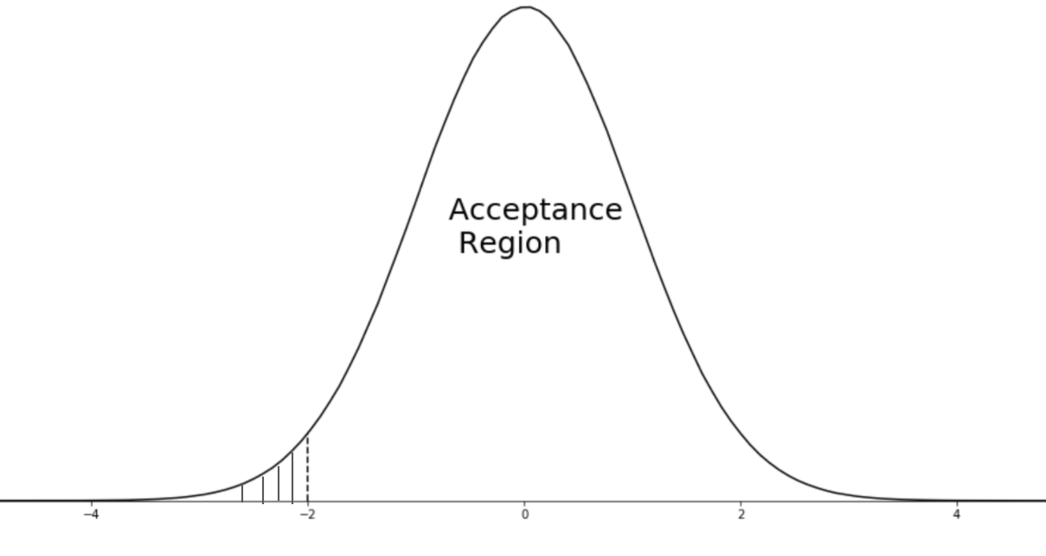

One-Tailed Test
A one-tailed test is a statistical hypothesis test set up to show that the sample mean would be higher or lower than the population mean, but not both
Example
Null Hypothesis: Response time to customer query =10 minutes
Alternative Hypothesis: Response time ≥ 10 minutes
Region of rejection would be the numbers greater than 10 (there is no bound on the lesser time interval)
Critical Region
α

Slide 30
Sample mean is an unbiased estimator of the population mean as mean of all possible sample of size n is equal to the population mean.
Although for any given sample mean, one is not sure how close the sample mean is to the population mean, we are assured that the mean of all possible sample means that could have been selected, is equal to the population mean.

Slide 31
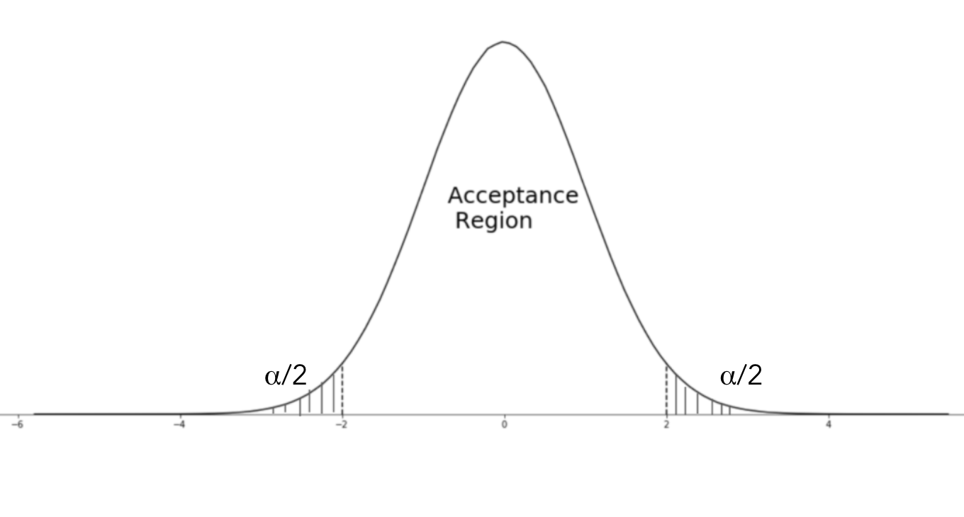
Two-Tailed Test
Two-tailed test is a method in which the critical area of a distribution is two-sided and tests whether a sample is greater than or less than a certain range of values. It is used in null-hypothesis testing and testing for statistical significance.
Example
Speed limit in a freeway 60 – 80 mph (acceptable range of values).
Region of rejection would be numbers from both sides of the distribution, that is, both <60 and >80 are defects.
Critical Region

Slide 32
Procedure for Testing a Hypothesis

Slide 33
Method 1 - Using Critical Region
Set the H_{o} and H_{a}
Compute the test statistic
Compare the test statistic with the appropriate table value
Draw the inference
Based of the decision rule take a decision. If the test statistic lies in the critical region, reject the null hypothesis, else accept

Slide 34
Method 2 - Using p-value
Set the H_{o} and H_{a}
Compute the test statistic
Obtain the p-value
Draw the inference
Reject the null hypothesis if the p-value is less than the level of significance

Slide 35
Hypothesis Testing
Hypothesis testing can be categorised as:
HYPOTHESIS TESTING
Small Sample Test
Large Sample Test
Sample size less than 30
Sample size more than 30

Slide 36
Test for Population Mean

Slide 37
Test for Population Mean - Exact Test
Testing for mean
One Sample
Two Sample
Paired Two Sample
Test whether the population mean is equal to a value
Ex. H_{o}: μ = μ₀
Test whether the two populations means are equal
Ex. H_{o}: μ₁ = μ₂
Test for after and before effect
Ex. H_{o}: d_{i} = 0
Or
H_{o}: x_{i} -y_{i} = 0

Slide 38
One-Sample Test for Mean - Two Sided
To test whether the population mean μ = μ₀, to test
H₀ : μ = μ₀ against H_{a} : μ ≠ μ₀
It implies:
H₀: The population mean is equal to μ₀
against H_{a}: The population mean is not equal to μ₀
Failing to reject H₀ implies that the population mean is equal to μ₀ at α level of significance

Slide 39
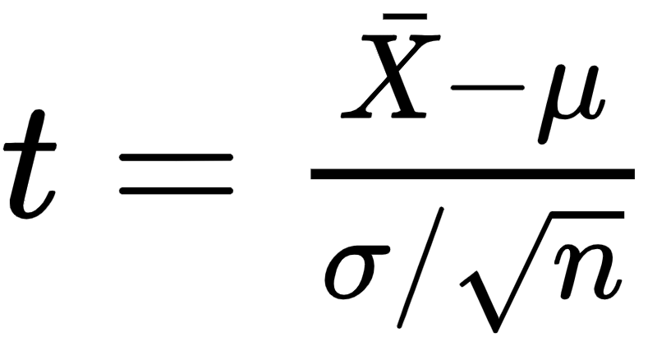
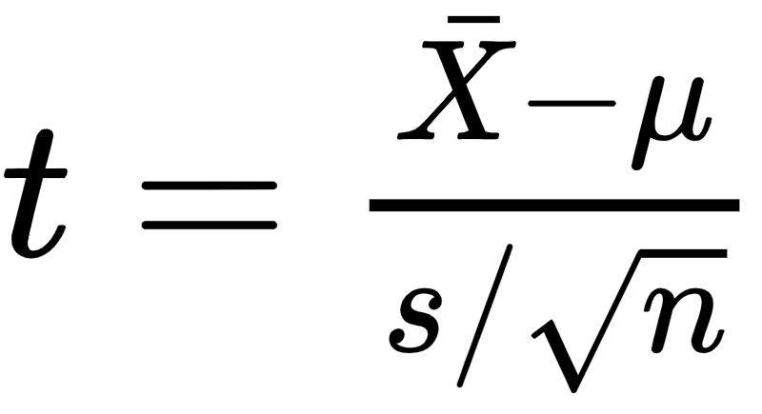
One-Sample Test for Mean
The test statistics is given by:
If σ is known
If σ is unknown
s² is the sample estimate of the population variance
Under H₀, the test statistics follows t distribution with n-1 degrees of freedom

Slide 40
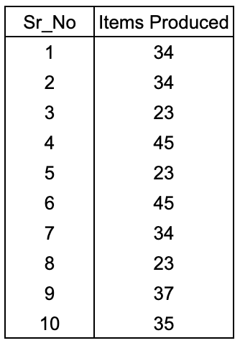
One-Sample t Test - Two Sided
Example
Question:
The Violet industries produces furniture for home and office use. The production engineer claims that the average number of furniture items produced is 30. Test his claim.

Slide 41
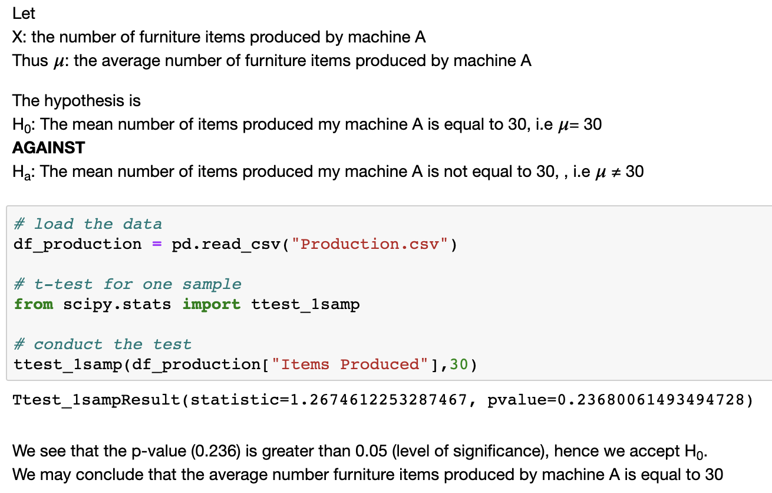
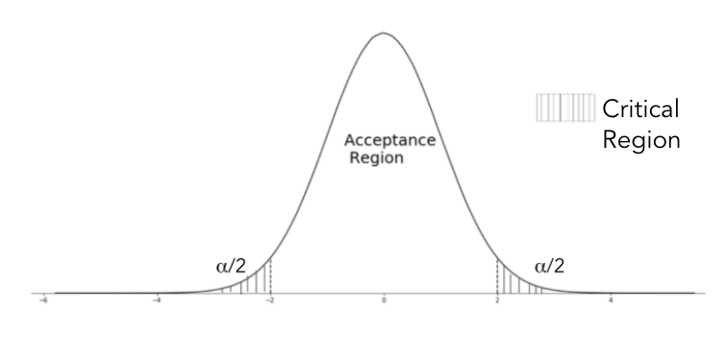
Example - One Sample t test - two sided

Slide 42
One-Sample Test for Mean - One Sided
To test whether the population mean μ = μ₀, to test
H₀ : μ = μ₀ against H_{a} : μ ≤ μ₀ Or μ ≥ μ₀
It implies
H₀: The population mean is equal to μ₀
against H_{a}: The population mean is greater than μ₀
Or The population mean is less than μ₀
Failing to reject H₀ implies that the population mean is equal to μ₀

Slide 43
One-Sample Test for Mean - One Sided
The test statistics is given by:
If σ is known
If σ is unknown
s² is the sample estimate of the population variance
Under H₀, the test statistics follows t distribution with n-1 degrees of freedom
The only difference in one sample and two sample test is the value of level of significance

Slide 44
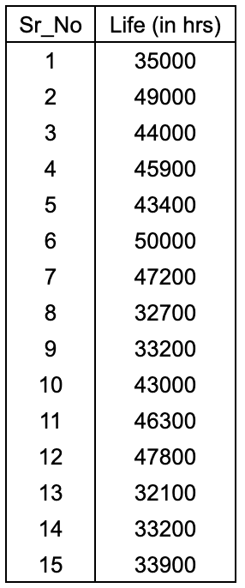
One Sample t test - One Sided
Example
Question:
The Blaze Industries Pvt. Ltd. claims that their manufactured electric bulbs have a life of 45000 hrs. Test the their claim at 5% level of significance.

Slide 45
One Sample t test - One Sided
Example
Solution:
We can test the claim such the life of bulb is not equal to 45000.
However, it would be more meaningful to test for life of bulbs is less than 45000 hours since it would justify the claim is false.
If the life is more than 45000 hours the claim would be stronger.
Thus we conduct a lower tail test
By default the in python the level of significance is 5%

Slide 46
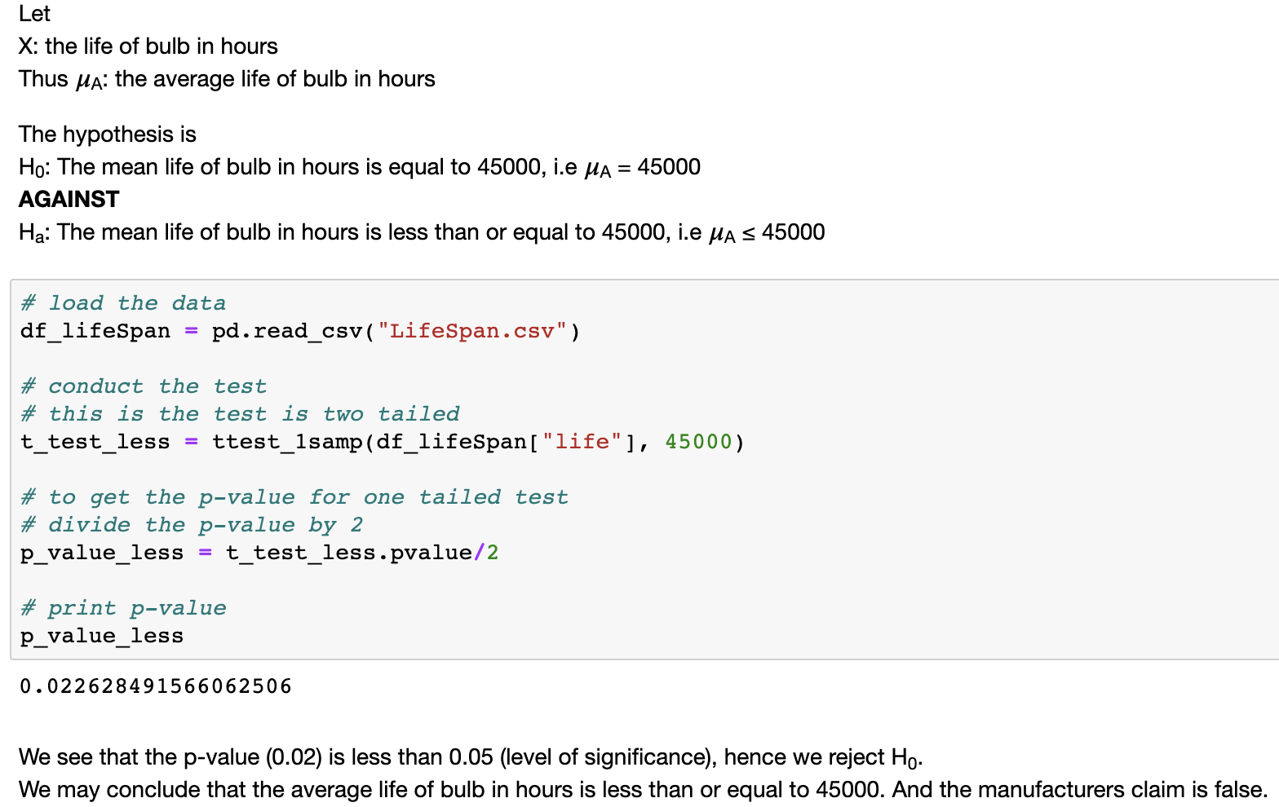
One-Sample t test - One Sided
Example

Slide 47
Two-Sample Test for Mean
Consider two populations of sizes n₁ and n₂ and with means μ₁ and μ₂ respectively
To test whether the population means μ₁ = μ₂, to test
H₀ : μ₁ = μ₂ against H_{a} : μ₁ ≠ μ₂
It implies
H₀: The means of the populations are equal
against H_{a}: The means of the populations not are equal

Slide 48
Discuss Question 4 from the
Faculty notes pdf for Hypothesis Testing

Slide 49
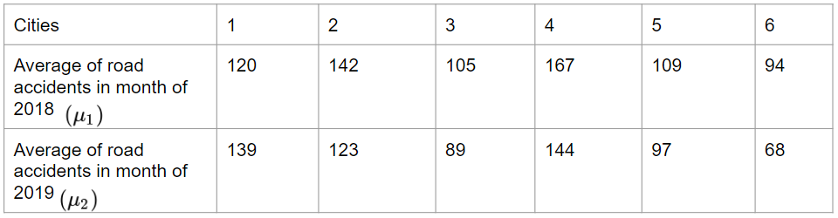

The department of transportation of UK considers sample of 6 metro cities in UK and collect the data on average number of road accidents in two year, before and after pandemic. Transportation ministry believes that there is significant difference in average number of road accidents in year 2019 and 2020 after lockdown in pandemic situation . Assume that the difference between two samples follow normal distribution.
Can we conclude that there is effect of lockdown on road accidents? Test
For solution please refer faculty notes pdf for Hypothesis Testing– Solution 5

Slide 50
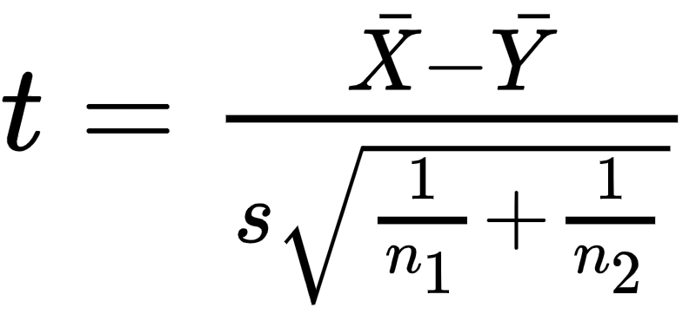
Two-Sample Test for Mean
The test statistics is given by:
where s is the pooled sample mean of the samples drawn from each populations
Under H₀, the test statistics follows t distribution with (n₁+n₂-2) degrees of freedom
Failing to reject H₀ implies that the population mean is equal to each other

Slide 51
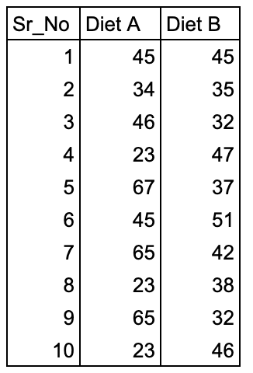
Two Sample t-test
Example
In a pig farm, to increase the weight of the pigs two different diets were given. The data for gain in weight is as given. Test whether the two diets differ significantly regarding their effect on increase in weight

Slide 52
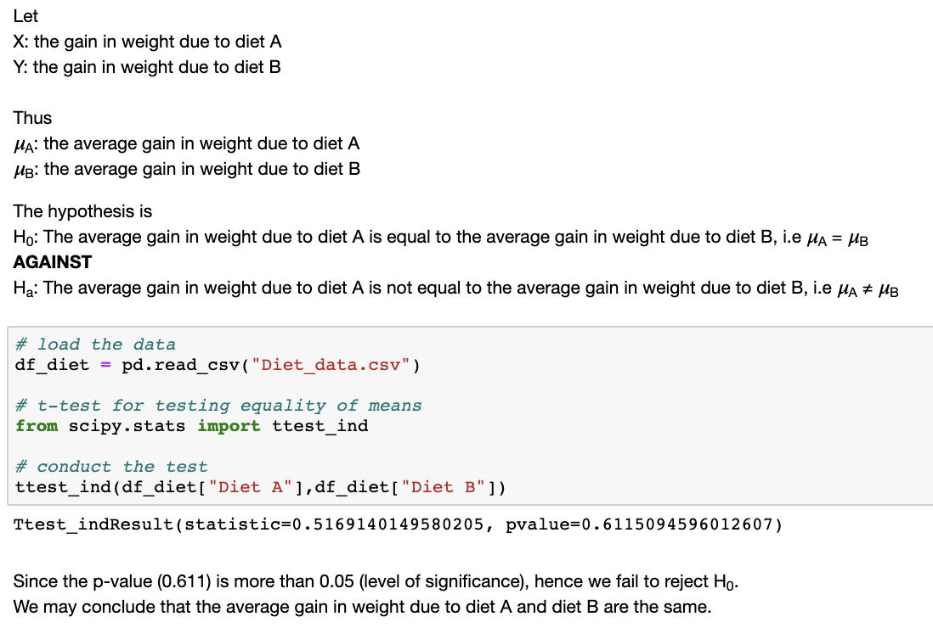
Two sample t-test
Example

Slide 53
Like the one sided tests for test sample means we can similarly test for one sided test for effect of training

Slide 54
Paired t test
To test whether there was any effect of a treatment/training
Let x_{i} be the data before training and y_{i} the data after training
Define d_{i} = x_{i} - y_{i}
To test whether the population means d_{i} = 0, to test
H₀ : d_{i} = 0 against H_{a} : d_{i} ≠ 0
It implies
H₀: There is no effect of training
against H_{a}: There is effect of training

Slide 55
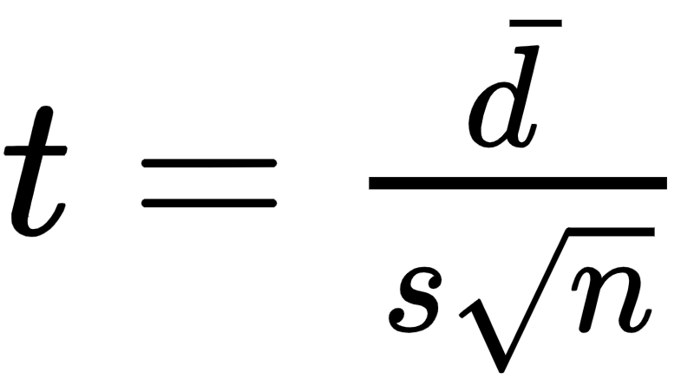

Paired t test
The test statistics is given by:
where is the mean difference in the paired population and s is the variation in d
Under H₀, the test statistics follows t distribution with (n-1) degrees of freedom
Failing to reject H₀ implies that there is no effect to training

Slide 56
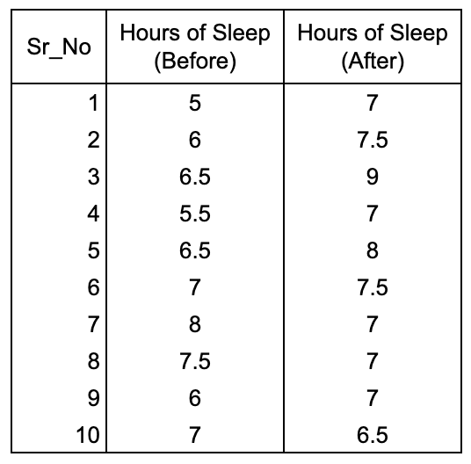
Paired t test
Example
Question:
An pharma company claims to have have produced a new drug which improves sleep of 18 year old teenagers. The hours of sleep for 10 teenagers before and after the giving the new drug is recorded. Test whether there is a significant difference in the average hours of sleep.

Slide 57
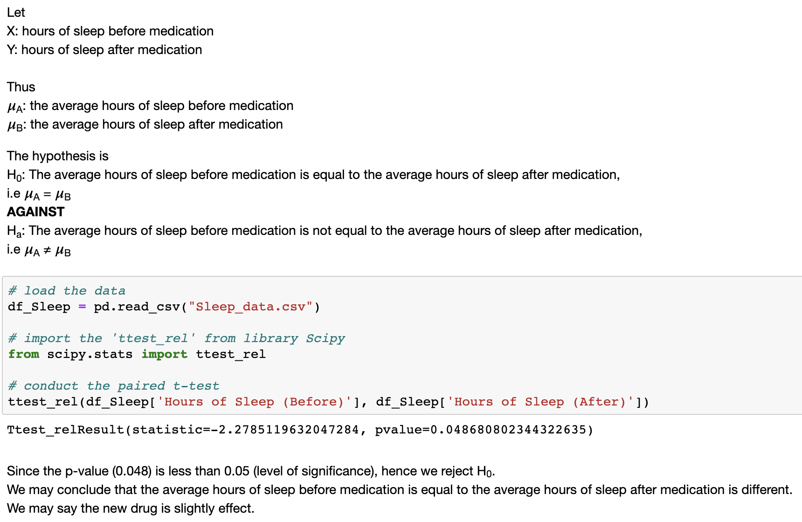
Paired t test
Example

Slide 58
Paired t test
Example

Slide 59
Summary
One sample test | To test the mean of one population
Two sample test | To compare means of two populations
Paired sample test | To test the before and affect effects

Slide 60
Test for Population Mean - Large Sample
Testing for mean
One Sample
Two Sample
Test whether the population mean is equal to a value
Ex. H_{o}: μ = μ₀
Test whether the two populations means are equal
Ex. H_{o}: μ₁ = μ₂

Slide 61
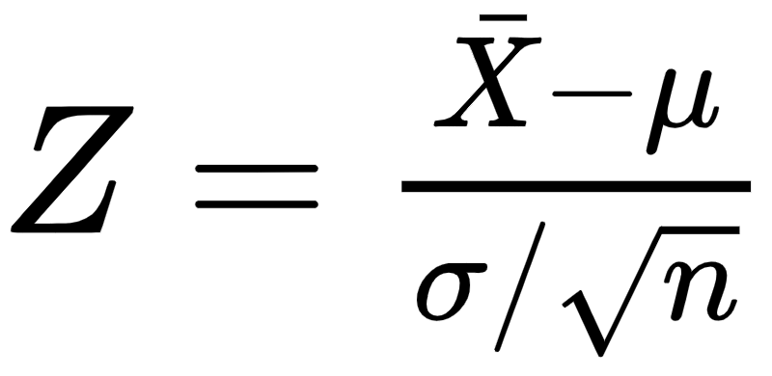
Central Limit Theorem
The Central Limit Theorem (CLT) which states that a large sample from a population with mean µ and σ, then the probability distribution of Z,
follows normal distribution with mean 0 and variance 1
Using the central limit theorem, we can construct tests for large samples.

Slide 62
One Large Sample Test for Mean
To test whether the population mean μ = μ₀, to test
H₀ : μ = μ₀ against H_{a} : μ ≠ μ₀ or μ ≥ μ₀ or μ ≤ μ₀
It implies
H₀: The population mean is equal to μ₀
against H_{a}: The population mean is not equal to μ₀ (μ ≠ μ₀)
Or The population mean is greater than μ₀ (μ ≥ μ₀)
Or The population mean is less than μ₀ (μ ≤ μ₀)

Slide 63
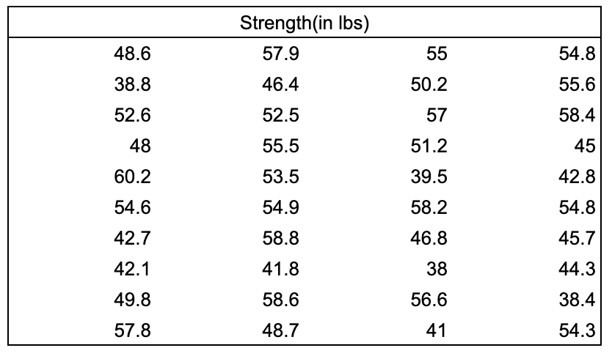
One Sample Test
Question:
A random sample of 40 glass rods is taken from a lot manufactured under a new process. They are tested for their breaking strength. Can we claim that the breaking strength is equal to 55 lbs?

Slide 64
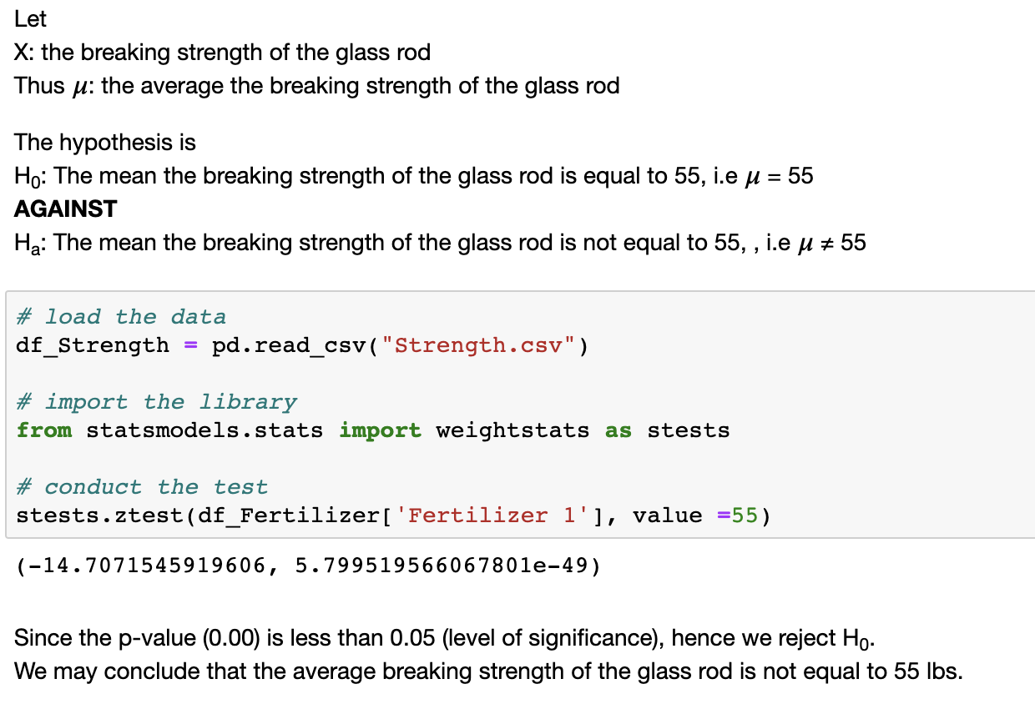
One Sample Test
Example

Slide 65
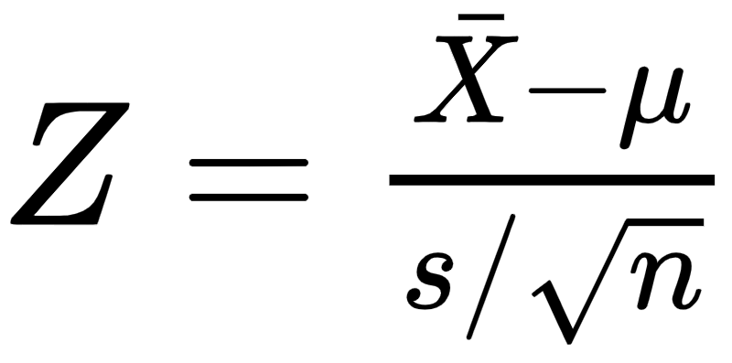
One Large Sample Test for Mean
The test statistics is given by:
If σ is known
If σ is unknown
s² is the sample estimate of the population variance
Under H₀, the test statistics follows N distribution with mean 0 and variance 1
Failing to reject H₀ implies that the population mean is equal to μ₀ at α level of significance
The only difference in one sample and two sample test is the value of level of significance

Slide 66
One Large Sample Test for Mean
To test whether the population mean μ = μ₀, to test
H₀ : μ₀= μ₁ against H_{a} : μ₀ ≠ μ₁ or μ₀ ≥ μ₁ or μ₀ ≤ μ₁
It implies
H₀: The population mean is equal to μ₀
against H_{a}: The population mean is not equal to μ₀ (μ₀ ≠ μ₁)
Or The population mean is greater than μ₀ (μ₀ ≤ μ₁)
Or The population mean is less than μ₀ (μ₀ ≥ μ₁)

Slide 67
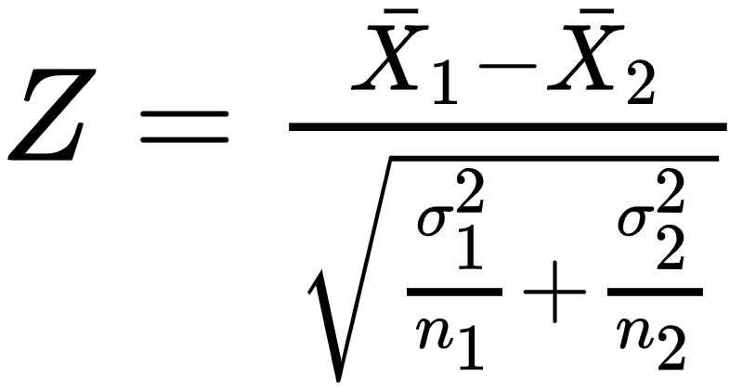
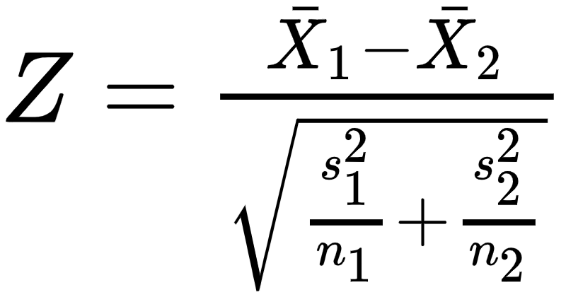
Two Large Sample Test for Mean
The test statistics is given by:
If σ is known
If σ is unknown
s² is the sample estimate of the population variance
Under H₀, the test statistics follows N distribution with mean 0 and variance 1
Failing to reject H₀ implies that the population mean is equal to μ₀ at α level of significance

Slide 68
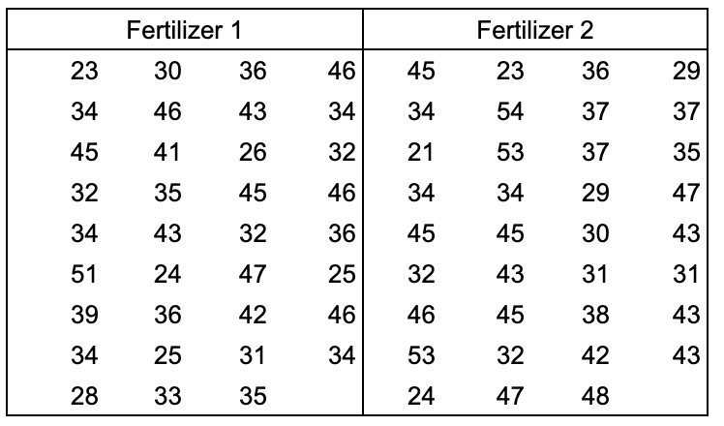
Two Sample Test
Question:
Two types of fertilizers are tested on farm lands of the same size. The yields in quintals are given below. Can we conclude that the two fertilizers have the same yield?

Slide 69
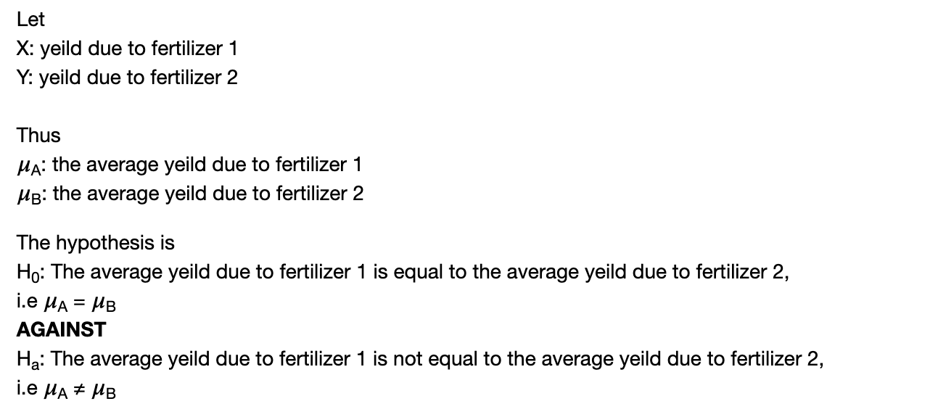
Two Sample Test
Example

Slide 70
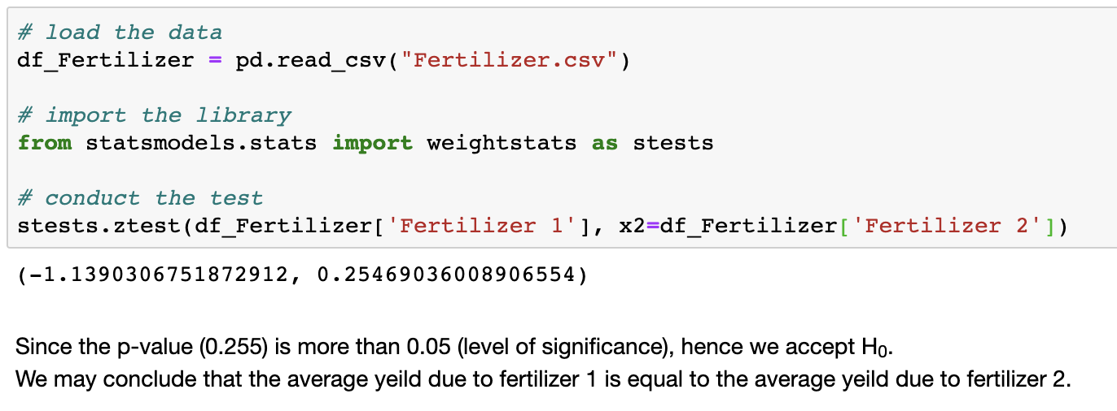
Two Sample Test
Example

Slide 71
Summary
Test for mean
Sample size < 30
Sample size ≥ 30
To test: μ = μ₀
To test: μ₀ = μ₁
To test: d = 0
To test: μ = μ₀
To test: μ₀ = μ₁

Slide 72
Because s is used to estimate the unknown sigma, the values of t are more variable than those of z. Therefore, t distribution has more area in the tails and less in the center than does the standard normal distribution.

Slide 73
Test for Normality of Data

Slide 74
Test for Normality
Testing for normality
Shapiro test
Jarque-Bera test
For data less than 5000 observations
For data more than 5000 observations

Slide 75
Test for Normality
The assumption of most machine learning algorithms is that the data should come from a normal distribution
This normality of a data can be checked using the statistical tests such as the Shapiro-Wilk test, Jarque-Bera test.
The test hypothesis is given as:
H₀: The data follows normal distribution
against H_{a}: The data does not follows normal distribution

Slide 76
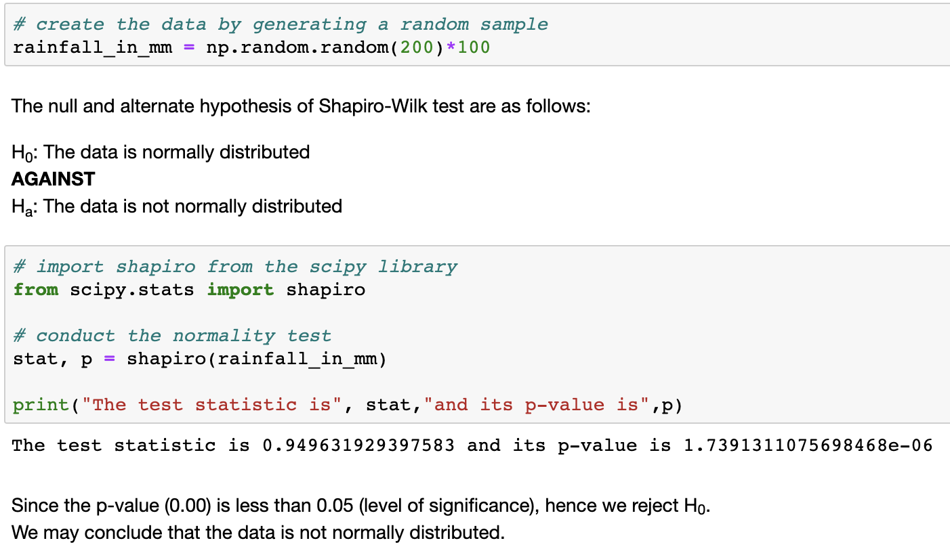
Shapiro-Wilk test

Slide 77
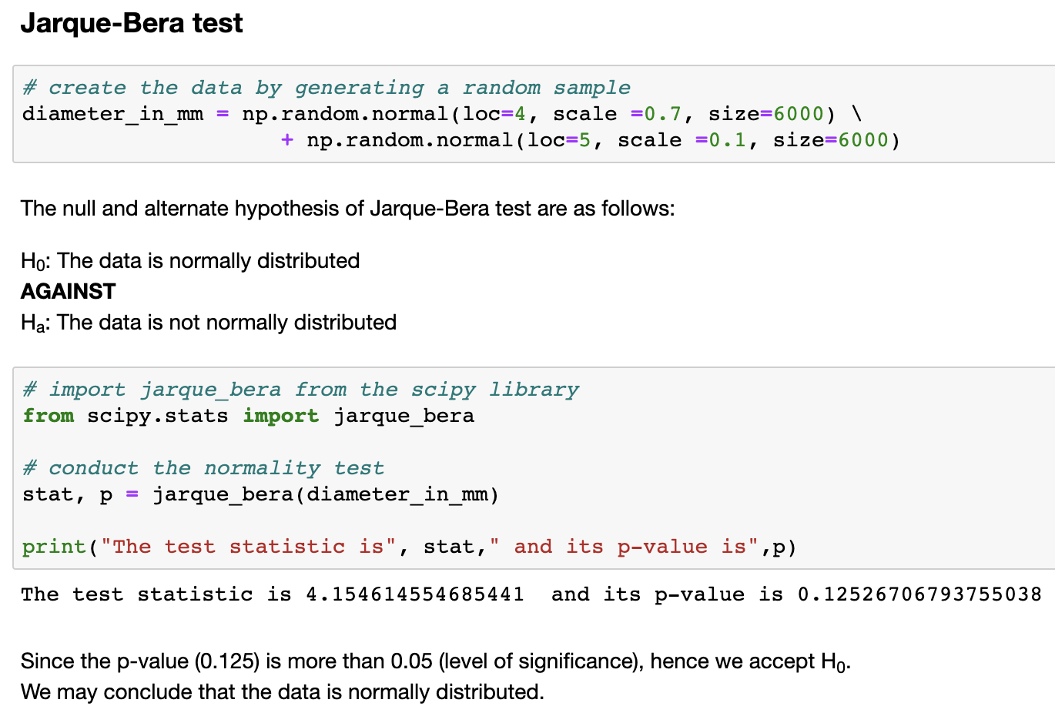
Jarque-Bera Test

Slide 78



Thank you
Mumbai | Bangalore | Pune | Chennai | Jaipur
ACCREDITED TRAINING PARTNER:

