Slide 1


UNDERSTANDING CRIME INFLUENCE ON REAL ESTATE USING CLOUD TECHNOLOGIES
MADE BY:-
DIVAYE BEHAL

Slide 2

DATA COLLECTION
Source: Kaggle
Link: https://www.kaggle.com/datasets/sandeep04201988/housing-price-index-using-crime-rate-data/
The crime data was acquired from the FBI Uniform Crime Reporting program's "Offenses Known and Clearances by Arrest" database for the year in question, held at the National Archives of Criminal Justice Data. The data was compiled and analyzed by Gabriel Dance, Tom Meagher, and Emily Hopkins of The Marshall Project; the analysis was published as Crime in Context on 18 August 2016.

Slide 3
WHAT IS INDEX NSA ?
The U.S. National Home Price NSA Index measures the change in the value of the U.S. residential housing market by tracking the purchase prices of single-family homes. The index is compiled and published monthly.

Slide 4

GOOGLE CLOUD TECHNOLOGIES USED
“BIG QUERY”( DATA ANALYSIS AND DATA VISUALIZATION ) .
“BIG QUERY ML” ( TRAIN,TEST & DEPLOY THE MACHINE LEARNING MODEL )

Slide 5
OBJECTIVE
TO SHOW THE BAD MARKET AFFECTS ON REAL ESTATES PROPERTIES IN UNITED STATES DUE TO HIGH CRIME RATES WHICH IS LEADING TO LOW “INDEX NSA” USING THE GOOGLE CLOUD TECHOLOGY .

Slide 6
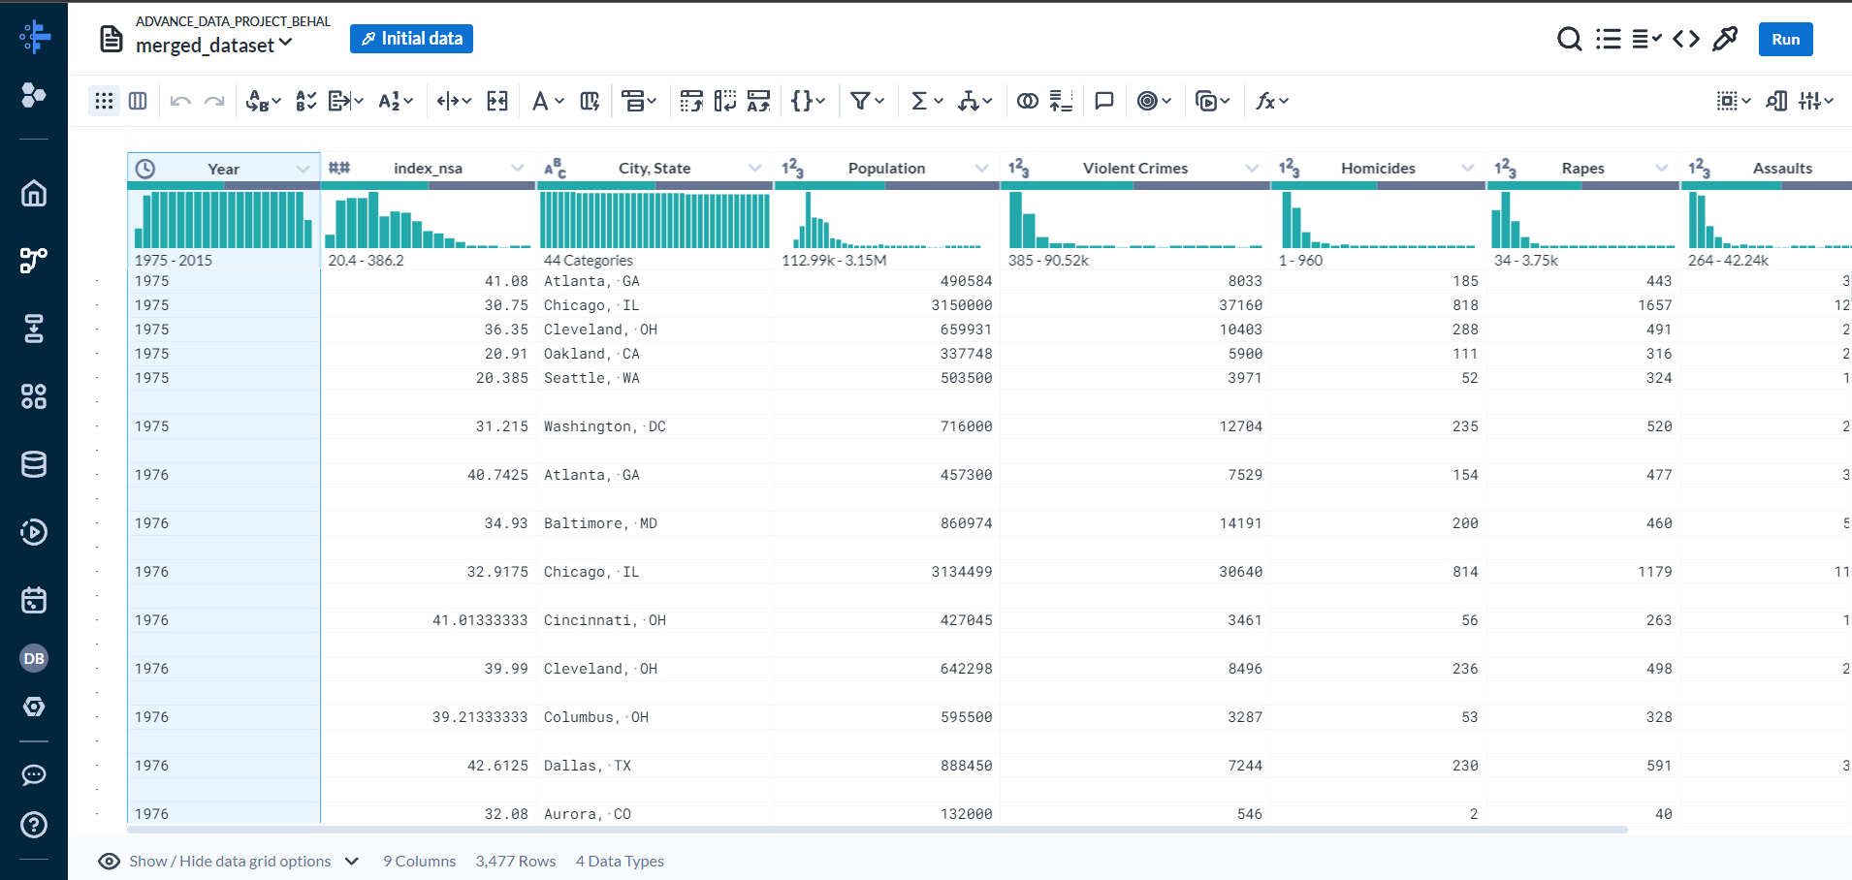
DATA SET

Slide 7
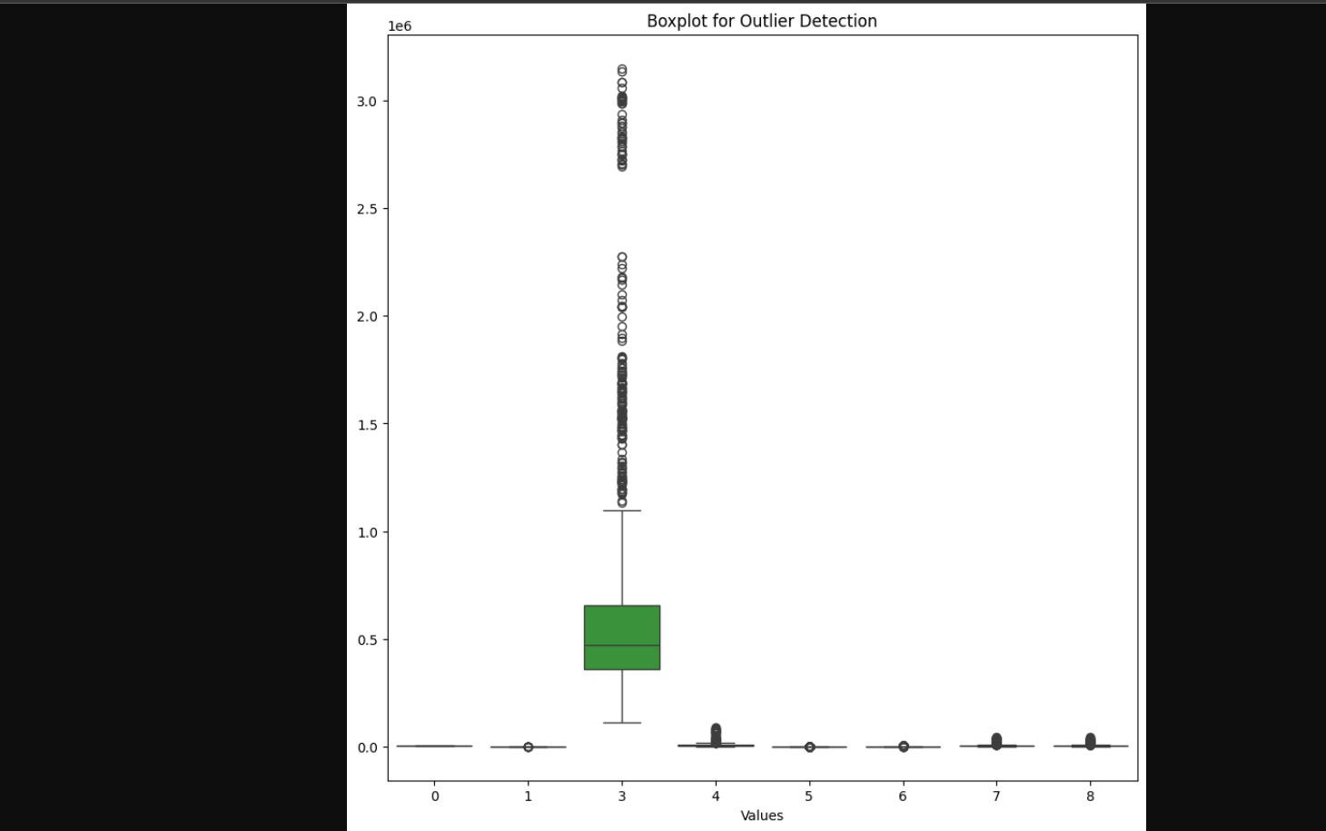
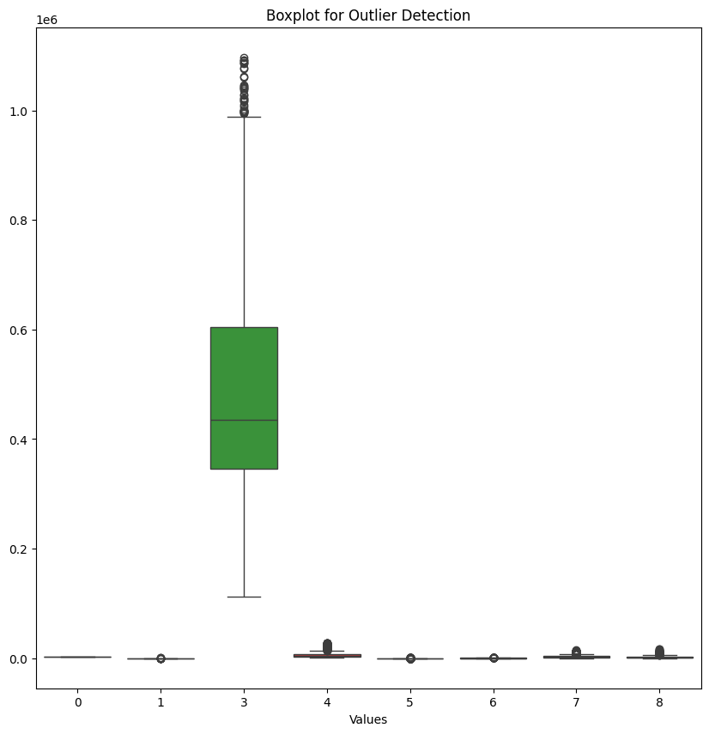
Outliers removal

Slide 8
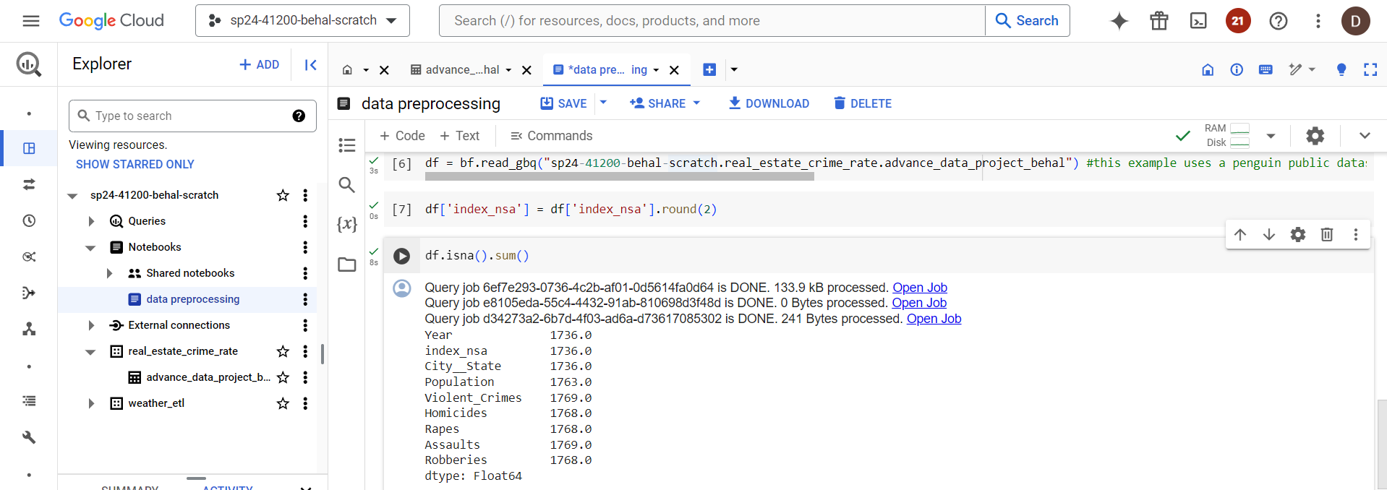
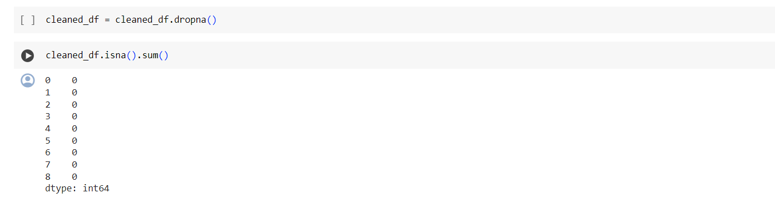
NULL VALUES

Slide 9
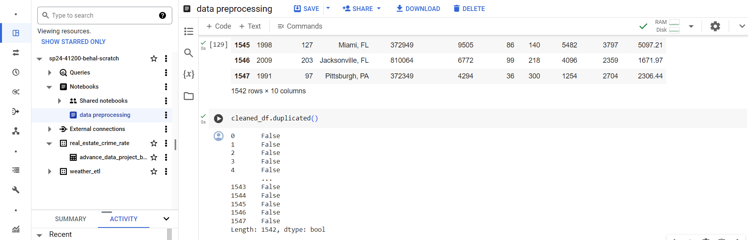
DUPLICATES VALUES

Slide 10
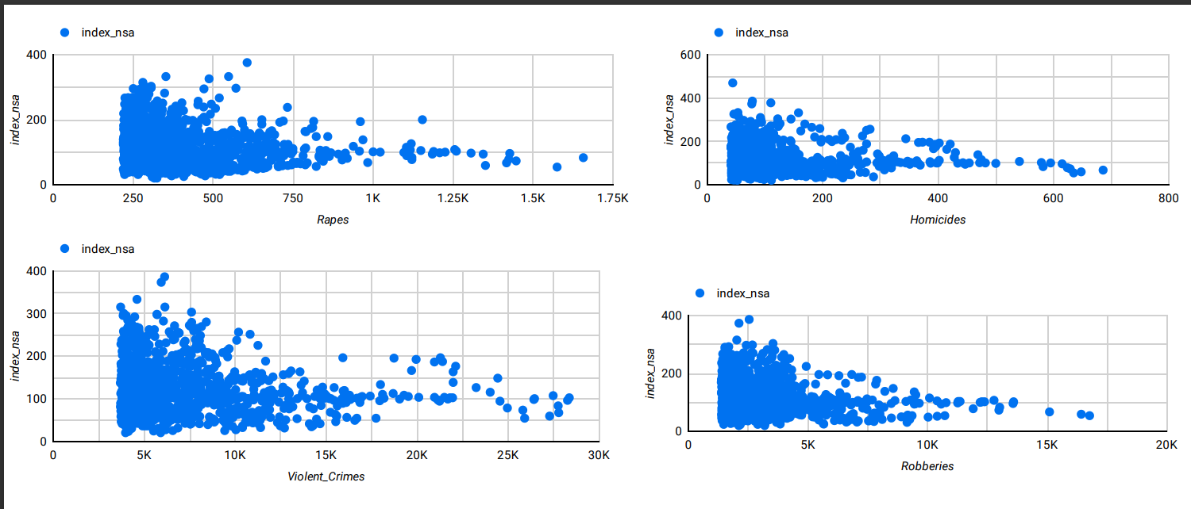
VISUALIZATION

Slide 11
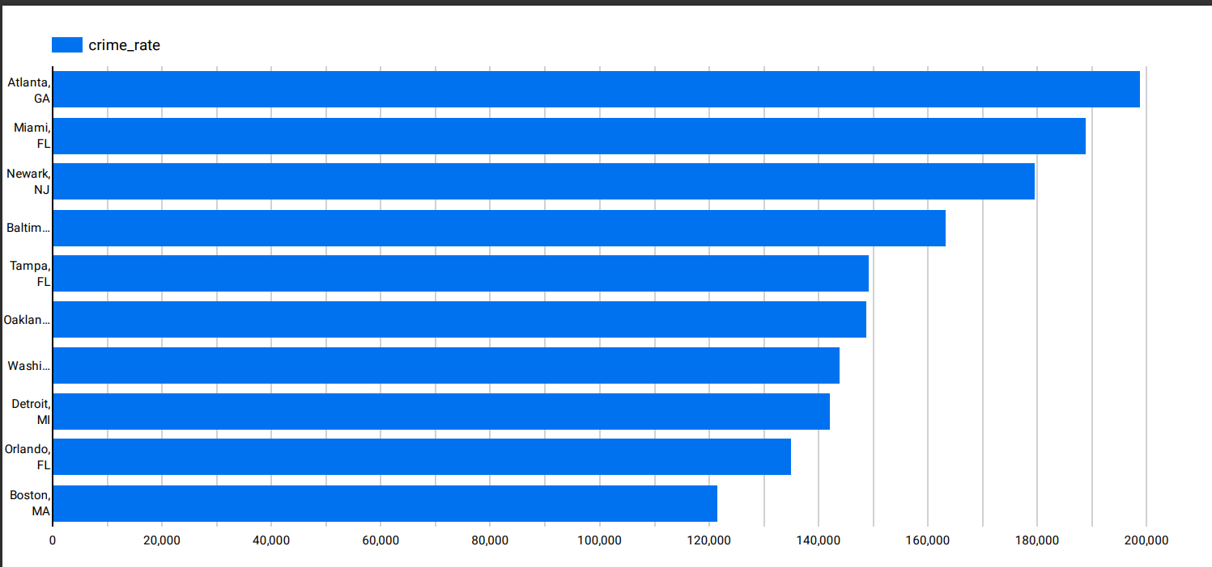

Slide 12
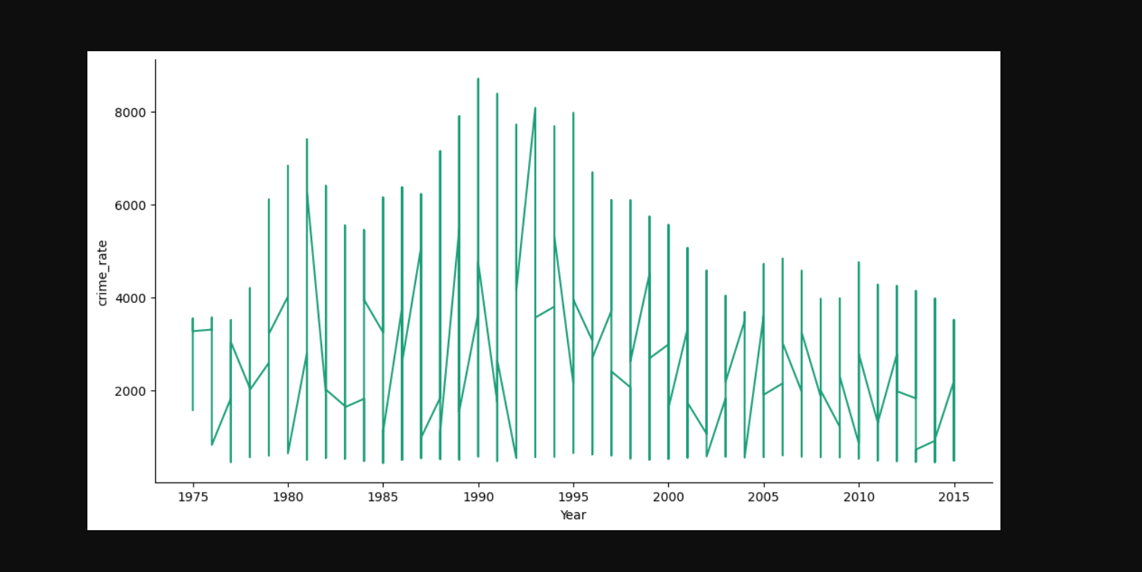

Slide 13
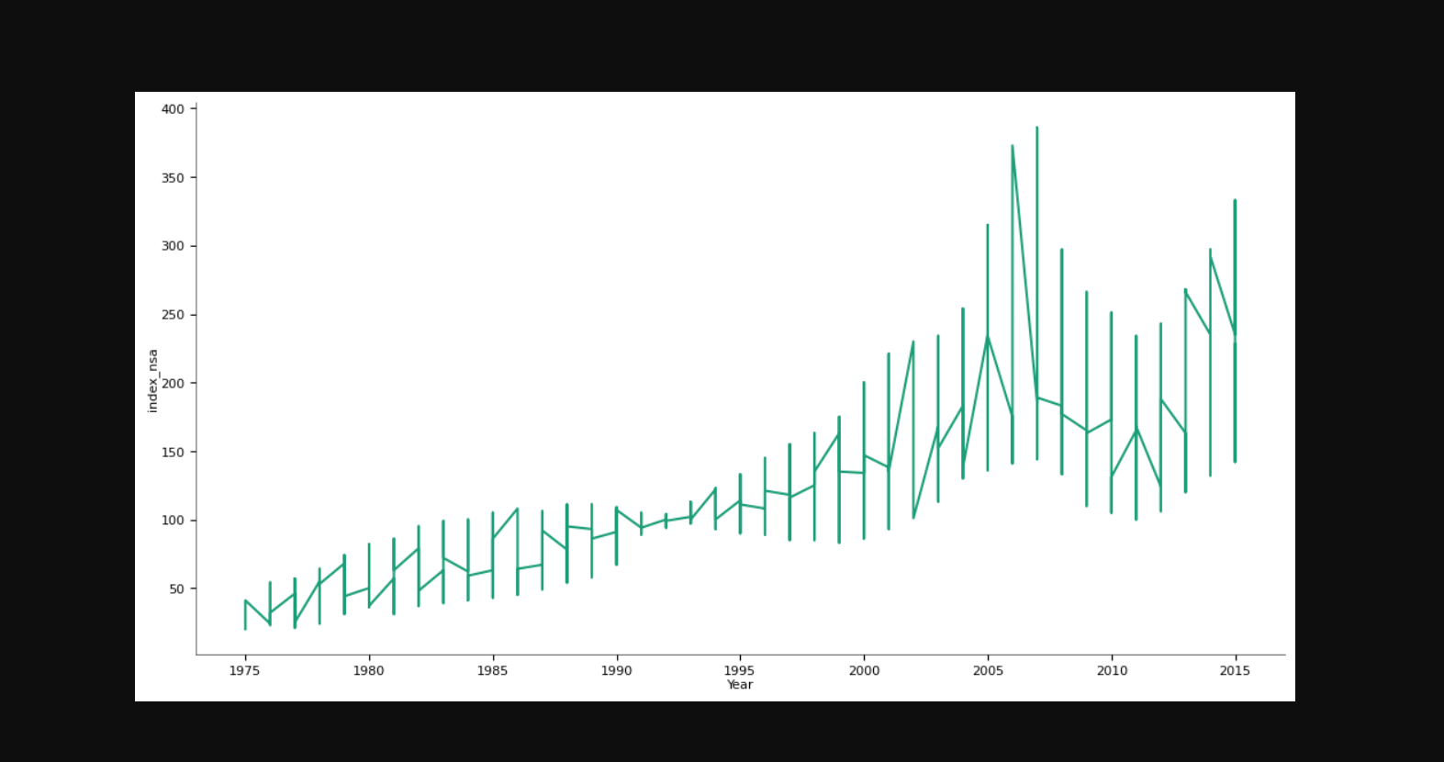

Slide 14
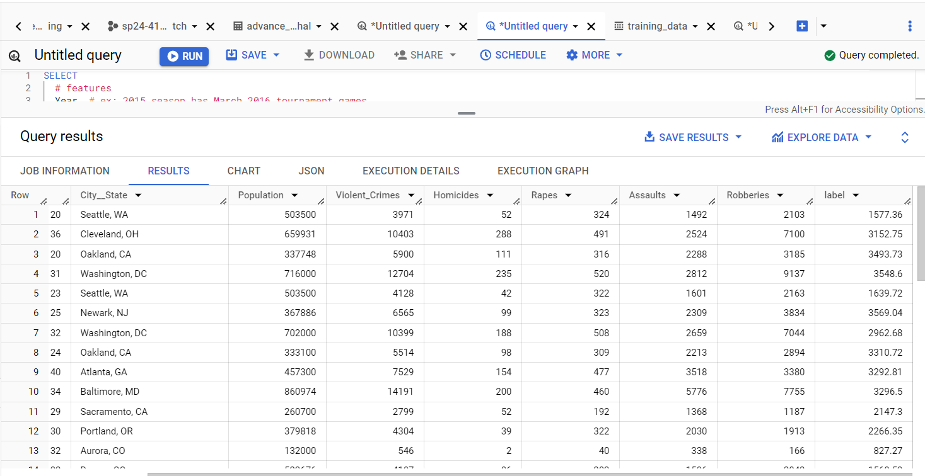
TRAINING DATA (MACHINE LEARNING)

Slide 15
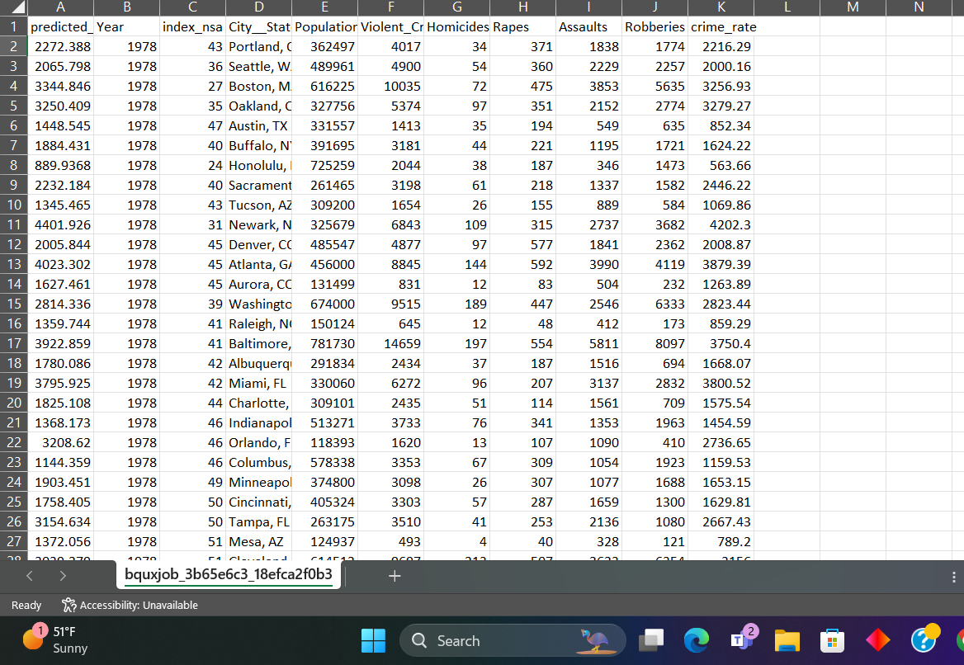
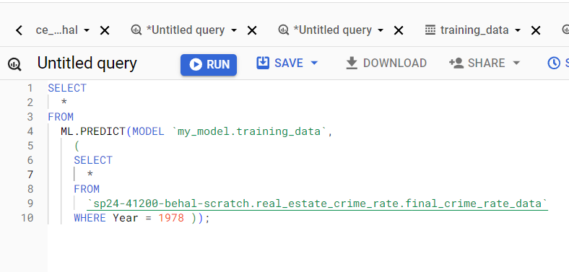
MODEL PREDICTIONS

Slide 16
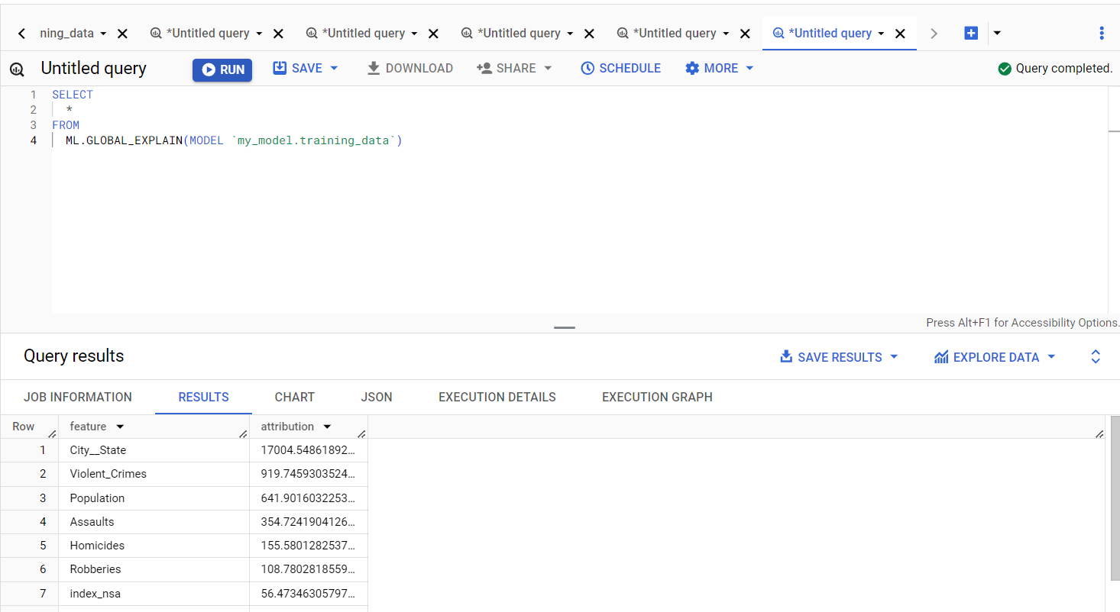
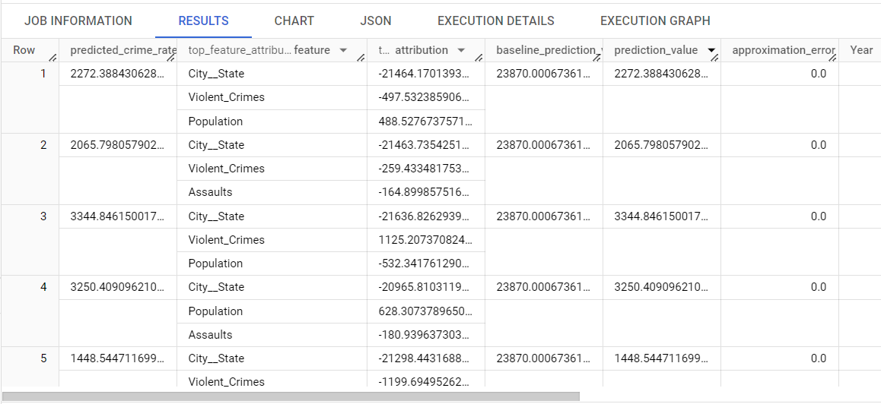

Slide 17
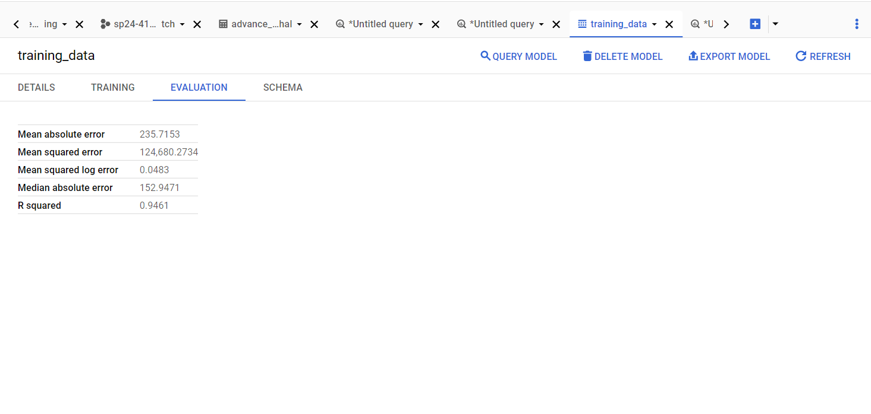
MODEL EVALUATION SCORES

Slide 18
REFRENCES
Effect of crimes on Housing price Index NAME : Naznee Mansoori E mail COLLEGE : IIT Kanpur
Meng Le Zhang, Conceptualization, Data curation, Formal analysis, Funding acquisition, Investigation, Methodology, Project administration, Supervision, Visualization, Writing – original draft, Writing – review & editing, ^{1 ,*} Monsuru Adepeju, Conceptualization, Funding acquisition, Investigation, Writing – review & editing, ² and Rhiannon Thomas, Data curation, Formal analysis, Investigation, Visualization, Writing – review & editing ¹
Analysis of the Correlation Between Crime Rate and Housing Price in Washington, D.C., USA Based on Big Data Hanshu Yang1, Meili Liu2, Jeng-Eng Lin3, and Chun-Te Lee4(B)
Do crime hot spots affect housing prices? Vania Ceccato &Mats Wilhelmsson

Slide 19

THANK YOU ANY QUESTIONS?

