Slide 1
Term Project
The Yelpenator
CAP6938 AI Knowledge Systems
Ben Prishtina
University of Central Florida
Fall 2026

Slide 2
TERMS:
LLM – Large Language Model

Slide 3
GIT HUB Source Code Location
Git Location Clone: git clone https://github.com/behar43/CAP6938_AI_Knowledge_Systems_Final_Project.git
Git URL: https://github.com/behar43/CAP6938_AI_Knowledge_Systems_Final_Project/tree/main

Slide 4
Topic Description
Yelp star ratings and review counts summarize overall customer satisfaction.
Individual users often have subjective dining preferences that aggregate ratings do not explicitly represent.
A highly rated restaurant may not provide the quiet atmosphere, romantic setting, or attentive service a particular user wants.
Evaluating these preferences requires examining customer reviews rather than relying exclusively on numerical ratings.

Slide 5
Solution
Yelpenator is an LLM-based restaurant recommendation agent that evaluates restaurants according to a user's qualitative dining preferences.
The agent combines structured restaurant information with unstructured customer reviews from the Yelp Open Dataset.
Semantic retrieval identifies relevant customer reviews based on meaning rather than exact keyword matches.
Qwen3 analyzes the retrieved evidence to determine whether restaurants satisfy the requested preferences.
The agent ranks restaurant candidates and decides whether additional analysis is necessary before presenting its recommendations.

Slide 6
Architecture
Python modular architecture: Separates restaurant discovery, review retrieval, language model inference, evidence analysis, and recommendation ranking.
Yelp Open Dataset: Provides structured restaurant information and unstructured customer reviews.
Data loading: load_restaurants() and load_reviews() initialize the restaurant and review datasets.
Semantic retrieval: The all-MiniLM-L6-v2 embedding model and FAISS identify customer reviews relevant to the user's preferences.
Language model: Qwen3:4b, executed locally through Ollama, interprets requests, analyzes review evidence, and supports agent decision-making.

Slide 7
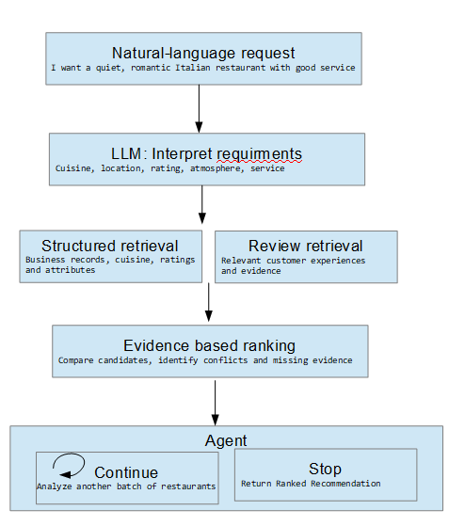
Architecture

Slide 8
Architecture
Ollama: Selected to simplify local language model execution without implementing inference infrastructure from scratch.
Qwen3:4b: Used for natural-language interpretation, review evidence classification, and agent decision-making.
NVIDIA RTX 2070: Development GPU used to execute the selected language model locally.
llm_client module: Provides the interface between Yelpenator and the Ollama inference server.
Alternative approaches considered: Direct inference using Hugging Face Transformers and PyTorch, or commercial cloud-based LLM APIs.

Slide 10
Live Demo

