Slide 1
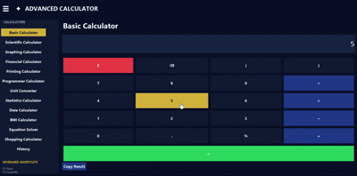
ADVANCED CALCULATOR
✦
NEXTHIKES IT SOLUTIONS
🗁
BY : Aswiniranjan Behera

Slide 2


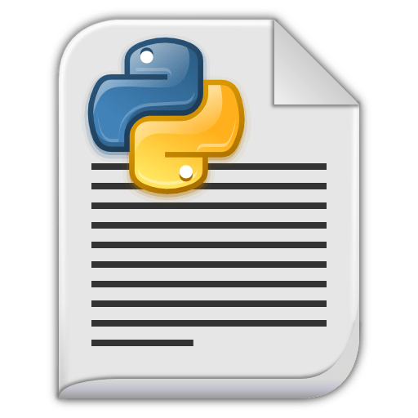
INTRODUCTION
➤
The Advanced Calculator is a desktop application developed using Python.
➤
It provides many calculators in one application.
It is designed with a modern dark navy-and-gold interface.
➤
It supports basic, scientific, financial, graphing, statistics, unit conversion,
and more.
➤
The project uses Tkinter for the graphical user interface.
➤

Slide 3
OVERVIEW OF PRESENTATION
1. INTRODUCTION
2. OBJECTIVE
3.TECHNOLOGIES USED
4.MAIN FEATURES
5.ADVANTAGES
6.LIMITATIONS
7.ABOUT CALCULATOR TABS
8.CONCLUSION
9.THANK YOU NOTE

Slide 4
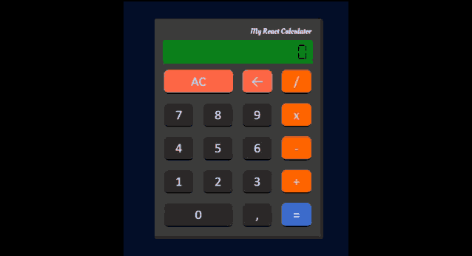
Objectives
Objectives
To create a multi-purpose calculator application.
To perform safe mathematical calculations.
To provide scientific and graphing features.
To store calculation history.
To export calculation results as TXT and PDF files.
To create a simple, attractive, and user-friendly interface.

Slide 5
Technologies Used
Technologies Used
Technologies Used
TECHNOLOGY
PURPOSE
Python
Main programming language
Tkinter
GUI development
NumPy
Creating graph x-values
Matplotlib
Drawing graphs
JSON
Saving calculation history
ReportLab
Creating PDF files
VS Code
Code editor

Slide 6

MAIN FEATURES
MAIN FEATURES
Basic Calculator
Printing Calculator
Financial Calculator
Statistics Calculator
Unit Converter
Graphing Calculator
Date / Age Calculator
Programmer Calculator
History
Scientific Calculator
BMI Calculator

Slide 7
ADVANTAGES
ADVANTAGES
All calculators are available in one application.
Easy to use and visually attractive.
Supports safe expression evaluation.
To store calculation history.
Exports results to TXT and PDF.
Graphing makes mathematical functions easier to understand.
Works offline after installing Python libraries.

Slide 8
LIMITATIONS
LIMITATIONS
Requires Python and required libraries to be installed.
Graphing Calculator requires NumPy and Matplotlib.
Trigonometric functions use radians, not degrees.
Complex-number graphs are not supported.
The application is desktop-based, not web-based.

Slide 9
ABOUT CALCULATOR TABS
ABOUT CALCULATOR TABS
  It Performs addition, subtraction, multiplication, division, modulus, and power operations also supports decimal numbers & Uses buttons such as C, ⌫, %, and =.
Basic Calculator
  It Supports functions such as sin, cos, tan, sqrt, log, ln, exp, and abs also Supports constants pi and e.
Scientific Calculator
  Plots mathematical functions such as sin(x), cos(x), x**2, and sqrt(x).
  User can enter the function and minimum/maximum x-values.
Graphing Calculator

Slide 10
  Calculates Simple Interest , Compound Interest , final amount after interest , estimated monthly EMI for loans.
  Useful for finance and banking-related calculations.
Financial Calculator
  Works like a calculation tape.
  The tape can be saved as a TXT file also it can be saved as a PDF file using ReportLab
Printing Calculator
  Converts numbers between Binary, Octal, Decimal, and Hexadecimal.
  Shows binary, octal, decimal, hexadecimal, and bit length.
Programmer Calculator
  Converts Length, Weight, Temperature, Data, and Time units.
  Automatically updates available units when the category changes.
Unit Converter

Slide 11
Statistics Calculator
  Accepts multiple numbers separated by commas.
  Calculates : Count, Sum, Mean, Median, Minimum, Maximum,
  Standard Deviation
  Calculates age in years, months, and days or total days between two dates.
  Adds days to a date.
Date Calculator
  Takes height in centimeters and weight in kilograms or Calculates Body Mass Index.
  Shows category: Underweight, Normal weight, Overweight, or Obese.
BMI Calculator

Slide 12
CHALLENGES FACED
CHALLENGES FACED
Understanding how to create a sidebar menu using Tkinter.
Making the sidebar scroll smoothly with the mouse wheel.
Handling invalid user input without crashing the application.
Creating a safe calculator engine that does not allow unsafe code.
Displaying Matplotlib graphs inside the Tkinter window.
Saving and loading calculation history using a JSON file.
Designing a clean and professional navy-and-gold user interface.

Slide 13
Problems Resolved
Problems Resolved
Created a scrollable sidebar using Canvas, Scrollbar, and Frame
Added mouse-wheel scrolling for the sidebar and calculator buttons.
Used try-except blocks to show clear error messages instead of crashing.
Used Python’s ast module to safely evaluate mathematical expressions.
Used FigureCanvasTkAgg to display Matplotlib graphs inside Tkinter.
Saved history automatically in calculator_history.json.
Added TXT and PDF export features for calculation history and printing tape.

Slide 14
References
References
Python Software Foundation — Python Documentation
https://docs.python.org/3/
Tkinter Documentation
https://docs.python.org/3/library/tkinter.html
Matplotlib Documentation
https://matplotlib.org/stable/
NumPy Documentation
https://numpy.org/doc/
Python ast Module Documentation
https://docs.python.org/3/library/ast.html
ReportLab Documentation
https://docs.reportlab.com/
GeeksforGeeks — Python Tkinter Tutorial
https://www.geeksforgeeks.org/python-tkinter-tutorial/
W3Schools — Python Tkinter Tutorial
https://www.w3schools.com/python/python_tkinter.asp

Slide 15
Conclusion
The Advanced Calculator successfully combines many calculation tools in one application.
It is built using Python, Tkinter, NumPy, Matplotlib, JSON, and ReportLab.
It provides a professional navy-and-gold user interface.
It is useful for students, teachers, programmers, and finance users.
The project can be improved further with more advanced mathematical and graphical features.

Slide 16

Special thanks to my Mentor for their valuable support and guidance.
Special thanks to my Mentor for their valuable support and guidance.
Any Questions?
THANK-YOU
Notes:
“That completes my presentation. My Advanced Calculator project provides many calculation tools in one application, such as basic, scientific, graphing, financial, statistics, unit conversion, date, and BMI calculators. It also saves history and allows users to export results as TXT or PDF files. I developed it using Python, Tkinter, NumPy, Matplotlib, JSON, and ReportLab. Thank you for listening.”

