Slide 1
Deep neural networks: from one neuron to networks that train
SESSION 1 · 150 MINUTES · UNDERGRADUATE ENGINEERING
Foundations · Learning · Training and generalization
teal: forward signal
orange: gradients · red: warnings
Notes:
[0:00 – 0:02] SAY: Welcome. Today: how a neural network computes, how it learns, and how to make it train and generalize. Teal means the forward signal; orange means gradients; red means a warning.
BACKGROUND (for you; not to read aloud):
One session, three parts: what a network computes, how it learns, and what makes deep networks train and generalize. Ten-minute break at 1:04, after Quick check 3, so neither half runs much past an hour.
Audience: students who know classical machine learning (logistic regression, trees, k-NN), calculus and probability, but not deep learning. Key deep-learning terms are defined before they are needed; the forward references (Adam on slide 5, “batch” on slide 16, dropout on slide 38, and Transformers/CNNs as names) are flagged in the notes.
Colour code all session: teal = forward signal and data; orange = gradients flowing backward; red = warnings and the ‘bad’ run in a chart; navy and grey are neutral. In data plots, teal and gold mark the two classes, with hollow vs filled markers where it matters.
How to use this deck: 52 lecture slides, including 6 four-minute quick checks (peer instruction: vote, discuss, revote, explain) and a 4-step worked build (setup, forward, backward, parameter gradients plus one update). Each lecture slide’s notes start with a clock time and SAY (roughly what to say) followed by BACKGROUND (for you; do not read it aloud). Every lecture slide ends with a “Next →” line: say it aloud as the bridge. All code on the slides is framework-neutral pseudocode; PyTorch names appear only in these notes, marked “PyTorch session preview”.
Appendix A is review material for today (quick-check answers, notation, linear regions of a ReLU net, universal approximation, why depth helps, Adam and AdamW in full, loss landscapes, history, when not to use a network, gradient checking). Appendix B goes further, for later sessions (normalization, double descent, loss and target formats, silent training bugs, learning-rate schedules, a full training recipe, activations by layer role).
Provenance: the first line of a slide’s notes states where its figure or numbers come from. EXPERIMENT = a training run (seeds stated); SIMULATION = a seeded numerical experiment; COMPUTED = a deterministic calculation; CONSTRUCTED = a hand-built network. Every such figure and number is regenerated by the scripts delivered with the deck (fmnist_experiments.py, small_figures.py, new_figures.py, figures_v7.py, fmnist_regularization.py; new in v8: classical_baselines.py for the k-NN and random-forest baselines on slide 16).

Slide 2
By the end of today you can…
OPENING
Part 1 · Foundations
Part 2 · Learning
Part 3 · Train & generalize
1
Explain why linear models fail on XOR and how a hidden layer fixes it
3
Derive a loss from a noise model; explain what momentum and Adam fix
5
Choose an initialization; explain residual connections
2
Compute an MLP's forward pass, shapes and parameter count
4
Run backpropagation by hand and read the four BP equations
6
Diagnose under- and overfitting; pick remedies in order
You should already know: matrix–vector products · the chain rule · logistic regression · train/validation/test splits · Python and NumPy
Next → the plan, and the example we follow all session
Notes:
[0:02 – 0:03] SAY: These six objectives are things you will be able to do by the end. We check them as we go.
BACKGROUND: Each objective is something students should be able to DO. Where each is checked: (1) Quick check 1; (2) the W[1] shape prediction on slide 16 and the parameter count on slide 17; (3) the loss derivation on slide 20 (students do the line), Quick check 2 (loss) and Quick check 3 (step size); (4) the hand calculation and Quick check 4; (5) Quick check 5 (initialization) and the residual question in the homework; (6) Quick check 6. Objectives 2 and 5 are only partly checked in class: use the exit ticket to see whether they landed.

Slide 3

Today's plan, and one example we will follow all session
OPENING
Part 1 · Foundations
Part 2 · Learning
Break
Part 2 (cont.)
Part 3 · Train & generalize
0:00
0:36
1:04
1:14
1:43
2:19
2:30
What a network computes
How it learns
Making it train and generalize
XOR, the neuron, activations, the forward pass
Losses, gradient descent, optimizers, backpropagation
Initialization, residuals, diagnosis, regularization
Running example
Fashion-MNIST (28 × 28 grey images, 10 classes) and a 784–128–64–10 MLP: built in Part 1, trained in Part 2, regularized in Part 3. Every curve for it comes from a script you can rerun.
Next → Part 1: why do we need more than a linear model?
Notes:
[0:03 – 0:05] SAY: Here is the clock. One running example ties it together: a small network on Fashion-MNIST that we build, train and then diagnose.
BACKGROUND (for you; not to read aloud):
The bar is the clock. One running example ties the parts together: a 784–128–64–10 MLP on Fashion-MNIST. We build it in Part 1, train it in Part 2, and diagnose and regularize it in Part 3 — every curve shown for it comes from a script delivered with the deck (fmnist_experiments.py, PyTorch; the 1,000-image experiment uses fmnist_regularization.py, NumPy), with fixed seeds.
Quick checks (six, about four minutes each): everyone votes A–D silently; if votes split, convince a neighbour for 60 seconds and revote (Mazur's peer instruction).

Slide 4
Foundations: what a network computes
PART 1 · ≈ 31 MINUTES
Why can't a linear model bend its boundary?
What does one neuron compute, and why can't it solve XOR?
Why must a nonlinearity sit between layers?
How does an MLP map inputs to outputs?
Notes:
[0:05] SAY: Part 1: what a network computes. Nothing learns yet.
BACKGROUND: Part 1 is about representation: what a network computes and why. Start from one neuron, find its limit (XOR), then build networks. Nothing is learned yet; that is Part 2.

Slide 5
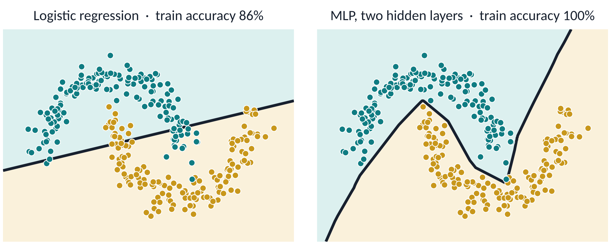
On raw inputs, linear models draw only straight boundaries
PART 1 · WHY NEURAL NETWORKS
Logistic regression predicts class 1 when z = wᵀx + b > 0: its boundary is a line (a hyperplane in n-D). No w or b can bend it.
Next → what one neuron computes, and why its boundary is a line
Notes:
[0:05 – 0:07] PROVENANCE: EXPERIMENT · SEED 0 · small_figures.py
SAY: Start with the model you already know. Same data, two models: logistic regression draws a straight line and stops at 86%; a bigger network bends the boundary and fits it. Why can't logistic regression bend?
BACKGROUND (for you; not to read aloud):
Hook, placed first on purpose: problem before mechanism. Same 300 points, two models, same gradient-descent code (two moons, 300 points, noise 0.12; both models trained by full-batch Adam, a gradient-descent variant introduced in Part 2, on the same loss; small_figures.py). Logistic regression computes z = wᵀx + b and ŷ = σ(z). It predicts class 1 when ŷ > 0.5, that is when z > 0, so its boundary wᵀx + b = 0 is a straight line. It reaches 86% training accuracy; no straight line can come close to 100% on these two moons. A 2→32→32→1 ReLU network fits the training data at 100% (ReLU is defined in a few slides; for now it is just “a bigger network”).
Linear models remain valuable (convex training, interpretable weights, little data needed). Today's question: how do we keep those strengths and still bend the boundary? The next two slides show that logistic regression is one neuron.

Slide 6
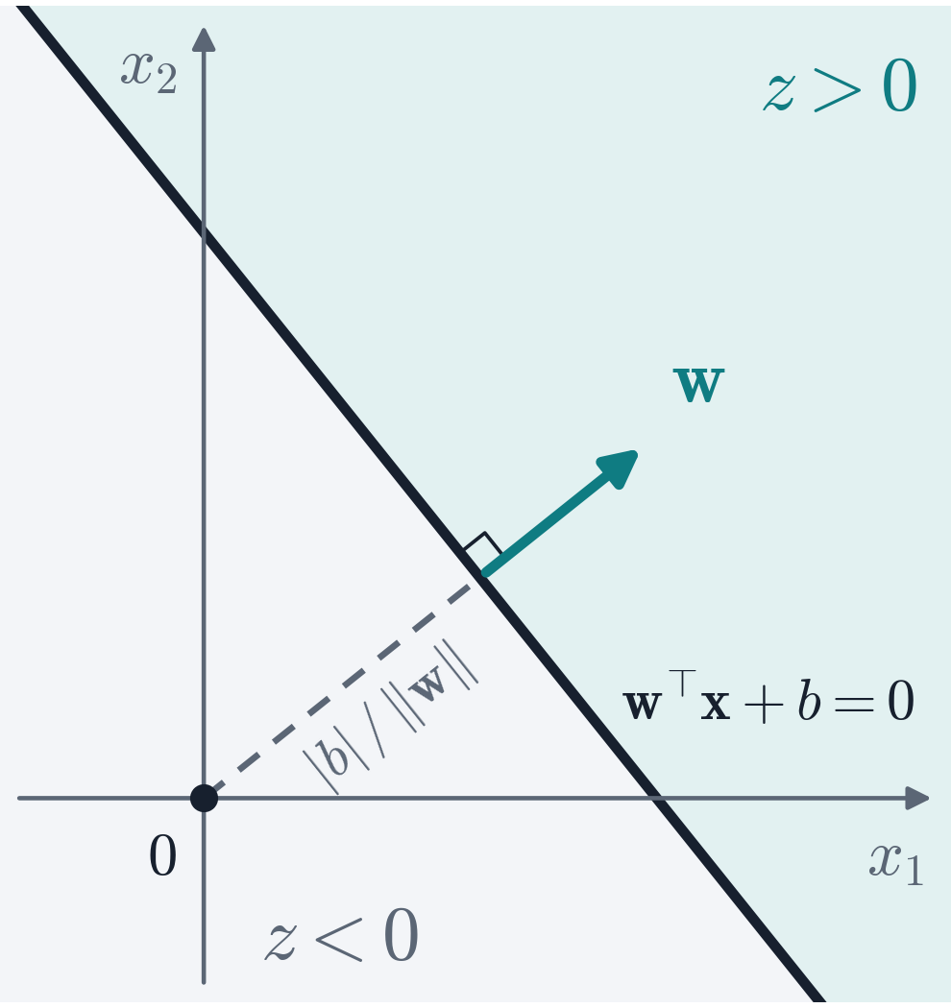


One neuron: a weighted sum and a threshold
PART 1 · THE NEURON
1
w ⟂ boundary
x₁
b
weights w
w points toward increasing z.
x₂
Σ
step
2
Bias shifts, never rotates
a
⋮
Distance to origin: |b| / ‖w‖.
xₙ
3
Fires on one side
a = 1 where z > 0: one side of one line.
z: weighted sum (score)
a: output, 1 = fires
Next → make the threshold smooth, so the neuron can learn
Notes:
[0:07 – 0:10] SAY: One neuron computes a weighted sum plus a bias and fires on one side of a line. w is perpendicular to that line; the bias shifts it.
BACKGROUND (for you; not to read aloud):
Bridge from the two-moons hook: logistic regression is one unit, so look at one unit closely. A neuron computes a weighted sum of its inputs plus a bias, z = wᵀx + b, and fires (a = 1) when z > 0: McCulloch & Pitts's threshold unit (1943), the building block of Rosenblatt's perceptron (1958). The biology analogy helps for about a minute: real neurons spike, dendrites compute nonlinearly, and brains do not run backpropagation.
Geometry: w is perpendicular to the boundary z = 0, because for two boundary points x, x′ we have wᵀ(x − x′) = 0. The bias shifts the boundary without rotating it; its distance from the origin is |b|/‖w‖, and (wᵀx + b)/‖w‖ is the signed distance to the boundary. So one neuron answers one question: which side of one line (hyperplane) is x on? The figure draws the axes through the origin, so the dashed segment from 0 to the boundary is exactly |b|/‖w‖ and is parallel to w.
Careful with words: the step IS a nonlinear function, so do not call this neuron 'linear'. Keep the word for later and pay it off in three steps: the sigmoid slide (next) shows a step cannot be trained by gradient descent; the XOR slide shows one unit, step or sigmoid, cannot bend the boundary; the depth-collapse slide shows where the nonlinearity must sit.

Slide 7


Smooth activations give gradients: the sigmoid neuron
PART 1 · THE NEURON
THE STEP NEURON: NO GRADIENT
g′(z) = 0 wherever it is defined: no gradient flows through a stack of steps.
THE LOGIT z IS THE LOG-ODDS; SOLVE FOR P
Maximum slope of σ: 1/4, at z = 0.
Scaling w and b by k: same boundary, k× steeper switch.
Logistic regression is a single sigmoid neuron.
Next → the simplest problem no straight line can solve: XOR
Notes:
[0:10 – 0:12] SAY: A step has zero slope, so gradient descent cannot train it. Smooth it into a sigmoid and you get logistic regression — which you already know. Remember: the sigmoid's slope is at most 1/4.
BACKGROUND (for you; not to read aloud):
Bridge from the neuron slide: the threshold works, but it cannot learn by gradient descent. Rosenblatt's perceptron (1958) used a hard step. Its learning rule converges on linearly separable data (Novikoff, 1962), but the step's derivative is 0 wherever it exists, so a STACK of steps gives no gradient and cannot be trained by gradient descent.
Swap the step for a sigmoid and you get logistic regression. Name it now: z, the log-odds, is called the LOGIT; the word is used from the running example onward. The sigmoid is what linear log-odds imply: assume log(p/(1−p)) = z and solve for p. Its derivative σ(1 − σ) is at most 1/4, at z = 0 — remember that 1/4; it returns on the activation slide and in Part 3.
Sharpness: scaling w and b by k keeps the boundary z = 0 but makes the sigmoid switch k times steeper (for a step, infinitely steep). Small ‖w‖ means gentle switching — weight decay in Part 3 uses exactly this.

Slide 8
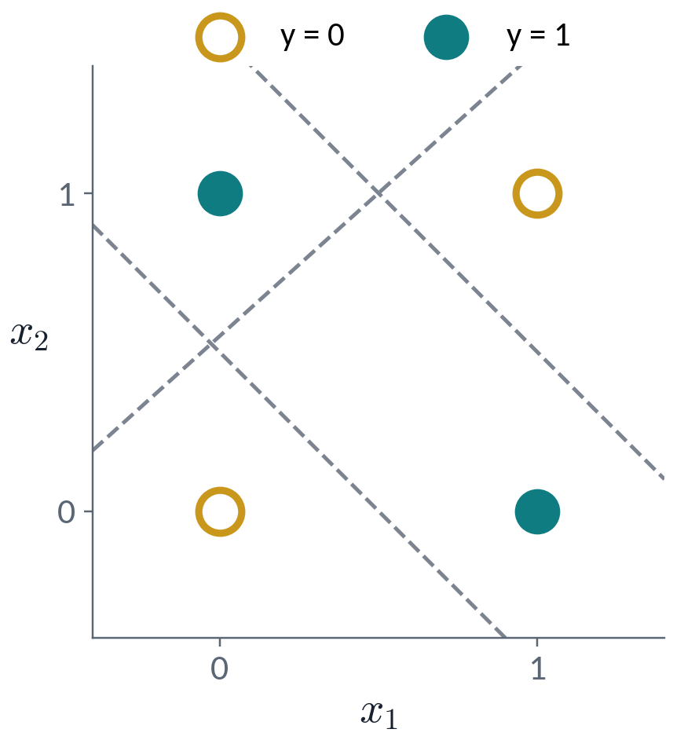


XOR: no straight line separates the classes
PART 1 · WHY NEURAL NETWORKS
PREDICT CLASS 1 WHEN THE SCORE IS POSITIVE. EACH POINT DEMANDS:
COMBINE ROWS 1 – 3
Contradiction with row 4: no such w₁, w₂, b exist.
Next → keep the straight line, change the space
Notes:
[0:12 – 0:15] SAY: Try to draw one line separating the XOR classes. You can't — and four inequalities prove it.
BACKGROUND (for you; not to read aloud):
Ask the room to draw one line with both teal points on one side and both orange points on the other (20 s). Every attempt (dashed) catches a wrong point.
Proof: predict class 1 when w₁x₁ + w₂x₂ + b > 0. Each point gives one inequality. Add the two class-1 rows and use b ≤ 0: w₁ + w₂ + b > −b ≥ 0, contradicting row 4. Minsky and Papert (1969) made limitations of this kind precise for single-layer perceptrons.
This inequality system is exactly one threshold neuron, the threshold neuron from the start of Part 1: no single perceptron computes XOR. Note the step was nonlinear all along; one unit still draws one line. The fix is more units, not a different threshold.

Slide 9
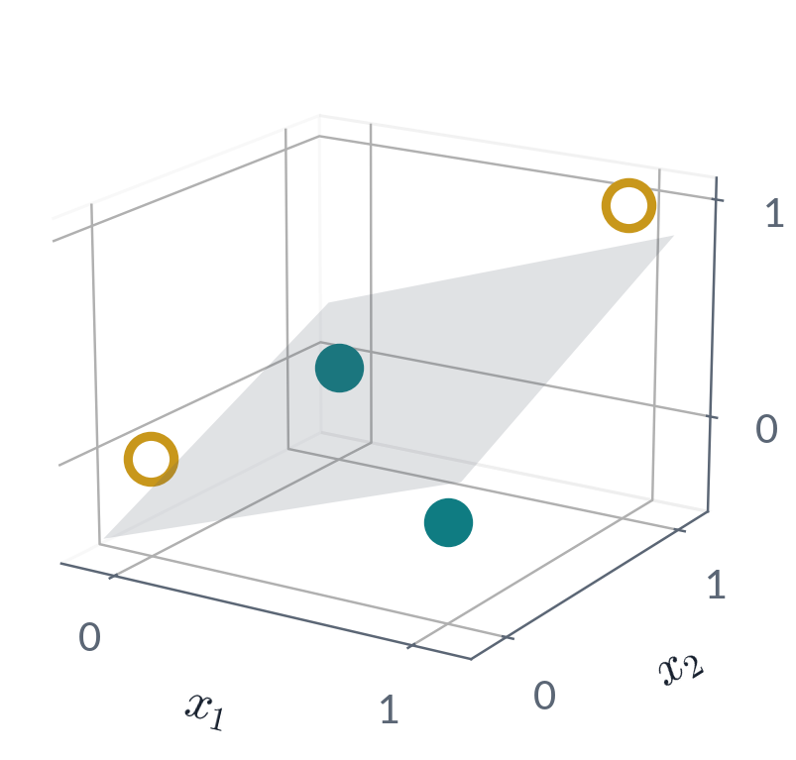

A better representation makes XOR easy
PART 1 · WHY NEURAL NETWORKS
x₁ | x₂ | x₁x₂ | y
0 | 0 | 0 | 0
0 | 1 | 0 | 1
1 | 0 | 0 | 1
1 | 1 | 1 | 0
LINEAR IN THE NEW SPACE
A hard problem in one representation can be easy in another.
Next → who designs such features? Let the network learn them
Notes:
[0:15 – 0:17] SAY: Add one feature, x₁ times x₂, and XOR becomes linear. The data didn't change; the representation did.
BACKGROUND (for you; not to read aloud):
Add one feature, the product x₁x₂. In the new 3-D space the four points ARE linearly separable (grey plane), and y = x₁ + x₂ − 2x₁x₂ exactly. The data did not change; the representation did. This is the central idea of the field. Note: in the original (x₁, x₂) plane this linear model’s boundary x₁ + x₂ − 2x₁x₂ = ½ is equivalent to (x₁ − ½)(x₂ − ½) = 0: the two crossing lines x₁ = ½ and x₂ = ½ (a degenerate hyperbola), not a single straight line — which is why the two-moons slide says “on raw inputs”.
Kernel methods (e.g. an RBF-kernel SVM) do this implicitly. The next slide asks the obvious question: who designs the features?

Slide 10
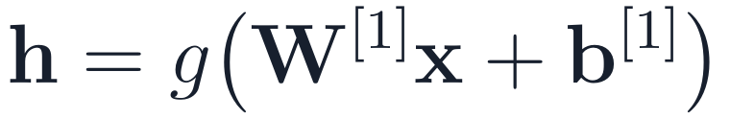
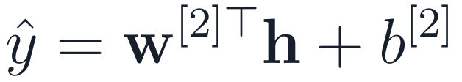
The neural-network idea: learn the features too
PART 1 · WHY NEURAL NETWORKS
Learned feature extractor
Linear model on top
x
ŷ
both trained together by gradient descent on one loss
1
Task-driven
2
Reusable
3
Composable
Shaped by the loss you care about, not by an expert's guess.
Edge and texture detectors transfer across vision tasks.
Layer 2 builds on layer 1: this hierarchy is what “deep” means.
Next → why g must sit between the layers
Notes:
[0:17 – 0:19] SAY: Hand-designing features doesn't scale. A neural network learns the features and the linear model together, by gradient descent on one loss.
BACKGROUND (for you; not to read aloud):
Hand-designing features breaks down at scale: you must already know the answer (which function of 224×224×3 = 150,528 pixels means "cat"?); candidate features explode (all degree-3 products of 1,000 inputs ≈ 1,000³/6 ≈ 1.7×10⁸); and features designed for one task rarely transfer.
So give the feature map its own parameters and learn them together with the linear model, by gradient descent on one loss. h is a learned representation of x; g is a nonlinear function applied elementwise; which one, and why it is needed at all, comes in the next few slides.
Three consequences: features are shaped by the loss we care about; early features (edges, textures) are reusable across tasks — transfer learning; and layers compose, which is what "deep" means.

Slide 11

Without a nonlinearity, depth collapses to one layer
PART 1 · ACTIVATIONS
x
W^{[1]}
W^{[2]}
W^{[3]}
ŷ
≡
x
W′
ŷ
three linear layers, no activation (biases omitted)
one linear layer
SUBSTITUTE UPWARD
Depth only pays off with a nonlinearity g between the layers.
Next → Quick check 1
Notes:
[0:19 – 0:21] SAY: Without a nonlinearity, stacking layers buys nothing: three linear layers multiply into one.
BACKGROUND (for you; not to read aloud):
The threshold neuron already used a nonlinearity; now see why one must sit between every pair of layers. Substitute each linear layer into the next: one matrix times x plus one bias. Ten linear layers equal one linear layer and still cannot do XOR. Worse, rank(W[3]W[2]W[1]) ≤ the smallest factor's rank, so a narrow middle layer can only restrict the map.

Slide 12
Quick check 1
PART 1 · QUICK CHECK
A 5-layer network uses g(z) = z (identity) in every hidden layer and a sigmoid on the output. Which decision boundaries can it draw?
Any smooth curve
Piecewise-linear curves
A
B
Only a straight line (a hyperplane)
It depends on the layer widths
C
D
Vote silently → convince your neighbour → revote. Answers: appendix.
Next → which g? Sigmoid, tanh or ReLU
Notes:
[0:21 – 0:25] SAY: Vote silently, discuss with a neighbour, revote.
BACKGROUND (for you; not to read aloud):
Peer instruction: everyone votes A–D silently (fingers or clicker); if votes split, give 60 s to convince a neighbour, then revote, then explain (about 4 minutes in all).
Answer: C. The hidden layers compose into one affine map, z = W′x + b′. The sigmoid is monotone, so ŷ > 0.5 exactly when z > 0: the boundary is still a hyperplane, whatever the width or depth. A nonlinearity on the output alone does not bend the boundary.
Distractor A catches students who think the output sigmoid adds curvature; B is the answer for ReLU networks (coming up), a good misconception to surface.

Slide 13
Sigmoid and tanh saturate; ReLU does not for z > 0
PART 1 · ACTIVATIONS
Saturation kills gradients
ReLU: slope 1 when active
Dying ReLU
σ′ ≤ 0.25, and σ′(6) ≈ 0.0025: ten sigmoid layers give ≤ 0.25¹⁰ ≈ 10⁻⁶ from σ′ alone.
The activation doesn't shrink the gradient (weights still can); cheap and sparse.
Negative on every input: zero gradient, and it may stay off for good.
Next → two ReLU units are enough to solve XOR
Notes:
[0:25 – 0:28] SAY: Sigmoid and tanh flatten out, so their slopes vanish; ReLU has slope 1 whenever it is on. The price: a unit that is always off stops learning.
BACKGROUND (for you; not to read aloud):
Left: the functions; right: their derivatives — what backpropagation multiplies, one factor per layer.
Sigmoid's slope never exceeds 0.25 and is below 0.007 for |z| > 5. Through ten sigmoid layers the activation-derivative factors alone contribute at most 0.25¹⁰ ≈ 10⁻⁶. (The weights also enter the product and could amplify it; large weights, however, push sigmoids deeper into saturation. Part 3 treats this properly.) tanh(z) = 2σ(2z) − 1 is zero-centred with slope up to 1, but its tails still saturate.
ReLU's slope is exactly 1 whenever the unit is active, so the activation itself does not shrink the gradient (the weight matrices still scale it); it is also cheap and sparse. For z < 0 its slope is exactly 0, a one-sided saturation, which is where dying ReLU comes from. Together with better initialization, GPUs and more data, it is a large part of why deep nets became trainable around 2010–2012 (Glorot et al., 2011; Krizhevsky et al., 2012). Cost: a unit whose input is negative for every example outputs 0 and receives zero gradient through that activation, so it may stay inactive for good ("dying ReLU"; for first-layer units with fixed inputs it is permanent), typically after too large a learning rate.

Slide 14
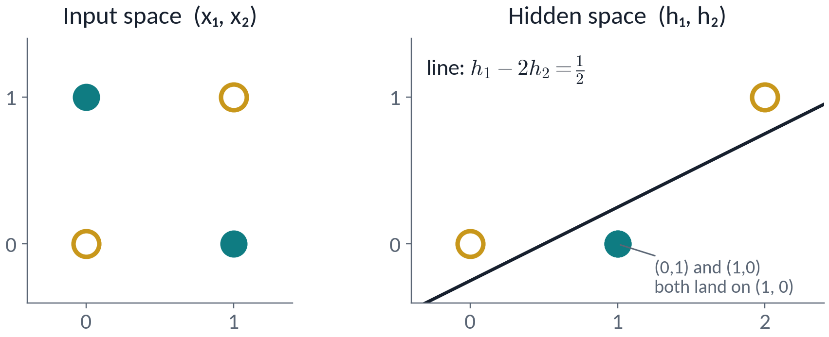

Two ReLU units solve XOR by remapping the space
PART 1 · ACTIVATIONS
bias 0
x₁
h₁
+1
y
x₂
h₂
−2
bias −1
all input weights = 1
The hidden layer makes the classes linearly separable; the output neuron just draws the line.
Next → the same rule, for any number of layers
Notes:
[0:28 – 0:30] SAY: Two ReLU units solve XOR. The hidden layer moves the points so that one straight line separates them.
BACKGROUND (for you; not to read aloud):
Now that ReLU is defined, return to XOR. Trace it. h₁ = ReLU(x₁ + x₂) behaves like OR; h₂ = ReLU(x₁ + x₂ − 1) like AND; y = h₁ − 2h₂ = OR − 2·AND equals XOR on the four corners. Table: (0,0)→0, (0,1)→1, (1,0)→1, (1,1)→2 − 2 = 0.
The figure is the insight: the hidden layer sends (0,1) and (1,0) to the SAME hidden point (1,0) and (1,1) to (2,1). In hidden space one straight line separates the classes. The output neuron is still linear; the hidden layer changed the representation.
Gradient descent need not find this particular OR/AND decomposition — many weight settings solve XOR, e.g. ReLU(x₁ − x₂) + ReLU(x₂ − x₁) = |x₁ − x₂|.

Slide 15
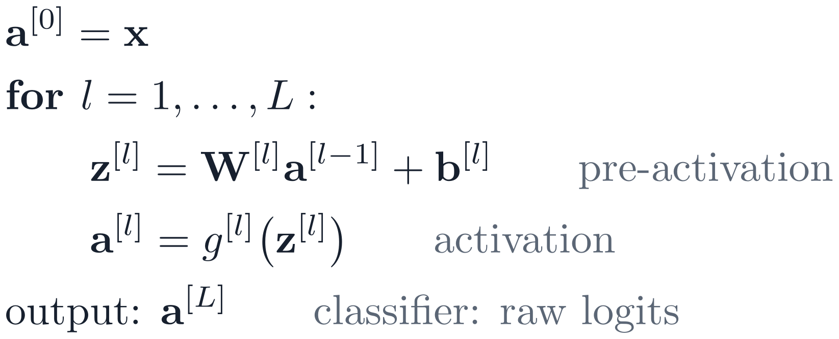


The forward pass repeats one rule per layer
PART 1 · THE MLP
W^{[1]}
W^{[2]}
W^{[3]}
FORWARD PASS, ONE EXAMPLE
SHAPE CHECK
a^{[0]}
a^{[1]}
a^{[2]}
a^{[3]}
= x
= logits
Next → a real network of this kind: our Fashion-MNIST MLP
Notes:
[0:30 – 0:32] SAY: Any depth is the same two lines per layer: weighted sum, then activation. For a classifier the output is a vector of raw scores called logits. Check shapes: W has one row per unit.
BACKGROUND (for you; not to read aloud):
Bridge: the XOR network had one hidden layer; the same rule repeats for any depth. A multi-layer perceptron stacks fully connected layers, each followed by a nonlinearity. Layer 0 is the input and has no parameters, so this network has L = 3 layers. Each layer computes a pre-activation z = Wa + b and an activation a = g(z). For a classifier the last layer has no activation (g[L] = identity), so the output a[L] = z[L] is the vector of raw logits; the probabilities ŷ = softmax(a[L]) are computed inside the loss (Part 2). For regression, the output a[L] is the prediction ŷ itself. Everything else today is choosing g, measuring the error, or differentiating it.
Shapes: row i of W[l] holds unit i's weights, one per unit of layer l−1, so W[l] has shape (n[l], n[l−1]). When shapes confuse you, write down what one row means, then count.

Slide 16
Running example: a 784–128–64–10 MLP
PART 1 · RUNNING EXAMPLE
Input batch
(128, 1, 28, 28)
Flatten
(128, 784)
Linear + ReLU
(128, 128)
70,000 images · 28 × 28 grey · 10 classes
Linear + ReLU
(128, 64)
train 55,000 · validation 5,000 · test 10,000
To beat (test): k-NN 85.3% · random forest 87.5%
Linear → logits
(128, 10)
Predict: what is the shape of W[1]? Answer on the next slide.
The batch dimension (128) never changes.
Next → the same network, written as pseudocode
Notes:
[0:32 – 0:34] SAY: Our running example: 28×28 images flattened to 784 numbers, then 128, 64 and 10 units. The batch dimension never changes.
BACKGROUND (for you; not to read aloud):
Fashion-MNIST (Xiao, Rasul & Vollgraf, 2017): 70,000 grey-scale 28×28 images of clothing in 10 classes, a drop-in replacement for MNIST that is harder to solve. We hold out 5,000 of the 60,000 training images for validation.
Read the shapes top to bottom, for a batch of 128. The batch dimension never changes: if it does, a reshape is wrong. The output is 10 raw logits per image; softmax lives inside the loss.
Prediction prompt (was Quick check 2): ask for the shape of W[1] before advancing; take a show of hands for (784, 128) vs (128, 784). The next slide reveals (128, 784): one row per unit. (784, 128) is the most common wrong answer.
Baselines to beat (on the slide): the classical methods students already know, on the same 55,000 training / 10,000 test images: k-NN 85.3% (k = 3, chosen on validation) and a 100-tree random forest 87.5% (3 seeds: 87.46, 87.60, 87.46%), from classical_baselines.py on raw pixels in [0, 1]. Payoff on slide 50 (notes): the full-data MLP reaches 88.3 ± 0.5% — roughly a tie with the forest (0.8 pp; the MLP’s 3-seed SD is 0.5 and the scripts use different validation splits). Say it honestly: on small grey images a plain MLP is not much better than a forest; convolutional networks, later in the course, are where deep learning pulls clearly ahead.
For this audience: a batch is a group of examples processed together in one step; mini-batches are explained on slide 25.

Slide 17
In pseudocode: a stack of layers that returns logits
PART 1 · RUNNING EXAMPLE
model = these layers, one after another:
flatten # (B,1,28,28) → (B,784)
linear 784 → 128, ReLU
linear 128 → 64, ReLU
linear 64 → 10 # raw logits, no softmax
x = 128 images # (128, 1, 28, 28)
logits = model(x) # (128, 10)
parameters = Σ over layers (n[l]·n[l−1] + n[l])
= 100,480 + 8,256 + 650
= 109,386
92%
of 109,386 parameters are in layer 1
Answer: W[1] is (128, 784), one row per unit. A batch stores examples as rows, so a layer computes X Wᵀ + b.
Next → Part 2: how does this network learn?
Notes:
[0:34 – 0:36] SAY: The same network in pseudocode. It ends in raw logits. 92% of its 109,386 parameters sit in the first layer.
BACKGROUND (for you; not to read aloud):
Framework-neutral pseudocode. The model is a stack of layers that ends in raw logits — no softmax; the loss applies it (Part 2).
Reveal the prediction from the previous slide: W[1] has shape (128, 784). A batch stores examples as rows, so each layer computes X Wᵀ + b with W of shape (out, in): the same W as in the maths (one row per unit), applied to a batch.
Parameters: each layer has n[l]·n[l−1] weights plus n[l] biases: 100,480 + 8,256 + 650 = 109,386. Layer 1 holds 92% because the 784-pixel input is fully connected — the seed of the case for convolutional networks.
PyTorch session preview: nn.Linear(784, 128).weight has shape (128, 784). nn.Sequential(nn.Flatten(), nn.Linear(784, 128), nn.ReLU(), …); nn.Linear(in, out) stores its weight as (out, in) and computes x @ W.T + b; count parameters with sum(p.numel() for p in model.parameters()); call model(x), not model.forward(x).

Slide 18
How a network learns
PART 2 · 0:36 – 1:43, BREAK AT 1:04
How do we turn “wrong” into a number?
Which way, and how far, should the weights move?
How do we get every gradient at once?
What do real training curves tell us?
Notes:
[0:36] SAY: Part 2: how the network learns — a loss, a direction and step size, and an efficient way to get every gradient.
BACKGROUND: Bridge: Part 1 built the forward pass of our running example. Now the network learns: choose a loss, step downhill with gradient descent, get the gradients it needs from backpropagation, and read the curves of our running example.

Slide 19

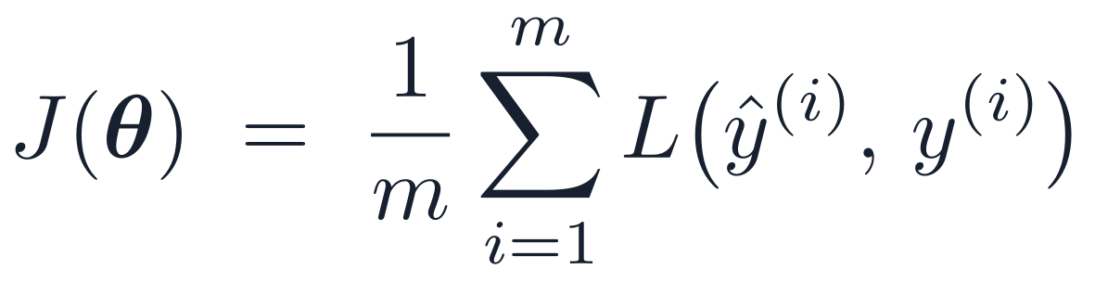
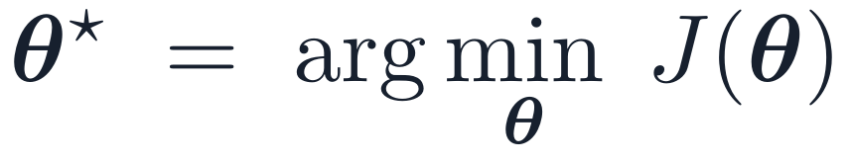
A loss is one number, and it has a slope
PART 2 · LOSSES
INPUT x
NETWORK
PREDICTION ŷ
P(sneaker) = 0.70
LOSS
ONE NUMBER
f(x; θ)
L(ŷ, y)
0.36
TARGET y
sneaker
109,386 parameters θ
compares the two
= −log 0.70
Loss: smooth; its slope tells
which way is downhill
TRAINING = MINIMIZING THE AVERAGE LOSS
Error rate: flat between jumps,
slope 0, so no direction
The data are fixed, so J is a function of the 109,386 parameters θ alone.
Accuracy is flat almost everywhere, so train on the loss; report accuracy, the thing we care about.
Next → which loss? Most losses are negative log-likelihoods
Notes:
[0:36 – 0:39] PROVENANCE: COMPUTED · 10 points, one sigmoid neuron, one weight swept
SAY: A loss compares the prediction with the label and returns one number: the sneaker got probability 0.70, so the loss is −log 0.70 = 0.36. Averaged over the training set it is the cost J, a function of the parameters alone. Why not just maximize accuracy? Because accuracy is flat: nudge a weight and almost no prediction flips. The loss changes smoothly, so its slope tells us which way to move.
BACKGROUND (for you; not to read aloud):
Top row, left to right, with the running example: a sneaker image goes through the network (all 109,386 parameters θ). The network outputs 10 raw logits; softmax turns them into probabilities ŷ (in code this happens inside the loss). With P(sneaker) = 0.70 the cross-entropy is −ln 0.70 = 0.357 ≈ 0.36. Cross-entropy approaches 0 as the true-class probability approaches 1 and grows without bound as it goes to 0. Logs are natural logs throughout.
Vocabulary: L(ŷ, y) is the per-example loss; J(θ) = (1/m) Σ L is the average over m examples, called the cost or objective (loosely also “the loss”). The data are fixed, so J is a function of θ only; training means θ* = argmin J.
The chart is computed, not sketched: one sigmoid neuron ŷ = σ(w·x + b) with b = −0.6 fixed, on 10 one-dimensional points x = (−2, −1.5, −1, −0.6, −0.3, 0.1, 0.4, 0.8, 1.3, 1.9) with labels y = (0, 0, 0, 1, 0, 0, 1, 1, 1, 1); no threshold separates them. Predict 1 when w·x + b > 0. Loss = mean binary cross-entropy. We sweep w from 0 to 4. The error rate (red) is a staircase 0.5 → 0.4 → 0.3 → 0.2 → 0.1, with jumps at w ≈ 0.32, 0.46, 0.75 and 1.5. Between jumps it is exactly flat, so its derivative is 0; gradient descent on it would never move.
The cross-entropy (teal) is smooth: it falls from 0.74 at w = 0 to a minimum of 0.39 near w = 2.48. It keeps decreasing on the flat stretch of the error rate because correct predictions become more confident; past the minimum it rises because the misclassified point (x = −0.6) becomes more confidently wrong. We train on the loss and report accuracy on validation and test data.
Next: which loss to choose. For most tasks it follows from a probability model of the targets — the negative log-likelihood.

Slide 20
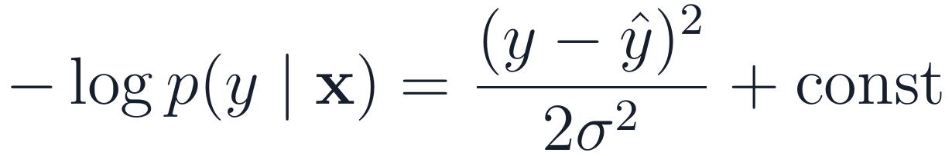

Most losses are negative log-likelihoods
PART 2 · LOSSES
Task
Target model
Negative log-likelihood
In pseudocode
Regression
y = f(x) + Gaussian noise
mse(ŷ, y)
Binary
Bernoulli, ŷ = σ(z)
bce_with_logits(z, y)
Multi-class
Categorical, ŷ = softmax(z)
cross_entropy(z, y)
Maximizing likelihood = minimizing NLL. With σ fixed, Gaussian noise gives squared error. Classification losses take raw logits z = a[L].
Next → many classes: softmax, and a check for step 0
Notes:
[0:39 – 0:42] SAY: A loss is a negative log-likelihood. Gaussian noise gives squared error; a yes/no label gives binary cross-entropy; many classes give cross-entropy.
BACKGROUND (for you; not to read aloud):
A loss turns "prediction and target disagree" into one number. For most tasks it follows from a probabilistic assumption about the targets.
Regression, derived on the slide (objective 3): y = f(x) + Gaussian noise of variance σ², so p(y | x) = N(y; ŷ, σ²) and −log p(y | x) = (y − ŷ)²/2σ² + ½ log(2πσ²). With σ fixed the constant drops out, so maximizing likelihood = minimizing squared error; the familiar ½(ŷ − y)² is this term with σ = 1. Ask students to do this line themselves (20 s): they have the probability for it. A typical mse function computes the mean of (ŷ − y)², without the ½: the factor only rescales the gradient, i.e. the effective learning rate. That also tells you when MSE is wrong: heavy-tailed noise → Huber loss; counts → Poisson loss.
Binary: a Bernoulli label with probability ŷ = σ(z); the NLL is binary cross-entropy. Multi-class: a categorical label via softmax; the NLL is cross-entropy, −log of the probability of the true class c.
Here z = z[L] = a[L], the network’s raw logits. The classification losses take these raw logits and apply sigmoid/softmax internally. PyTorch session preview: nn.MSELoss, nn.BCEWithLogitsLoss, nn.CrossEntropyLoss. We average over the batch, J = (1/m)Σ L, so the gradient scale does not depend on batch size.

Slide 21

Softmax, and the first-loss sanity check
PART 2 · LOSSES
SANITY CHECK ON STEP 0
softmax
Running example, first loss: 2.63 (2.6–3.0 over 3 seeds; He init).
First loss ≫ ln K (say 10–15)? Logit differences are huge: check input scaling, initialization and labels.
−log 0.9 = 0.105 · −log 0.5 = 0.693 · −log 0.01 = 4.61
Next → why not just use squared error?
Notes:
[0:42 – 0:44] PROVENANCE: EXPERIMENT · 3 SEEDS · fmnist_experiments.py
SAY: Softmax turns logits into probabilities. Sanity check: an untrained 10-class model should start near ln 10 ≈ 2.3.
BACKGROUND (for you; not to read aloud):
Softmax exponentiates and normalizes K logits: outputs are positive and sum to 1; every output depends on every logit; and softmax(z + c) = softmax(z) (shift invariance), which makes the stable implementation possible.
Cross-entropy with a one-hot target is −log of the true-class probability: 0.9 → 0.105, 0.5 → 0.693, 0.01 → 4.61.
Sanity check: if a fresh model's logits are near zero, every class gets ≈ 1/K and the first loss is ≈ ln K (2.30 for 10 classes). Standard initializations give logits of order 1, so the first loss is typically somewhat above ln K: our running example started at 2.63 (2.63–3.02 across three seeds). A first loss of 10 or 15 means the logits differ hugely (softmax ignores a constant shift, so only differences matter): check input standardization, initialization and labels. (Karpathy's recipe suggests initializing the last layer so the first loss is ≈ ln K.)

Slide 22


Cross-entropy keeps learning when MSE stalls
PART 2 · LOSSES
MSE ON A SIGMOID
σ(z) = 0.0001, y = 1 → ∂L/∂z ≈ −0.0001
CROSS-ENTROPY ON A SIGMOID
same case → ∂L/∂z ≈ −1
Use cross-entropy for classification: its gradient w.r.t. the logit is largest when the model is confidently wrong.
Next → Quick check 2: a common softmax bug
Notes:
[0:44 – 0:46] SAY: Why not squared error for classification? On a sigmoid it stops learning exactly when the model is confidently wrong. Cross-entropy doesn't.
BACKGROUND (for you; not to read aloud):
With MSE on a sigmoid output, ∂L/∂z carries a factor σ′(z) (orange). If the truth is 1 and the model confidently predicts 0.0001, the error is large but σ′ ≈ 0.0001, so learning stalls exactly when the model is most wrong (left of the chart). With cross-entropy the σ′ cancels against the derivative of the log, leaving σ(z) − y: full strength when needed. The same cancellation for softmax + cross-entropy gives ŷ − y. Students will see this cancellation again in the worked backprop example (δ₂ = a₂ − y).
Two further reasons: class labels are not "real values plus Gaussian noise" (wrong likelihood), and for a single neuron MSE∘sigmoid is non-convex in w while cross-entropy∘sigmoid is convex.

Slide 23
Quick check 2
PART 2 · QUICK CHECK
Training loss stalls near 1.6 while validation accuracy is about 85%. The model ends in a softmax layer whose output goes to cross_entropy(·, y). Which change fixes it?
Remove the final softmax; pass raw logits
Raise the learning rate
A
B
Train for more epochs
Convert the labels to one-hot
C
D
Vote silently → convince your neighbour → revote. Answers: appendix.
Next → what this bug does to our running example
Notes:
[0:46 – 0:50] SAY: Vote silently, discuss with a neighbour, revote — don't advance until the revote.
BACKGROUND (for you; not to read aloud):
Peer instruction: everyone votes A–D silently; if votes split, about 2 minutes with a neighbour, then revote, then 1 minute of explanation. Do not advance until the revote: the next slide reveals the answer.
Answer: A. cross_entropy applies log-softmax itself, so a softmax layer at the end of the model applies softmax twice. Removing it fixes the bug. The stem deliberately does not say that the loss applies softmax: students must know it.
Distractors: B and C treat the plateau as an optimization problem (a classic misreading); D confuses target formats (integer class indices are fine). For K = 10, the redundant softmax imposes a loss floor ln(K − 1 + e) − 1 ≈ 1.46, which is why the loss stalls near 1.6. PyTorch session preview: nn.CrossEntropyLoss expects raw logits.

Slide 24


Pass raw logits to the loss: softmax twice fails silently
PART 2 · LOSSES
WITH THE BUG, FOR K CLASSES
Validation accuracy 82–88% across 3 seeds (vs ≈ 89% without the bug), yet ≈ 99% confident: easy to miss.
INSIDE THE FUSED LOSS: LOG-SUM-EXP
End the model in raw logits; the cross-entropy loss applies log-softmax once.
Next → model and loss are set; now feed it data in mini-batches
Notes:
[0:50 – 0:52] PROVENANCE: EXPERIMENT · 3 SEEDS · fmnist_experiments.py
SAY: Applying softmax twice raises no error, but the loss can't go below 1.46 and the probabilities are wrong. End the model in raw logits.
BACKGROUND (for you; not to read aloud):
Reveal for Quick check 2. Runs of our running example (fmnist_experiments.py, 3 seeds): identical model, data and optimizer; the only difference is a softmax at the end of the model. The bug raises no error; the loss simply cannot go below ln(K − 1 + e) − 1 ≈ 1.46 because the loss applies log-softmax to inputs that are already in (0, 1). The dashed grey line is that floor; the buggy run levels off just above it, near 1.63. Final training loss 1.56–1.63 vs ≈ 0.14; validation accuracy 81.7–87.9% vs 88.7–89.7% — in the best seed close enough that nobody notices, and the probabilities it outputs are badly miscalibrated — measured (calibration_check.py, 15-bin expected calibration error on validation): ECE 0.11–0.17 with the bug vs 0.04–0.05 without; the buggy model reports 98.5–98.9% mean confidence while being 82–88% accurate. Why: with softmax applied twice, the loss is no longer a proper scoring rule for the reported probabilities, so it keeps rewarding more confidence. Even the correct model is slightly overconfident (94% confidence, 89–90% accuracy).
Why fused losses: in float32, e^1000 overflows to inf. A fused cross-entropy loss subtracts the maximum logit first (valid by shift invariance), so every exponent is ≤ 0 and one term equals exactly 1. Targets: integer class indices of shape (m,), or class probabilities of shape (m, K). Full target-format table: appendix.
Bridge: model and loss are set; before stepping downhill, decide how data reach the model (mini-batches).

Slide 25

Feeding the network: standardize, then mini-batches
PART 2 · DATA
STANDARDIZE WITH TRAINING STATISTICS
Batch | Full | Mini | Single
Gradient | exact | good | noisy
Hardware | costly | best | poor
Verdict | rare | use this | rare
Never compute μ, σ on validation or test data: that leaks information.
each epoch: shuffle the 55,000 training examples,
cut them into mini-batches of 128
→ 430 updates per epoch
validation: batches of 512, no shuffle, no updates
gradient noise ∝ 1/√m
m = batch size. Epoch: one pass over the data; iteration: one update.
Stochastic gradient descent (SGD) = gradient descent on mini-batches: noisy but cheap steps, 430 per epoch.
Next → step downhill: gradient descent, and how big a step
Notes:
[0:52 – 0:54] SAY: Standardize with training statistics only, then feed mini-batches: 430 updates per epoch. Each step uses a noisy but cheap gradient — that is stochastic gradient descent, SGD (bottom of the slide).
BACKGROUND (for you; not to read aloud):
Bridge: one gradient step on all 55,000 images is slow, so we use mini-batches. Moved before the gradient-descent slides so that “SGD” is defined before it is used. The train/validation/test bar was removed from the slide (students know splits); say one sentence: three splits: train (fit), validation (choose hyperparameters and the checkpoint), test (touch once, at the end). Parameters (W, b) are learned by gradient descent on the training split; hyperparameters (η, batch size, epochs, layer sizes) are values you set, chosen on the validation split. Standardize inputs with statistics computed on the TRAINING split only — using validation or test statistics leaks information.
Mini-batches of 32–512 examples are what everyone uses. The standard deviation of the gradient noise falls only as 1/√m (its variance as 1/m): 100× the batch buys 10× less noise. Epoch = one pass over the training data; iteration = one update: 55,000 images with batch 128 → 430 iterations per epoch. Shuffle the training set every epoch; evaluation needs no shuffling. Full-batch gradients are exact but rarely fit in memory for real datasets; single examples waste the GPU's parallelism.

Slide 26



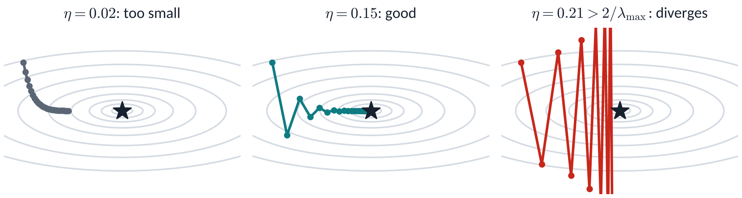
Gradient descent: the sharpest direction caps η
PART 2 · GRADIENT DESCENT
UPDATE RULE
WHY: FIRST-ORDER TAYLOR
STABILITY ON A BOWL
Computed on J = ½(θ₁² + 10θ₂²): the largest curvature is 10, so η must stay below 0.2.
Next → a ravine: one η cannot suit every direction
Notes:
[0:54 – 0:57] PROVENANCE: COMPUTED · small_figures.py
SAY: Gradient descent steps against the gradient. The steepest direction limits the step size: here η must stay below 0.2.
BACKGROUND (for you; not to read aloud):
Bridge from the loss slides: model and loss are fixed, so now minimize. First decide what to do with a gradient; then (next slides) how to compute it cheaply. Why the negative gradient? A first-order Taylor expansion says the change in loss is ∇Jᵀ Δθ, most negative for a step opposite the gradient — valid only for SMALL steps.
The panels are computed (small_figures.py) on J = ½(θ₁² + 10θ₂²): curvatures 1 and 10. On J = ½λθ² the update θ ← (1 − ηλ)θ converges only if η < 2/λ. In a network λ is the largest Hessian eigenvalue, so the SHARPEST direction caps η for every direction: here 2/10 = 0.2, and η = 0.21 diverges. That mismatch is ill-conditioning, attacked by momentum and Adam on the next slides.
Learning-rate symptoms: nan within a few steps → far too large; oscillating or plateauing high → too large; steady fall then flattening → good; glacial → too small. Starting points: AdamW 3×10⁻⁴; SGD + momentum 0.9 at 0.1 for CNNs with batch normalization at batch 256. Tune with a learning-rate range test (Smith, 2017).
Caveat for curious students: in real networks the η < 2/λ_max rule is a local, quadratic picture. Full-batch gradient descent typically drives the sharpness up to about 2/η and keeps reducing the loss, non-monotonically — the 'edge of stability' (Cohen et al., ICLR 2021).
Bridge: next, a ravine — a bowl far steeper in one direction than another.

Slide 27

Ravines defeat plain GD; momentum and Adam help
PART 2 · OPTIMIZERS
GD
GD + momentum (β = 0.9)
Adam
Rotated ravine (curvatures 1 and 25), learning rates tuned per optimizer. A 2-D toy: rankings on real networks vary.
GD
GD + momentum
Adam
One η for every direction: bounces across, creeps along.
v ← βv + g, θ ← θ − ηv: oscillations cancel, speed builds.
Divides each coordinate by its gradient RMS: steps of roughly size η.
loss after 40 steps: 8.6e-3
loss after 40 steps: 5.8e-3
loss after 40 steps: 6.9e-4
Next → Quick check 3: how large can η be here?
Notes:
[0:57 – 1:00] PROVENANCE: COMPUTED · TUNED STEP SIZES · small_figures.py
SAY: In a ravine one step size can't suit both directions. Momentum averages out the bouncing; Adam rescales each parameter's step. A toy — rankings on real networks vary.
BACKGROUND (for you; not to read aloud):
These runs are full-batch and deterministic, so the panels say GD, not SGD (SGD means mini-batch gradients). A ravine is steep across and gentle along. The gradient is dominated by the steep direction, so plain gradient descent (GD) bounces between the walls and crawls along the floor: raise η and it diverges, lower it and progress stops. This is ill-conditioning (curvature ratio 25 here).
Fair comparison: computed runs, 40 steps each, on a ravine ROTATED by 30° (so it is not aligned with the coordinates, which would unfairly favour Adam's per-coordinate scaling), with each optimizer's learning rate TUNED by grid search for the lowest final loss. Final losses: GD 8.6e-3 (η = 0.075), momentum 5.8e-3 (η = 0.016), Adam 6.9e-4 (η = 0.32); small_figures.py. A 2-D toy only: rankings on real networks depend on the problem and on tuning.
Momentum keeps a decaying sum of gradients: oscillating components cancel, consistent ones add up; with constant gradient the velocity tends to g/(1 − β) = 10g for β = 0.9 — so along a consistent direction its steps are up to 10× larger than plain GD with the same η. Retune η when you switch; there is no fixed conversion factor (Quick check 3 notes give the exact limit on a quadratic). Adam rescales each coordinate by a running RMS of its own gradients.
Why Adam wins on this toy: the ravine is rotated, so Adam's per-coordinate scaling cannot line up with its axes. One plausible reason is its normalized, near-constant-size steps with its own tuned η, but Adam also has momentum and bias correction, and this experiment does not isolate which part helps. It shows only that, tuned for this 40-step budget on this quadratic, Adam reached the lowest loss — not that Adam is generally superior, and not that it 'adapts to the curvature'.

Slide 28
Quick check 3
PART 2 · QUICK CHECK
Plain gradient descent on the ravine you just saw (curvatures 1 and 25). It converges only if the learning rate η is below:
2 / 1 = 2
1 / 25 = 0.04
A
B
No limit: the loss is convex
2 / 25 = 0.08
C
D
Vote silently → convince your neighbour → revote. Answers: appendix.
Next → 10-minute break; then: how do we get every gradient at once?
Notes:
[1:00 – 1:04] SAY: Vote, discuss, revote.
BACKGROUND (for you; not to read aloud):
Peer instruction: everyone votes A–D silently; if votes split, 60 s with a neighbour, then revote (about 2 minutes), then explain.
Answer: D. On a quadratic, gradient descent converges only if η < 2/λ_max (the gradient-descent slide). Rotating the ravine does not change its curvatures (1 and 25), so η < 2/25 = 0.08; the tuned GD rate on the ravine slide (0.075) sits just below it. At that η the gentle direction shrinks only by a factor (1 − 0.08 × 1) = 0.92 per step: the slow crawl that momentum and Adam address.
Distractors: A uses the gentle curvature; B (1/λ_max) solves the steep direction in one step but is not the stability limit; C confuses convexity (one minimum) with convergence for any step size.
For curious students: heavy-ball momentum (v ← βv + ∇J, θ ← θ − ηv) is stable on a quadratic for η < 2(1 + β)/λ_max. In real networks there is no fixed rule: retune η by experiment when you switch optimizers.
Bridge: then the 10-minute break (question on screen). Every update needs ∇J for all parameters. Adam and AdamW in full are in Appendix A6; weight decay comes in Part 3.

Slide 29
Back at 1:14
10-MINUTE BREAK
Something to think about:
A network has 10⁸ parameters. Measuring each gradient by nudging that one parameter costs one forward pass (1 ms). How long does ONE training step take? What would you do instead?
Notes:
[1:04 – 1:14] SAY: Ten-minute break. Think about the question on the screen.
BACKGROUND (for you; not to read aloud):
Break at 1:04, after Quick check 3: 64 minutes before, 76 after. Leave the question on screen; it leads straight into the first slide after the break.
Answer (open with it at 1:14): 10⁸ parameters × 1 forward pass of 1 ms each = 10⁵ s ≈ 28 hours for ONE step (twice that with centred differences). Instead, reuse the chain rule: backpropagation gets all 10⁸ gradients for about 3 forward passes.

Slide 30
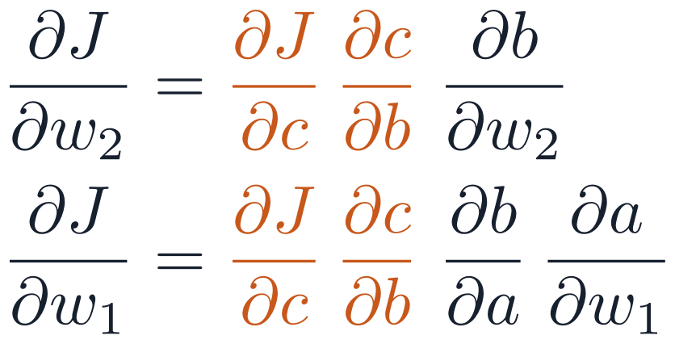

Backpropagation: all gradients for ≈ 3 forward passes
PART 2 · BACKPROPAGATION
FINITE DIFFERENCES
BACKPROPAGATION
1
It is the chain rule
10⁸
≈ 3
A value used in two places gets the sum of both gradients.
forward passes per step: one per parameter, for 10⁸ parameters
forward-pass equivalents per step (forward + backward), for all 10⁸ gradients at once
2
Reverse mode reuses work
One backward sweep: ideal for one loss, many parameters.
forward: values; each step uses a parameter wᵢ
x
w₁
a
w₂
b
w₃
c
w₄
J
3
Not the learning rule
Backprop computes gradients; SGD or Adam uses them.
backward: one sweep; the orange product is computed once and reused
Next → try it by hand on a two-neuron network
Notes:
[1:14 – 1:16] SAY: Backprop is the chain rule organized so shared products are computed once. All gradients cost about three forward passes, instead of one forward pass per parameter.
BACKGROUND (for you; not to read aloud):
Finite differences — nudge one parameter, rerun the forward pass — are a useful check but hopeless for training: 10⁸ parameters need about 10⁸ forward passes per step (2 × 10⁸ for centred differences), over a day per step at 1 ms each.
Backpropagation gets ALL gradients in one backward pass costing roughly 2× a forward pass, so a training step costs about 3 forward passes. Both headline numbers are counted in the same unit: forward passes per step.
The diagram: each step of the chain uses one parameter (w₁ … w₄). Going backward from J, the product ∂J/∂c · ∂c/∂b (orange) is computed once and reused for ∂J/∂w₂ and ∂J/∂w₁, and so on down the chain — that reuse is reverse-mode automatic differentiation. Computing each parameter’s gradient separately from the input side (forward mode) would need one sweep per parameter; with one loss and many parameters, reverse mode wins.
Branches: if a value feeds two later nodes, its gradient is the SUM of the gradients arriving from both (multivariable chain rule). Example: y = u·x with u = x gives dy/dx = x + x = 2x. Backpropagation COMPUTES gradients; an optimizer such as SGD or Adam USES them.

Slide 31

Worked example: your turn, forward pass first
PART 2 · BACKPROPAGATION
2.0
?
?
?
?
?
w₁, b₁
σ
w₂, b₂
σ
BCE
x
z₁
a₁
z₂
a₂
L
YOUR TURN · 3 MINUTES
SETUP
1. z₁ = w₁x + b₁
2. a₁ = σ(z₁) = 1 / (1 + e^(−z₁))
3. z₂ = w₂a₁ + b₂
4. a₂ = σ(z₂)
5. L = −[y ln a₂ + (1 − y) ln(1 − a₂)]
w₁ = 0.5, b₁ = 0.1, w₂ = 0.8, b₂ = −0.3
x = 2.0, y = 1.0, L = binary cross-entropy
Compute z₁, a₁, z₂, a₂ and L to four decimals. Tips: e^(−1.1) ≈ 0.3329, e^(−0.3002) ≈ 0.7407; with y = 1, L = −ln a₂.
Next → check your forward pass
Notes:
[1:16 – 1:20] SAY: Your turn: compute the forward pass with your neighbour. Three minutes.
BACKGROUND (for you; not to read aloud):
Build 1 of 4 — students compute. Give 3 minutes; pairs are fine. Two scalar neurons, both sigmoid, and binary cross-entropy — the classification loss from the cross-entropy slide. With y = 1 it is simply L = −ln a₂.
Ask for z₁, a₁, z₂, a₂ and L to four decimals. Answers on the next slide: 1.1, 0.7503, 0.3002, 0.5745, 0.5543. Common slips: forgetting b₂ = −0.3; using log base 10 instead of ln.

Slide 32
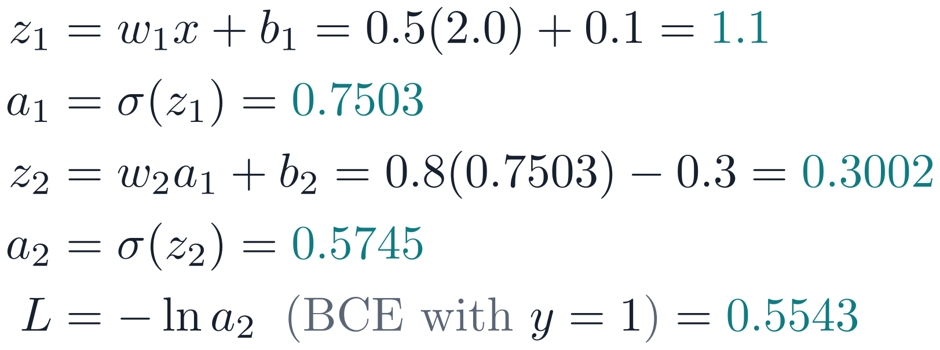
Worked example: forward, then backward, by hand
PART 2 · BACKPROPAGATION
2.0
1.1
0.7503
0.3002
0.5745
0.5543
w₁, b₁
σ
w₂, b₂
σ
BCE
x
z₁
a₁
z₂
a₂
L
FORWARD PASS
SETUP
w₁ = 0.5, b₁ = 0.1, w₂ = 0.8, b₂ = −0.3
x = 2.0, y = 1.0, L = binary cross-entropy
Check your numbers against these. Next we go backward, one local derivative at a time.
Next → now backward, one local derivative at a time
Notes:
[1:20 – 1:21] SAY: Check your numbers. We keep every value for the backward pass.
BACKGROUND: Build 2 of 4 — check the forward pass: 1.1, 0.7503, 0.3002, 0.5745, 0.5543. Ask who matched to three decimals. Keep these values: the backward pass reuses every one of them.

Slide 33
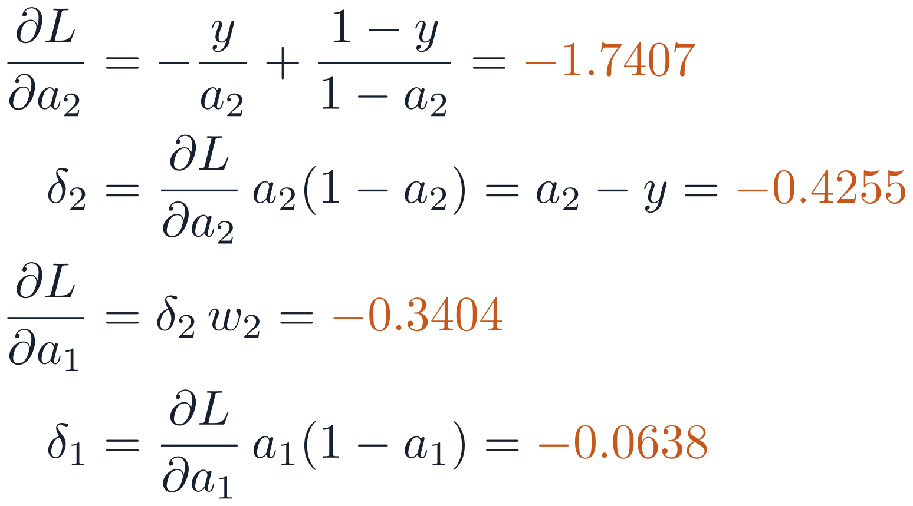

Worked example: forward, then backward, by hand
PART 2 · BACKPROPAGATION
2.0
1.1
0.7503
0.3002
0.5745
0.5543
w₁, b₁
σ
w₂, b₂
σ
BCE
x
z₁
a₁
z₂
a₂
L
δ₁ = −0.0638
−0.3404
δ₂ = −0.4255
−1.7407
ERROR SIGNALS, ONE LOCAL DERIVATIVE AT A TIME
6.7×
smaller: δ₁ vs δ₂ after ONE sigmoid layer, since w₂·σ′(z₁) = 0.8 × 0.187
Twenty such layers and almost nothing reaches the front: vanishing gradients.
Next → turn the error signals into weight gradients
Notes:
[1:21 – 1:24] SAY: Backward, one step at a time. The sigmoid's slope cancels in the output error, as on the cross-entropy slide. One sigmoid layer shrinks the error almost 7×.
BACKGROUND (for you; not to read aloud):
Build 3 of 4 — backward, one local derivative at a time. For BCE, ∂L/∂a₂ = −y/a₂ + (1 − y)/(1 − a₂) = −1/a₂ = −1.7407. Multiply by σ′(z₂) = a₂(1 − a₂) = 0.2445 to get δ₂ = a₂ − y = −0.4255: the σ′ cancels, exactly as on the cross-entropy slide. Send δ₂ back through w₂ (−0.3404) and multiply by σ′(z₁) = 0.1874 to get δ₁ = −0.0638.
δ shrank by a factor of 6.7 in ONE sigmoid layer (factor w₂·σ′(z₁) = 0.8 × 0.187): vanishing gradients in miniature. All values checked against centred finite differences.

Slide 34
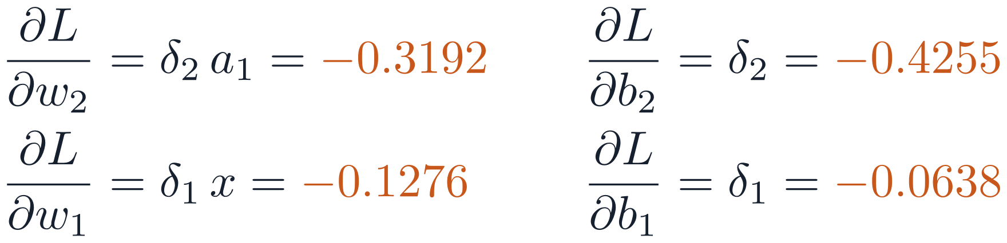

Worked example: forward, then backward, by hand
PART 2 · BACKPROPAGATION
2.0
1.1
0.7503
0.3002
0.5745
0.5543
w₁, b₁
σ
w₂, b₂
σ
BCE
x
z₁
a₁
z₂
a₂
L
δ₁ = −0.0638
−0.3404
δ₂ = −0.4255
−1.7407
PARAMETER GRADIENTS
ONE GRADIENT STEP, η = 0.5
θ ← θ − η · ∂L/∂θ
w₁ 0.5 → 0.5638
b₁ 0.1 → 0.1319
w₂ 0.8 → 0.9596
b₂ −0.3 → −0.0872
Loss 0.5543 → 0.4166
Weight: error × input
Bias: the error itself
Next → Quick check 4: what if w₂ = 0?
Notes:
[1:24 – 1:27] SAY: Weight gradient = error × input. Bias gradient = the error itself.
BACKGROUND (for you; not to read aloud):
Build 4 of 4 — parameter gradients: ∂L/∂w₂ = δ₂a₁ = −0.3192, ∂L/∂b₂ = −0.4255, ∂L/∂w₁ = δ₁x = −0.1276, ∂L/∂b₁ = −0.0638. Pattern: weight gradient = error at the weight's output × activation at its input; bias gradient = the error itself. The dark box takes one gradient step with η = 0.5: θ ← θ − η ∂L/∂θ gives w₁ 0.5638, b₁ 0.1319, w₂ 0.9596, b₂ −0.0872, and the loss falls from 0.5543 to 0.4166 (recompute the forward pass to check). This is the payoff: the gradients exist to make that number go down.
The automatic-differentiation slide (three slides on) reproduces the gradients. In code you would pass the logit z₂ to a fused bce_with_logits loss rather than computing ln a₂ yourself.

Slide 35
Quick check 4
PART 2 · QUICK CHECK
In the worked example, set w₂ = 0 (everything else unchanged). What is ∂L/∂w₁?
Exactly 0
Unchanged: −0.1276
A
B
Larger in magnitude
Undefined
C
D
Vote silently → convince your neighbour → revote. Answers: appendix.
Next → the same rules for any layer: four equations
Notes:
[1:27 – 1:31] SAY: Vote, discuss, revote.
BACKGROUND (for you; not to read aloud):
Peer instruction: everyone votes A–D silently (fingers or clicker); if votes split, give 60 s to convince a neighbour, then revote, then explain.
Answer: A. Layer 1's error arrives only through w₂: ∂L/∂a₁ = δ₂·w₂ = 0, so δ₁ = 0 and ∂L/∂w₁ = δ₁·x = 0. Vanishing gradients and dead units block learning by the same mechanism.
Placed right after the hand calculation on purpose: concrete case first, then the general rule. The next slide's BP2 sends the error back through Wᵀ — exactly the path that w₂ = 0 blocks here.

Slide 36





The four equations of backpropagation
PART 2 · BACKPROPAGATION
Output error: loss gradient × the unit's own slope (elementwise g).
BP1
Send the error back through Wᵀ, then gate by g′. Why Wᵀ: unit j feeds every unit k above, so ∂L/∂aⱼ = Σₖ Wₖⱼ δₖ.
BP2
Bias gradient = the error signal.
BP3
Weight gradient = error × input activation (outer product).
BP4
derived directly: softmax is not elementwise
Next → a computer can apply these rules for us
Notes:
[1:31 – 1:34] SAY: The same rules for any layer: four equations. The error flows back through Wᵀ and is gated by each unit's slope.
BACKGROUND (for you; not to read aloud):
The general case for a fully connected network. Define the error signal δ[l] = ∂L/∂z[l] on the PRE-activation; then the parameter gradients take one line each.
BP1: for an elementwise output activation g, each output unit's error is its loss gradient times its own slope. Softmax is NOT elementwise, so BP1 in this form does not apply to it; for softmax + cross-entropy one derives directly ∂L/∂z[L] = ŷ − y (shown on the slide as a separate line).
BP2, the transpose: unit j of layer l feeds every unit k of layer l+1, so ∂L/∂aⱼ[l] = Σₖ Wₖⱼ[l+1] δₖ[l+1]. Summing over k with j fixed walks down column j of W[l+1], which is row j of W[l+1]ᵀ. Write this index form first, then the matrix form.
BP2: z[l] affects the loss through every unit of layer l+1, so the chain rule sums over them — a product with the TRANSPOSE of the next layer's weights (forward maps n[l] → n[l+1]; backward must map n[l+1] → n[l]) — gated elementwise by g′. A saturated unit blocks its error.
BP3, BP4: ∂z/∂b = 1 gives the bias gradient; the weight gradient is the outer product of the error and the input activation — exactly the pattern from the worked example. For a batch with examples as rows, dW = Δᵀ A sums the outer products over the batch automatically.

Slide 37
Automatic differentiation runs these equations for you
PART 2 · BACKPROPAGATION
x, y = 2.0, 1.0
w1, b1, w2, b2 = 0.5, 0.1, 0.8, −0.3
# mark each one: "track gradients"
a1 = sigmoid(w1·x + b1) # every operation
a2 = sigmoid(w2·a1 + b2) # is recorded in a graph
L = −(y·ln(a2) + (1 − y)·ln(1 − a2))
backward(L) # reverse-mode autodiff:
# runs BP1–BP4 for you
grad(w1) → −0.1276 # same as by hand
grad(w2) → −0.3192
1
Gradients accumulate
So clear them before every step.
2
Activations are stored
Memory grows with batch size.
3
Evaluate without a graph
Turn off gradient tracking to save memory.
4
Same numbers as by hand
−0.1276 and −0.3192.
Next → put it all together: the training loop
Notes:
[1:34 – 1:36] SAY: Frameworks run these equations for you and reproduce our hand-computed numbers. Gradients accumulate, so clear them every step.
BACKGROUND (for you; not to read aloud):
The worked example as framework-neutral pseudocode. Marking values as “track gradients” records every operation in a graph during the forward pass; backward(L) runs reverse-mode differentiation and fills in the gradient of every tracked value. The values match the hand calculation.
Consequences: (1) gradients ACCUMULATE across backward calls — deliberately, so gradients from several small batches can be summed — hence clear them every step. (2) BP4 needs forward activations, so they are stored until backward: memory grows with batch size; running out of memory during backward is fixed first by a smaller batch. (3) For evaluation, turn gradient tracking off: no graph, no stored activations. (4) Gradient checkpointing (Chen et al., 2016) recomputes activations instead of storing them, costing roughly one extra forward pass. Implementing a gradient by hand? Verify it with centred differences (appendix).
PyTorch session preview: requires_grad=True, L.backward(), w1.grad, optimizer.zero_grad(), torch.no_grad() / torch.inference_mode().

Slide 38
The training loop: five steps, every mini-batch
PART 2 · GRADIENT DESCENT
for each epoch:
set training mode # dropout on (Part 3)
for each mini-batch (x, y):
clear old gradients # 1 clear old ∇
logits = model(x) # 2 forward
loss = loss_fn(logits, y) # 3 loss
backward(loss) # 4 backprop
θ ← θ − η∇J # 5 update
set evaluation mode # dropout off
without gradient tracking:
val_loss = evaluate(model, val_batches)
1 clear ∇
5 update
2 forward
every
mini-batch
4 backward
3 loss
Training mode to learn; evaluation mode, no gradient tracking, to validate.
Next → run it on our running example
Notes:
[1:36 – 1:38] SAY: Every mini-batch: clear, forward, loss, backward, update. Commit it to memory.
BACKGROUND (for you; not to read aloud):
Framework-neutral pseudocode. Every training loop: clear old gradients, forward, loss, backward, update. Around it: training mode before training (dropout on; batch normalization uses batch statistics — dropout comes in Part 3, batch normalization in Appendix B); evaluation mode and no gradient tracking for validation. Commit it to memory.
PyTorch session preview: model.train(), optimizer.zero_grad(), loss.backward(), optimizer.step(), model.eval(), torch.no_grad(), DataLoader.

Slide 39
Running example: training curves after 20 epochs
PART 2 · RUNNING EXAMPLE
Val loss is best at epoch 5 (other seeds: 15 and 9), yet val accuracy still creeps up: the model grows over-confident. Keep the checkpoint that is best on the metric you care about, and compare seeds: one run can mislead.
Next → Part 3: making deep networks train and generalize
Notes:
[1:38 – 1:43] PROVENANCE: EXPERIMENT · SEED 0 OF 3 · fmnist_experiments.py
SAY: Our MLP after 20 epochs: training loss keeps falling; validation loss is best at epoch 5 and then rises while accuracy creeps up. Keep the best checkpoint.
BACKGROUND (for you; not to read aloud):
Our 784–128–64–10 MLP, Adam (η = 10⁻³; the optimizer slides earlier in Part 2), batch 128, He initialization, standardized inputs, 55,000 training images (fmnist_experiments.py, seed 0 shown). Training loss keeps falling (to 0.14); validation loss bottoms out at epoch 5 (0.325) and then RISES to 0.38, while validation accuracy still creeps up (88.8% at epoch 5, 89.7% at epoch 20).
Lesson 1: the model is starting to overfit in the mildest way — it becomes over-confident on validation examples it gets wrong, which raises the loss before it lowers accuracy. Lesson 2: keep the checkpoint that is best on the metric you care about (by validation loss: epoch 5; by validation accuracy: epoch 20), not blindly the last one; the best epoch moves with the seed (5, 15, 9 across three seeds), so select it on validation rather than hard-coding a number of epochs. Lesson 3: always plot both curves. Lesson 4: one run can mislead; the seed sets the initial weights and the batch order (more in Appendix A7, loss landscapes). Part 3 diagnoses and treats this.
Why depth matters at all, and the theory of depth separations, is in the appendix.

Slide 40
Making deep networks train and generalize
PART 3 · ≈ 36 MINUTES
Keep signals and gradients at scale: initialization
Make very deep nets trainable: residual connections
Diagnose the gap: under- vs overfitting
Close the gap: data, augmentation, regularization
Warm-up: a 30-layer plain MLP trains worse than a 10-layer one, on the TRAINING set. Overfitting? (Answered on the next slides.)
Notes:
[1:43] SAY: Part 3: making deep networks train, then making them generalize. Warm-up: a 30-layer plain MLP trains worse than a 10-layer one, on the training set. Overfitting? Take a quick show of hands.
BACKGROUND (for you; not to read aloud):
Answer: not overfitting — training loss is worse too. Deep plain networks are hard to OPTIMIZE, for two separate reasons with two fixes. (1) Signal scale: with a poor initialization the signal shrinks or grows layer by layer (He et al., 2015 trained a 30-layer ReLU net with He init that stalled under Xavier) — the next three slides. (2) Even with good init and BatchNorm, deeper plain nets reached higher training error (He et al., 2016, the degradation problem); residual connections fix that. Part 3 ends by diagnosing our running example and testing remedies on it. Normalization layers and double descent are in Appendix B (later sessions).

Slide 41

Depth multiplies: gradients vanish or explode
PART 3 · GRADIENT FLOW
UNROLL BP2 DOWN TO LAYER 1
Vanishing
Early layers stay near random; loss plateaus, no error.
Exploding
10⁶
Loss spikes, or jumps to inf or nan.
10⁴
10²
1
10⁻²
Diagnose it
10⁻⁴
10⁻⁶
Plot each layer's gradient norm: early ≪ late means vanishing.
10⁻⁸
10⁻¹⁰
Remedies: He initialization (next), residual connections (a factor-1 path), gradient clipping, normalization (Appendix B).
Next → first fix: start with the right weight scale
Notes:
[1:44 – 1:47] SAY: Backprop multiplies one factor per layer. Factors below 1 make gradients vanish; above 1, explode. Log each layer's gradient norm to see it.
BACKGROUND (for you; not to read aloud):
Unroll BP2 to layer 1: the gradient is a product of L − 1 factors, each a weight matrix gated by activation slopes (the product is ordered: l = 2 on the left). Products of many numbers shrink geometrically if the typical factor is below 1, blow up if above, and stay usable only near 1: 0.9³⁰ ≈ 0.04, 0.5³⁰ ≈ 10⁻⁹, 1.5³⁰ ≈ 2×10⁵.
Vanishing gradients are insidious: late layers still learn, the loss falls and plateaus too high, no error appears. Exploding gradients show up as loss spikes or inf/nan, classically in RNNs. Diagnose by logging the gradient norm of every layer: early layers orders of magnitude below late ones means vanishing. Remedies on the slide: He initialization (next) keeps the typical factor near 1; residual connections add a gradient path with factor exactly 1, though their main motivation is the degradation problem (slide 45). The chart plots log₁₀ of the product on a fixed linear axis (−10 to 6); the 10ⁿ labels are text boxes grouped with the chart, so move or resize the group, not the chart alone. If you change the data, keep the axis range or re-place the labels.

Slide 42
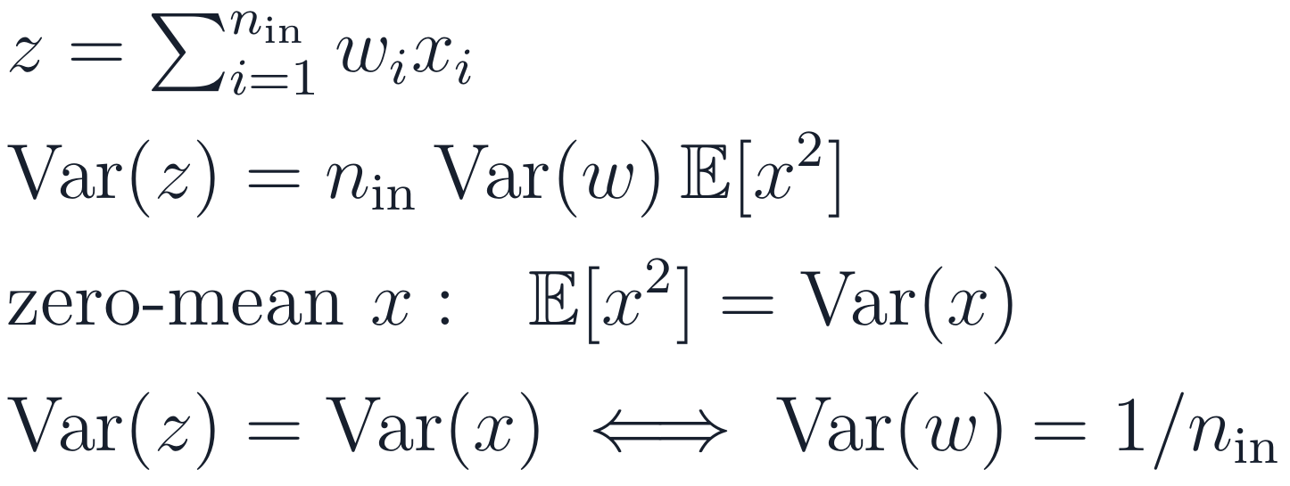

Initialize to keep the pre-activation variance constant
PART 3 · INITIALIZATION
KEEP THE VARIANCE CONSTANT
Activation | Initialization | Var(w)
ReLU, GELU | He / Kaiming | 2 / n_{in}
tanh | Xavier / Glorot | 2 / (n_{in} + n_{out})
SELU, linear | LeCun | 1 / n_{in}
W ~ Normal(mean 0, std √(2 / n_in)) # He
b = 0 # biases may start at 0
RELU HALVES IT, SO DOUBLE IT (HE)
Assumes weights i.i.d., zero-mean, independent of x. Library defaults can be smaller (e.g. Var(w) = 1/(3n_{in})): set He explicitly for deep ReLU nets.
Never all-zero weights: identical units stay identical forever.
Next → Quick check 5: predict before the simulation
Notes:
[1:47 – 1:51] SAY: Choose the initial weight scale so the signal keeps its size layer after layer. ReLU halves it, so He initialization doubles the variance: 2 over fan-in.
BACKGROUND (for you; not to read aloud):
What initial weight scale keeps the PRE-ACTIVATION variance constant with depth (at initialization, under the assumptions below)? Note: the post-ReLU activations are not zero-mean, so their variance is not preserved — Var(ReLU(z)) ≈ 0.34·Var(z) for Gaussian z — but their second moment is. One unit, zero bias, weights i.i.d., zero-mean and independent of the inputs: Var(z) = n_in·Var(w)·E[x²]. For zero-mean inputs E[x²] = Var(x), so keeping Var(z) = Var(x) needs Var(w) = 1/n_in (LeCun). ReLU outputs are NOT zero-mean, which is why the He box works with E[x²] = E[ReLU(z)²] = ½Var(z).
Xavier/Glorot (2010) balances forward (1/n_in) and backward (1/n_out): 2/(n_in + n_out); it assumes an activation roughly linear and symmetric near 0, fine for tanh (sigmoid is not zero-centred and is rarely used in hidden layers today). ReLU zeroes the negative half of a symmetric input, halving the mean square, so He et al. (2015) double it: 2/n_in; with it they trained a 30-layer ReLU network that stalled under Xavier.
Convolutions: n_in = k·k·C_in (a 3×3 convolution with 64 input channels: n_in = 576, He std ≈ 0.059). The code line gives the standard deviation, √(2/n_in), because NumPy (normal(loc, scale)) and PyTorch (init.normal_(std=…)) take a standard deviation, not a variance. PyTorch session preview: nn.init.kaiming_normal_(w, nonlinearity='relu'). Its default for linear and conv layers is Kaiming-uniform with a = √5, i.e. Var(w) = 1/(3·n_in): conservative; set He initialization explicitly for deep ReLU nets trained from scratch. Never all-zero weights: identical units get identical gradients forever (symmetry). Biases may start at 0.

Slide 43
Quick check 5
PART 3 · QUICK CHECK
A tanh network trains well. You switch every activation to ReLU but keep Xavier initialization (20 layers, all 256 wide). What happens to the forward signal?
Nothing: Xavier works for any activation
It grows by about √2 per layer and explodes
A
B
It shrinks by about √2 per layer and vanishes
Only the output layer is affected
C
D
Vote silently → convince your neighbour → revote. Answers: appendix.
Next → the simulation: four initializations, 20 layers
Notes:
[1:51 – 1:55] SAY: Predict before the simulation. Vote, discuss, revote.
BACKGROUND (for you; not to read aloud):
Ask for a prediction before the simulation. Peer instruction: everyone votes A–D silently; if votes split, 60 s with a neighbour, then revote, then explain.
Answer: C. With n_in = n_out = 256, Xavier gives Var(w) = 2/(256 + 256) = 1/256, half of He's 2/256. ReLU halves the mean square at every layer, so the activation std falls by √2 per layer: after 20 layers about 0.58 × (1/√2)¹⁹ ≈ 8 × 10⁻⁴ — the Xavier row of the next slide (simulated: 1.1 × 10⁻³). Fix: He initialization.
Distractor B is the right mechanism with the wrong sign (that is std 1.0); D misses that the factor compounds.

Slide 44
Simulation: 20 ReLU layers, four initializations
PART 3 · INITIALIZATION
Init | Layer 1 | Layer 10 | Layer 20
He | 0.82 | 0.83 | 1.14
Xavier | 0.58 | 0.03 | 1.1 × 10⁻³
std 0.01 | 0.09 | 2.8 × 10⁻¹⁰ | 1.3 × 10⁻¹⁹
std 1.0 | 9.30 | 2.8 × 10¹⁰ | 1.3 × 10²¹
10
1
10⁻¹
10⁻²
10⁻³
Of these four, only He keeps the signal at a stable scale through 20 ReLU layers.
10⁻⁴
Width 256, 1,000 random inputs, one seeded NumPy run. Post-ReLU std is a fixed fraction of the pre-activation std, so both stay flat under He.
Next → good start, yet deep plain nets still train worse: the warm-up question
Notes:
[1:55 – 1:57] PROVENANCE: SIMULATION · SEED 0 · small_figures.py
SAY: 20 ReLU layers: only He keeps the signal at a steady scale. Xavier halves it every two layers; too small vanishes, too large explodes.
BACKGROUND (for you; not to read aloud):
Reveal for Quick check 5: students have just predicted the Xavier case. The chart shows only He and Xavier so the subtle case is visible; the extreme cases (std 0.01, std 1.0) are in the table. Twenty ReLU layers of width 256, 1,000 standard-normal inputs, standard deviation of the post-ReLU activations per layer (log₁₀ on a fixed linear axis from −4 to 1; the 10ⁿ labels are text boxes grouped with the chart). The init slide keeps the PRE-activation variance constant; for Gaussian z, Var(ReLU(z)) ≈ 0.34·Var(z), so the post-ReLU std is roughly a fixed fraction of the pre-activation std (exactly so for zero-mean Gaussian pre-activations) and both stay flat under He, one seeded NumPy run.
He keeps the signal at order 1 (0.82 at layer 1, 1.14 at layer 20; finite-width fluctuations). Xavier ignores ReLU's halving and loses a factor √2 in standard deviation per layer — it halves about every TWO layers — reaching 1.1 × 10⁻³, close to the theoretical 0.58 × (1/√2)¹⁹ ≈ 8 × 10⁻⁴. std 0.01 vanishes to 1.3 × 10⁻¹⁹; std 1.0 explodes to 1.3 × 10²¹. Other schemes (e.g. scaled orthogonal initialization) can also work; this slide compares only these four. Backward gradients behave the same way, since BP2 multiplies by the same matrices.

Slide 45


Residual connections: why deeper can still train
PART 3 · RESIDUAL CONNECTIONS
x_{l}
LEARN A CORRECTION, NOT THE WHOLE MAP
F(x_{l})
Linear / Conv
Gradient view: the identity I gives every gradient a path with factor exactly 1.
identity
skip
ReLU
Eases degradation
1
Linear / Conv
Deeper plain nets trained worse even with good init and BatchNorm (He et al., 2016); residual nets did not.
2
Extra blocks are cheap to ignore
+
F → 0 makes a block the identity.
3
Everywhere since 2015
x_{l+1}
ResNets (images); Transformers (language).
Next → it trains; does it generalize? Diagnose the gap
Notes:
[1:57 – 2:01] SAY: Residual connections add the input back: a block only has to learn a correction, and doing nothing is easy. This is what lets very deep networks train.
BACKGROUND (for you; not to read aloud):
Answer to the warm-up question (second half). He et al. (2016) found that deeper PLAIN networks reach higher TRAINING error than shallower ones — the degradation problem. It is not overfitting, and in their words it is 'unlikely to be caused by vanishing gradients': the plain nets were trained with BatchNorm and the backward gradients had 'healthy norms'. They conjecture that deep plain nets converge exponentially slowly. So good initialization alone does not fix it. For this audience keep the message simple: residual connections are what make very deep networks trainable; this nuance is background.
The fix: let a block learn a correction F(x) and add the input back, x_{l+1} = x_l + F(x_l). An unhelpful block only has to push F toward 0 to become the identity, so extra blocks should not raise training error. Their residual nets did not degrade; ResNet-152 trained in 2015. Residual connections substantially ease, but do not mathematically guarantee, the optimization of very deep networks: the product of the block Jacobians can still be badly conditioned.
A second, complementary view (He et al., ECCV 2016, 'Identity mappings'): the block's Jacobian is I + ∂F/∂x, so the backward product always contains a path with factor exactly 1. Residual connections are in essentially every modern deep architecture, including every Transformer block. Practical trick: initialize the last layer of each residual branch to zero (with normalization, its γ; Goyal et al., 2017) so every block starts as the identity. Real ResNet blocks also contain normalization layers (Appendix B1).

Slide 46
Diagnose the gap first, then pick remedies
PART 3 · DIAGNOSIS
Symptom | Diagnosis | Action
Train high, val high | Underfitting | Bigger model, train longer, check η
Train low, val much higher | Overfitting | The ladder on the right
Train ≈ val, both good | Good fit | Scale up; compare baselines
Loss flat from the start | Bug or bad η | Overfit one small batch
WHEN OVERFITTING: A TYPICAL ORDER
1
Keep best-validation checkpoint
2
More data, if you can get it
3
Data augmentation
4
Transfer learning
5
Weight decay
6
Dropout
First check: can it overfit 100 examples? If not, suspect a bug or a setup error (η, regularization left on).
OUR RUNNING EXAMPLE
Train loss 0.14 and falling; val loss up from 0.33 (epoch 5) to 0.38. Which row?
7
Smaller model (last)
Next → remedy 3: augmentation, more data for free
Notes:
[2:01 – 2:04] SAY: Compare training and validation to diagnose. Our running example is in row 2: early overfitting. Then try remedies in this order.
BACKGROUND (for you; not to read aloud):
The training–validation gap tells you which problem you have. Validation loss slightly below training loss is usually normal: dropout and augmentation make training harder but are off at evaluation. Point to the teal box: our running example (the 20-epoch curves) sits in row 2 — training loss keeps falling (0.14) while validation loss rises after epoch 5 (0.33 → 0.38): early overfitting. The ladder treats it in order: rung 1 (keep the best checkpoint) we already did on the 20-epoch curves; rung 2 (more data) is the 55× bar on the experiment slide; the next slides take rung 3, then 4, then 5 and 6.
Always keep the checkpoint with the best validation metric — it is nearly free. That is different from early STOPPING (halting when validation stops improving): halting is optional and needs patience matched to the learning-rate schedule, because validation loss often improves again after a learning-rate drop.
Then, as a typical order (adapt it to the problem): more data if you can get it (often the most expensive option), augmentation, transfer learning from a pretrained model — for images with a pretrained backbone available, often the first thing to try — weight decay, dropout. Shrinking the model is the last resort: large, well-regularized models usually do at least as well (Appendix B3).
Before any of this (Karpathy, 2019): check that the model can overfit one small batch. If it cannot reach near-zero loss on 100 examples, suspect a bug first, then a setup error: learning rate, regularization or augmentation left on, too few steps.

Slide 47
Data augmentation: free data, if the label survives
PART 3 · REGULARIZATION
Transform | Keeps the label for | Breaks it for
Horizontal flip | clothes, photos | digits, text
Vertical flip | satellite, cells | street scenes
Rotation | microscopy | 6 vs 9
Colour jitter | most objects | colour = the class
training (fresh draw every epoch):
crop 80–100 %, resize to 28×28
flip left–right with probability 0.5
pixels to numbers in [0, 1]
standardize: (x − 0.286) / 0.353
validation and test:
to [0, 1], then standardize only
Never augment validation or test data.
Fashion-MNIST mean and std of the training pixels.
Stronger (later sessions): Mixup, CutMix, RandAugment. Label smoothing softens the targets instead.
Next → remedy 4: transfer learning
Notes:
[2:04 – 2:06] SAY: Augmentation creates new training examples, but only with transforms that keep the label. Never augment validation or test data.
BACKGROUND (for you; not to read aloud):
For convolutional image models, augmentation is usually among the highest-leverage regularizers: a shirt is still a shirt after a small crop or brightness change, while every pixel changes. Be candid: for our MLP on flattened pixels, this exact recipe did not help (experiment slide). Think about each transform: horizontal flips suit clothes and natural photos but not digits or text; vertical flips suit satellite and microscopy images, not street scenes; rotation confuses 6 and 9.
Never augment validation or test data beyond deterministic resizing/cropping. Stronger methods: Mixup and CutMix (batch-level, producing probability targets), RandAugment/TrivialAugment, and label smoothing. PyTorch session preview: torchvision.transforms.v2 (RandomResizedCrop, RandomHorizontalFlip, ToImage + ToDtype, Normalize).

Slide 48
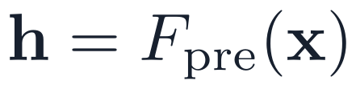


Transfer learning: reuse features learned on big data
PART 3 · REGULARIZATION
Pretrained feature extractor
New output layer
x
ŷ
pretrained on a large dataset
new: trained on your small dataset
1
Freeze, train the head
2
Fine-tune with a small η
3
Match the original inputs
Keep the extractor fixed; train only the new output layer. Best with very little data.
Then update all layers gently. Helps when your images differ more from the original data.
Preprocess (image size, standardization) exactly as the pretrained model expects.
Next → remedies 5 and 6: weight decay and dropout
Notes:
[2:06 – 2:08] SAY: Transfer learning: reuse a network trained on a huge dataset, add a new output layer, and train that — then optionally fine-tune everything gently.
BACKGROUND (for you; not to read aloud):
Rung 4 of the remedy ladder. Transfer learning reuses the “reusable features” idea from Part 1: a network trained on a large dataset (for images, e.g. ImageNet) already has useful edge and texture detectors. F_pre on the slide stands for all of its layers.
Two ways: (1) freeze the pretrained extractor and train only a new output layer (the “head”) — fast, best with very little data; (2) fine-tune: then update all layers with a small learning rate (often 10× smaller than from scratch), best when your data differ more from the original. The new output layer has as many units as your classes and is trained only on your data.
Match the inputs: resize and standardize exactly as the pretrained model was trained (for ImageNet models typically 224 × 224 RGB with the ImageNet mean and std); a mismatch silently degrades the features.
Early stopping (halt when validation stops improving for some number of epochs, the “patience”) is different from keeping the best checkpoint (rung 1): keeping the checkpoint is nearly free; halting early is optional and its patience must suit the learning-rate schedule.
Quick check 6 at the end of Part 3 returns to it.

Slide 49



Weight decay and dropout
PART 3 · REGULARIZATION
L2 WEIGHT DECAY
TYPICAL P
Large FC layers: 0.5
Transformers: 0.1
Conv nets with normalization: ≈ 0
1
Shrink, then step
one training step, p = 0.5
Each update multiplies W by (1 − ηλ). With Adam, use AdamW: it applies this shrink directly.
INVERTED DROPOUT
2
Less sensitive functions
An intuition: small weights, gentler outputs.
3
Weights only
E[a] is the same in training and testing; evaluation mode turns dropout off.
Not biases (nor normalization scales).
Next → do these remedies help with only 1,000 images?
Notes:
[2:08 – 2:12] SAY: Weight decay shrinks weights every step; dropout randomly switches units off during training. Both are off or unchanged at test time.
BACKGROUND (for you; not to read aloud):
Weight decay adds (λ/2)‖W‖² to the loss, so every step first shrinks W by (1 − ηλ). Weight decay discourages large weights and can limit how sensitive the network is to input changes (for one sigmoid neuron, ‖w‖ sets the sharpness — Part 1; for a deep ReLU net, small layer norms bound its Lipschitz constant). Its actual effect on smoothness and generalization depends on the architecture and optimizer: for weights feeding a normalization layer the function is scale-invariant, and decay mostly acts by changing the effective learning rate; Bayesian reading: a zero-mean Gaussian prior. Typical λ: ≈ 10⁻⁴ – 5×10⁻⁴ for SGD on CNNs; 0.01 – 0.1 with AdamW. Weights only. With Adam, coupled L2 is divided by √v̂ and barely regularizes some weights; AdamW applies the shrink directly (Loshchilov & Hutter, 2019; Appendix A6).
Dropout (Srivastava et al., 2014): during training zero each unit with probability p, independently per example and per pass, and divide survivors by 1 − p (inverted dropout) so E[a] matches test time, when dropout is off. Explanations: units cannot co-adapt; an implicit ensemble of 2ⁿ weight-sharing sub-networks; noise injection. Typical p: 0.5 for large fully connected layers, 0.1 in many Transformer recipes (many large-scale pre-training runs use none), little or none inside conv layers with batch normalization.

Slide 50
Regularizers tame the loss; more data lifts accuracy
PART 3 · RUNNING EXAMPLE
1,000 images: every variant within 0.6 pp of 79.8% (3 seeds). 55× more data: +8.5 pp.
A likely reason for the tie: the best-validation checkpoint already stops before the loss climbs, so flattening the climb (left) barely changes it.
Bars: test accuracy at the best-validation checkpoint. Dropout 0.5; AdamW λ = 0.5, deliberately strong (shrink per step ηλ = 5×10⁻⁴).
Next → Quick check 6: pick the next experiment
Notes:
[2:12 – 2:15] PROVENANCE: EXPERIMENT · 3 SEEDS · fmnist_regularization.py
SAY: With only 1,000 images, the regularizers flatten the climbing validation loss on the left, but the test accuracy at the best checkpoint barely moves. 55 times more data adds 8.5 points. A likely reason for the tie: keeping the best checkpoint already stops before the climb.
BACKGROUND (for you; not to read aloud):
The same MLP trained on only 1,000 of the 55,000 training images (Adam or AdamW, lr 10⁻³, batch 100, 150 epochs, He init), selected on the 5,000 validation images and scored once on the 10,000 test images at the best-validation-loss checkpoint; 3 seeds per configuration; curves show seed 0 (fmnist_regularization.py, pure NumPy, so the numbers differ slightly from fmnist_experiments.py).
Test accuracy, 3-seed mean ± SD: none 79.8 ± 0.6; dropout 0.5 + AdamW weight decay 0.5 (weights only) 80.2 ± 0.4; crop + flip augmentation 79.6 ± 0.3; all three 79.3 ± 0.5; full 55,000 images (20 epochs, batch 128) 88.3 ± 0.5. Flip alone (not on the slide) gave 79.0. Best validation loss: 0.560, 0.548, 0.565, 0.570.
A likely reason for the tie (an interpretation, not something this experiment isolates): keeping the best-validation checkpoint is itself a form of early stopping. Without regularization the validation loss bottoms out near epoch 13 and climbs back to ≈ 0.97; dropout + weight decay and augmentation flatten that rise, but the checkpoint already avoided it, so test accuracy hardly changes. The standard error of a 10,000-image test accuracy near 80% is about 0.4 points.
On λ = 0.5: larger than the 0.01–0.1 starting range recommended in Appendix A6, chosen deliberately strong; with AdamW at η = 10⁻³ the per-step shrink is ηλ = 5×10⁻⁴. The slide reports one setting per method, so it is not a tuned comparison. With all three regularizers the model is still improving at epoch 150 (best epochs 142–147): under-trained, not useless.
Callback to slide 16: the 55k bar (88.3 ± 0.5%) is roughly a tie with the random forest’s 87.5% and 3 points above k-NN’s 85.3% (classical_baselines.py; k = 3 and 5 tie at 85.5% validation accuracy; different validation split from these scripts, so treat gaps under a point as noise).
Why augmentation did not help here: an MLP treats each pixel position as a separate input, so a crop or flip produces an input it must learn from scratch; convolutional networks share weights across positions and typically benefit much more.

Slide 51
Quick check 6
PART 3 · QUICK CHECK
2,000 labeled images: train accuracy 99.8%, validation 71%. Data and evaluation checks pass. Which is the best first experiment?
Train for more epochs
Fine-tune a model pretrained on a related task
A
B
Remove regularization so it fits better
Shrink the network
C
D
Vote silently → convince your neighbour → revote. Answers: appendix.
Next → wrap-up: today in three sentences
Notes:
[2:15 – 2:19] SAY: Vote silently, discuss with a neighbour, revote.
BACKGROUND (for you; not to read aloud):
Peer instruction: everyone votes A–D silently; if votes split, about 2 minutes with a neighbour, then revote and explain.
Answer: B. Train 99.8% vs validation 71% is a large generalization gap, and the stem rules out a broken pipeline. Fine-tuning a model pretrained on a related task is the strongest first try (rung 4 of the ladder, often first in practice for images) — but still an experiment, compared on the same validation set, ideally alongside augmentation.
Distractors: A (more epochs) and C (less regularization) widen the gap; D (shrink the network) is the last rung. Caveat worth saying: a gap alone cannot distinguish overfitting from data shift, leakage or label problems — that is why the stem says the checks pass.

Slide 52
Today in three sentences
WRAP-UP
1
Part 1 · Foundations
BEFORE NEXT SESSION
A network learns its own features: linear layers interleaved with nonlinearities. Without g, depth collapses.
Redo the worked example with x = 1, then take one step (η = 0.5)
NumPy: code it; check gradients with centred differences
Count parameters of 784–256–10; predict the first loss for 100 classes
Derive BP2 for one hidden layer
One sentence: why can a residual block “do nothing”?
2
Part 2 · Learning
Losses are negative log-likelihoods; curvature caps η, Adam helps; backprop gets every gradient for ≈ 3 forward passes.
3
Part 3 · Train & generalize
He init and residual connections let deep nets train; diagnose the gap, then add data before regularizers.
Exit ticket (1 minute): what was the muddiest point today?
Notes:
[2:19 – 2:30] SAY: Today in three sentences. Then one minute: write your muddiest point on a card.
BACKGROUND (for you; not to read aloud):
Each part reduces to one sentence; if students can say these and justify them, they have the foundations. Then the one-minute exit ticket: "What was the muddiest point today?" on a card. Read them before next session and open with the top two. Use the remaining minutes for questions.
Practice before next session (answers): with x = 1 the forward pass gives z₁ = 0.6, a₁ = 0.6457, z₂ = 0.2165, a₂ = 0.5539, L = −ln a₂ = 0.5907; gradients ∂L/∂w₁ = ∂L/∂b₁ = −0.0816, ∂L/∂w₂ = −0.2880, ∂L/∂b₂ = −0.4461; one step with η = 0.5 gives w₁ 0.5408, b₁ 0.1408, w₂ 0.9440, b₂ −0.0770 and loss 0.4555. The NumPy version should match these to 4 decimals and pass a centred-difference check (Appendix A10, relative error below 10⁻⁷ in float64). A residual block can “do nothing” because driving F to 0 leaves x_{l+1} = x_l, the identity; 784–256–10 has 200,960 + 2,570 = 203,530 parameters; first loss for 100 classes ≈ ln 100 = 4.61; BP2 for one hidden layer is δ[1] = (W[2]ᵀ δ[2]) ⊙ g′(z[1]); the loop is the five steps of the training-loop slide. Next session turns this pseudocode into PyTorch.

Slide 53
Appendix A
APPENDIX A · REVIEW OF TODAY
A1 Quick-check answers
A2 Notation
A3 Linear regions of a ReLU net
A4 Universal approximation
A5 Why deep? Depth separations
A6 Adam and AdamW in full
A7 Loss landscapes
A8 From 1943 to today
A9 When not to use a network
A10 Gradient checking
Notes:
Appendix A: review material for today's lecture. Appendix B (after it) goes further, for later sessions: material kept out of the lecture so the 150 minutes have room for the quick checks and questions.

Slide 54
Quick-check answers (1–3)
A1 · QUICK-CHECK ANSWERS
1
Answer C: Only a straight line (a hyperplane)
The hidden layers compose into one affine map z = W′x + b′; the sigmoid is monotone, so ŷ > 0.5 exactly when z > 0. The boundary is a hyperplane whatever the width or depth.
2
Answer A: Remove the final softmax; pass raw logits
cross_entropy applies log-softmax itself, so the model applied softmax twice: the 10-class loss cannot go below ≈ 1.46. Reading the model, not the plateau alone, finds the bug.
3
Answer D: 2 / 25 = 0.08, the steepest direction sets the limit
On a quadratic, gradient descent converges only if η < 2/λ_max; rotating the ravine does not change its curvatures. Just below 0.08 the gentle direction shrinks only by 0.92 per step: the crawl that momentum and Adam address.
Notes:
Appendix review. Answers 1–3: C, A, D. Derive the reasons; do not ask students to memorize letters. (Former Quick check 2, the W[1] shape, is now the prediction prompt on the running-example slide.)

Slide 55
Quick-check answers (4–6)
A1 · QUICK-CHECK ANSWERS
4
Answer A: Exactly 0
Layer 1's error arrives only through w₂: ∂L/∂a₁ = δ₂·w₂ = 0, so δ₁ = 0 and ∂L/∂w₁ = δ₁·x = 0. Vanishing gradients and dead units block learning by the same mechanism.
5
Answer C: It shrinks by about √2 per layer and vanishes
Xavier with n_in = n_out = 256 gives Var(w) = 1/256, half of He's 2/256. ReLU halves the mean square per layer, so the std falls by √2 per layer: by (1/√2)¹⁹ ≈ 1.4×10⁻³ from layer 1 to layer 20. Fix: He initialization.
6
Answer B: Fine-tune a model pretrained on a related task
Train 99.8% vs validation 71% is overfitting (the checks rule out a broken pipeline). More epochs (A) and less regularization (C) widen the gap; shrinking the network (D) is the last rung of the ladder. A pretrained model is the strongest first try, but still an experiment: compare it on the same validation set.
Notes:
Appendix review. Q4: layer 1’s error reaches it only through w₂, so w₂ = 0 blocks it. Q5: RMS scaling under ReLU assumptions; Xavier loses a factor √2 in std per layer. Q6: a large gap with checked data — fine-tuning a related pretrained model is the best first experiment; more epochs or less regularization widen the gap; shrinking the network is the last resort.

Slide 56
Notation used all session
A2 · NOTATION
Symbol | Meaning | Symbol | Meaning
x, 𝐱, 𝐖 | scalar, vector, matrix | z[l] | pre-activation of layer l
x(i) | the i-th training example | a[l] | activation of layer l; a[0] = x; a[L] = logits
W[l], b[l] | weights, bias of layer l | g, g′ | activation, its derivative
n[l] | units in layer l | ŷ, y | prediction (value or probabilities), target
m | examples in a mini-batch | δ[l] | error signal ∂L/∂z[l]
η | learning rate | L, J | loss on one example; batch mean
Derivations: one example is a column vector. In code, a batch stores examples as rows, so a layer computes X Wᵀ + b.
Notes:
Square brackets index layers; round brackets index examples.

Slide 57

A ReLU network computes a patchwork of linear pieces
A3 · EXPRESSIVE POWER
146
linear regions (900 × 600 grid) of a 2–12–12–1 ReLU net
1
Inside a patch: exactly linear
One on/off pattern of all 24 ReLUs.
2
Boundary: a polyline
Straight pieces that follow curves.
Try it: playground.tensorflow.org
Notes:
Appendix A3 (moved out of the lecture for time; use it if students ask what a ReLU network computes). PROVENANCE: EXPERIMENT · SEED 0 · small_figures.py
SAY if used: A trained ReLU network is a patchwork: inside each patch it is exactly linear, and the boundary is made of straight pieces that follow the curve.
BACKGROUND (for you; not to read aloud):
A real network trained for this slide: 2 → 12 → 12 → 1 ReLU units on the two-moons data (100% training accuracy).
Each coloured patch is a region of input space where every ReLU is on or off in one fixed pattern; inside it the whole network is exactly linear. 146 such regions are found on a 900 × 600 grid of this window (tiny regions can be missed, so the true count is at least this). The black decision boundary is therefore piecewise linear, yet it follows the curved moons. More units and more layers mean more pieces.
Live demo: playground.tensorflow.org — choose the XOR or spiral dataset, ReLU, and watch the boundary bend as you add hidden units.

Slide 58


Universal approximation, stated honestly
A4 · EXPRESSIVE POWER
Grey: target f(x). Teal: a hand-built (not trained) one-hidden-layer ReLU network.
THEOREM (INFORMAL)
Not “any function”
Width can be huge
Continuous f on compact K; one hidden layer of enough non-polynomial units (ReLU, sigmoid):
Continuous, compact domain.
Exponential in input dimension (worst case).
Existence ≠ findable
Fit ≠ generalize
GD may not find it.
Fitting is not the goal.
Notes:
PROVENANCE: CONSTRUCTED · small_figures.py
Appendix A4, moved out of the lecture for time; use it if students ask “can a network fit anything?”. Picture first: a one-hidden-layer ReLU network builds a piecewise-linear interpolation of a continuous curve, and the error shrinks as units are added (hand-constructed ReLU networks with knots chosen to minimize the maximum error, not trained; max errors 0.65, 0.14, 0.014 for 3, 6, 24 units).
Theorem (informal): for any continuous f on a compact set K and any ε > 0, some network with ONE hidden layer, finitely many units and a non-polynomial activation is within ε of f everywhere on K (precise condition, Leshno et al. 1993: a locally bounded, piecewise-continuous activation that is not a polynomial almost everywhere; Cybenko 1989 for sigmoids; Hornik 1991; Leshno et al. 1993). The activation must be non-polynomial — which is exactly why the identity network of Quick check 1 is not universal. A related depth result: ReLU networks of width n + 4 and unbounded depth can approximate any Lebesgue-integrable function in the L¹ sense (Lu et al., 2017).
What it settles: sufficiently large networks have enormous expressive power. It does not say that YOUR network is large enough (two ReLU units cannot fit the curve on this slide), nor that the required size is practical. In practice, performance also depends on optimization, regularization and data.

Slide 59

Why deep? Composition multiplies what each layer can do
A5 · WHY DEEP?
1
Each layer can fold the input
k layers, constant width: 2ᵏ pieces.
2
Proven separations
Θ(k³) layers × Θ(1) width vs O(k) layers needing Ω(2ᵏ) nodes (Telgarsky, 2016).
3
Honest caveat
Worst-case constructions; the benefit on real data is empirical.
Notes:
One hidden layer suffices in principle (UAT), but depth can be exponentially more efficient. A tent map built from 2 ReLUs, composed k times, has 2^k linear pieces; a shallow network needs roughly one unit per piece. Telgarsky (COLT 2016): networks with Θ(k³) layers and Θ(1) nodes per layer cannot be approximated by networks with O(k) layers unless those have Ω(2^k) nodes. Montúfar et al. (2014): the number of linear regions of ReLU networks can grow exponentially with depth but only polynomially with width.
Parity is NOT a good example: n-bit parity needs only n hidden threshold units at depth 2 (shown in the 1986 PDP-volume chapter by Rumelhart, Hinton & Williams); the exponential lower bounds for parity concern AND/OR circuits.
These are worst-case constructions; that real data rewards depth is an empirical, well-supported observation (compositional data; feature hierarchies visualized by Zeiler & Fergus, 2014).

Slide 60


Adam = momentum + per-parameter steps; use AdamW
A6 · OPTIMIZERS
ADAM (KINGMA & BA, 2015)
Optimizer | Good default for | Typical η
AdamW | Most new work, incl. Transformers | 3 × 10⁻⁴
SGD + momentum | Image classifiers (CNNs) | 0.1 (batch 256)
Defaults: β₁ = 0.9, β₂ = 0.999, ε = 10⁻⁸
Start with AdamW (weight decay 0.01 – 0.1). Do not decay biases (or normalization scales).
ADAMW: DECAY THE WEIGHTS DIRECTLY
Check your library: “Adam + weight decay” is often plain L2, not AdamW.
Notes:
Appendix A6 (moved out of the lecture for time; slide 27 introduces Adam in words, slide 49 introduces AdamW with weight decay). SAY if used: Adam keeps a running average of gradients and of their squares and steps by their ratio. Use AdamW, which applies weight decay directly. Defaults on the slide.
BACKGROUND (for you; not to read aloud):
Adam (Kingma & Ba, 2015) keeps a running mean of the gradient (momentum) and of its square (RMSProp), corrects both for starting at zero (with m₀ = 0, E[m_t] = (1 − β₁ᵗ)E[g]), and steps by their ratio — roughly a signal-to-noise ratio: consistent gradients give steps near ±η, noisy ones shrink the step.
AdamW (Loshchilov & Hutter, 2019): with plain SGD, an L2 penalty equals weight decay; with Adam it does not, because the λθ term is divided by √v̂ and parameters with large gradient history are barely regularized. AdamW applies decay directly to the weights. Many libraries implement “Adam with weight decay” as the coupled L2 version. PyTorch session preview: Adam(weight_decay=…) is coupled L2 by default (recent versions add decoupled_weight_decay=True); AdamW is the decoupled one (default weight_decay = 0.01). Exclude biases and normalization parameters from decay.
SGD with momentum and a tuned schedule remains competitive for image classification; the Adam-versus-SGD generalization gap is real in some settings but small and recipe-dependent.
Glossary for this audience: Transformers are the architecture behind language models; CNNs (convolutional networks) are image models; both come in later sessions. 2026 note: for large-scale LLM pretraining, matrix-aware optimizers such as Muon (Jordan et al., 2024; Liu et al., 2025) have been used in several frontier models and can beat AdamW at scale. AdamW remains the right default to teach and to use first.

Slide 61
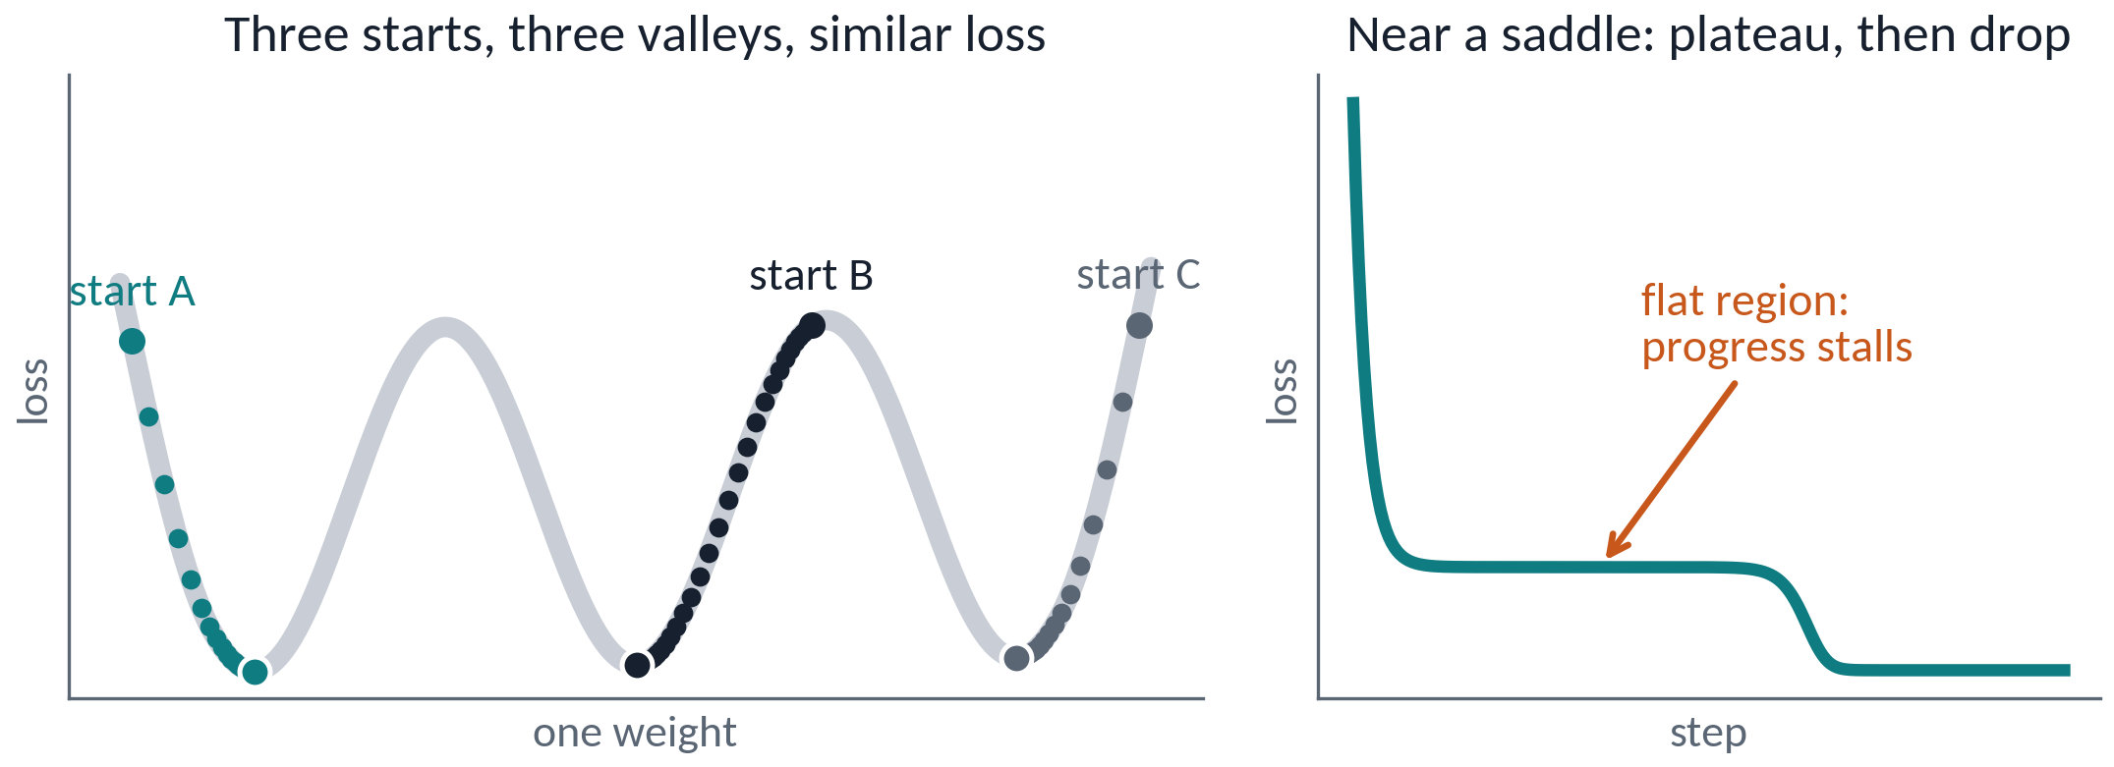
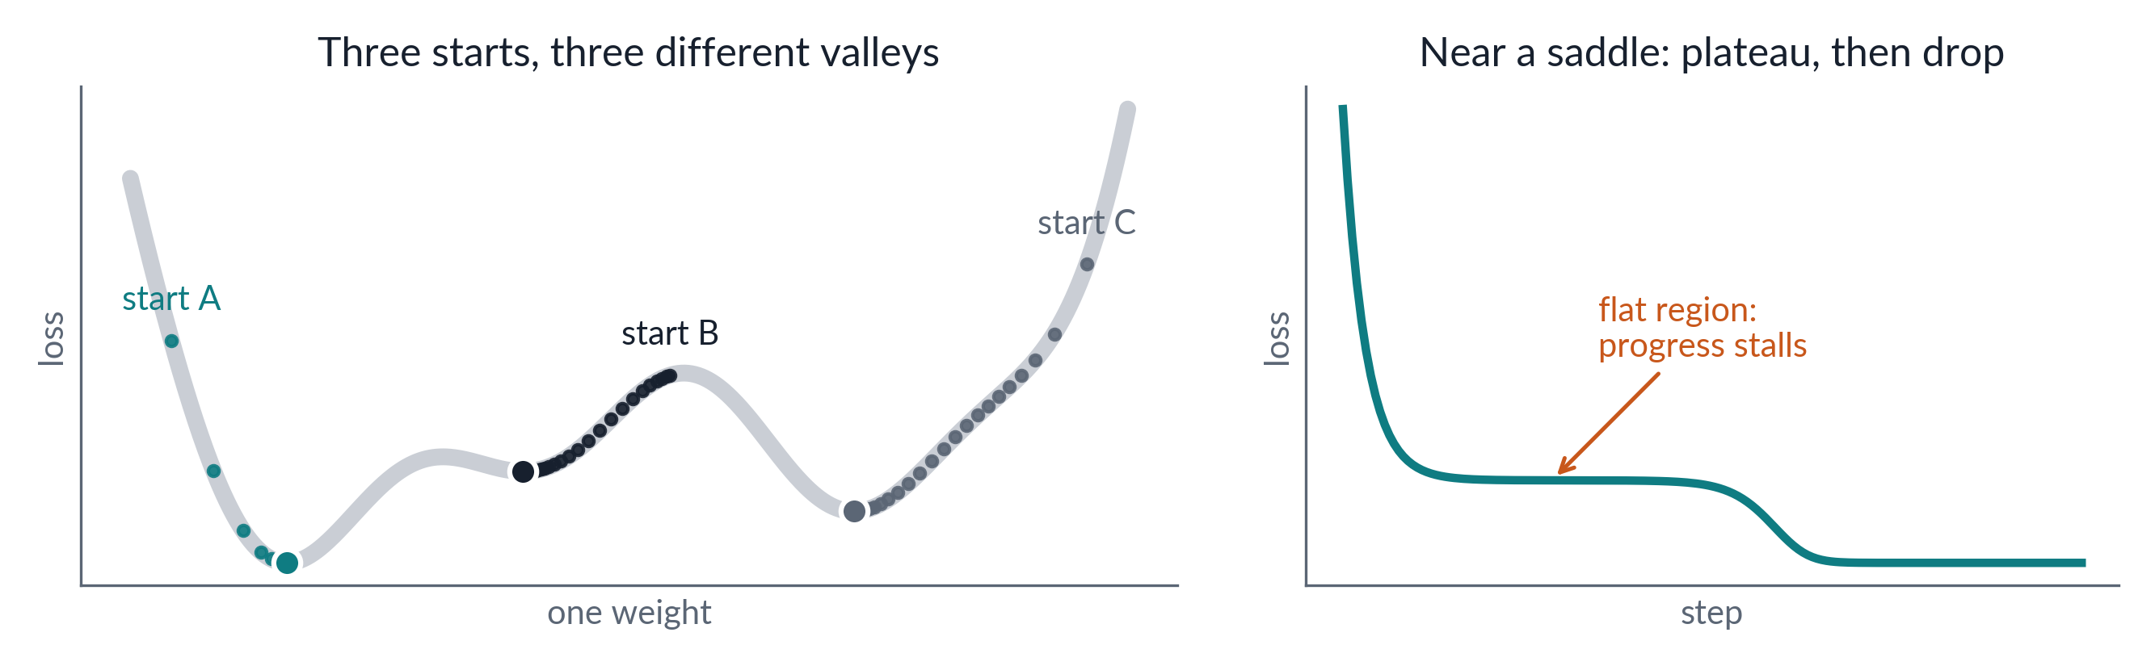
A network’s loss is not one bowl
A7 · LOSS LANDSCAPES
Left: a 1-D cartoon; in high dimensions, saddles (not bad minima) are the main obstacle. Right: near a saddle the loss stalls, then drops.
WHY GRADIENT DESCENT STILL WORKS
Many valleys
Flat regions
Logistic regression has one bowl. A network has many valleys and flat regions, yet in large networks most valleys that gradient descent reaches are about equally good.
Different starts, different weights.
Tiny gradients, slow progress.
The seed matters
Run several seeds
It sets the start and batch order.
One run can mislead.
Notes:
Appendix A7 (moved out of the lecture for time; slide 39 keeps the practical lesson: compare seeds). PROVENANCE: COMPUTED · figures_v7.py
SAY if used: A network's loss is not one bowl: different starts end in different valleys, and flat regions slow progress. In large networks the valleys reached are usually about equally good. Run several seeds.
BACKGROUND (for you; not to read aloud):
Logistic regression’s loss is convex: one bowl, one minimum, any start works. A network’s loss is non-convex: many valleys (local minima), flat regions and saddle points, and many equivalent solutions (swap two hidden units and the function is unchanged).
Left (figures_v7.py, deterministic): plain gradient descent from three starting weights ends in three different valleys with nearly equal loss (0.00, 0.02, 0.04) — a one-weight cartoon of the claim below. A 1-D picture cannot show what makes high-dimensional landscapes benign (most critical points are saddles), so present it as a cartoon. Right: gradient descent on J(u, v) = u² − v² + v⁴/2, started next to the saddle point at the origin: the loss drops, stalls while the escape direction grows slowly, then drops again. A plateau in a real training curve can look like this.
Why training still works: in large networks, most minima that gradient descent reaches have similar loss, and saddle points rather than bad minima are the main obstacle (Dauphin et al., 2014; Choromanska et al., 2015). Mini-batch noise and momentum help escape flat regions.
Practical lesson: the random seed sets the initial weights and the order of the mini-batches, so results vary from run to run. That is why this deck reports three seeds for the running example.

Slide 62
From 1943 to today: backprop was not the bottleneck
A8 · HISTORY
1943
1969
1998
2015
2020–22
McCulloch & Pitts
Minsky & Papert
LeCun et al.
ResNet
AlphaFold 2, GPT-3, ChatGPT
threshold neuron
limits of 1 layer
LeNet-5
152 layers
1958
1986
2012
2017
2024
Rosenblatt
Rumelhart et al.
AlexNet
Transformer
Nobel Prizes
perceptron
backprop popular
GPUs + ReLU
self-attention only
Physics, Chemistry
Backprop was popularized in 1986; deep learning took over around 2012, once data (ImageNet), GPUs and training techniques (ReLU, better initialization, dropout, later normalization and residuals) caught up.
Notes:
Reverse-mode differentiation: Linnainmaa (1970); proposed for networks by Werbos (1974); popularized by Rumelhart, Hinton & Williams (1986). Deep learning took over around 2012, driven by data (ImageNet, 2009), GPUs and algorithmic training techniques — ReLU, careful initialization, dropout, then BatchNorm, residual connections and Adam — most of which Part 3 teaches. 2024 Nobel Prizes: Physics to Hopfield and Hinton; Chemistry to Baker, Hassabis and Jumper.

Slide 63
When not to reach for a neural network
A9 · JUDGMENT
Small data
Tabular data
A few hundred rows: regularized linear models, boosted trees or a Gaussian process.
Boosted trees (XGBoost, LightGBM, CatBoost) are hard to beat; tabular foundation models such as TabPFN (v3 in May 2026, v3.5 in Sept 2026) now rival them on many datasets.
Each decision must be audited
No baseline yet
A logistic regression or a small tree is easier to defend.
Fit the simple model first; it tells you what score is easy.
Neural networks win on abundant data whose structure is hard to describe by hand: images, audio, text, molecules.
Notes:
Grinsztajn et al. (NeurIPS 2022): tree ensembles still outperformed deep models on typical medium-sized tabular benchmarks. TabPFN (Hollmann et al., Nature 2025), a pretrained tabular foundation model, outperformed tuned baselines on datasets up to 10,000 samples; TabPFN-2.5 (Prior Labs, November 2025) extended this to about 50,000 rows; TabPFN-3 (Prior Labs, May 2026) supports up to about 1,000,000 rows × 200 features (fewer rows with more features), and Prior Labs reports it beating tuned gradient-boosted trees on many benchmarks — a vendor claim, so verify on your own data. TabPFN-3.5 followed in September 2026; Prior Labs also offers API-only variants. The TabPFN-3 weights are licensed for research and internal evaluation (commercial use needs a licence), although the package code moved to Apache 2.0 in September 2026. Fit a strong simple baseline first.

Slide 64

Verify hand-written gradients with centred differences
A10 · GRADIENT CHECKING
≤ 10⁻⁷
10⁻⁷ – 10⁻²
> 10⁻²
correct
investigate
probably a bug
float64 · dropout off · sample parameters · two forward passes per check · rules of thumb (CS231n); with kinks (ReLU at 0), up to 10⁻⁴ is usually fine
Notes:
Use the centred difference (error O(ε²)) and a relative error. Use float64, make the loss deterministic (dropout off), and check a random subset of parameters: each check costs two forward passes. Thresholds follow the CS231n notes: above 10⁻² the gradient is probably wrong; 10⁻² to 10⁻⁴ is uncomfortable; below 10⁻⁴ is usually fine for losses with kinks (ReLU at 0) but too high for smooth ones (tanh, softmax); 10⁻⁷ or less is correct.

Slide 65
Going further
APPENDIX B · GOING FURTHER (LATER SESSIONS)
B1 Batch normalization
B2 Normalization variants
B3 Double descent
B4 Losses and target formats
B5 Six silent training mistakes
B6 Learning-rate schedules
B7 A modern training recipe
B8 Activations by layer role
Notes:
Going further, for later sessions: B1–B3 cover normalization and double descent; B4–B7 support the coding sessions, ending with a full training recipe; B8 summarizes which activation each layer uses. All code here is pseudocode; the notes name the PyTorch calls.

Slide 66

Batch normalization: standardize, then rescale
B1 · NORMALIZATION
FOR EACH FEATURE, OVER A MINI-BATCH OF M
TRAINING MODE
EVALUATION MODE
Use this batch's μ and σ²; update running averages.
Use the running averages: deterministic.
1
Smoother loss landscape (one explanation)
conv → batch norm → ReLU
# conv: 64 → 128 channels, 3×3, no bias
# bias off: batch norm's β already shifts
# batch norm over 128 channels: learns γ, β
# ReLU
Larger learning rates stay stable.
2
Not mainly “covariate shift”
The original motivation; later doubted.
Transformers: LayerNorm or RMSNorm. Tiny batches: GroupNorm.
Notes:
BatchNorm (Ioffe & Szegedy, 2015) standardizes each feature (each channel in a CNN) over the mini-batch, then applies a learned scale γ and shift β — which can undo the normalization, so no representational power is lost.
Train vs eval: training uses the batch's mean and variance and updates running averages; eval uses the running averages, so predictions are deterministic and independent of the other examples in the batch. PyTorch's momentum = 0.1 is the weight of the NEW batch statistic. Detail: training-time normalization uses the biased batch variance, while the running variance stores the unbiased estimate. Forgetting evaluation mode is the classic bug (PyTorch: model.eval()): validation accuracy then changes with validation batch size; with batch size 1, BatchNorm2d normalizes each image by its own spatial statistics (BatchNorm1d raises an error).
Why it helps: the original "internal covariate shift" explanation is now doubted (Santurkar et al., 2018 injected extra shift and training still went well). A leading explanation (Santurkar et al., 2018), itself still debated: it smooths the loss landscape so larger learning rates are stable. Also: the output is invariant to the scale of the preceding weights; batch noise adds mild regularization.
Variants differ in which statistics they compute, over which axes, and whether evaluation uses the current input or accumulated statistics: LayerNorm (per example — Transformers), RMSNorm (no mean subtraction — many recent LLMs), GroupNorm (small-batch vision). Figure in the appendix.

Slide 67

Normalization variants: which axes, which statistics
B2 · NORMALIZATION
Layer | Statistics over | Batch-dependent? | Typical use
BatchNorm | N, H, W per channel | Yes | CNNs, decent batch size
LayerNorm | all features of one example | No | Transformers, RNNs
GroupNorm | H, W and a channel group | No | Small-batch vision
InstanceNorm | H, W per example and channel | No | Style transfer
RMSNorm | like LayerNorm, no mean | No | Many recent LLMs
Notes:
BatchNorm, LayerNorm, GroupNorm and InstanceNorm compute (x − mean)/std over different axes, then a learned scale and shift; they also differ in how statistics are used (BatchNorm switches to running averages at evaluation; the others use the current example). Teal cells share one mean and variance; height and width are always pooled. RMSNorm (Zhang & Sennrich, 2019) drops the mean subtraction.

Slide 68
Double descent: test error can fall again
B3 · GENERALIZATION
1
p < n: the classical U
p = n = 60
Too simple, then too variable.
2
p ≈ n: the peak
Just enough capacity to fit the noise.
3
p ≫ n: second descent
Many exact fits exist; the minimum-norm one can generalize again.
Large and regularized beats small here: ridge removes the peak.
Notes:
PROVENANCE: SIMULATION · MEDIAN OF 30 RUNS · small_figures.py
Classical statistics predicts a U-shaped test error against model size. Modern networks have far more parameters than examples and still generalize. Simulation (small_figures.py): least squares on p random ReLU features of 20-dimensional Gaussian inputs, n = 60 training points, noise sd 0.3, median of 30 runs.
Unregularized (minimum-norm) fit: test error follows the U (best 0.51 at p = 13), PEAKS at the interpolation threshold p = n = 60 (18.8) — the model can only just fit the noisy training data and must contort — then descends again to 0.20 at p = 3000 (Belkin et al., 2019; deep networks: Nakkiran et al., 2020). With a ridge penalty (λ = 0.01) the peak disappears and the large model reaches 0.19.
Honest caveat: this is not a law. Rerun the same script with 5-dimensional inputs and the classical optimum (0.088 at p = 18) beats the largest unregularized model (0.164). Whether more parameters help depends on the data, the model and the implicit or explicit regularization. Among many exact fits, minimum-norm solutions (which gradient descent from zero initialization finds for least squares) often generalize better than the worst interpolators — but minimum norm is not minimum roughness. Explicit regularization can remove the peak (Nakkiran et al., 2021).

Slide 69
Loss functions and target formats
B4 · LOSSES
Task | Loss | Model output | Target
Regression | mse | (m, 1) raw | (m, 1) float
Robust regression | huber | (m, 1) raw | (m, 1) float
Binary | bce_with_logits | (m, 1) logits | (m, 1) float 0/1
Multi-class | cross_entropy | (m, K) logits | (m,) class indices, or (m, K) probabilities
Multi-label | bce_with_logits | (m, K) logits | (m, K) float 0/1
These losses apply sigmoid or softmax themselves: pass raw outputs.
Notes:
Classification losses take raw logits. PyTorch session preview: nn.MSELoss, nn.HuberLoss, nn.BCEWithLogitsLoss, nn.CrossEntropyLoss. CrossEntropyLoss accepts int64 class indices (m,) or float class probabilities (m, K) since PyTorch 1.10 (used by label smoothing, Mixup, CutMix). Match prediction and target shapes exactly for MSELoss: (m, 1) vs (m,) broadcasts to (m, m) with only a warning.

Slide 70
Six training mistakes that may not raise an exception
B5 · SILENT BUGS
1
Softmax applied twice
2
Unintended gradient accumulation
Loss floor ≈ 1.46 for 10 classes; miscalibrated outputs.
Gradients not cleared: they sum across steps (fine only when intended).
3
No evaluation mode for validation
4
Layers the framework cannot see
Dropout stays on; BatchNorm uses batch statistics.
Stored in a plain list, not registered: never updated.
5
Optimizer built for another model
6
Shape mismatch in a squared-error loss
Re-created model after the optimizer: loss never moves.
(m, 1) vs (m,) broadcasts to (m, m); at most a warning.
Notes:
Reference for the coding sessions. PyTorch names: zero_grad(), model.eval(), nn.ModuleList, MSELoss. Bug 1 is measurably overconfident: ≈ 99% mean confidence at 82–88% accuracy (calibration_check.py). Each of these runs and prints a loss but gives the wrong answer; at most a warning appears (the MSELoss shape mismatch warns, and the warning is easy to miss in a long log). Accumulating gradients over several mini-batches is a legitimate technique; omitting zero_grad() is a bug only when the accumulation is unintended. Students should check this list before asking "why doesn't my model learn?".

Slide 71
Update each learning-rate schedule at the right frequency
B6 · SCHEDULES
Schedule | Update the rate
One-cycle | every batch
Linear warmup | every batch; warmup counted in steps
Cosine decay | per epoch or per batch (period = epochs or steps)
Step decay | per epoch (e.g. ×0.1 at epochs 30, 60, 90)
Reduce on plateau | per epoch, fed the validation loss
Print the learning rate every epoch.
Notes:
A wrong step frequency raises no error and silently changes the schedule. Print the current learning rate every epoch (PyTorch: optimizer.param_groups[0]["lr"]; schedulers OneCycleLR, LambdaLR, CosineAnnealingLR, MultiStepLR, ReduceLROnPlateau).

Slide 72
A complete training recipe (illustrative settings)
B7 · PUTTING IT TOGETHER
optimizer ← AdamW, η 3e-4, weight decay 0.05
schedule ← one cycle: warm up 10 %, cosine decay
loss_fn ← cross-entropy, label smoothing 0.1
for each epoch:
set training mode
for each mini-batch (x, y):
clear gradients
backward(loss_fn(model(x), y))
clip gradient norm to 1.0
update θ; advance schedule # every batch
set evaluation mode
val ← evaluate(model) # no gradient tracking
if val < best: save checkpoint
1
Warm up, then decay
Every batch; peak at 10 %.
2
Clip after backward
Caps rare gradient spikes.
3
Keep the best checkpoint
Chosen on validation.
Notes:
Everything together, as pseudocode (PyTorch session preview: torch.optim.AdamW, lr_scheduler.OneCycleLR(pct_start=0.1), nn.CrossEntropyLoss(label_smoothing=0.1), clip_grad_norm_, torch.save): AdamW with decoupled weight decay (in practice put biases and normalization parameters in a no-decay group); a one-cycle schedule stepped every BATCH. OneCycleLR's default pct_start is 0.3 (warm up over the first 30% of steps); here we set 0.1. It starts at max_lr/25, anneals with a cosine (anneal_strategy='cos') and ends near max_lr/(25·10⁴). With Adam-family optimizers its cycle_momentum=True default also cycles β₁ between 0.85 and 0.95 — silent unless you know it.
Label-smoothed cross-entropy; gradient clipping after backward and before step; evaluation in eval mode under torch.no_grad(); keep the best checkpoint by validation loss. zero_grad() sets gradients to None by default since PyTorch 2.0.
Warmup matters for Transformers and large batches because early gradients and Adam's second-moment estimates are unreliable (Goyal et al., 2017; Liu et al., 2020). Stepping a scheduler at the wrong frequency raises no error and silently changes the schedule: print the learning rate (B6).
The hyperparameters (weight decay 0.05, label smoothing 0.1, clipping at 1.0, pct_start 0.1) are illustrative starting points, not recommendations: validate them; for a small Fashion-MNIST MLP some are unnecessary.

Slide 73
Choose the activation by the layer’s role
B8 · ACTIVATIONS BY LAYER ROLE
Layer role | Use | Why
Hidden layers (MLP, CNN) | ReLU | Simple, fast; if many units die, lower η or try Leaky ReLU
Classifier output | None: raw logits | The loss applies sigmoid / softmax stably
Regression output | None (identity) | A bounded output caps what can be predicted
Positive output | Softplus | Smooth and > 0 (or predict log y)
Never apply softmax twice: end classifiers in raw logits.
Notes:
Appendix B8, moved out of the lecture for time. Each layer’s activation follows from its role. The output rows and the warning repeat the lesson of the double-softmax slide: classifier outputs are raw logits, because the loss applies sigmoid/softmax internally and stably.
Hidden layers: ReLU by default. Dying ReLU: first lower the learning rate; Leaky ReLU keeps a small negative slope (default α = 0.01; drawn at 0.1 so it is visible) and so a nonzero gradient for z < 0.
The chart also shows GELU = z·Φ(z) and SiLU = z·σ(z), smooth ReLU variants used in Transformer models later in the course. They flatten toward 0 as z → −∞: smooth, not saturation-free.

Slide 74
References and further reading (1/2)
REFERENCES
Textbooks and courses
Goodfellow, Bengio & Courville (2016). Deep Learning. MIT Press.
Prince, S. (2023). Understanding Deep Learning. MIT Press.
Zhang, Lipton, Li & Smola (2023). Dive into Deep Learning. Cambridge UP.
Stanford CS231n course notes. Karpathy, A. (2019). A recipe for training neural networks.
Mazur, E. (1997). Peer Instruction. Prentice Hall.
Data
Xiao, Rasul & Vollgraf (2017). Fashion-MNIST. arXiv:1708.07747.
Part 1
McCulloch & Pitts (1943); Rosenblatt (1958); Novikoff (1962); Minsky & Papert (1969).
Cybenko (1989); Hornik (1991); Leshno et al. (1993); Lu et al. (2017).
Glorot, Bordes & Bengio (2011). Deep sparse rectifier networks. AISTATS.
Hendrycks & Gimpel (2016). GELUs. Shazeer (2020). GLU variants.
Grinsztajn et al. (2022). NeurIPS. Hollmann et al. (2025). Nature 637.
Krizhevsky, Sutskever & Hinton (2012). ImageNet classification with deep CNNs. NeurIPS.
Prior Labs (2025). TabPFN-2.5. arXiv:2511.08667. Prior Labs (2026). TabPFN-3: Technical Report; TabPFN-3.5 (Sept 2026).
Notes:
Primary sources for the claims in this deck, plus textbooks and courses.

Slide 75
References and further reading (2/2)
REFERENCES
Part 2
Linnainmaa (1970); Werbos (1974); Rumelhart, Hinton & Williams (1986). Nature 323; and PDP Vol. 1, Ch. 8.
Chen et al. (2016). Sublinear memory cost (checkpointing).
Smith (2017). Cyclical learning rates. WACV. Dauphin et al. (2014). NeurIPS. Choromanska et al. (2015). AISTATS.
Montúfar et al. (2014). NeurIPS. Telgarsky (2016). COLT. Zeiler & Fergus (2014). ECCV.
Cohen et al. (2021). Gradient descent on neural networks typically occurs at the edge of stability. ICLR.
Jordan et al. (2024). Muon (blog). Liu et al. (2025). Muon is scalable for LLM training. arXiv:2502.16982.
Part 3
Glorot & Bengio (2010). AISTATS. He et al. (2015). ICCV. He et al. (2016). CVPR.
Kingma & Ba (2015). Adam. Loshchilov & Hutter (2017, 2019). SGDR; AdamW.
Goyal et al. (2017). Large minibatch SGD. Ioffe & Szegedy (2015). Batch norm.
Santurkar et al. (2018). Ba et al. (2016). Wu & He (2018). Zhang & Sennrich (2019).
Srivastava et al. (2014). Dropout. Belkin et al. (2019). PNAS.
Nakkiran et al. (2020). ICLR. Nakkiran et al. (2021). Optimal regularization can mitigate double descent. ICLR.
Zhang et al. (2018). mixup. Yun et al. (2019). CutMix. Cubuk et al. (2020). RandAugment.
Liu et al. (2020). On the variance of the adaptive learning rate and beyond (RAdam). ICLR.
He, Zhang, Ren & Sun (2016b). Identity mappings in deep residual networks. ECCV.
Notes:
Primary sources for the claims in this deck, plus textbooks and courses.

