Slide 1
Layer resolved Sustained activity
Ehinger & de Lange

Slide 2
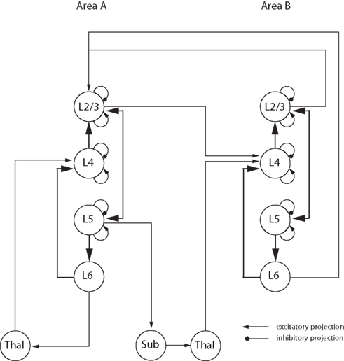
Cortical Layers interact with each other
It is a dynamical system but so far in laminar fMRI we are not really investigating processing dynamics

Slide 3
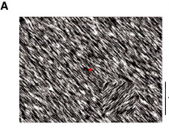
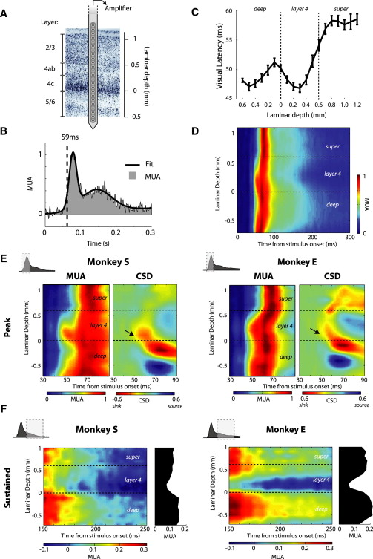
F) Ongoing layer-specific sustained response

Slide 4
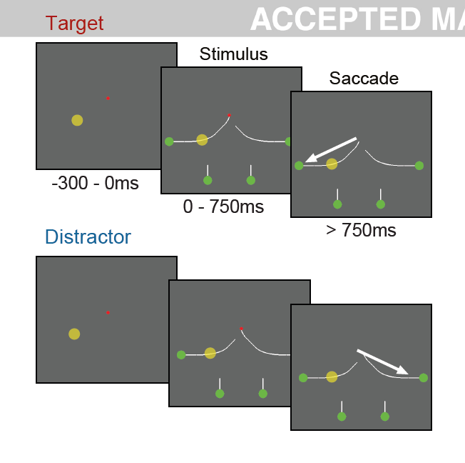
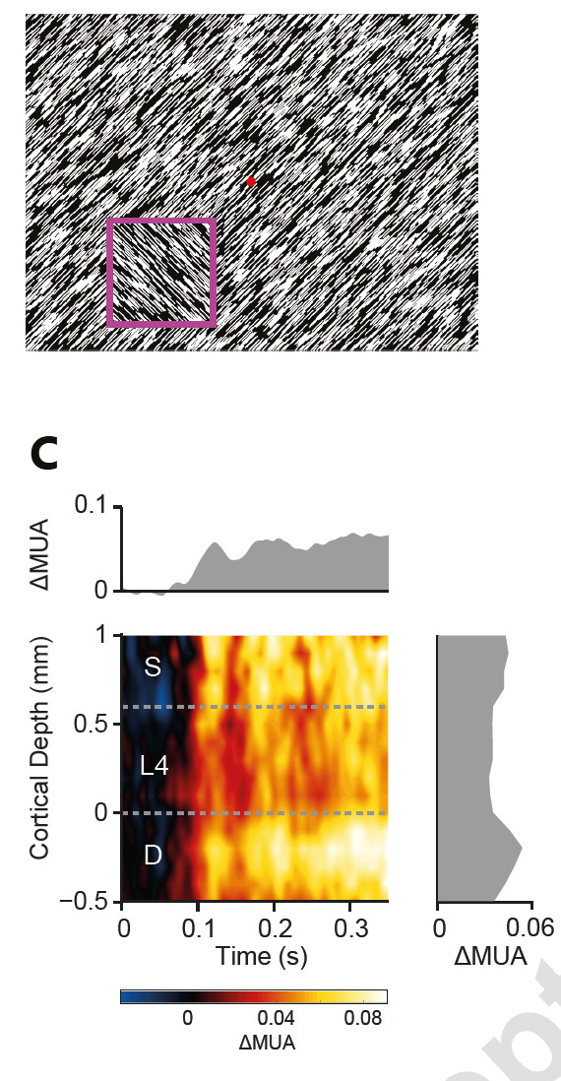
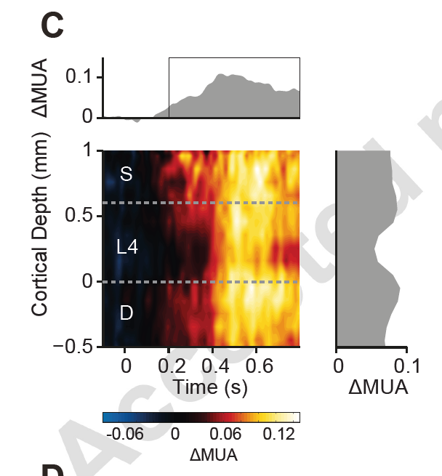
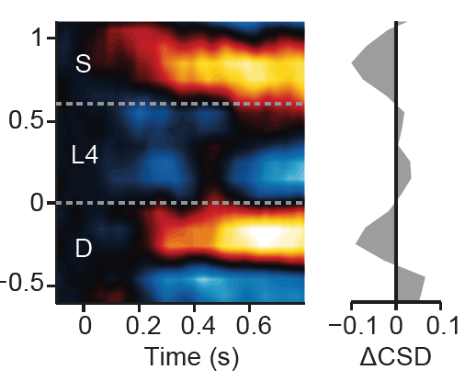
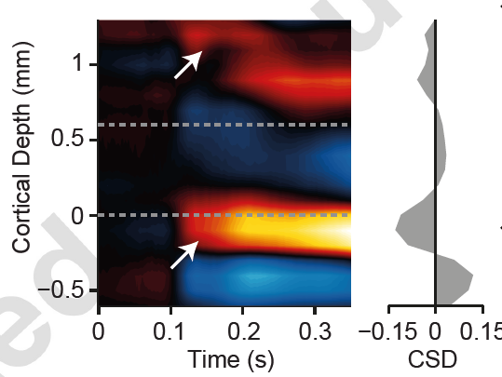
A phasic layer-effect exists in single cell recordings
Top Down information necessary – but still unclear what happens if we only show a stimulus?

Slide 5
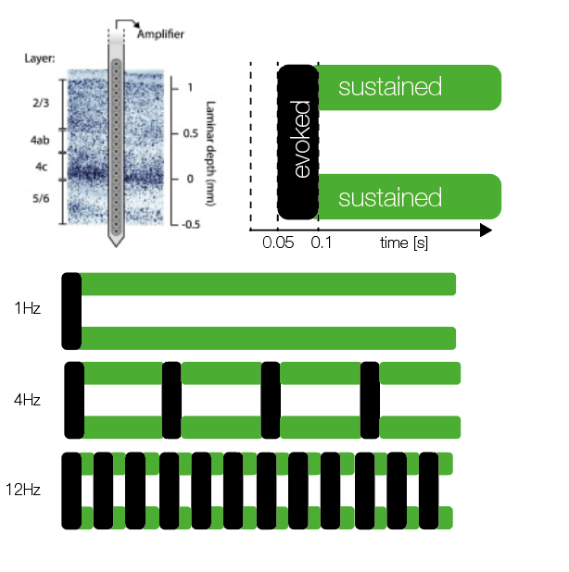
(draining vein artefact ignored here)

Slide 6
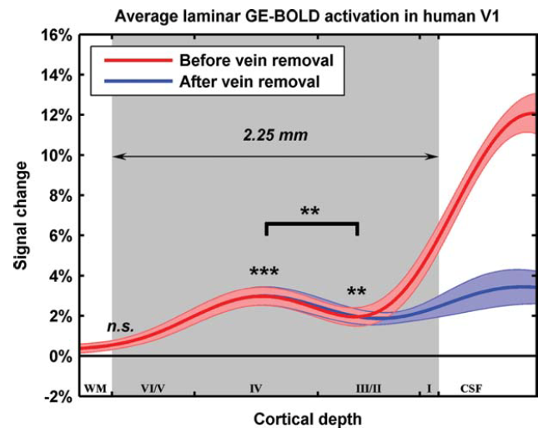
Koopmanns 2010, Checkerboard 7.5Hz

Slide 7
3x2(x2) Block Design
% Sustained Response
1Hz
4Hz
12Hz
‘’On’’ (stimulus task)
Attention
‘’Off’’ (fixation dot task)

Slide 8
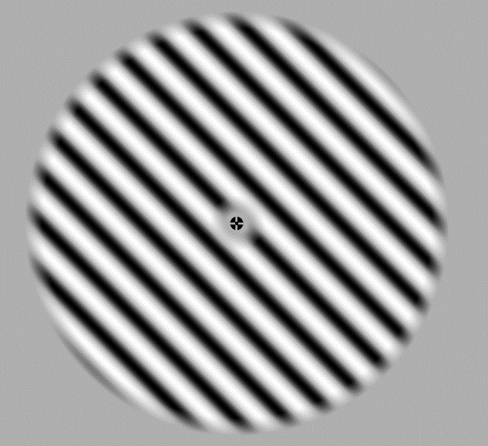
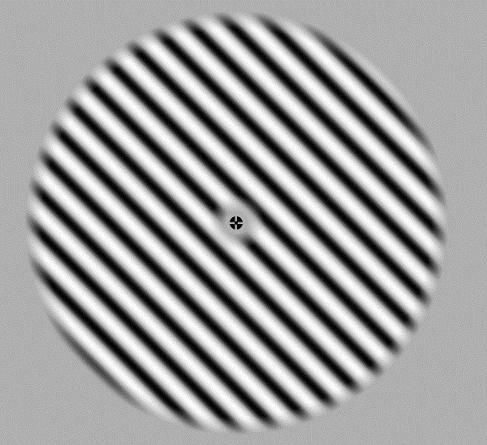
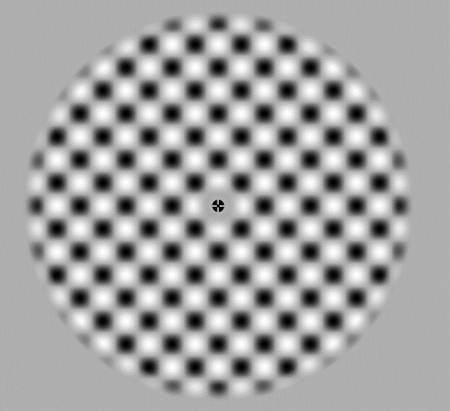
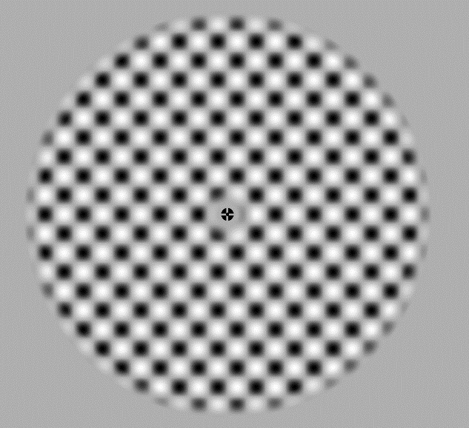
Catch-Stimuli
Normal Stimuli
Catch Stimuli
Stimulus-Catch trials have higher spatial frequency

Slide 9
2x3(x2) Last Factor is Orientation
We want “orientation’’ in order to subtract non-orientation-selective voxel activity from selective ones
I want to use standard orientation localizer with 4Hz flicker – very similar to one condition – problematic?

Slide 10
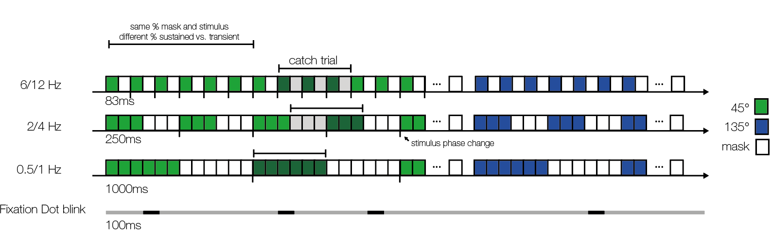
Stimulus Balancing
Phase change after every stimulus/mask change => No afterimage
Catch-Stimulus onset only during stimulus/mask-change => no catch-stimulus popout

Slide 11
So what would we learn?
Layer profile of sustained / transient activity
Translation of invasive findings to human
A new avenue to investigate interactions within layers

Slide 12
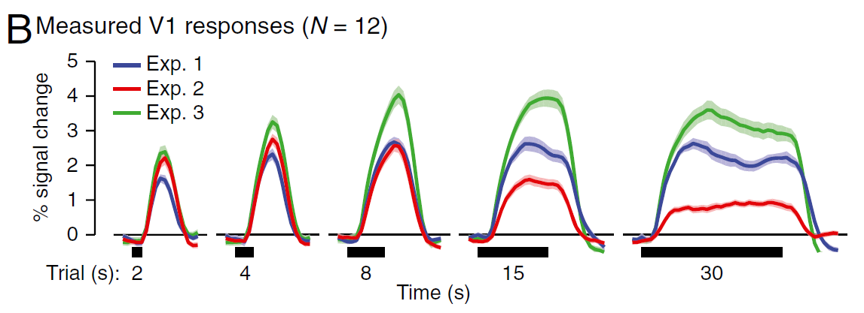
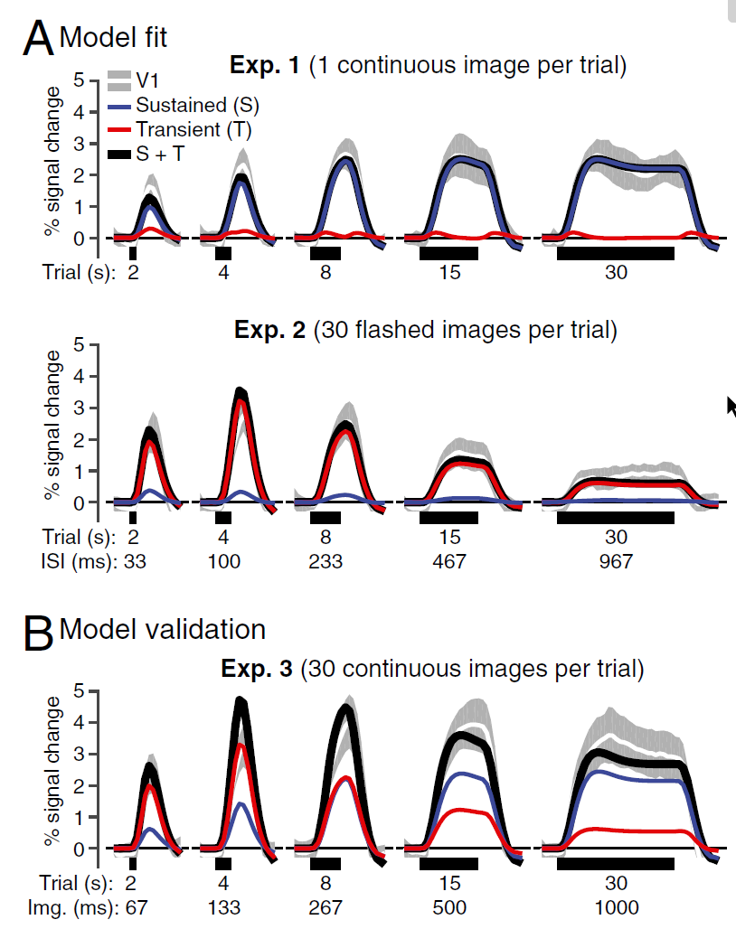
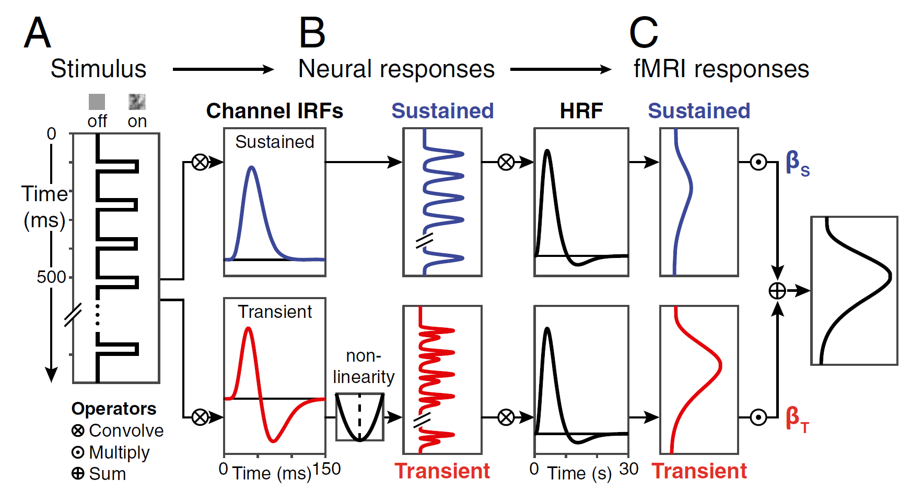
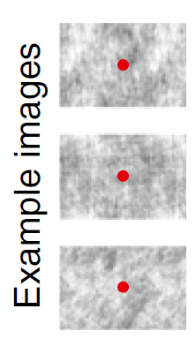
GLM doing very badly for Exp 2 (very short stim. dur.)

Slide 13
M-Pathway (transient) 4αC,
project to 4B
vs.
P-Pathway (sustained) 4βC
http://fourier.eng.hmc.edu/e180/lectures/v1/node9.html

Slide 14
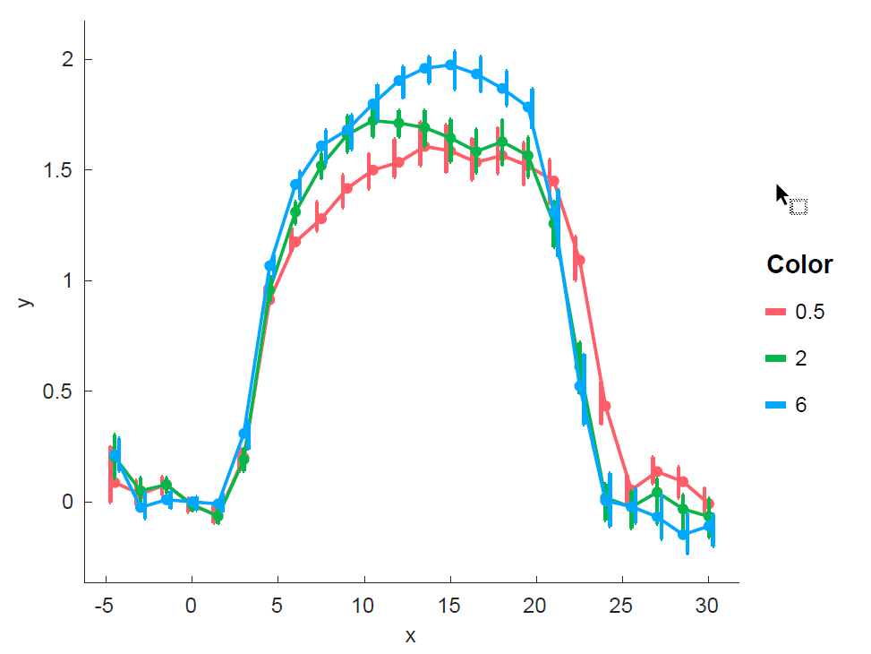
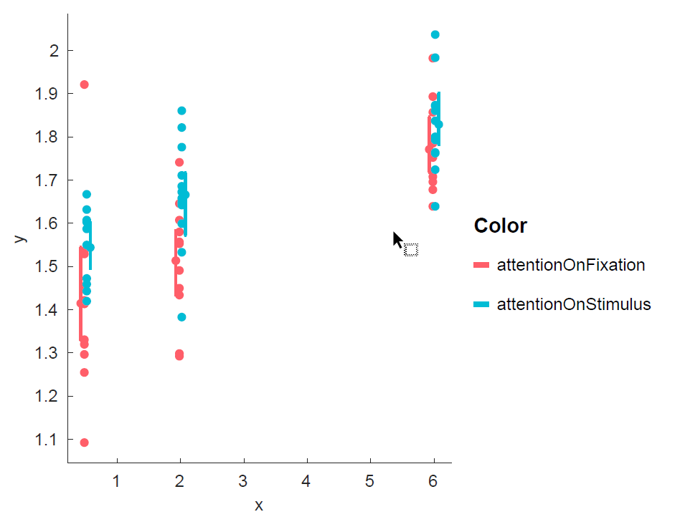
3T Subject

Slide 15
Open Issues
Power - Will the effect be large enough to see?
More stimulus switches/transients in fast vs. slow condition
Localizer – Localizer is design-wise closer to one one the conditions

