Slide 1
Machine Learning
For
Breast Cancer Detection
Behjat Saeidian
Python
Professor: Mr. Doozandeh

Slide 2
Breast Cancer
And
Machine Learning?

Slide 3
Outline
What is breast cancer?
What is machine learning?
Wisconsin dataset
Evaluate metrics
K-Nearest Neighbors algorithm
Random Forest algorithm
Naive Bayes algorithm
Support vector Machine algorithm
Summary
References

Slide 4
What is Breast Cancer?

Slide 5
Breast Cancer
cells in the breast grow out of control
The most frequently occurring cancer among women
Early detection increase chances of survival
Mammogram is a medical Technique for detection

Slide 6
What is Machine Learning?

Slide 7
Machine Learning
Branch of Artificial Intelligence
Inculcates the ability of learning into system
Supervised learning
Unsupervised learning

Slide 8
Wisconsin Dataset

Slide 9
Wisconsin Dataset
357 benign instance
212 malignant instance

Slide 10
Evaluation Metrics

Slide 11

Evaluation Metrics
Accuracy : $\frac{TP + TN}{TP + FP + TN + FN}$
Recall : $\frac{TP }{TP + FN}$
Precision : $\frac{TP }{TP + FP}$
F1 Score : $\frac{2∗(Precision∗Recall) }{Precision + Recall}$
TP : True positive
TN : True negative
FP : False Positive
FN : False Negative

Slide 12
K-Nearest Neighbors
(KNN)

Slide 13
What is KNN?
Supervised machine learning algorithm
Calculate distance to other data
Euclidean distance , Manhattan distance, Hamming distance, …
Find K-nearest neighbors
Set label for data
Classification : mode of K labels
Regression : mean of K labels

Slide 14
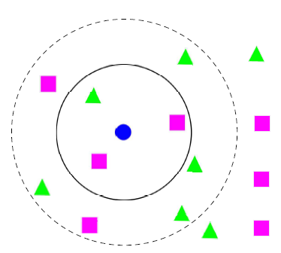
KNN Classification
Blue circle is test sample
Green triangle means malignant
Pink square means benign
Different k , Different labels
Run algorithm many times with different k to find optimal k

Slide 15
KNN Results
Accuracy = 95.9%
Precision = 98.27%
Recall = 90.47%
F1 Score = 94.20%

Slide 16
Random Forest

Slide 17
What is Random Forest?
Supervised machine learning algorithm
Large number of individual Decision Tree
Majority – Voting or averaging on decision trees results
Use for Classification and Regression

Slide 18
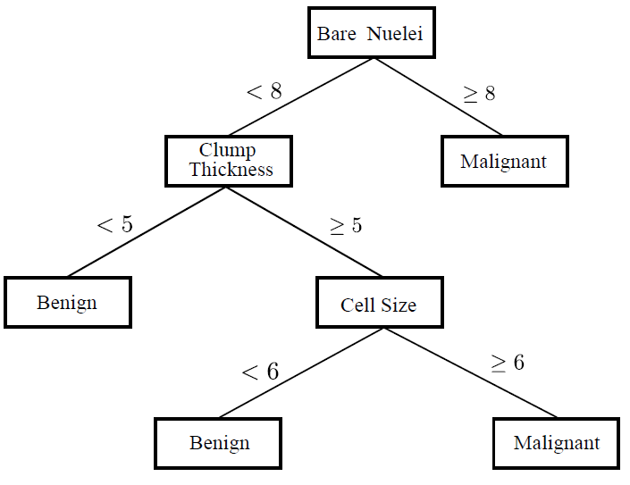
Decision Tree
Benign or malignan?

Slide 19
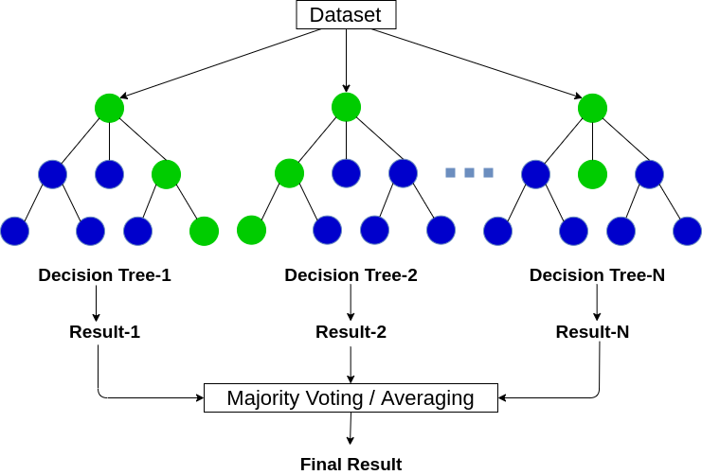
Random Forest

Slide 20
Random Forest Results
Accuracy = 94.74%
Precision = 92.18%
Recall = 93.65%
F1 Score = 92.90%

Slide 21
Naive Bayes

Slide 22
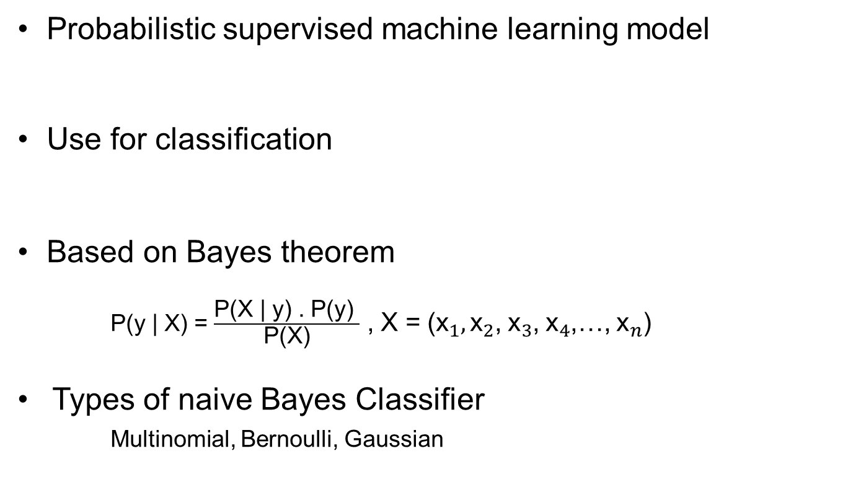
What is Naive Bayes?
Probabilistic supervised machine learning model
Use for classification
Based on Bayes theorem
P(y | X) = $\frac{\text{P}\text{(}\text{X}\text{ | }\text{y}\text{)}\text{ . }\text{P}\text{(}\text{y}\text{) }}{\text{P}\text{(}\text{X}\text{)}}$ , X = (${\text{x}}_{1},{\text{x}}_{2}$, ${\text{x}}_{3}$, ${\text{x}}_{4}$,…, ${\text{x}}_{n}$)
Types of naive Bayes Classifier
Multinomial, Bernoulli, Gaussian

Slide 23
Naive Bayes Results
Accuracy = 94.47%
Precision = 88.52%
Recall = 85.71%
F1 Score = 87.09%

Slide 24
Support Vector Machine
(SVM)

Slide 25
What is SVM?
Supervised machine learning algorithm
Use for Classification and regression
Find hyperplane for separate classes
Set label for data

Slide 26
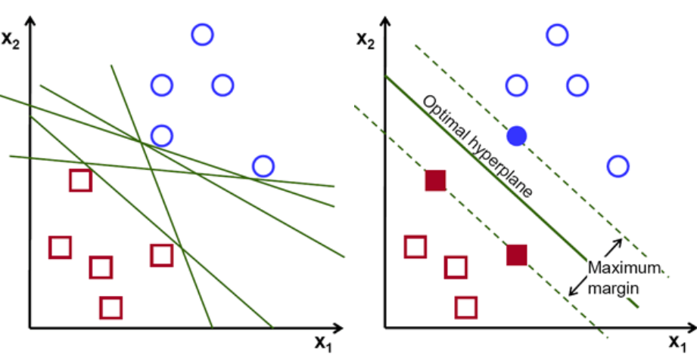
SVM
Optimal Hyperplane has maximum margin

Slide 27
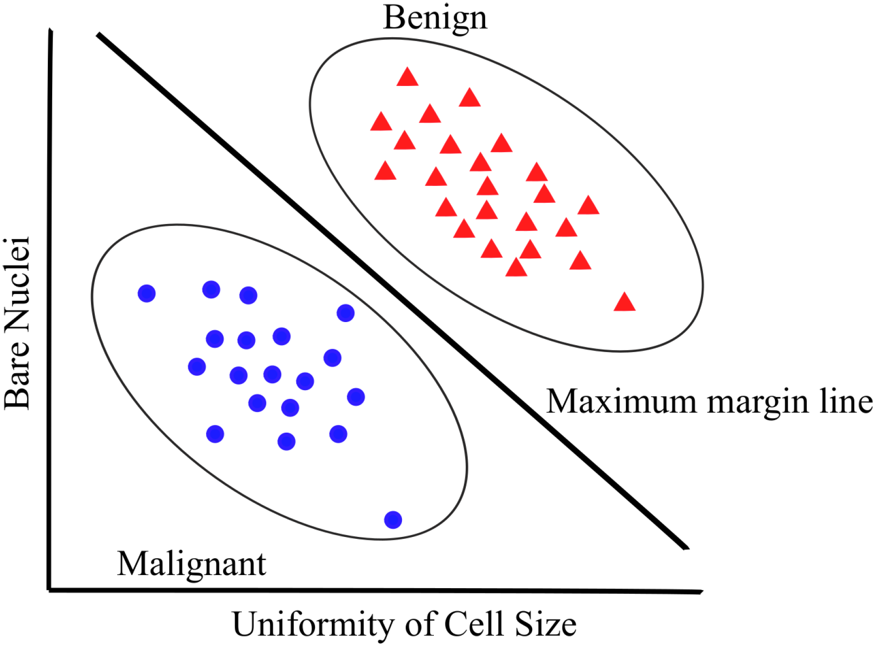
SVM Results
Accuracy = 97.0%
Precision = 96.55%
Recall = 96.85 %
F1 Score = 96.69%

Slide 28
Summary
Early detection of breast cancer can save a lot of lifes
Compare four supervised machine learning algorithm on Wisconsin dataset for Breast Cancer detection
KNN, Random Forest, Naive Bayes on same condition
KNN has best accuracy(95.90) , precision(98.27) , F1 Score(94.2)
Random Forest(93.65) has best recall
SVM has 97% accuracy , 96.55% precision , 96.85% recall and 96.69% F1 Score

Slide 29
References
[1] Shubham Sharma, Archit Aggarwal, Tanupriya Choudhury, “Breast Cancer Detection Using Machine Learning Algorithms”,2018
[2] Dana Bazazeh, Raed Shubairm, “Comparative Study of Machine Learning Algorithms for Breast Cancer Detection and Diagnosis”,2016
[3] Wenbin Yue, Zidong Wang, Hongwei Chen, Annette Payne, Xiaohui Liu,
“Machine Learning with Applications in Breast Cancer Diagnosis and Prognosis”,2018

Slide 30
Thank You ☺
Questions?

