Slide 1

“Push yourself because, no one else is going to do it for you”

Slide 2

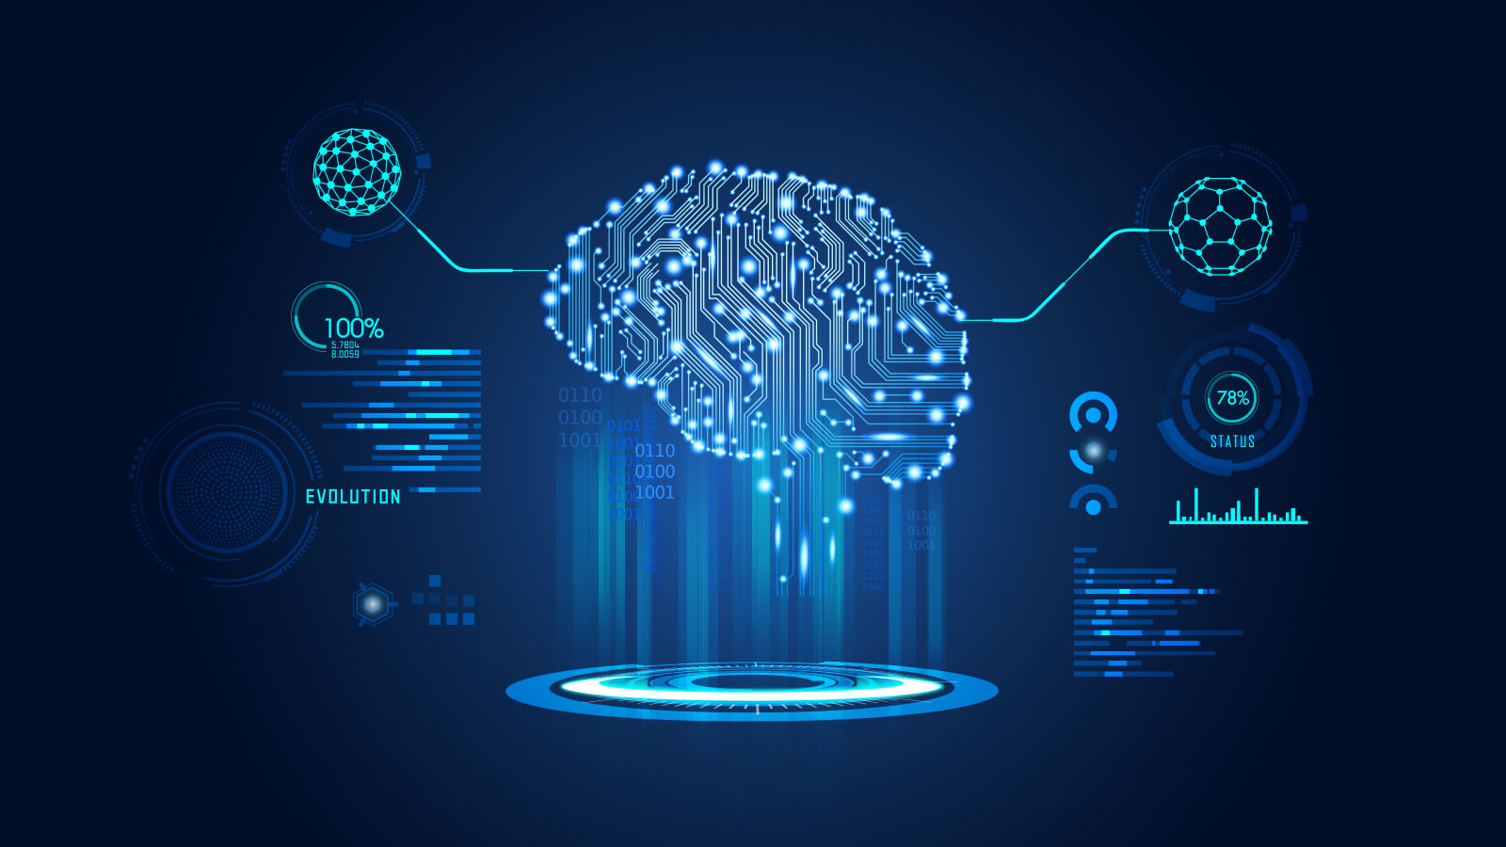
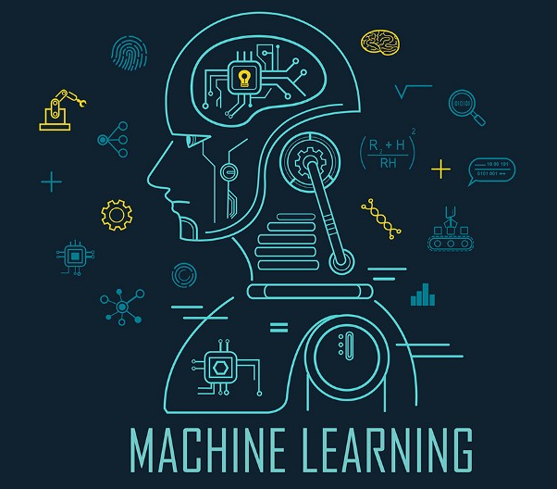
Machine Learning
Introduction

Slide 3

Humans vs Machines
How to make Machines Learn
What is Machine Learning ?
Examples of Machine Learning
Overview of Machine Learning

Slide 4
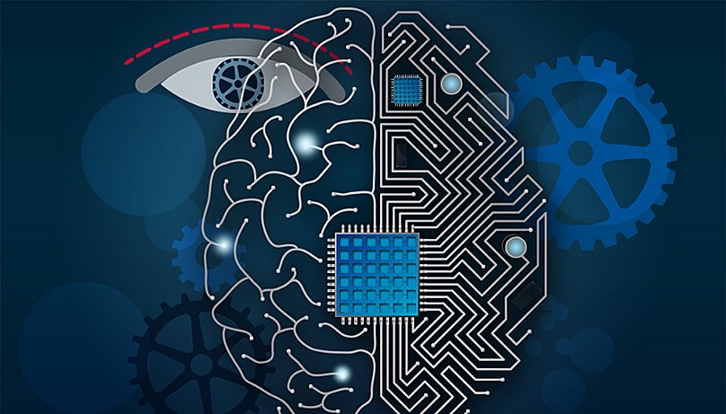
Humans Vs Machines
How is a machine different from humans?
Why can’t a machine learn by itself?

Slide 5
Humans Vs Machines
Our history and our literature show us that for most of human history machines were seen as tools to help people do more than they were capable of on their own.
Machines followed orders of humans and performed tasks while humans are capable of performing tasks by themselves. Humans can do this because they learn from past experience and make a decision according to the experiences while the machine doesn’t learn from past experience. Thus, machines aren’t capable of making decisions by themselves.
Thus, a machine cannot learn by itself and requires to learn decision making. In ML we incorporate decision-making capabilities in machines so that they can mimic human behavior.

Slide 6
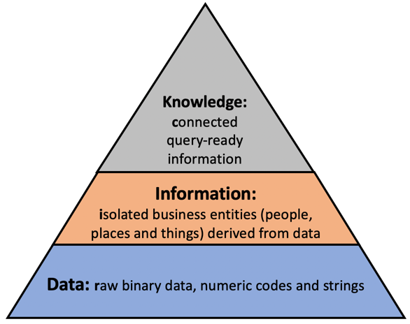
How to make a Machine Learn?
According to Tom Mitchell, a machine is said to learn from experience E with resect to some task T and some performance measure P, if its performance on T, as measured by P, improves with experience E.
In general, the following are the steps to make machines learn –
Gathering raw data or experience [ BIG DATA HADOOP ]
Converting data into information [ DATA MINING ]
Gathering knowledge from information [ MACHINE LEARNING ]
Becoming intelligent to make decisions

Slide 7

What is Machine Learning ?

Slide 8
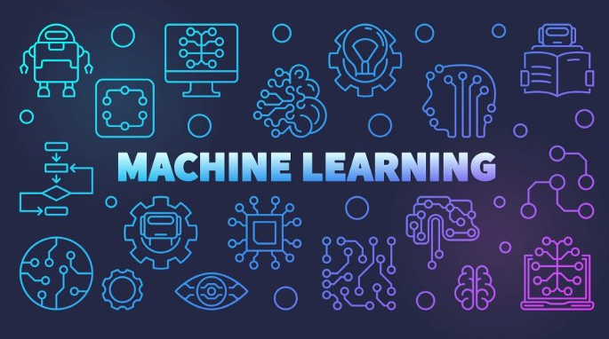
What is Machine Learning ?
Machine Learning (ML) is a branch of computer science where we develop algorithms that make a machine learn to do something without actually making computations about it.
The basic premise of machine learning is to build algorithms that can receive input data and use statistical analysis to predict an output while updating outputs as new data becomes available.

Slide 9
Difference between AI, ML and DL

Slide 10
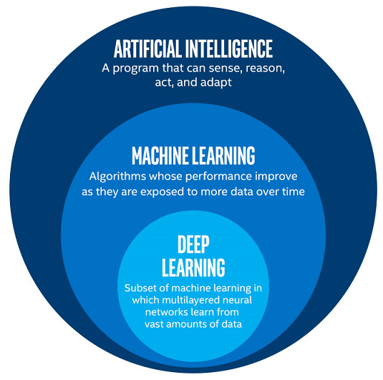
Difference between AI, ML and DL

Slide 11
Difference between AI, ML and DL
Artificial Intelligence | Machine Learning | Deep Learning
AI means to replicate a human brain, the way a human brain thinks, works and functions. | Machine learning is one subfield of AI. The core principle here is that machines take data and “learn” for themselves. | Deep Learning is a subset of ML. The main difference between deep and machine learning is, machine learning models become better progressively but the model still needs some guidance
The main goal here is to increase the success rate of an algorithm instead of increasing accuracy. | The main goal here is to increase the accuracy of an algorithm instead of its success rate. | The main goal here is to increase the accuracy of an algorithm without any explicit help from the programmer.

Slide 12
Examples of Machine learning

Slide 13





Examples of Machine learning
PREDICTION
Housing Price
Probability of fault
Stock Market
IMAGE RECOGNITION
Biometric Locks
Face Detection
Image classification
SPEECH RECOGNITION
Voice Dialing
Call Routing
Conversations
MEDICAL DIAGNOSIS
Cancer Recognition
Predicting Diseases
SMART ASSISTANTS
Google Assistant
Amazon Alexa
Cortana

Slide 14
Overview of Machine Learning
MACHINE LEARNING
Supervised ML
Unupervised ML
Reinforcement Learning
Regression
Linear Regression
Decision Tree Regression
Random Forest Regression
Classification
Logistic Regression
K-Nearest Neighbor
Support Vector Machines
Naïve Bayes
Decision Tree
Random Forest
Clustering
K Means Clustering
Hierarchal Clustering
Environment / Decision based learning

Slide 15
Thank You

