Slide 1
Sentiment Analysis
Presented by
Prakhar Sharma 2815062
Ayush Khanna 2815070
Vaibhav Behl 2815091

Slide 2

What is SA ?
Identify the orientation of opinion in a piece of text
Can be generalized to a wider set of emotions
The movie
was fabulous!
The movie
stars Mr. X
The movie
was horrible!

Slide 3
Tripod of Sentiment Analysis
Cognitive Science
Sentiment Analysis
Machine Learning
Machine Learning
Natural Language Processing
Natural Language Processing

Slide 4
Motivation
Knowing sentiment is a very natural ability of a human being.
Can a machine be trained to do it?
SA aims at getting sentiment-related knowledge especially from the huge amount of information on the internet
Can be generally used to understand opinion in a set of documents

Slide 5
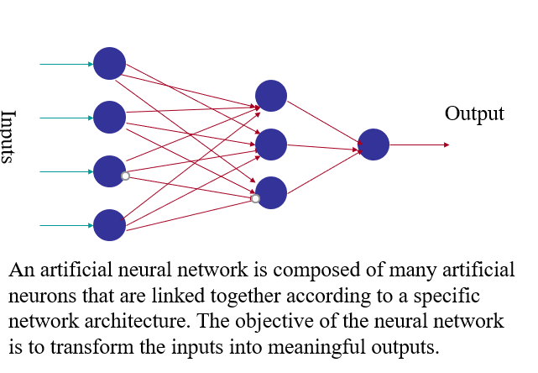
Artificial neural networks

Slide 6
Classification report
Precision Score
TP – True Positives FP – False Positives
Precision – Accuracy of positive predictions. Precision = TP/(TP + FP)
Recall Score
FN – False Negatives
Recall (aka sensitivity or true positive rate): Fraction of positives That were correctly identified. Recall = TP/(TP+FN)

Slide 7
F1 Score
F1 Score (aka F-Score or F-Measure) – A helpful metric for comparing two classifiers. F1 Score takes into account precision and the recall. It is created by finding the the harmonic mean of precision and recall.
F1 = 2 x (precision x recall)/(precision + recall)

Slide 8
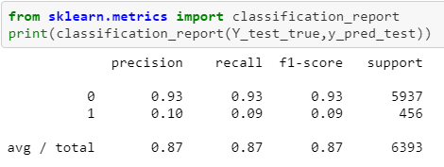
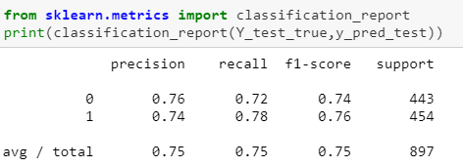
Output ( test data)
Without sampling
With sampling

Slide 9
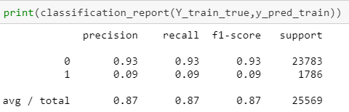
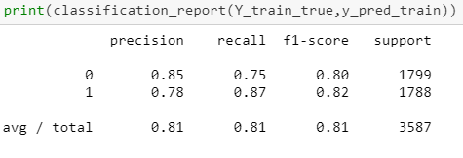
Output (train data)
Without sampling
With sampling

Slide 10
Confusion matrix
A confusion matrix is a summary of prediction results on a classification problem. The number of correct and incorrect predictions are summarized with count values and broken down by each class. This is the key to the confusion matrix. The confusion matrix shows the ways in which your classification model is confused when it makes predictions. It gives us insight not only into the errors being made by a classifier but more importantly the types of errors that are being made.

Slide 11
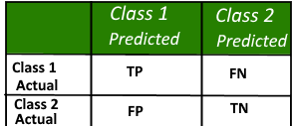
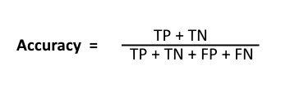
Here, • Class 1 : Positive • Class 2 : Negative
Definition of the Terms: • Positive (P) : Observation is positive (for example: is an apple). • Negative (N) : Observation is not positive (for example: is not an apple). • True Positive (TP) : Observation is positive, and is predicted to be positive. • False Negative (FN) : Observation is positive, but is predicted negative. • True Negative (TN) : Observation is negative, and is predicted to be negative. • False Positive (FP) : Observation is negative, but is predicted positive.
Classification Rate/Accuracy: Classification Rate or Accuracy is given by the relation:

Slide 12
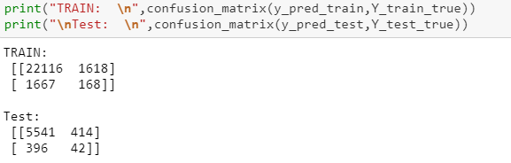
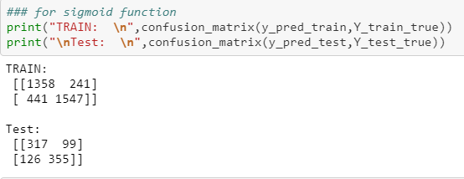
Output
Without sampling
With sampling

Slide 13
Thank You

