Slide 1


CloudSurfer
Beh Ming Jun

Slide 2
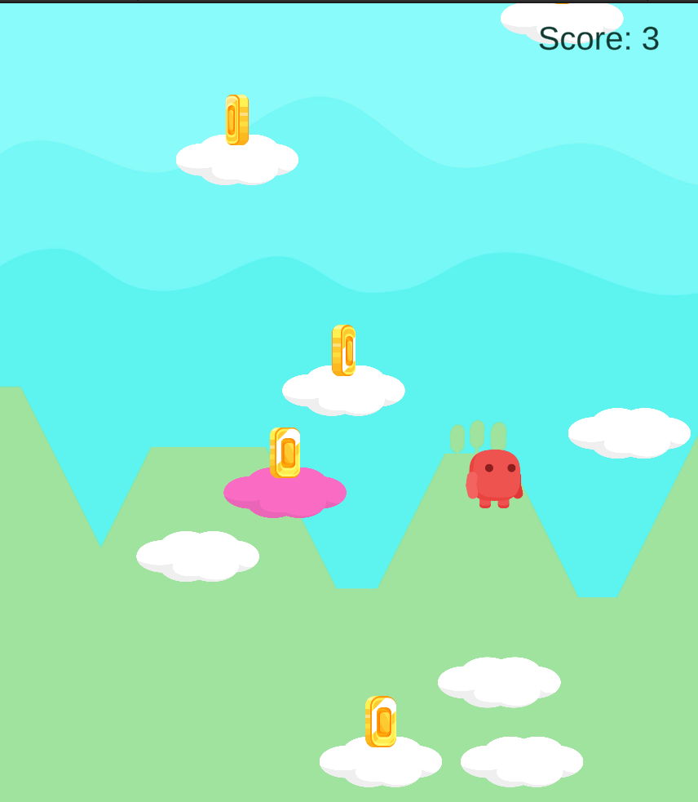
Introduction
I got inspired by a few of my favourite childhood mobile games – Doodle Jump and Mega Jump.
Hence, I created my own CloudSurfer – a 2D unity mobile game.

Slide 3


Softwares
Unity
C#
Used to make the game scene and objects interact.
Used to code out the game scripts using UnityEngine Library

Slide 4
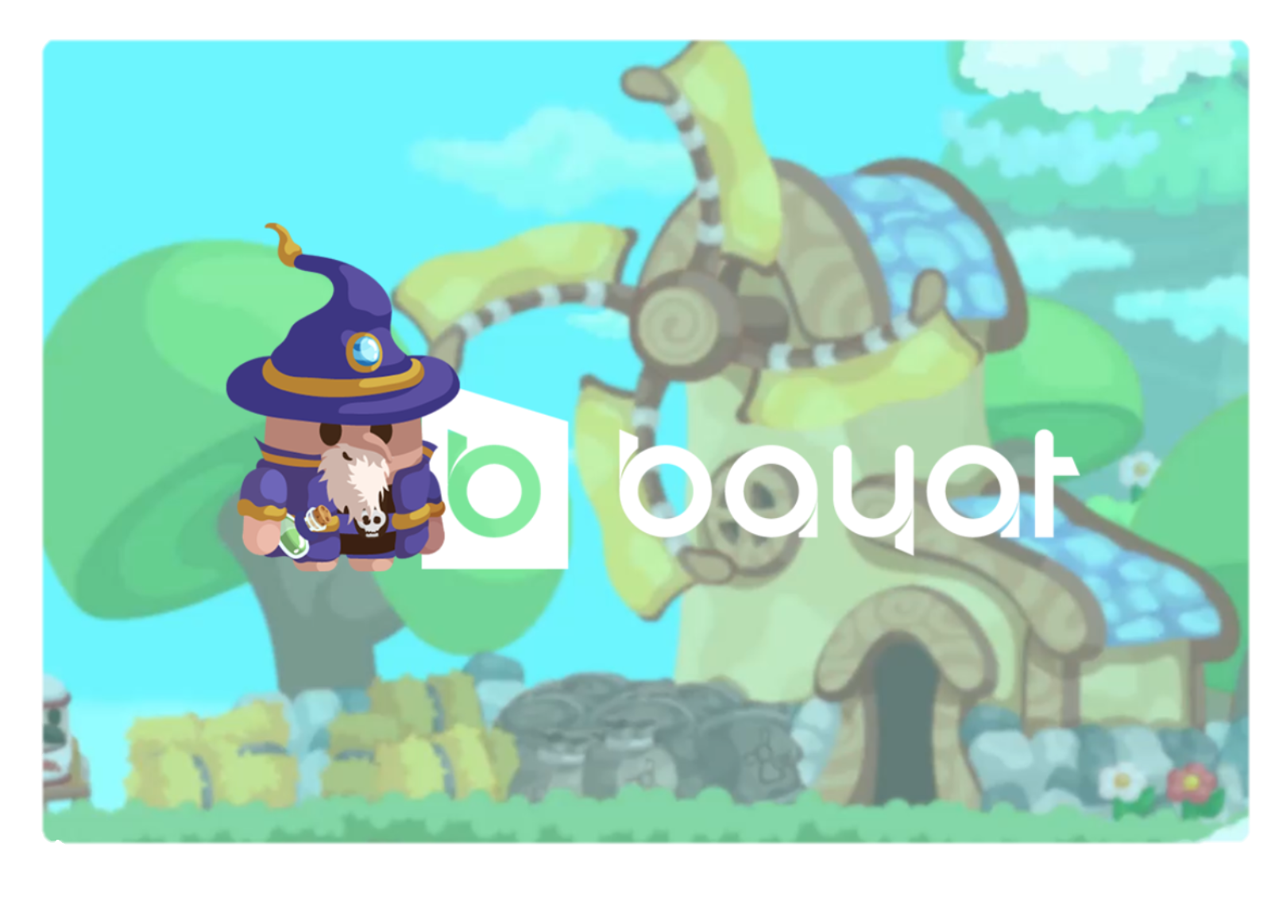
Assets
Bayat Games
Bayat Games provided the free assets pack with the amazing player, coin, background images etc.

Slide 5
Game Objects
01
Mr CloudSurfer
Mr CloudSurfer is a olympic jumper and collects gold coins as his hobby!

Slide 6


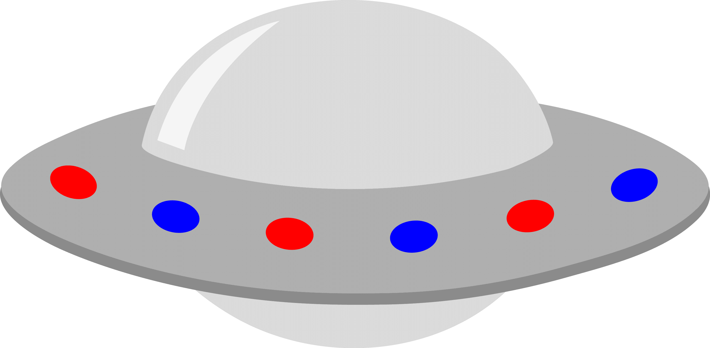
Game Objects
02
03
04
05
Platform
Coin
Land on the platform to jump even higher.
Collect coins to get higher score.
SuperPlatforms
UFO
Jump even higher when you land on these super platforms!
Avoid UFOs at all costs.

Slide 7
Game Scripts
CameraFollow | Camera will follow the player.
Player | Controls player movement and ends the game if player falls out of screen.
Platform | Pushes player up (simulate jumping by player) and has a coin object (random spawn). When out of screen, respawn.
Coin | When player touches coin, use Score Manager to add points and destroy itself.

Slide 8
Game Scripts
UFOEnemy | Destroys the Player object and calls GameManager to end the game.
LevelGenerator | Generates the platforms, super platforms and UFO randomly.
GameManager | In charge of loading the GameOver and MainMenu screen.
ScoreManager | Keeps track and update the score on the game screen.

Slide 9
Game Scripts
MainMenu | Start the Game Scene.
GameOverScreen | Displays the final score and allows player to play again or go back to Main Menu.

Slide 10
Game Interactions
Left Arrow Button | Moves player to the left.
Right Arrow Button | Moves player to the right.
Touch Screen | Interact with the Main Menu and Game Over buttons.

Slide 11
Game Demo

Slide 12
Possible Extensions
Moving UFO
Platform that breaks after a single jump
Highscore tracking
Power ups eg. Shield to protect player from UFO or magnet to automatically collect all the coins
Implementing mobile version (tilt phone to move player)

Slide 13
Challenges
Take Note
1. Need to consider how the different scripts work together since there are many ways of doing things (object composition)
2. A lot of unexpected issues arise when running the game

Slide 14
Learning Points
Take Note
1. Build a good foundation
2. Have a design plan first
3. Don’t give up
4. Google and Youtube are your friends
5. Have fun ☺

Slide 15
Thank you!
CREDITS: This presentation template was created by Slidesgo, including icons by Flaticon, infographics & images by Freepik

