Slide 1
Behnish Mann (Dogwood Health Consulting)
Let’s Build Smart on FHIR App in Python
Notes:
https://github.com/nazrulworld/fhir.resources

Slide 2

Who am I?
Behnish Mann
FHIR Developer
Dogwood Health Consulting

Slide 3
Session Goals
SMART Launch Setup/Standalone Launch
OAuth Authentication via MyChart(Epic)
Token Exchange and Scopes
RESTful FHIR Queries with Epic Sandbox/HAPI

Slide 4
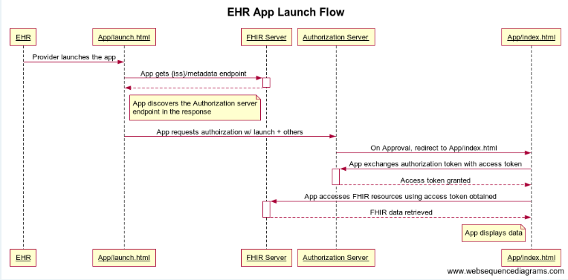
EHR App Launch Flow
Notes:
https://fhir.epic.com/interconnect-fhir-oauth/api/FHIR/R4/

Slide 5
oAuth 2.0 Workflow
Launch: The EHR initiates the app, passing a launch context to it.
Authorization Request: The app requests authorization from the EHR's authorization server.
Authorization Grant: If the user (or the EHR system itself) authorizes the request, the server returns an authorization code.
Access Token Request: The app exchanges the authorization code for an access token.
Access Token Response: The server returns an access token and a patient identifier.
API Calls: The app uses the access token to access the FHIR API and retrieve patient data.

Slide 6
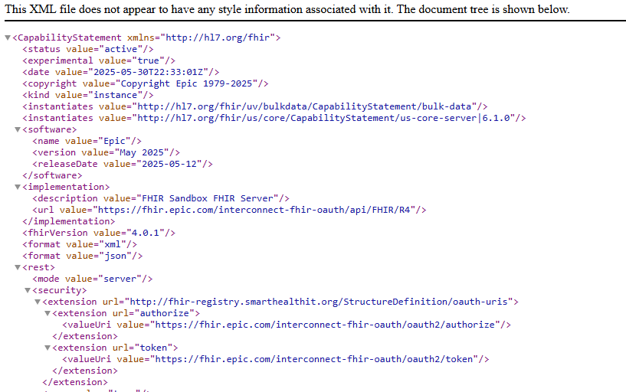
Metadata
Notes:
https://fhir.epic.com/interconnect-fhir-oauth/api/FHIR/R4/

Slide 7
Authorization Parameters
Response_type = code
Client_id = Provider by Vendor
Redirect_uri = url of your callback
Scope = Patient.Read, write
State
Launch

Slide 8
Access Token Parameters
Code= Received from previous step
Grant_type =token
Client_id
Redirect_uri
State

Slide 9
Install – Modules and Libraries
Install Python
Create New Project in VS Code
Install following modules:
Flask (Terminal: ‘pip install flask’)
Bootstrap
App Layout set-up
Install following libraries:
Fhirpy
Fhir.resources

Slide 10
Python Library – FHIRpy
What is FHIRpy?
A lightweight Python library for FHIR data manipulation
Built on top of the FHIR data model, designed for ease of use
Compatible with FHIR R4, R3, and DSTU2 versions
Key Features:
Search, create, update, delete, and read FHIR resources
Use FHIRPath to extract and manipulate data
Bundle resource support for batch and transaction operations
JSON and XML serialization/deserialization
Notes:
http://157.245.79.105:8080/fhir/Patient

Slide 11
Python Library – FHIR.resources
What is FHIR.resources?
A Python package for FHIR resource model generation
Automatically generates Python classes from FHIR specifications
Supports FHIR R4, R3, and DSTU2 versions
Key Features:
Provides Pythonic access to FHIR resources and their elements
Validates resources against FHIR specifications
Includes FHIRPath support for data extraction and manipulation
Interoperable with other FHIR libraries and tools

Slide 12
Let’s Build Python app!

Slide 13
Contact
You can find / reach me here:
behnish.mann@dogwoodhealthconsulting.com

Slide 14
Common Issues & Tips
Redirect URI mismatch → check your app registration
Invalid scopes → ensure proper SMART scopes
Epic sandbox may have demo patients only

Slide 15
Q&A
Text to add to slide

Slide 16
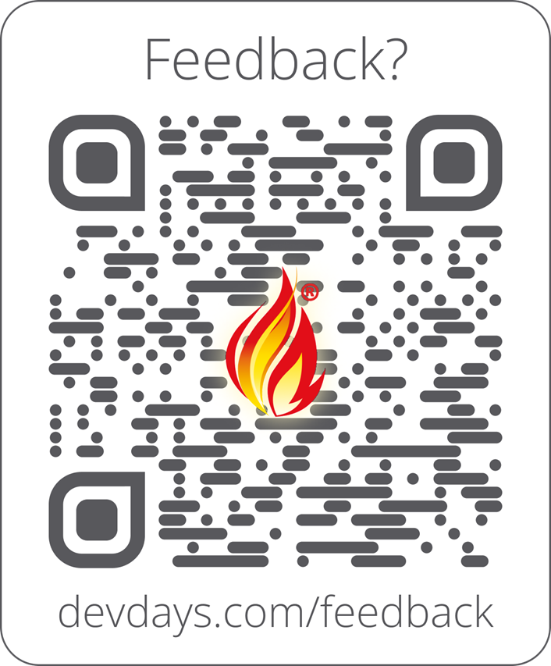
Feedback
Include link and/or QR code to collect feedback on your talk and DevDays
https://www.devdays.com/feedback/

