Slide 1
Optimal control of An axial dispersion tubular reactor with delayed recycle
Authors
Behrad Moadeli
Guilherme Ozorio Cassol, PhD
Stevan Dubljevic, PhD

Slide 2
Presentation Outline
Introduction and Literature Review
Open-loop System Design
Optimal Control
Results and Discussion
Conclusion
References

Slide 3
1- Introduction and Literature Review
Distributed Parameters System
Axial Dispersion Tubular Reactor with Recycle
Notion of Delay in Recycle Flow
Problem Statement
Literature Review

Slide 4
Distributed Parameter Systems (DPS)
Spatially varying states in model
Partial Differential Equations (PDE)
Infinite-dimensional systems
Regulator / Observer design becomes challenging

Slide 5
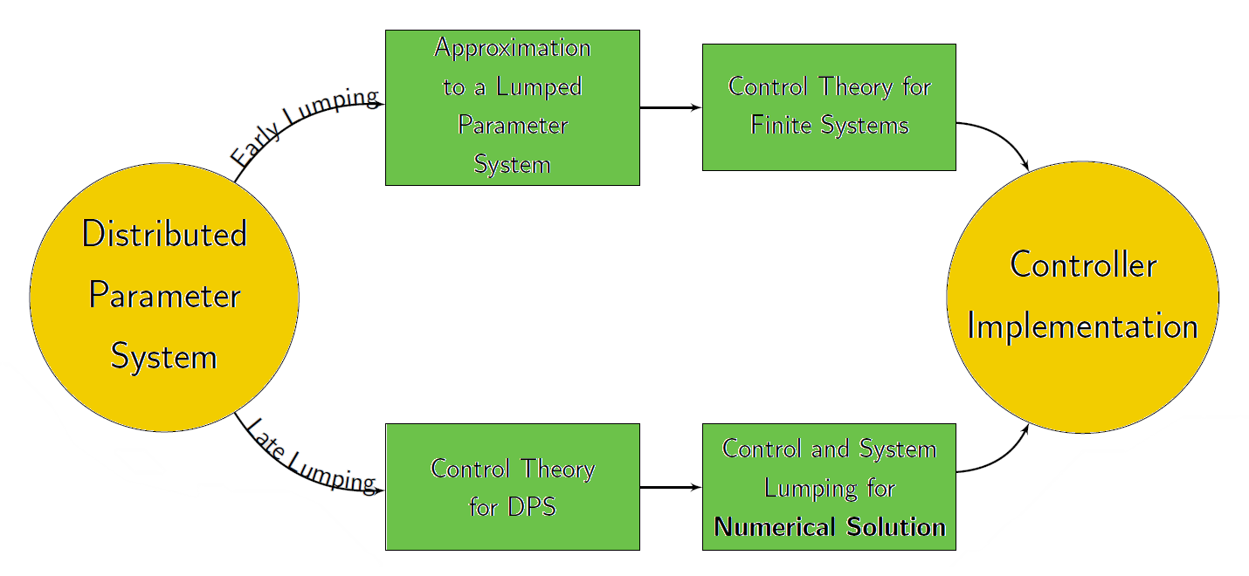
DPS: Early Lumping vs. Late Lumping
[1]

Slide 6
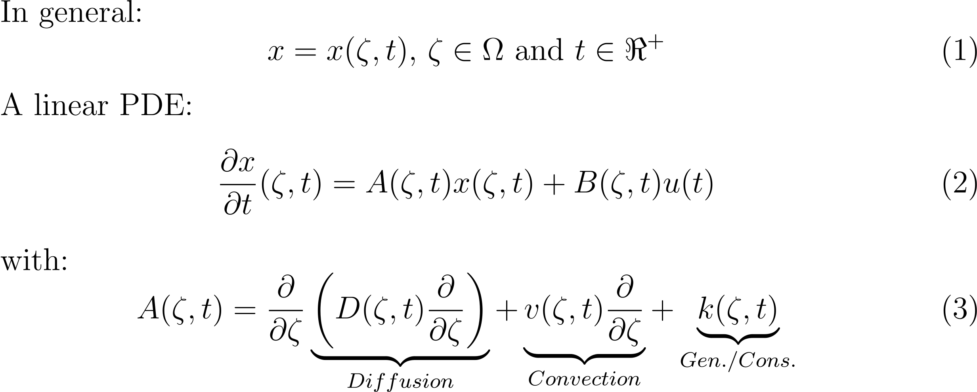
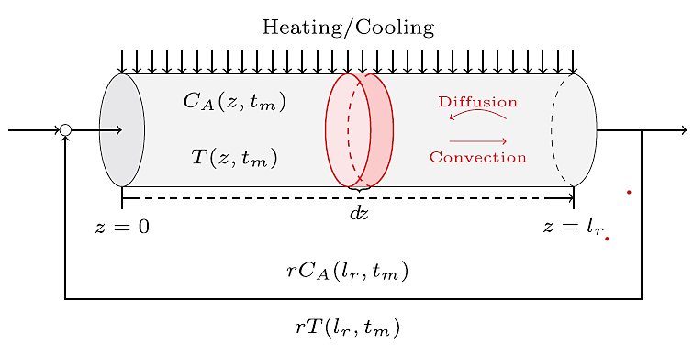
Axial Dispersion Tubular Reactor
Figure 1 - Schematic view an axial dispersion tubular reactor with recycle [2]

Slide 7
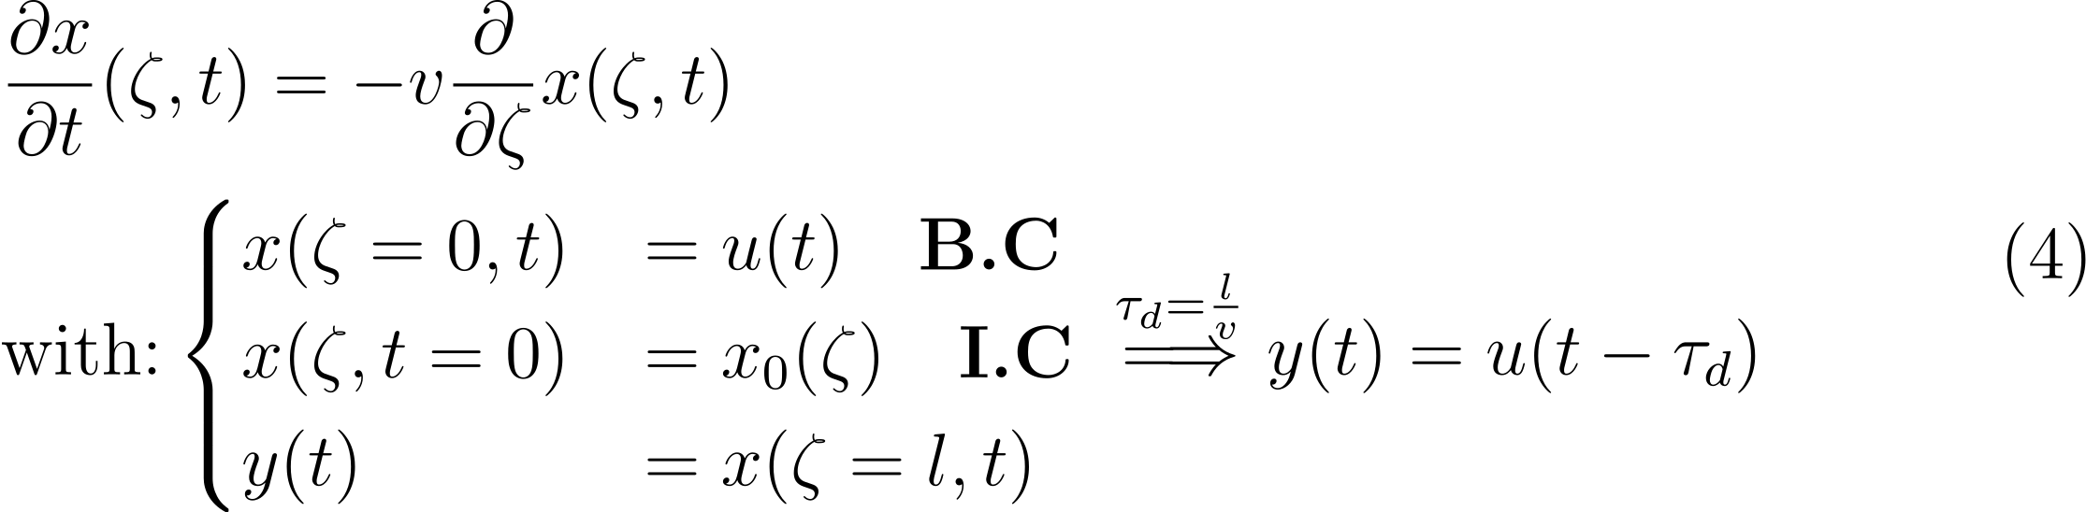
Notion of Delay
Recycle flow: Pure Transport (Plug Flow)
Equivalent to Notion of Delay:
Figure 2 – Pure Transport Representation

Slide 8
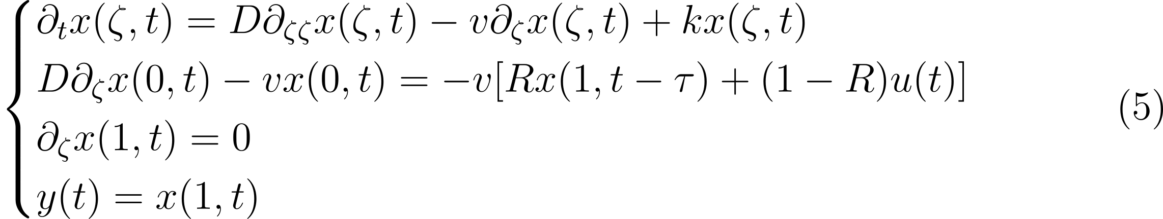
Problem Statement: Model
Dispersion Tubular Reactor: Second Order Parabolic PDE
Recycle Flow: First Order PDE
Considering Danckwerts boundary conditions
Input applied at the Boundary (Boundary-Control Problem)

Slide 9
Problem Statement: Methodology and Goals
Open-loop modeling using Late Lumping Methods
Spectrum (Eigenvalue) Analysis
Determining Dominant Modes
Continuous Infinite-dimensional Optimal Controller
Confirm Stability of the Closed-loop System

Slide 10
Literature Review
Optimal in-domain Control of Scalar Infinite-dimensional Systems [3]
Optimal Boundary Control of Infinite-dimensional Spectral Systems [4]
Model Predictive Control of Axial Dispersion Tubular Reactors with Instantaneous Recycle [2]
Optimal Boundary Control of First-order Hyperbolic Systems [5]

Slide 11
2- Open-loop System Design
Eigenvalue Problem
Adjoint Operator
Characteristic Equation
Eigenvalue Distribution (Spectrum Analysis)
Eigenfunctions (Bi-orthogonal Basis)
Dominant Modes

Slide 12
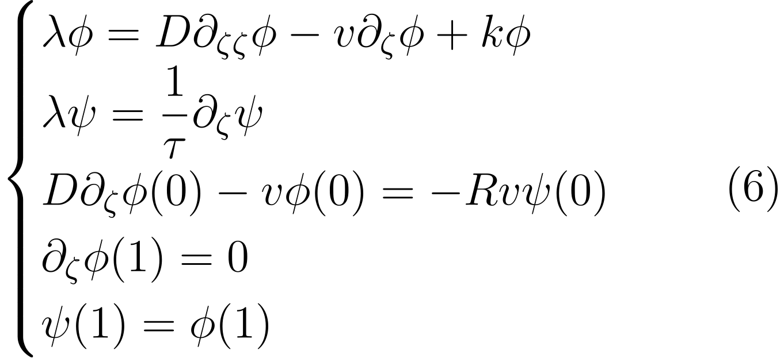
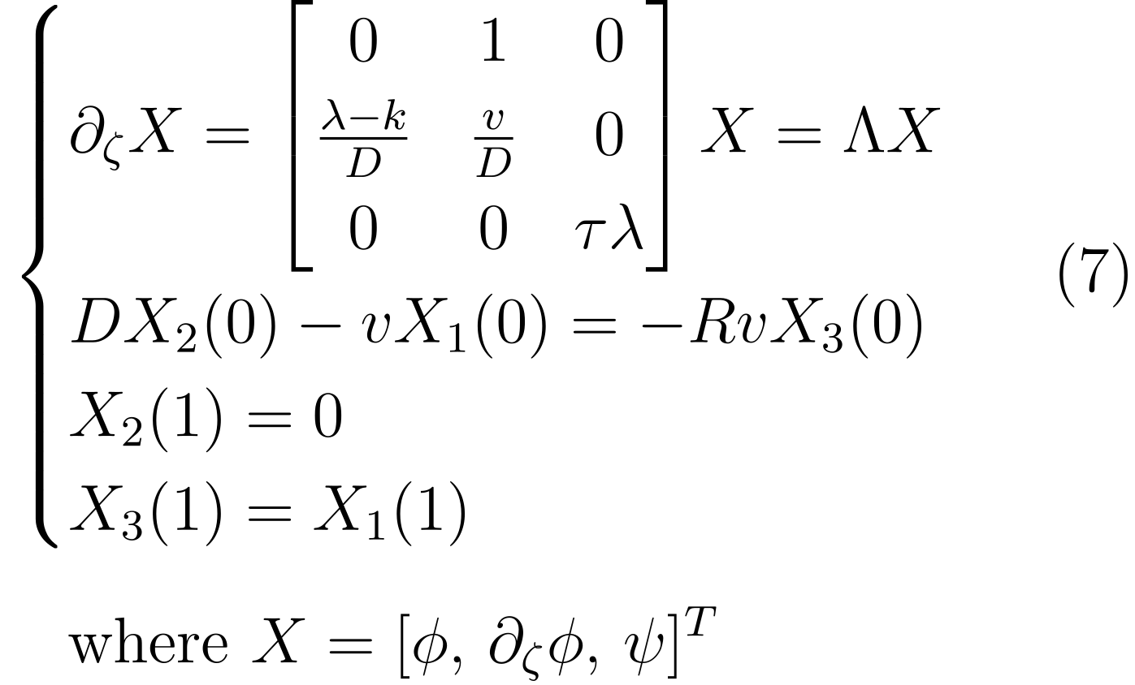
Eigenvalue Problem

Slide 13
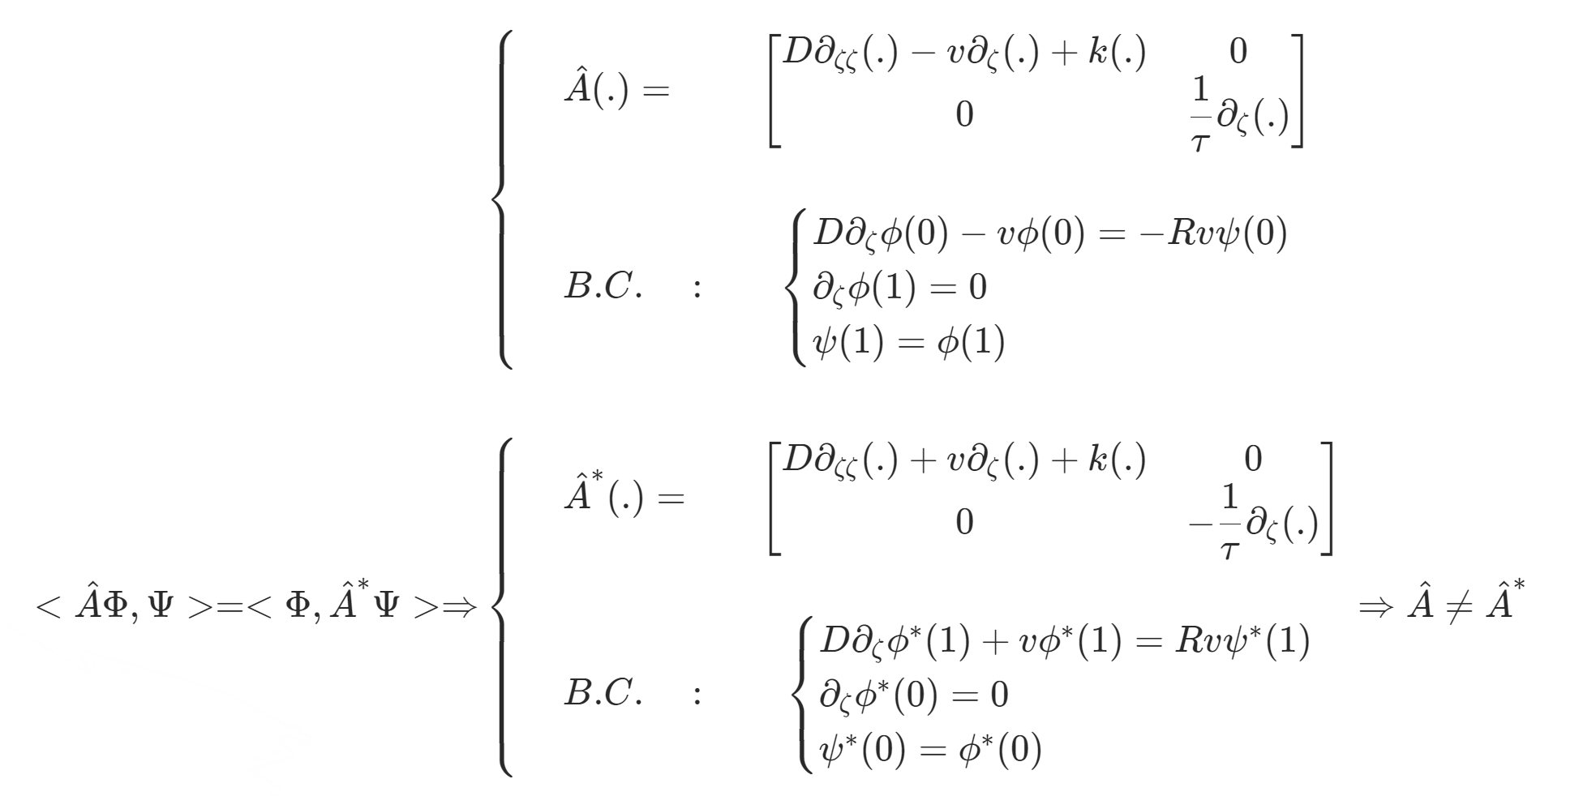

Finding the Adjoint Operator

Slide 14
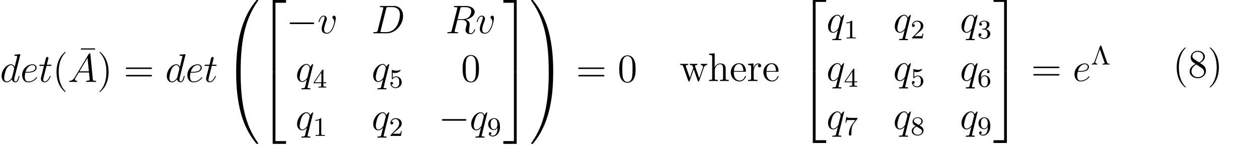
Characteristic Equation
Breaking 2nd order PDE in a system of two 1st order PDEs
Solving for the eigenvalues:
(9)

Slide 15
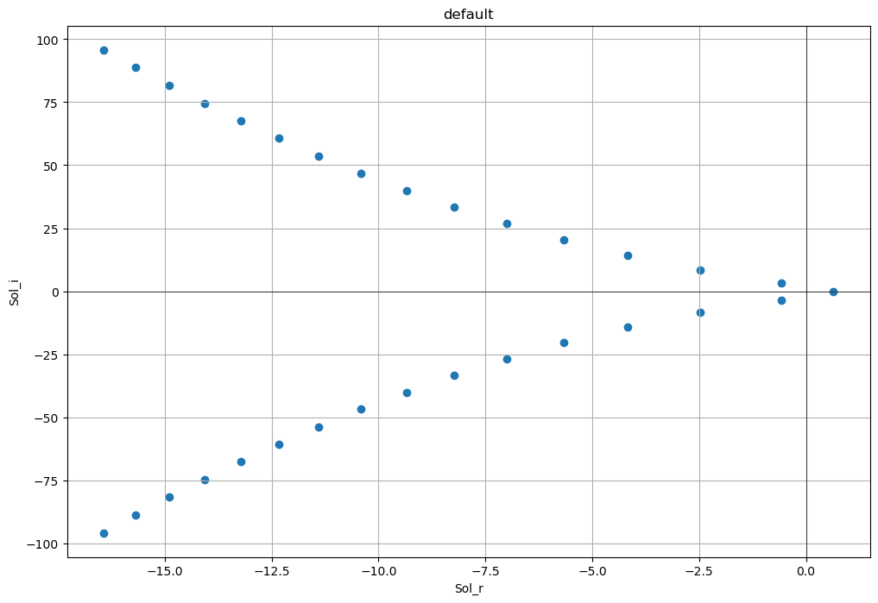
Eigenvalue Distribution

Slide 16
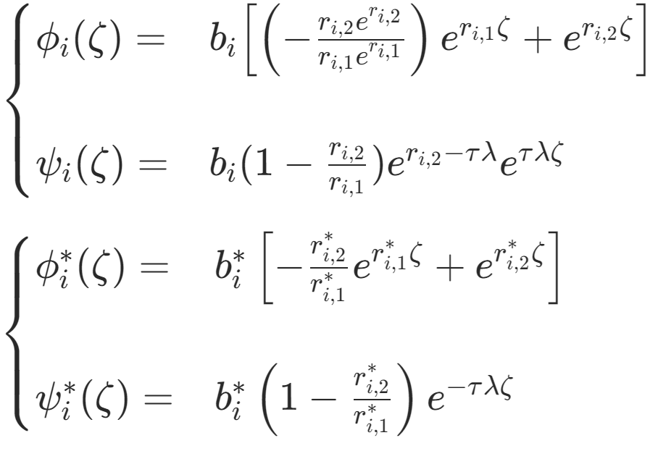
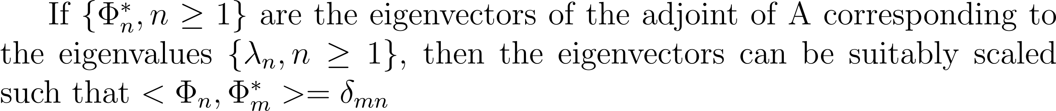
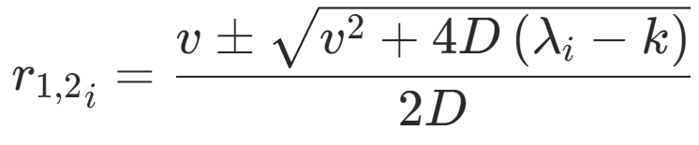
Eigenfunctions (Bi-orthogonal Basis)
Normalizing coefficients may be found utilizing Bi-orthogonality Theorem [2] as follows:
(10)

Slide 17
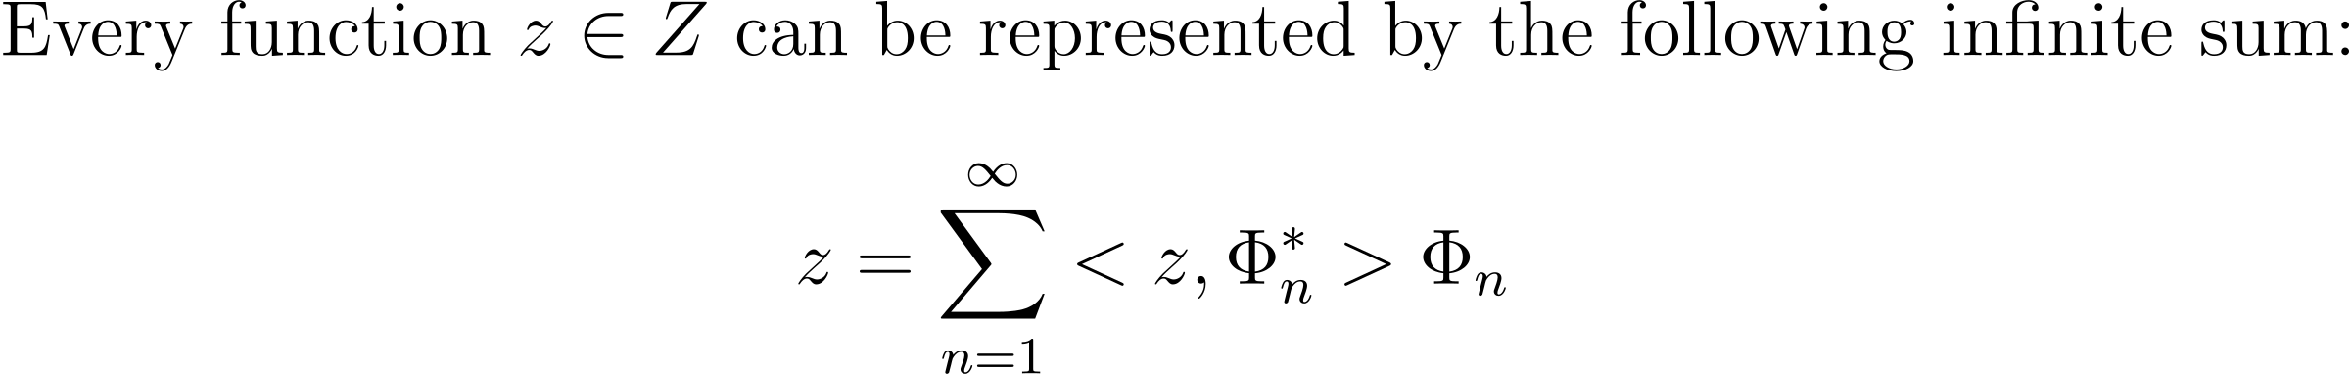
Dominant Modes (Eigenvalues)
Using the following Corollary [2] of the previous Theorem makes way for determining the Dominant Modes of the system dynamics, by trying to reconstruct any arbitrary function that belongs to our function space with sufficient accuracy using a finite sum, instead of the infinite sum:
(11)

Slide 18
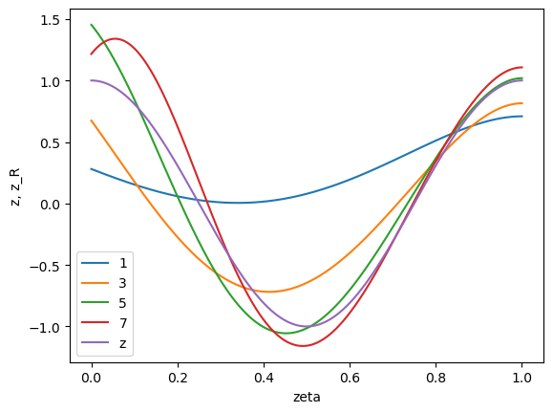
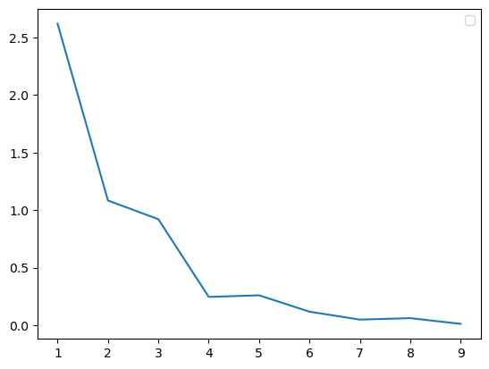
Dominant Modes (Eigenvalues)
Figure 3 – Arbitrarily chosen function z(ζ) and its reconstructed approximations z_{R}(ζ)
Figure 4 – Reconstruction error [z(ζ)- z_{R}(ζ))² against the number of modes used
7 modes chosen: ( λ_{i} for i = 1, …, 7 )

Slide 19
3- Controller Design
Linear Quadratic (LQ) State Feedback Optimal Controller
Continuous Algebraic Riccati Equation (ARE)

Slide 20
LQ State Feedback Optimal Controller
The goal is to find the input that minimizes the following cost function:
The solution of this optimal control problem can be obtained by solving Algebraic Riccati Equation (ARE):
The quadratic cost function is minimized by the following optimal control law:

Slide 21
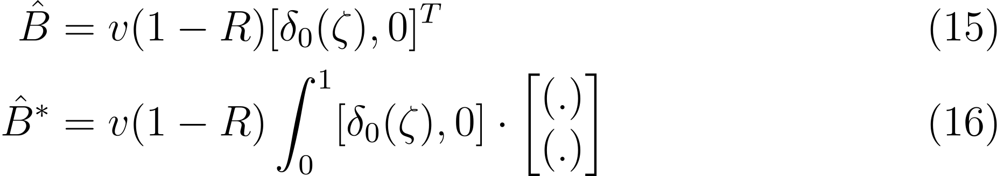
Continuous Algebraic Riccati Equation
For this system with boundary control, we can write:
Q and R are also assumed to be as follows:

Slide 22
4- Results and Discussion
Infinite Dimensional Feedback Gain
Closed-loop System Input
Input Response of the System (Stability)

Slide 23
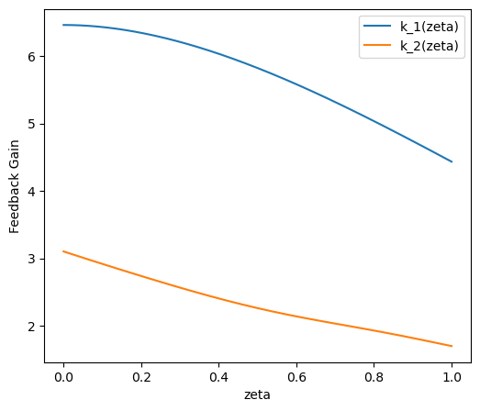
Infinite Dimensional Feedback Gain
ARE is solved numerically to get P
K(ζ) = [k_1(ζ), k_2(ζ)] will be obtained accordingly as functions of space
u(t) = <K(ζ) . X(ζ,t)>
Feedback Gain shown in Figure 5:
Figure 5 – Feedback Gain K(ζ) = [k_1(ζ), k_2(ζ)] versus zeta

Slide 24
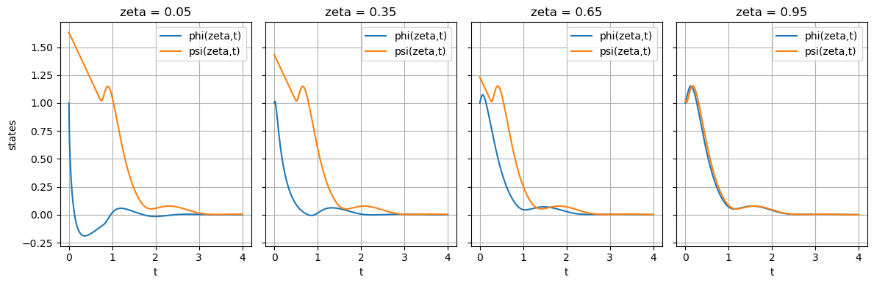
Input Response (Stability)
Figure 6 – Input response vs. time at four different locations of the reactor and the recycle stream – i.e. phi(zeta,t) and psi(zeta,t), respectively

Slide 25
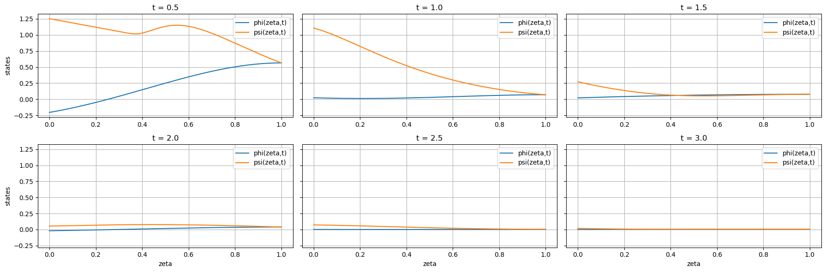
Input Response (Stability)
Figure 7 – Input response vs. zeta at six different times for phi(zeta,t) and psi(zeta,t)

Slide 26
Conclusion
Open-loop System:
Notion of Delay and Pure Transport
Axial Dispersion Tubular Reactor with Delayed Recycle
A 3x3 system of coupled PDEs
Late Lumping
Closed-loop System:
Infinite-horizon Linear Quadratic State Feedback Optimal Control
Boundary Control
Stability is achieved

Slide 27
Further Considerations and Future Work
Study the effect of Parameters on Eigenvalue Distribution
State Reconstruction to address Full State Feedback issue
Study the limitations of addressing the system through Early Lumping Methods
Considering Constraints and Designing MPC

Slide 28
References
Khatibi S, Cassol GO, Dubljevic S. Model predictive control of a non-isothermal axial dispersion tubular reactor with recycle. Computers & Chemical Engineering. 2021 Feb 1;145:107159.
RAY, W. HARMON. "Advanced process control." (1982): 505.
Curtain R, Zwart H. Introduction to infinite-dimensional systems theory: a state-space approach. Springer Nature; 2020 Apr 5.
Mohammadi L, Aksikas I, Dubljevic S, Forbes JF. Optimal boundary control of coupled parabolic PDE–ODE systems using infinite-dimensional representation. Journal of Process Control. 2015 Sep 1;33:102-11.
Xu X, Dubljevic S. Output regulation boundary control of first-order coupled linear MIMO hyperbolic PIDE systems. International Journal of Control. 2020 Mar 3;93(3):410-23.

Slide 29
Thank You!
Any Questions?

