Slide 1

ALGONQUIN COLLEGE
School of Advanced Technology
LECTURE SESSION
NET2008: DevOps
Week 2: Course Introduction
Bachelor of Information Technology: Network Technology

Slide 2
SECTION 1
What is DevOps?
What does a DevOps Engineer do?
NET2008 DevOps · LECTURE · Week 2 · Algonquin College
3

Slide 3
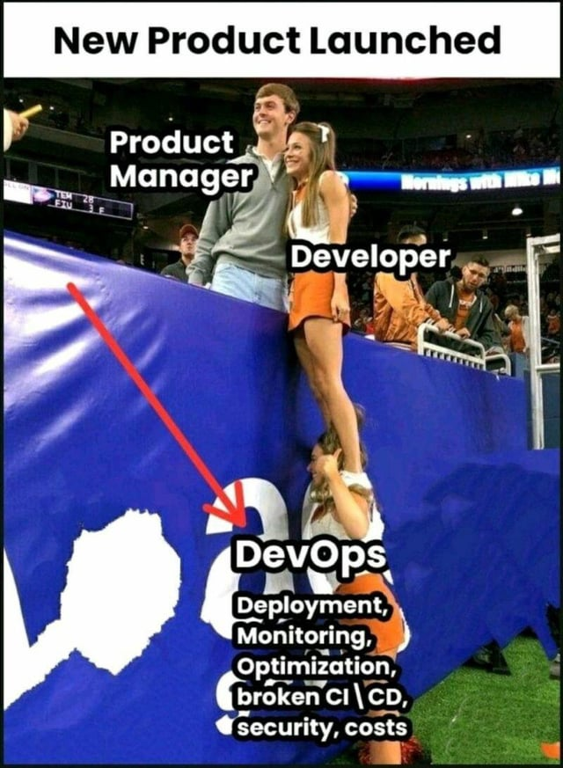
SECTION 1
Why did DevOps emerge?
Imagine This…
Developer finishes a feature: “It works on my laptop!”
Operations says: “It doesn't work in production.”
Release takes weeks
Everyone blames everyone
It was what it looked like before DevOps:
Development and Operations as separate silos
Developers → write code
QA → test
Operations → deploy/run
Security → review
Lots of handoffs
Slow feedback
What’s the core idea of DevOps?
NET2008 DevOps · LECTURE · Week 2 · Algonquin College
4
Notes:
The DevOps Idea
Bring Development, QA and Operations together
Shared responsibility
Automation/pipelines
Continuous feedback
Faster and safer delivery
Note that DevOps absolutely involves automated testing, but that doesn't mean the DevOps Engineer replaces the QA/Test Engineer nor the Developer:
Software Developer: Build the application
QA/Test Engineer: Determine whether the application works correctly
DevOps Engineer: Automate and enable the process of building, testing, deploying and operating it
Security Engineer: Make the system secure

Slide 4
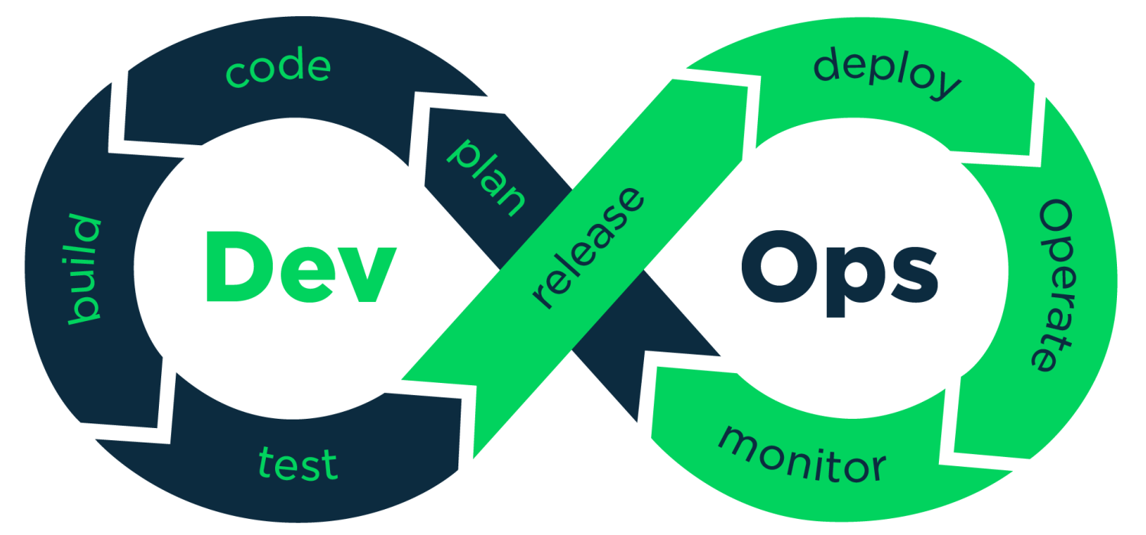
SECTION 1
DevOps unifies software development and IT operations into one continuous practice.
DevOps merges development and operations teams into one continuous infinity loop, shown below.
NET2008 DevOps · LECTURE · Week 2 · Algonquin College
4
Notes:
Development side (Dev)
Plan
Teams define what needs to be built — new feature(s)/user stories, bug fixes/performance improvements, requirements, security updates, and priorities. This is where product managers, developers, testers, SW security, and stakeholders align on scope. Tools like Jira is commonly used here.
2. Code
Developers write the actual application code, following agreed-upon practices and requirements. This includes using version control (like Git) and code reviews. The goal is clean, maintainable, and well-documented code.
3. Build
The source code is compiled/packaged into a runnable artifact (binaries, containers, executables), something that can actually be executed or deployed. This step often includes dependency resolution, static code analysis, and increasingly, containerization — packaging the app and its runtime environment into a Docker image. Note that build automation tools like Maven, Gradle, Webpack can be used in this step.
4. Test
Automated (and sometimes manual) tests in different levels verify the software works as intended:
Unit tests < Developer
Integration tests< Developer + QA
API tests < Developer + QA
End-to-end tests < QA + Developer
Regression tests < QA
Performance/load tests > QA/Performance Engineer
Security testing < Security/DevSecOps
Test automation infrastructure in CI/CD < DevOps
Analyzing production failures < SRE (who is in charge of reliability, availability, scalability, monitoring, and incident response of production systems.)
The goal is to catch bugs before they reach production. Tools include Selenium, JUnit, pytest are commonly used.
The bridge: Release
Once code passes testing, it's approved and scheduled for deployment (usually by the product manager). This often involves versioning, release notes, release artifacts, publish the container images, and staging environment validation. Release management ensures the right version reaches production at the right time.
Operations side (Ops)
5. Deploy
The approved build code is pushed to production environment. This can be automated via CI/CD pipelines using tools like Kubernetes, Ansible, or cloud-native deployment services. Infrastructure-as-Code tools such as Terraform can be used to provision and configure the infrastructure required for the deployment.
Terraform > provision infrastructure
Ansible > configure infrastructure/software
Kubernetes > run and manage containerized applications
Techniques like blue-green deployment (blue: the current live version serving all real traffic, green: the new version which is fully deployed, but not yet receiving traffic) or canary release (expose the new version to a small subset of real users first, and gradually increase exposure if things look healthy) reduce risk.
6. Operate
Once live, the system needs to be managed day-to-day — scaling infrastructure, managing configurations, handling incidents, and ensuring uptime. This is where SRE (Site Reliability Engineering) practices, load balancing, and infrastructure-as-code come into play.
7. Monitor
Teams continuously track system health, performance, and user behavior using logging, metrics, and alerting tools (like ELK, Nagios, or Zabbix). Monitoring surfaces issues before they become outages and generates data that flows back into planning — feeding the next iteration of the loop.
The cycle then loops back to Plan, using insights from monitoring to inform the next set of features or fixes — which is why it's drawn as a continuous infinity loop rather than a linear pipeline.

Slide 5
SECTION 1
DevOps is one of the highest-demand, highest-paid roles in IT!
Canada (average)
$120,668/yr · entry $92,500 · experienced $147,767
United States (average)
$144,000/yr · entry $118,271 · senior $174,000-$179,000
WHY IT PAYS THIS WELL
The U.S. Bureau of Labor Statistics projects DevOps-related roles to grow 15% between 2024 and 2034, far faster than the average occupation. Demand outpaces the supply of people who can write code, run infrastructure, and keep both reliable at once.
NET2008 DevOps · LECTURE · Week 2 · Algonquin College
6
Notes:
Canada — $120,668/yr · entry $92,500 · experienced $147,767
https://ca.talent.com/salary?job=devops+engineer
For Ottawa, Indeed currently reports:
DevOps Engineer: $129,337 CAD/year average
Senior DevOps Engineer: $134,440 CAD/year average
https://ca.indeed.com/career/devops-engineer/salaries/Ottawa--ON
https://ca.indeed.com/career/senior-devops-engineer/salaries/Ottawa--ON
United States — Average: ~$133,662 USD/year, Typical range: ~$86,361–$206,868
Indeed, August 2026
https://www.indeed.com/career/devops-engineer/salaries
Salary.com reports a $134,599 average as of September 2026, with experience-based estimates ranging from approximately $82,382 for entry-level to $149,922 for senior-level (5–8 years) and $165,642 for 8+ years.
https://www.salary.com/research/salary/listing/devops-engineer-salary
---
Job Demand & Growth
Canada's Job Bank lists DevOps Engineer under the broader Software Engineers and Designers (NOC 21231) occupation. The national 2024–2033 outlook indicates that labour demand and supply are expected to be broadly in balance, although prospects vary considerably by province.
There is no dedicated U.S. BLS occupation/SOC for "DevOps Engineer." DevOps roles overlap several occupations, including software development, systems/infrastructure, cloud, and SRE.
A useful indicator is the BLS projection for Software Developers, which is projected to grow 16% from 2024–2034. The broader category of software developers, QA analysts and testers is projected to grow 15% over the same period.
https://www.bls.gov/ooh/computer-and-information-technology/software-developers.htm
IEEE-USA also identifies software developers among seven technology occupations projected to experience double-digit employment growth through 2034.
https://insight.ieeeusa.org/articles/seven-tech-occupations-poised-for-double-digit-job-growth-by-2034/
---
Sample job posting:
https://ca.jooble.org/rjdp/7758290854988074769?utm_campaign=google_jobs_apply&utm_source=google_jobs_apply&utm_medium=organic

Slide 6
SECTION 1
DevOps is the starting point: the same mindset now drives a growing family of operations disciplines.
The DevOps philosophy — automation, version control, continuous feedback, shared ownership between teams — has proven so effective that it has been applied to nearly every discipline that combines engineering with day-to-day operations.
MLOps
AIOps
DataOps
Machine Learning lifecycles
AI for IT operations
Data pipelines & analytics
Automating model training, deployment, monitoring, and retraining as data drifts.
AI-driven anomaly detection, automated incident triage, and root-cause analysis at scale.
CI/CD for data engineering: reliable, tested, and governed data from source to analytics.
DevSecOps
NetOps
FinOps
Security in the pipeline
Network operations
Cloud cost accountability
Security integrated into every stage of the pipeline — not audited at the end, but built in.
DevOps practices applied to network infrastructure: version-controlled configs, automated deploys, and continuous monitoring.
Engineering, finance, and operations aligned on cloud spend — cost as an engineering decision.
NET2008 DevOps · LECTURE · Week 2 · Algonquin College
Notes:
Point: DevOps started in software engineering, but the mindset — automation, version control, continuous feedback, shared ownership — has proven general. Every field that combines engineering with running things in production has adopted it under a new name. MLOps for machine learning, AIOps for AI-driven IT operations, DataOps for data engineering, DevSecOps for security, NetOps for networks, FinOps for cloud cost. The tools you learn here transfer directly. Learning DevOps well opens the door to whichever specialization the industry needs next.

Slide 7
SECTION 2
How This Course Works
NET2008 DevOps · LECTURE · Week 2 · Algonquin College
7

Slide 8
SECTION 2
Every week runs as two separate sessions: a lecture and a lab.
Lecture
Concepts, worked examples, live demonstration. Slides alternate with a short notebook for each topic: we explain an idea, then run it together, then move to the next idea.
Lab
A separate, graded, hands-on session. You apply what the lecture covered to a new, larger problem, independently.
NET2008 DevOps · LECTURE · Week 2 · Algonquin College
8

Slide 9
SECTION 3
Getting Your Environment Ready
NET2008 DevOps · LECTURE · Week 2 · Algonquin College
12

Slide 10
SECTION 3
Three things need to work: Python, Jupyter, and GitHub.
Python 3.11+ installed and runnable from a terminal
Jupyter (via VS Code's Jupyter extension, or JupyterLab) opening and running a notebook
A GitHub account created, ready for Week 6
Your Algonquin IT account confirmed working: required for Netlab access later this term
NET2008 DevOps · LECTURE · Week 2 · Algonquin College
13

