Slide 1

Egoism
Noun Description:
Concern for one‘s own interest and welfare.

Slide 2
Behram ÇELEN
http://behram.org

Slide 3

Egoism:
Egoism is the theory that one’s self is, or should be, the motivation and the goal of one’s own action.
Altruism is the opposite of egoism.

Slide 4
Types of Egoism:
Descriptive and Psychological Egoism
Normative Egoism
Rational Egoism
Ethical Egoism
Conditional Egoism

Slide 5
Descriptive and Psychological Egoism
Called “psychological egoism”
Human nature as being wholly self-centered and self-motivated

Slide 6
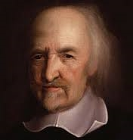
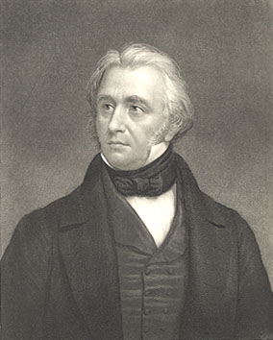
What proposition is there respecting human nature which is absolutely and universally true?

Slide 7
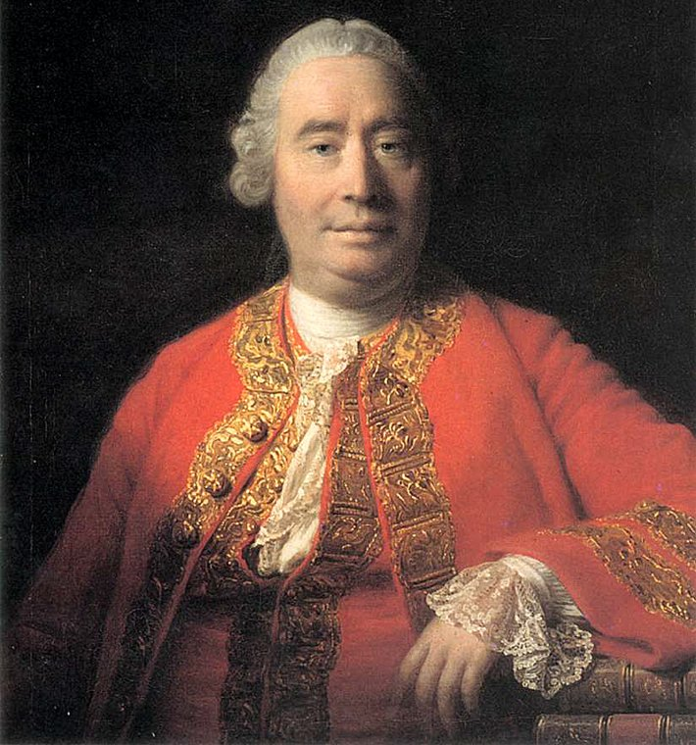
David Hume
Enquiry Concerning the Principles of Morals.
Self-interest opposes moral sentiments that may engage one in concern for others
Psychological egoism attempts to reduce human motivation to a single cause, which is a ‘fruitless’ task

Slide 8
Normative Egoism
Ought to promote the self above other values.
Befriend himself before he can befriend others.

Slide 9
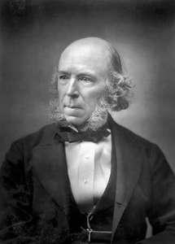
Herbert Spencer
Ethics has to recognize the truth, recognized in unethical thought, that egoism comes before altruism.

Slide 10
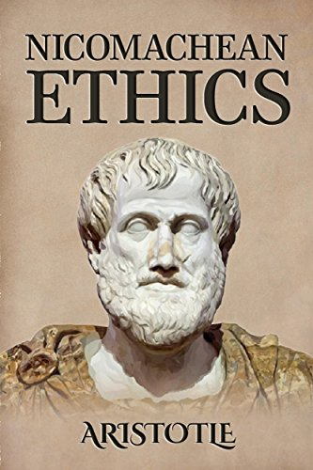
Nicomachean Ethics (Book)
A man must befriend himself before he can befriend others.

Slide 11
Rational Egoism
The promotion of one’s own interests is always in accordance with reason.
Prisoner’s Dilemma

Slide 12
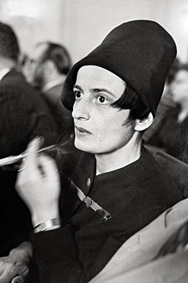
Ayn Rand - Novelist
The actor must always be the beneficiary of his action and that man must act for his own rational self-interest.
Selfishness is a proper virtue to pursue.

Slide 13
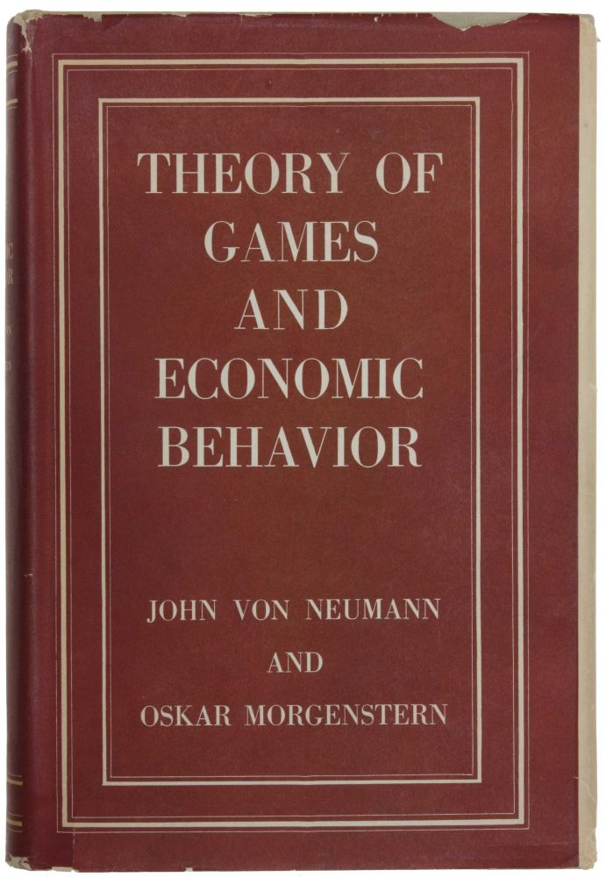
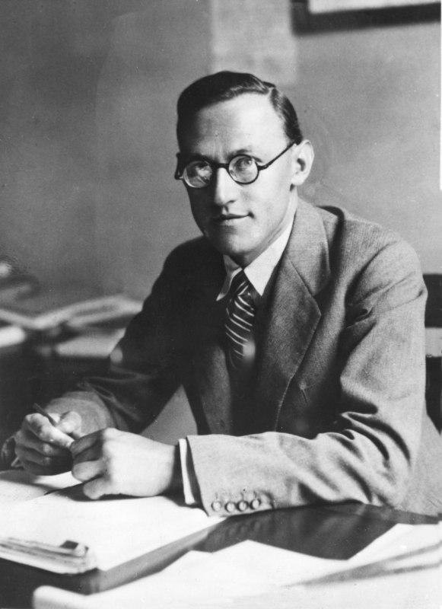
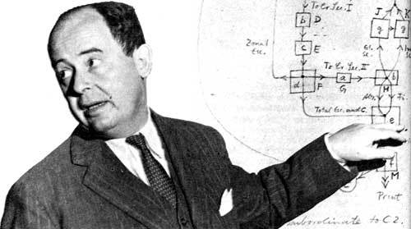
Game Theory

Slide 14
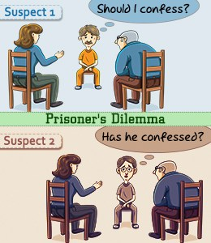
Prisoner’s Dilemma

Slide 15
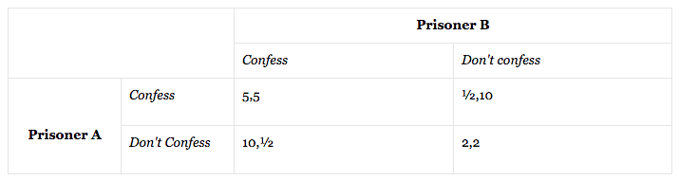
Prisoner’s Dilemma
Two criminals, A and B, face different sentences depending on whether they confess their guilt or not.

Slide 16
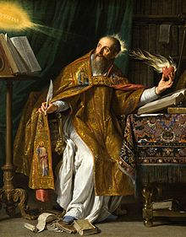
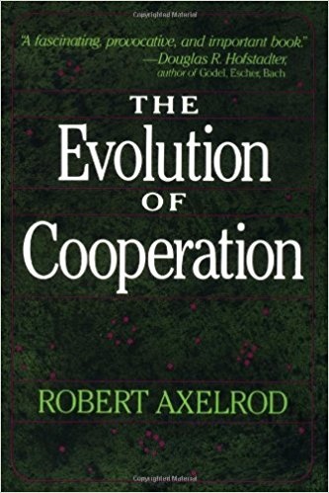
Robert Axelrod
Love, and do as you will

Slide 17
Ethical Egoism
the promotion of one’s own good is in accordance with morality.
the individual aims at her own greatest good

Slide 18
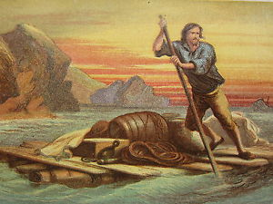
Robinson Crusoe

Slide 19
Conditional Egoism
Morally acceptable if it leads to morally acceptable ends

Slide 20
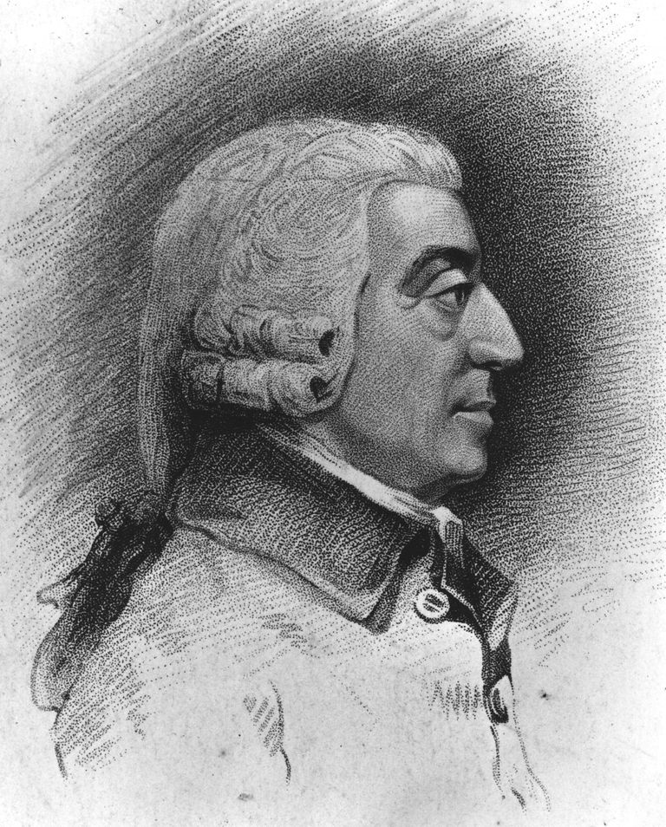
Wealth of Nations - Adam Smith
It is not from the benevolence of the butcher, the brewer, or the baker, that we expect our dinner, but from their regard to their own interest. We address ourselves, not to their humanity but to their self-love, and never talk to them of our own necessities but of their advantages

Slide 21

Public Good Theory

Slide 22
Conclusion
All actions necessarily benefit the agent’s environment.
Some are born to rule and others are born to be ruled. - Aristotle

Slide 23
References;
http://www.iep.utm.edu/egoism/
Sidgwick, Henry. The Methods of Ethics. MacMillan: London, 1901.
https://plato.stanford.edu/entries/egoism/
Baier, K., 1958, The Moral Point of View, Ithaca: Cornell.
https://www.youtube.com/watch?v=aaz2_y692T4
Shaver, R., 1999, Rational Egoism, Cambridge: Cambridge University Press.

Slide 24

Thanks for Listening
behramcelen@gmail.com
You can find this presentation in github.com/behram

