Slide 1
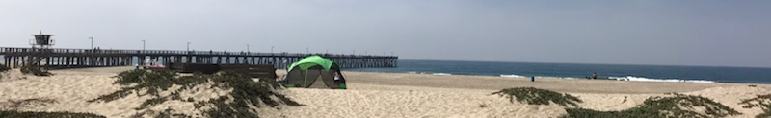
Groundwater Flow and Solute Transport Modeling
August 20-23, 2018
Port Hueneme, California
Langevin, Hughes, Paulinski

Slide 2
Class Information
Instructors
Chris Langevin
Joe Hughes
Scott Paulinski
Lectures
Class exercises
MODFLOW/MODPATH/MT3D
Groundwater Vistas
ModelViewer
Discussions
Case studies
Special Topics

Slide 3
Agenda Day 1
Class logistics and introduction
The Modeling Process
Governing equations and numerical methods for groundwater flow
Demo: Mechanics of flow and transport modeling
Exercise 1: Building a simple 2D model from scratch
LUNCH
Case study -- Miami-Dade groundwater model
Exercise 2: Working with an existing MODFLOW model

Slide 4
Agenda Day 2
Hydrogeologic frameworks and water budgets
Case study: LA Basin groundwater model
Introduction to MODFLOW
Exercise 3: Building a cross section model
LUNCH
MODFLOW stress and advanced packages
Description of the class project model
Exercise 4: Building the class project model

Slide 5
Agenda Day 3
Model calibration
Exercise 5: Class project model calibration and prediction
LUNCH
Exercise 6: Particle flow
Solute transport modeling
Exercise 7: Class project particle tracking of a contaminant plume
Discussion of class project model calibration and predictions

Slide 6
Agenda Day 4
Solute transport governing equations
Exercise 8: Simulating advective and dispersive movement of a contaminant plume
Exercise 9: Simulation of remediation alternatives
LUNCH
Class project: Students break into teams to design a model for a class project
Special topics
Wrap up and/or time for working with participant models

Slide 7
Software
MODFLOW
MODPATH
MT3DMS
Groundwater Vistas
ModelViewer
Zonebudget
Git
Notepad++
Python and Flopy

Slide 8
Special Topics
Advanced model calibration
PEST
Unstructured grids
Local grid refinement
Alternative mesh types
Advanced MODFLOW Packages
Streamflow routing
Lake
Unsaturated zone
Multi-aquifer wells
Variable density modeling
Seawater intrusion
Heat transport
Python
Jupyter notebooks
Flopy
Version control
Git

