Slide 1
INTRODUCTION TO MODFLOW

Slide 2
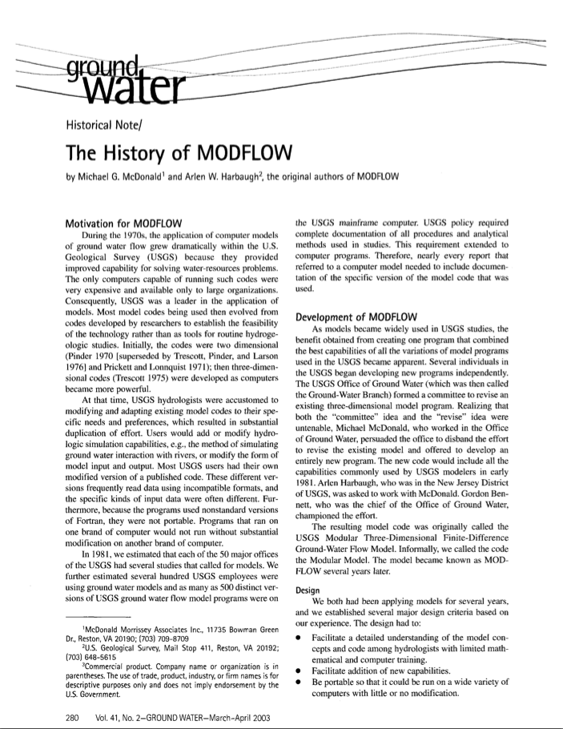
History
1970’s proliferation of groundwater models led to numerous diverging codes within the USGS
The best capabilities were combined to form MODFLOW
Notes:
1970s: codes showed feasibility of method, but not applied
1981: 500 different versions of groundwater models were found on mainframe
Guiding principles: could be understood, add new capabilities, portable, optimized.

Slide 3
Design Objectives and How Objectives Were Met
Portable – run on “all” computers with minimal modification
FORTRAN without using vendor enhancements
Efficient
FORTRAN
Easy to Understand
Modular structure
Coding style
Documentation linked to code
Easy to enhance
Modular structure
Documentation

Slide 4




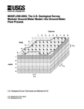

Core Versions
1984
1988
1996
2000
2005
2017
What do we mean by “core” version?
Production version
Stable
Well documented
Well tested
Starting point for new developments
Notes:
Production codes
Well tested
USGS headquarters supported

Slide 5
MODFLOW Variants
MODFLOW-LGR
MODFLOW-NWT
MODFLOW-USG
SEAWAT
CFP
GSFLOW
GWM
MODFLOW-OWHM
MODFLOW-GWT

Slide 6
Overview of Groundwater Flow in MODFLOW-2005

Slide 7
PROCESSES: MODFLOW is More Than Groundwater Flow
GWF – Groundwater Flow Process
GWT – Groundwater Transport Process
GWM – Groundwater Management
GSFLOW – Rainfall runoff with MODFLOW

Slide 8
Differential Equation for Groundwater Flow
K_{xx}, K_{yy}, and K_{zz} are values of hydraulic conductivity along the x, y, and z coordinate axes,
which are assumed to be parallel to the major axes of hydraulic conductivity (L/T).
h is the potentiometric head (L).
W is a volumetric flux per unit volume representing sources and/or sinks of water, with W<0.0 for
flow out of the ground-water system, and W>0.0 for flow into the system (T⁻¹).
S_{S} is the specific storage of the porous material (L⁻¹).
t is time (T).

Slide 9
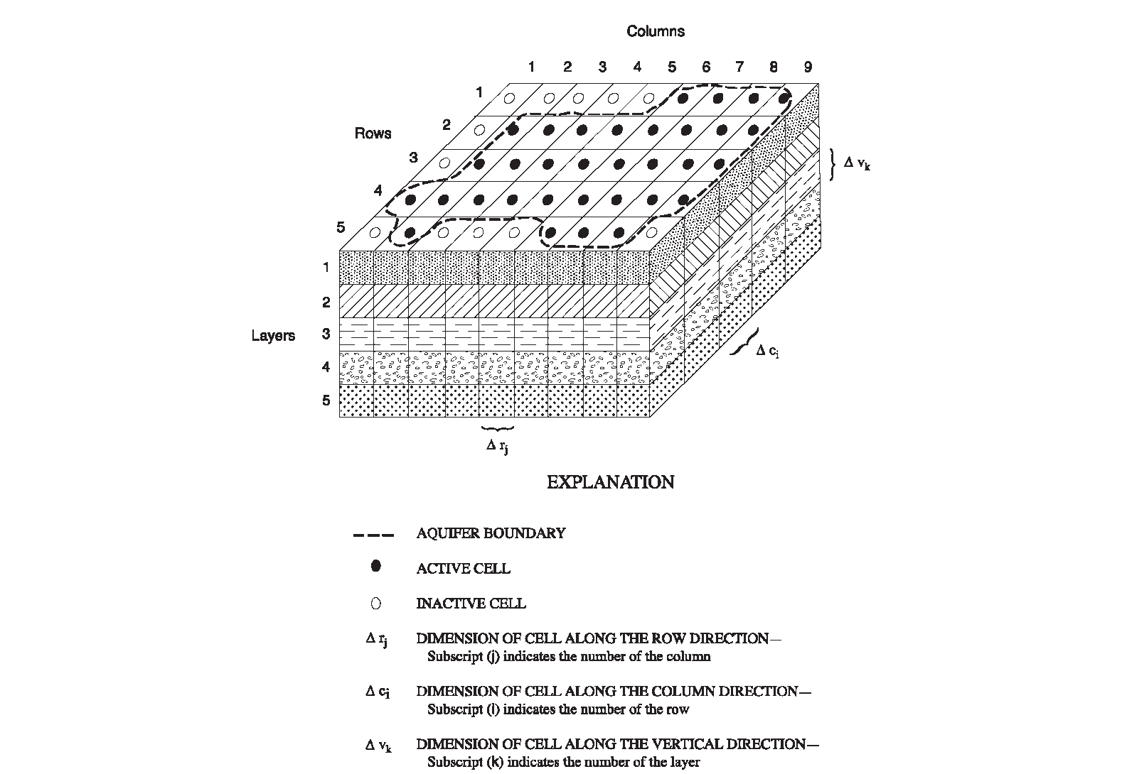
Finite-Difference Discretization for Space

Slide 10
Finite-Difference Equation

Slide 11
Computer Program
Allocate and Read
STRESS LOOP
Stress
Read and Prepare
TIME-STEP LOOP
Advance Time
ITERATION LOOP
Formulate
Approximate
No
Close?
Yes
Output Control
Water Budget
Output
Yes
More Time Steps?
No
Yes
More Stress Periods?
No
Deallocate Memory

Slide 12
Fundamental Packages in MODFLOW
Package Name Abbreviation
Basic | BAS
Layer-Property Flow | LPF
Well | WEL
Recharge | RCH
River | RIV
Drain | DRN
Evapotranspiration | EVT
General-Head Boundary | GHB
Preconditioned Conjugate Gradient | PCG

Slide 13
Data to Define Terms for the Flow Equation
Arrays – one value for every cell in one or more layers
for example:
Hydraulic conductivity
Initial head
Lists – One or more values at cells that are identified by layer, row, and column
For example
Wells
Cells that comprise a stream
Methods of Defining data
Values directly read from files
Values constructed from parameters

Slide 14
Parameters
Generic meaning of “PARAMETER”
Any input data for a model
Meaning of “PARAMETER” in MODFLOW-2005
A specially designated value that can define input values for many cells
Changing the parameter value changes all of the associated input values
Necessary for parameter estimation because we don’t have enough observation data to estimate values for all cells
Parameters provide a convenient way to modify input data even if not using parameter estimation

Slide 15
Basic Package

Slide 16
Basic Package for Groundwater Flow
Name File
Space discretization
Time discretization
Stress periods
Time steps
Allocate fundamental arrays
Initial conditions
Boundary conditions
Control output
Output Volumetric budget
Output head and drawdown

Slide 17
Name File
Input data for a simulation is contained in many files
Discretization File
Each Package
Input arrays can be in separate files
Input lists can be in separate file
There can also be many output files – e.g. listing, head, budget, concentration
The Name File is a file that specifies the name and type of most files being used in a simulation
Options are activated based on the file type – e.g. WEL, RIV, OC, PCG

Slide 18
Example Name File
LIST 2 twrip.lst
DIS 10 twrip.dis
BAS6 3 twrip.ba6
LPF 11 twrip.lpf
WEL 12 twrip.wel
DRN 13 twrip.drn
RCH 18 twrip.rch
PCG 19 twrip.pcg
OC 22 twrip.oc

Slide 19
Discretization File: Space Discretization
Number of layers, rows, and columns (NLAY, NROW, NCOL)
Length units (LENUNI)
Existence of Quasi-3D Confining Units (LAYCBD)
Width of cells along a row – X direction (DELR)
Width of cells along a column – Y direction (DELC)
TOP elevation of system
Bottom elevation of every cell in each model layer
Bottom elevation of Quasi-3D Confining Units that exist

Slide 20
Time and Length Units
Length and Time Units must be consistent for all data
For example ft and days:
Flow – cubic feet per day (ft³/d)
Hydraulic conductivity – feet per day (ft/d)
Transmissivity – square feet per day (ft²/d)
Recharge flux – feet per day (ft/d)
Time step length – days
Specific storage – per ft (1/ft)
MODFLOW lets you specify the units, but MODFLOW does not convert input data based on the units being used– the units specification is just for user information

Slide 21
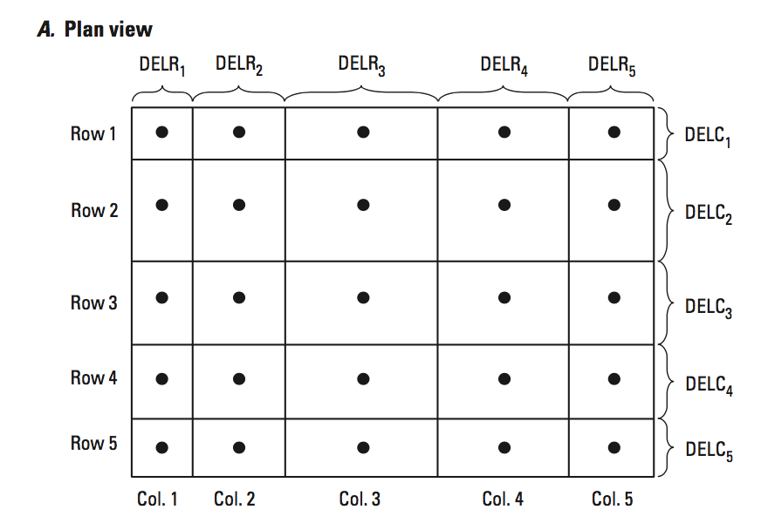
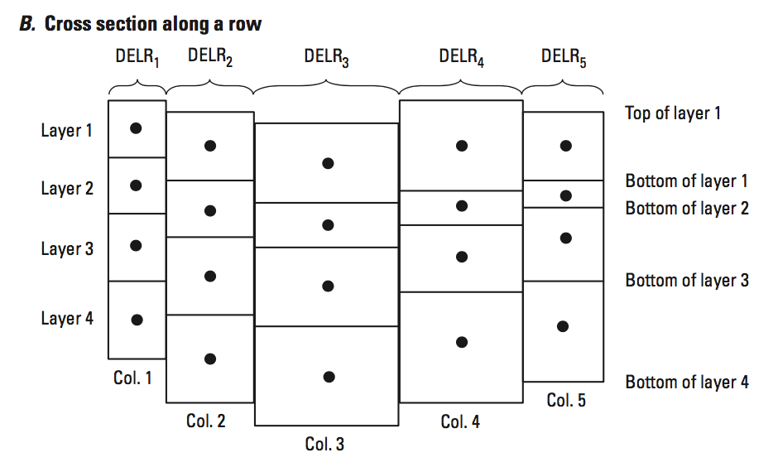
Discretization

Slide 22
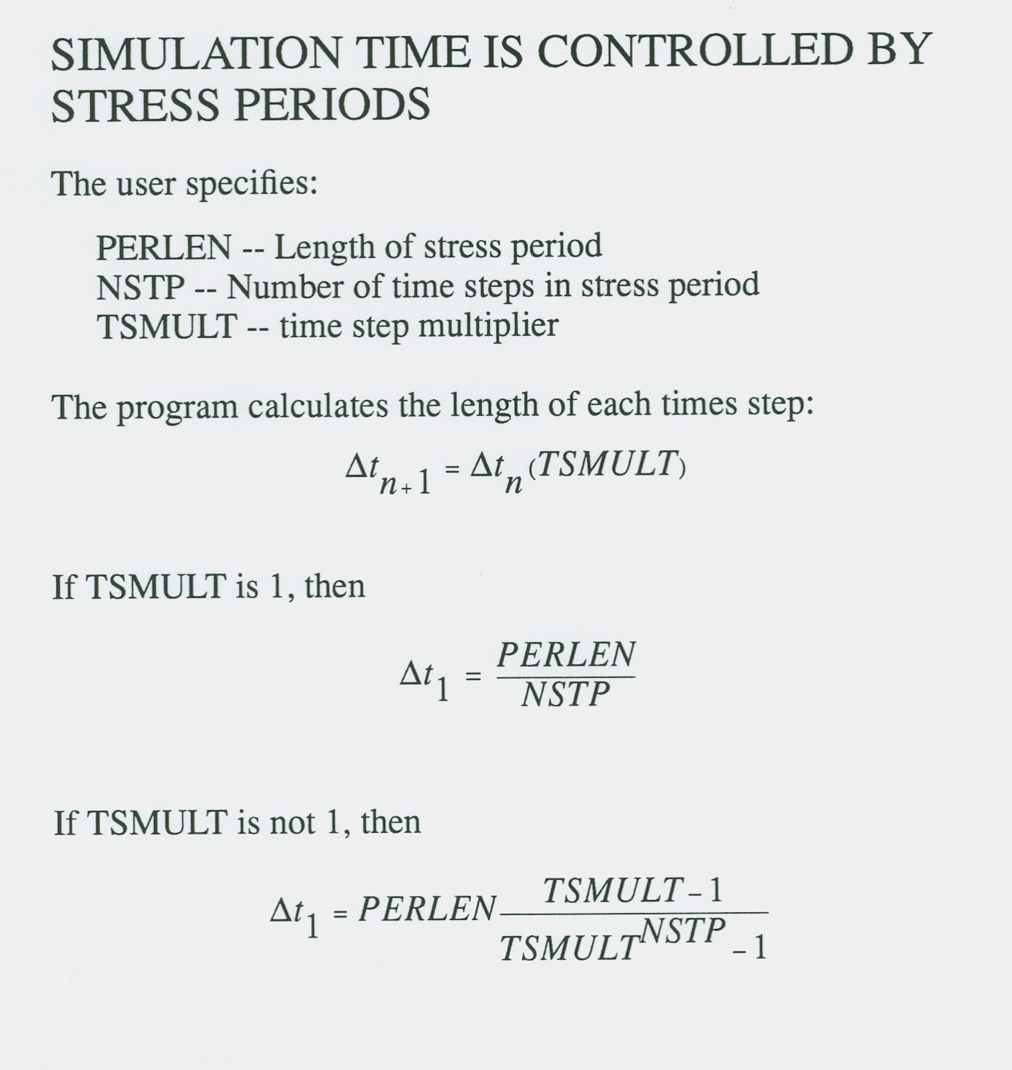
22

Slide 23
Choosing Stress Periods
Pumping
Recharge
Time
Time
Stress Periods and Time Steps
23

Slide 24
Choosing Stress Periods
Pumping
Recharge
Time
Time
Stress Periods
24

Slide 25
Choosing Stress Periods
Pumping
Recharge
Time
Time
Stress Periods
25

Slide 26
Discretization File: Time Discretization
Number of stress periods (NPER)
Time units (ITMUNI)
For each stress period
Total length (PERLEN)
Number of time steps (NSTP)
Time-step multiplier (TSMULT)
Steady-state or transient
Mixed steady-state and transient simulations are allowed

Slide 27
Steady-State Simulations
Steady state is simulated as a stress period with 0 storage
Specify a single time step for a steady-state stress period – using multiple time steps would produce duplicate answers
The length of the steady-state stress period and the time step multiplier have no impact on the computed heads

Slide 28
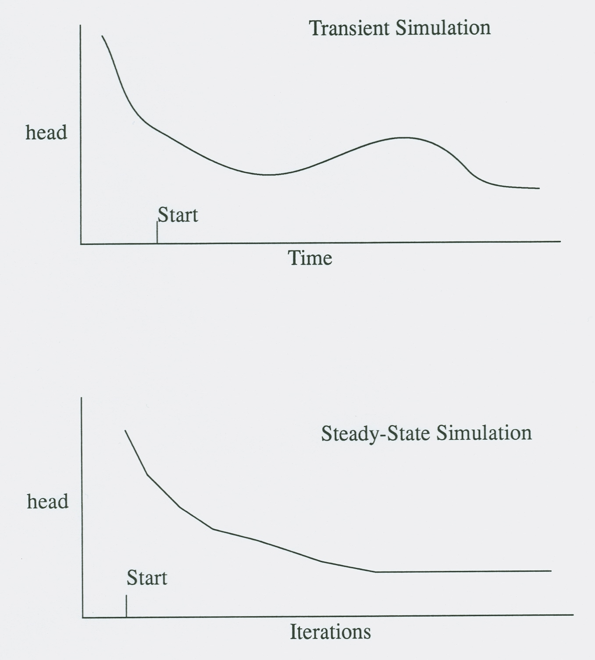
Establishing Initial Conditions
Initial conditions are required even if a simulation is steady state
28

Slide 29
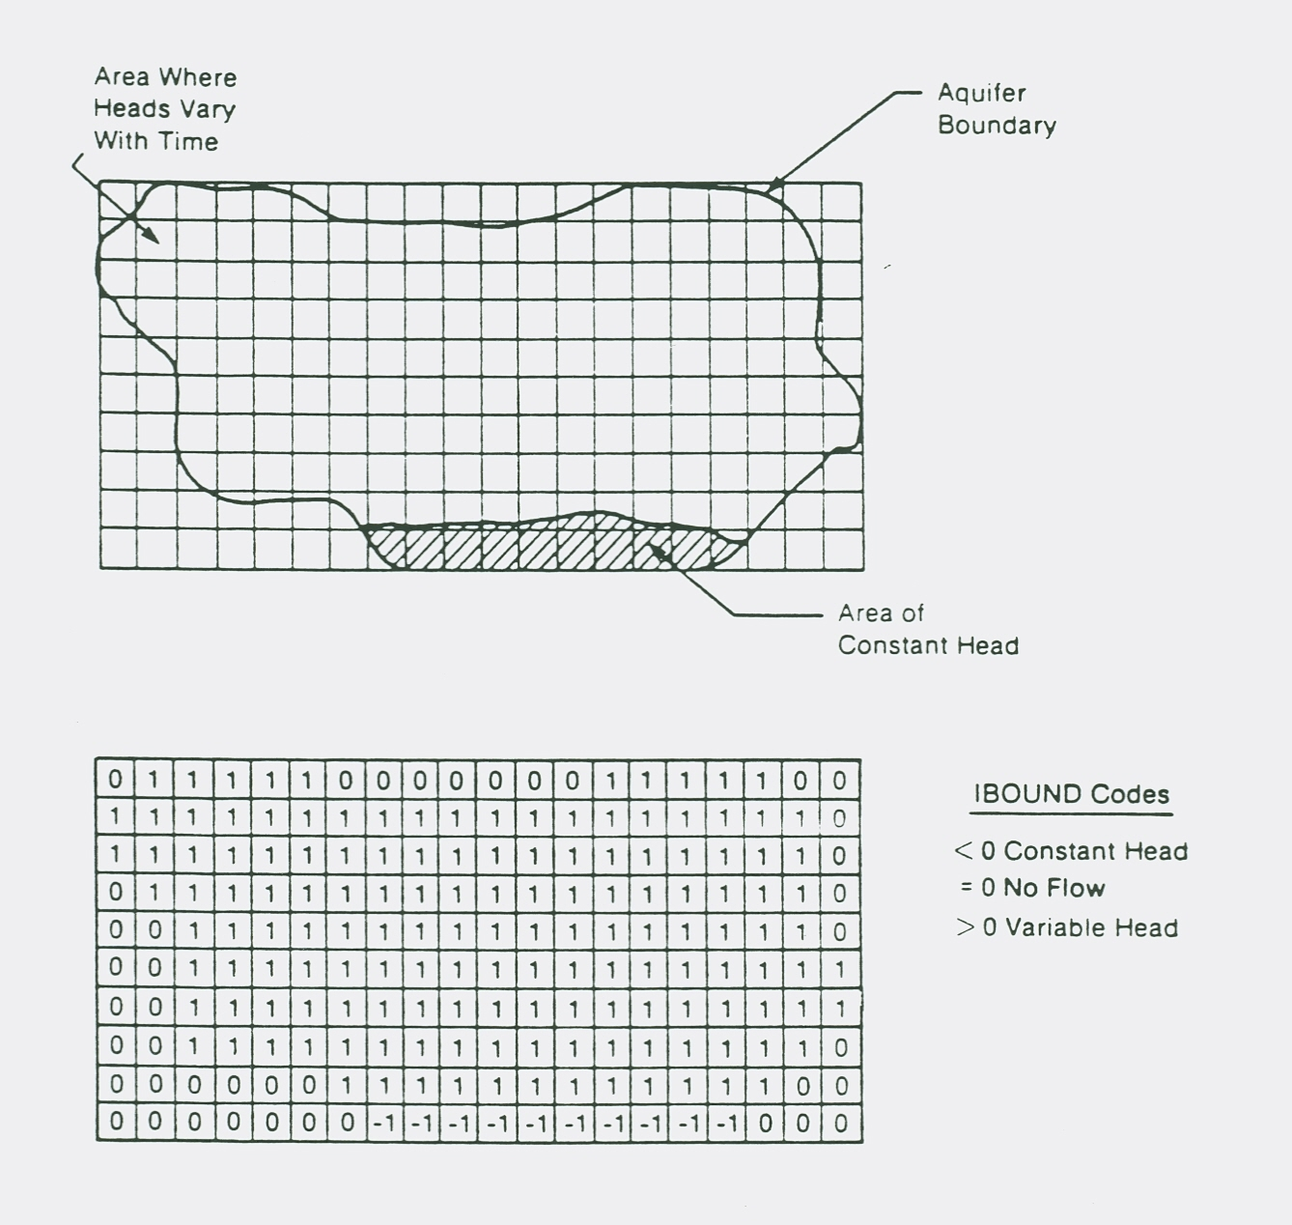
Boundary Conditions

Slide 30
VOLUMETRIC BUDGET FOR ENTIRE MODEL AT END OF TIME STEP 8 IN STRESS PERIOD 1
------------------------------------------------------------------------------
CUMULATIVE VOLUMES L**3 RATES FOR THIS TIME STEP L**3/T
------------------ ------------------------
IN: IN:
--- ---
STORAGE = 56359216.0000 STORAGE = 12796.0039
CONSTANT HEAD = 51957100.0000 CONSTANT HEAD = 42671.6211
WELLS = 0.0000 WELLS = 0.0000
RIVER LEAKAGE = 0.0000 RIVER LEAKAGE = 0.0000
RECHARGE = 184680000.0000 RECHARGE = 102600.0000
TOTAL IN = 292996320.0000 TOTAL IN = 158067.6250
OUT: OUT:
---- ----
STORAGE = 6.1035 STORAGE = 0.0000
CONSTANT HEAD = 2.5733 CONSTANT HEAD = 0.0000
WELLS = 126000000.0000 WELLS = 70000.0000
RIVER LEAKAGE = 166986064.0000 RIVER LEAKAGE = 88094.2656
RECHARGE = 0.0000 RECHARGE = 0.0000
TOTAL OUT = 292986080.0000 TOTAL OUT = 158094.2660
IN - OUT = 10243.3232 IN - OUT = -26.6406
PERCENT DISCREPANCY = 0.00 PERCENT DISCREPANCY = -0.02
TIME SUMMARY AT END OF TIME STEP 8 IN STRESS PERIOD 1
SECONDS MINUTES HOURS DAYS YEARS
-----------------------------------------------------------
TIME STEP LENGTH 5.39448E+07 8.99081E+05 14985. 624.36 1.7094
STRESS PERIOD TIME 1.55520E+08 2.59200E+06 43200. 1800.0 4.9281
TOTAL TIME 1.55520E+08 2.59200E+06 43200. 1800.0 4.9281
30

Slide 31
Layer Property Flow

Slide 32
Layer-Property Flow Package
Formulate terms for calculating flow through porous medium
Calculate conductance
Calculate storage terms
Calculate porous medium budget terms
Flow to storage
Flow to constant-head cells
Flow between adjacent cells

Slide 33
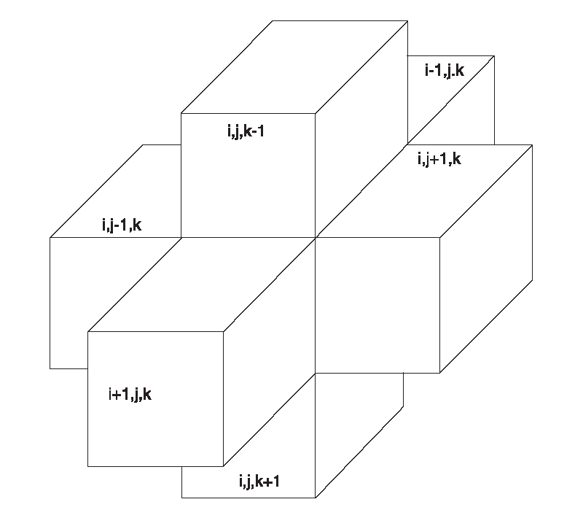
Consider the Finite-Difference Equation for 1 Cell – cell i,j,k
Cell i,j,k is in the middle of this cluster of cells i is the row j is the column k is the layer

Slide 34
Finite-Difference Equation for 1 Cell

Slide 35

Conductance
If flow is horizontal, we can write conductance in terms of transmissivity:

Slide 36
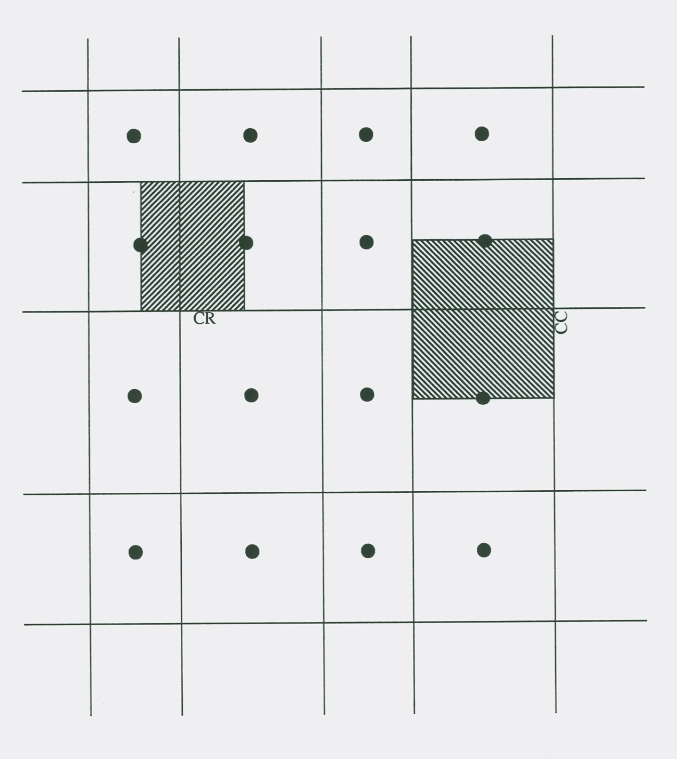
Horizontal Conductance Between Nodes
Plan View

Slide 37
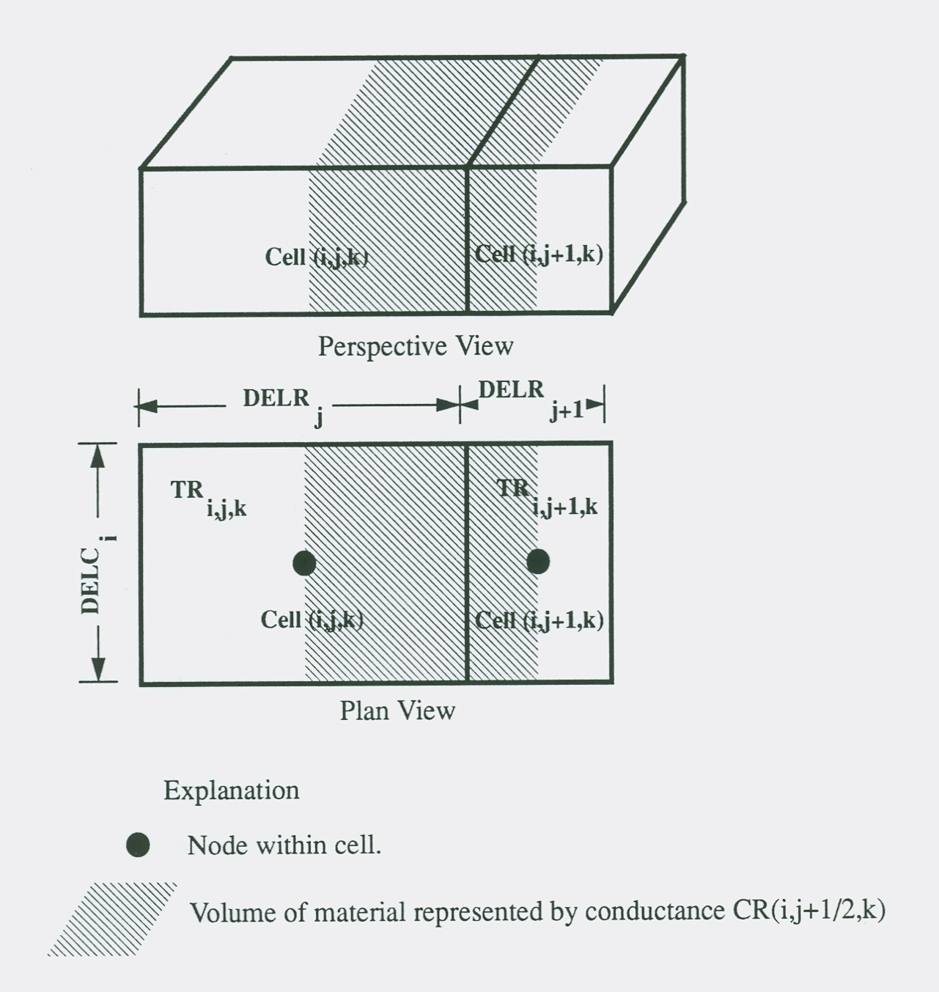
Horizontal Conductance Between Nodes
Assumptions:
1. Node in center of cell
2. Hydraulic Conductivity can change at cell boundary

Slide 38

Equivalent Conductance of Multiple Conductance Blocks in Series
The assumption of continuity of head across subprisms gives:
Substituting for using Darcy’s Law gives
Each q_{i} is the same, which is the total Q:
Which implies that
therefore

Slide 39
Horizontal Conductance Between 2 Nodes
Applying the equation for conductance in series to 2 blocks gives:
DELR_{j}
DELR_{j+1}
TR_{i,j,k}
TR_{i,j+1,k}
DELC_{i}
i,j,k
i,j+1,k
CR_{i,j+1/2,k}

Slide 40
Convertible Layers
Layers can be marked as:
Confined
Convertible
Specified with the LAYTYP variable in LPF
Allows cells to convert between confined and unconfined during the simulation

Slide 41
Horizontal Conductance for Convertible Layers
Cell i,j,k-1
TOP(i,j,k)
h(i,j,k)
Cell i,j,k
BOT(i,j,k)
If a layer is designated as convertible, transmissivity is calculated throughout the simulation at each cell:
If h ≥ TOP, T = (TOP – BOT) K
If BOT < h < TOP, T = (h – BOT) K
If h ≤ BOT, cell is changed to no flow

Slide 42
Horizontal Conductance for Convertible Layers
Allocate and Read
STRESS LOOP
Stress
Read and Prepare
TIME-STEP LOOP
The fact that T, which is part of horizontal conductance, varies with h makes the flow equation nonlinear. We cannot directly solve this flow equation, so we simplify the equation.
h-BOT is assumed constant and lags by 1 iteration – that is, when formulating the flow equation for iteration n, T is formulated based on head from iteration n-1:
If h^{n-1} ≥ TOP, T^{n} = (TOP – BOT) K
If BOT < h^{n-1} < TOP, T^{n} = (h^{n-1} – BOT) K
If h^{n-1} ≤ BOT, cell is changed to no flow
If the solution converges, then h will change very little from iteration to iteration, so h^{n-1} is very close to h^{n}
Advance Time
ITERATION LOOP
Formulate
Approximate
No
Close?
Yes
Output Control
Water Budget
Output
Yes
More Time Steps?
No
Yes
More Stress Periods?
No
Deallocate Memory

Slide 43
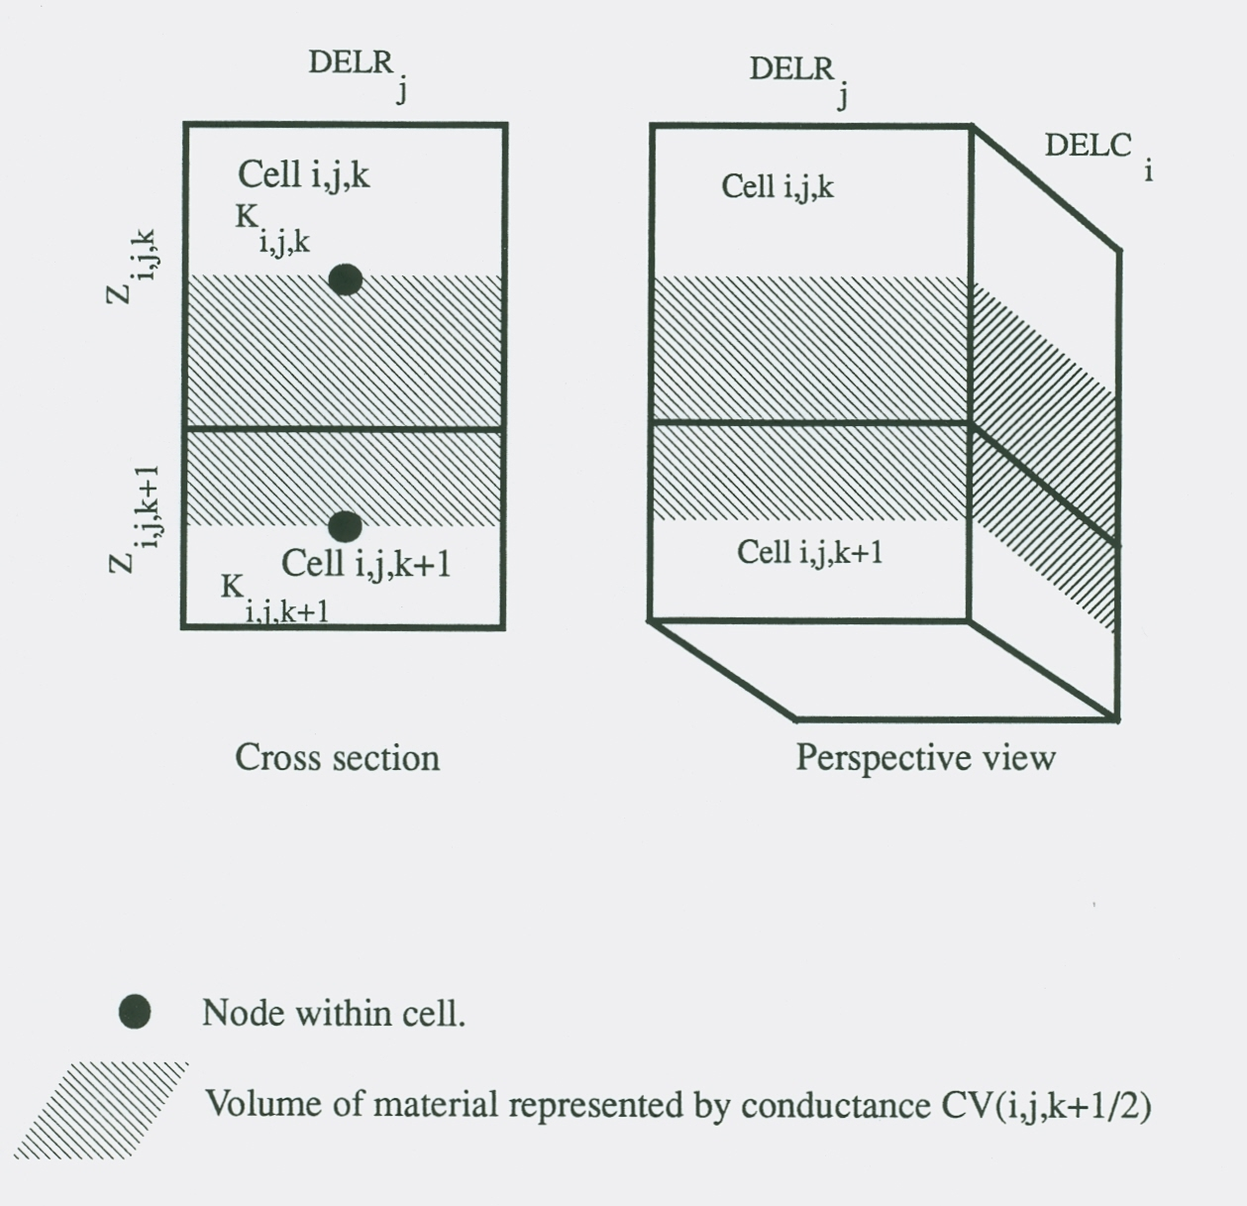
Vertical Conductance

Slide 44

Vertical Conductance

Slide 45
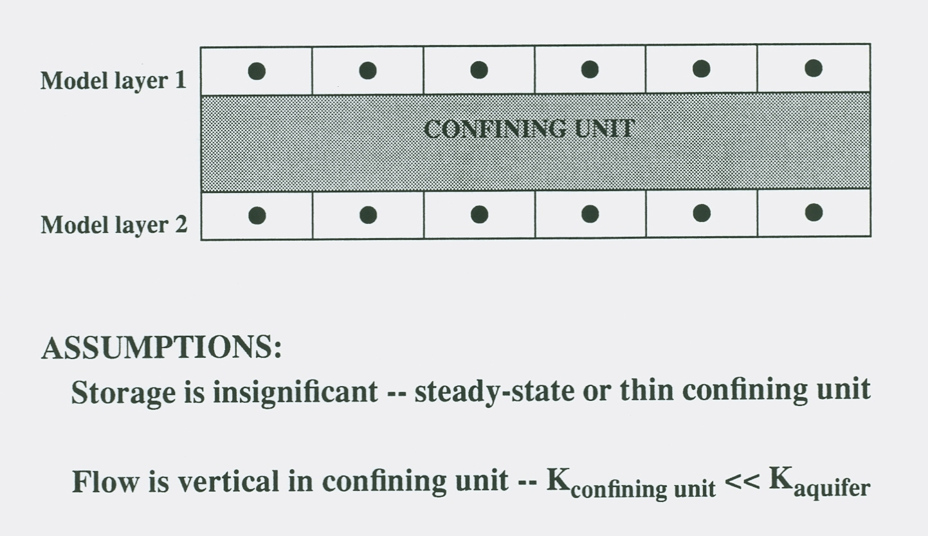
Quasi 3-D Approximation

Slide 46
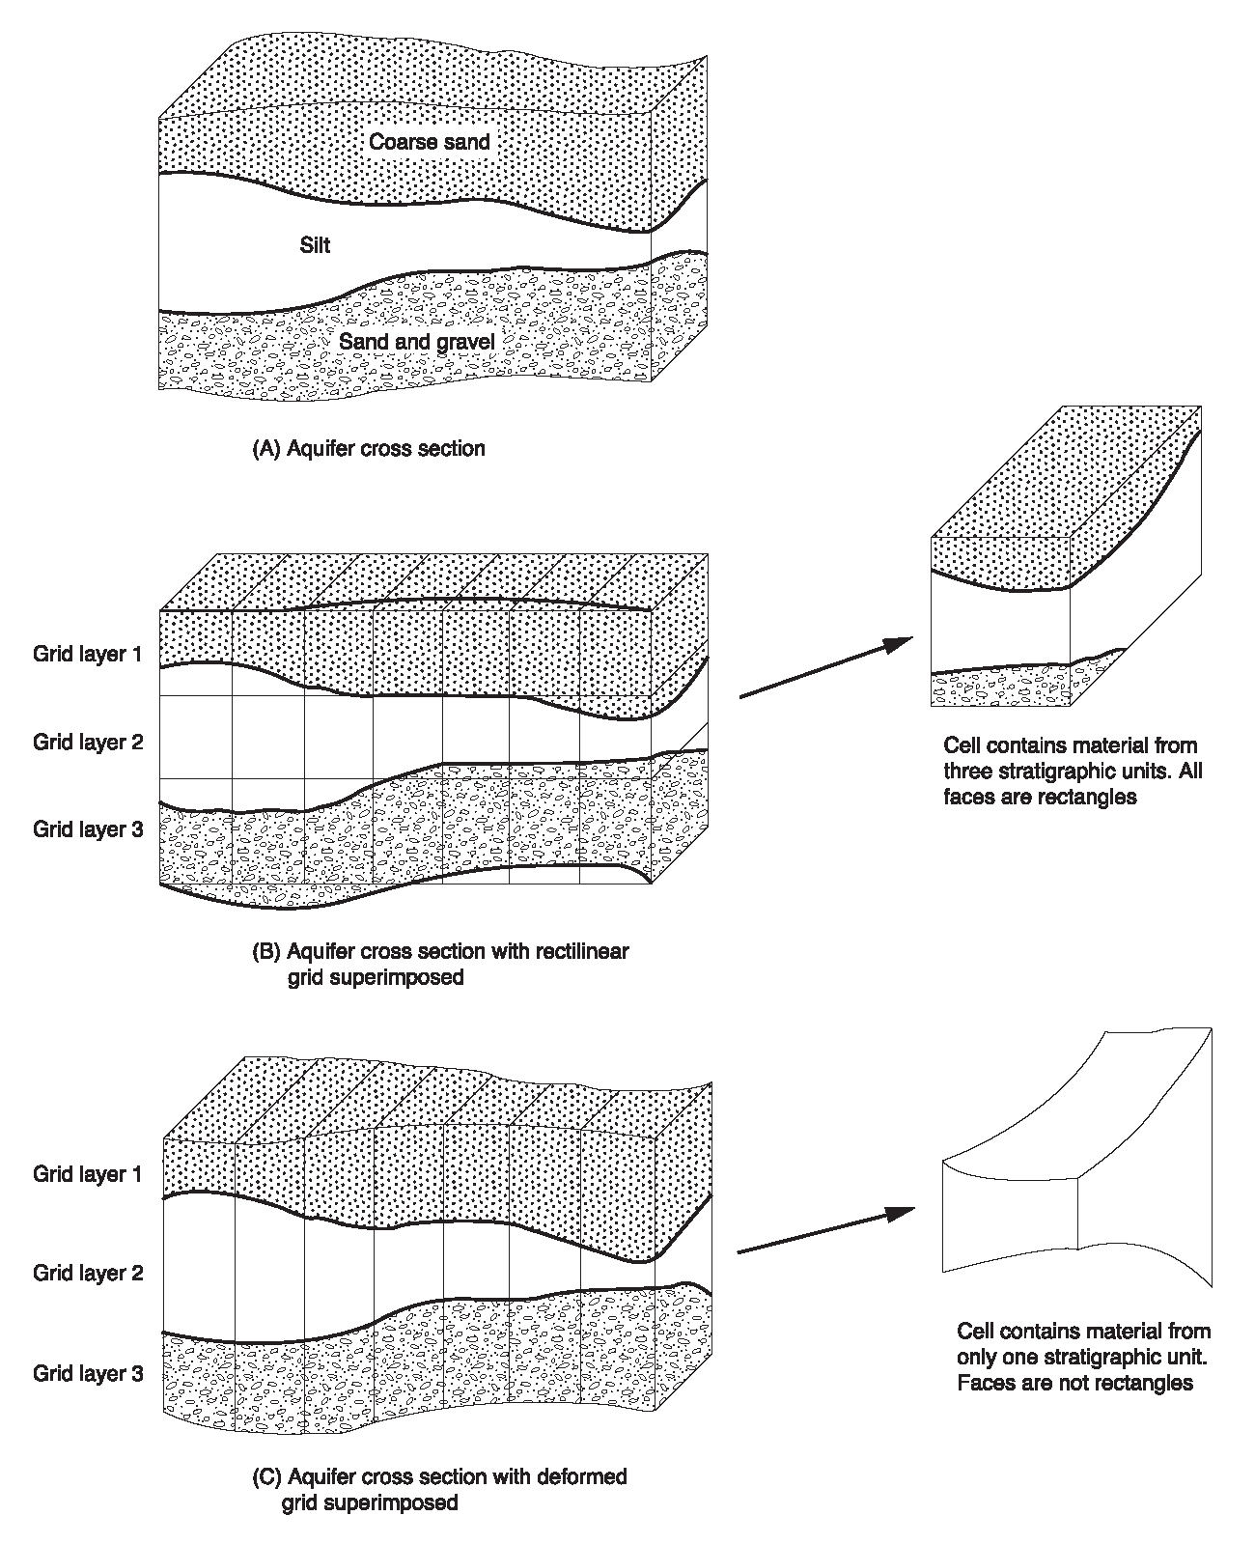
Use of Distorted Vertical Grids
To allow for layers that do not have uniform thickness, Z is allowed to vary cell by cell.
The Discretization File contains elevations for each cell.
Variable thickness affects horizontal and vertical conductance calculations.
Distorted grids allow the use of fewer layers, but they introduce errors that are difficult to quantify.

Slide 47
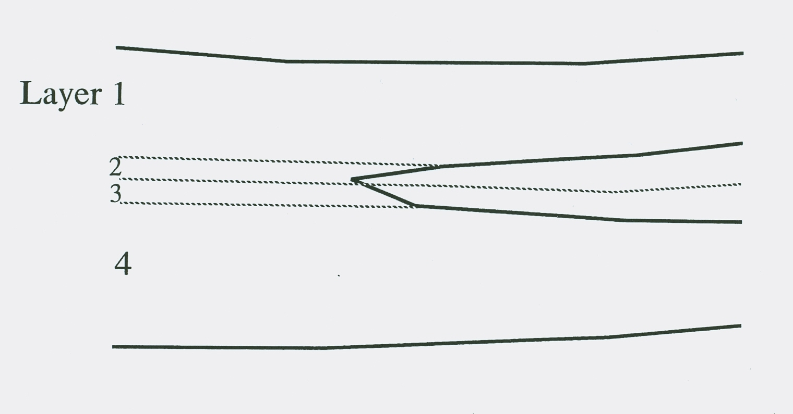
Cell Thickness When Geologic Units Pinch Out

Slide 48
Storage Terms
Storage outflow:
SS ∆v, which is dimensionless, is often called Storage Capacity (SC), which yields:
Storage outflow:
SC is the Specific Yield for water-table situations.

Slide 49
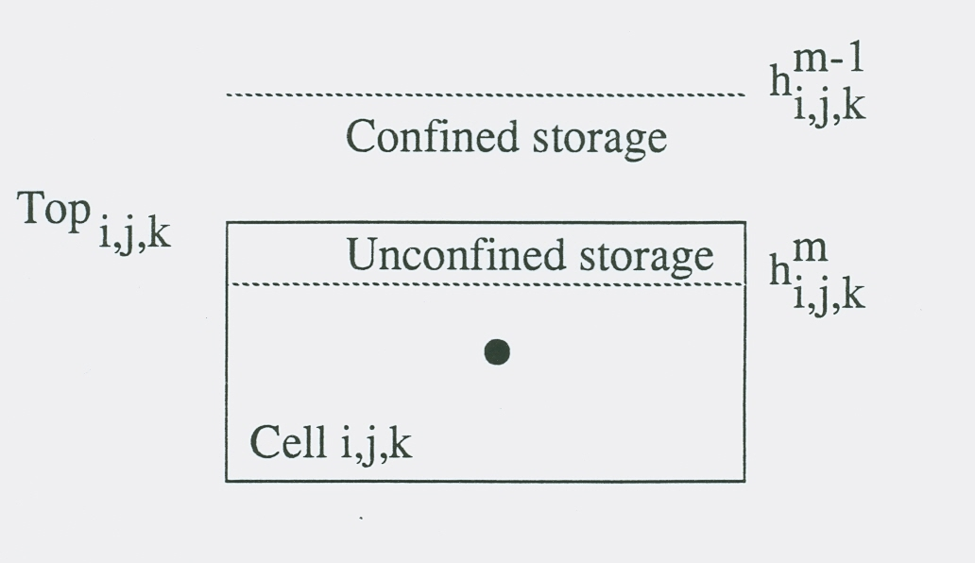
Convertible Layers Storage Calculation
SCA is storage capacity at the beginning of the time step and SCB is the storage capacity at the end of the time step.

Slide 50
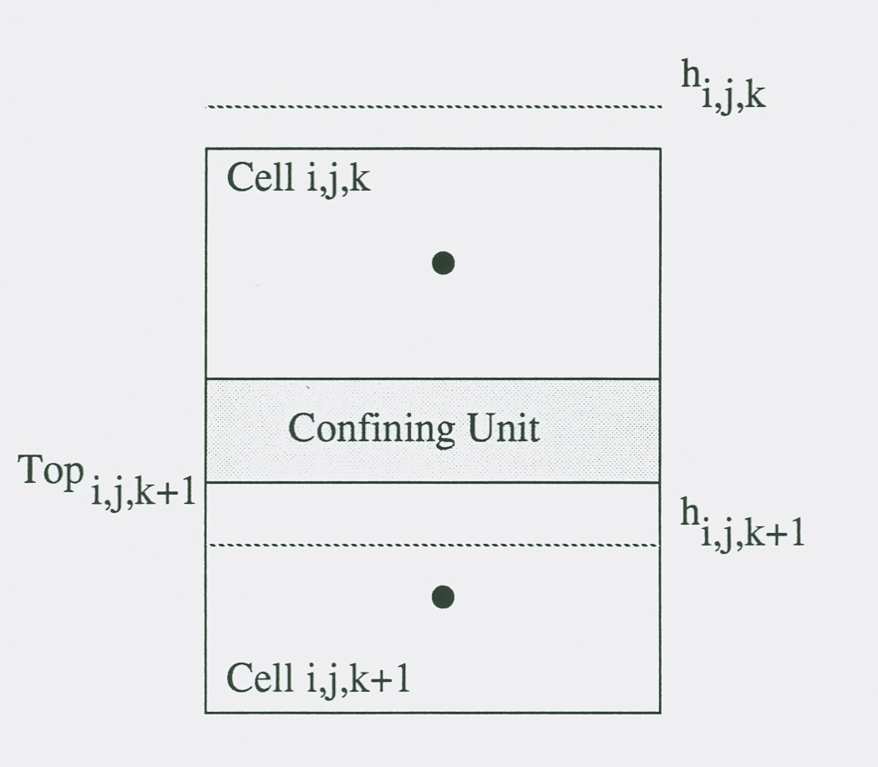
Convertible Layers Vertical Flow Calculation

Slide 51
Layer-Property Flow Package Options
Options
STORAGECOEFFICIENT
THICKSTRT
NOPARCHECK
CONSTANTCV
NOCVCORRECTION
NOVFC
Specified at the top of the LPF Input File

Slide 52
LPF Input File
# LPF Input File for MODFLOW
THICKSTRT NOVFC CONSTANTCV
53 -1E+30 0
0 0
0 0
1 1
0 0
0 0
CONSTANT 1.000000E+00 #hk Layer 1
CONSTANT 1.000000E+00 #vka Layer 1
CONSTANT 1.000000E+00 #hk Layer 2
CONSTANT 1.000000E+00 #vka Layer 2

Slide 53
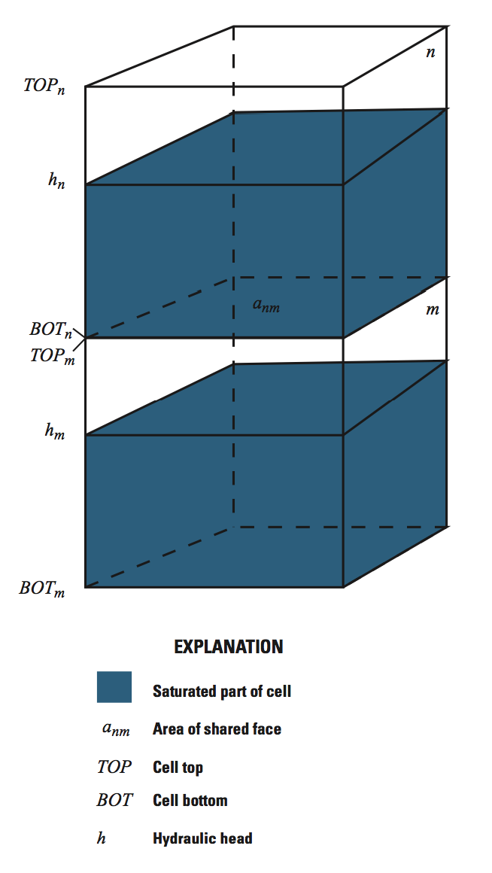
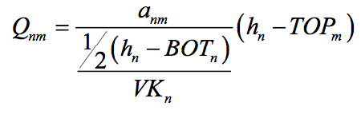
Default flow calculation for partially-dewatered conditions

Slide 54
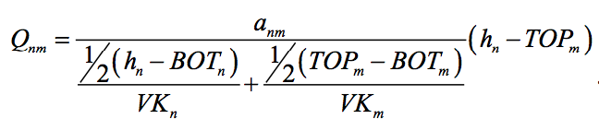
“NOCVCORRECTION”

Slide 55
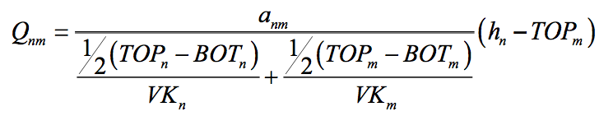
“CONSTANTCV”

Slide 56
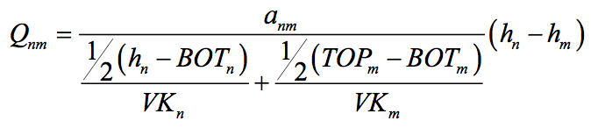
“NOVFC”
Can be combined with “CONSTANTCV” to make problem easier to solve.

Slide 57
Limitations on Using Nonlinear Terms
Numerical problems can occur
Inappropriate cells may convert to no flow (go dry)
Failure to converge
Costs are higher
More data to prepare
Extra effort to deal with numerical problems
Adjust initial head
Adjust solvers
Adjust hydraulic and stress data
Longer execution times

Slide 58
Summary of LPF Package Input Requirements
LAYTYP—Layer-type flag
0 for confined
Not 0 for convertible
LAYVKA—Vertical anisotropy flag
0 to indicate that VKA is vertical hydraulic conductivity
Not 0 to indicate that VKA is horizontal to vertical anisotropy
CHANI —Horizontal anisotropy – one value for each layer.
HK—horizontal hydraulic conductivity along rows
VKA—Vertical hydraulic conductivity or the ratio of horizontal hydraulic conductivity along rows (HK) to vertical hydraulic conductivity
VKCB—Vertical hydraulic conductivity of a Quasi-3D confining bed below a layer
Ss—specific storage
Sy—Specific yield

