Slide 1
Overview of Ground-Water Flow in MODFLOW-2005

Slide 2
PROCESSES: MODFLOW is More Than Ground-Water Flow
GWF – Ground-Water Flow Process
GWT – Ground-Water Transport Process
GWM – Ground-Water Management
GSFLOW – Rainfall runoff with MODFLOW
This class will deal primarily with GWF

Slide 3
Differential Equation for Ground-Water Flow
K_{xx}, K_{yy}, and K_{zz} are values of hydraulic conductivity along the x, y, and z coordinate axes,
which are assumed to be parallel to the major axes of hydraulic conductivity (L/T).
h is the potentiometric head (L).
W is a volumetric flux per unit volume representing sources and/or sinks of water, with W<0.0 for
flow out of the ground-water system, and W>0.0 for flow into the system (T⁻¹).
S_{S} is the specific storage of the porous material (L⁻¹).
t is time (T).

Slide 4
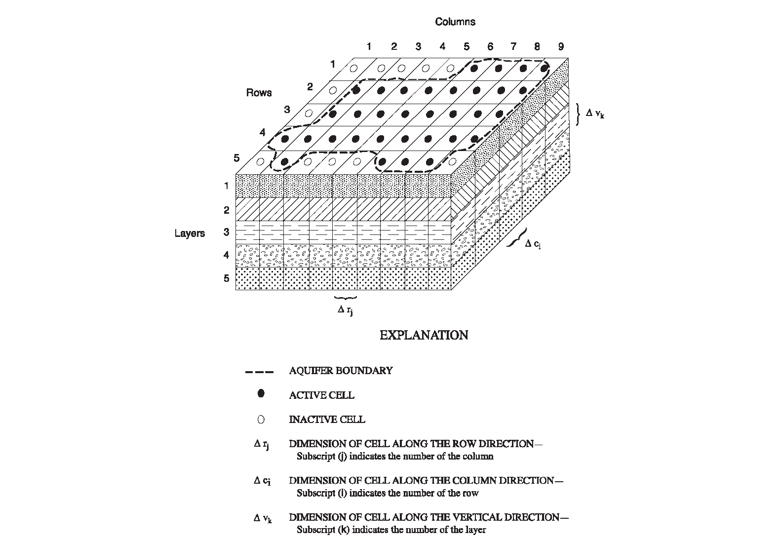
Finite-Difference Discretization for Space

Slide 5
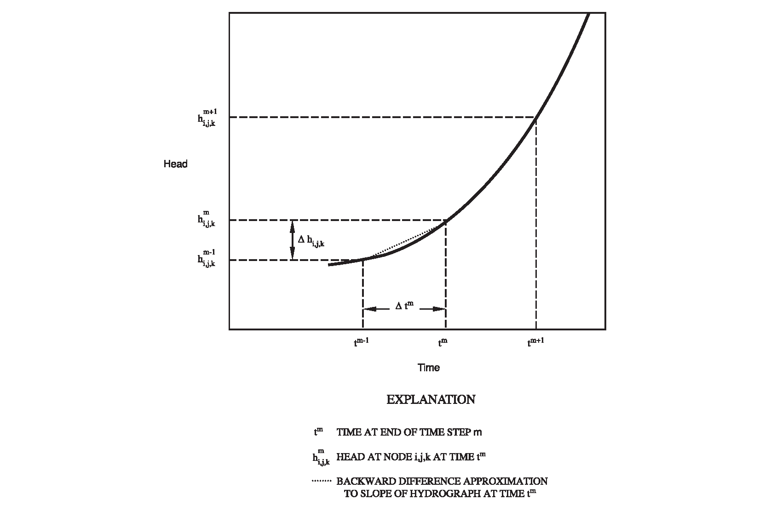
Finite-Difference Discretization for Time

Slide 6
Finite-Difference Equation

Slide 7
Finite-Difference Equation Rearranged for Solution
Where:

Slide 8
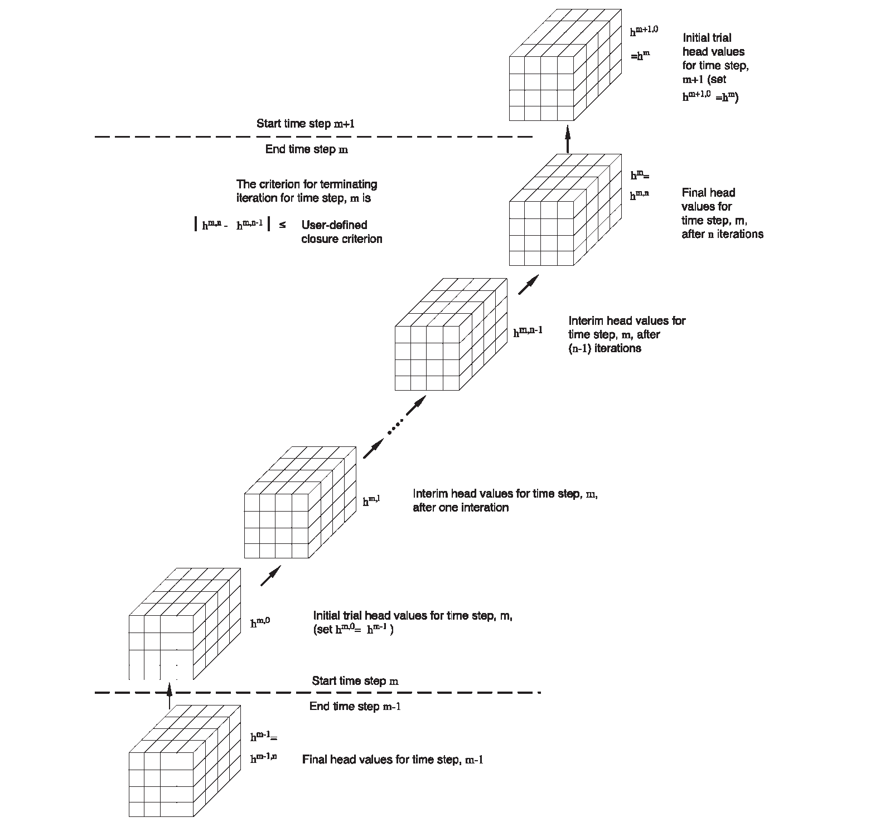
Iteration

Slide 9
Computer Program
Allocate and Read
STRESS LOOP
Stress
Read and Prepare
TIME-STEP LOOP
Advance Time
ITERATION LOOP
Formulate
Approximate
No
Close?
Yes
Output Control
Water Budget
Output
Yes
More Time Steps?
No
Yes
More Stress Periods?
No
Deallocate Memory

Slide 10
Fundamental Packages in MODFLOW
Package Name Abbreviation
Basic | BAS
Layer-Property Flow | LPF
Well | WEL
Recharge | RCH
River | RIV
Drain | DRN
Evapotranspiration | EVT
General-Head Boundary | GHB
Preconditioned Conjugate Gradient | PCG

Slide 11
Subroutines categorized by Procedure and Package
 | BAS | BCF | LPF | HFB | WEL | RCH | RIV | DRN | EVT | GHB | SIP | PCG | DE4
Allocate and Read (AR) | X | X | X | X | X | X | X | X | X | X | X | X | X
Stress (ST) | X
Read and Prepare (RP) |  |  |  |  | X | X | X | X | X | X
Advance (AD) | X
Formulate (FM) | X | X | X | X | X | X | X | X | X | X
Approximate (AP) |  |  |  |  |  |  |  |  |  |  | X | X | X
Output Control (OC) | X
Water Budget (BD) |  | X | X |  | X | X | X | X | X | X
Output (OT) | X
Deallocate (DA) | X | X | X | X | X | X | X | X | X | X | X | X | X

Slide 12
Discretization Data
All discretization data in one place
Elevations always required even if GWF does not need them because there is a good chance other processes will need them
Not always required in original versions of MODFLOW to save memory

Slide 13
Data to Define Terms for the Flow Equation
Arrays – one value for every cell in one or more layers
for example:
Hydraulic conductivity
Initial head
Lists – One or more values at cells that are identified by layer, row, and column
For example
Wells
Cells that comprise a stream
Methods of Defining data
Values directly read from files
Values constructed from parameters

Slide 14
Parameters
Generic meaning of “PARAMETER”
Any input data for a model
Meaning of “PARAMETER” in MODFLOW-2005
A specially designated value that can define input values for many cells
Changing the parameter value changes all of the associated input values
Necessary for parameter estimation because we don’t have enough observation data to estimate values for all cells
Parameters provide a convenient way to modify input data even if not using parameter estimation

Slide 15
Example of array parameters
Desired array:
7.0 8.0 9.0 30.0 30.0
8.0 9.0 10.0 30.0 30.0
9.0 10.0 30.0 30.0 30.0
10.0 10.0 30.0 30.0 30.0
Zone Array
Define Parameters HKA and HKB:
Make hydraulic conductivity equal to the value of HKA times the multiplier array at cells where zone array = 2
Make the hydraulic conductivity equal to the value of HKB times the multiplier array at cells where zone array = 5
The desired array results if HKA=10.0 and HKB=30.0
2 2 2 5 5
2 2 2 5 5
2 2 5 5 5
2 2 5 5 5
Multiplier Array
0.7 0.8 0.9 1.0 1.0
0.8 0.9 1.0 1.0 1.0
0.9 1.0 1.0 1.0 1.0
1.0 1.0 1.0 1.0 1.0

Slide 16
Example of list parameters
Desired list
Define Parameters RIVA and RIVB:
Make the Riverbed Conductance equal to the value of RIVA times the Factor in the corresponding list of river locations
Make the Riverbed Conductance equal to the value of RIVB times the Factor in the corresponding list of river locations
The desired list results if RIVA=10.0 and RIVB=20.0
Layer Row Col. Conductance
1 10 11 140.0
1 11 12 150.0
1 11 13 160.0
1 12 13 360.0
1 13 14 400.0
List for Parameter RIVA
List for Parameter RIVB
Layer Row Col. Factor
1 10 11 14.0
1 11 12 15.0
1 11 13 16.0
Layer Row Col. Factor
1 12 13 18.0
1 13 14 20.0

Slide 17
Parameter Definition
Parameters can only be specified for part of the input data:
LPF, CHD, GHB, RIV, DRN, WEL, RCH, EVT, and HFB allow parameters
Array parameters
For each layer, specify multiplier and zone arrays
NONE is a special multiplier array
ALL is a special zone array
If an array is defined using parameters, values for all cells in all layers must be defined by the parameters – i.e. cannot define values for some cells using parameters and some without using parameters
Additive parameters
List parameters
Can mix parameters with non-parameter data
Additive parameters

Slide 18
Design Objectives and How Objectives Were Met
Portable – run on “all” computers with minimal modification
FORTRAN without using vendor enhancements
Efficient
FORTRAN
Easy to Understand
Modular structure
Coding style
Documentation linked to code
Easy to enhance
Modular structure
Documentation

Slide 19
MODFLOW Documentation: Techniques and Methods 6-A16
MODFLOW-2005, the U.S. Geological Survey Modular Ground-Water Model – the Ground-Water Flow Process
Concepts
Input Instructions
Programmer documentation
TM 6-A16 replaces TWRI 6-A1, MODFLOW-96, and MODFLOW-2000 documentation

Slide 20
Basic Package for Ground-Water Flow
Name File
Space discretization
Time discretization
Stress periods
Time steps
Allocate fundamental arrays
Initial conditions
Boundary conditions
*Control output
Output Volumetric budget
*Output head and drawdown
*Topics discussed in later presentations

Slide 21
Name File
Input data for a simulation is contained in many files
Discretization File
Each Package
Most processes
Input arrays can be in separate files
Input lists can be in separate file
There can also be many output files – e.g. listing, head, budget, concentration
The Name File is a file that specifies the name and type of most files being used in a simulation
Options are activated based on the file type – e.g. WEL, RIV, OC, PCG

Slide 22
Example Name File
LIST 2 twrip.lst
DIS 10 twrip.dis
BAS6 3 twrip.ba6
LPF 11 twrip.lpf
WEL 12 twrip.wel
DRN 13 twrip.drn
RCH 18 twrip.rch
PCG 19 twrip.pcg
OC 22 twrip.oc

Slide 23
Discretization File: Space Discretization
Number of layers, rows, and columns (NLAY, NROW, NCOL)
Length units (LENUNI)
Existence of Quasi-3D Confining Units (LAYCBD)
Width of cells along a row – X direction (DELR)
Width of cells along a column – Y direction (DELC)
TOP elevation of system
Bottom elevation of every cell in each model layer
Bottom elevation of Quasi-3D Confining Units that exist

Slide 24
Time and Length Units
Length and Time Units must be consistent for all data
For example ft and days:
Flow – cubic feet per day (ft³/d)
Hydraulic conductivity – feet per day (ft/d)
Transmissivity – square feet per day (ft²/d)
Recharge flux – feet per day (ft/d)
Time step length – days
Specific storage – per ft (1/ft)
MODFLOW lets you specify the units, but MODFLOW does not convert input data based on the units being used– the units specification is just for user information

Slide 25
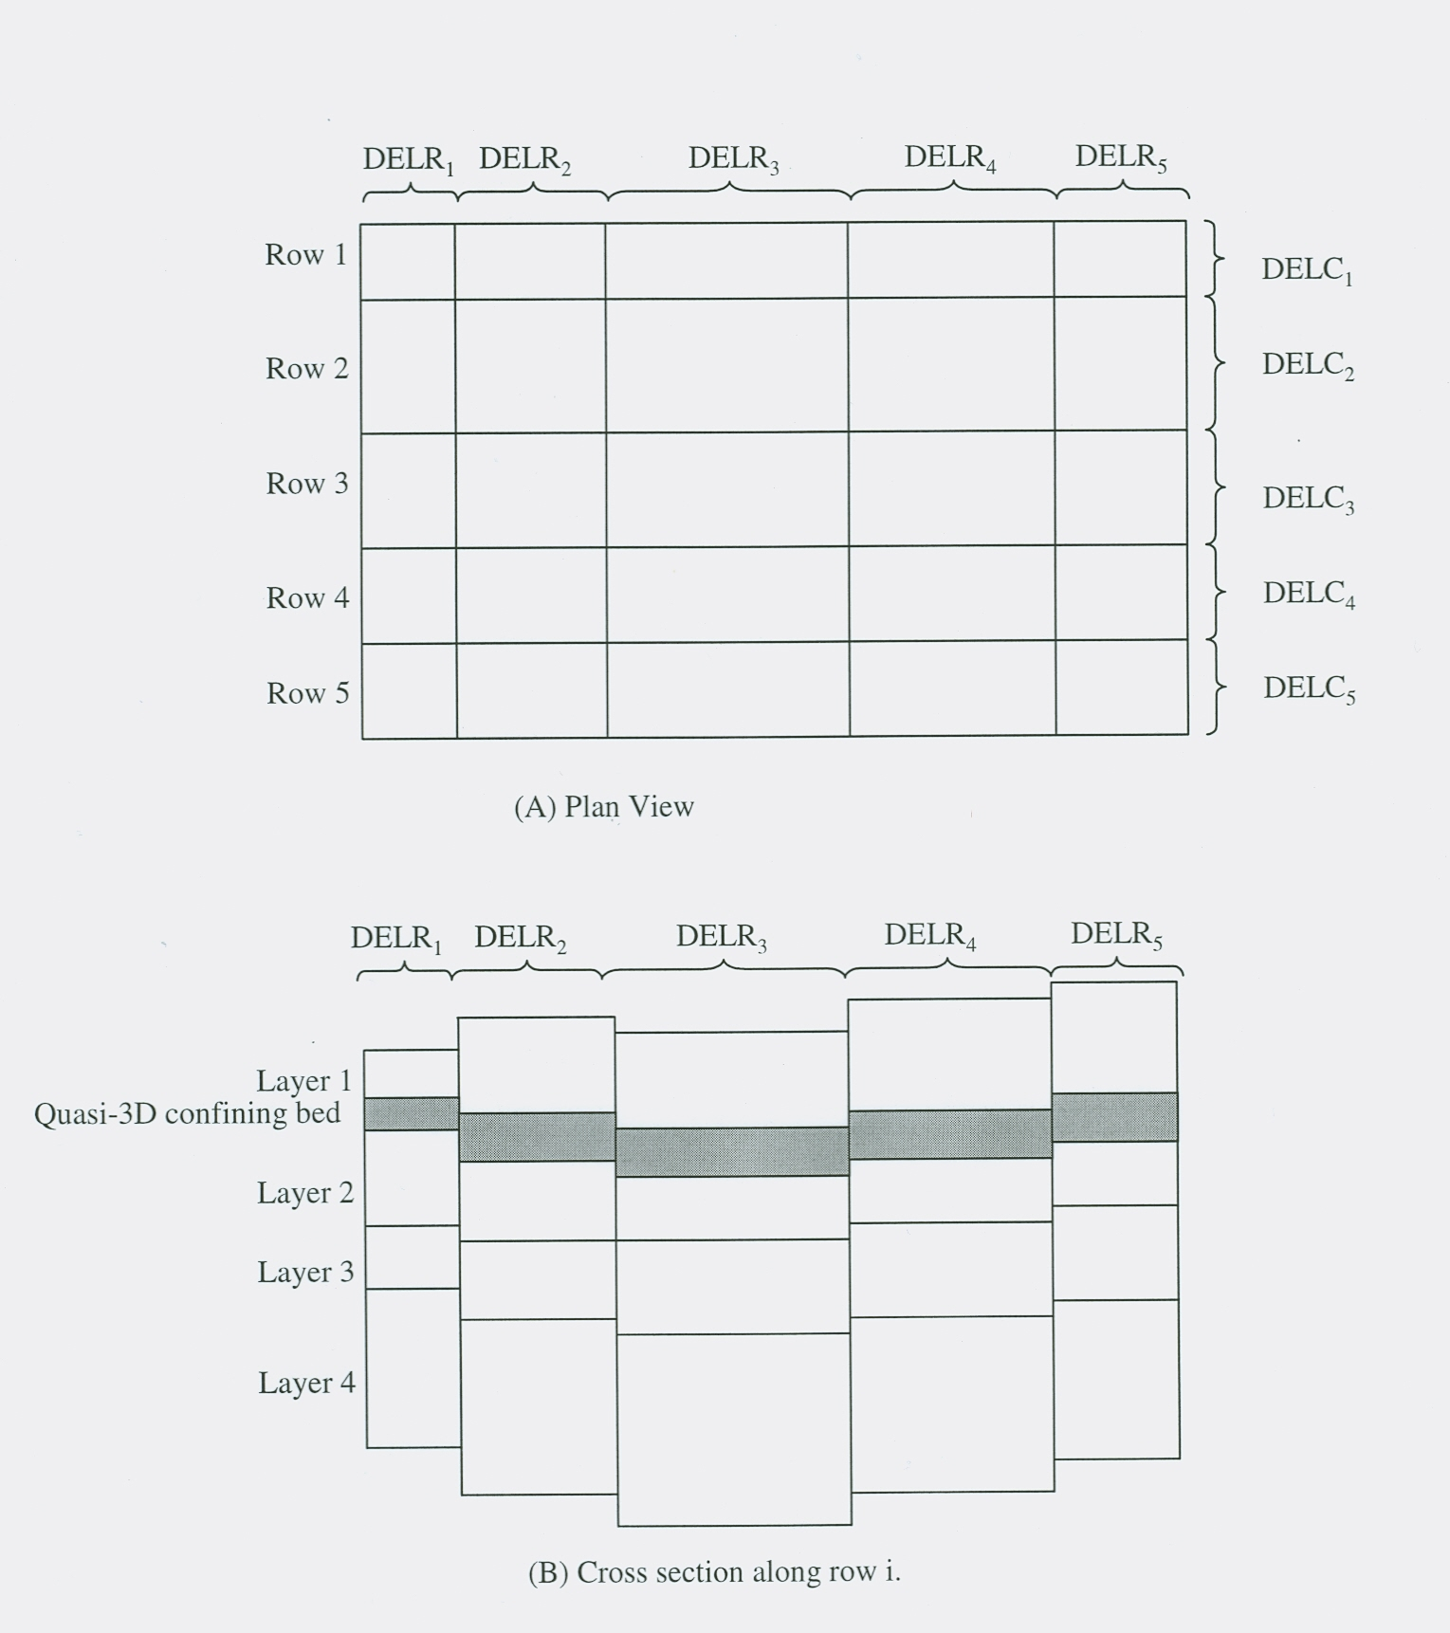
MODFLOW Grid
25

Slide 26
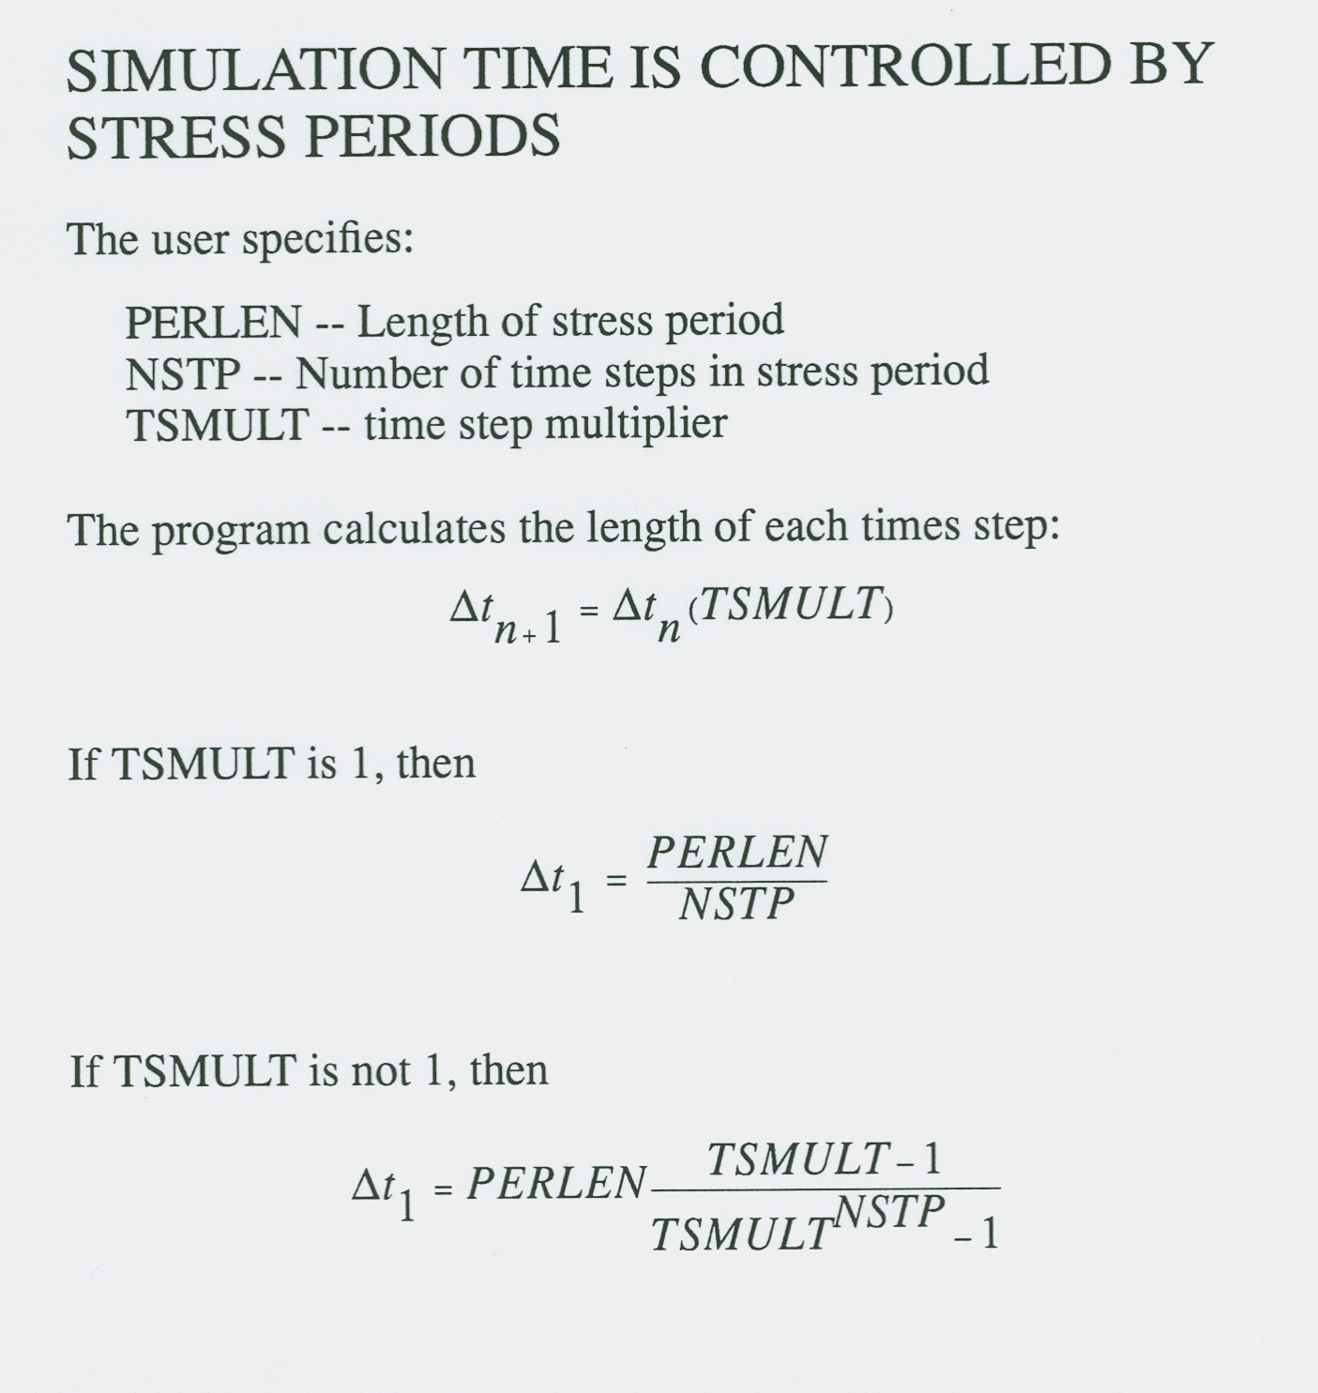
26

Slide 27
Choosing Stress Periods
Pumping
Recharge
Time
Time
Stress Periods and Time Steps
27

Slide 28
Choosing Stress Periods
Pumping
Recharge
Time
Time
Stress Periods
28

Slide 29
Choosing Stress Periods
Pumping
Recharge
Time
Time
Stress Periods
29

Slide 30
Discretization File: Time Discretization
Number of stress periods (NPER)
Time units (ITMUNI)
For each stress period
Total length (PERLEN)
Number of time steps (NSTP)
Time-step multiplier (TSMULT)
Steady-state or transient
Mixed steady-state and transient simulations are allowed

Slide 31
Steady-State Simulations
Steady state is simulated as a stress period with 0 storage
This facilitates reading data – even a steady-state simulation has input data
Specify a single time step for a steady-state stress period – using multiple time steps would produce duplicate answers
The length of the steady-state stress period and the time step multiplier have no impact on the computed heads

Slide 32
Allocation of Arrays for Flow Equation
3-D arrays:
h -- HNEW
CR
CC
CV
HCOF
RHS
HOLD
IBOUND

Slide 33
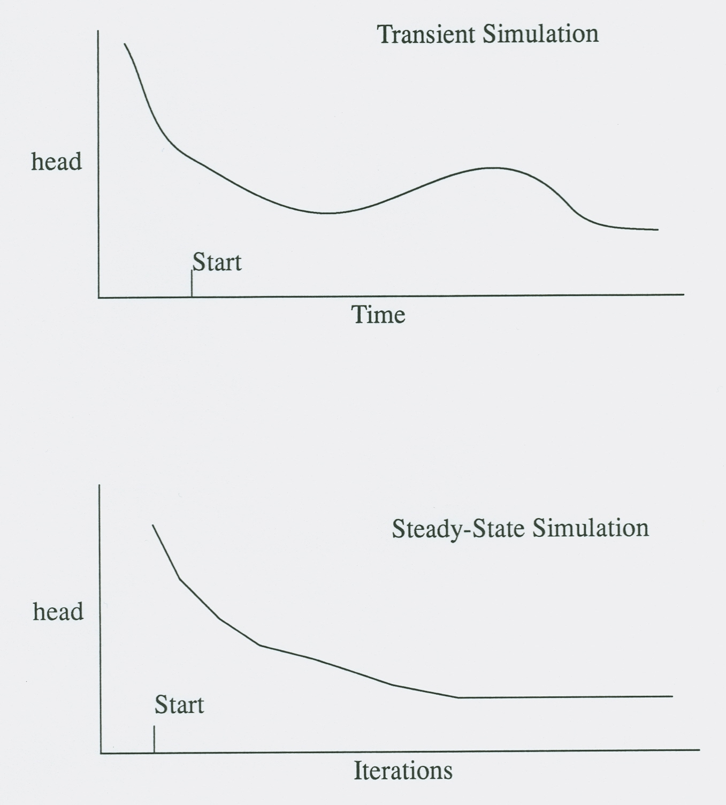
Establishing Initial Conditions
Initial conditions are required even if a simulation is steady state
33

Slide 34
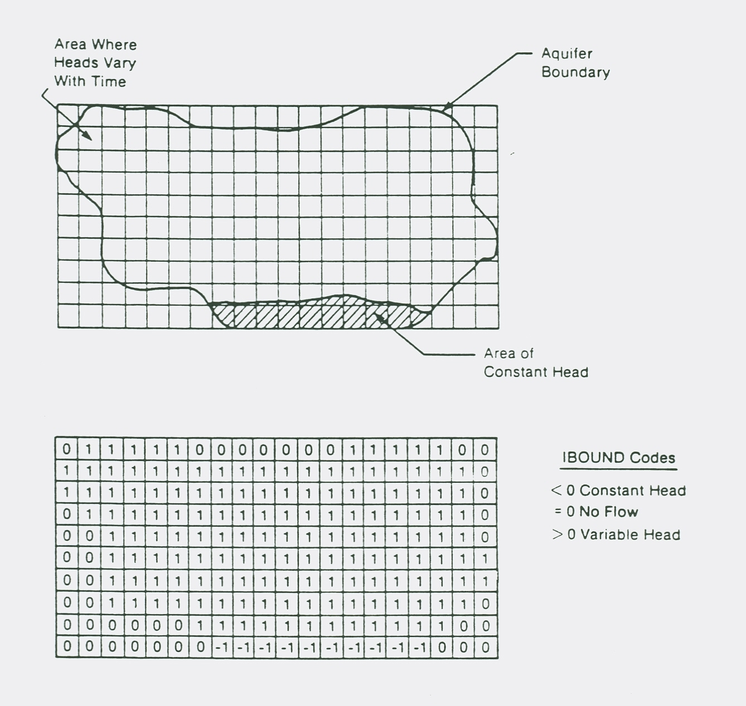
Boundary Conditions

Slide 35
VOLUMETRIC BUDGET FOR ENTIRE MODEL AT END OF TIME STEP 8 IN STRESS PERIOD 1
------------------------------------------------------------------------------
CUMULATIVE VOLUMES L**3 RATES FOR THIS TIME STEP L**3/T
------------------ ------------------------
IN: IN:
--- ---
STORAGE = 56359216.0000 STORAGE = 12796.0039
CONSTANT HEAD = 51957100.0000 CONSTANT HEAD = 42671.6211
WELLS = 0.0000 WELLS = 0.0000
RIVER LEAKAGE = 0.0000 RIVER LEAKAGE = 0.0000
RECHARGE = 184680000.0000 RECHARGE = 102600.0000
TOTAL IN = 292996320.0000 TOTAL IN = 158067.6250
OUT: OUT:
---- ----
STORAGE = 6.1035 STORAGE = 0.0000
CONSTANT HEAD = 2.5733 CONSTANT HEAD = 0.0000
WELLS = 126000000.0000 WELLS = 70000.0000
RIVER LEAKAGE = 166986064.0000 RIVER LEAKAGE = 88094.2656
RECHARGE = 0.0000 RECHARGE = 0.0000
TOTAL OUT = 292986080.0000 TOTAL OUT = 158094.2660
IN - OUT = 10243.3232 IN - OUT = -26.6406
PERCENT DISCREPANCY = 0.00 PERCENT DISCREPANCY = -0.02
TIME SUMMARY AT END OF TIME STEP 8 IN STRESS PERIOD 1
SECONDS MINUTES HOURS DAYS YEARS
-----------------------------------------------------------
TIME STEP LENGTH 5.39448E+07 8.99081E+05 14985. 624.36 1.7094
STRESS PERIOD TIME 1.55520E+08 2.59200E+06 43200. 1800.0 4.9281
TOTAL TIME 1.55520E+08 2.59200E+06 43200. 1800.0 4.9281
35

Slide 36
Layer-Property Flow Package
Formulate terms for calculating flow through porous medium
Calculate conductance
Calculate storage terms
Calculate porous medium budget terms
Flow to storage
Flow to constant-head cells
Flow between adjacent cells

Slide 37
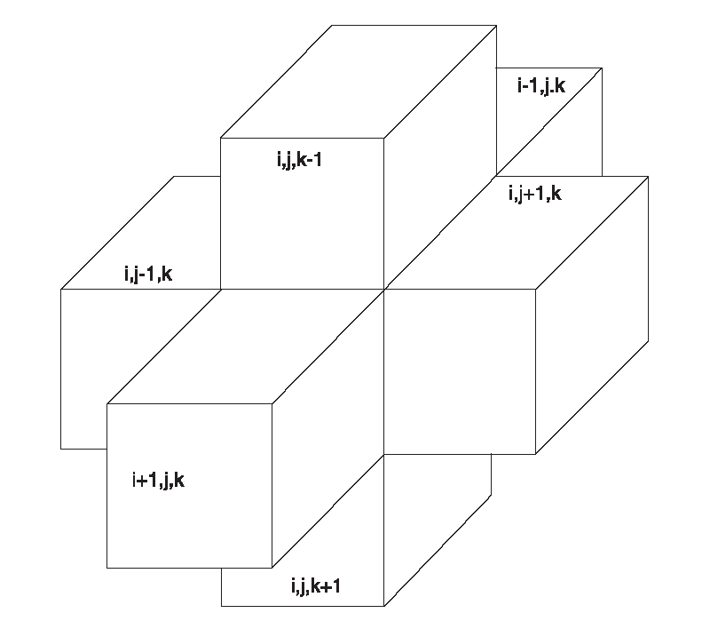
Consider the Finite-Difference Equation for 1 Cell – cell i,j,k
Cell i,j,k is in the middle of this cluster of cells i is the row j is the column k is the layer

Slide 38
Finite-Difference Equation for 1 Cell

Slide 39

Conductance
If flow is horizontal, we can write conductance in terms of transmissivity:

Slide 40
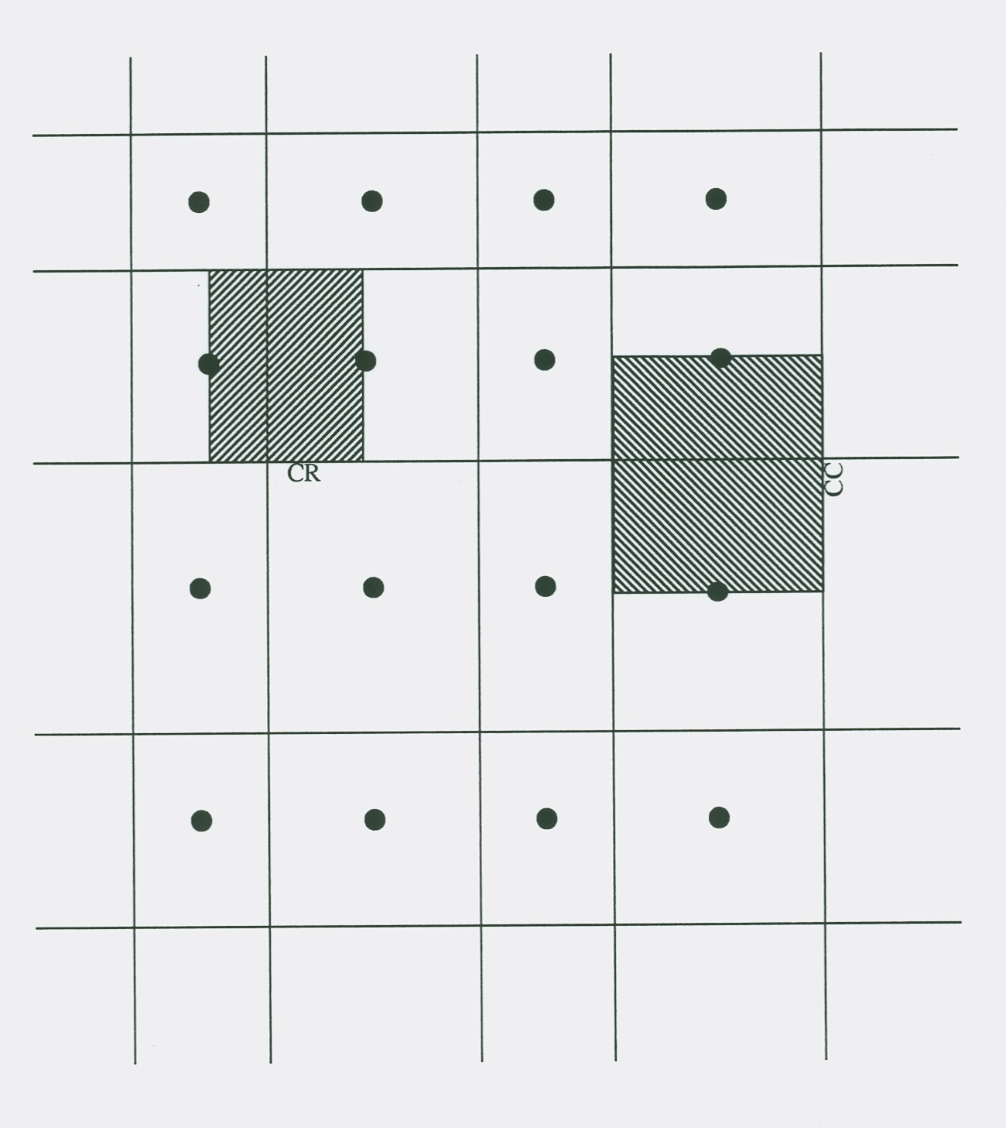
Horizontal Conductance Between Nodes
Plan View

Slide 41
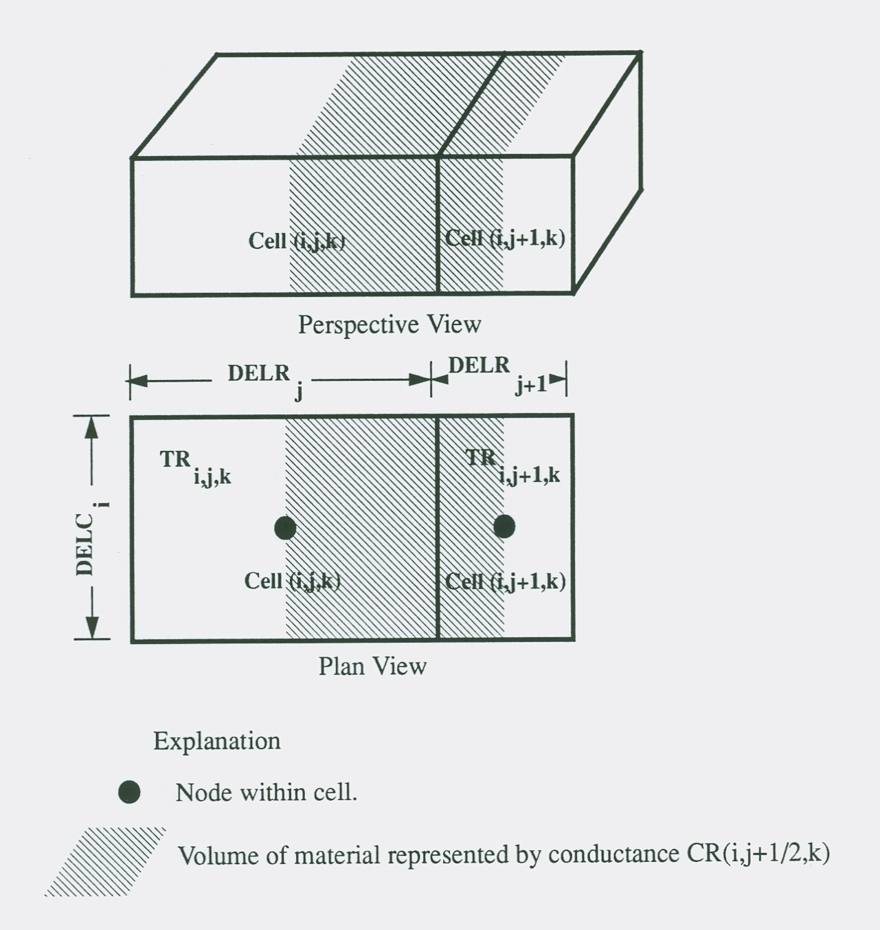
Horizontal Conductance Between Nodes
Assumptions:
1. Node in center of cell
2. Hydraulic Conductivity can change at cell boundary

Slide 42

Equivalent Conductance of Multiple Conductance Blocks in Series
The assumption of continuity of head across subprisms gives:
Substituting for using Darcy’s Law gives
Each q_{i} is the same, which is the total Q:
Which implies that
therefore

Slide 43
Horizontal Conductance Between 2 Nodes
Applying the equation for conductance in series to 2 blocks gives:
DELR_{j}
DELR_{j+1}
TR_{i,j,k}
TR_{i,j+1,k}
DELC_{i}
i,j,k
i,j+1,k
CR_{i,j+1/2,k}

Slide 44
Horizontal Conductance for Convertible Layers
Cell i,j,k-1
Quasi3D confining Unit
TOP(i,j,k)
h(i,j,k)
Cell i,j,k
BOT(i,j,k)
If a layer is designated as convertible, transmissivity is calculated throughout the simulation at each cell:
If h ≥ TOP, T = (TOP – BOT) K
If BOT < h < TOP, T = (h – BOT) K
If h ≤ BOT, cell is changed to no flow

Slide 45
Horizontal Conductance for Convertible Layers
Allocate and Read
STRESS LOOP
Stress
Read and Prepare
TIME-STEP LOOP
The fact that T, which is part of horizontal conductance, varies with h makes the flow equation nonlinear. We cannot directly solve this flow equation, so we simplify the equation.
h-BOT is assumed constant and lags by 1 iteration – that is, when formulating the flow equation for iteration n, T is formulated based on head from iteration n-1:
If h^{n-1} ≥ TOP, T^{n} = (TOP – BOT) K
If BOT < h^{n-1} < TOP, T^{n} = (h^{n-1} – BOT) K
If h^{n-1} ≤ BOT, cell is changed to no flow
If the solution converges, then h will change very little from iteration to iteration, so h^{n-1} is very close to h^{n}
Advance Time
ITERATION LOOP
Formulate
Approximate
No
Close?
Yes
Output Control
Water Budget
Output
Yes
More Time Steps?
No
Yes
More Stress Periods?
No
Deallocate Memory

Slide 46
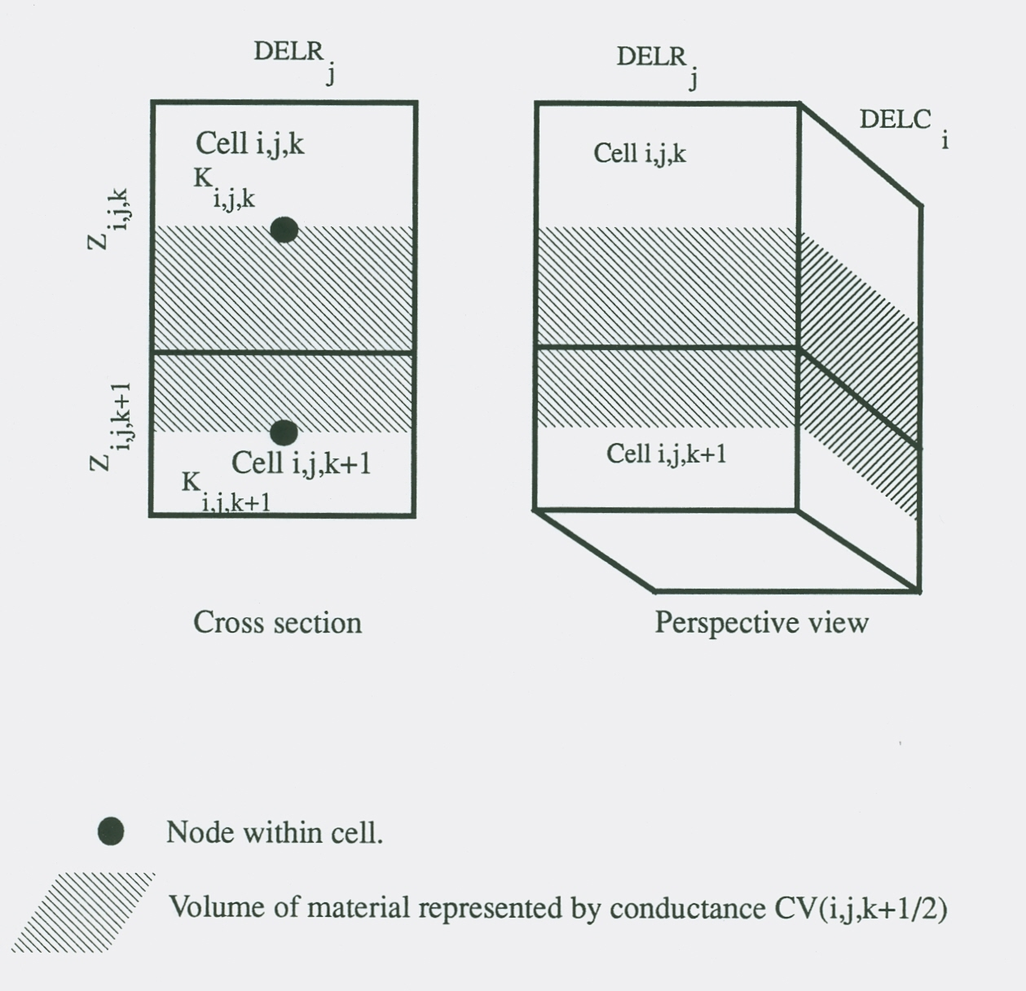
Vertical Conductance

Slide 47

Vertical Conductance

Slide 48
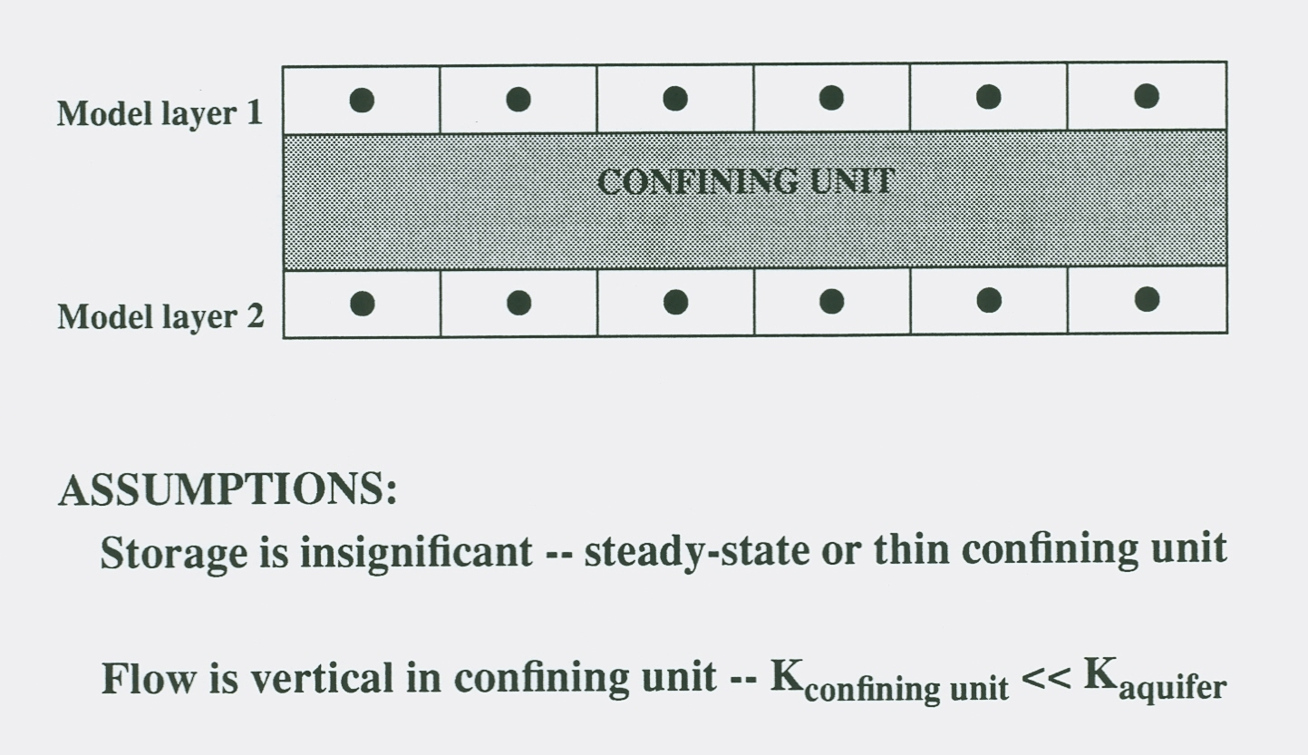
Quasi 3-D Approximation

Slide 49
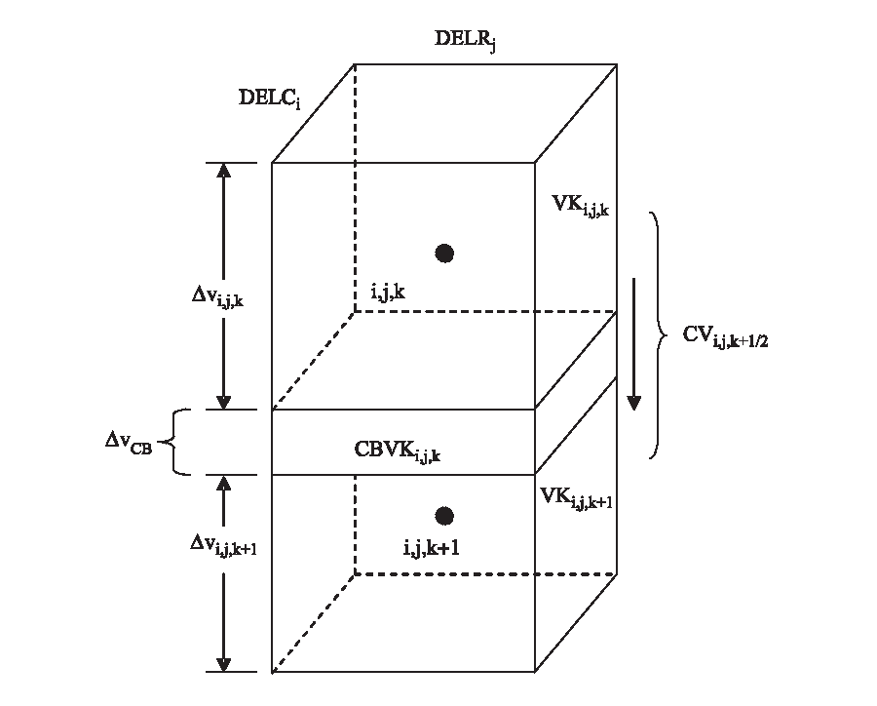
Vertical Conductance for Quasi 3-D Approximation
Example: Kupper=Klower=100, Kcb=1, and bupper=blower=bcb=100
CVupper=CVlower=100A/50=2A and CVcb=1A/100=.01A

Slide 50
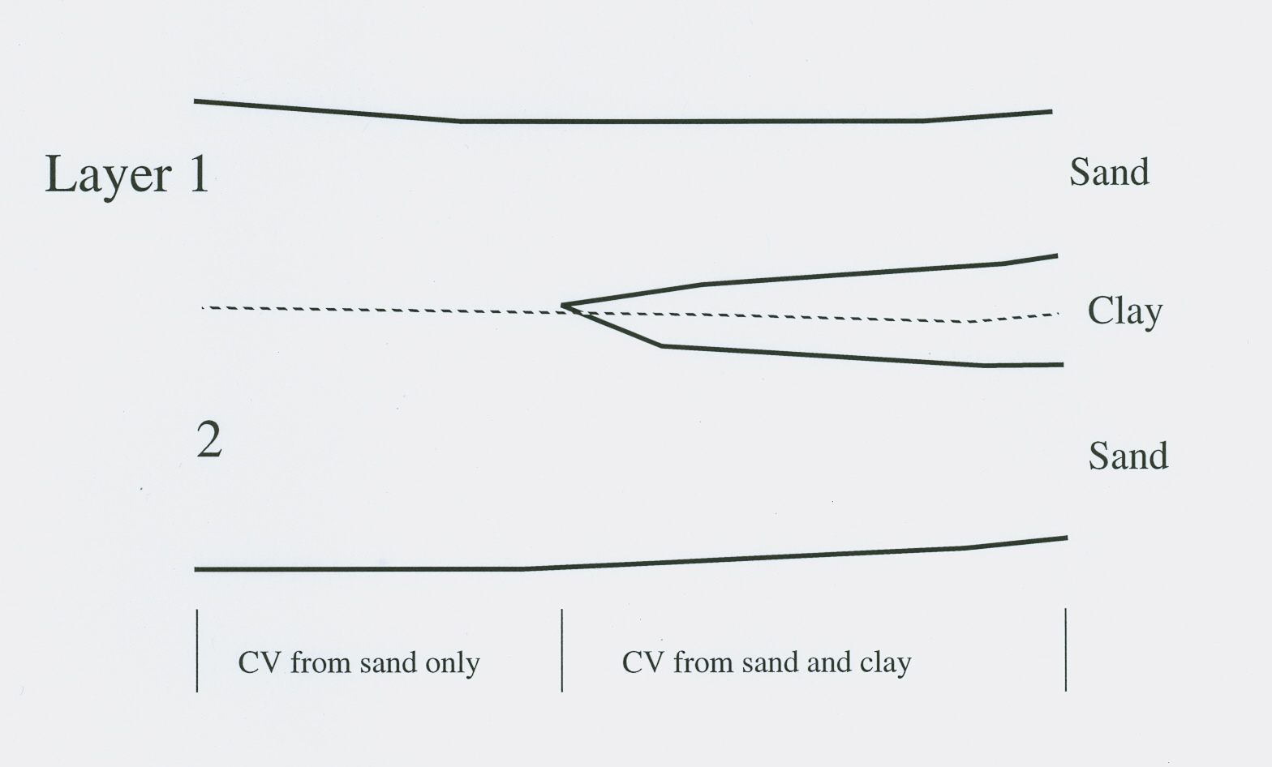
Quasi 3-D Beds that Pinch Out

Slide 51
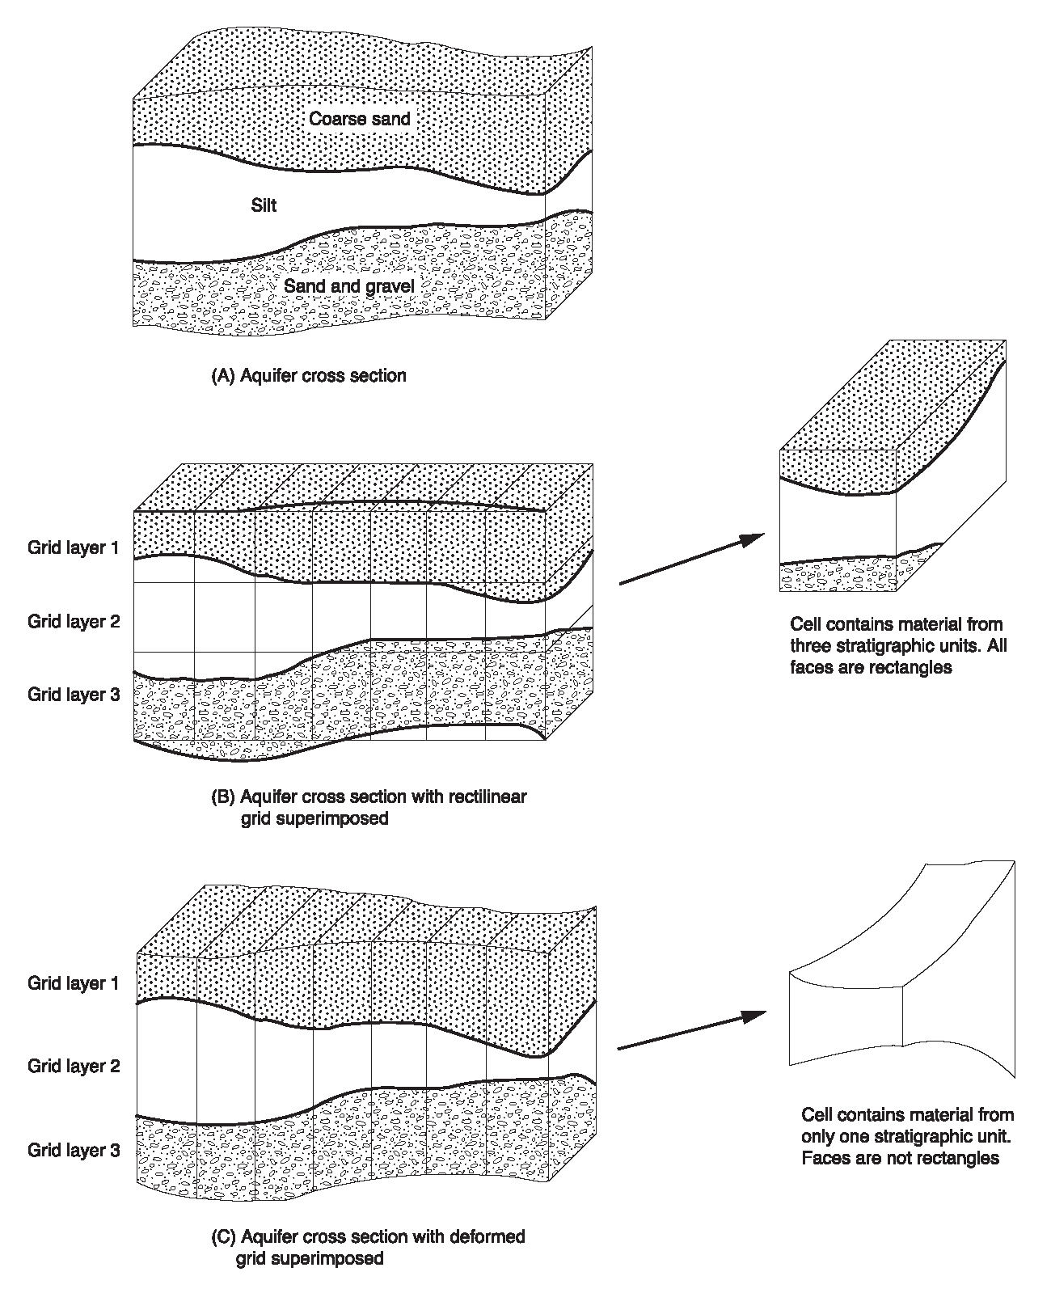
Use of Distorted Vertical Grids
To allow for layers that do not have uniform thickness, Z is allowed to vary cell by cell.
The Discretization File contains elevations for each cell.
Variable thickness affects horizontal and vertical conductance calculations.
Distorted grids allow the use of fewer layers, but they introduce errors that are difficult to quantify.

Slide 52
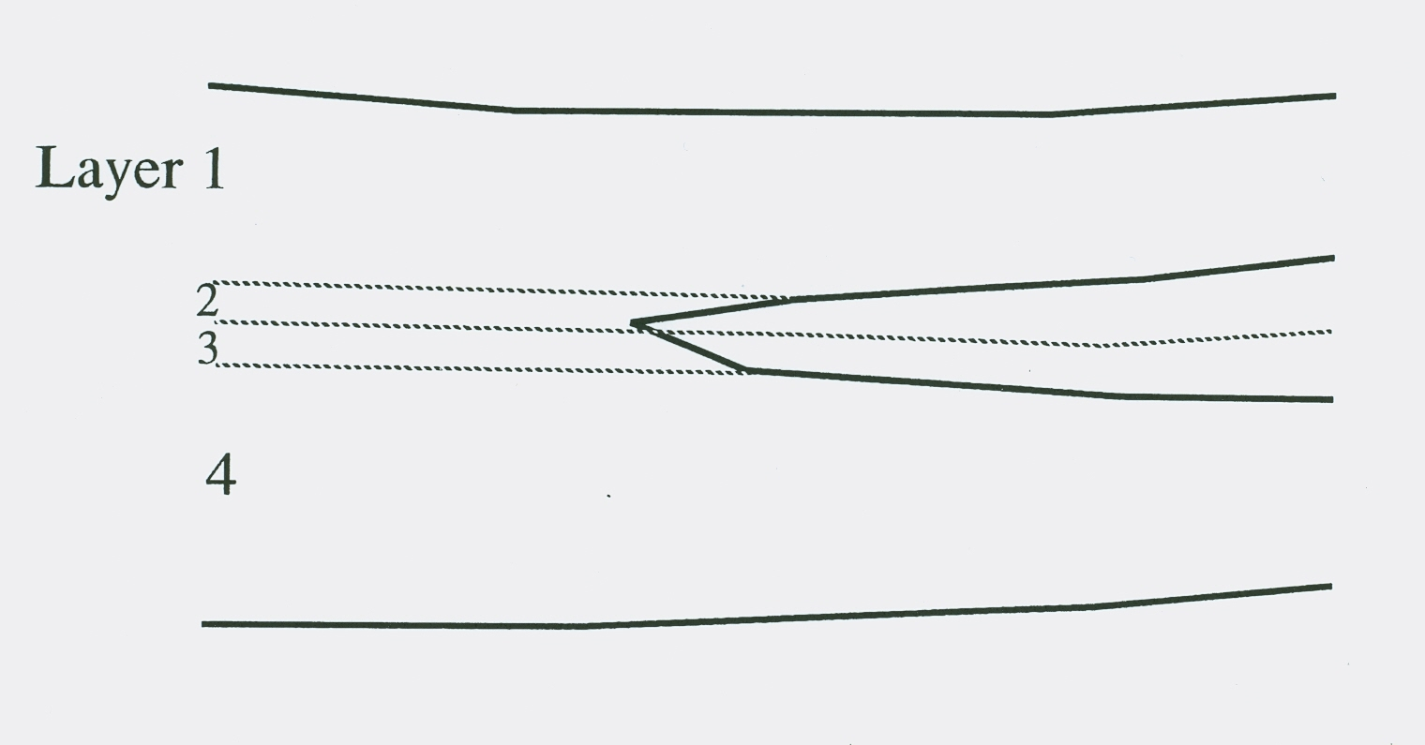
Cell Thickness When Geologic Units Pinch Out

Slide 53
Storage Terms
Storage outflow:
SS ∆v, which is dimensionless, is often called Storage Capacity (SC), which yields:
Storage outflow:
SC is the Specific Yield for water-table situations.

Slide 54
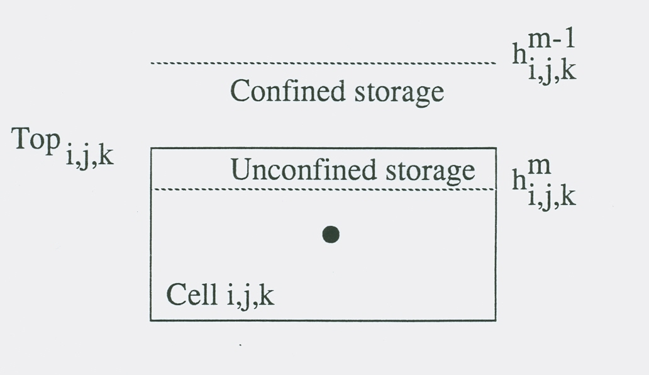
Convertible Layers Storage Calculation
SCA is storage capacity at the beginning of the time step and SCB is the storage capacity at the end of the time step.

Slide 55
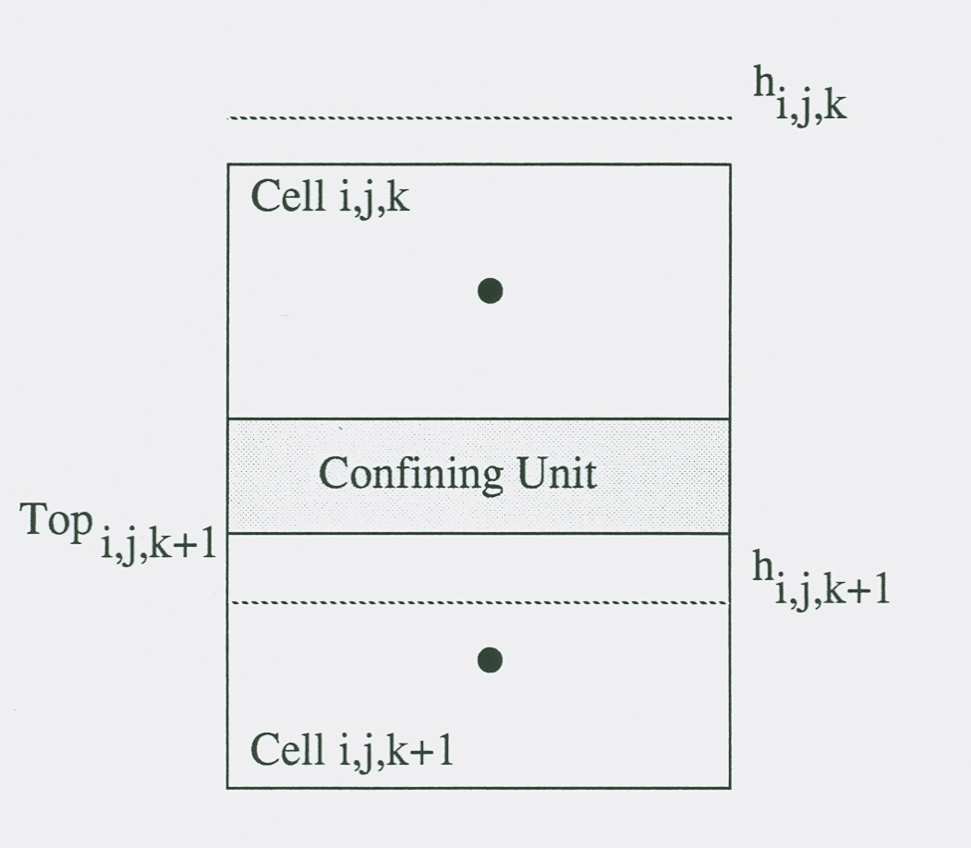
Convertible Layers Vertical Flow Calculation

Slide 56
Layer-Property Flow Package Options
Options
STORAGECOEFFICIENT
THICKSTRT
NOPARCHECK
CONSTANTCV
NOCVCORRECTION
NOVFC
Specified at the top of the LPF Input File

Slide 57
LPF Input File
# LPF Input File for MODFLOW
THICKSTRT NOVFC CONSTANTCV
53 -1E+30 0
0 0
0 0
1 1
0 0
0 0
CONSTANT 1.000000E+00 #hk Layer 1
CONSTANT 1.000000E+00 #vka Layer 1
CONSTANT 1.000000E+00 #hk Layer 2
CONSTANT 1.000000E+00 #vka Layer 2

Slide 58
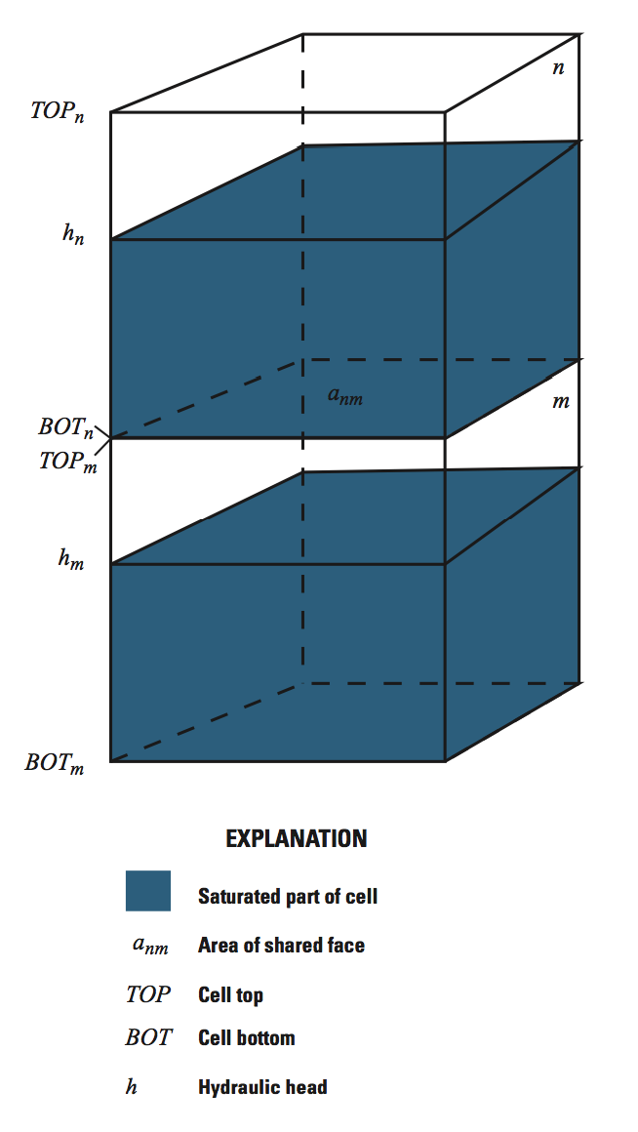
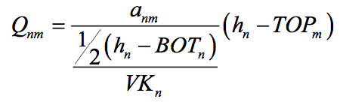
Default flow calculation for partially-dewatered conditions

Slide 59
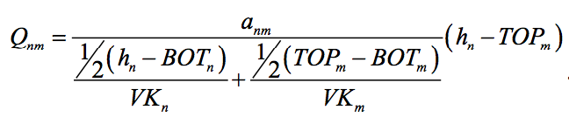
“NOCVCORRECTION”

Slide 60
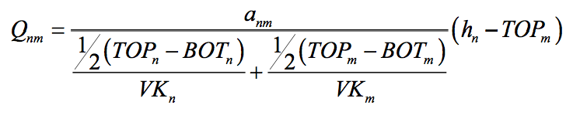
“CONSTANTCV”

Slide 61
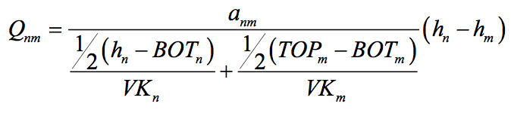
“NOVFC”
Can be combined with “CONSTANTCV” to make problem easier to solve.

Slide 62
Limitations on Using Nonlinear Terms
Numerical problems can occur
Inappropriate cells may convert to no flow (go dry)
Failure to converge
Costs are higher
More data to prepare
Extra effort to deal with numerical problems
Adjust initial head
Adjust solvers
Adjust hydraulic and stress data
Longer execution times

Slide 63
Summary of LPF Package Input Requirements
LAYTYP—Layer-type flag
0 for confined
Not 0 for convertible
LAYVKA—Vertical anisotropy flag
0 to indicate that VKA is vertical hydraulic conductivity
Not 0 to indicate that VKA is horizontal to vertical anisotropy
CHANI —Horizontal anisotropy – one value for each layer.
HK—horizontal hydraulic conductivity along rows
VKA—Vertical hydraulic conductivity or the ratio of horizontal hydraulic conductivity along rows (HK) to vertical hydraulic conductivity
VKCB—Vertical hydraulic conductivity of a Quasi-3D confining bed below a layer
Ss—specific storage
Sy—Specific yield

