Slide 1
Lecture 7
Solute transport modeling

Slide 2
Solute and Heat Transport
Need to represent solute transport because density is a function of concentration, and concentration may change in response to flow field
Density is also a function of temperature. As temperature increases, density decreases. Temperature may change in response to flow field

Slide 3
Solute Transport Processes
Physical Transport of solute
Advection
Diffusion
Mechanical Dispersion
Reactive Transport
Geochemical reactions
Biological reactions

Slide 4
Advection
Transport of solute in flowing groundwater with average groundwater velocity
In most cases, advection is primary process for solute transport

Slide 5
Advective Velocity and Mass Flux
Velocity of Advective Transport
Advective Mass Flux
advective velocity
interstitial velocity
pore water velocity
seepage velocity
q: specific discharge (Darcy flux; Darcy velocity)
Mass per unit time per unit bulk area
θ: “effective” porosity

Slide 6
Derivation of Equation for Advective Transport
Δz
q_{x}C_{x}
q_{x+Δx}C_{x+Δx}
Δy
Δx
ΔStorage= ΔC⋅θ/ Δt
In – Out = ΔStorage
1 Dimension

Slide 7
Equation for Advective Transport
3 Dimensions

Slide 8
Dispersion
Spreading of a solute over a greater area than would be predicted solely from average groundwater velocity
v Δ t₂
vΔt₁
Longitudinal dispersion
Transverse dispersion

Slide 9
Hydrodynamic Dispersion
Molecular Diffusion
Mechanical Dispersion

Slide 10
Molecular Diffusion
(A) Container with saline water and distilled water separated by a glass plate
(B) Ionic distribution after removal of glass plate
Spread of solute caused by concentration gradients
(C) Ionic distribution at time t1 after removal of plate
(D) Final ionic distribution

Slide 11
Fick’s Law of Diffusion
F: diffusion mass flux
D*: effective diffusion coefficient [L²/T]
D₀: molecular diffusion coefficient in open water
τ: is the tortuosity, defined as the length of a sample divided by the length of a flow path through a sample (τ < 1)

Slide 12
Mechanical Dispersion
Spreading of solute as a result of differences in actual velocity and average velocity
Pore Scale
Macro Scale

Slide 13
Representation of Mechanical Dispersion in Transport Model
By detailed (complete) description of hydraulic conductivity field
By analogy to Fick’s second law of diffusion, i.e., mass flux (F) due to dispersion is proportional to concentration gradients

Slide 14
Dispersion Coefficients for 1-D Flow in X direction

Slide 15
Dispersion Coefficients
α_{L} = longitudinal dispersivity
α_{TH} = horizontal transverse dispersivity
α_{TV} = vertical transverse dispersivity
D* = molecular diffusion coefficent
Originally from Burnett and Frind (1987), and currently used in MT3DMS

Slide 16
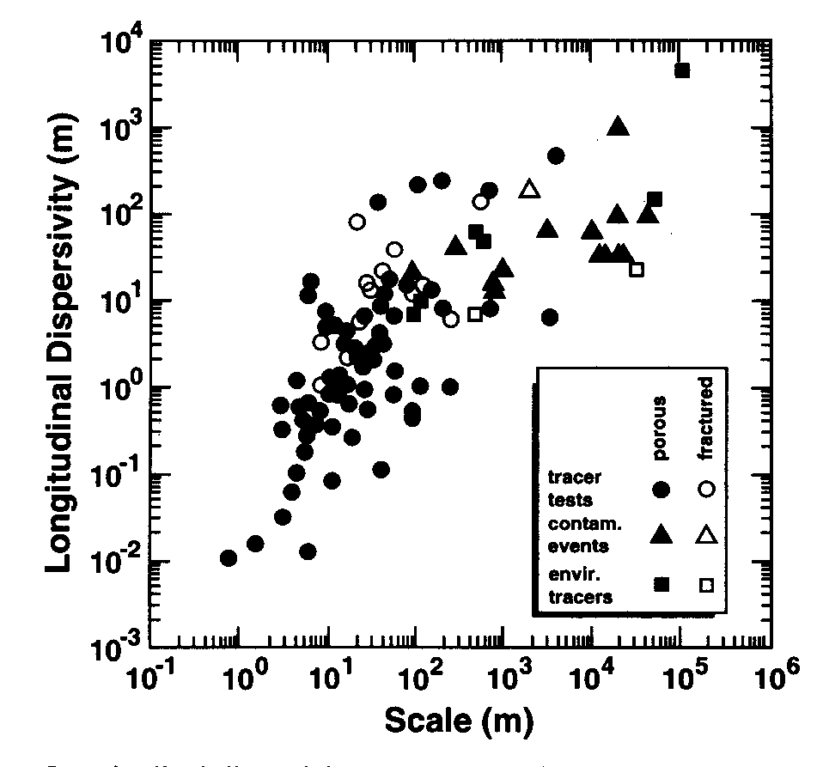
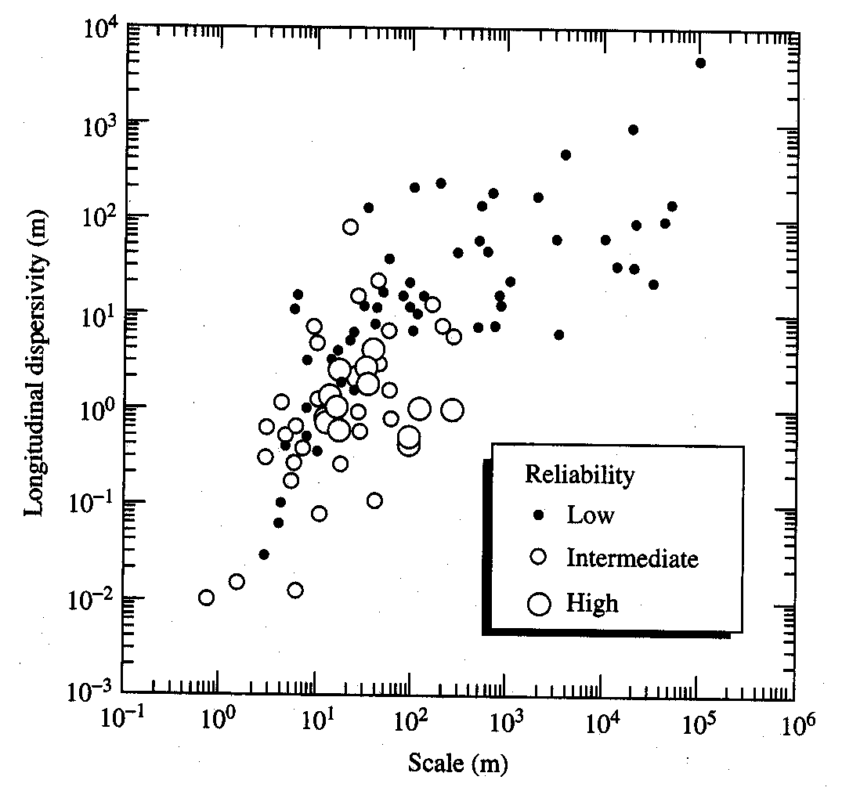
Values of Longitudinal Dispersivity
Source: Gelhar et al. (1992)

Slide 17
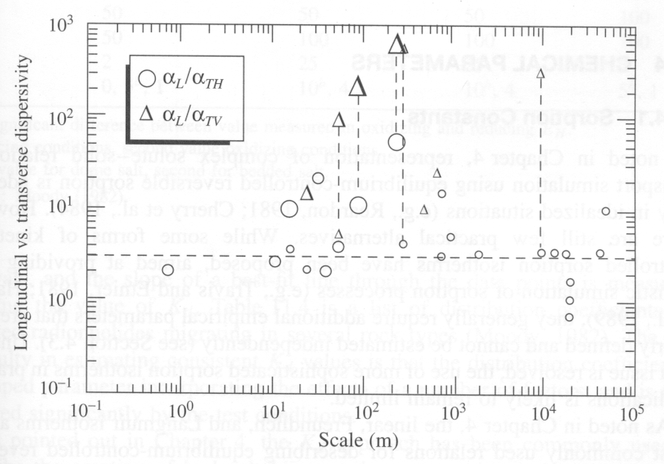
Dispersivity Ratios
Source: Gelhar et al. (1992)

Slide 18
Derivation of Equation for Dispersive Transport
Inflow=F_{x}θ
Outflow=F_{x+Δx}θ
ΔStorage= ΔC⋅θ/ Δt
In – Out = ΔStorage
F_{x}
F_{x+Δx}
Δz
Δy
Δx
1D and v is aligned with x axis

Slide 19
Advection-Dispersion Equation
Assumptions
v and D are spatially uniform
v is aligned with x axis
no sinks/sources
DSP
ADV

Slide 20
Governing Equation for Solute Transport
ADV
DSP
SSM
RCT
Or, as in MT3DMS
DSP
ADV
SSM
RCT

Slide 21
Validity of the Advection-Dispersion Model
Dispersion should only be used to account for solute spreading caused by small-scale, randomly distributed heterogeneities in the hydraulic conductivity field. Larger K trends should be explicitly delineated and included in the flow model.

Slide 22
Alternative to Advection-Dispersion Model
Dual-domain (dual-porosity) mass transfer
matrix
silt
fracture
sand
clay
1. Fractured flow system
2. Heterogeneous porous media

Slide 23
Dual-Domain Mass Transfer Approach
Aquifer is conceptualized as consisting of two distinctive and overlapping domains:
a mobile (or fast) domain where transport is mainly by advection, and
an immobile (or slow) domain where transport is mostly by diffusion
Interaction between the two domains is characterized by kinetic mass transfer
Mobile domain
Immobile domain

Slide 24
Dual Domain Equations
θ_{m} = porosity of mobile domain
θ_{m} = porosity of the immobile domain
= θ_{m} + θ_{im} = total porosity
= first-order mass transfer rate between the mobile and
immobile domains

Slide 25
Single-Species Chemical Reactions
Sorption
Mass transfer (or partitioning) process between the contaminants dissolved in groundwater (solution phase) and the contaminants sorbed on porous media (solid phase) including absorption (incorporation into the interior of a solid); adsorption (attraction to a surface); and ion exchange
First-order rate reactions
Radioactive decay
Biodegradation
Hydrolysis

Slide 26
Equilibrium-Controlled Sorption
Key assumptions
LEA (local equilibrium assumption)—mass transfer (partitioning) process is instantaneous
Reversible—total mass is not changed
Retardation concept
Advancing contaminant plume appears “retarded” because dissolved contaminants are sorbed on to porous materials, leaving less solute for transport
Retreating contaminant plume appears “retarded” because sorbed contaminants are de-sorbed into the dissolved phase, leaving more solute behind

Slide 27
Sorption Isotherms
Linear sorption
Freundlich sorption
Langmuir sorption
Nonequilibrium sorption

Slide 28
Freundlich and Langmuir Isotherms
Freundlich isotherm. A linear isotherm is a special case for which the exponent, a, is equal to 1.
A Langmuir isotherm where S is the maximum sorption capacity
S
Sorbed Concentration
a<1
Sorbed Concentration
a=1
a=1
a>1
Dissolved Concentration
Dissolved Concentration

Slide 29
Method for Including Sorption into Transport Model
Retardation Coefficient

Slide 30
1st-Order Irreversible Rate Reactions
Rate coefficient for dissolved species
Rate coefficient for sorbed species
relation between rate coefficient [T⁻¹] and half life [T]

Slide 31
Zero-Order Reactions
Rate coefficient for dissolved species
Rate coefficient for sorbed species
γ₁ [ML⁻³T⁻¹] and γ₂ [MM⁻¹T⁻¹] are the zeroth-order rate coefficients for the dissolved and sorbed phase. Positive rate coefficients indicate decay; negative values indicate growth.

Slide 32
Heat/Energy
Stored
Conducted
Dispersed
Convected
Produced/Lost
Key parameters
Thermal conductivity (k_{T})
Specific heat capacity (c_{P})

Slide 33
Heat Capacity
Heat is stored in the fluid and solid
Heat capacity of the fluid and solid represented as: &
Energy stored in fluid:
Energy stored in the solid:

Slide 34
Heat/Energy Transport
Fourier’s law for heat transport:
Heat is conducted through fluid and solid
Thermal conductivity of the fluid and solid represented as: &
Bulk thermal conductivity:

Slide 35
Heat Flux
Dispersive heat flux:
Convective heat flux:
Produced/Lost (reaction):

Slide 36
Heat/Energy Transport (conserve Energy/Mass)
Stored
Conducted and Dispersed
Convected
Sink/Source
RCT(produced/lost)

Slide 37
Factor out for minimal change in density
…and remember
Production and decay
are distributed sources/sinks

Slide 38
Equation simplified to…
Substitute:
And substitute the Thermal Distribution Factor:
And substitute the Molecular Diffusion Coefficient:

Slide 39
Heat transport…
Solute transport…

