Slide 2
0 | 1 | 2 | 3 | 4 | 5
0
1
2
3
4
5
h_{0,0 =} P_{0,0}

Slide 4
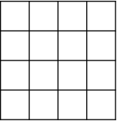
Direction=down
Direction=up
Direction=right
Direction=left

