Slide 1
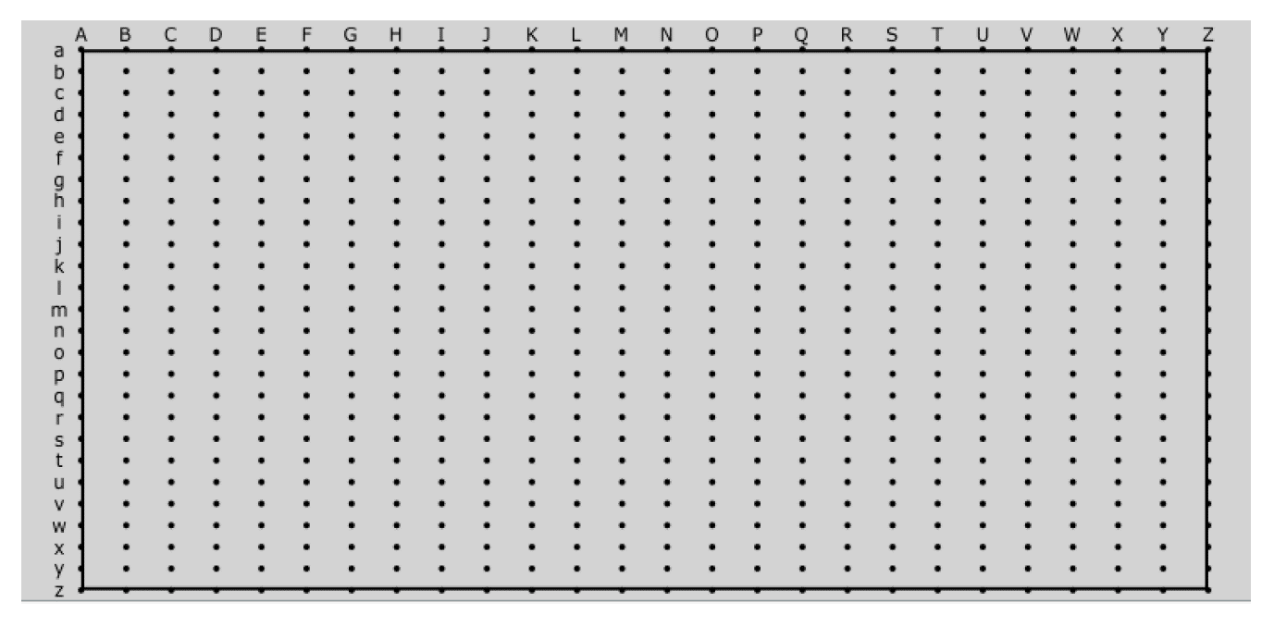
Clear Groove
Record
MidiVisualizer_Groove2Drum
Overdub
Groove Offset
Groove Velocity
MidiVisualizer_Groove
Follow
Random A
Random B
Interpolate
Snap To A
Snap To B
MidiVisualizer_A
Uncertainty
MidiVisualizer_B

