Slide 1
Lumbar fusion cage - lattice DOE and optimisation
Design of experiments and optimisation of 4 lattice variants (fusion_cage_diamond, fusion_cage_gyroid, fusion_cage_kelvin, fusion_cage_octet)
nTopCL campaign, 2026-09-20
SURROGATE DEMO - figures generated from the mock model, not from nTop

Slide 2
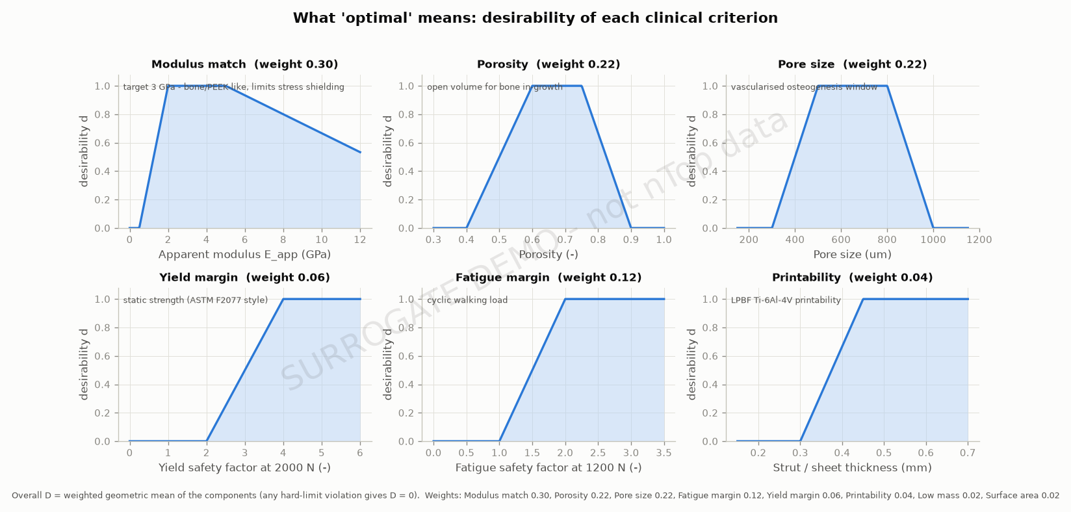
What 'optimal' means
Weighted geometric mean of clinical desirabilities; any hard-limit violation scores zero
• Apparent modulus 2.0-5.0 GPa (bone/PEEK-like) - weight 0.30
• Porosity 60%-75% - weight 0.22
• Pore size 500-800 um - weight 0.22
• Yield SF >= 2.0 at 2000 N (hard); fatigue SF >= 1.0 at 1200 N
• Strut >= 0.3 mm (LPBF); mass and surface area as tie-breakers

Slide 3
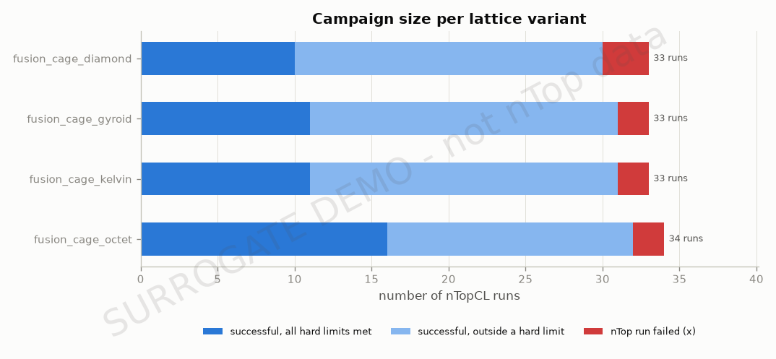
Method: sequential DOE driven through nTopCL
Every run is one ntopcl.exe call with a JSON input file; outputs are parsed automatically
• Cell Size 1.5-4.0 mm, Strut Thickness 0.3-0.9 mm, Shell Thickness 0.5-1.5 mm
• Screening: full_factorial + 3 centre points
• Response surface: ccd_face; 10 Latin-hypercube runs
• Adaptive infill: 2 x 3 runs (exploit / explore / diversify)
• Surrogates: quadratic RSM vs thin-plate RBF, chosen by leave-one-out error
• Verification: top 3 predicted designs re-run in nTop

Slide 4
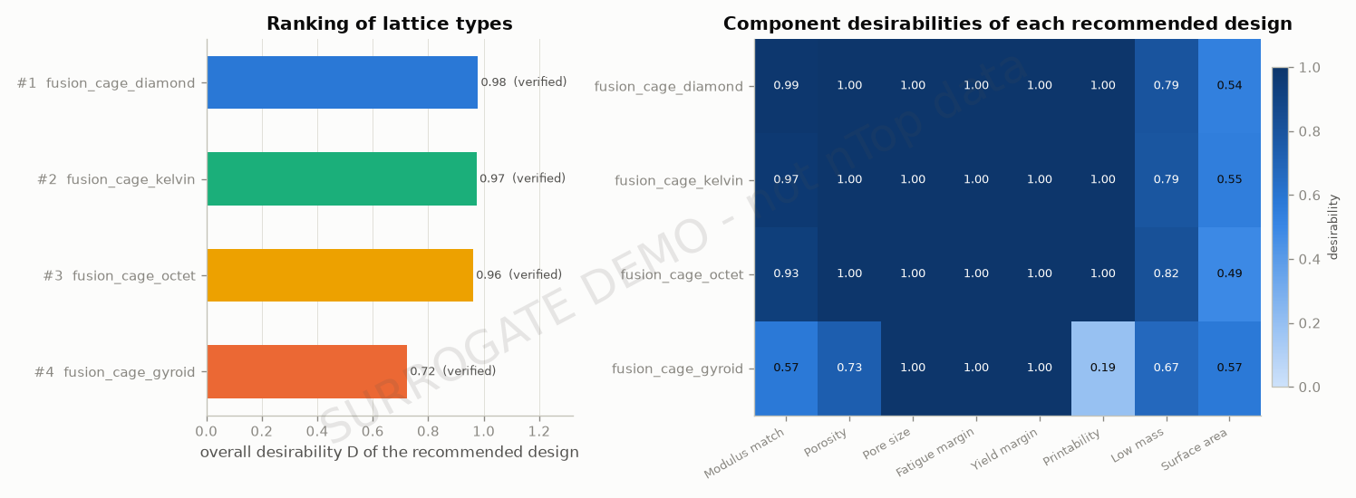
Ranking of lattice types

Slide 5
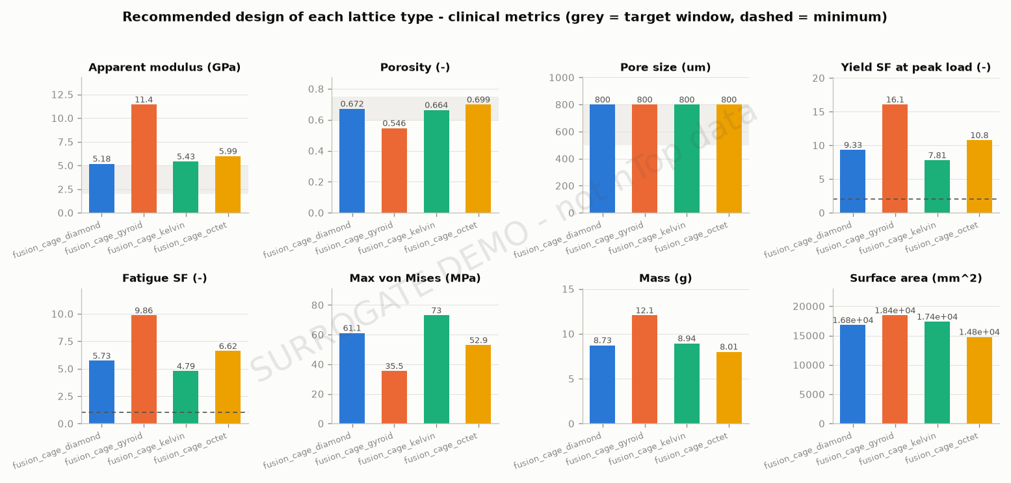
Clinical metrics of the recommended designs

Slide 6
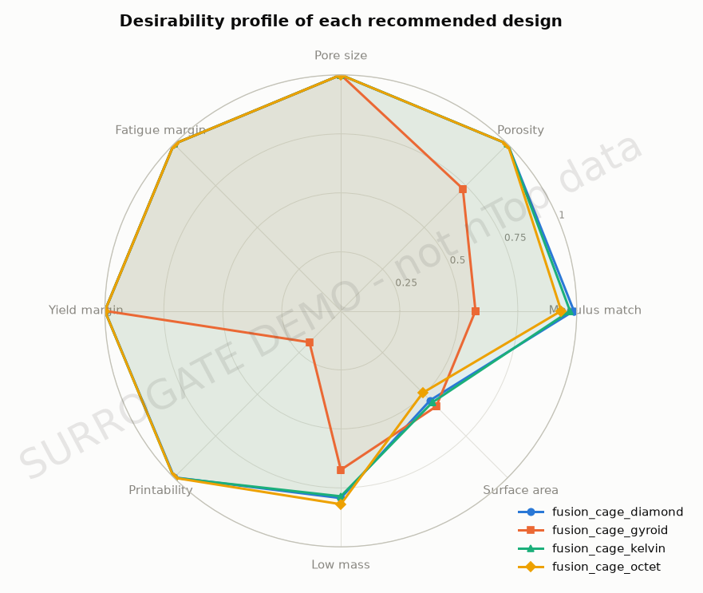
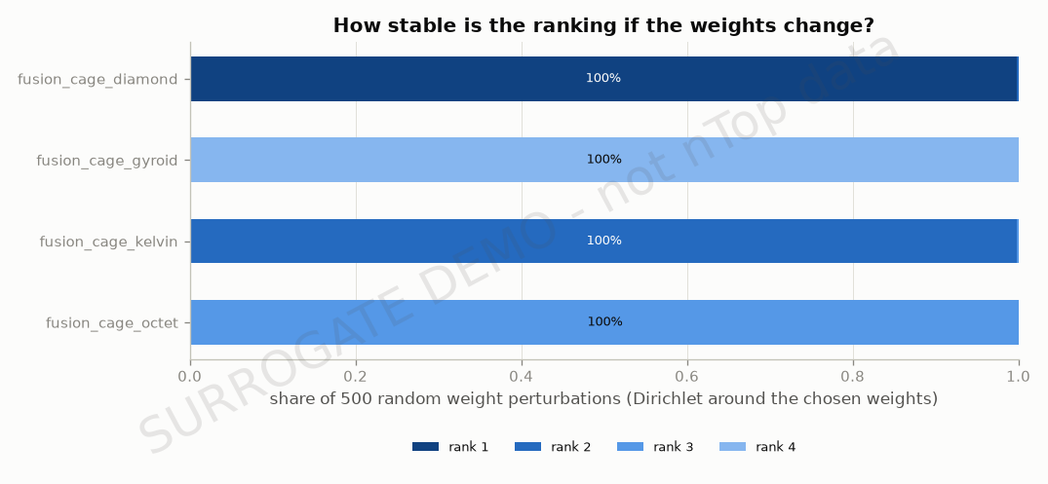
Desirability profile and ranking robustness

Slide 7
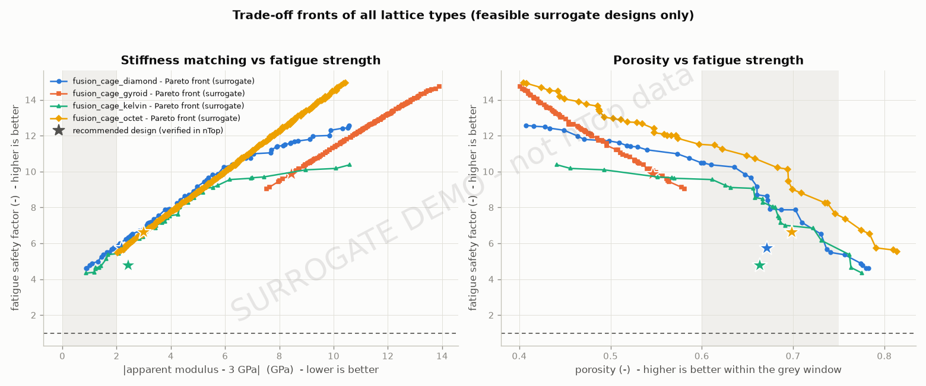
Trade-off fronts of all lattice types
stiffness matching vs fatigue strength, porosity vs fatigue strength (feasible designs only)

Slide 8
Recommended design per lattice
rank | variant | D_recommended | Cell Size | Strut Thickness | Shell Thickness | E_app_GPa | porosity | pore_um | sf_yield | sf_fatigue | mass_g
1 | fusion_cage_diamond | 0.979 | 1.92 | 0.45 | 0.5 | 5.18 | 0.672 | 800 | 9.33 | 5.73 | 8.73
2 | fusion_cage_kelvin | 0.975 | 2.08 | 0.45 | 0.5 | 5.43 | 0.664 | 800 | 7.81 | 4.79 | 8.94
3 | fusion_cage_octet | 0.962 | 2.27 | 0.45 | 0.5 | 5.99 | 0.699 | 800 | 10.8 | 6.62 | 8.01
4 | fusion_cage_gyroid | 0.724 | 2.05 | 0.328 | 0.5 | 11.4 | 0.546 | 800 | 16.1 | 9.86 | 12.1

Slide 9
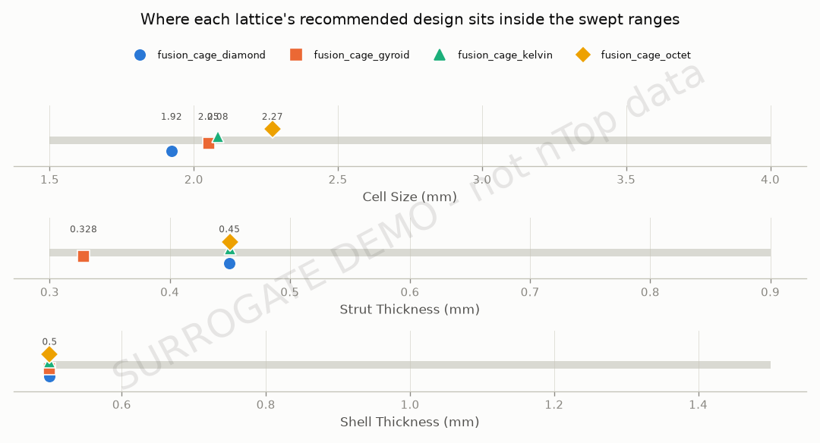
Recommended factor settings

Slide 10
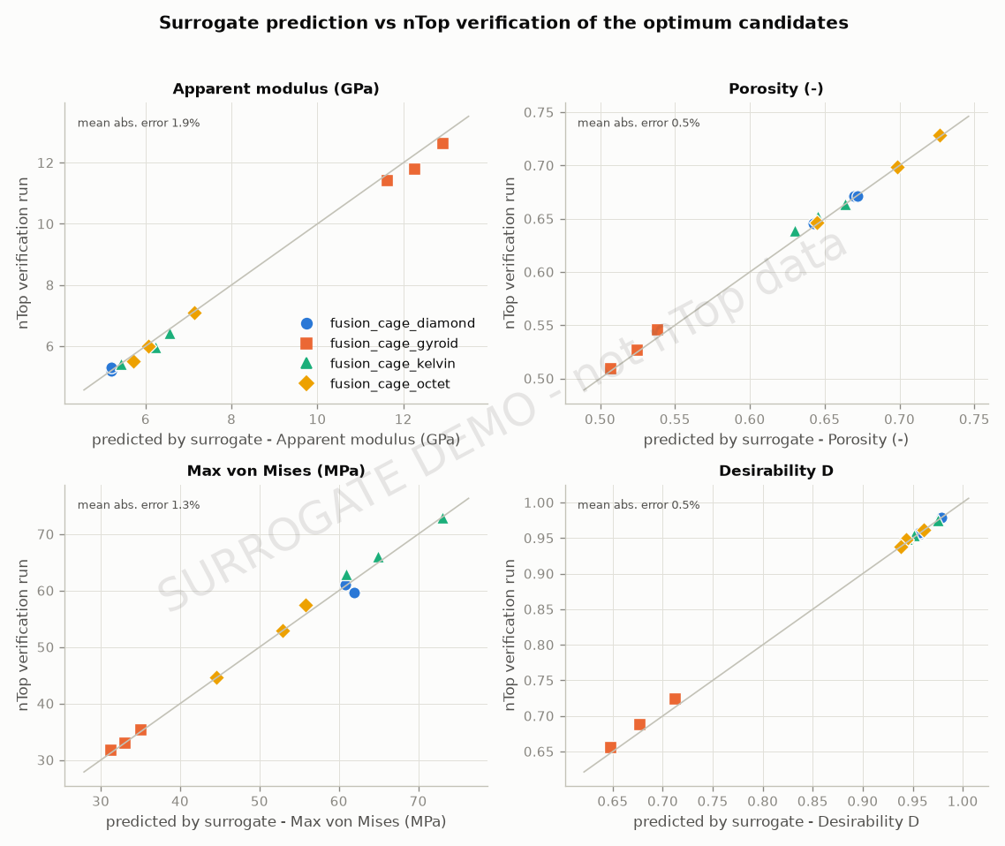
Surrogate vs nTop verification

Slide 11
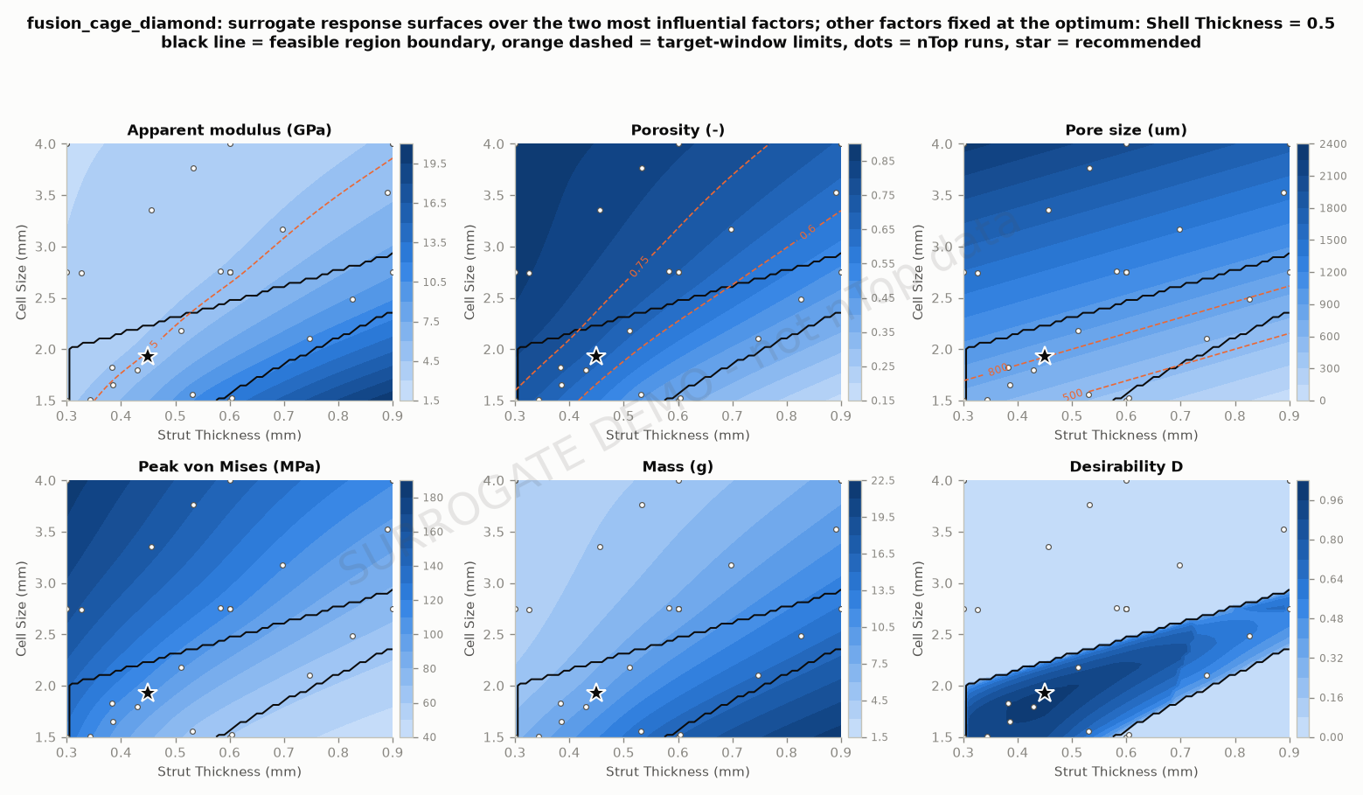
fusion_cage_diamond: response surfaces
Cell Size = 1.92, Strut Thickness = 0.45, Shell Thickness = 0.5 | D = 0.979

Slide 12
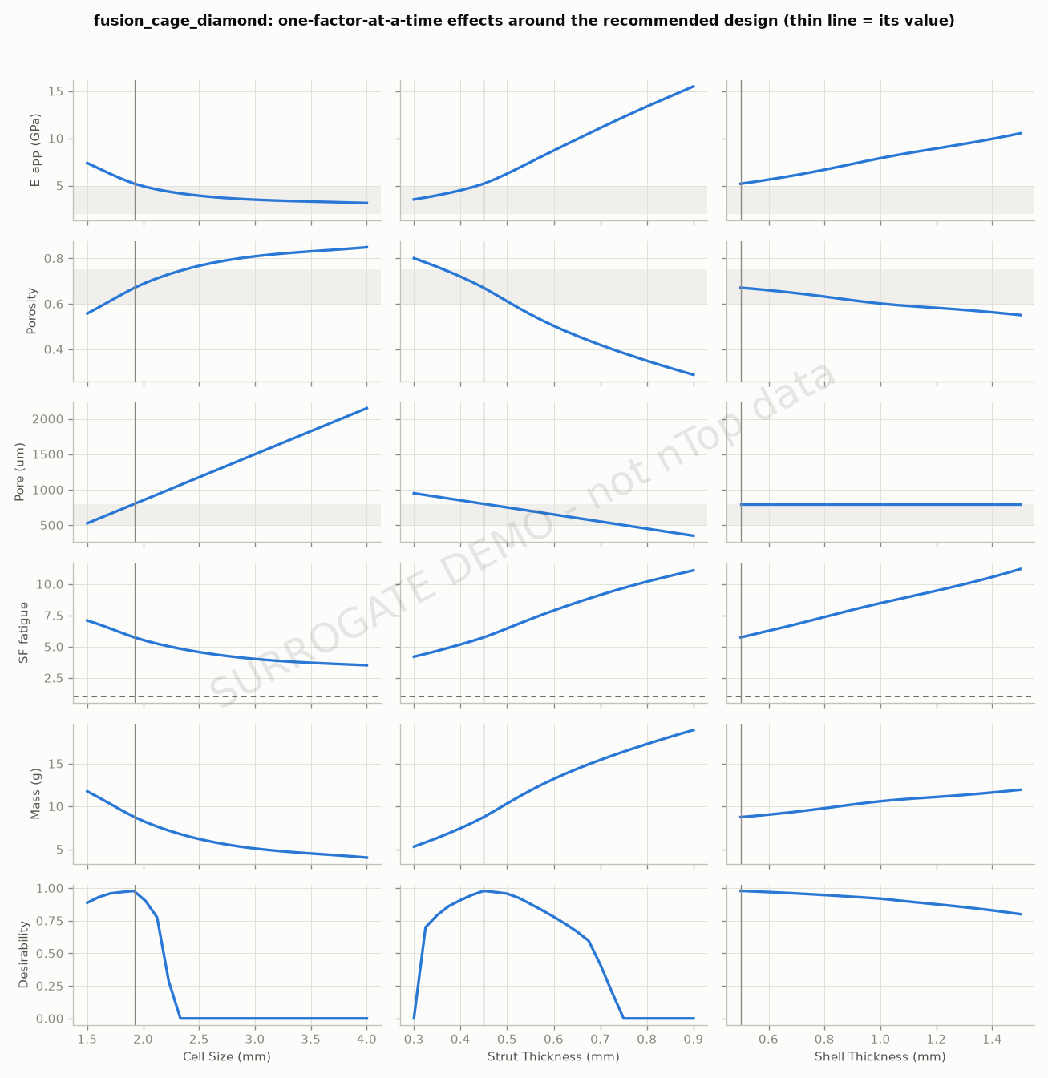
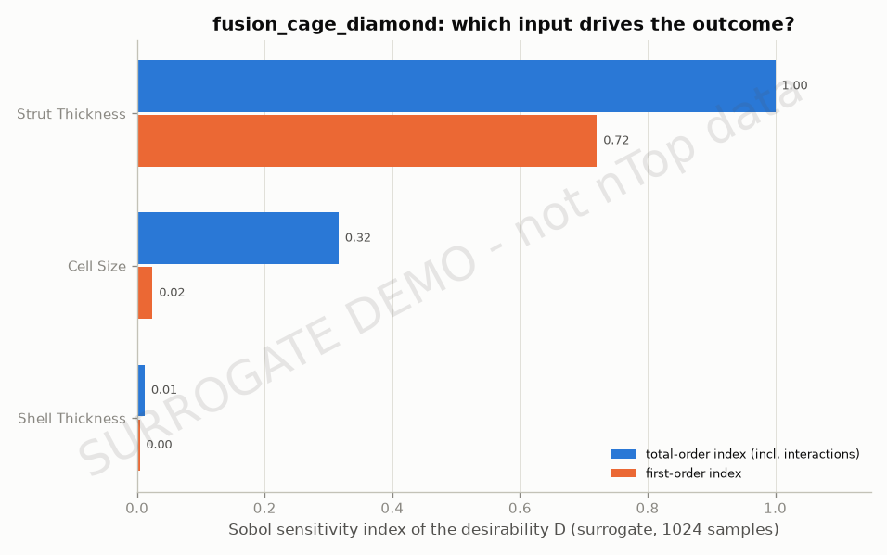
fusion_cage_diamond: main effects and sensitivity
Cell Size = 1.92, Strut Thickness = 0.45, Shell Thickness = 0.5 | D = 0.979

Slide 13
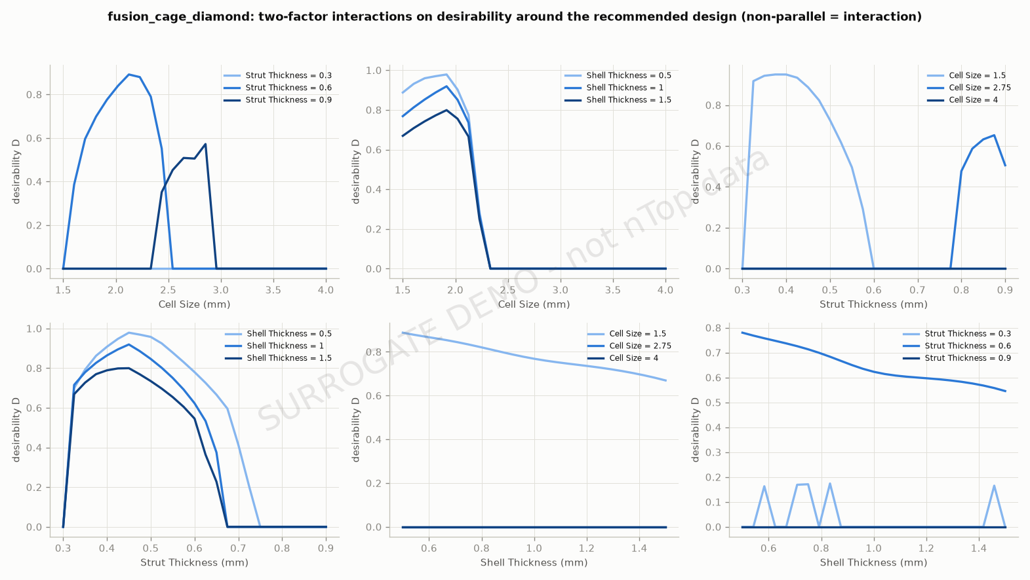
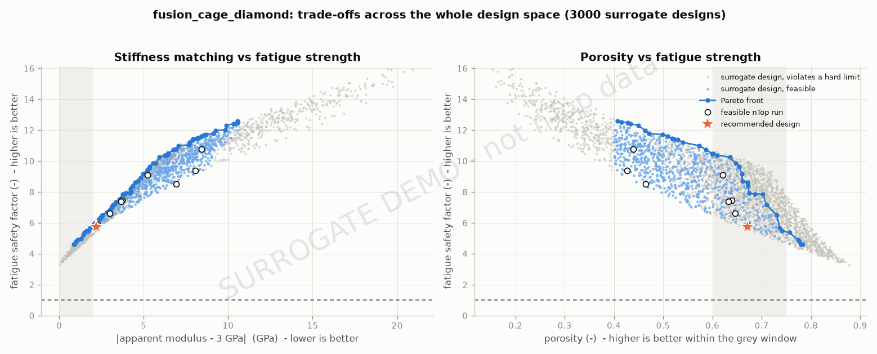
fusion_cage_diamond: trade-off and interactions
Cell Size = 1.92, Strut Thickness = 0.45, Shell Thickness = 0.5 | D = 0.979

Slide 14
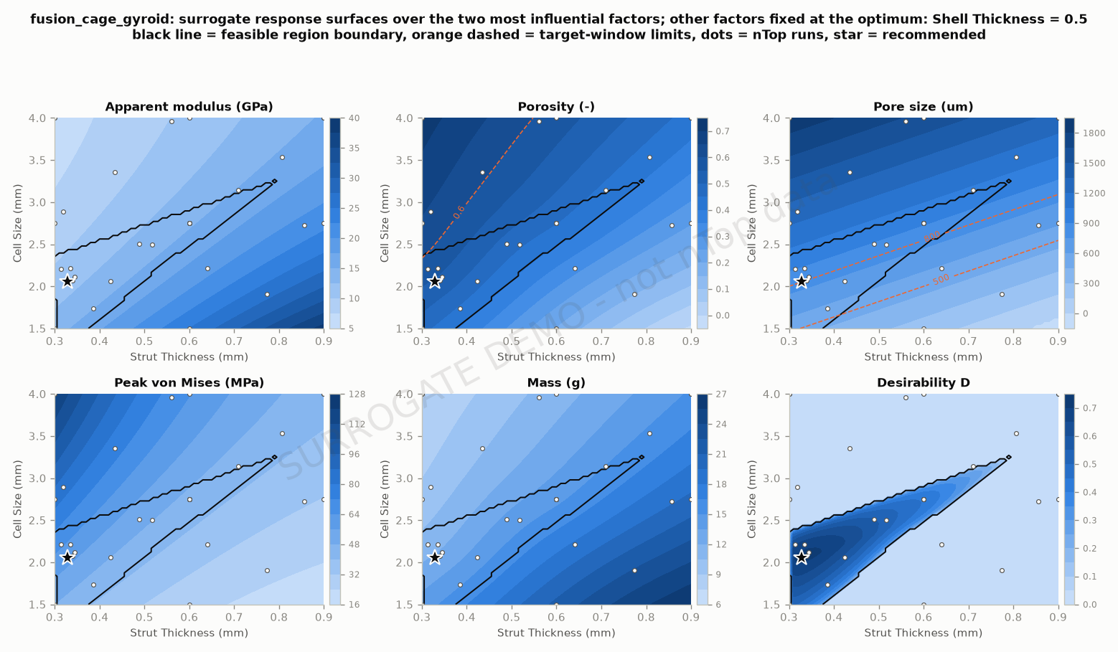
fusion_cage_gyroid: response surfaces
Cell Size = 2.05, Strut Thickness = 0.328, Shell Thickness = 0.5 | D = 0.724

Slide 15
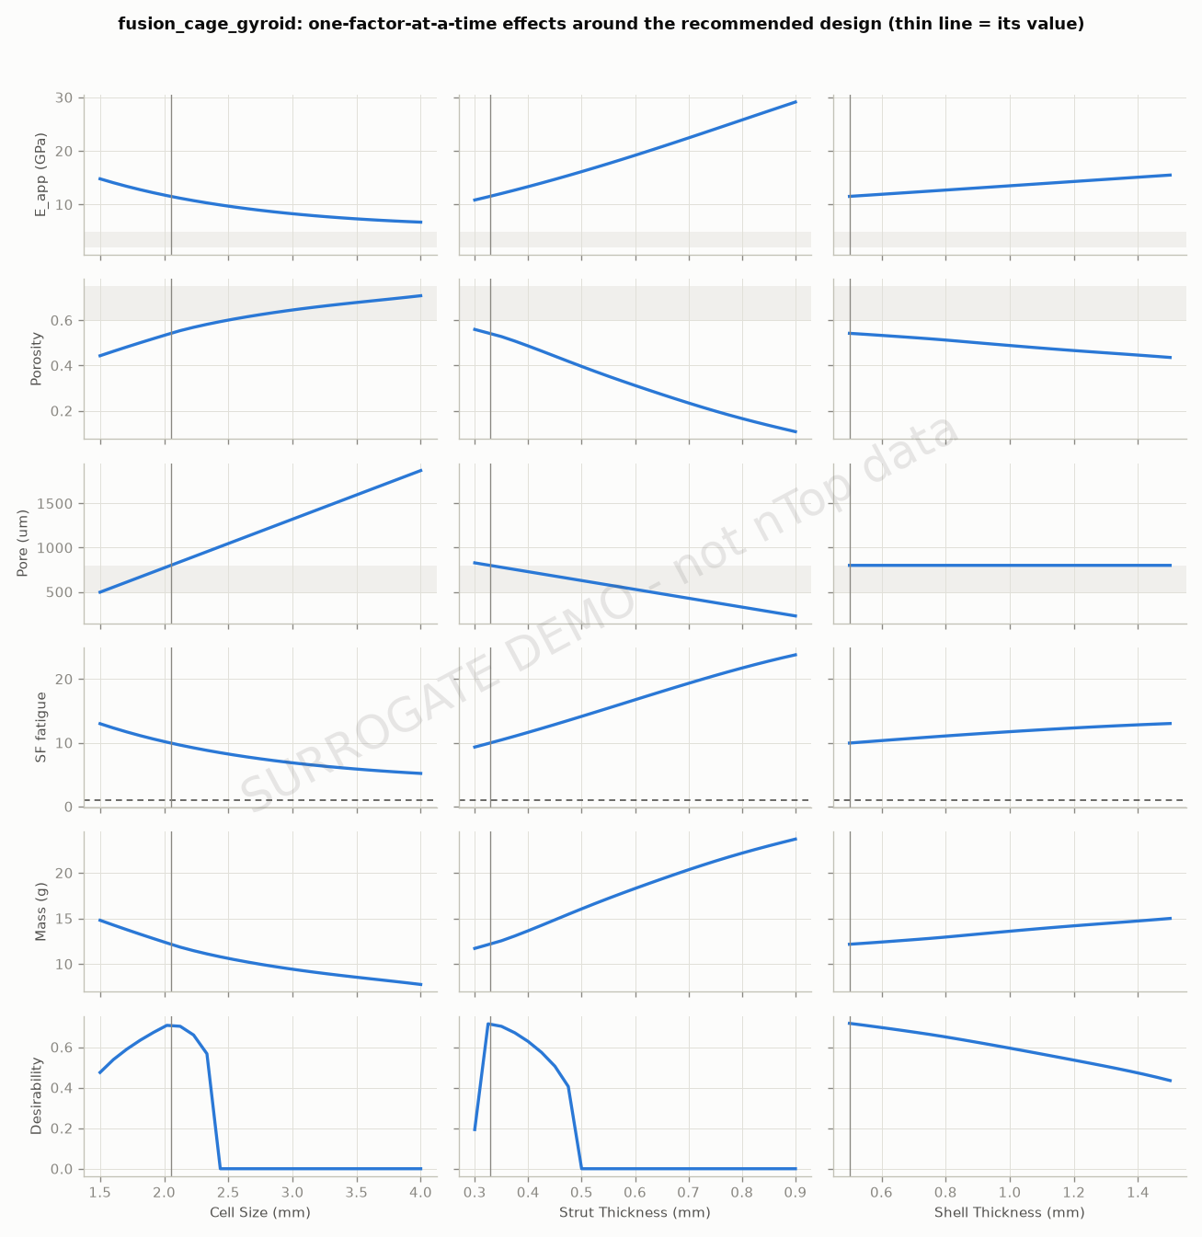
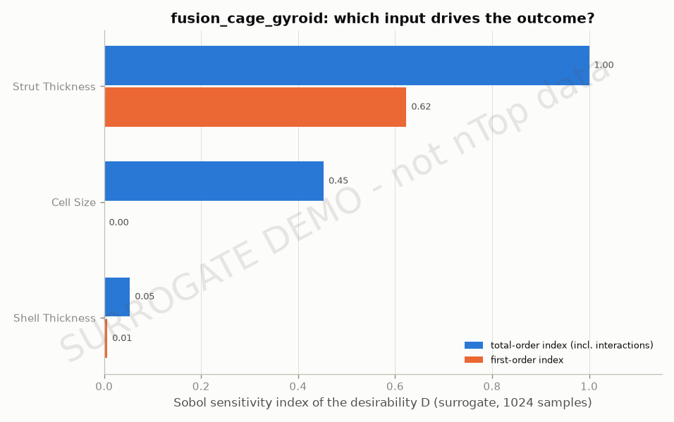
fusion_cage_gyroid: main effects and sensitivity
Cell Size = 2.05, Strut Thickness = 0.328, Shell Thickness = 0.5 | D = 0.724

Slide 16
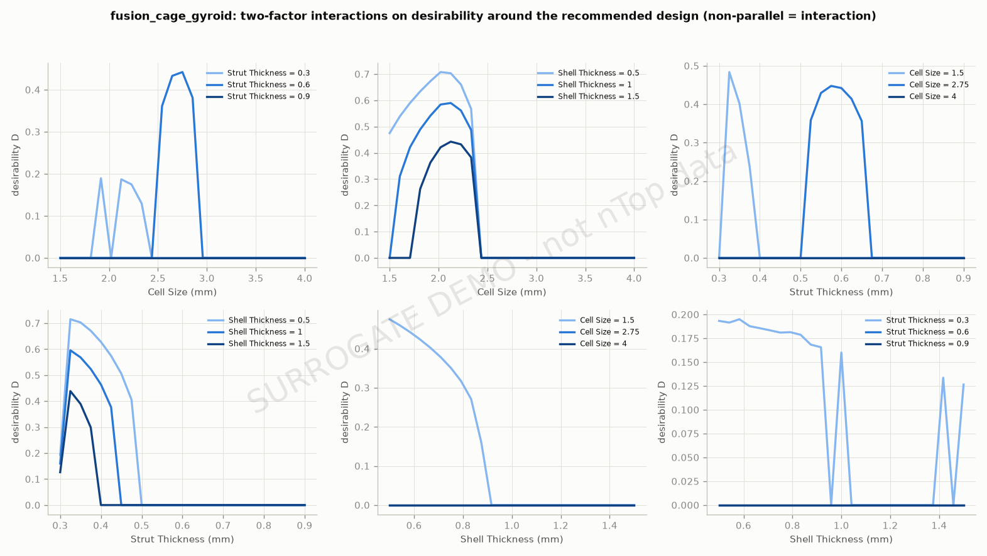
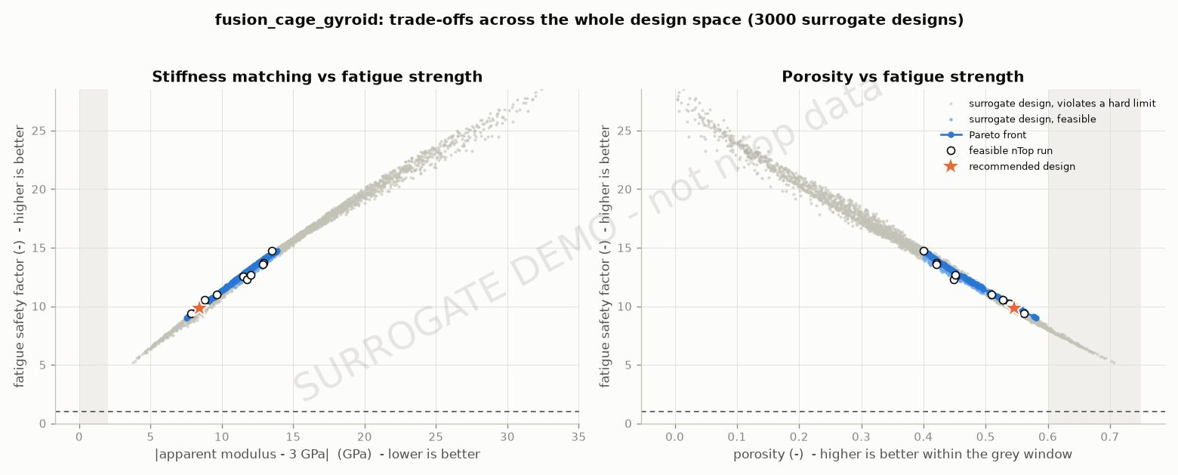
fusion_cage_gyroid: trade-off and interactions
Cell Size = 2.05, Strut Thickness = 0.328, Shell Thickness = 0.5 | D = 0.724

Slide 17
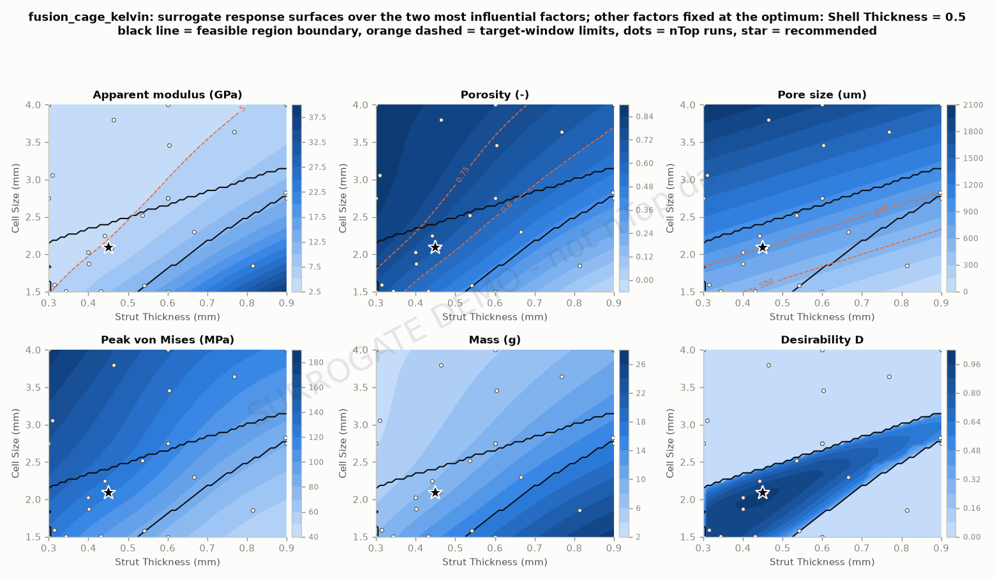
fusion_cage_kelvin: response surfaces
Cell Size = 2.08, Strut Thickness = 0.45, Shell Thickness = 0.5 | D = 0.975

Slide 18
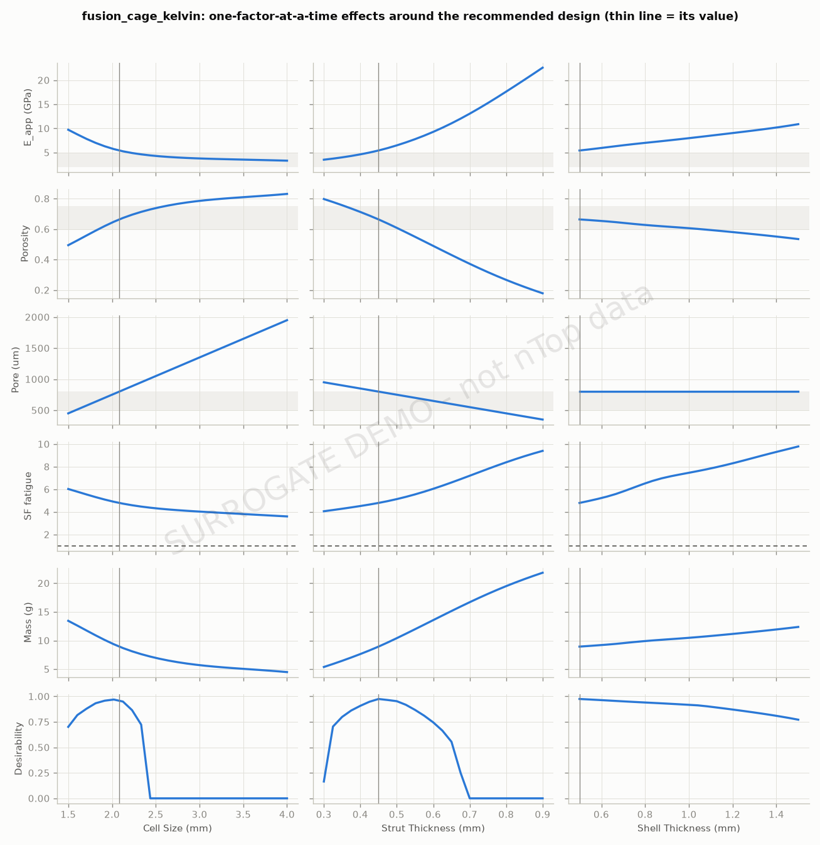
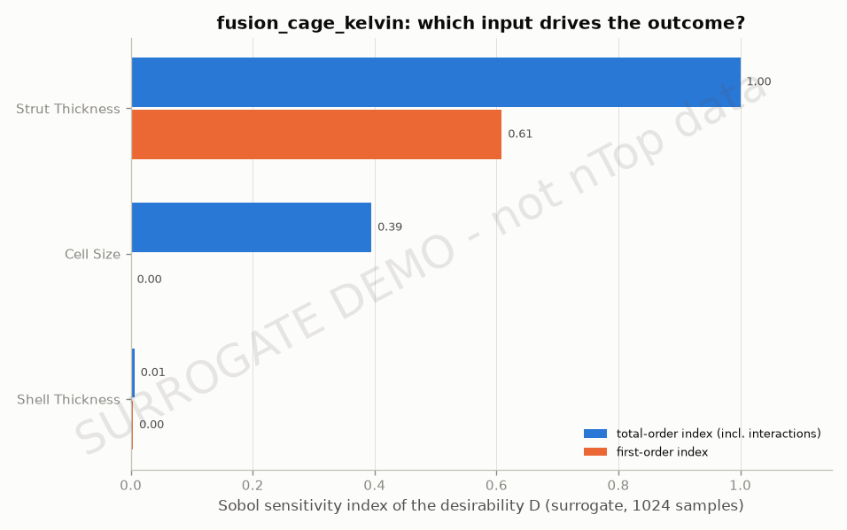
fusion_cage_kelvin: main effects and sensitivity
Cell Size = 2.08, Strut Thickness = 0.45, Shell Thickness = 0.5 | D = 0.975

Slide 19
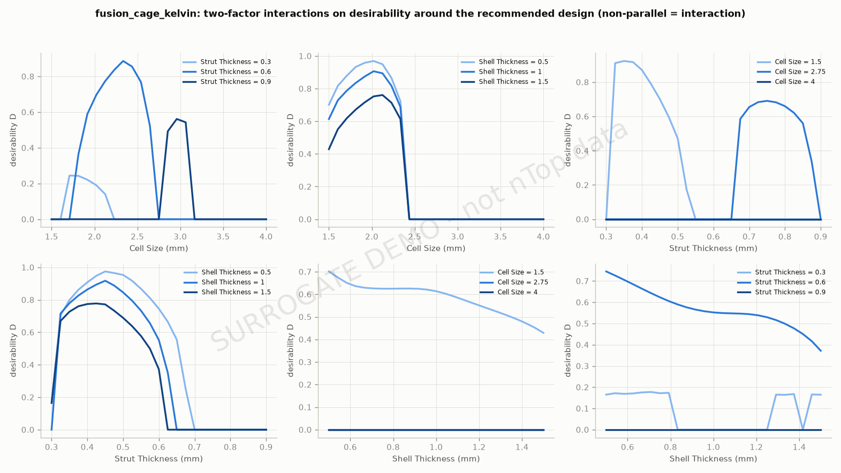
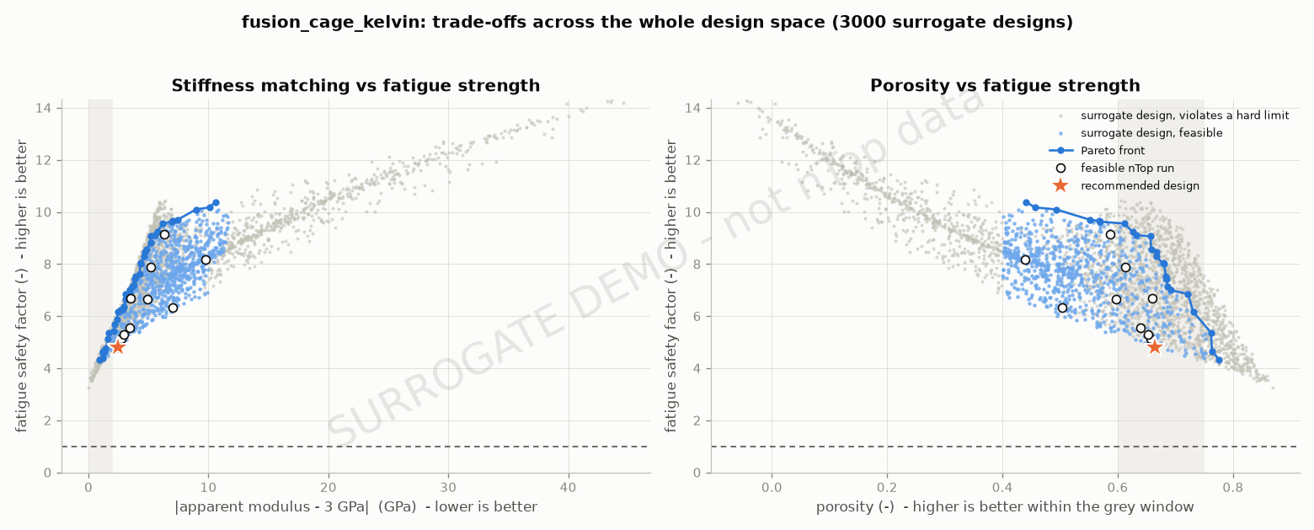
fusion_cage_kelvin: trade-off and interactions
Cell Size = 2.08, Strut Thickness = 0.45, Shell Thickness = 0.5 | D = 0.975

Slide 20
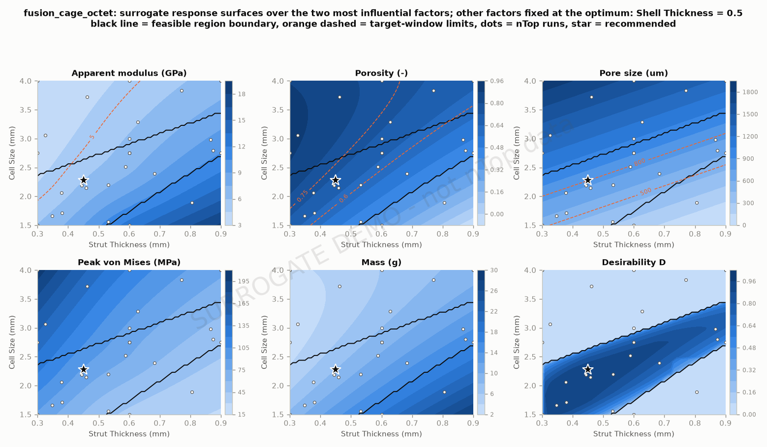
fusion_cage_octet: response surfaces
Cell Size = 2.27, Strut Thickness = 0.45, Shell Thickness = 0.5 | D = 0.962

Slide 21
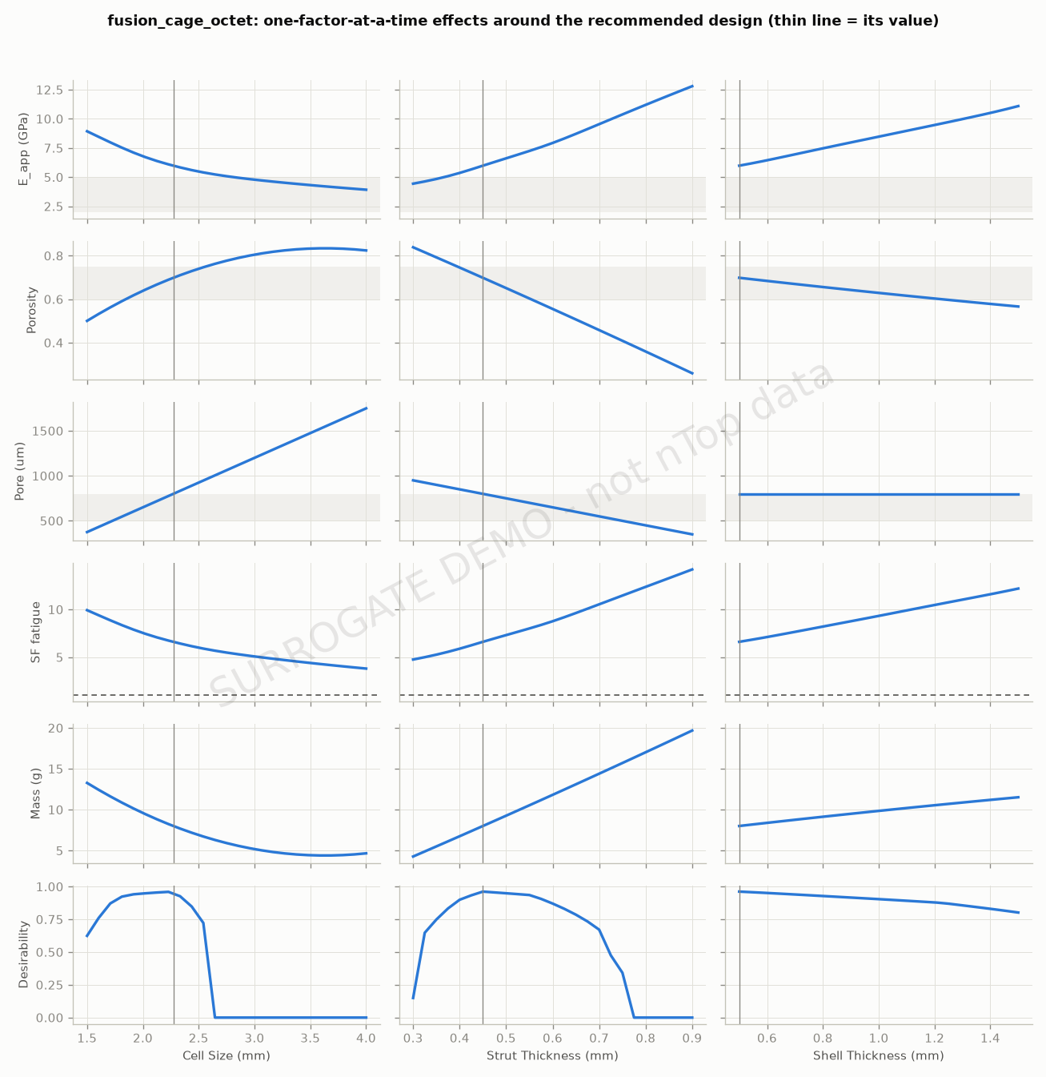
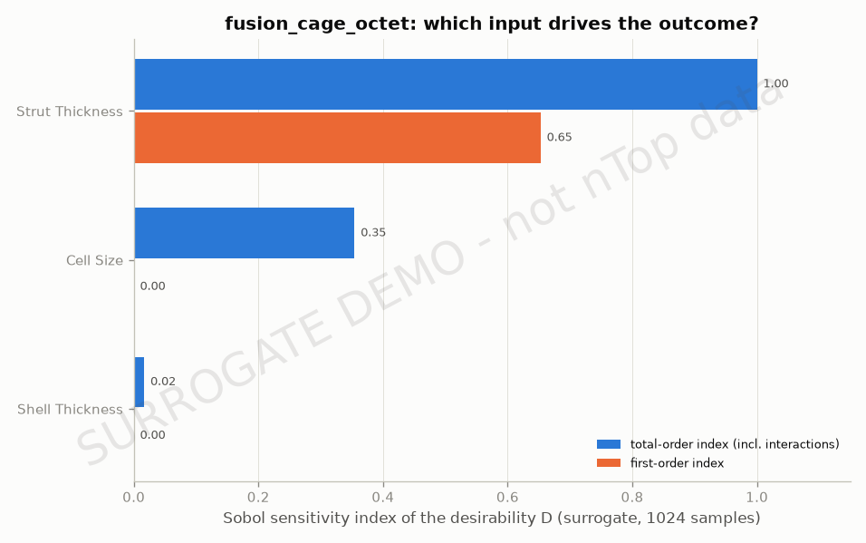
fusion_cage_octet: main effects and sensitivity
Cell Size = 2.27, Strut Thickness = 0.45, Shell Thickness = 0.5 | D = 0.962

Slide 22
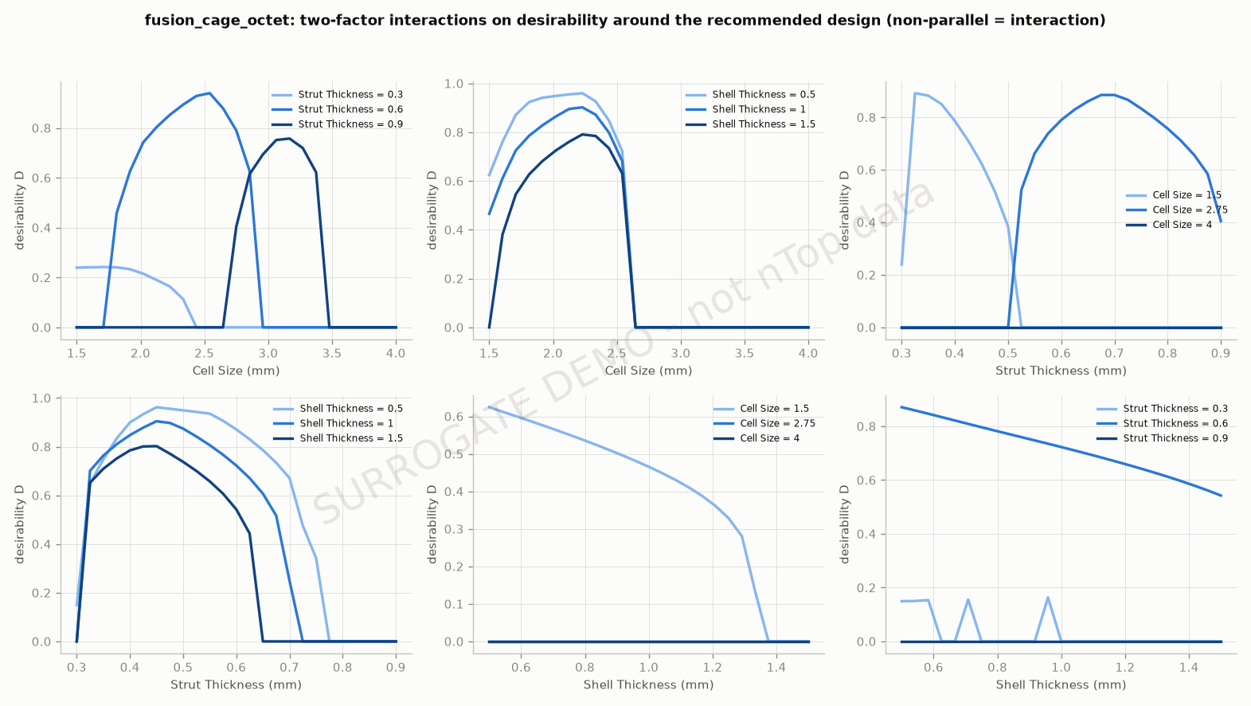
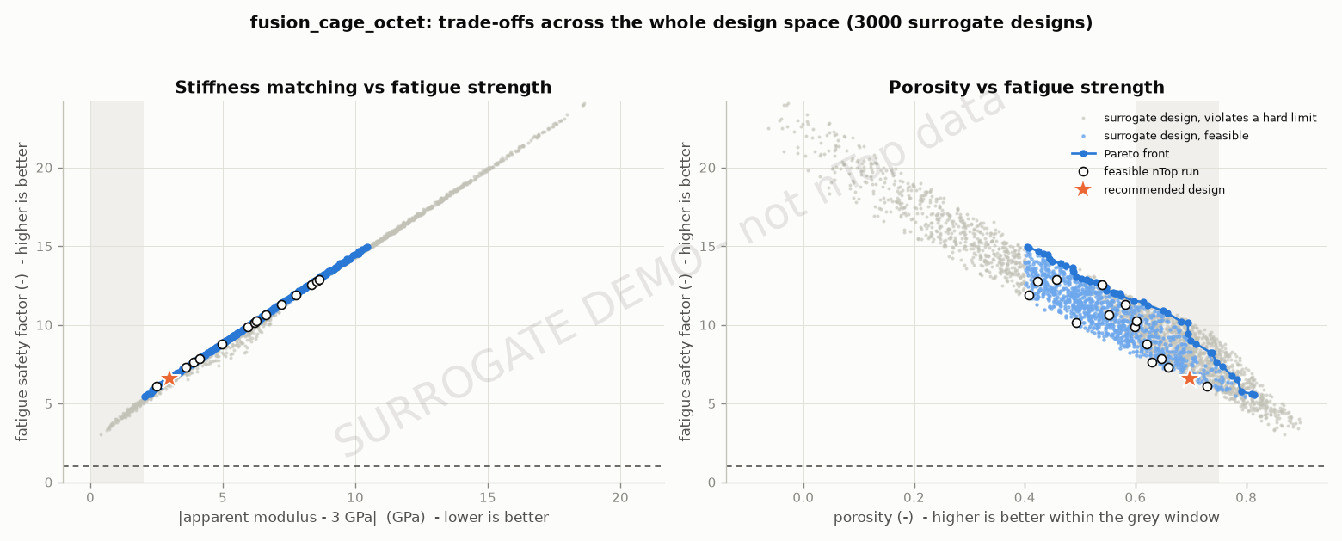
fusion_cage_octet: trade-off and interactions
Cell Size = 2.27, Strut Thickness = 0.45, Shell Thickness = 0.5 | D = 0.962

Slide 23
Recommendation
• fusion_cage_diamond (diamond) ranks first with D = 0.979 (verified)
• Settings: Cell Size = 1.92 mm, Strut Thickness = 0.45 mm, Shell Thickness = 0.5 mm
• E_app = 5.18 GPa, porosity = 0.67, pore = 800 um, SF yield = 9.3, SF fatigue = 5.7, mass = 8.7 g
• Ranking robustness: see the weight-perturbation slide - a robust winner keeps rank 1 in most perturbations
• Next steps: confirm with a refined FE mesh and an ASTM F2077 compression / fatigue test of the printed design

Slide 24
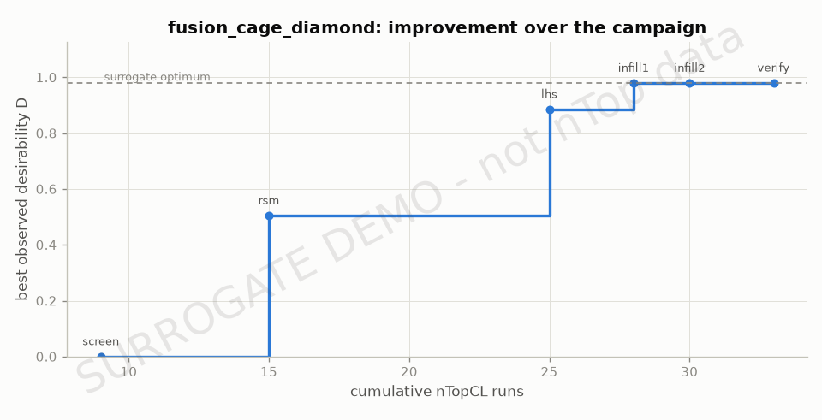
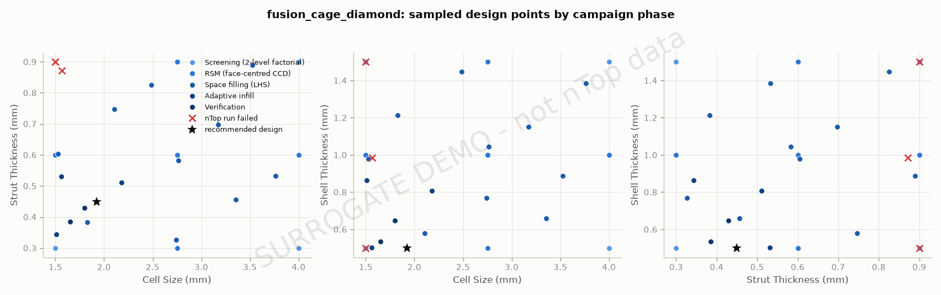
Appendix - fusion_cage_diamond: sampled designs and convergence

Slide 25
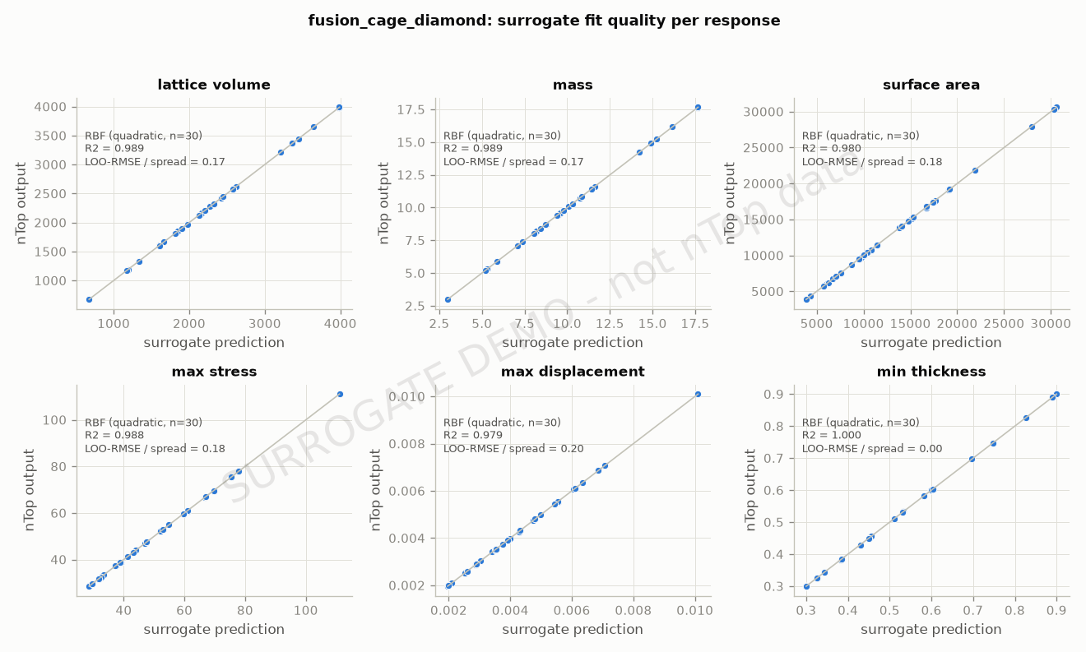
Appendix - fusion_cage_diamond: surrogate fit quality

Slide 26
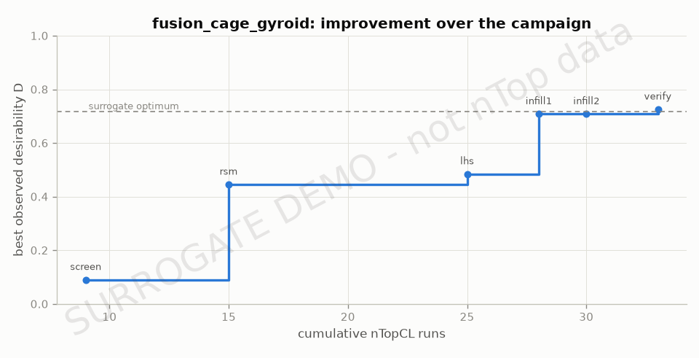
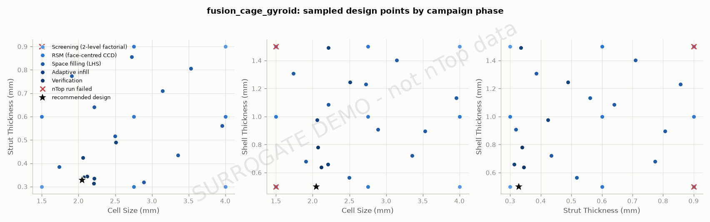
Appendix - fusion_cage_gyroid: sampled designs and convergence

Slide 27
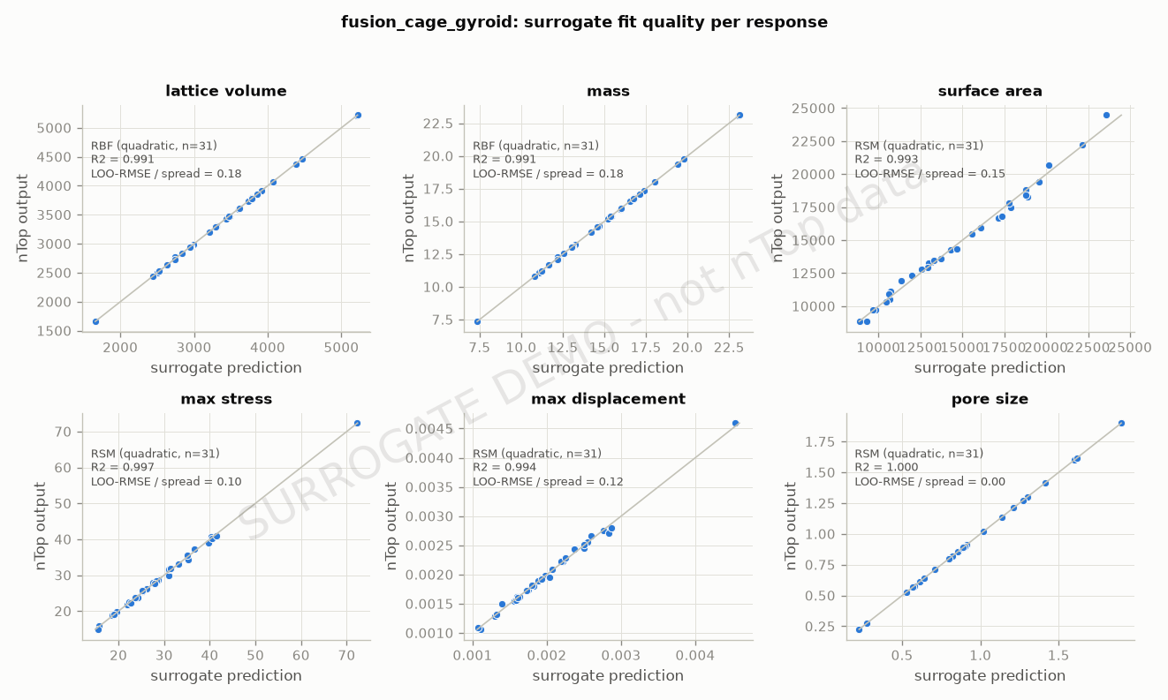
Appendix - fusion_cage_gyroid: surrogate fit quality

Slide 28
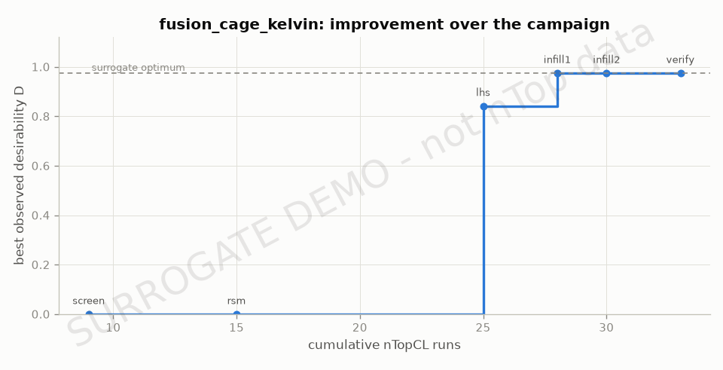
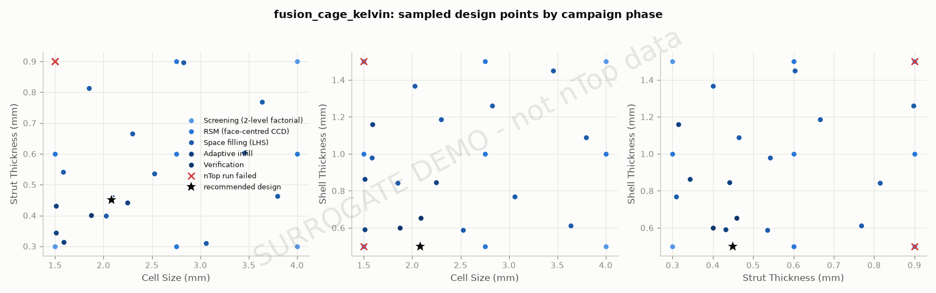
Appendix - fusion_cage_kelvin: sampled designs and convergence

Slide 29
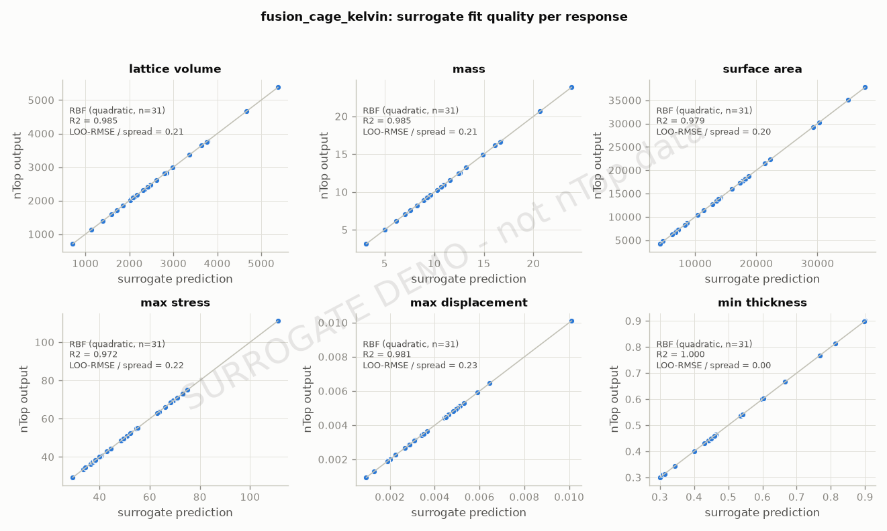
Appendix - fusion_cage_kelvin: surrogate fit quality

Slide 30
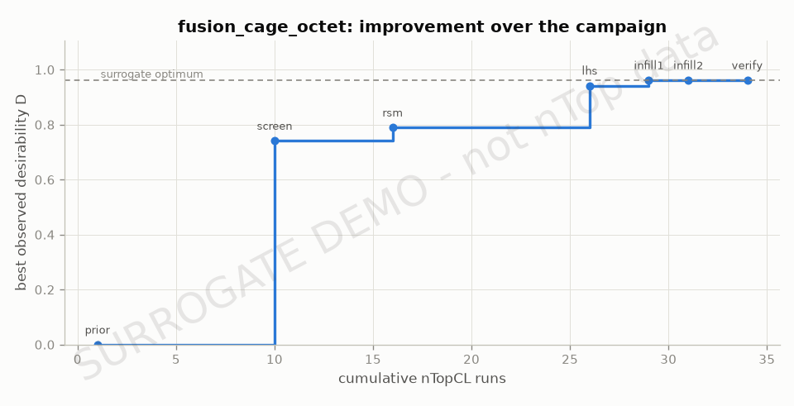
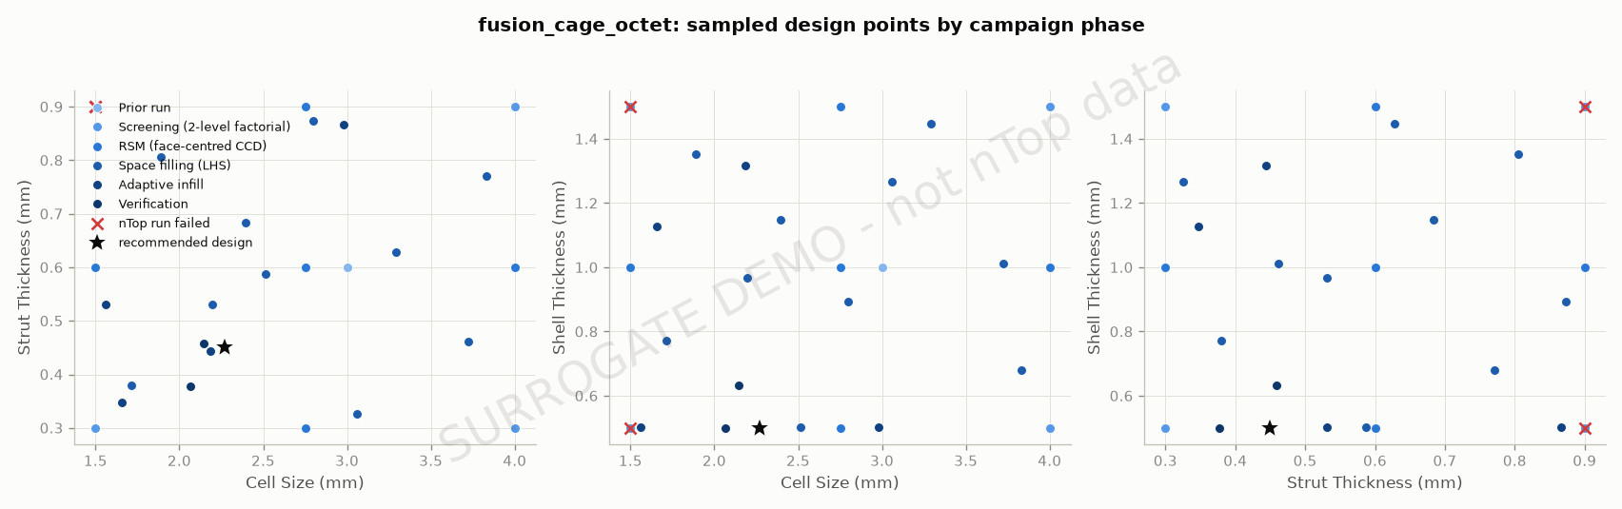
Appendix - fusion_cage_octet: sampled designs and convergence

Slide 31
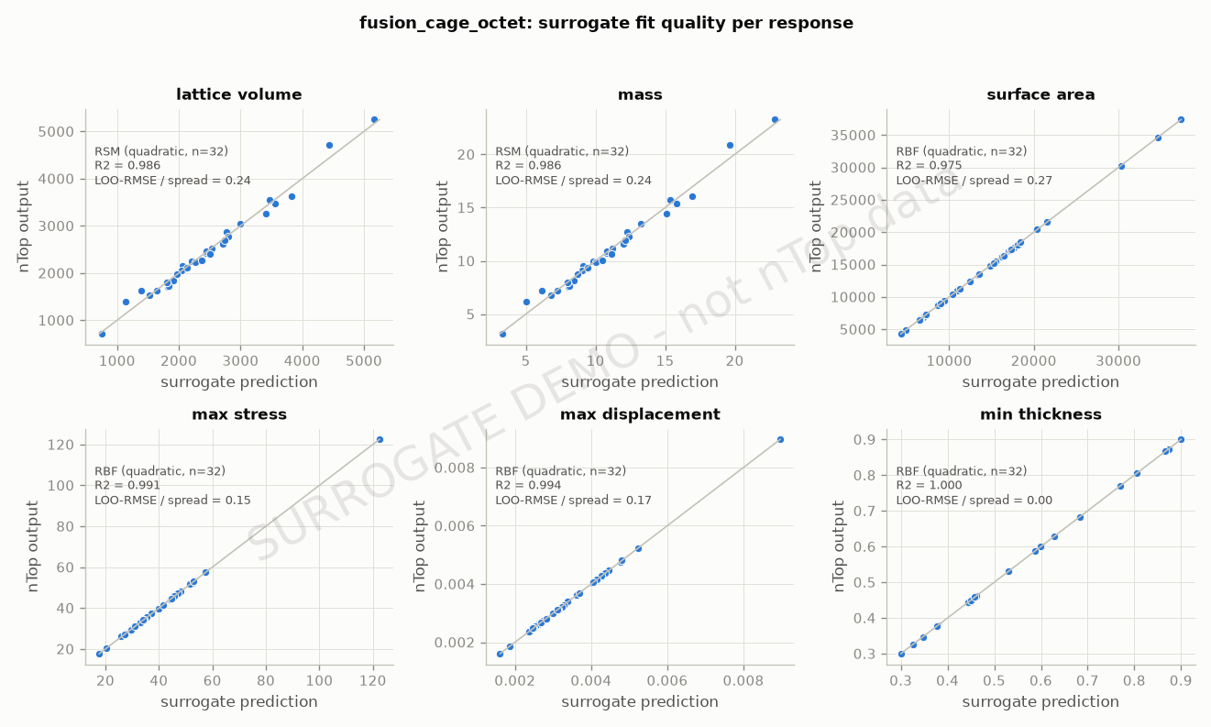
Appendix - fusion_cage_octet: surrogate fit quality

