Slide 1
Introduction

Slide 2
Description
In the project I'm automated the theatre ticket system to C++ Application in which we have 3 types of events which the user will select to book ticket in theatre which we are supposed to design the application.

Slide 3
Design

Slide 4
So, Basically, we have total two diagrams that are.
Use Case Diagram
Class Diagram

Slide 5

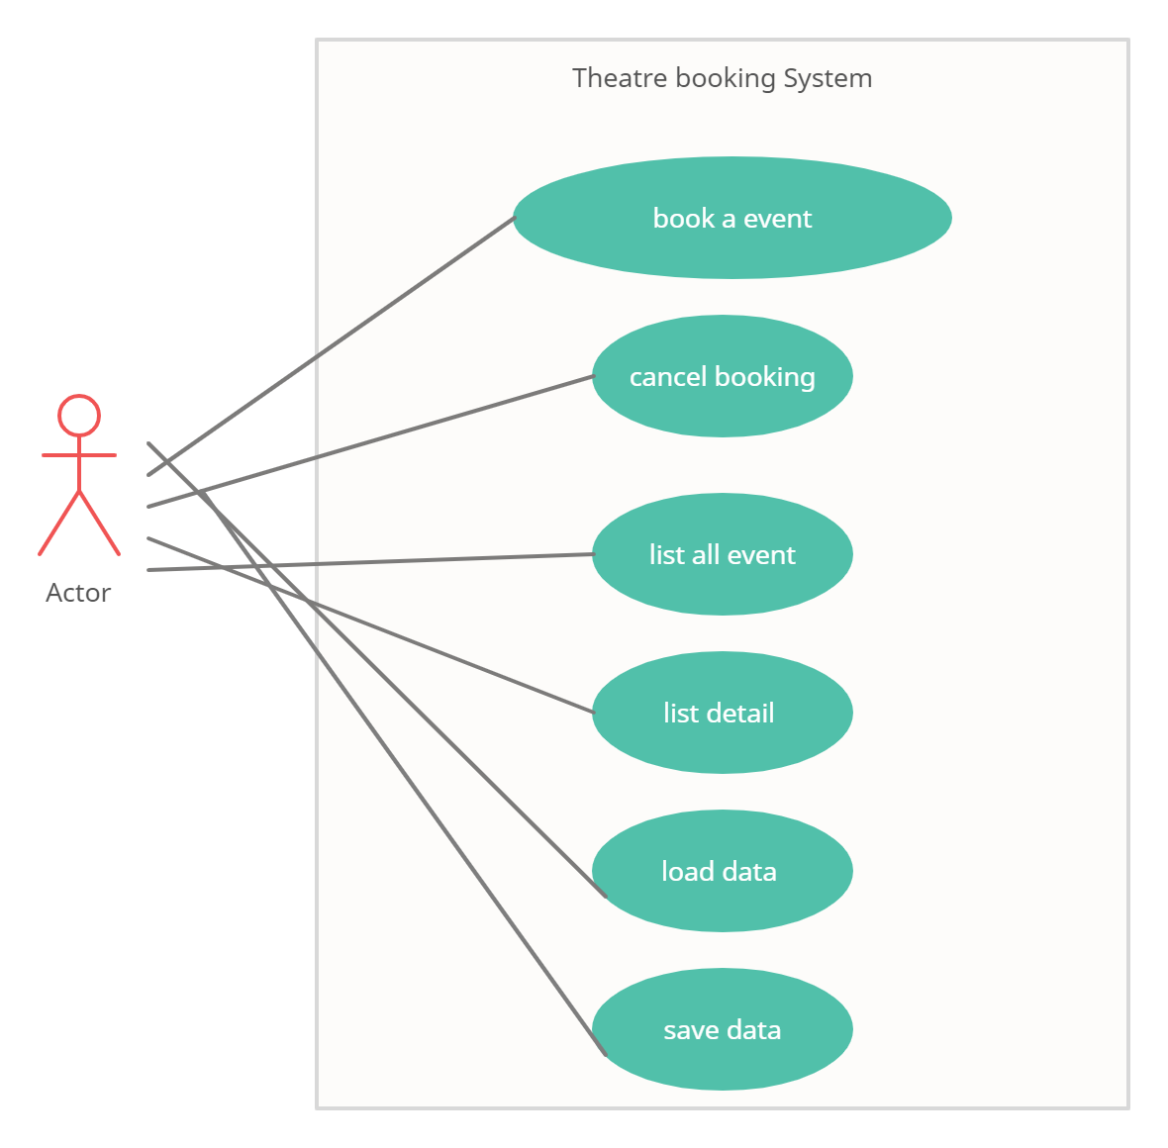
Use Case Diagram

Slide 6
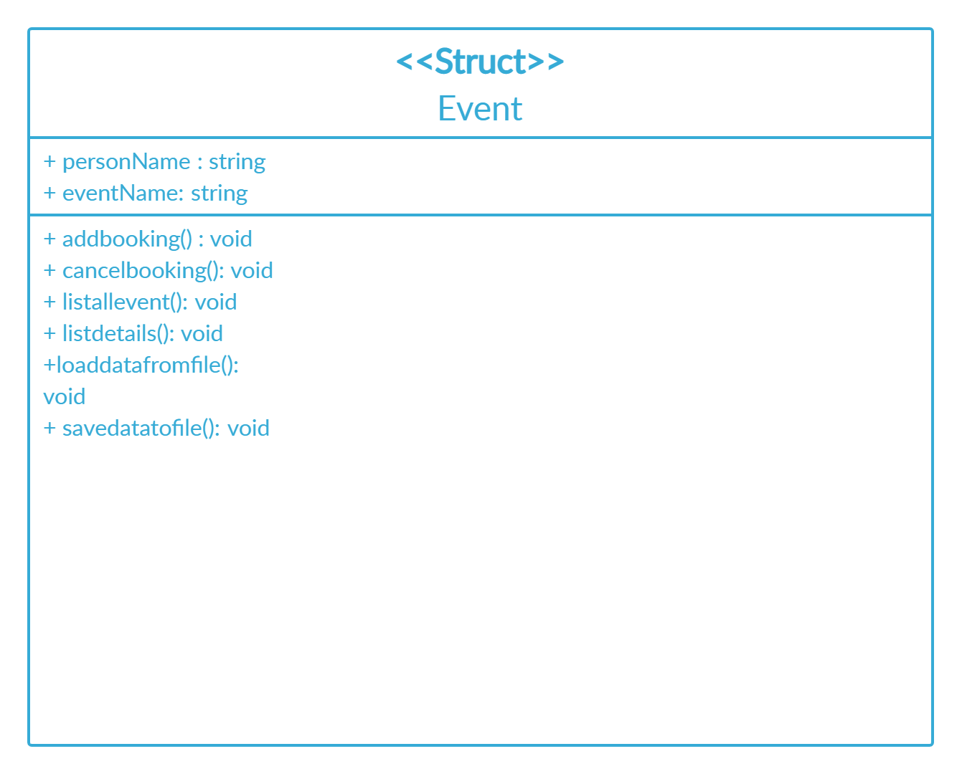
Class Diagram

Slide 7
Implementation

Slide 8
Approach
Application is using iostream and string to handles the data store in strings and it uses struct two to create object of Events which contain EventName and PersonName which is Useful when add a new booking event to the system.
And then this argue person name and event name from user on console to book the event and same for all other features as well.

Slide 9
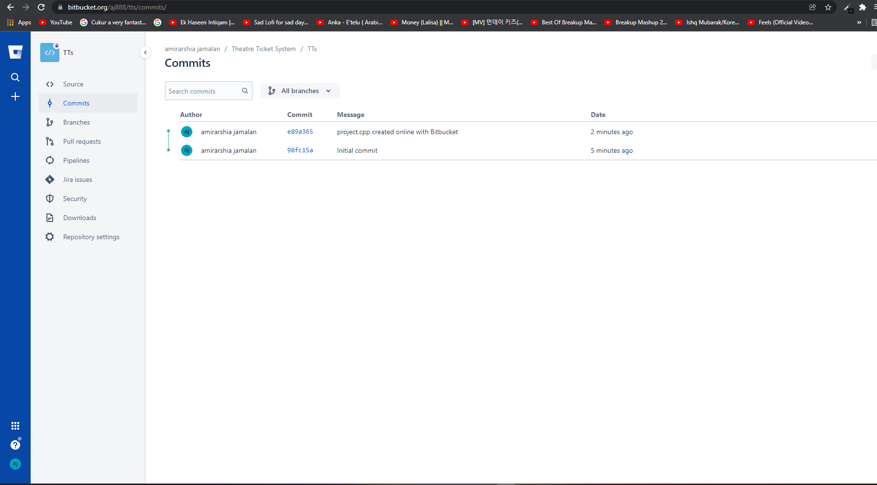
BitBucket

Slide 10
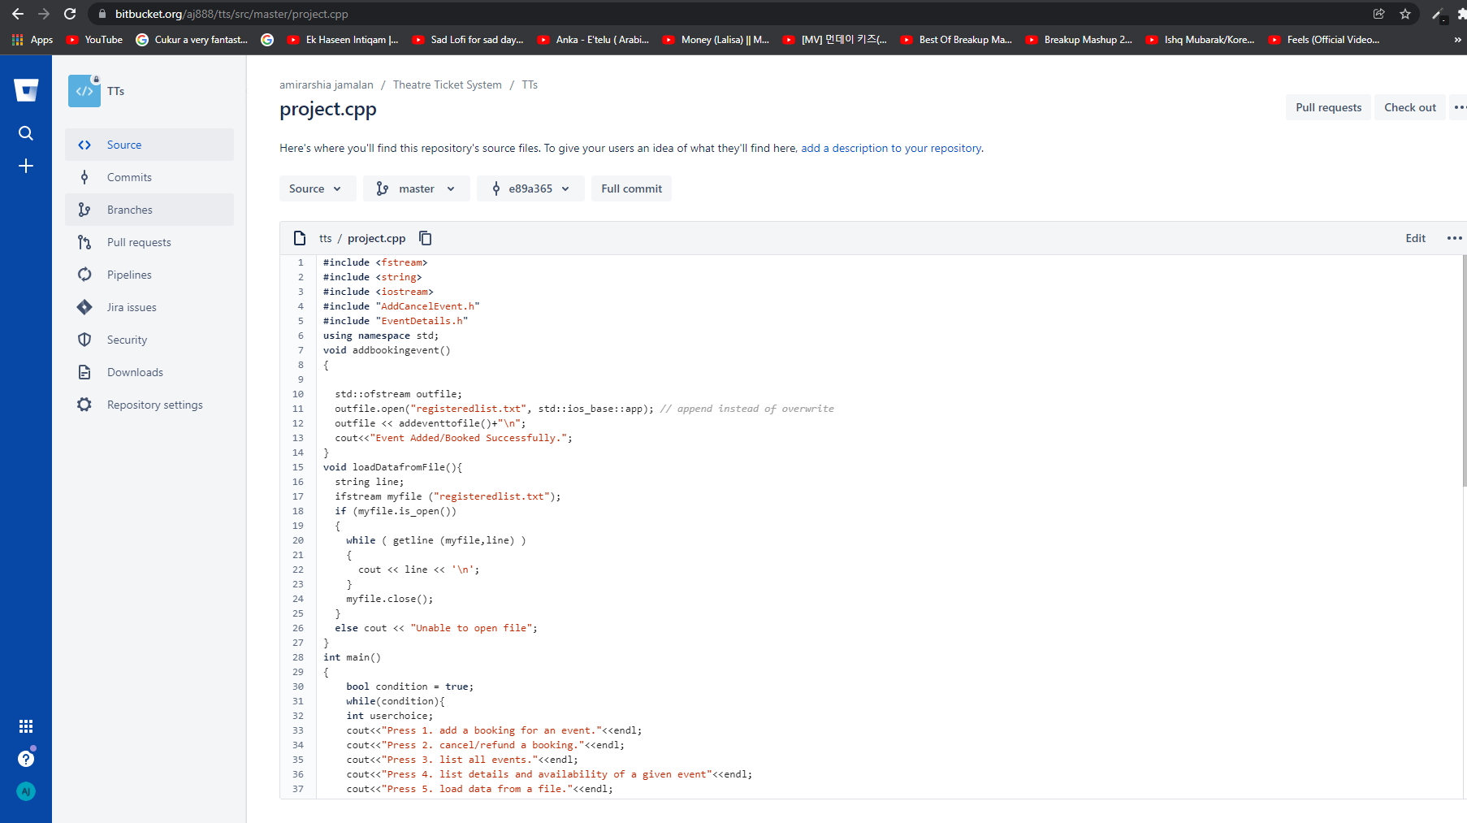
Bitbucket

Slide 11
Testing

Slide 12
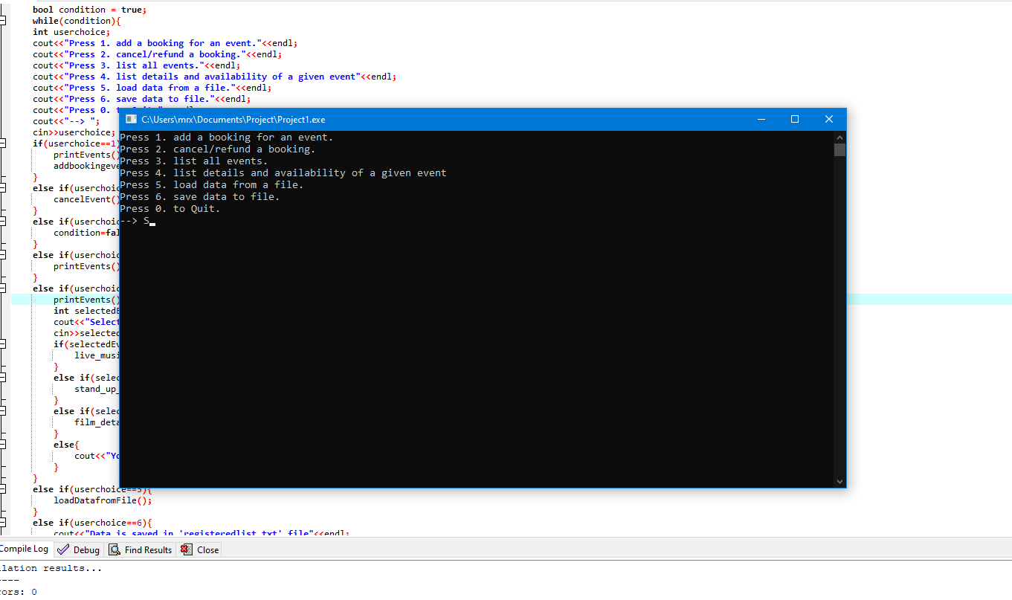

Slide 13
Software Demonstration

Slide 14
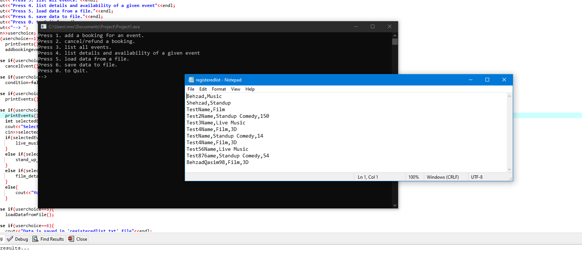

Slide 15
Conclusion

Slide 16
C++ has the same advantages as C, but with more features. C++ has a steep learning curve that makes it less approachable by a novice programmer. Big applications should not be written in C++, but a small to medium sized applications can be written in C++ for added speed and scalability.

