Slide 1
Analysis of Contemporary Human Lifespan
by Sukeerth Kalluraya, Malvika Manohar, Behzod Mirpochoev, and Suresh Nayak - Group 15

Slide 2

Description
The Age dataset contains structured information on the life, work, and death of more than a million deceased famous people. The people in this dataset belong to a variety of groups defined by nationality, gender, occupation, era, etc. Our project focuses on mining this data set to extract any meaningful relationships between these groups. In particular, we plan to understand how the general life expectancy of a person is impacted by the attributes contained in the data set.

Slide 3
Among famous personalities, is the percentage of death by suicide more skewed towards either gender?
Which occupations involve a higher degree of accidents leading to death?
Has the general life expectancy of famous people increased with time?
Given information about a person, such as country and year of birth, gender, and occupation, can we predict one’s lifespan?

Slide 4
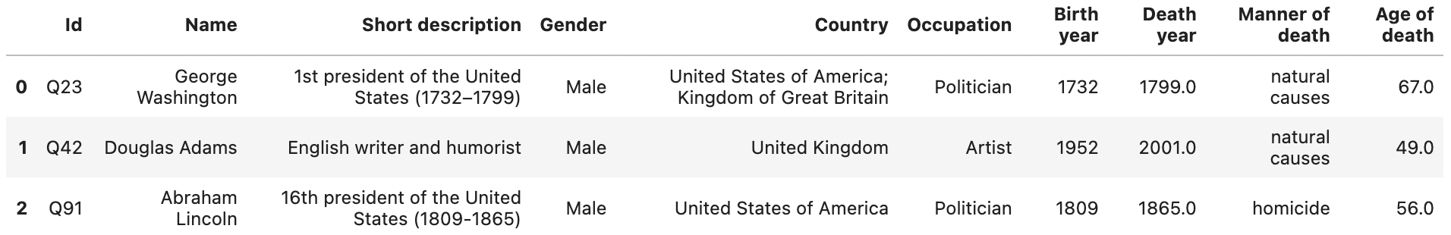
Dataset
Dataset: https://www.kaggle.com/datasets/imoore/age-dataset
This structured dataset is available as a csv file.
There are 1,222,997 data objects where each data object represents a historical figure.
The dataset contains 10 attributes for each data object.

Slide 5
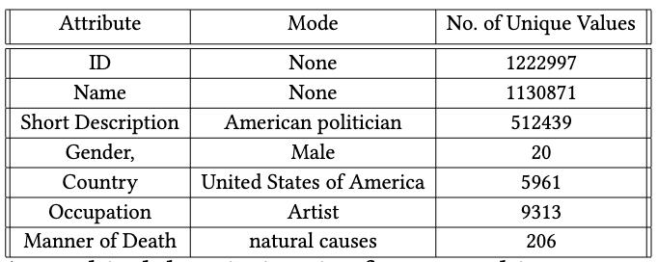
Dataset
The central tendencies of the nominal attributes are as follows:

Slide 6
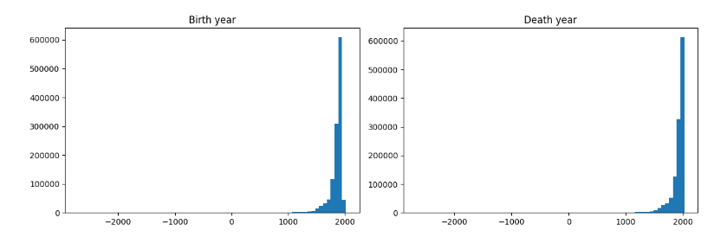
Dataset
The central tendencies of the numerical attributes are as follows:

Slide 7
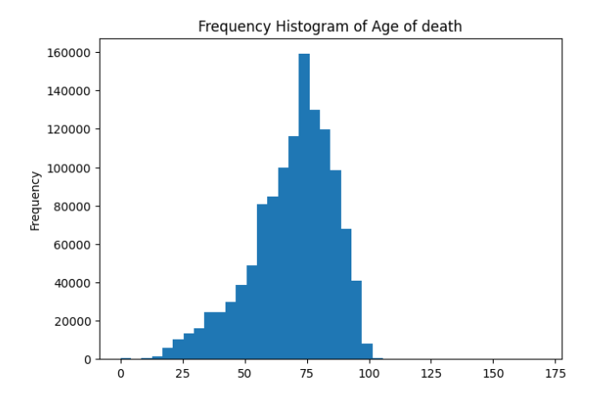
Dataset

Slide 8
Data Preprocessing
Remove the entry of the creator of the data set.
Convert the values of the attribute to consist forms. Eg: Gender.
Filter out data objects of people born before the 18th century.
Encode categorical data

Slide 9
Data Preprocessing
Prepare Short Description for NLP tasks:
Convert to lowercase
Remove punctuation, tabulation and digits.
Remove stopwords
Perform Lemmatization

Slide 10
Tools
The tools required for the implementation of our project includes:
pandas: For data cleaning and manipulation.
numpy: For data transformation and analysis.
pandasql: For querying pandas dataframe using SQL syntax.
sklearn: For object classification, clustering.
nltk: For text analysis
matplotlib and seaborn: For creating static and interactive visualizations.

Slide 11
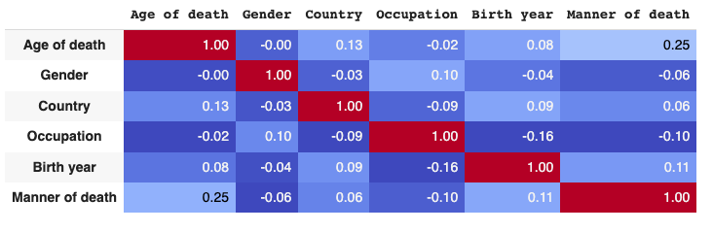
Correlation Matrix
Correlation Matrix for the attribute Age of Death, Gender, Country, Birth Year, Manner of death
Notes:
Correlation Matrix for the attribute Age of Death, Gender, Country, Birth Year, Manner of death all fields beeing encoded and scaled down to values between 1- and 1. This heat map represents the correlation between the selected attributes such as Age of Death, Gender, Country Birth Year and Manner of death.
The Age of Death is slightly correlated to manner of death. This is because most of the natural deaths occur after the age of 60 but in case of unnatural deaths the age of death is distributed across the range

Slide 12
Methods
Methods:
Perform Descriptive analysis by plotting and charting each attribute to better understand and summarize the patterns already present in the data.
Regression models used:
K neighbors Regressor
Linear Regression
Decision Tree Regressor
Random Forest Regressor
Notes:
We have performed data analysis techniques we deem fit after comparison of such techniques against one another with empirical data

Slide 13
Regression Models:
Model Name | Mean Absolute Error
K neighbors Regressor | 12.47
Linear Regression | 14.85
Decision Tree Regressor | 13.83
Random Forest Regressor | 11.96
Notes:
We selected 4 regression models to fit this data. Out of these models Random forest regressor performs the best with least mean absolute error.
So we trained the model and used this model to generate the evaluation matrix

Slide 14
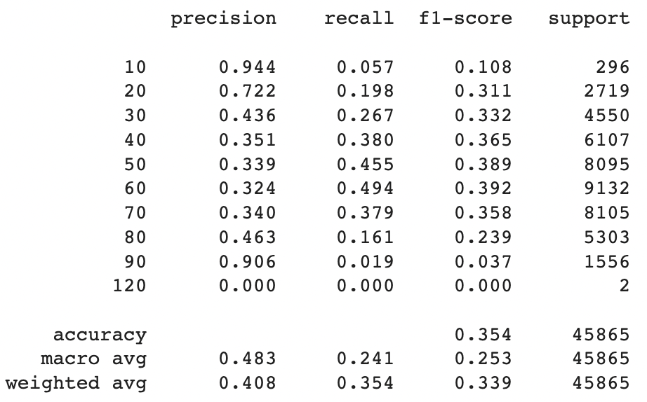
Evaluation matrix: Random forest regressor
Notes:
We have rounded the actual death age and predicted death age to its closest multiple of 10. For example 24 will be rounded to 20 for sake of reducing the dimensionality of the evaluation matrix. so for 10 age group of 0-10 the model predicts with an accuracy of 0,944, recall 0.057b and so on.
As aforementioned, we intend to compare our classifications of life expectancy based on risk factors, cause of death, and group relationships through comparison with the empirical data. We intend to verify our model through performance measures, such as:
Accuracy
Precision
Specificity
Recall
etc.

Slide 15
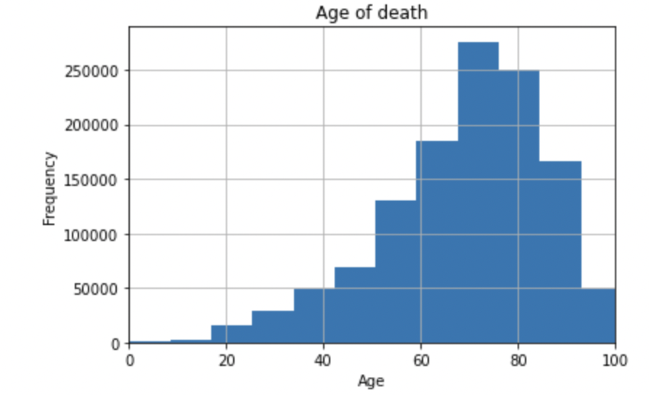
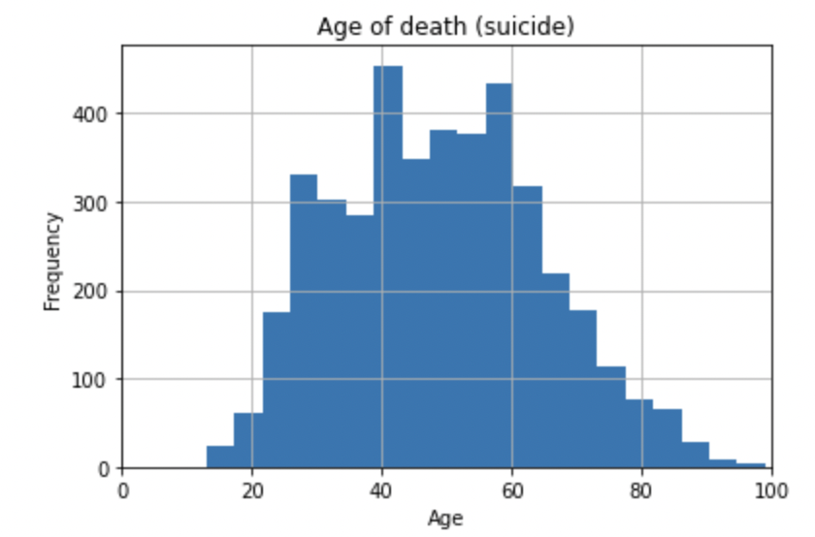
Age of Death - Overall vs Suicide
Notes:
Negative skew
Positive skew and younger
40 and 60 years, why?

Slide 16
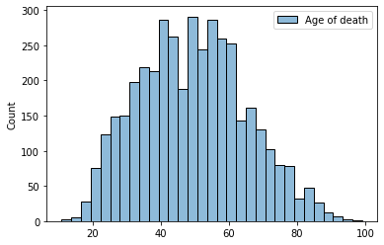
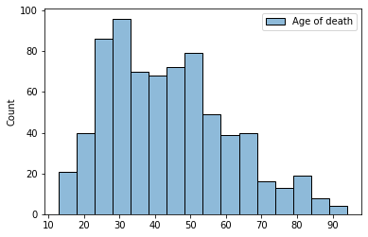
Age of Death(Suicide) - Male vs Female
Notes:
9:1 to 5:1
Women - younger

Slide 17
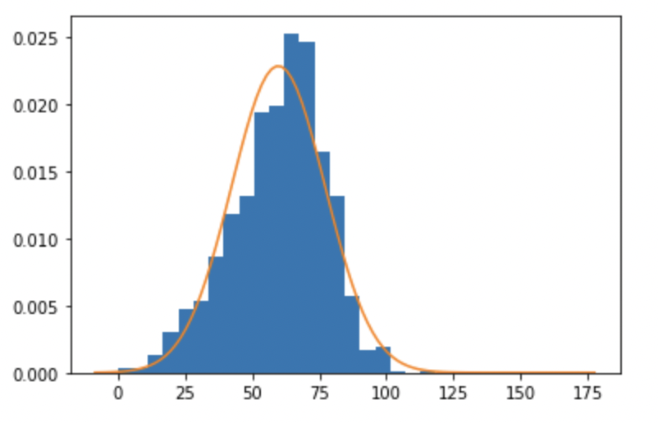
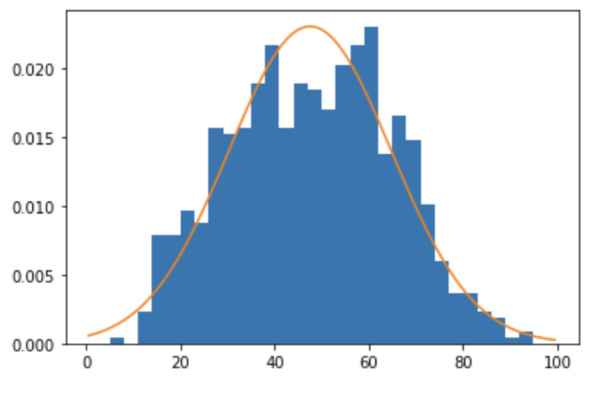
Age of Death - Natural vs Unnatural
Notes:
Natural - 60
Unnatural - 40 and 65?

Slide 18
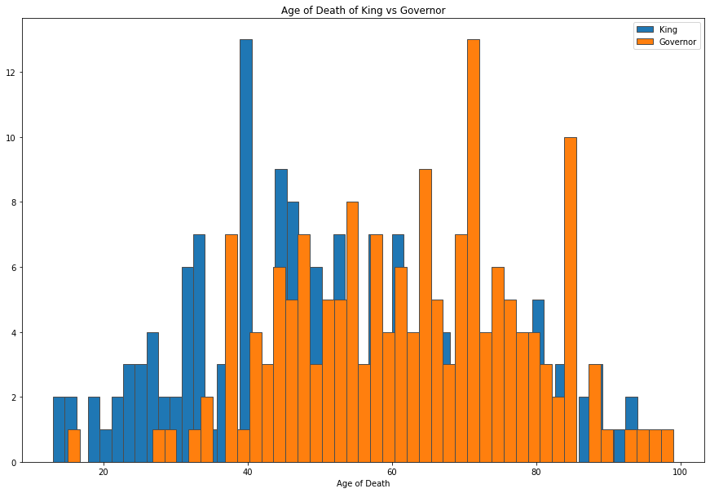
Age of Death - King vs Governor

Slide 19
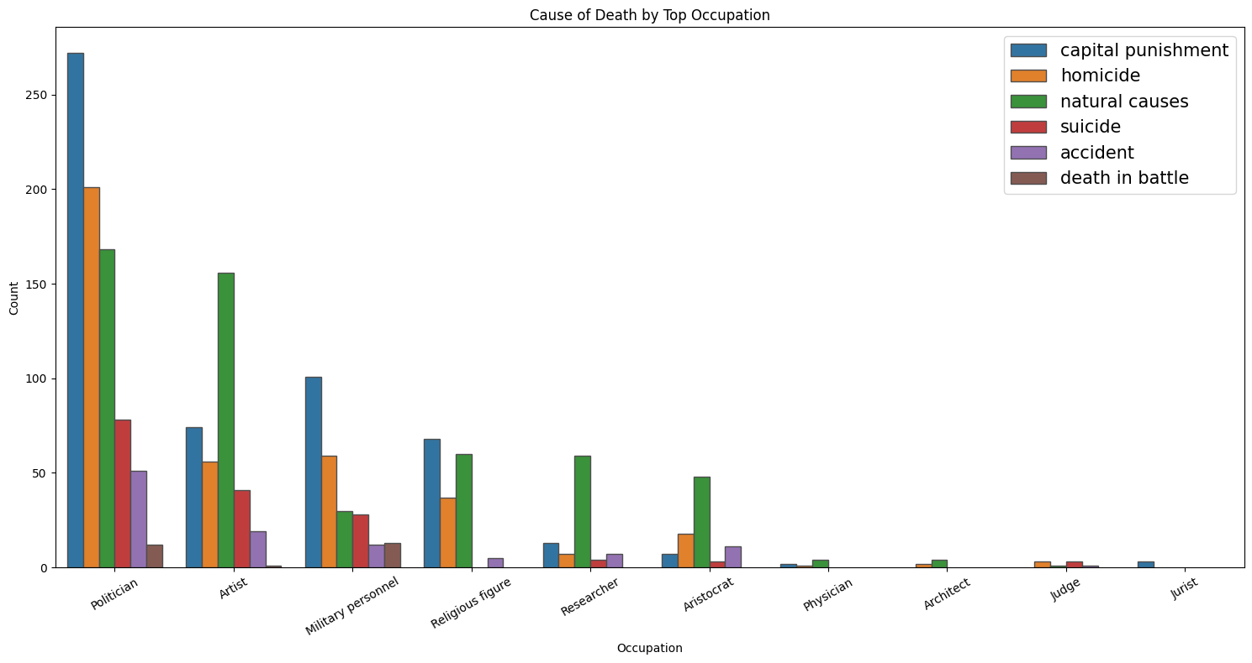
Manner of Death vs Occupation

Slide 20
Application
Studies based on suicide rates
Identify risky occupations
Gender Study
Political Science
Scope to learn about the less privileged

