Slide 1
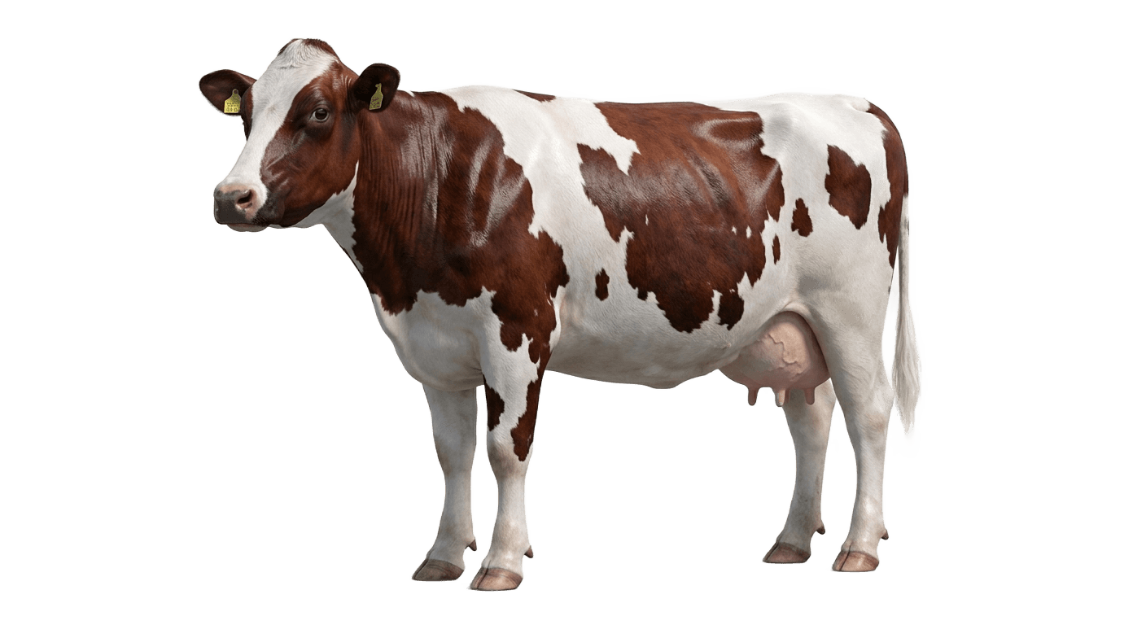
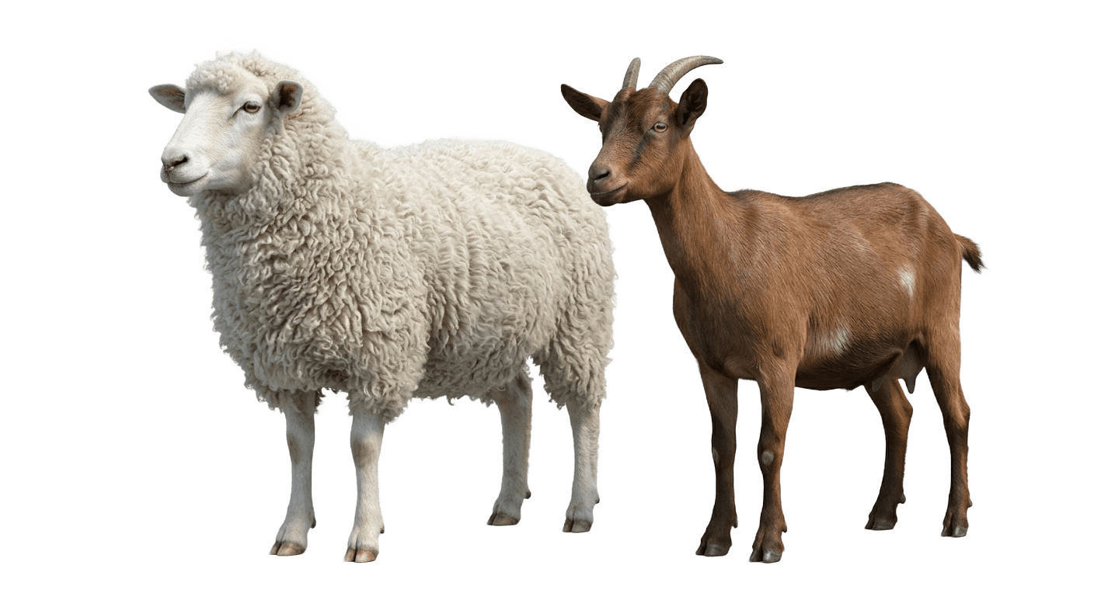
Halolmia
A trusted livestock marketplace with a halal earning engine built in.
Investor pitch
Uzbekistan-first
Marketplace • Trust layer • Payments • Creator rewards • Savings • Farmer financing
01

Slide 2
HALOLMIA
The old livestock market is too important to stay this messy.
High-value animal trades still depend on scattered chats, weak trust, and manual follow-up.
Fragmented demand
Trust gap
No earning layer
Listings live across groups, calls, and informal networks.
Buyers need proof: seller identity, reviews, photos, location, and history.
People can trade animals, but cannot systematically earn from the marketplace they help grow.
02

Slide 3
HALOLMIA
Halolmia is already more than a listings app.
Mobile, admin, bot, and Convex backend work together as one commerce operating system.
Mobile app
Admin panel
Browse, search, save, chat, call, sell, pay, promote, reels.
Moderation, users, feed control, dealers, ads, reels, reports, payments.
Telegram bot
Convex backend
Browse and sell from Telegram with phone verification.
Realtime marketplace data, auth handshakes, payments, trust, bounty, savings.
03

Slide 4
HALOLMIA
Every transaction makes the network harder to copy.
Photos & video
Each listing, message, review, verification, payment, and video strengthens the trust graph.
Seller identity
Location
Verified deal
less fear, faster trade
Reviews
Chat & calls
Admin moderation
04

Slide 5
HALOLMIA
The breakthrough: users can earn from the marketplace they grow.
Halolmia Daromad gives people halal ways to make money by creating real value inside the ecosystem.
Creator bounty
Dealer leads
Users earn from qualified content, installs, activations, and campaign performance.
Creators and partners generate demand for official dealers and promoted sellers.
Savings goals
Farmer financing
Users save toward animals through wallet and card deposits.
Verified sellers request capital for real livestock trade, then share upside after sale.
05

Slide 6
HALOLMIA
We start with measurable rewards before regulated financial products.
That lets Halolmia build trust, data, and compliance before scaling into financing.
1
2
3
4
Creator rewards
Lead marketplace
Savings plus
Verified deal pools
Pay for measurable distribution.
Reward verified buyer/seller referrals.
Move goal-based savings into commerce flows.
Finance real sellers with admin and sharia review.
06

Slide 7
HALOLMIA
Revenue stacks across commerce, distribution, and capital.
The model begins with marketplace revenue and expands into performance and financing products.
Promoted listings
Alo / Zo'r / VIP / Lux feed boosts
Dealer products
Showcase videos, profiles, lead packages
Payments
Wallet top-ups, savings, promotion checkout
Performance fees
Take-rate on verified financing outcomes
Ads
Sponsored marketplace placements
07

Slide 8
HALOLMIA
The moat is the full loop: trust, supply, demand, and money.
Most marketplaces stop at listings. Halolmia connects the entire livestock commerce cycle.
Trust
Supply
Demand
Money
verified sellers, reviews, moderation
farmers, dealers, and animal owners
buyers from app and Telegram
savings, rewards, payments, financing
The defensibility is not one feature. It is the network data created when listings, identity, video, messages, payments, and rewards happen in one place.
08

Slide 9

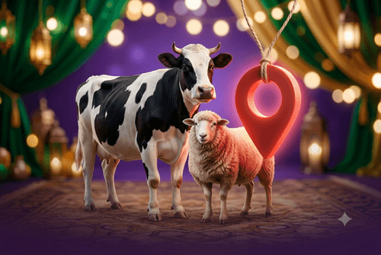
HALOLMIA
Growth is built into the product, not bolted on later.
Creators and sellers are not only users; they become paid distribution partners.
Acquire sellers
creator bounty, Telegram bot, dealer onboarding
Activate buyers
search, reels, trust badges, chat and calls
Monetize sellers
promotions, dealer packages, lead products
Expand earning
bounty to referrals to verified deal financing
09

Slide 10
HALOLMIA
The roadmap turns trust into a financial platform.
Every phase adds revenue without breaking user trust.
Now
Next 90 days
6 months
12 months
Marketplace, admin, bot, reels, savings, bounty primitives
Creator dashboard, referral tracking, dealer lead packages
Verified seller financing requests and manual deal operations
Audited halal deal pools with transparent risk and payout reporting
10

Slide 11
HALOLMIA
The raise accelerates the trust moat and earning engine.
Capital goes into product, supply onboarding, compliance, and measurable distribution.
Product
creator/referral dashboards, wallet polish, deal ops workflows
Supply
farmer and dealer onboarding across priority regions
Trust
verification, moderation tooling, legal and sharia review
Growth
performance campaigns tied to installs, listings, and transactions
11

Slide 12

Halolmia can become the money layer for trusted livestock commerce.
The ask: partner with us to scale from marketplace traction into the halal earning engine for farmers, dealers, creators, buyers, and everyday savers.
Marketplace first
Earning engine next
Halolmia • Investor pitch • 2026
12

