Slide 1
LSTM

Slide 2
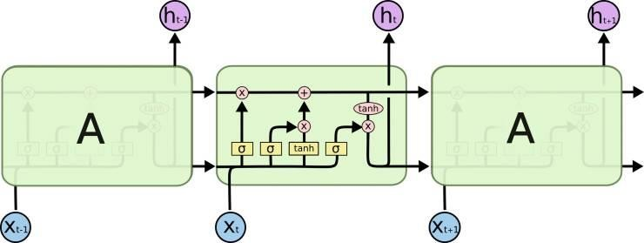
LSTM

Slide 3
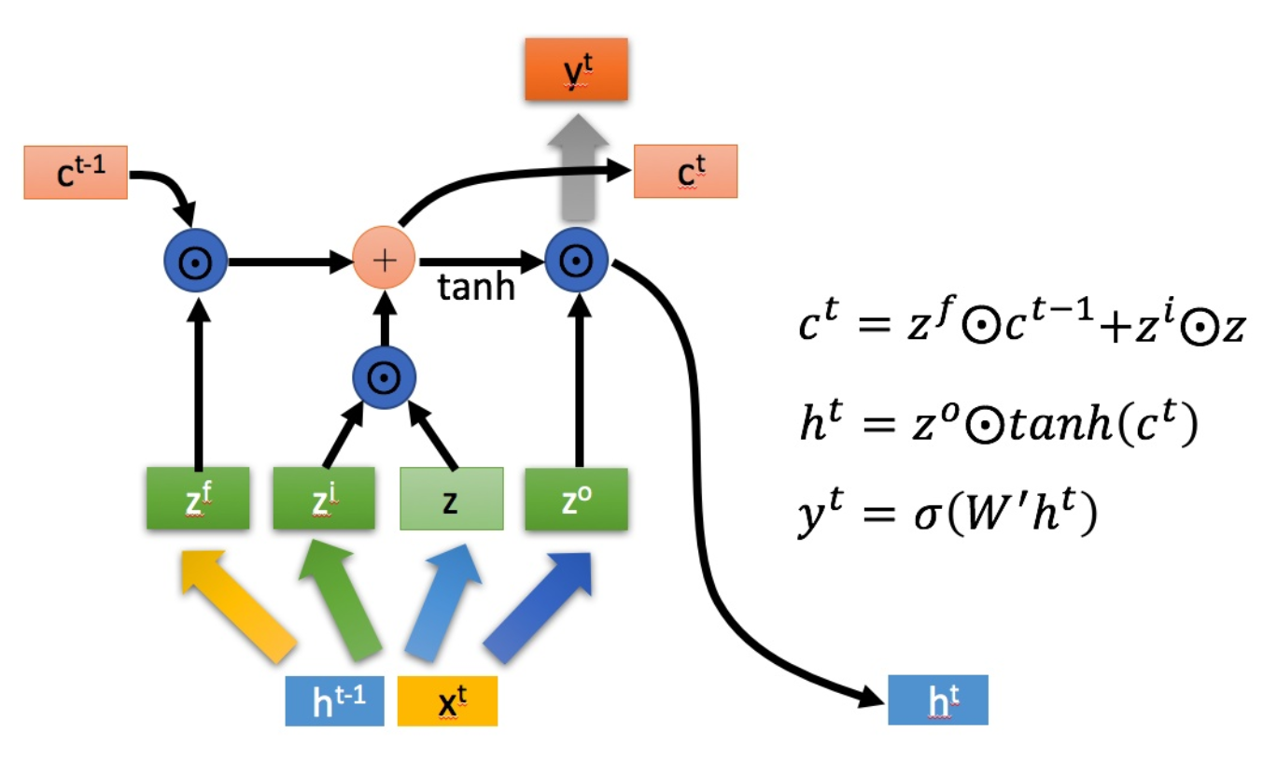
LSTM

Slide 4
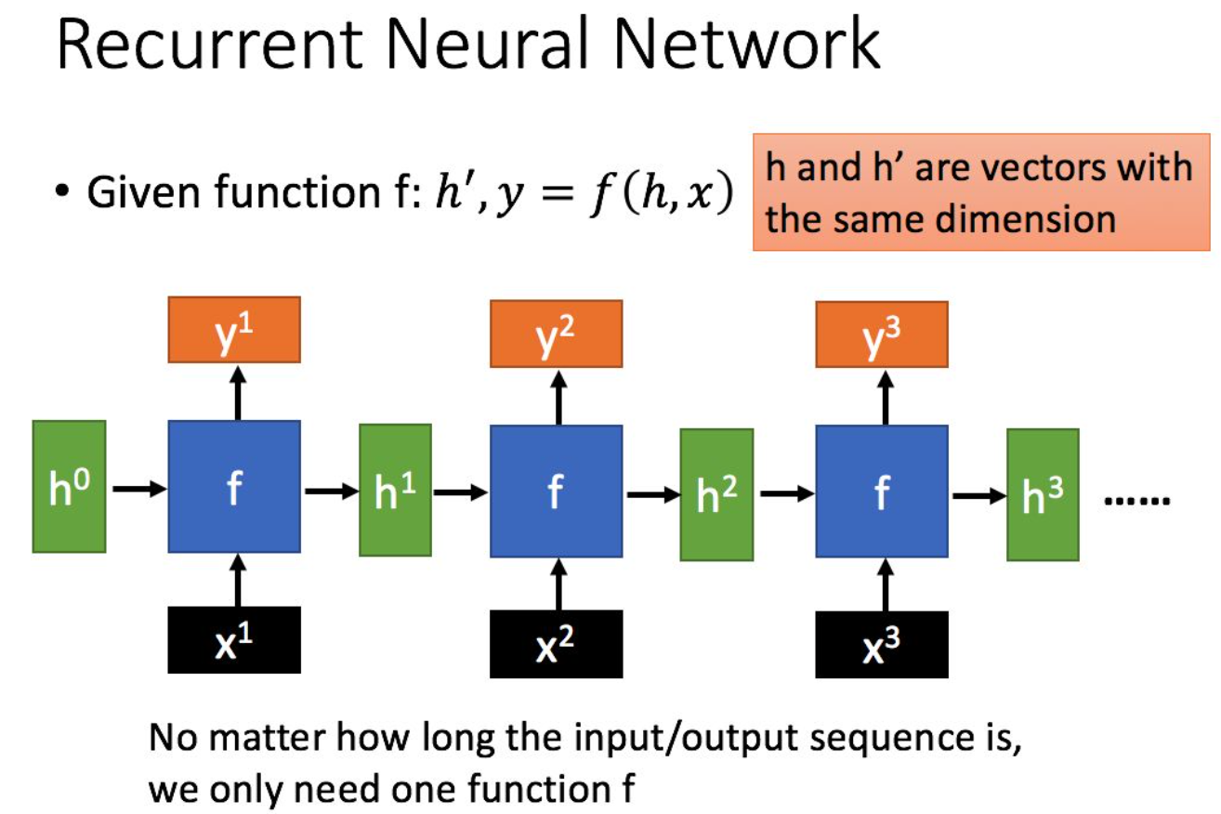
LSTM

Slide 5
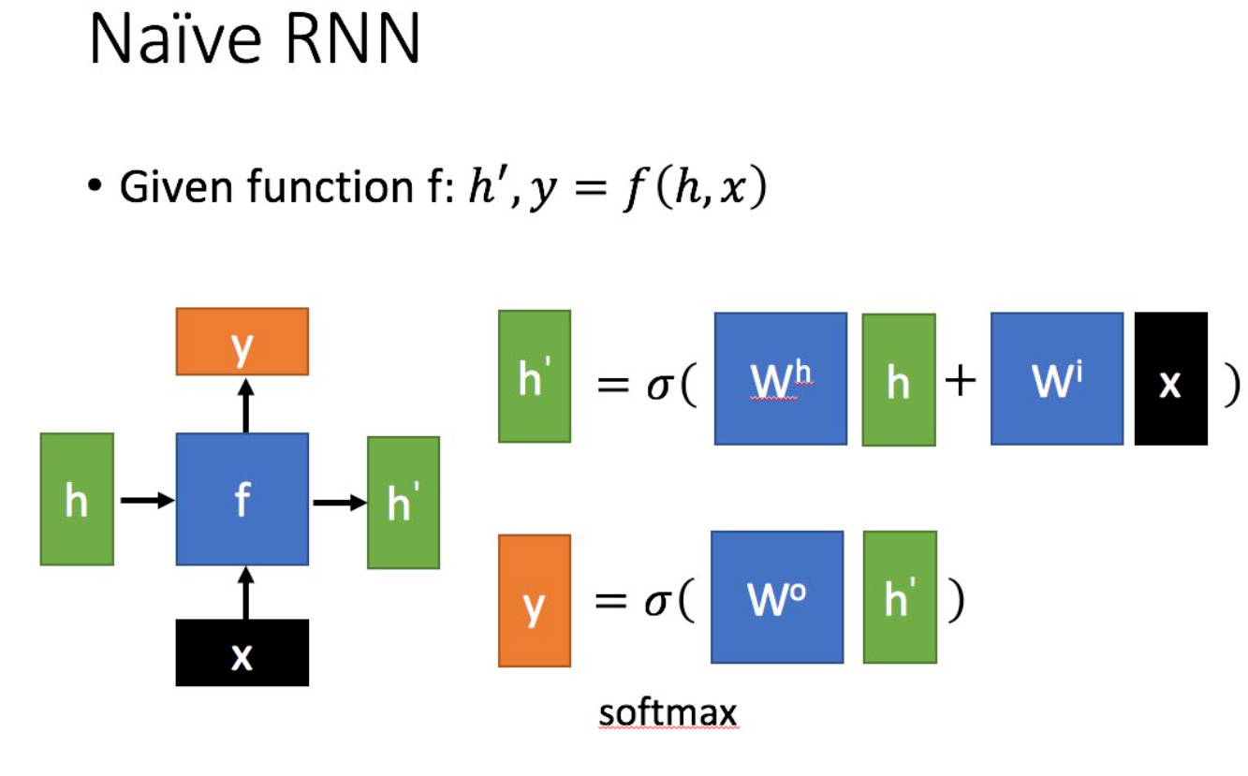
LSTM

Slide 6
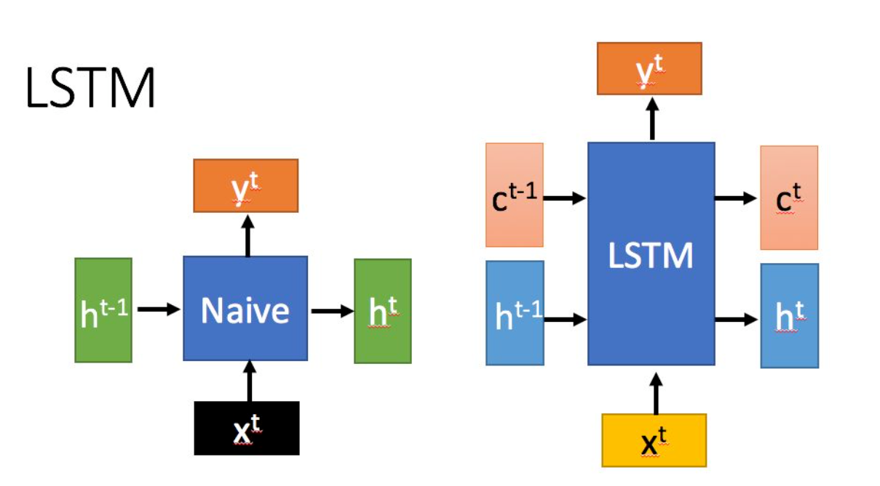
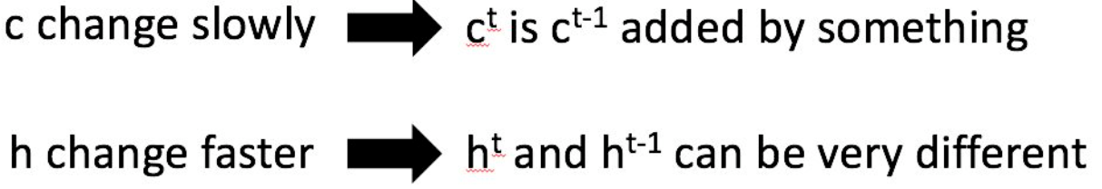
LSTM

Slide 7
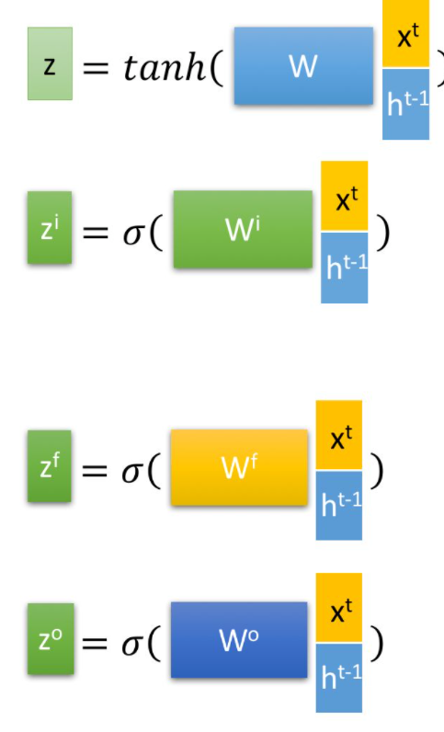
LSTM
细胞状态
输入门
遗忘门
输出门

Slide 8
Thanks Q&A

