Slide 1
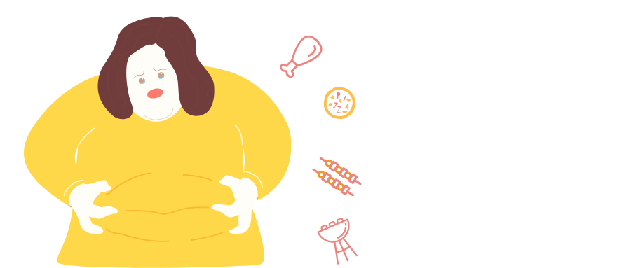
Obesity Level Predictor API development
BIS 634 Final Project
Fall 2023
Bei Jiang
MS Health Informatics
Notes:
Today I will present my work on the "Obesity Level Predictor" for the final project, to uncover patterns, correlations, and insights that could contribute to a better understanding of these health conditions and potentially aid/eɪd/ in their prediction

Slide 2
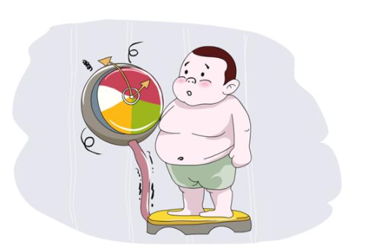
Dataset & Motivation
The data consist of the estimation of obesity levels in people from the countries of Mexico, Peru and Colombia, with ages between 14 and 61 and diverse eating habits and physical condition
Obtaining 17 attributes and 2111 records
Eg. Frequent consumption of high caloric food (FAVC),
Calories consumption monitoring (SCC), Family history,
Gender, Age, Height and Weight…
Outcome: Obesity level deducted(NObesity)
Insufficient_Weight => 0; Normal_Weight => 1; Obesity_Type_I, II, III => 2,3,4;
Overweight_Level_I,II => 5,6
Motivations
Increase awareness
Provide insights
Notes:
First let’s see the dataset. The obesity dataset is a rich collection of data aimed at estimating obesity levels in individuals. It includes a wide demographic from these three countries, covering ages between 14 and 61.
This dataset covers 17 distinct attributes across 2,111 records, some attributes related with eating habit like Frequent consumption of high caloric/kəˈlɒrɪk/ food, some related with physical condition like Calories consumption monitoring, and others such as family history with overweight, Gender, Age, Height and Weight. And our aim is to predict the outcome obesity level including these 7 categories.
My motivations for the project are to increase awareness of obesity which is a critical global health issue and to provide insights into the varying factors contributing to obesity

Slide 3
Acquisition of the Dataset
Acquired via file download on Kaggle Dataset
https://www.kaggle.com/datasets/aravindpcoder/obesity-or-cvd-risk-classifyregressorcluster
FAIRness Evaluation:
The dataset is well-annotated with comprehensive metadata
The attributes are clearly defined
License: The dataset is licensed under CC BY-SA 4.0, which is clearly stated.
Notes:
I acquire the csv file from Kaggle and here’s the link
And The dataset is well-annotated with comprehensive metadata, The attributes are clearly defined and the license is permissive and encourages sharing and adapting the dataset

Slide 4
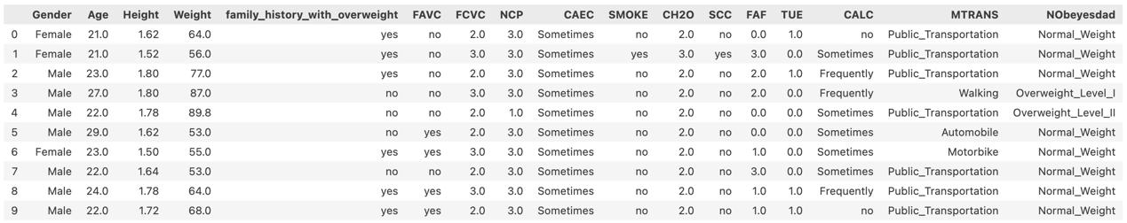
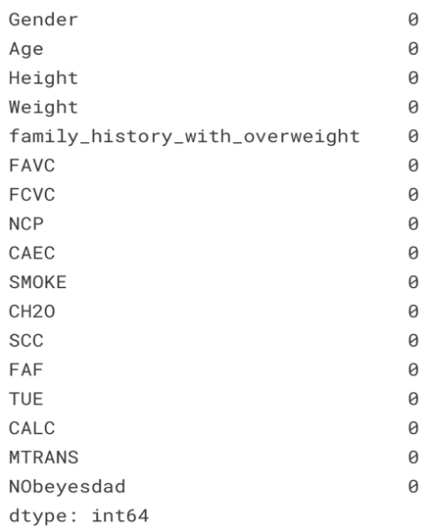
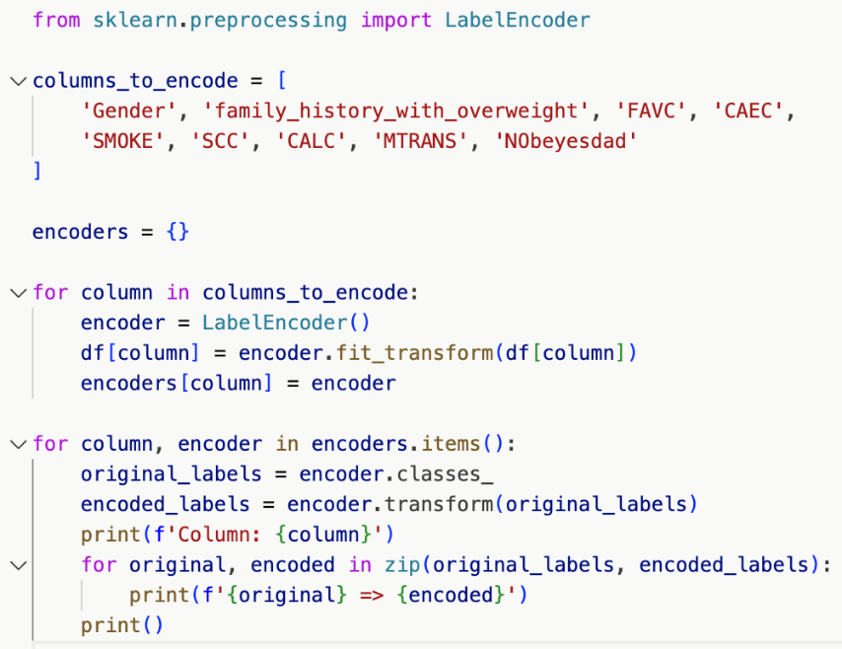
Data Preprocessing
Dataset Head overview:
• Handling Missing Data
• Handling Categorical Data: encoding categorical variables into numeric form
Notes:
Now come to data preprocessing part. We can see that the data contains numerical data and continuous data, so it can be used for analysis based on algorithms of classification. Then we check for the missing data, and There is no missing values for all columns. For the ease of data analysis, we convert categorical variables into numeric form. For instance, the gender column, female is map into 0, male is 1

Slide 5
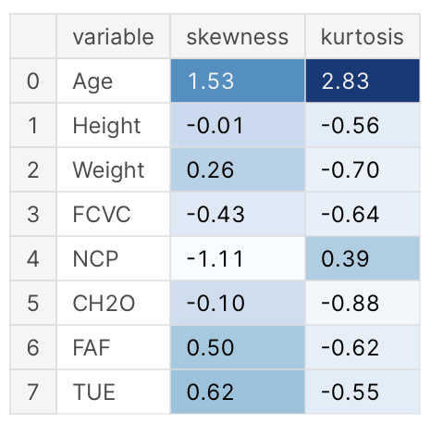
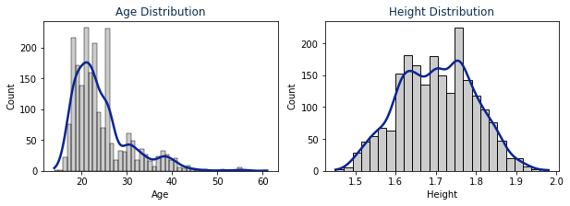
Summary Statistics
Skewness and the Kurtosis of the numerical data
Notes:
For summary statistics, We Check the Skewness and the Kurtosis/kərˈtoʊsɪs/ of the numerical data. From the general guideline that if the skewness is less than -1 or greater than 1, the data are highly skewed, and if the kurtosis is greater than +2, the distribution is too peaked. So we visualize the two variables "Age" and "Height", to see the shape of and kurtosis.
Then We surprisingly find that the "Age" variable is significantly skewed and has outliers (Most ages are between 19 and 25), but the "Height" variable is distributed normally.

Slide 6
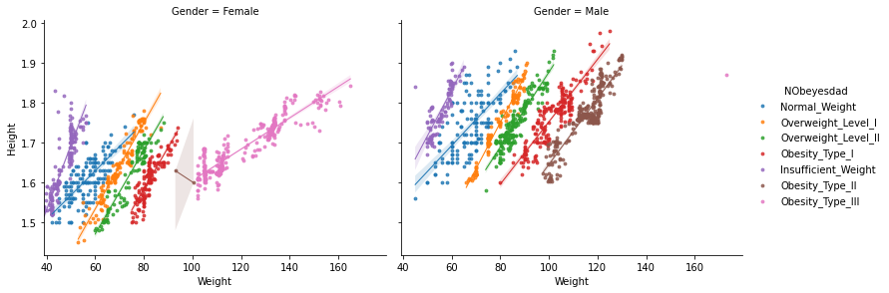
The figure consists of two separate plots for 'Female' and 'Male', allowing for a gender-specific analysis of the relationship between 'Weight' and 'Height'
Notes:
And this is another interesting figure consisting of two separate plots for 'Female' and 'Male', allowing for a gender-specific analysis.
We can see that Obesity_Type_III, the pink dots, the majority of the points go to women, with only one point referring to a single man; Obesity_Type_II brown dots, the majority of the points go to men, with two points going to women

Slide 7
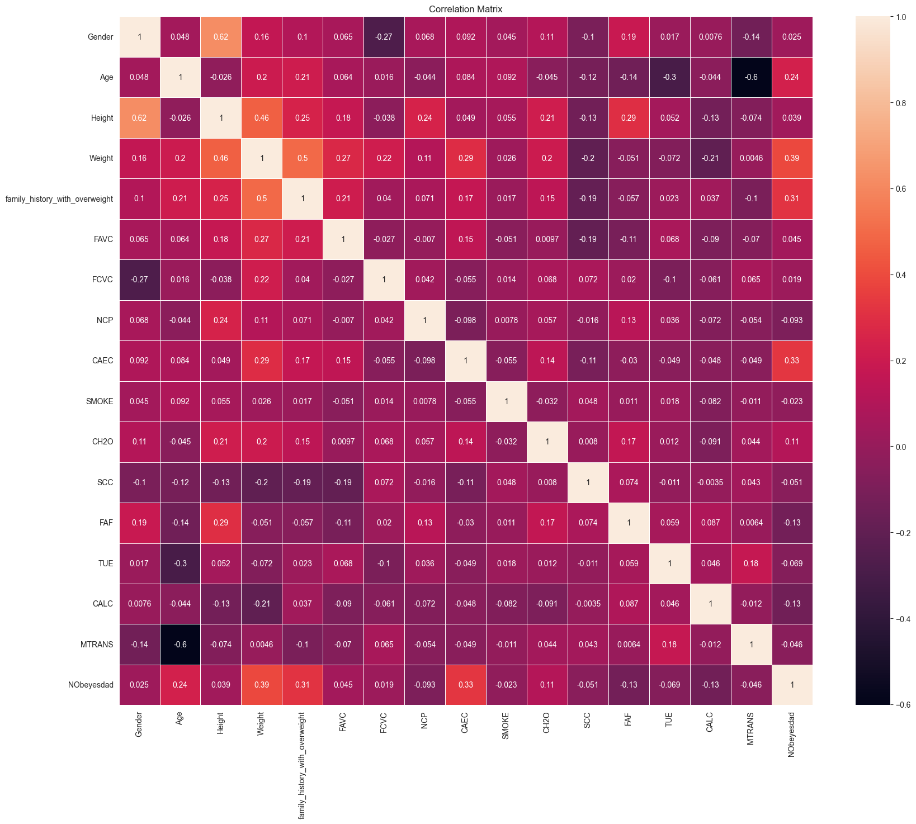
Correlation heatmap
Notes:
Here We also can visualize the strength and direction of the linear relationships between our variables by correlation heatmap. And we can see that Age and Transportation used (MTRANS) seem to have a negative correlation, suggesting that as age increases, people are more likely to choose automobile or bike. In addition, 'Family_history_with_overweight' has a moderately positive correlation with 'Weight', which might indicate a genetic or lifestyle influence on weight

Slide 8
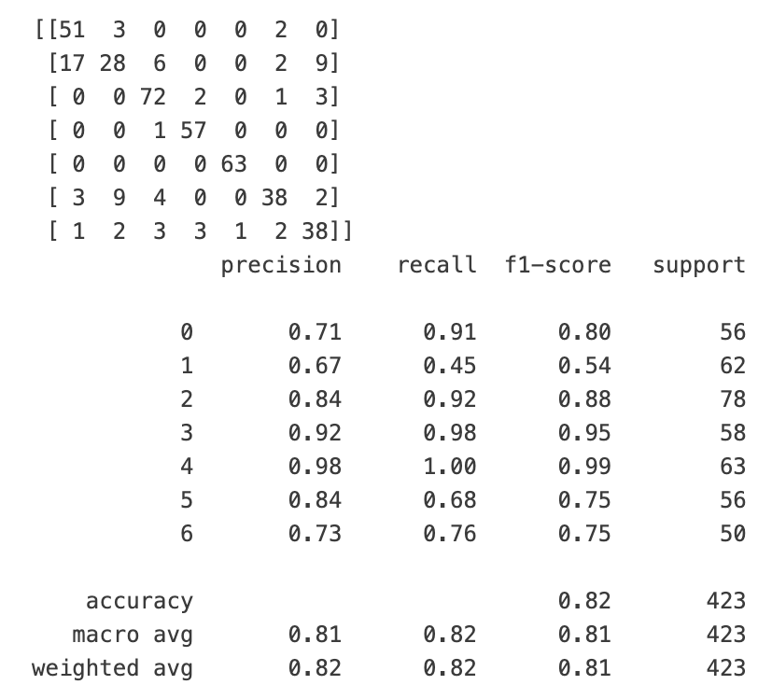
Data Analysis
Chosen Analytical Methods: KNN
Choose 80% of data as training set, 20% as test set, K = 5
Results:
Notes:
For data analysis, we choose K nearest neighbor as the Analytical Method with 80% of data as training set, 20% as test set, K = 5
We have some surprises and insights from the results. First is the confusion matrix shows some misclassifications, particularly for the class labeled '1’. And The results show that some categories, such as those labeled '3' and '4', have very high precision and recall, meaning the model performs exceptionally well in classifying these categories. In contrast, category '1' shows notably lower precision and recall, indicating the model struggles with this particular class. And finally, The overall accuracy of the model is 0.82

Slide 9
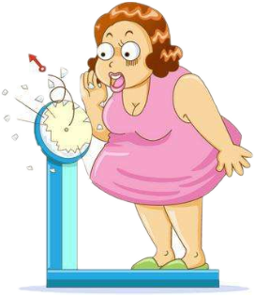
Server API and Web Front-End
Notes:
So now I will demonstrate my web interface

Slide 10
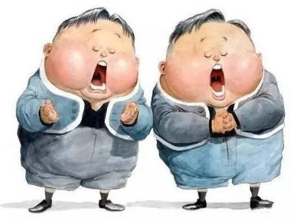
Challenges and Surprising Findings
Challenges:
HTML format
The implementation of the model results' transmission to the prediction results web interface
Surprising Results:
Misclassification of 'Normal_Weight' group
Notes:
During the course of the project, various challenges emerged, one of which could be related to the HTML format and the implementation of the model results' transmission to the prediction results web interface.
And an unexpected result from the analysis was that category '1', which represents the 'Normal_Weight' group, showed a notably very low precision. This is surprising because one might expect the 'Normal_Weight' category to be the most balanced and well-represented in the dataset, leading to more accurate predictions.

Slide 11
THANKS FOR LISTENING!

