Slide 1

Quantum Leap
Building Real Quantum Programs with Python
Beilak Aliev
Team Lead

Slide 2
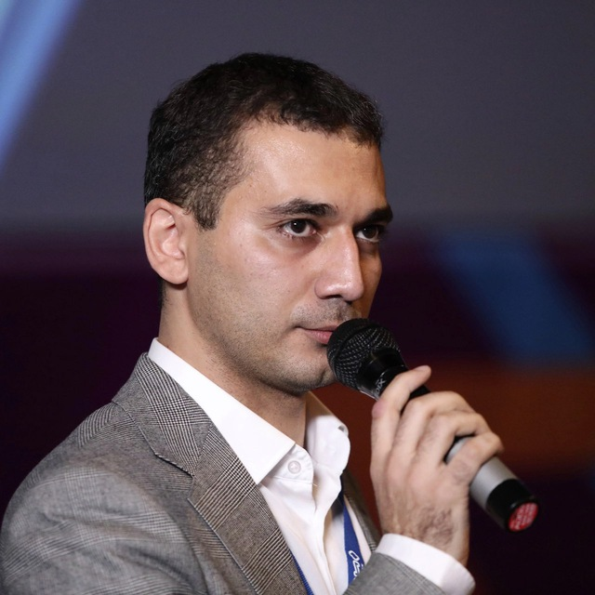
Beilak Aliev
12+ years in software engineering
Team Lead on weekdays
Quantum computing researcher on Saturdays

Slide 3
history

Slide 4
QUANTUM MILESTONES
Yuri Manin
Richard Feynman
Peter Shor: factoring algorithm
Grover’s search: O(√N)
433 qubits
1121 qubits
1980
1982
1994
1996
2022
2023

Slide 5
Where Can Quantum Computing Benefit Business?

Slide 6
Benefit
Industry | Business problems | Potential value
Pharmaceuticals | Drug discovery, molecular simulation, chemical reactions | Faster research and development of new medicines
Materials | Battery development, new materials, chemical catalysts | Discover better materials
Finance | Risk analysis, Monte Carlo simulations, portfolio optimization | Faster risk calculations and more complex financial models
Logistics | Route planning, scheduling, resource allocation | Better use of resources
AI | Classification, anomaly detection | Potential advantages in specific ML tasks

Slide 7
Quantum advantage

Slide 8
Quantum advantage
Quantum computers solve specific types of problems.
Problem type | Quantum algorithms | Potential advantage
Quantum Simulation | VQE, Hamiltonian Simulation | Model molecules and materials that are difficult to simulate classically
Search | Grover's Algorithm | Reduce search complexity from (O(N)) to (O(√N))
Monte Carlo & Probability | Amplitude Estimation | Reduce complexity
Factorization | Shor's Algorithm | Exponential speedup over the best known classical factoring methods, in terms of input length
Optimization & ML | QAOA, QNN, VQC | Potential gains for specific problems; no general advantage demonstrated yet

Slide 9
Mini-theory

Slide 10
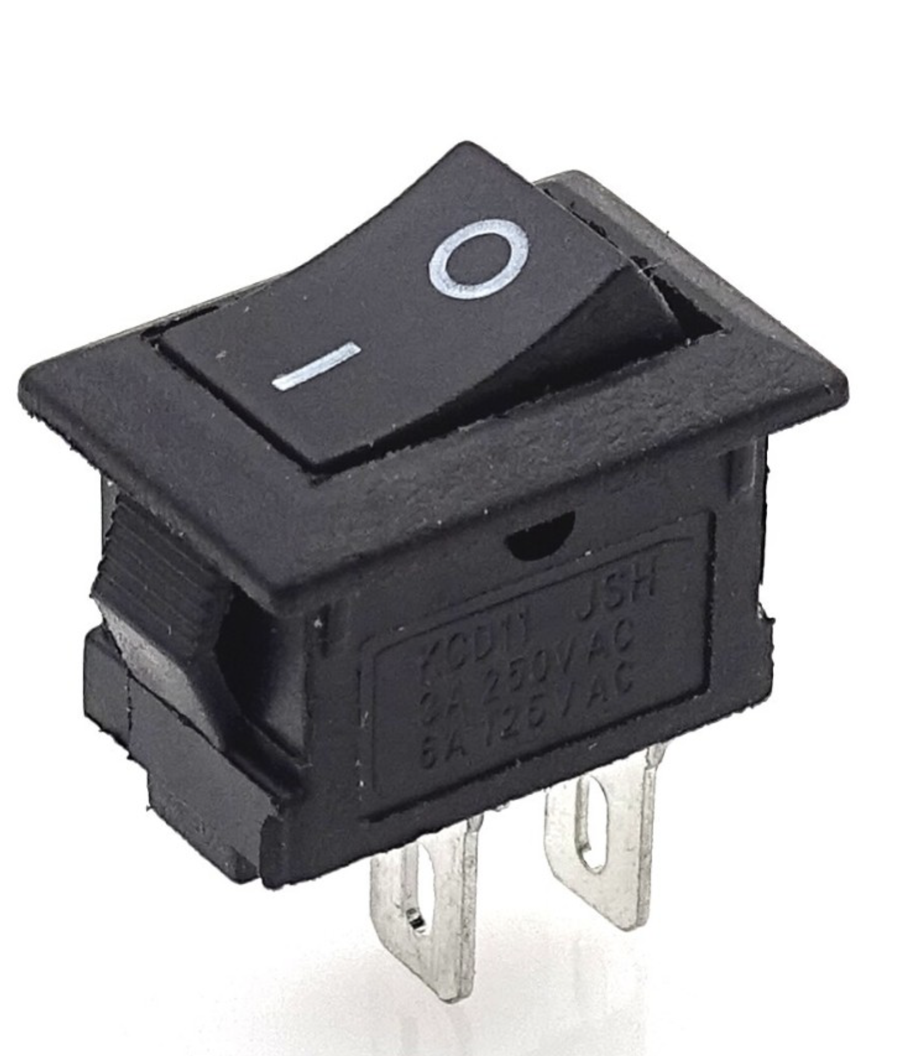
CLASSICAL BITS
A bit stores 0 or 1
Voltage: low or high
Switch: off or on

Slide 11
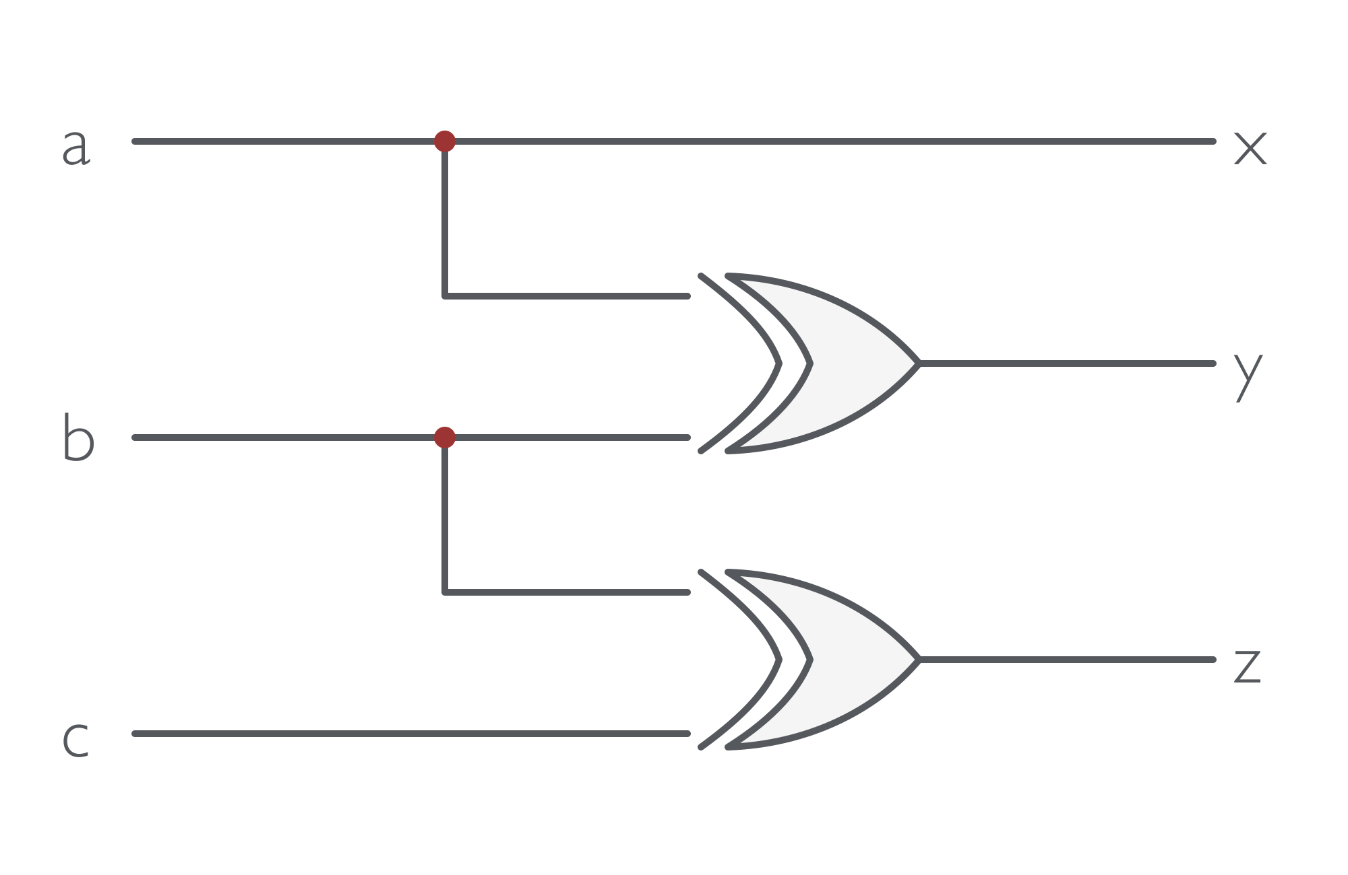
CLASSICAL LOGIC
Logic gates transform bits
XOR outputs 1 when inputs differ

Slide 12
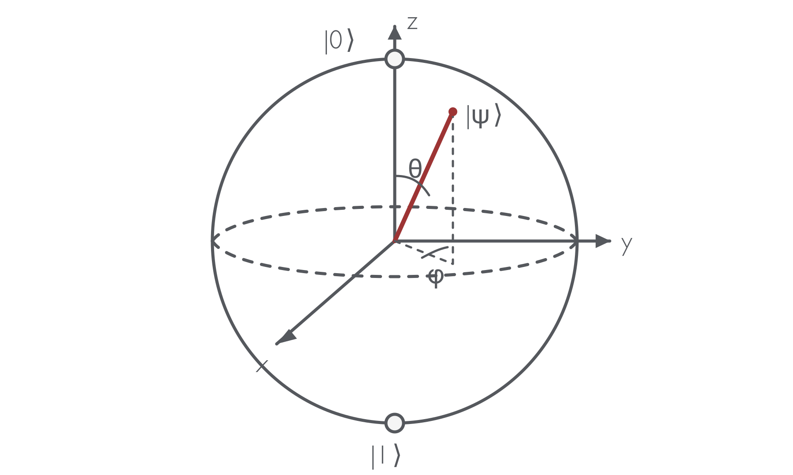
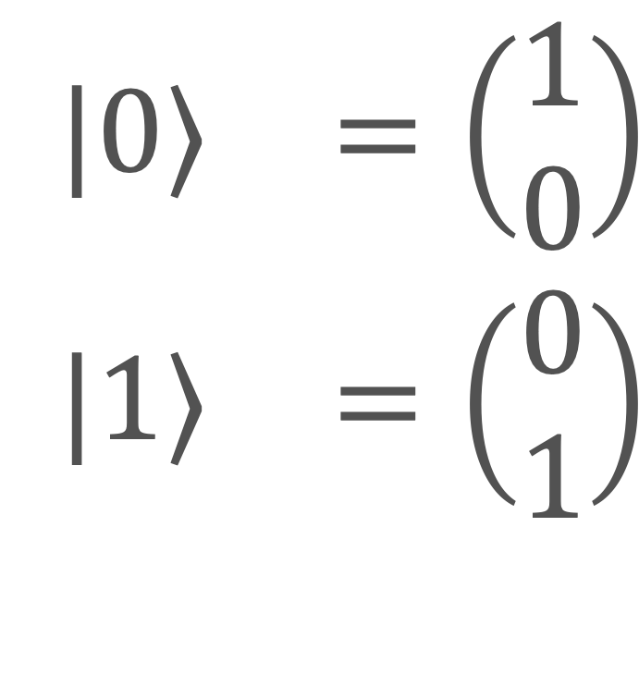
QUBITS
0 and 1 are basis states
Superposition combines both
Measurement yields 0 or 1
$$\begin{matrix}|0⟩ & =\left(\begin{aligned}1 \\ 0\end{aligned}\right) \\ |1⟩ & =\left(\begin{aligned}0 \\ 1\end{aligned}\right)\end{matrix}$$

Slide 13
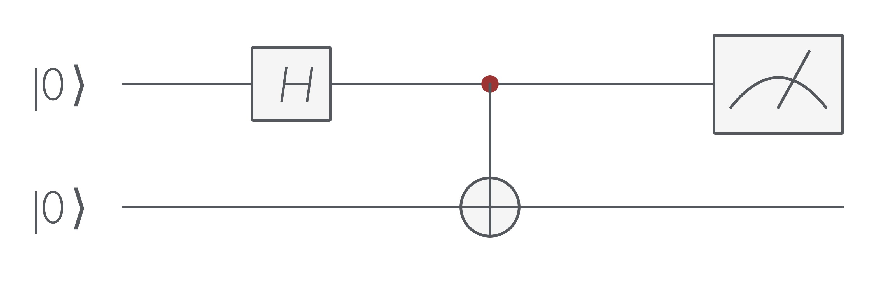
QUANTUM CIRCUIT

Slide 14
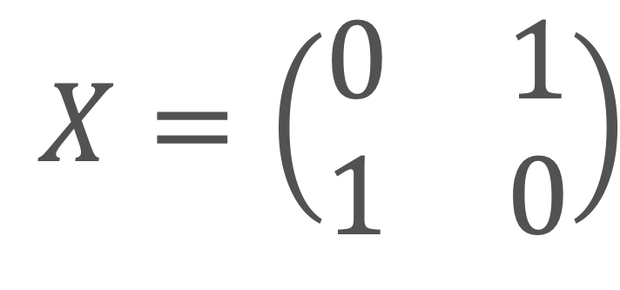
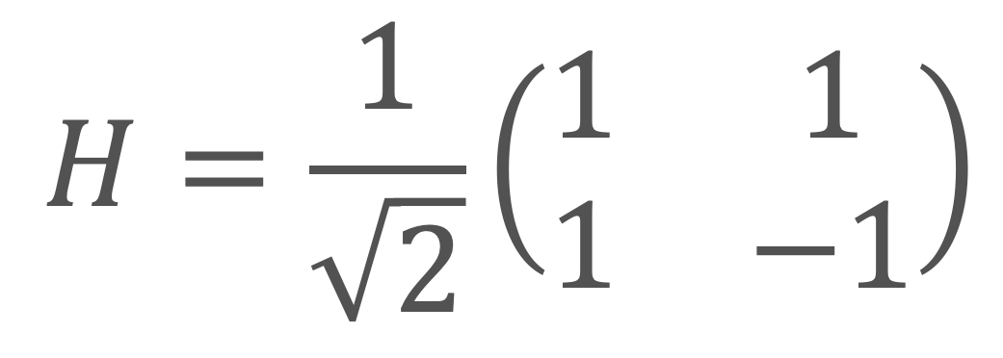
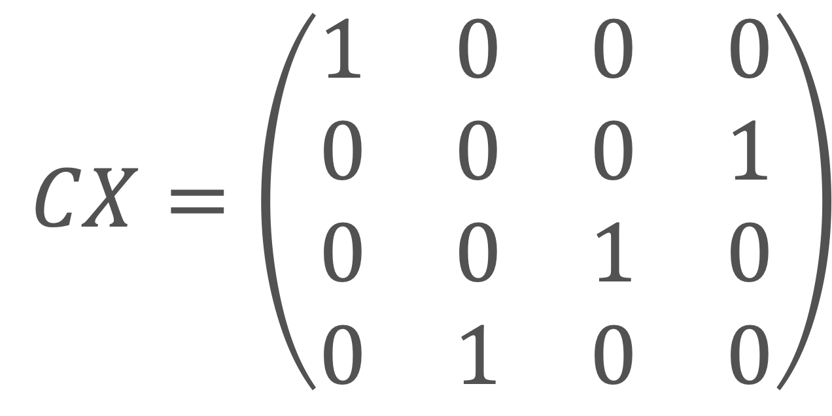
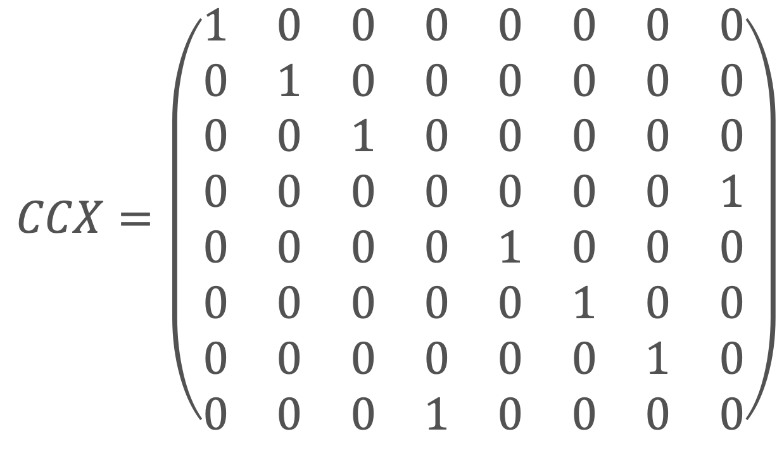
GATES AS MATRICES
$$CX=\left(\begin{matrix}1 & 0 & 0 & 0 \\ 0 & 0 & 0 & 1 \\ 0 & 0 & 1 & 0 \\ 0 & 1 & 0 & 0\end{matrix}\right)$$
$$H=\frac{1}{\sqrt{2}}\left(\begin{matrix}1 & 1 \\ 1 & −1\end{matrix}\right)$$
$$CCX=\left(\begin{matrix}1 & 0 & 0 & 0 & 0 & 0 & 0 & 0 \\ 0 & 1 & 0 & 0 & 0 & 0 & 0 & 0 \\ 0 & 0 & 1 & 0 & 0 & 0 & 0 & 0 \\ 0 & 0 & 0 & 0 & 0 & 0 & 0 & 1 \\ 0 & 0 & 0 & 0 & 1 & 0 & 0 & 0 \\ 0 & 0 & 0 & 0 & 0 & 1 & 0 & 0 \\ 0 & 0 & 0 & 0 & 0 & 0 & 1 & 0 \\ 0 & 0 & 0 & 1 & 0 & 0 & 0 & 0\end{matrix}\right)$$
$$X=\left(\begin{matrix}0 & 1 \\ 1 & 0\end{matrix}\right)$$

Slide 15
Quantum Programming Ecosystem

Slide 16
Quantum Programming Ecosystem
Languages
Libraries
Frameworks & SDKs
Python
C++
Q#
OpenQASM
Quil
Qiskit Aer (Simulation)
OpenFermion (Quantum chemistry)
QuTiP (Quantum physics)
Qiskit (IBM)
Cirq (Google)
PennyLane (Xanadu)
QDK (Microsoft)
Amazon Braket (AWS)
Ocean SDK (D-Wave)

Slide 17
practice

Slide 18
quantum hello world

Slide 19
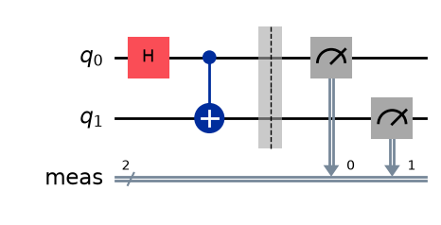
quantum hello world
from qiskit import QuantumCircuit
# Circuit
qc: QuantumCircuit = QuantumCircuit(2)
qc.h(0) # Hadamard gate
qc.cx(0, 1) # Controlled not gate
qc.measure_all()
qc.draw(output="mpl")

Slide 20
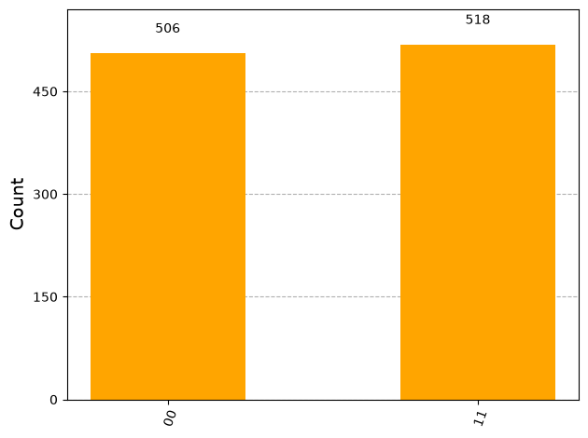
MEASURE Q hello world
# SIMULATOR
from qiskit_aer.primitives import SamplerV2
from qiskit.visualization import plot_histogram
sampler = SamplerV2()
job = sampler.run([qc], shots=1024)
sim_result = job.result()
sim_counts = sim_result[0].data.meas.get_counts()
plot_histogram(sim_counts, color="orange")

Slide 21
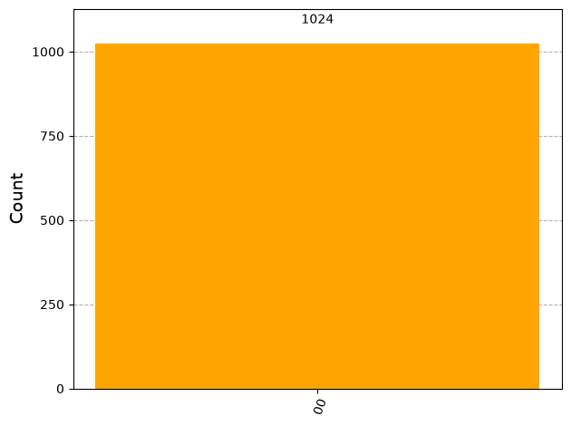
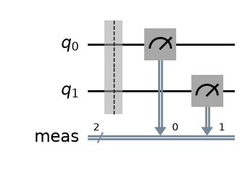
quantum hello world
# Circuit
qc: QuantumCircuit = QuantumCircuit(2)
qc.measure_all()

Slide 22
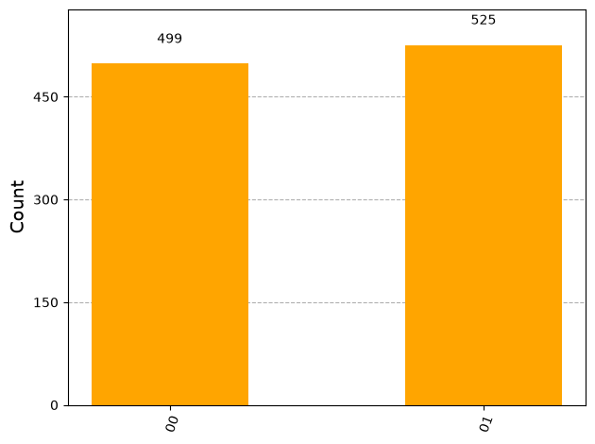
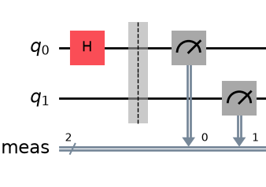
quantum hello world
# Circuit
qc: QuantumCircuit = QuantumCircuit(2)
qc.h(0) # Hadamard gate
qc.measure_all()

Slide 23

quantum hello world
# Circuit
qc: QuantumCircuit = QuantumCircuit(2)
qc.h(0) # Hadamard gate
qc.cx(0, 1) # Controlled not gate
qc.measure_all()

Slide 24
Run on real hardware
Quantum hello world

Slide 25
Find QPU
from qiskit_ibm_runtime import QiskitRuntimeService
service = QiskitRuntimeService(
channel="ibm_quantum_platform",
token=TOKEN,
instance='auto',
)
# 1. Select a real quantum processor
backend = service.least_busy(
operational=True,
simulator=False,
min_num_qubits=2,
)
print(f"Selected QPU: {backend.name}")
Selected QPU: ibm_marrakesh

Slide 26
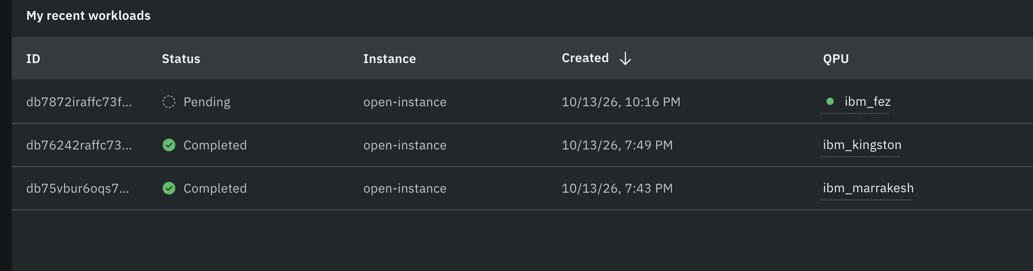
from qiskit.transpiler import generate_preset_pass_manager
# 2. Adapt the circuit to IBM hardware
pm = generate_preset_pass_manager(
backend=backend,
optimization_level=1,
)
isa_qc = pm.run(qc)
# 3. Execute on a real quantum computer
sampler = IBMSampler(mode=backend)
job = sampler.run([isa_qc], shots=1024)
print(f"Job ID: {job.job_id()}")
Job ID: db75vbur6oqs7386r6tg

Slide 27
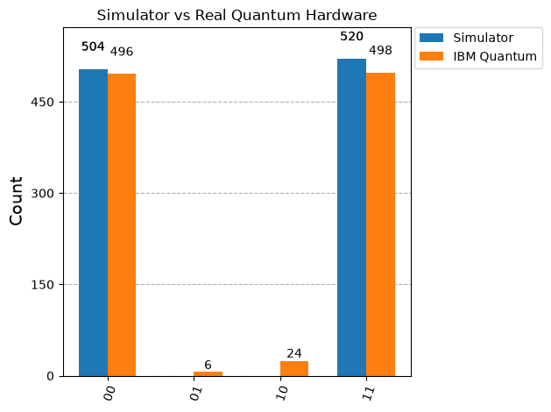

Slide 28
VQE

Slide 29
Variational Quantum Eigensolver
A hybrid quantum-classical algorithm for finding minimum-energy states.
Quantum part: Prepares quantum states and measures their energy.
Classical part: Optimizes the quantum circuit parameters to minimize energy.
Applications: Optimization problems

Slide 30
VQE
Step-by-Step

Slide 31
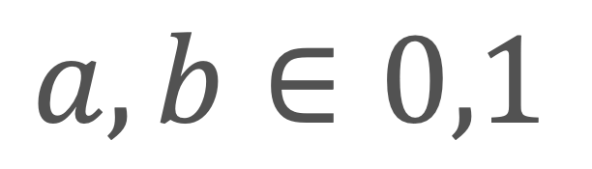
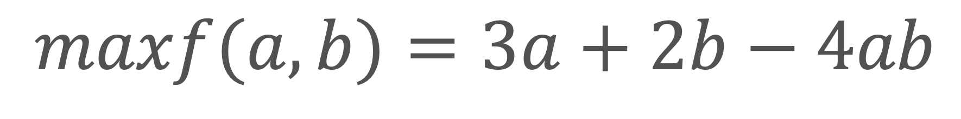
VQE step 1
$$maxf(a,b)=3a+2b−4ab$$
Define the Problem
$$a,b∈0,1$$

Slide 32
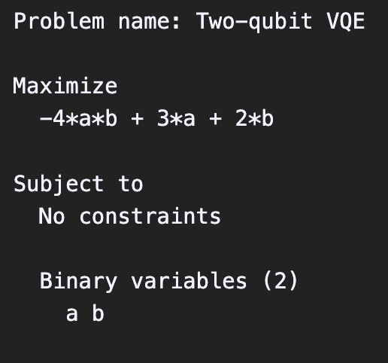
VQE step 2
from qiskit_optimization import QuadraticProgram
small_problem = QuadraticProgram("Two-qubit VQE")
small_problem.binary_var("a")
small_problem.binary_var("b")
small_problem.maximize(
  linear={"a": 3, "b": 2},
  quadratic={("a", "b"): -4}
  )
print(small_problem.prettyprint())
Build a Quadratic Program
Describe the variables and the objective function in a structured mathematical model that would be converted into Qiskit.

Slide 33
VQE step 3
Convert to Ising
Transform the optimization problem into an energy-minimization problem represented by a Hamiltonian.
cost_operator, _ = small_problem.to_ising()

Slide 34
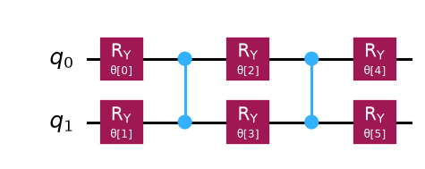
VQE step 4
from qiskit.circuit.library import n_local
small_ansatz = n_local(
2, "ry", "cz", reps=2,
entanglement=“full”,
)
small_ansatz.draw(output="mpl", scale=1.1)
Create a Quantum Circuit
Build a parameterized circuit (ansatz) that prepares candidate quantum states.

Slide 35
VQE step 5
from qiskit.primitives import StatevectorSampler
from qiskit_algorithms import SamplingVQE
small_vqe = SamplingVQE(
sampler=StatevectorSampler(
  default_shots=1024, seed=42,
      ),
ansatz=small_ansatz,
optimizer=COBYLA(maxiter=20),
callback=record_small_energy,
)
small_result = small_vqe.compute_minimum_eigenvalue(cost_operator)
Run Hybrid Optimization
Quantum measurements estimate energy. COBYLA updates circuit parameters to minimize it.

Slide 36
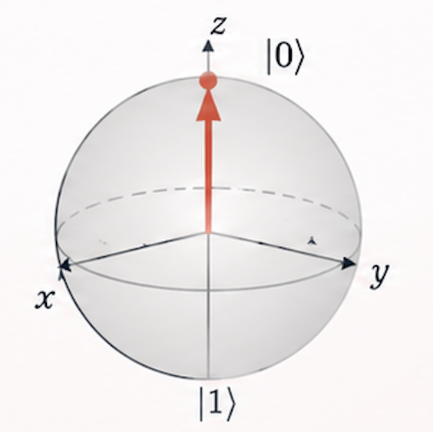
VQE step 5.1
Initialize Parameters
Start with an initial rotation angles θ.

Slide 37
VQE step 5.2
Prepare Quantum State
Apply the parameterized gates to prepare a candidate quantum state.

Slide 38
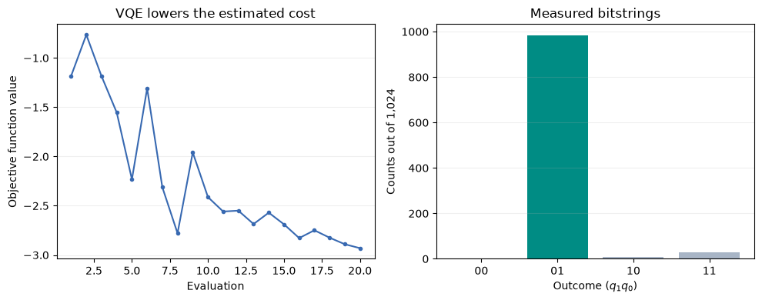
VQE step 5.3
Measure
Apply the parameterized gates to prepare a candidate quantum state.

Slide 39

VQE step 5.4
Estimate Ising Energy
Calculate the expected energy from the measured probabilities and Hamiltonian.
$$E(θ)=\underset{x}{∑}P(x|θ)E_{H}(x)$$

Slide 40
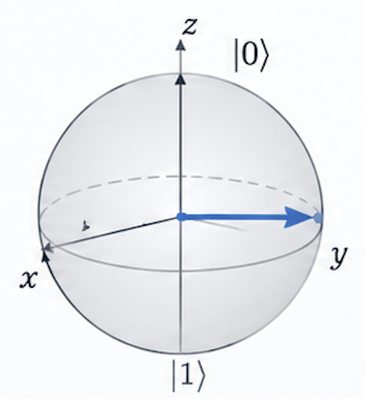
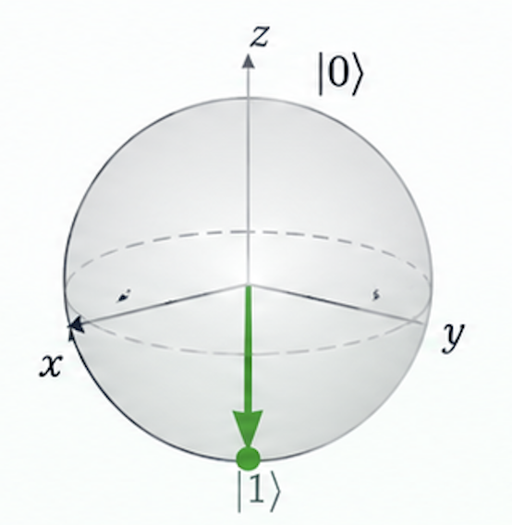
VQE step 5.5
Update Parameters
COBYLA calculate new rotation angles.

Slide 41
VQE step 6
Measure & Decode

Slide 42
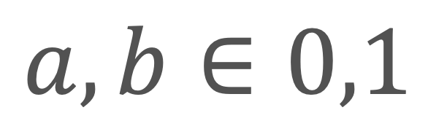




VQE step 7
Measure & Decode
$$3=3∗1+2∗0−4∗1∗0$$
$$maxf(a,b)=3a+2b−4ab$$
$$a,b∈0,1$$
$$q0=1q1=0$$
$$a=1b=0$$

Slide 43
Vqe on QPU

Slide 44
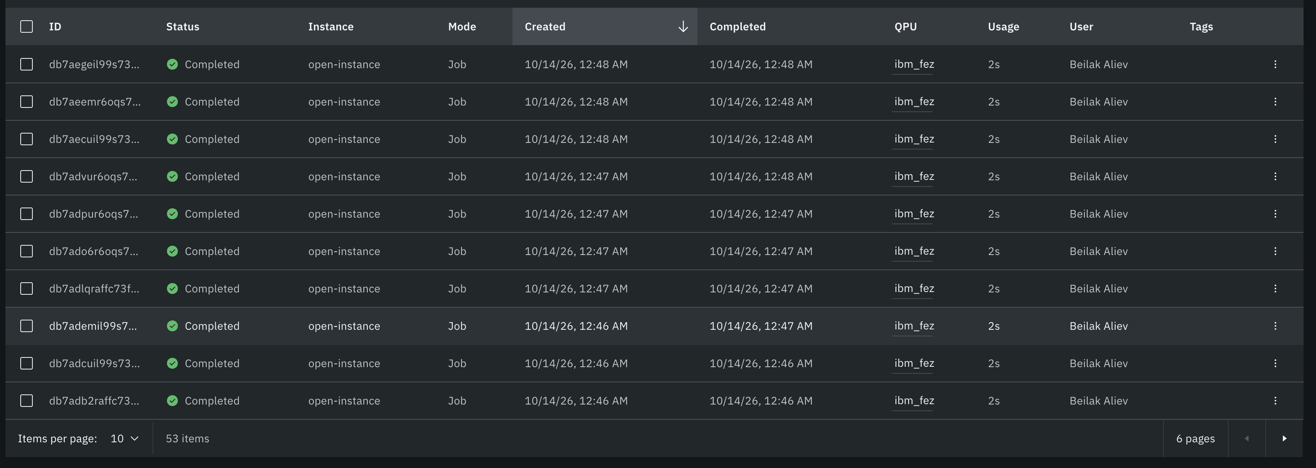

Slide 45
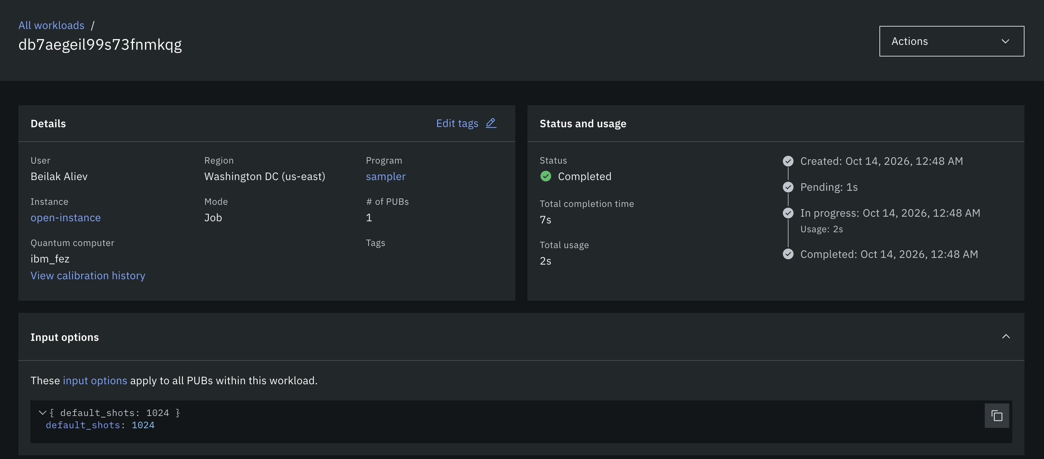

Slide 46
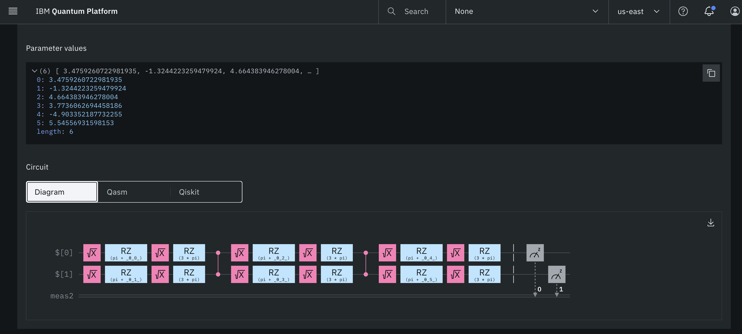

Slide 47
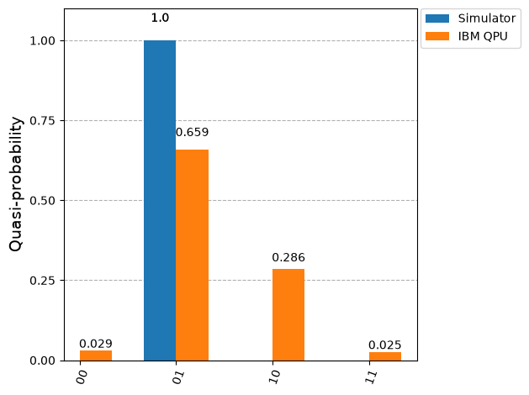

Slide 48
Shortest-path problem
OR
How to get from Moscow to Florianópolis?

Slide 49
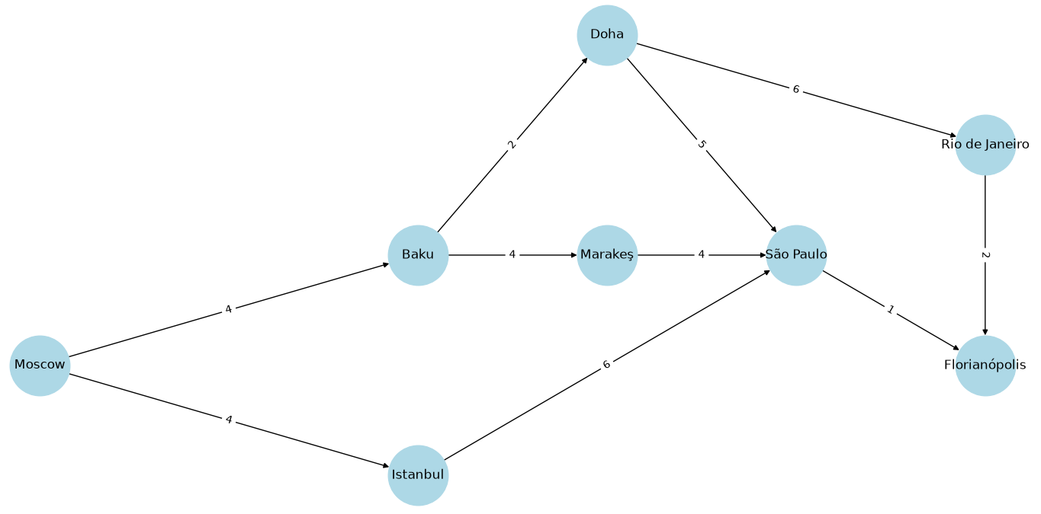
0. Problem Definition

Slide 50
Search Space
10 flights → 10 binary variables
2¹⁰ = 1,024 possible combinations
Only 4 valid routes - [ We don’t know this! :-) ]

Slide 51
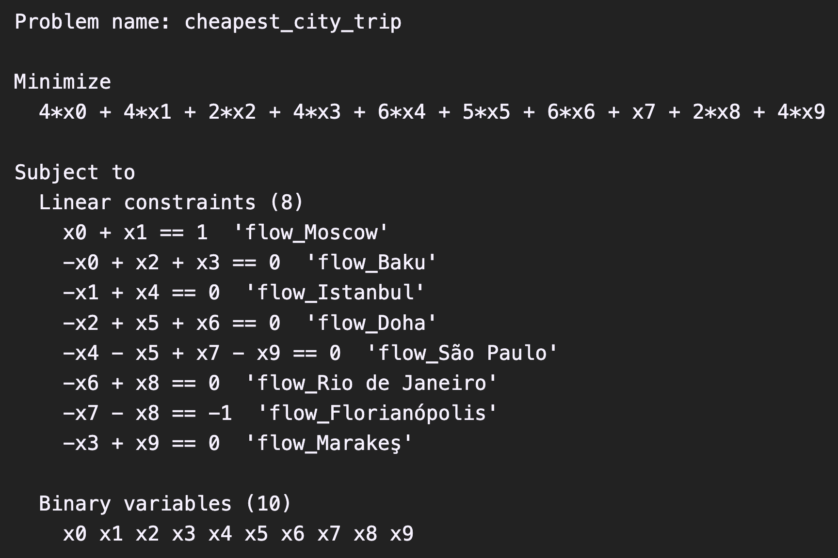
1. Math Formulation
Bit | Flight | Cost
x0 | Moscow → Baku | 4
x1 | Moscow → Istanbul | 2
x2 | Baku → Doha | 2
x3 | Baku → Marakeş | 4
x4 | Istanbul → São Paulo | 10
x5 | Doha → São Paulo | 5
x6 | Doha → Rio | 6
x7 | São Paulo → Florianópolis | 1
x8 | Rio → Florianópolis | 2
x9 | Marakeş → São Paulo | 4

Slide 52
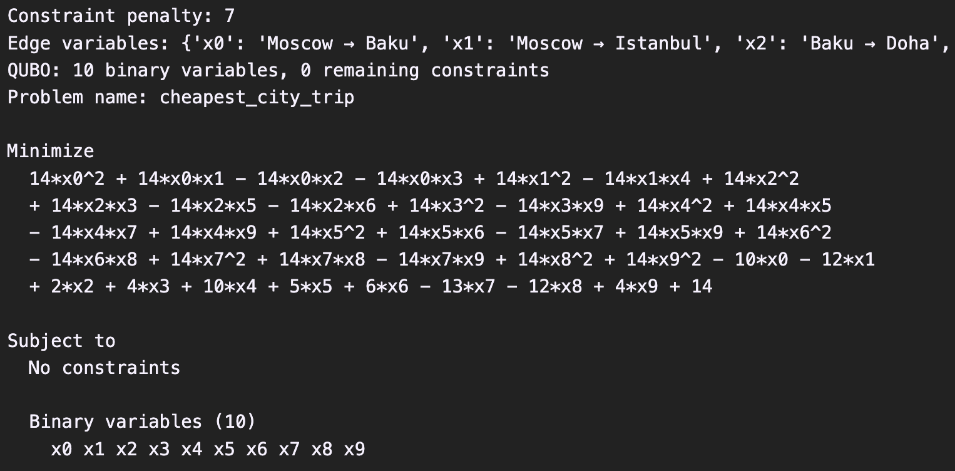
2. To QUBO
from qiskit_optimization.converters import QuadraticProgramToQubo
converter = QuadraticProgramToQubo(penalty=7)
qubo = converter.convert(problem)

Slide 53
3. QAOA Init
from qiskit.primitives import StatevectorSampler
from qiskit_algorithms import QAOA
from qiskit_algorithms.optimizers import COBYLA
from qiskit_optimization.algorithms import MinimumEigenOptimizer
qaoa = QAOA(
sampler=StatevectorSampler(default_shots=1024, seed=42),
optimizer=COBYLA(maxiter=100),
reps=2)
optimyzer = MinimumEigenOptimizer(qaoa, converters=converter)

Slide 54
4. Hybrid Optimisation
Convert QUBO to Ising
Execute quantum circuits
Measure
Optimise with COBYLA
Select the best solution
result = optimyzer.solve(problem)

Slide 55
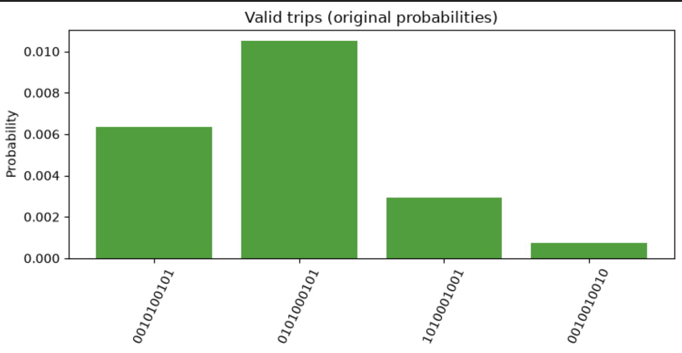
4. Hybrid Optimisation
0101000101. Moscow → Baku → Doha → Rio de Janeiro → Florianópolis; cost: 14
0010100101. Moscow → Baku → Doha → São Paulo → Florianópolis; cost: 12
1010001001. Moscow → Baku → Marakeş → São Paulo → Florianópolis; cost: 13
0010010010. Moscow → Istanbul → São Paulo → Florianópolis; cost: 13

Slide 56
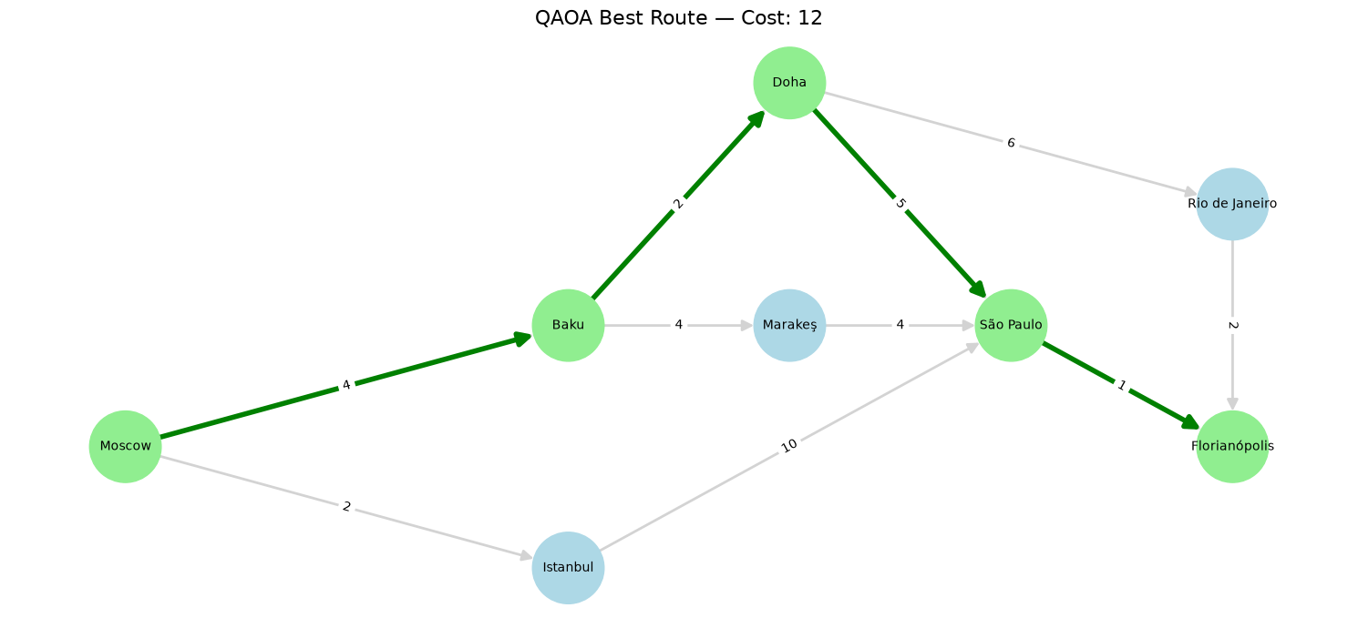
How to get from Moscow to Florianópolis?

Slide 57



Quantum Leap
Building Real Quantum Programs with Python

