Slide 1
Credit Default Analysis

Slide 2
Abstract
The business context
Data exploration key takeaways
Data preprocess implemented
Models
Evaluate model performance
Other options

Slide 3
The business context
Credit card issuer wants to better predict the probability of its customers default
Help issuer better understand current and potential customers, inform their future business strategy
Data include key features like credit amount, age, gender, education, marriage status, repayment status, monthly bill statement and payment, and the label data is 1 (default) and 0 (no default)

Slide 4
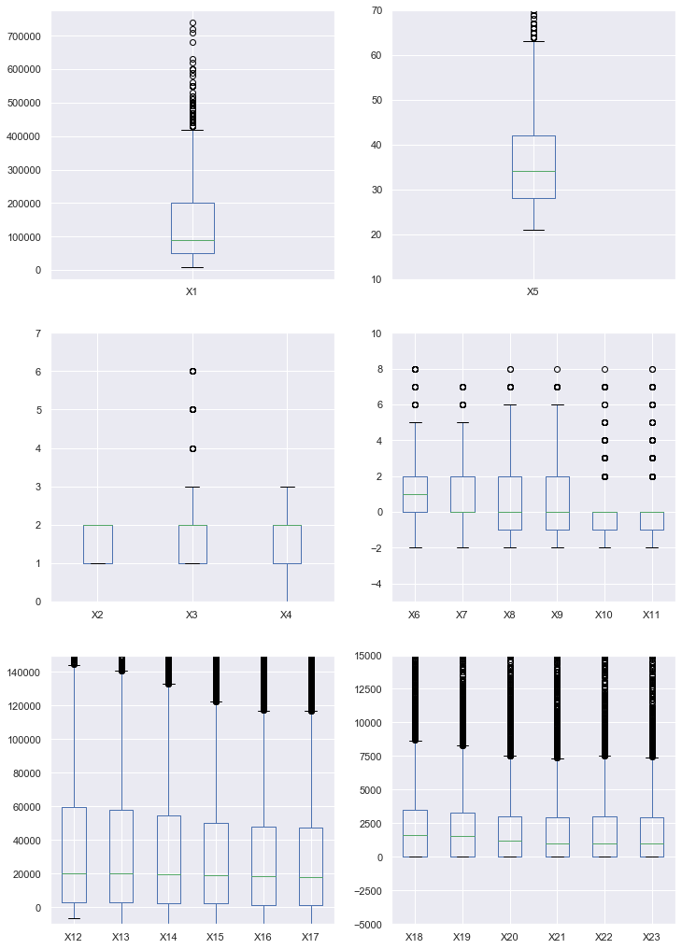
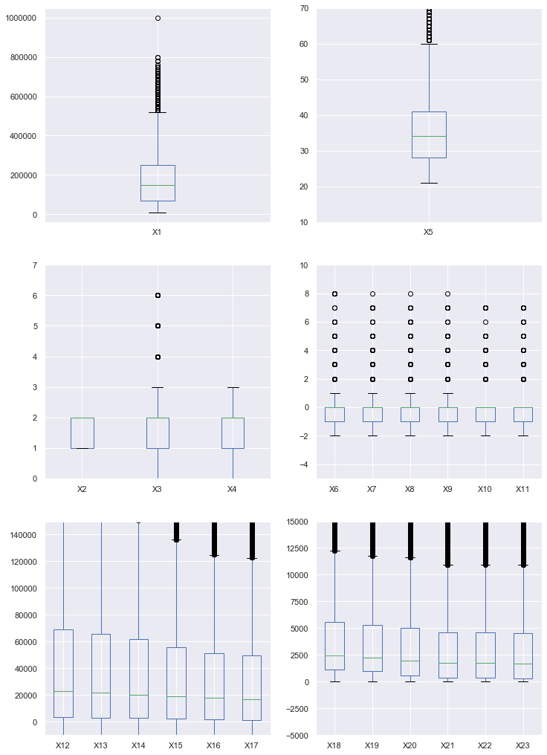
Data exploration key takeaways: Comparing Class 1(default) and Class 0(no default)
default has lower credit limit then no-default
default and no-default group has similar age distribution
X3- education, 0,5,6 is unknown categories
X4- marriage, 0 is unknown category
X6-X11: Repayment status (-2=no consumption, -1=pay duly, 0=the use of revolving credit, 1=payment delay for one month, 2=payment delay for two months, … 8=payment delay for eight months, 9=payment delay for nine months and above)
default group repayment status has higher value than no-default group, tend to use more credit, borrow more
X12-X17: amount of bill statement is increasing from April to September
X18-X23: no-default group has higher amount of payment, and payment is increasing from April to September
Class 1 default
Class 0 not default

Slide 5
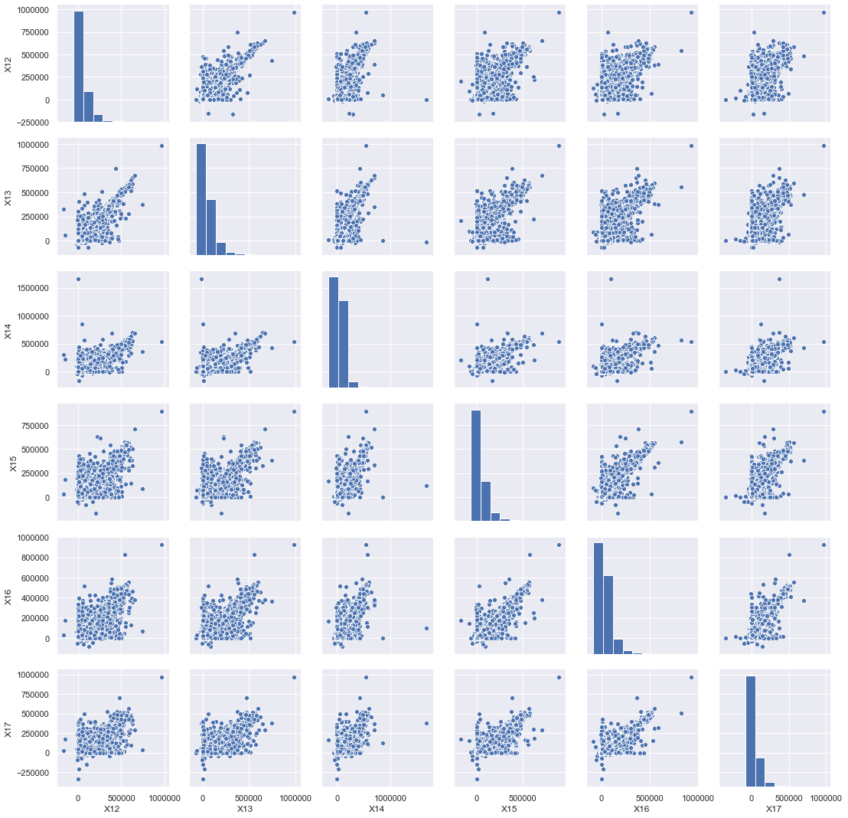
Data exploration key takeaways: X12-X17 are highly correlated
These columns have similar names and by definition show correlation
May indicate potential multicollinearity problem
Need feature selection

Slide 6
Data preprocessing implemented
Columns X2 – X4, X6 – X11 are categorical need encode the categorical features
Columns X1, X5, X12-X23 are numerical features, need standardization
Split dataset to training set and test set (0.3)

Slide 7
Models: logistic regression
Why choose this model
Data fits model
High interpretability of model
Two approaches to fit
Stochastic gradient descent with logistic loss function
Recursive feature selection and fitting a normal logistic regression

Slide 8

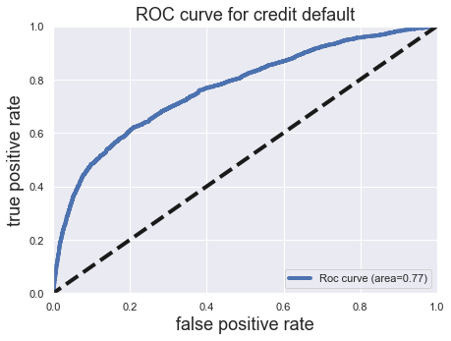
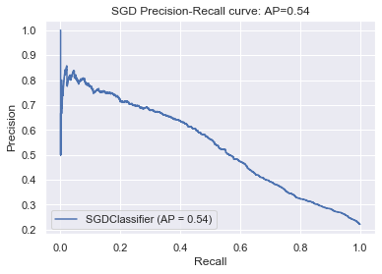
Model performance: SGD
Look at confusion matrix
Model can capture more true positive, how ever, model also has very high false positive rate
ROC curve shows accuracy is 0.77
When increasing TP rate, FP rate is increasing quickly
It depends on the business strategy to choose appropriate point on ROC curve
Precision recall curve
When TP rate is 0.6, only ~45% chance it’s predicting correctly
Business impact
Model is good at capturing True Positive
Recommend this model to focus on risk control

Slide 9

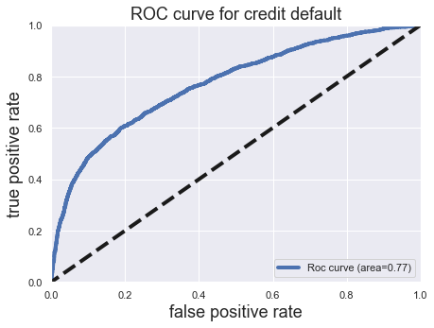
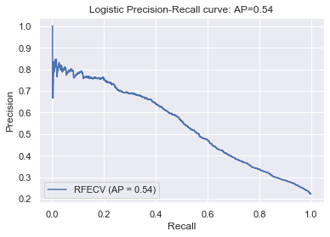
Model performance: recursive feature selection
Recursive feature selection approach has similar result as SGD approach
Recursive feature selection approach is not necessary

Slide 10
Other options
Other classification models, like RandomForest and Gradient Boosting machine (GBM)
Deep learning
Ensemble methods

