Slide 1

LOW LEVEL DESIGN (LLD)
INEURON
OCTOBER 27
LOW-LEVEL DESIGN (LLD)
DATA VISUALIZATION OF BIRD STRIKES BETWEEN 2000 – 2011
PRESENTED BY
Abhinav Singh

Slide 2
TABLE OF CONTENTS
LOW LEVEL DESIGN (LLD)
1.INTRODUCTION | 3
1.1 INTRODUCTION : What is a low level document | 4
1.2 INTRODUCTION : Scope | 6
1.3 INTRODUCTION : Project introduction | 7
2. PROBLEM STATMENT | 8
3. DATABASE INFORMATION | 9
4. ARCHITECTURE | 11
4.1 Architecture Description | 12

Slide 3
LOW LEVEL DESIGN (LLD)
Introduction
What is Low-Level Design Document?
The goal of the Low-level design document (LLDD) is to give the internal logic design of the actual program code for the Sales Analysis dashboard. LLDD describes the class diagrams with the methods and relations between classes and programs specs. It describes the modules so that the programmer can directly code the program from the document.
1.2 What is Scope?
Low-level design (LLD) is a component-level design process that follows a step-by-step refinement process. The process can be used for designing data structures, required software architecture, source code and ultimately, performance algorithms. Overall, the data organization may be defined during requirement analysis and then refined during data design work.
1.3 Project Introduction
Transport and communication is one of the crucial domain in field of analytics. Environmental impacts and safety are, nowadays, two major concerns of the scientific community with respect to transport scenarios and to the ever-growing urban areas. These issues gain more importance due to the increasing amount of vehicles and people. Seeking for new solutions is reaching a point where available technologies and artificial intelligence, especially MAS, are being recognized as ways to cope and tackle these kinds of problems in a distributed and more appropriate way.
A bird strike is strictly defined as a collision between a bird and an aircraft which is in flight or on a take-off or landing roll. The term is often expanded to cover other wildlife strikes - with bats or ground animals. Bird Strike is common and can be a significant threat to aircraft safety. For smaller aircraft, significant damage may be caused to the aircraft structure and all aircraft, especially jet-engine ones, are vulnerable to the loss of thrust which can follow the ingestion of birds into engine air intakes. This has resulted in several fatal accidents. Bird strikes may occur during any phase of flight, but are most likely during the take-off, initial climb, approach and landing phases due to the greater numbers of birds in flight at lower levels. To have a closer look the following document visually depicts the data collected on Bird Strikes by FAA between 2000-2011.

Slide 4
LOW LEVEL DESIGN (LLD)
2. Problem Statement
A bird strike is strictly defined as a collision between a bird and an aircraft which is in flight or on a take-off or landing roll. The term is often expanded to cover other wildlife strikes - with bats or ground animals. Bird Strike is common and can be a significant threat to aircraft safety. For smaller aircraft, significant damage may be caused to the aircraft structure and all aircraft, especially jet-engine ones, are vulnerable to the loss of thrust which can follow the ingestion of birds into engine air intakes. This has resulted in several fatal accidents. Bird strikes may occur during any phase of flight, but are most likely during the take-off, initial climb, approach and landing phases due to the greater numbers of birds in flight at lower levels. To have a closer look the following document visually depicts the data collected on Bird Strikes by FAA between 2000-2011.
3. Dataset Information
Record ID Aircraft: Type Airport: Name Altitude bin
Aircraft: Make/Model Wildlife: Number struck
Wildlife: Number Struck Actual Effect: Impact to flight
Flight Date
Effect: Indicated Damage Aircraft: Airline/Operator Origin State
When: Phase of flight Conditions: Precipitation Cost: Total $
Number of people injured
Pilot warned of birds or wildlife?

Slide 5
LOW LEVEL DESIGN (LLD)
4. Architecture description
1. Raw Data Collection
The Dataset was taken from iNeuron’s Provided Project Description Document
https://drive.google.com/drive/folders/1hLkL5HO4xG9rIjL8XeS6q- uAjwbTDSX6?usp=sharing
2. Data Pre-Processing
Before building any model, it is crucial to perform data pre-processing to feed the correct data to the model to learn and predict. Model performance depends on the quality of data fed to the model to train. This Process includes a) Handling Null/Missing Values b) Handling Skewed Data c) Outliers Detection and Removal
3. Data Cleaning
Data cleaning is the process of fixing or removing incorrect, corrupted, incorrectly formatted, duplicate, or incomplete data within a dataset. a) Remove duplicate or irrelevant observations b) Filter unwanted outliers c) Renaming required attributes
4. Exploratory Data Analysis (EDA)
Exploratory Data Analysis refers to the critical process of performing initial investigations on data to discover patterns, spot anomalies, test hypothesized check assumptions with the help of summary statistics and graphical representations.
Reporting
Reporting is a most important and underrated skill of a data analytics field. Because being a Data Analyst you should be good in the easy and self explanatory report because your model will be used by many stakeholders who are not from a technical background.
High-Level Design Document (HLD)
Low-Level Design Document (LLD)
Architecture
Wireframe
Detailed Project Report
PowerPoint Presentation
5. Reporting

Slide 6
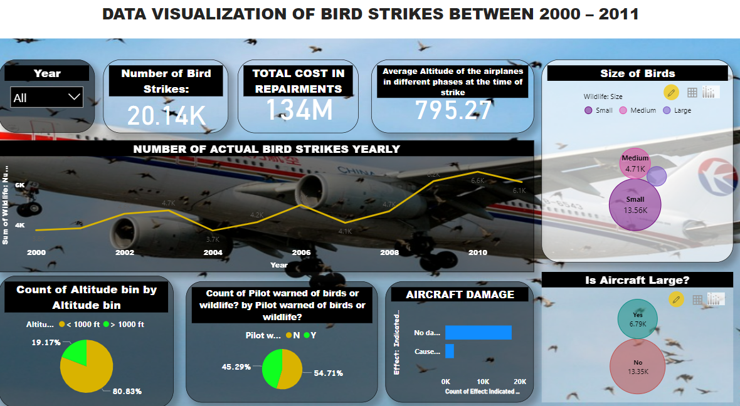
6. Modelling
Data Modelling is the process of analyzing the data objects and their relationship to the other objects. It is used to analyze the data requirements that are required for the business processes. The data models are created to store the data in a database. The Data Model's main focus is on what data is needed and how we have to organize data rather than what operations we have to perform.
7. Deployment
Dashboard created on Power Bi

